Slide 1
A Digital Microfluidic Biochip Synthesis Framework
Daniel Grissom¹, Kenneth O’Neal¹, Benjamin Preciado¹,
Hiral Patel¹, Robert Doherty¹, Nick Liao², Philip Brisk¹
¹Department of Computer Science and Engineering
Bourns College of Engineering
University of California, Riverside
²The Bishop’s School
La Jolla, CA, USA
VLSI-SOC, Santa Cruz, CA, USA, Oct 7-10, 2012

Slide 2

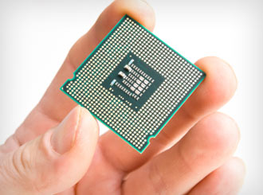
Objective
Miniaturized, automated programmable (bio-)chemistry
http://www.chemistry.umu.se/digitalAssets/4/4612_science_chemistry.gif
http://files.healthymagination.com/wp-content/uploads/2010/08/chip.jpg

Slide 3
Outline
DMFB technology
DMFB synthesis
DMFB benchmarks
DMFB synthesis framework
Implementation status and public release
Conclusions

Slide 4
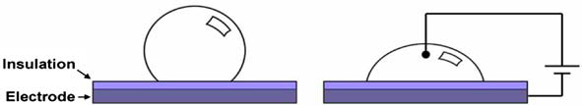
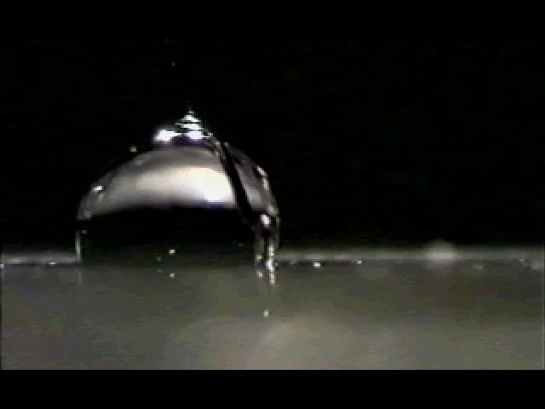
Electrowetting on Dielectric (EWoD)
20-80V
R.B. Fair, Microfluid Nanofluid (2007) 3:245–281, Fig. 3
http://microfluidics.ee.duke.edu/

Slide 5
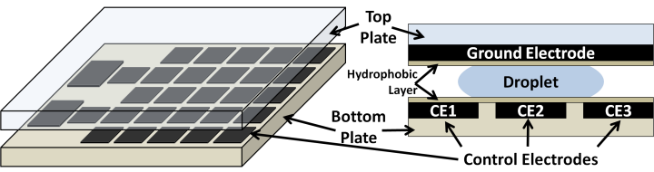
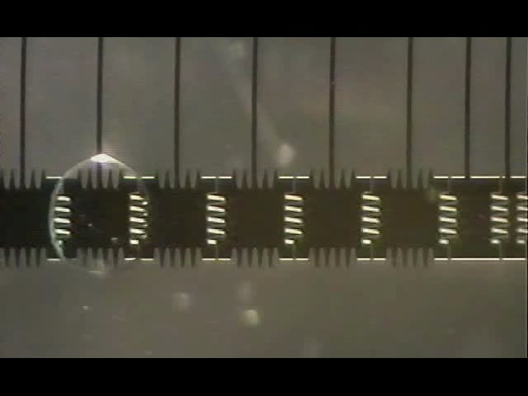
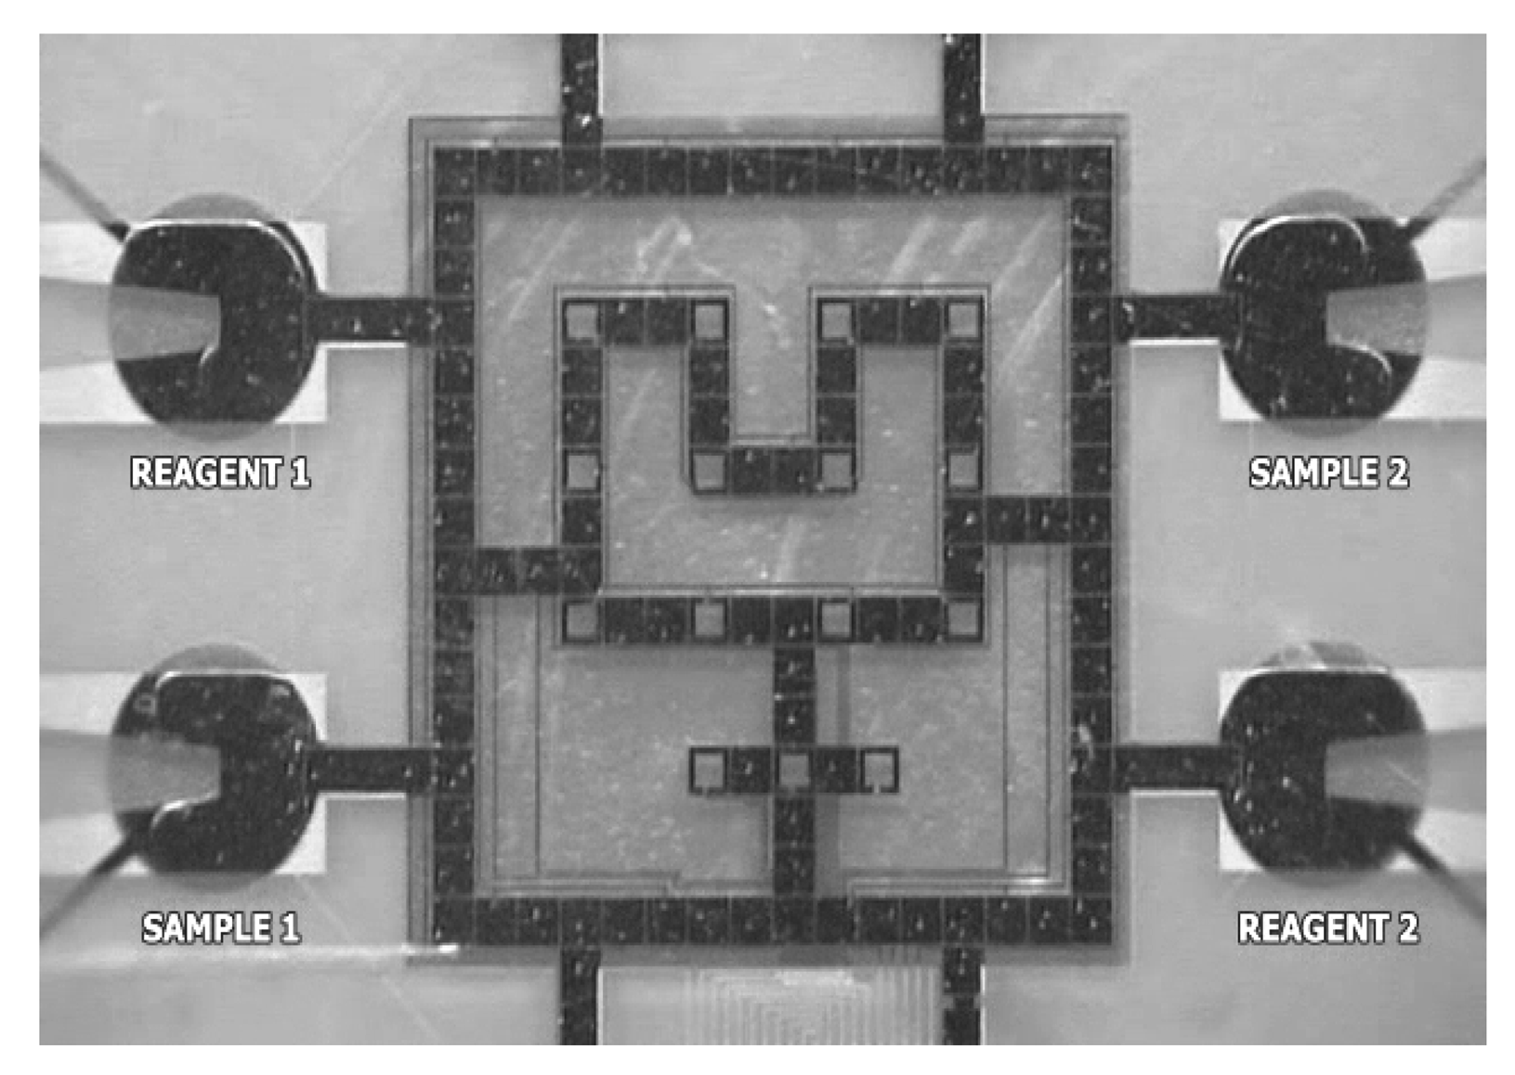
2D Electrowetting Arrays
D. Grissom and P. Brisk, GLS-VLSI (2012) 103-106, Fig. 1
http://microfluidics.ee.duke.edu/
K. Chakrabarty and J. Zeng , ACM JETC (2005) 1(3):186–223, Fig. 1(e)

Slide 6
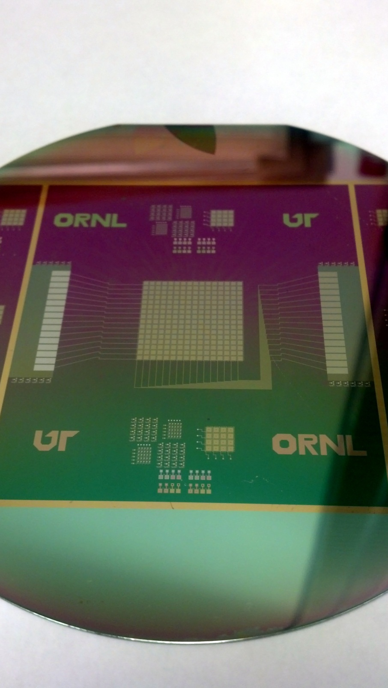
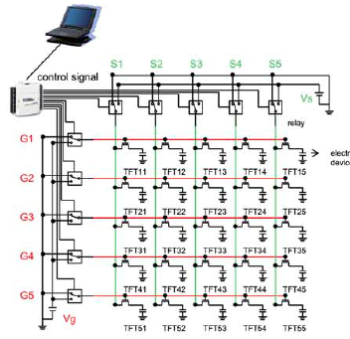
Active Matrix Control
J.H. Noh et al., Lab-on-a-Chip (2012) 2:353-369, Fig. 1
M+N inputs independently control MxN electrodes
16x16 device fabricated and tested 3 weeks ago by Dr. Philip D. Rack’s group at the University of Tennessee, Knoxville, and Oakridge National Laboratory
Notes:
Linear number of control inputs control a quadratic number of electrodes
Device is fabricated using Thin-film transistors
Addressing scheme is similar to LCD screens

Slide 7
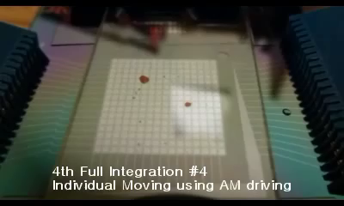
Active Matrix Addressing in Action

Slide 8
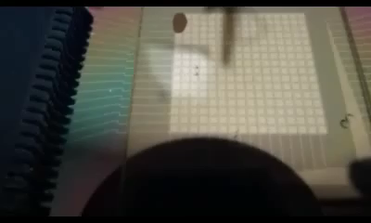
“Blob” Motion

Slide 9
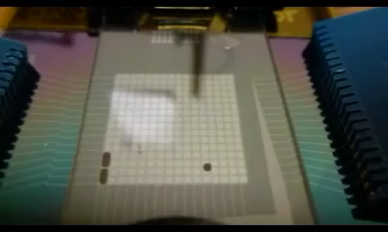
“Oblong Blob” Motion

Slide 10
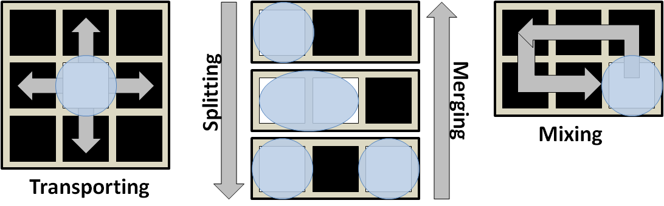
Fundamental Operations
+ External components
  Heaters, detectors, sensors, etc.
  Placed at pre-specified locations on the DMFB
  Route droplet(s) to the location

Slide 11
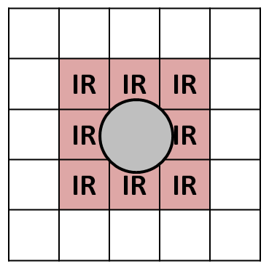
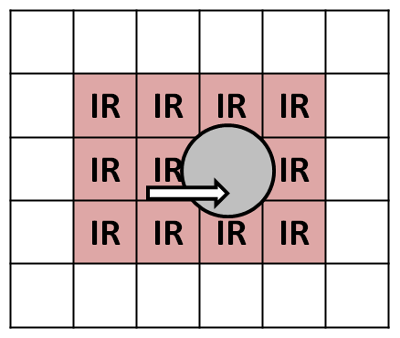
Spacing Rules for Droplet Transport
IR = Interference Region
At rest
In motion
Prevent inadvertent merging with other droplets

Slide 12
Outline
DMFB technology
DMFB synthesis
DMFB benchmarks
DMFB synthesis framework
Implementation status and public release
Conclusion

Slide 13
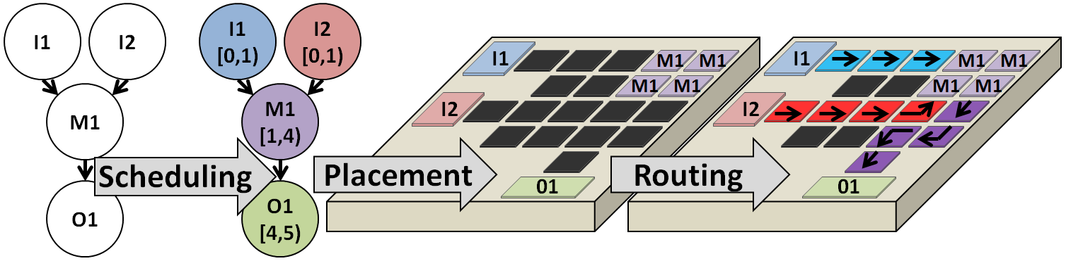
DMFB Synthesis Steps
Scheduling: Affects assay run time dramatically.
Resources: Competition is tough. Storage is physical, taking up valuable board space.
Goal: Legality, minimized schedule length.

Slide 14
DMFB Scheduling Algorithms:
Runtime vs. Solution Quality
Polynomial-time
heuristics
Iterative improvement algorithms
Optimal
Force-directed list scheduling
K. O’Neal et al., VLSI-SoC (2012)
Path scheduling
D. Grissom and P. Brisk.,
DAC (2012): 26-35
Genetic algorithm
A.J. Ricketts et al.,
DATE (2006): 329-334
ILP
J. Ding et al., IEEE TCAD
(2001) 20(12): 1463-1468
List scheduling / Genetic algorithm / ILP
F. Su and K. Chakrabarty, ACM JETC (2008) 3(4): article #16

Slide 15
DMFB Placement Algorithms
Iterative improvement algorithms
Polynomial-time
heuristics
Optimal
2D placement via simulated annealing
F. Su and K. Chakrabarty, ACM TODAES (2006) 11(3):682-710
3D placement via simulated annealing
(Includes Scheduling)
P-H. Yuh et al., ACM JETC (2007)
3(3):article #13
Pre-placed a-priori
D. Grissom and P. Brisk
CODES-ISSS (2012)
ILP (Process-variation aware)
Liao and Hu, IEEE TNBS
(2011) 10(1): 51-58

Slide 16
DMFB Routing Algorithms
Iterative improvement algorithms
Polynomial-time
heuristics
Optimal
F. Su et al.,
DATE (2006): 323-328
R. L’Orsa et al.
Proc. SPIE 7318
Ant Colony Optimization
I. Pan et al., IEEE ISED
(2011): 223-229
M. Cho and D. Z. Pan,
IEEE TCAD (2008) 27(10): 1714-1724
P. Roy et al.
GLS-VLSI 2010:
441-446
A* Search
K. F. Bohringer, IEEE TCAD
(2006) 25(2): 329-339
P-H. Yuh et al.,
IEEE TCAD (2008) 27(11): 1928-1941
K. Singha et al.
IEEE MESA 210: 251-256
P. Roy et al.,
Integration 45(3): 316-330
T-W. Huang and T-Y. Ho.,
ICCD 2009: 445-450

Slide 17
Outline
DMFB technology
DMFB synthesis
DMFB benchmarks
DMFB synthesis framework
Implementation status and public release
Conclusion

Slide 18
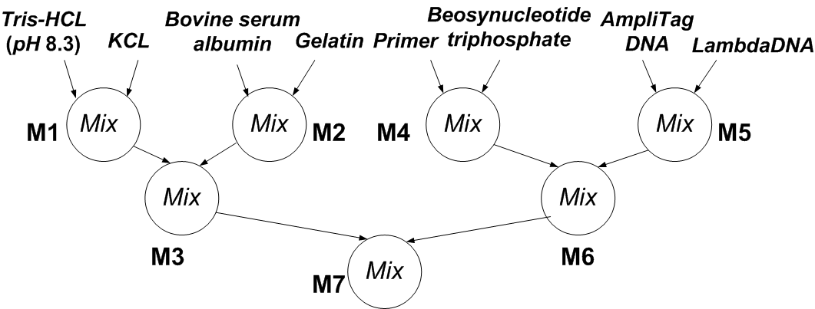
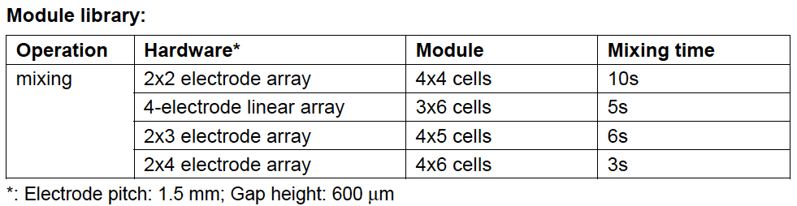
PCR Mixing Stage
http://www.ee.duke.edu/~fs/Benchmark.pdf

Slide 19
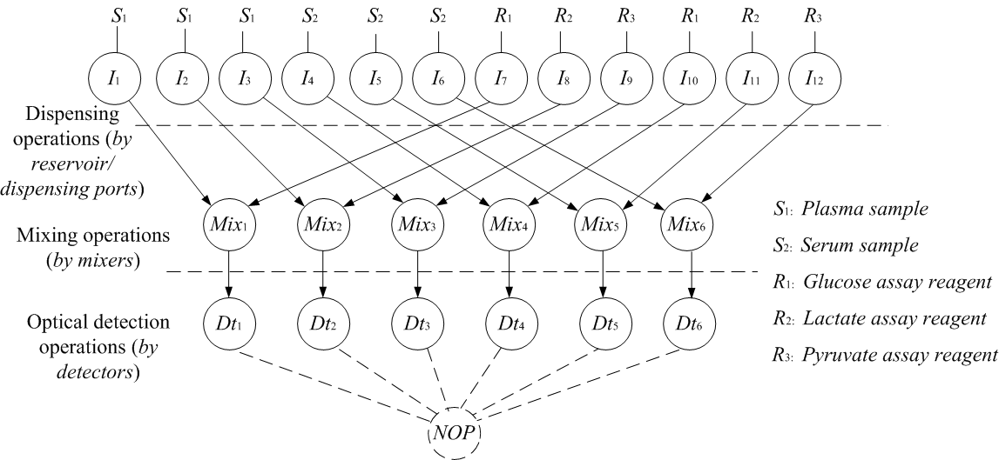
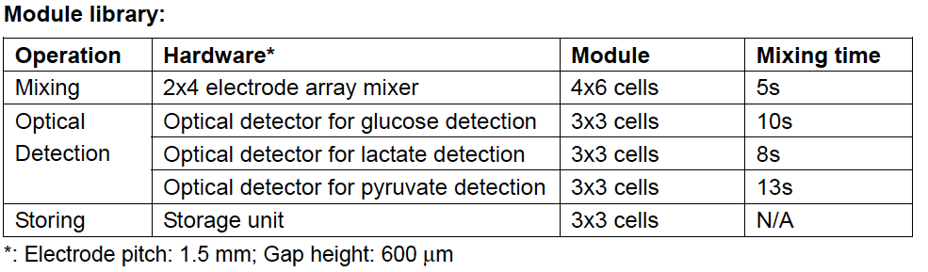
Multiplexed In-vitro Diagnostics
http://www.ee.duke.edu/~fs/Benchmark.pdf

Slide 20
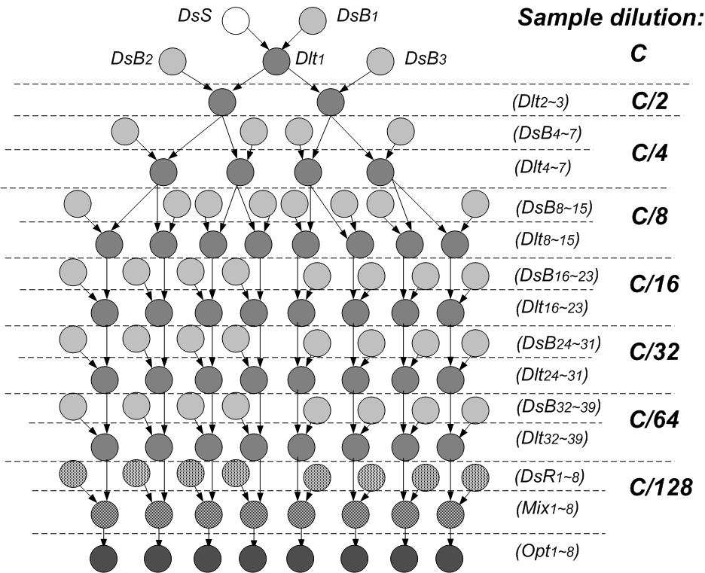
Protein Assay
http://www.ee.duke.edu/~fs/Benchmark.pdf

Slide 21
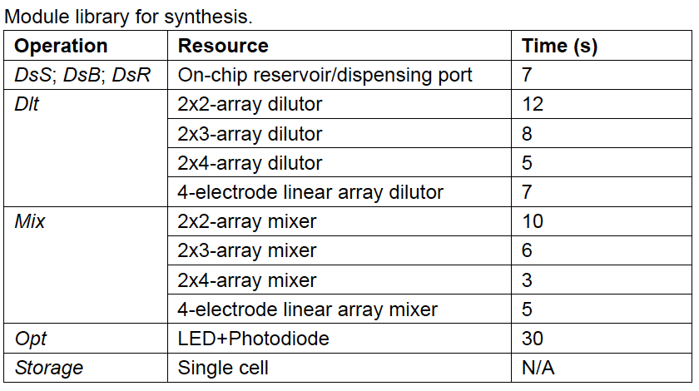
Protein Assay Module Library
http://www.ee.duke.edu/~fs/Benchmark.pdf

Slide 22
Outline
DMFB technology
DMFB synthesis
DMFB benchmarks
DMFB synthesis framework
Implementation status and public release
Conclusion

Slide 23
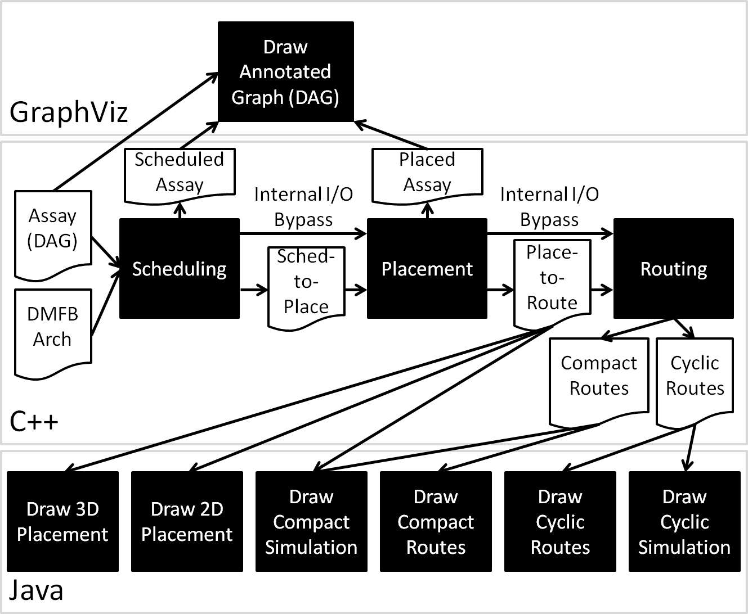
Framework Overview
DAG visualization
Synthesis modules and interfaces
Place-and-route visualization

Slide 24
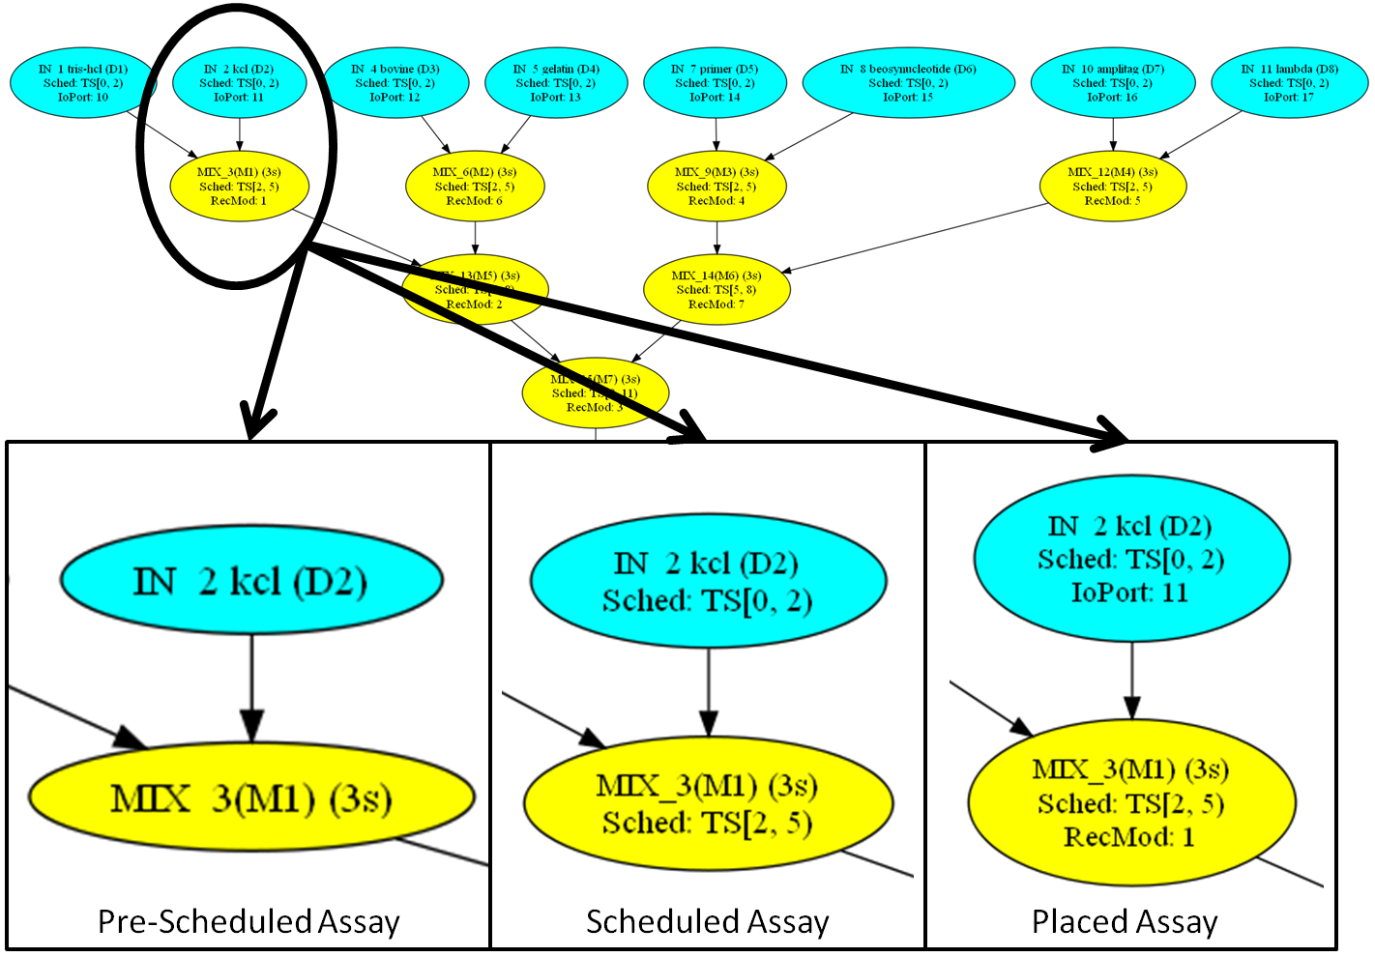
DAG Visualization

Slide 25
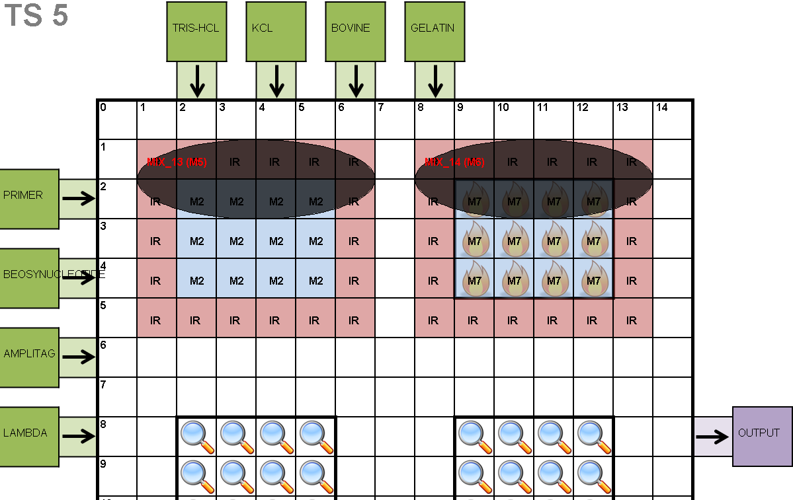
2D Placement Visualization

Slide 26
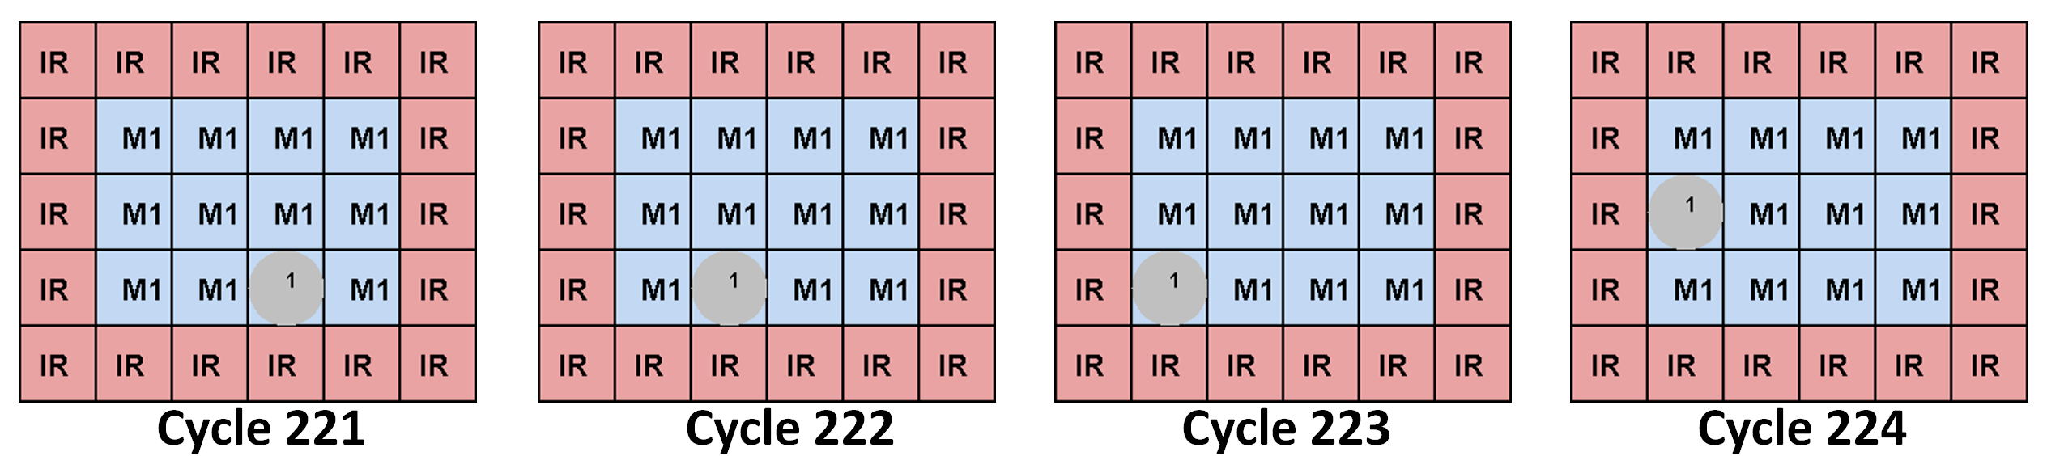
Droplet Mixing Visualization
Depict a merged droplet traversing the module
Conceptual depiction of droplet mixing is too difficult

Slide 27
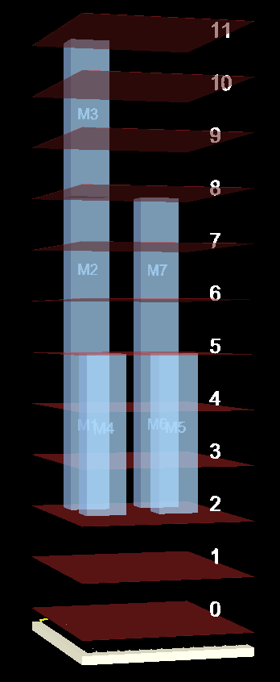
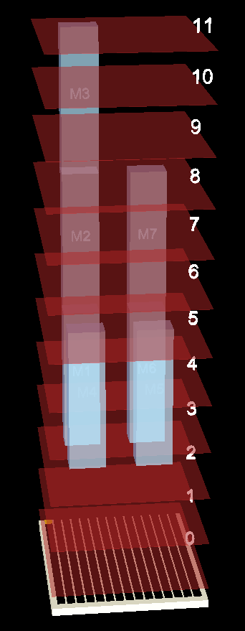
3D Placement Visualization
Operations stretched vertically over execution area.
Allows for rotation and fly by perspective at any angle
Allows viewing of scheduled and placed array TS by TS.

Slide 28
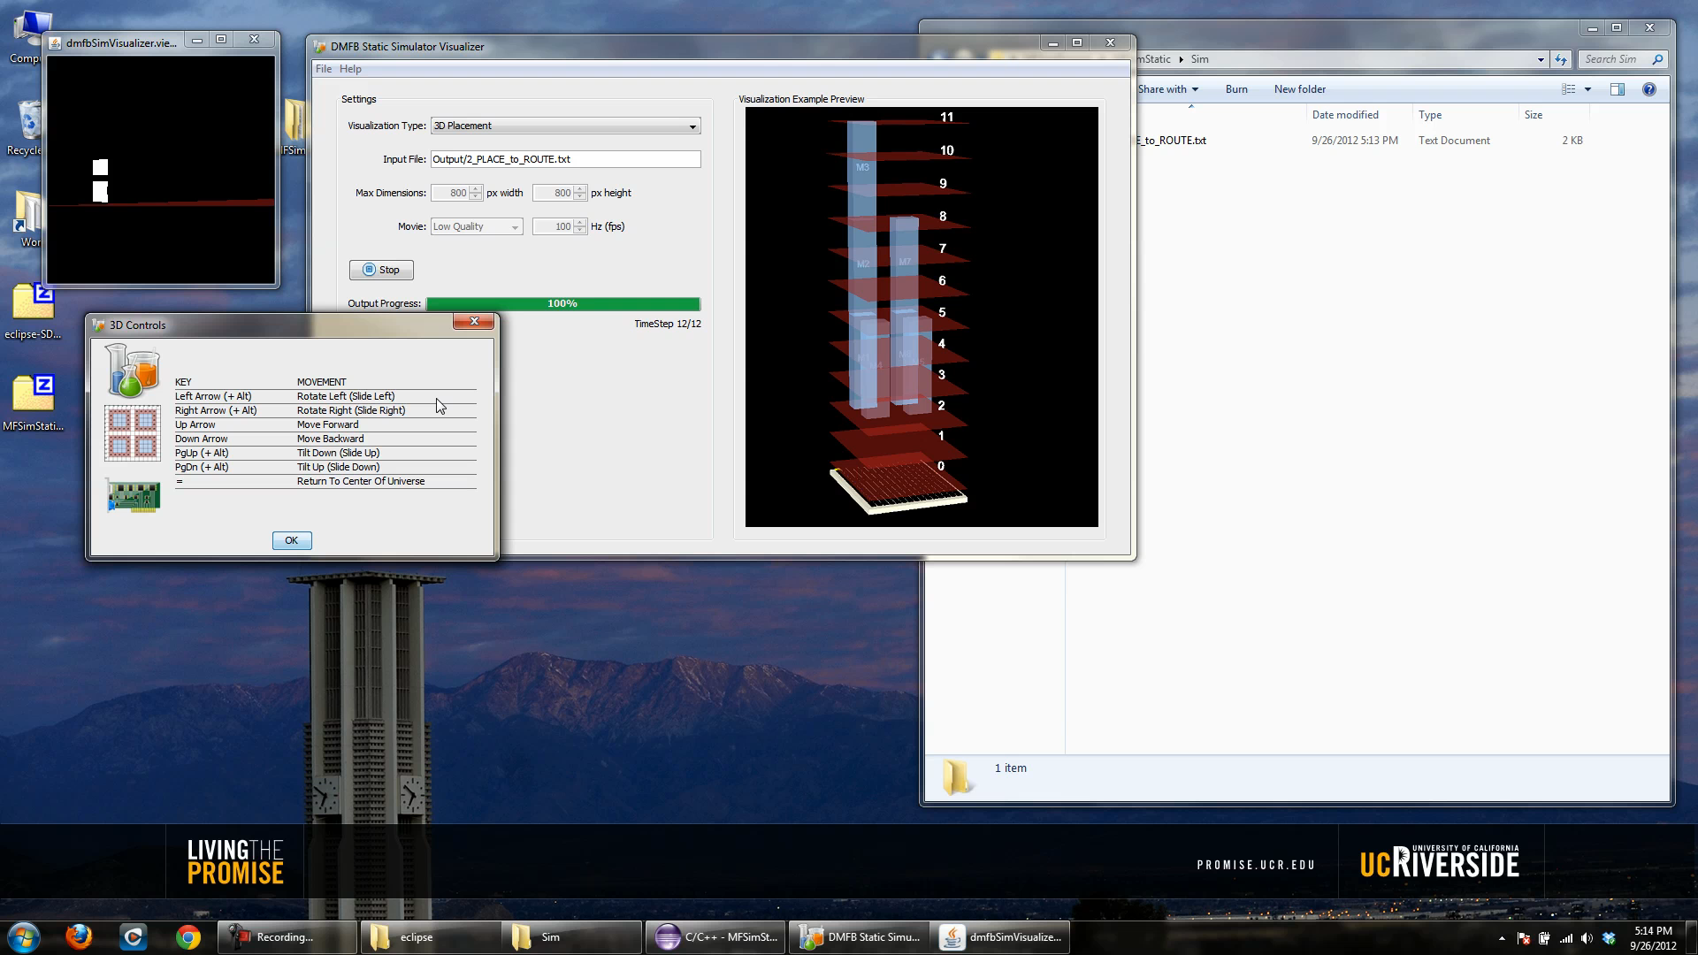
3D Placement Video

Slide 29
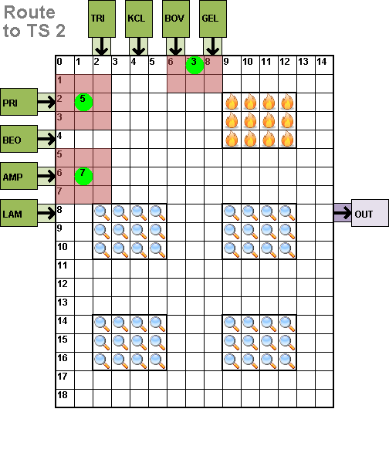
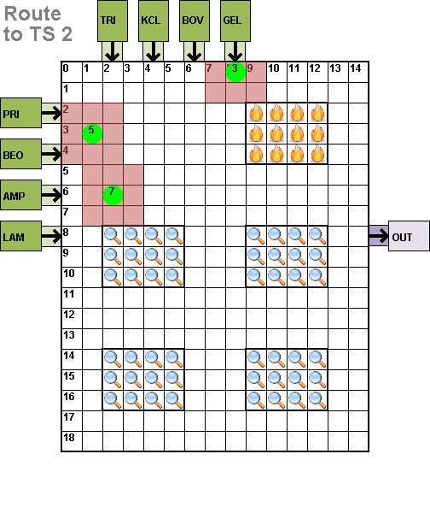
Visualization: Routing

Slide 30
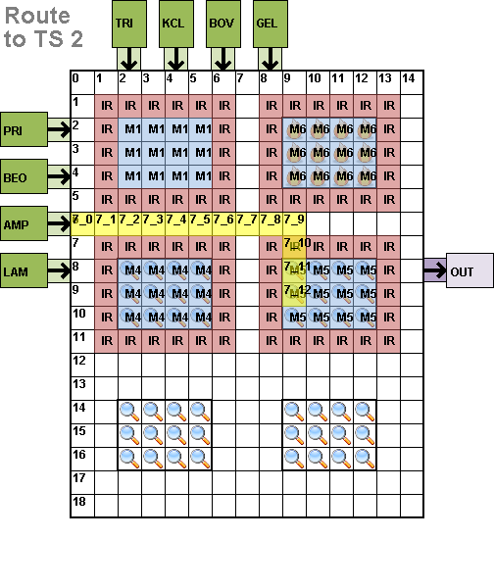
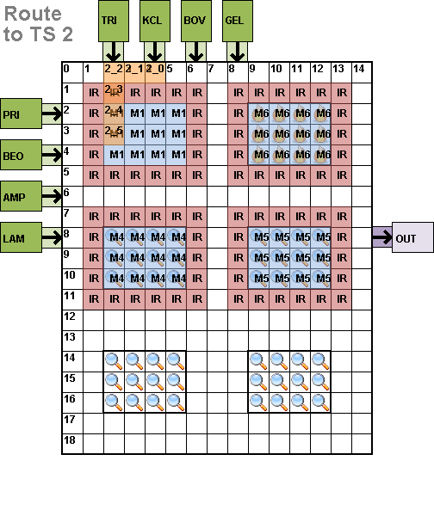
Visualization: Compact Routes

Slide 31
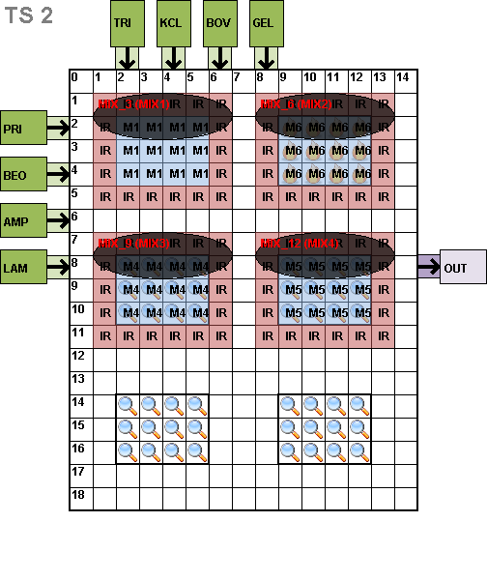
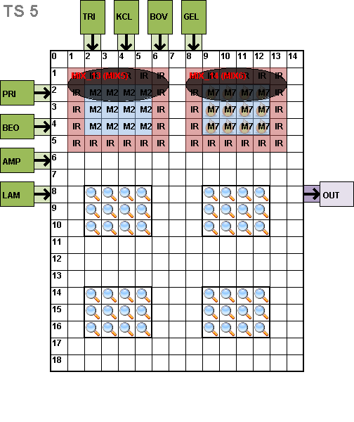
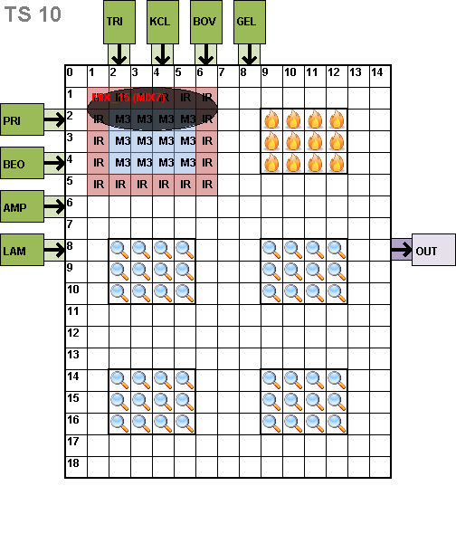
Example: PCR Mixing

Slide 32
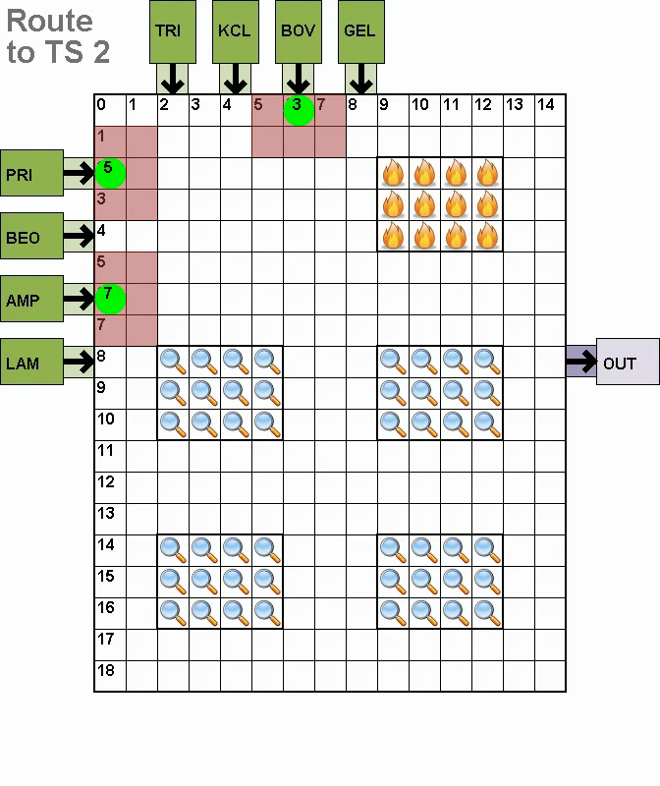
Example Video: PCR Mixing
Can view individual PNG files for each time-step, or “stitch” them together to form a video
Note: videos are real-time and may induce seizures!

Slide 33
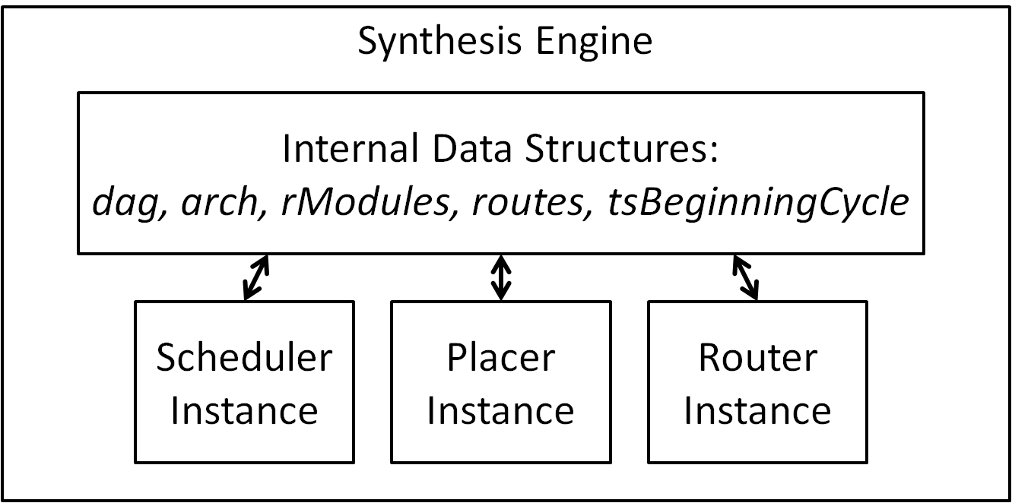
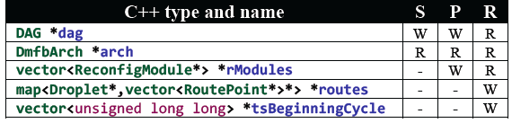
Software Architecture and Data Structures

Slide 34
Outline
DMFB technology
DMFB synthesis
DMFB benchmarks
DMFB synthesis framework
Implementation status and public release
Conclusion

Slide 35
Implementation Status
We use Eclipse
  Not a requirement, but recommended
Several undergraduate students have successfully implemented algorithms
  UCR CS 179J senior design course, Winter 2012
  Undergraduate student researchers from Winter 2012 through Summer 2012
Framework used for papers published at
  VLSI-SoC 2012 (Force-directed list scheduling)
  CODES-ISSS 2012 (Fast DMFB synthesis)

Slide 36
Algorithms Implemented
5 scheduling algorithms
  List scheduling
  Force-directed list scheduling (VLSI-SoC 2012)
  Path scheduling
  Two genetic algorithms
2 placement algorithms
  Pre-placed a-priori (CODES-ISSS 2012)
  Simulated annealing (2D placement)
4-5 routers
  Many similarities; hard to differentiate
  Most are adaptations of classic VLSI routing algorithms

Slide 37
Public Release
http://microfluidics.cs.ucr.edu/
  In 1-2 weeks
  Waiting for clearance from UCR Office of Research
Source code + visualization tools
YouTube tutorial videos

Slide 38
Outline
DMFB technology
DMFB synthesis
DMFB benchmarks
DMFB synthesis framework
Implementation status and public release
Conclusion

Slide 39
Conclusion
Open source DMFB synthesis framework
Future work
  Control real DMFBs, beyond software simulation
Targeted user groups
  Present: Computer engineers
    Develop and compare DMFB synthesis algorithms
  Future: DMFB device engineers
    Testing and verification
  Future: Chemists and biologists
    Run assays on real devices

