Slide 1
Force-Directed List Scheduling for DMFBs
Kenneth O’Neal, Dan Grissom, Philip Brisk
Department of Computer Science and Engineering
Bourns College of Engineering
University of California, Riverside
VLSI-SOC, Santa Cruz, CA, USA, Oct 7-10, 2012

Slide 2

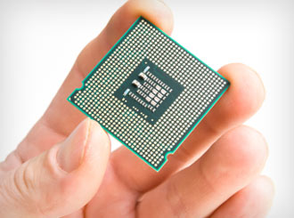
Objective
Miniaturized, automated programmable (bio-)chemistry
http://www.chemistry.umu.se/digitalAssets/4/4612_science_chemistry.gif
http://files.healthymagination.com/wp-content/uploads/2010/08/chip.jpg

Slide 3
Outline
Digital microfluidic biochip (DMFB) technology
DMFB synthesis
DMFB scheduling: problem formulation
Force-directed list scheduling
Experimental results
Conclusion

Slide 4
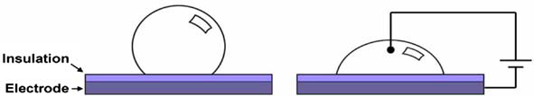
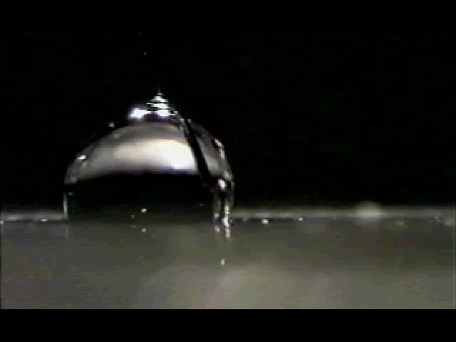
Electrowetting on Dielectric (EWoD)
20-80V
R.B. Fair, Microfluid Nanofluid (2007) 3:245–281, Fig. 3
http://microfluidics.ee.duke.edu/

Slide 5
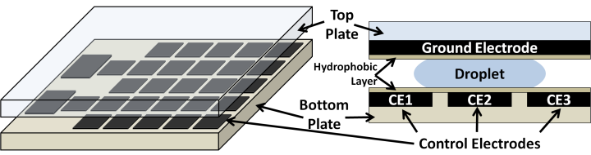
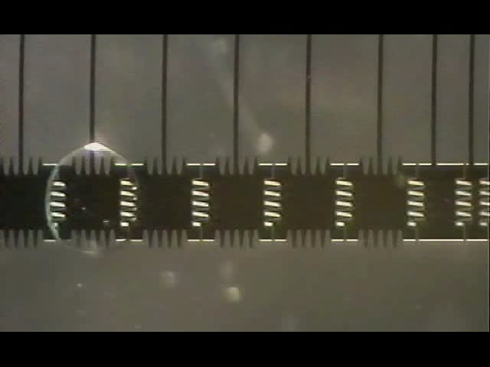
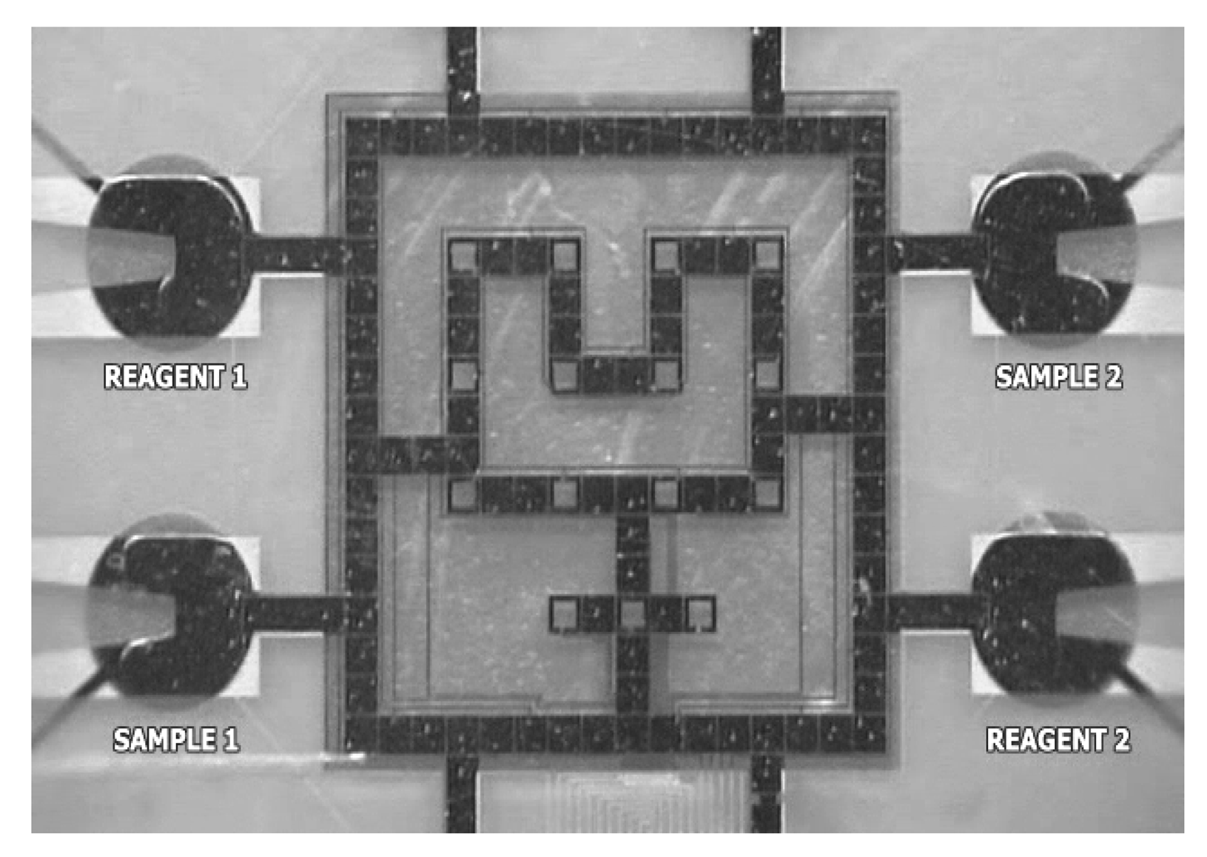
2D Electrowetting Arrays
D. Grissom and P. Brisk, GLS-VLSI (2012) 103-106, Fig. 1
http://microfluidics.ee.duke.edu/
K. Chakrabarty and J. Zeng , ACM JETC (2005) 1(3):186–223, Fig. 1(e)

Slide 6
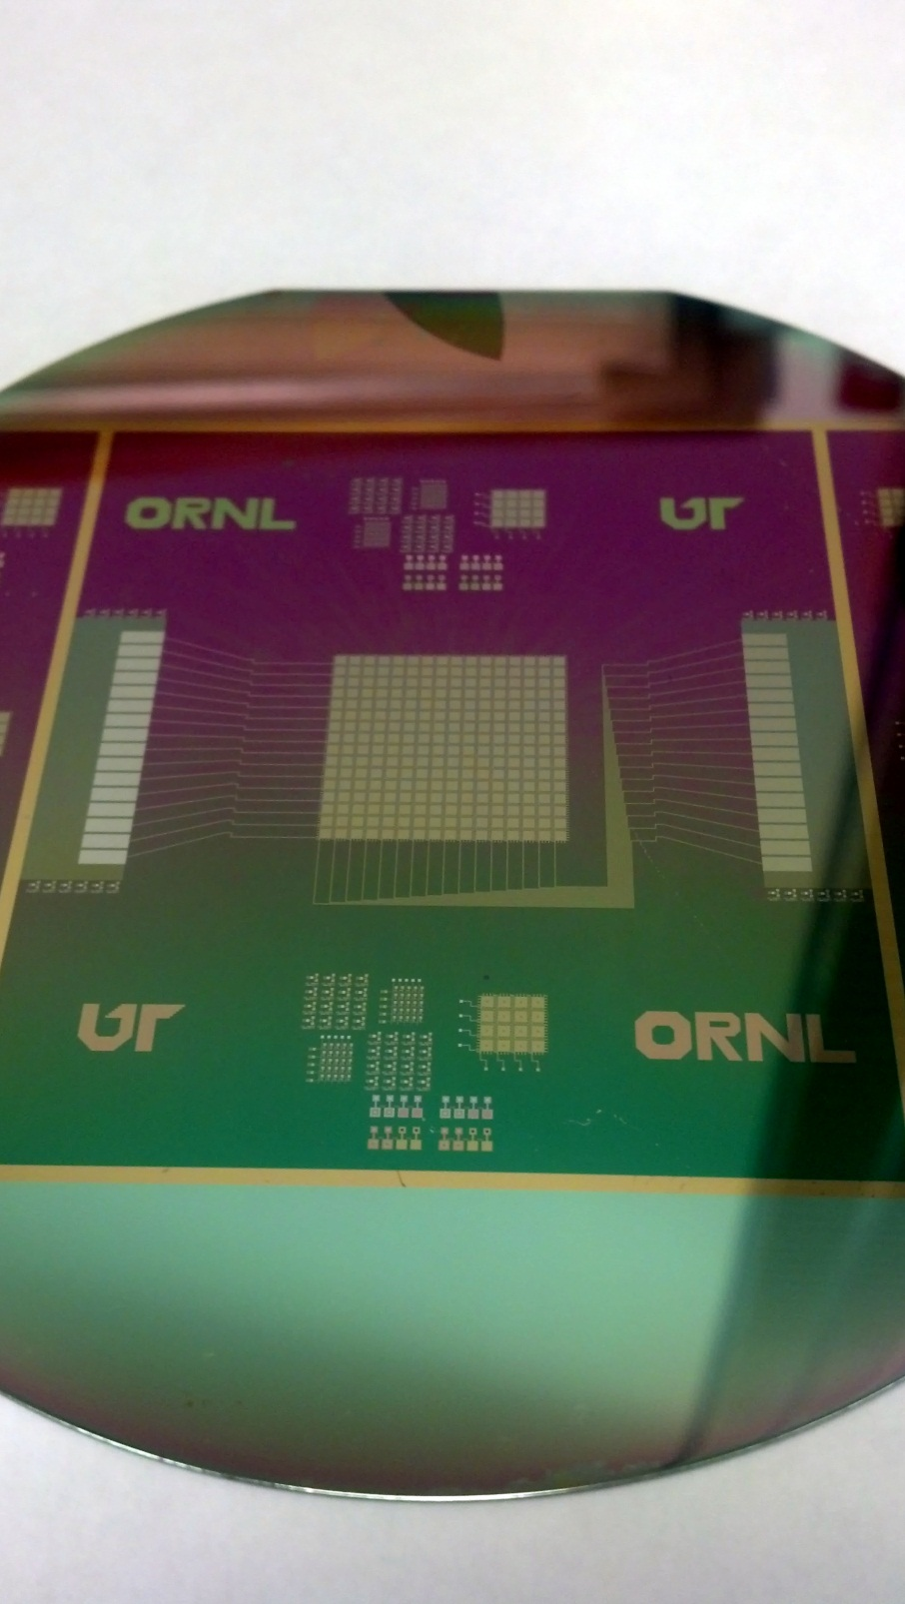
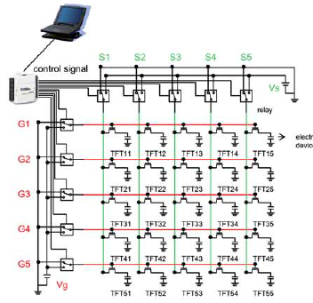
Active Matrix Control
J.H. Noh et al., Lab-on-a-Chip (2012) 2:353-369, Fig. 1
M+N inputs independently control MxN electrodes
16x16 device fabricated and tested 3 weeks ago by Dr. Philip D. Rack’s group at the University of Tennessee, Knoxville, and Oakridge National Laboratory
Notes:
Linear number of control inputs control a quadratic number of electrodes
Device is fabricated using Thin-film transistors
Addressing scheme is similar to LCD screens

Slide 7
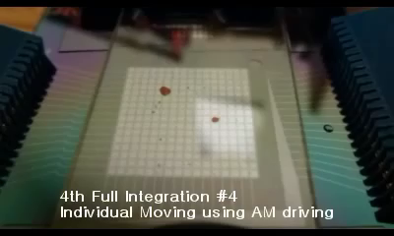
Active Matrix Addressing in Action

Slide 8
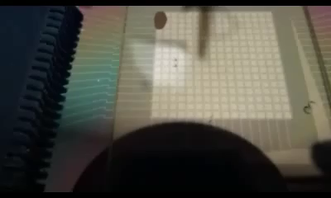
“Blob” Motion

Slide 9
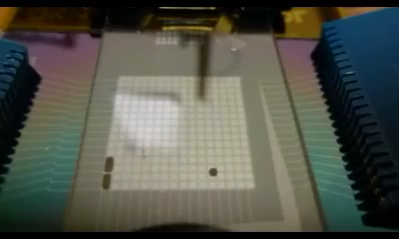
“Oblong Blob” Motion

Slide 10
Outline
Digital microfluidic biochip (DMFB) technology
DMFB synthesis
DMFB scheduling: problem formulation
Force-directed list scheduling
Experimental results
Conclusion

Slide 11
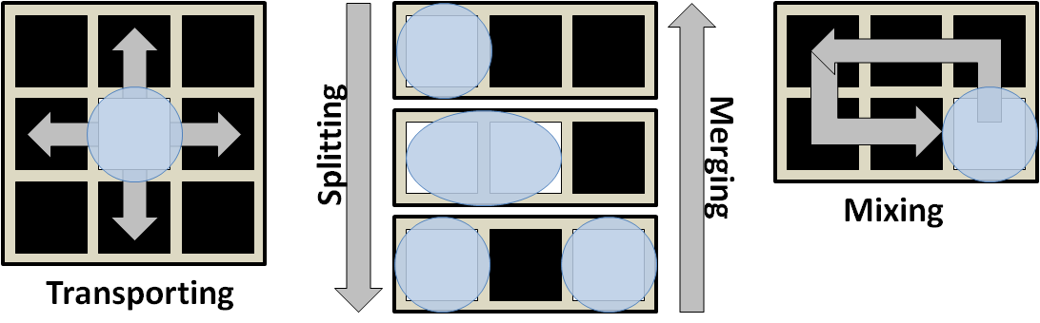
Fundamental Operations
+ External components
  Heaters, detectors, sensors, etc.
  Placed at pre-specified locations on the DMFB
  Route droplet(s) to the location

Slide 12
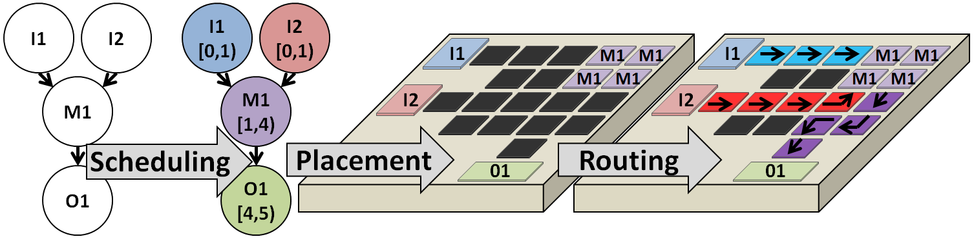
DMFB Synthesis
  Schedule assay operations
  Place assay operations on the DMFB
  Route droplets to their destinations

Slide 13
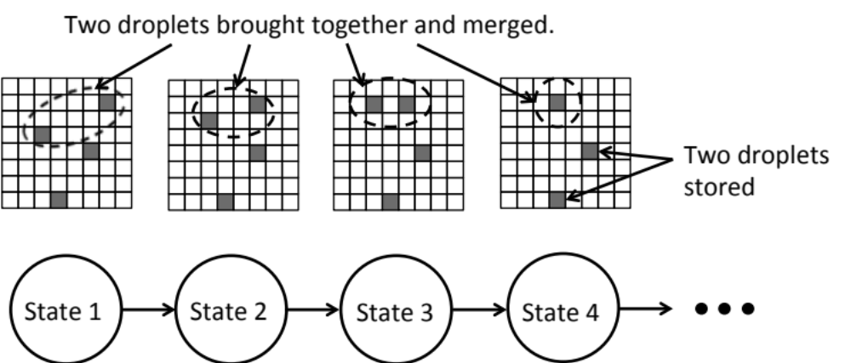
Linear State Machine Control Model
Complex and adaptive control models are beyond the scope of this work

Slide 14
Outline
Digital microfluidic biochip (DMFB) technology
DMFB synthesis
DMFB scheduling: problem formulation
Force-directed list scheduling
Experimental results
Conclusion

Slide 15
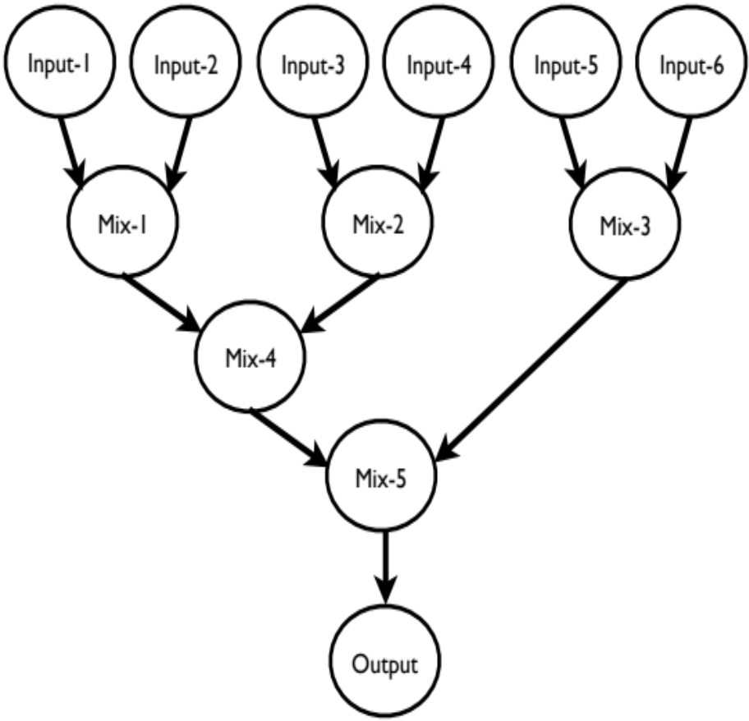
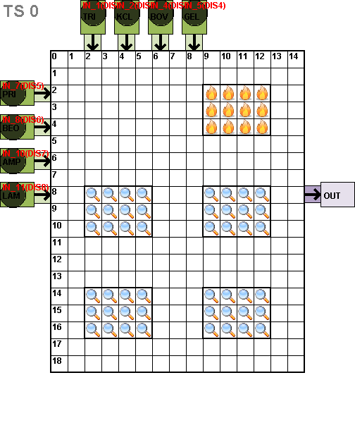
Inputs
Assay Specification
Architecture
Dimensions
I/O resources
External components

Slide 16
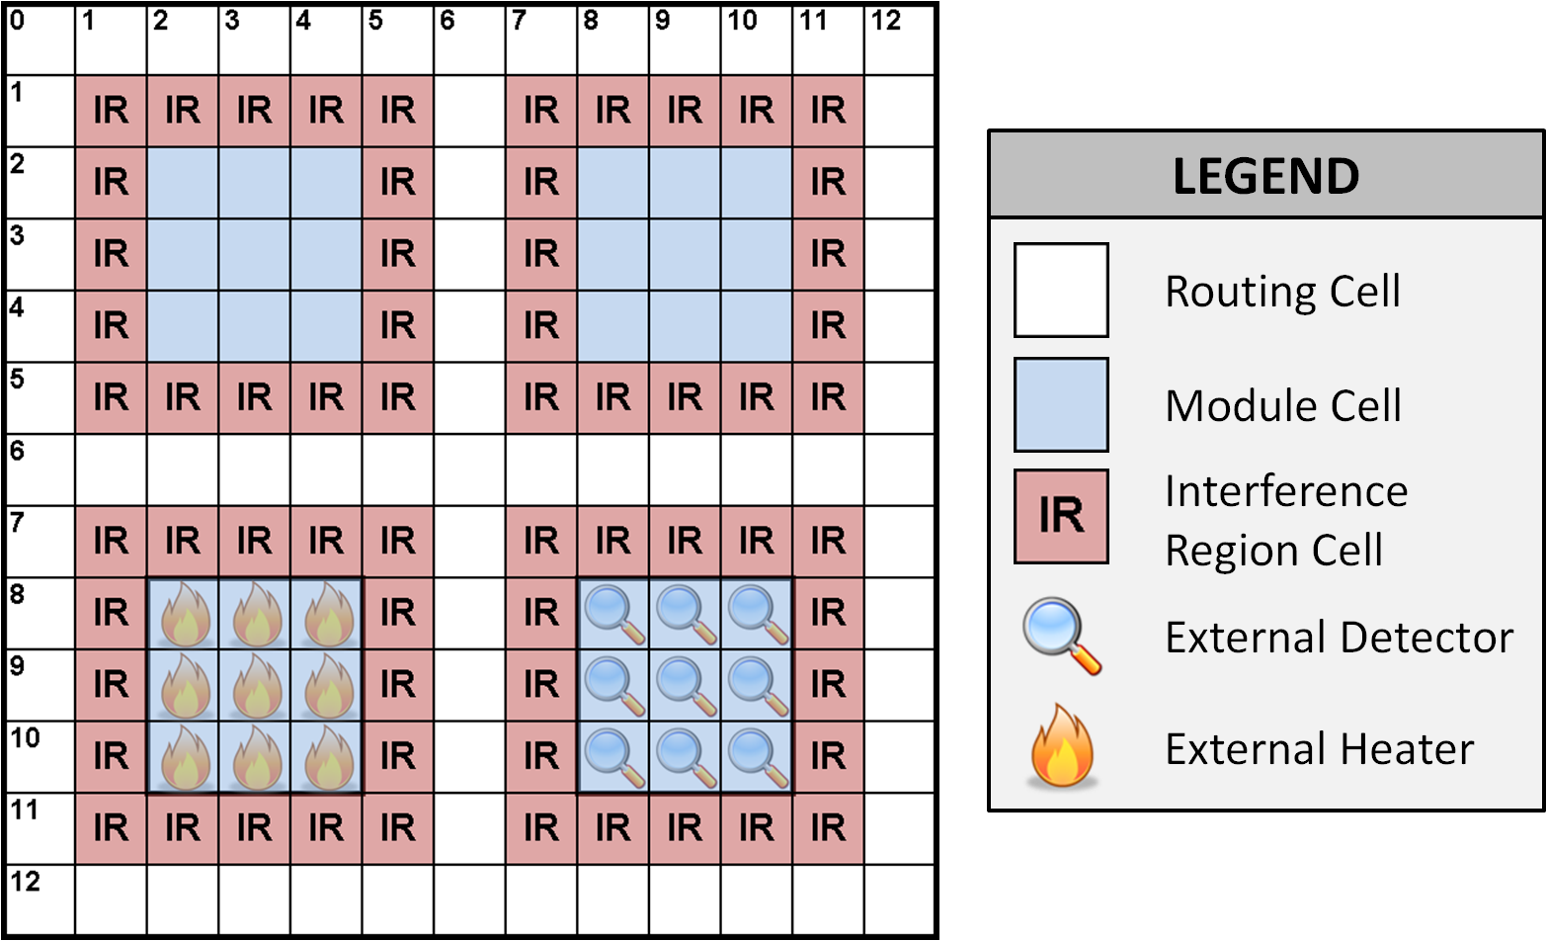
Work Modules: Resource Constraints
Decouples scheduling from placement

Slide 17
Problem Formulation
Objective:
  Minimize schedule length
Constraints:
  DAG dependence constraints
  DFMB physical resource constraints
    Work modules can store up to k droplets
    Work modules perform at most one operation at a time
    External component constraints
    I/O constraints
Notes:
External component constraints
A heater cannot perform detection
If I only have 2 heaters, I can’t schedule 3 heating operations at once.

Slide 18
DMFB Scheduling Algorithms:
Runtime vs. Solution Quality
Polynomial-time
heuristics
Iterative improvement algorithms
Optimal
Force-directed list scheduling
This paper
Path scheduling
D. Grissom and P. Brisk.,
DAC (2012): 26-35
Genetic algorithm
A.J. Ricketts et al.,
DATE (2006): 329-334
ILP
J. Ding et al., IEEE TCAD
(2001) 20(12): 1463-1468
List scheduling / Genetic algorithm / ILP
F. Su and K. Chakrabarty, ACM JETC (2008) 3(4): article #16

Slide 19
Outline
Digital microfluidic biochip (DMFB) technology
DMFB synthesis
DMFB scheduling: problem formulation
Force-directed list scheduling
Experimental results
Conclusion

Slide 20
List Scheduling
Greedy approach
Put schedulable nodes into a priority queue
  A node is schedulable if it is an input node, or all of its predecessors have been scheduled already
  When a resource (I/O, work module) becomes available, the highest priority node is removed from the queue and is scheduled
  Update the priority queue
Priority Function
  Longest path from the current node to an output
  F. Su. And K. Chakrabarty, ACM JETC (2008) 3(4): article #16

Slide 21
Force-Directed List Scheduling
List scheduling with priority function based on force-directed scheduling from high-level synthesis of digital circuits
  P.G. Paulin and J. P. Knight, IEEE TCAD (1989) 8(6): 661-679

Slide 22
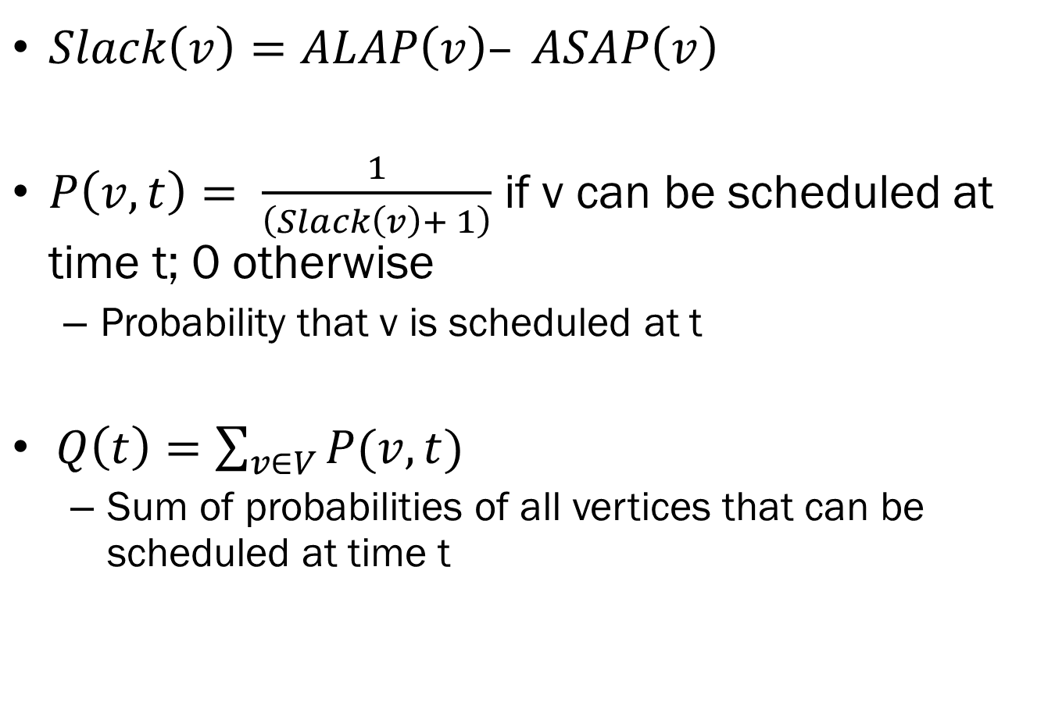
Force Computation (1/2)
$Slack\left(v\right)=ALAP\left(v\right)– ASAP\left(v\right)$
$P\left(v, t\right)= \frac{1}{\left(Slack\left(v\right)+ 1\right)}$ if v can be scheduled at time t; 0 otherwise
  Probability that v is scheduled at t
$Q\left(t\right)=\sum_{v∈V}{P(v,t)}$
  Sum of probabilities of all vertices that can be scheduled at time t

Slide 23
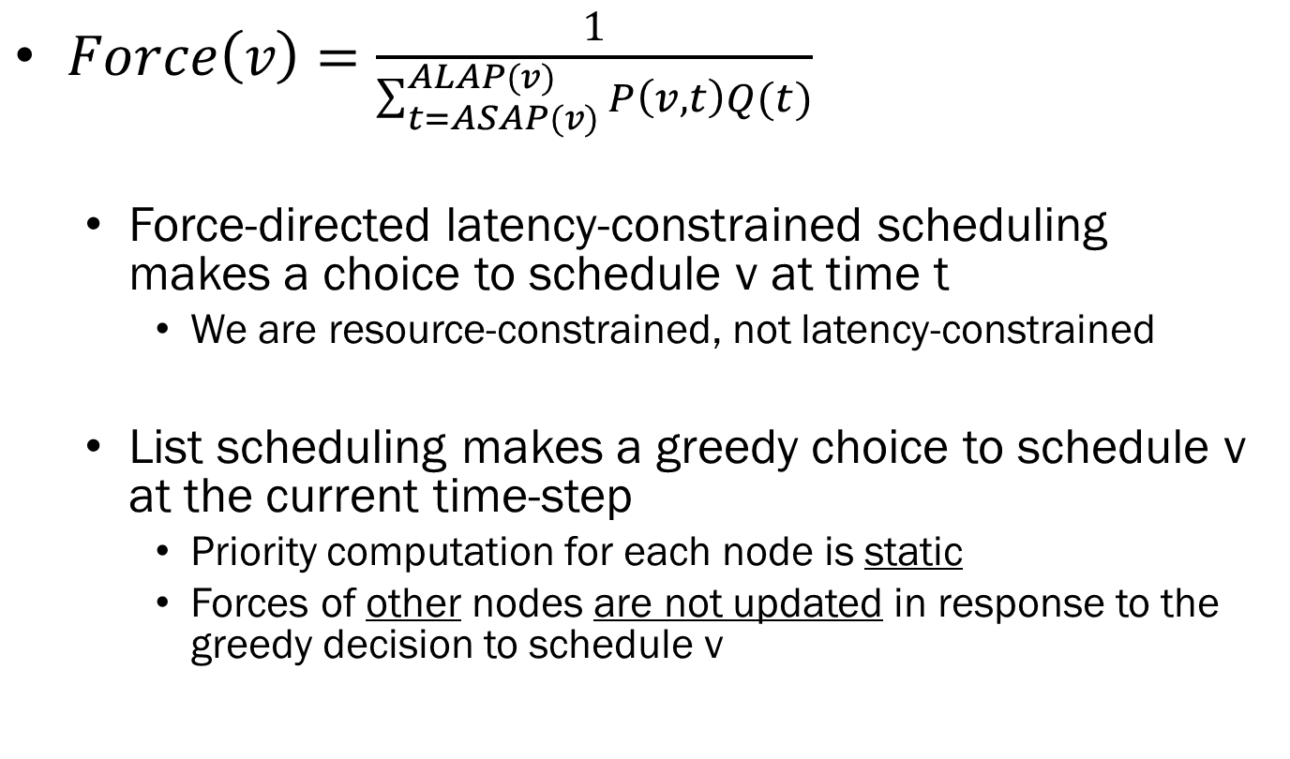
Force Computation (2/2)
$Force\left(v\right)=\frac{1}{\sum_{t=ASAP(v)}^{ALAP(v)}{P\left(v,t\right)Q(t)}}$
  Force-directed latency-constrained scheduling makes a choice to schedule v at time t
    We are resource-constrained, not latency-constrained
  List scheduling makes a greedy choice to schedule v at the current time-step
    Priority computation for each node is static
    Forces of other nodes are not updated in response to the greedy decision to schedule v

Slide 24
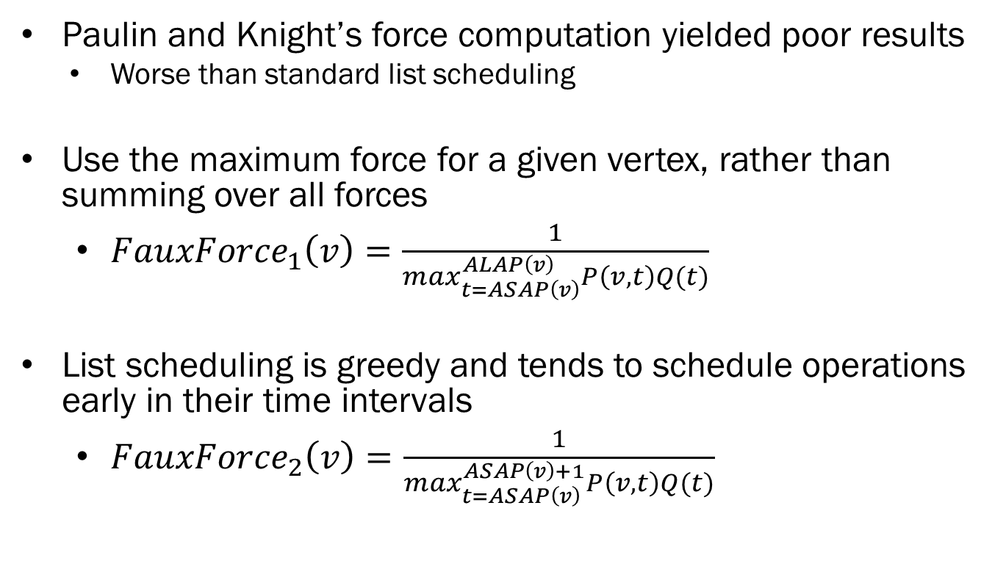
Alternative Force Computation
  Paulin and Knight’s force computation yielded poor results
    Worse than standard list scheduling
  Use the maximum force for a given vertex, rather than summing over all forces
  List scheduling is greedy and tends to schedule operations early in their time intervals

Slide 25
Outline
Digital microfluidic biochip (DMFB) technology
DMFB synthesis
DMFB scheduling: problem formulation
Force-directed list scheduling
Experimental results
Conclusion

Slide 26
Experimental Comparison
List scheduling (LS)
  F. Su and K. Chakrabarty, ACM JETC (2008) 3(4): article #16
  Ignores the rescheduling step of “Modified” LS
Path scheduling (PS)
  D. Grissom and P. Brisk, DAC (2012): 26-35
Genetic Algorithms (GA-1, GA-2)
  F. Su and K. Chakrabarty, ACM JETC (2008) 3(4): article #16
  A. J. Ricketts et al., DATE (2006): 329-334
  Initial population size = 20; run for 100 generations
Force-directed List Scheduling (FDLS-1, FDLS-2)
  Using FauxForce₁ and FauxForce₂

Slide 27
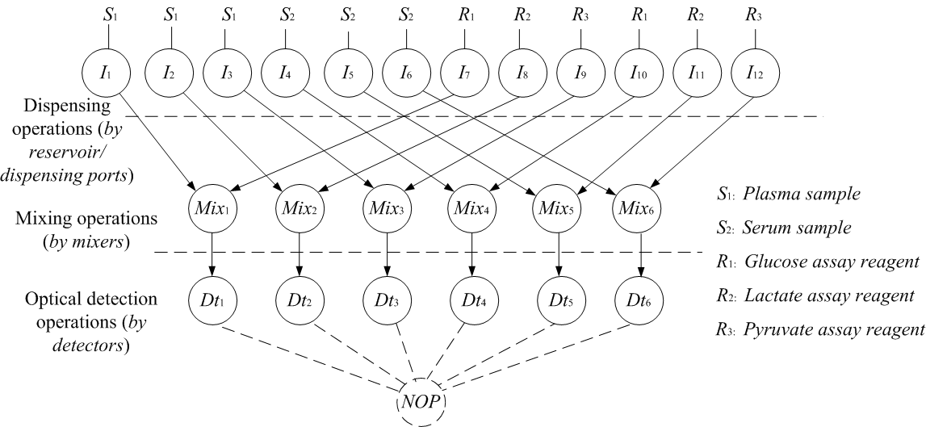
Multiplexed In-vitro Diagnostic Benchmark

Slide 28
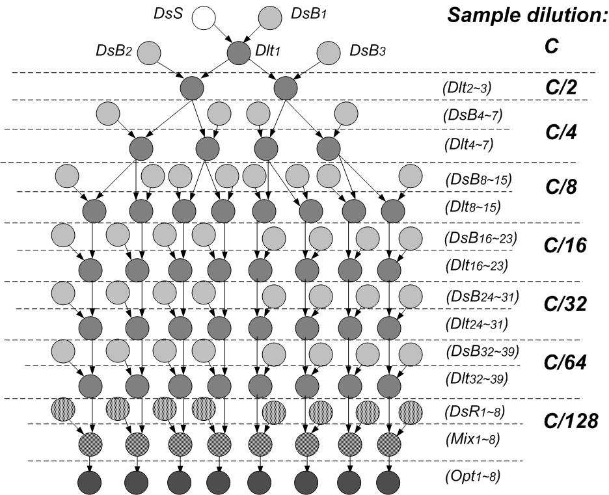
Protein Benchmark

Slide 29
Target Device
15x19 DMFB
  6 work chambers
  All work chambers have detectors
  Each work chamber can store up to k droplets
  Experiments use k=2 and k=4

Slide 30
In-vitro Results
Assay Execution Time (Seconds)
Identical results for k=4 and k=2 droplets stored per work module
(4s_4r)
(3s_4r)
(3s_3r)
(2s_3r)
(2s_2r)

Slide 31
Protein Results
Assay Execution Time (Seconds)
k=4 droplets stored per module
k=2 droplets stored per module

Slide 32
Scheduler Runtime (k=4)
~12,500
Scheduler Runtime (ms)
~15,000
~10,000
~5,000
~3,000
~1,500
~10,000
154
198
(4s_4r)
(3s_4r)
(3s_3r)
(2s_3r)
(2s_2r)
Protein
In-vitro

Slide 33
Outline
Digital microfluidic biochip (DMFB) technology
DMFB synthesis
DMFB scheduling: problem formulation
Force-directed list scheduling
Experimental results
Conclusion

Slide 34
Conclusion
FDLS is a new polynomial-time scheduling heuristic for DFMB synthesis
FDLS generally produced better results than list scheduling (LS) and path scheduling (PS)
PS did perform better than FDLS for Protein, k=2
Schedule quality approached genetic algorithms GA-1 and GA-2

