Slide 1
Fast Online Synthesis of Generally Programmable Digital Microfluidic Biochips
Dan Grissom and Philip Brisk
University of California, Riverside
CODES+ISSS (ESWEEK)
Tampere, Finland, October 10

Slide 2
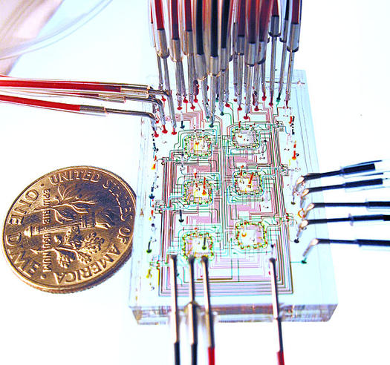
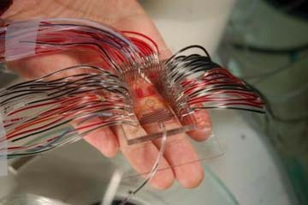
The Future Of Chemistry
Microfluidics
Miniaturization + Automation

Slide 3




Applications
Biochemical assays and immunoassays
  Clinical pathology
Drug discovery and testing
  Rapid assay prototyping
  Testing new drugs (via lung-on-a-chip)
Biochemical terror and hazard detection
DNA extraction & sequencing

Slide 4
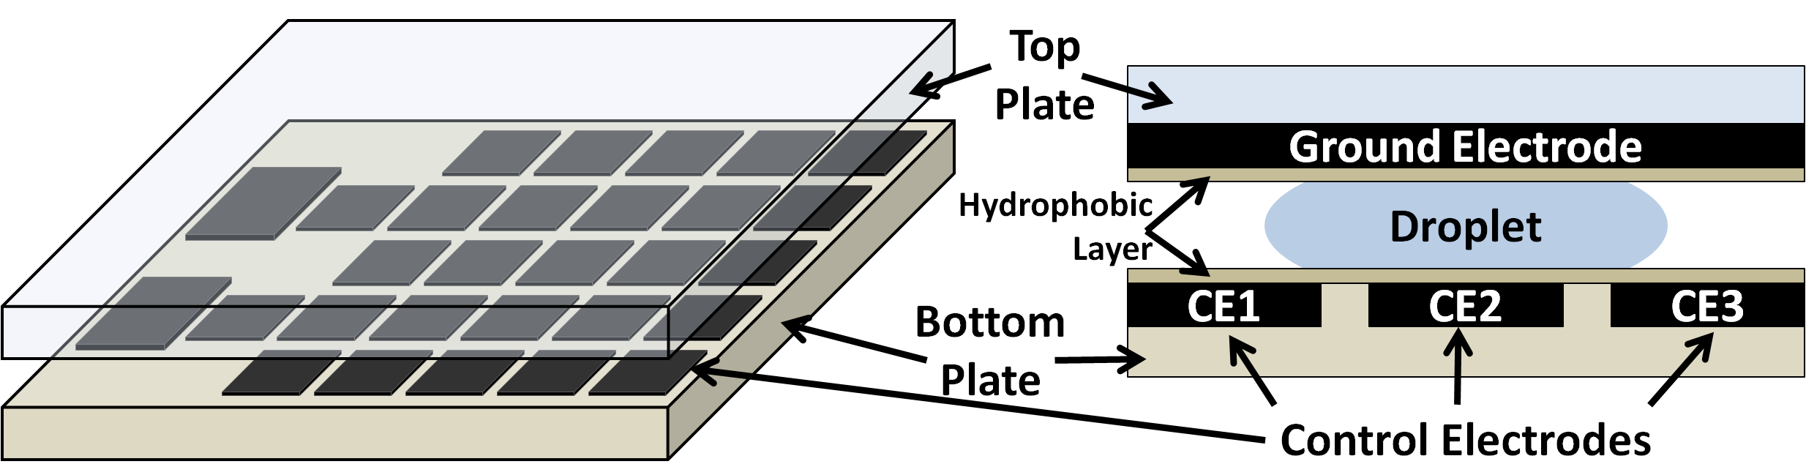
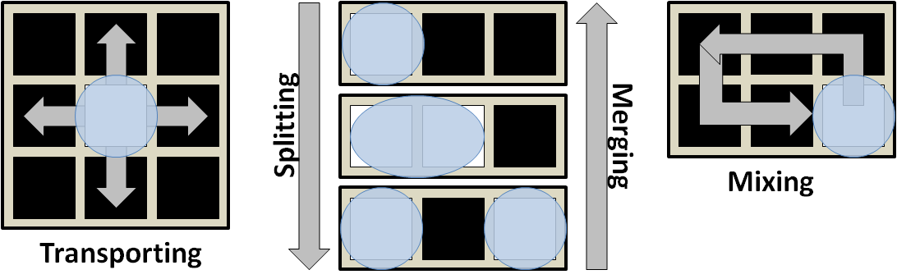
Digital Microfluidic Biochips (DMFB) 101

Slide 5
DMFB High Level Synthesis
Resource-constrained scheduling of operations into time-steps
  Time-step ~ scheduling unit, usually 1s or 2s
Placement of operations during each time-step into modules
  Module ~ 2D group of cells where operation takes place for 1+ time-steps
Routing of droplets between operations between time-steps

Slide 6
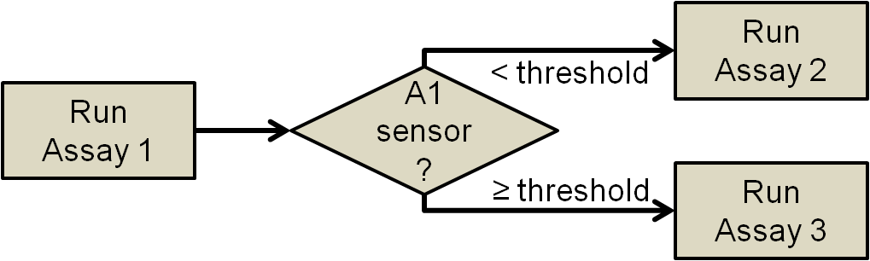
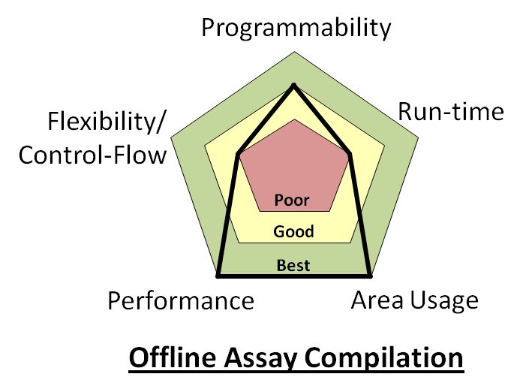
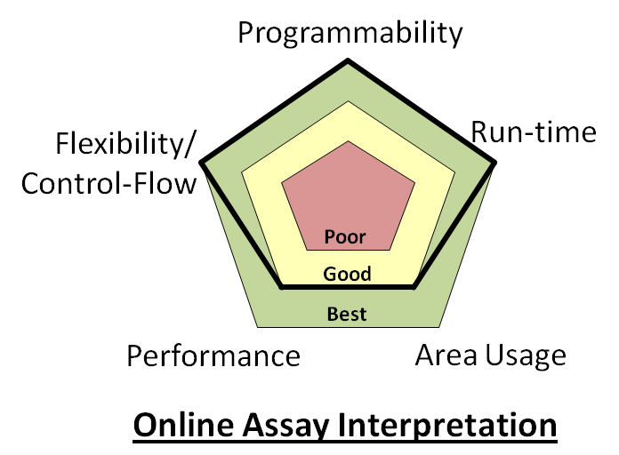
High Level Motivation
Goal: Online Synthesis
Why: Programmability, control-flow, live-feedback
Problem: Past, optimized methods are too complex
Solution: Synthesis with good results in little time

Slide 7
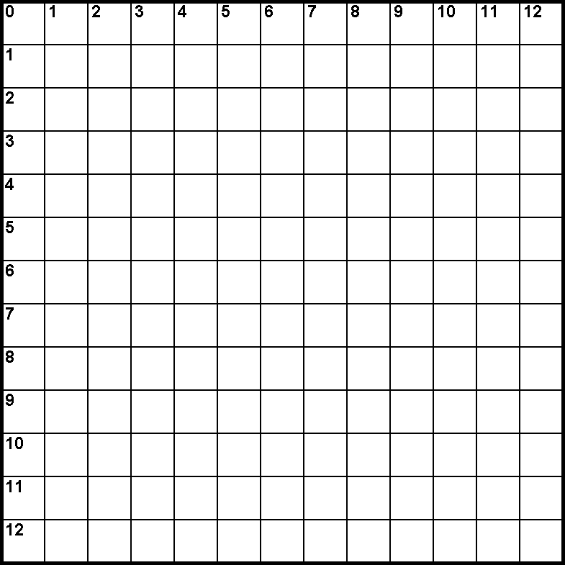
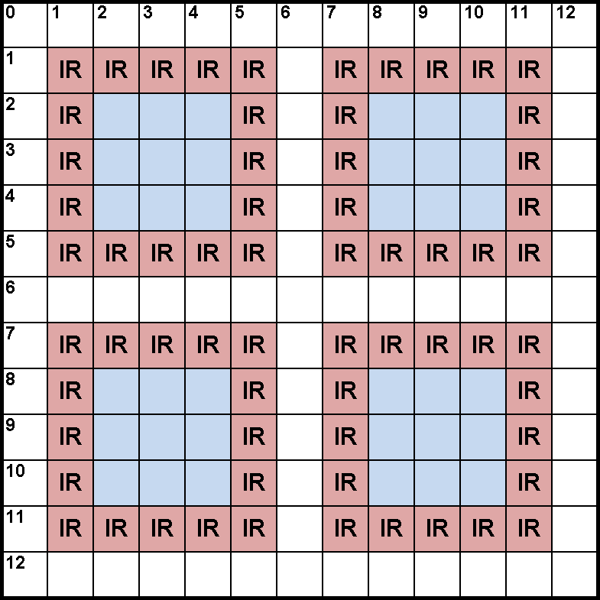
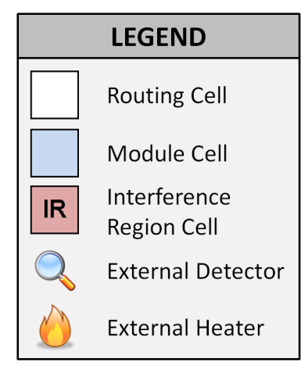
Solution: Virtual Topology
Virtual topology applied to physical DMFB
  All cells are physically the same
  Virtual topology restricts location of operations (modules)
  Regular module placement

Slide 8
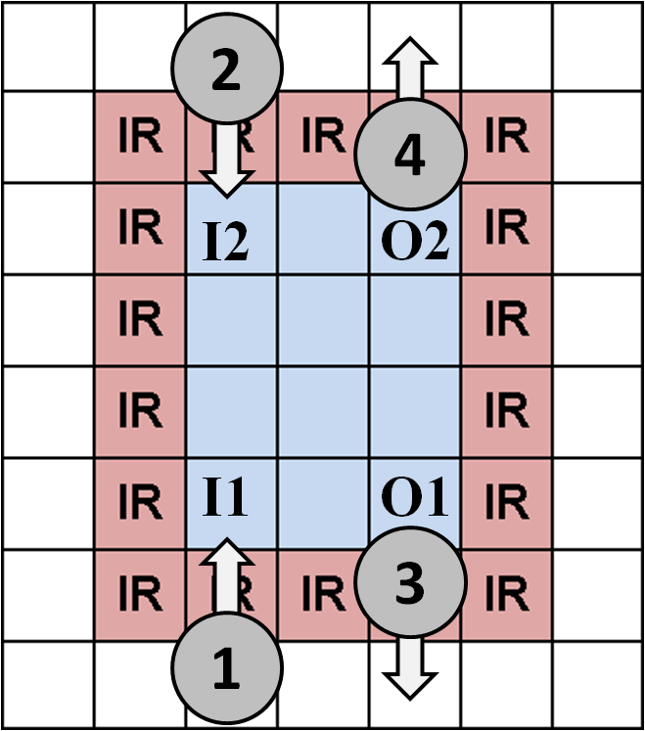
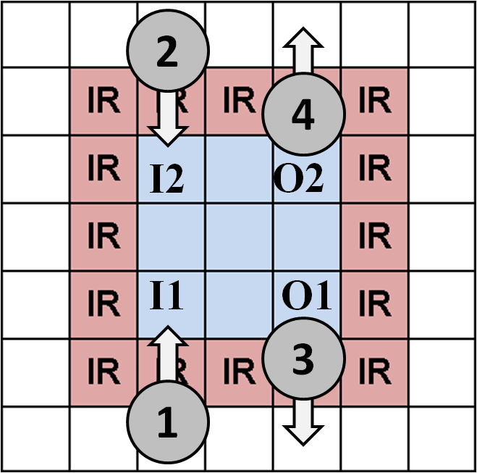
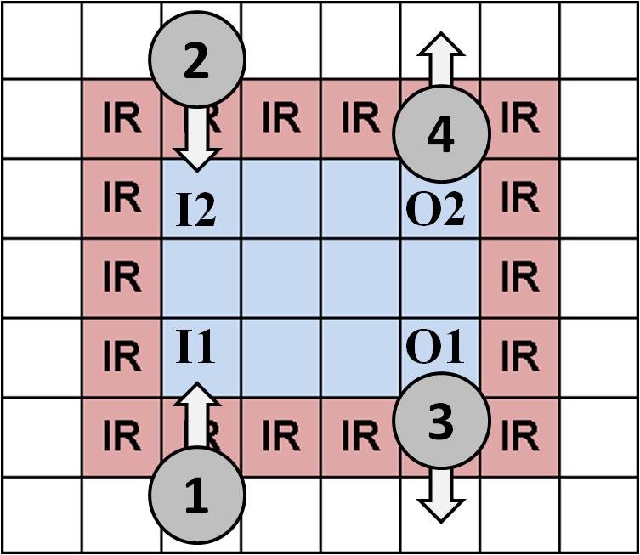
Modules & Virtual I/O Ports
Modules can be different sizes
Input (output) ports on top/bottom left (right) cells
Droplets can wait in I/O cells as long as necessary
  Arriving droplets will not interfere with departing droplets

Slide 9
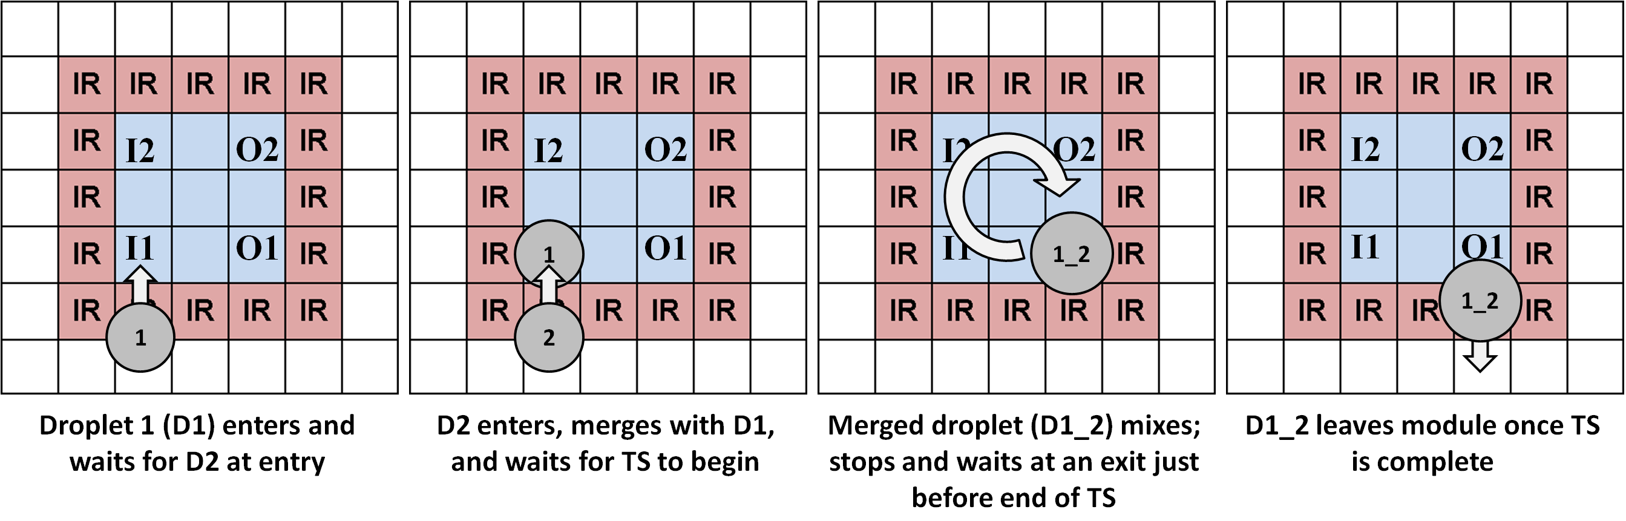
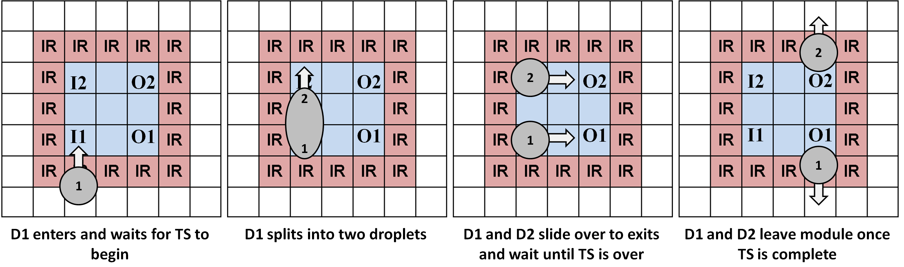
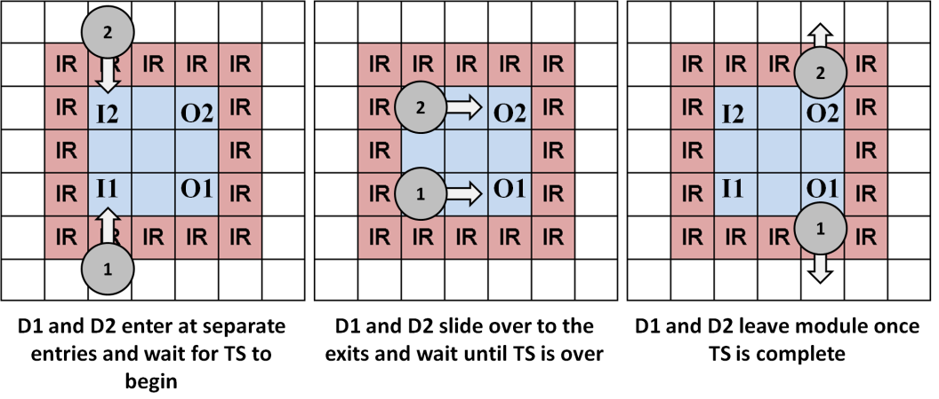
Droplet Synchronization
Mix operation
Split operation
Storage operation

Slide 10
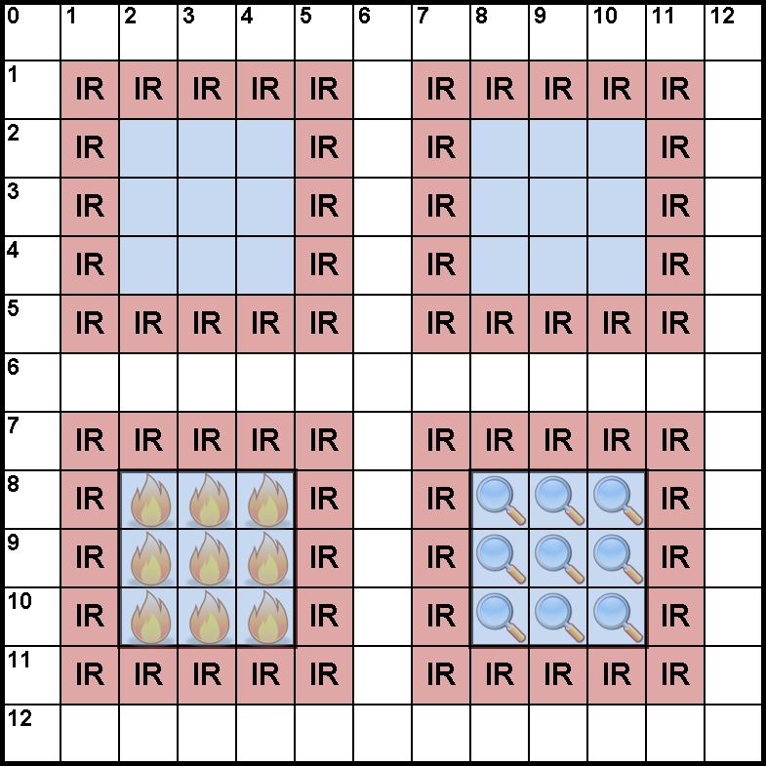
Why a Virtual Topology?
Simplifies the synthesis process
  Scheduling: Gives clear number of resources (no guessing)
  Placement: No placement; instead choose a free module
  Routing: Topology and module syncing guarantees routability

Slide 11
Scheduling
We choose list-scheduling (LS) with several constraints
  Constructive algorithm -- one iteration
  Much faster than iterative algorithms (e.g., genetic algorithms)
  Total number of available resources dictated by virtual topology
Resources available each time-step
2 general modules
1 heating module
1 detect module

Slide 12
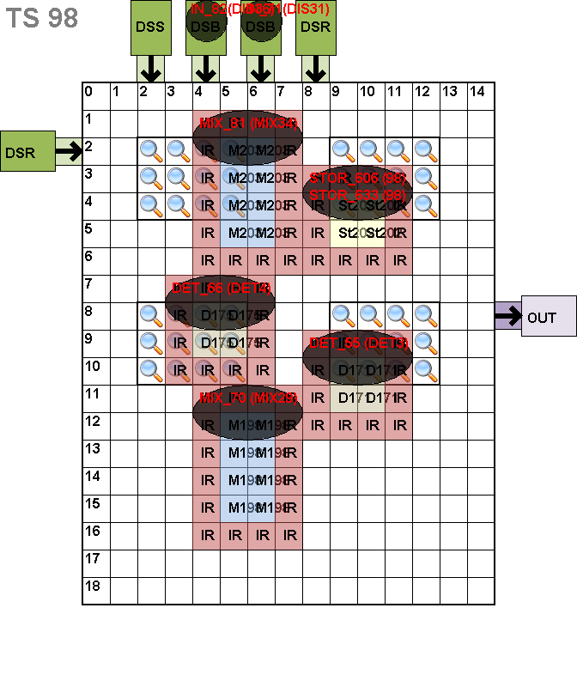
Placement
We convert placement into a binding problem
  Modules are pre-placed at regular intervals
  Module can be viewed as a fixed resource
    It’s either available or not
Traditional Free Placement
Proposed Fixed Placement

Slide 13
Placement (…continued)
Operations are bound to modules of the same type
Will never have to reschedule since fixed placement gave scheduler precise resource availability
M1
T:[2-5)
R:B
M2
T:[2-5)
R:B
M3
T:[2-5)
R:H
M4
T:[2-5)
R:D
M5
T:[5-8)
R:B
M6
T:[5-8)
R:B
M1
T:[8-11)
R:B
Ex: Time-step 2

Slide 14
Placement (…continued)
Greedy left-edge algorithm used for binding
  Operations sorted by start time into module-type bins
  Operations bound greedily to specific modules

Slide 15
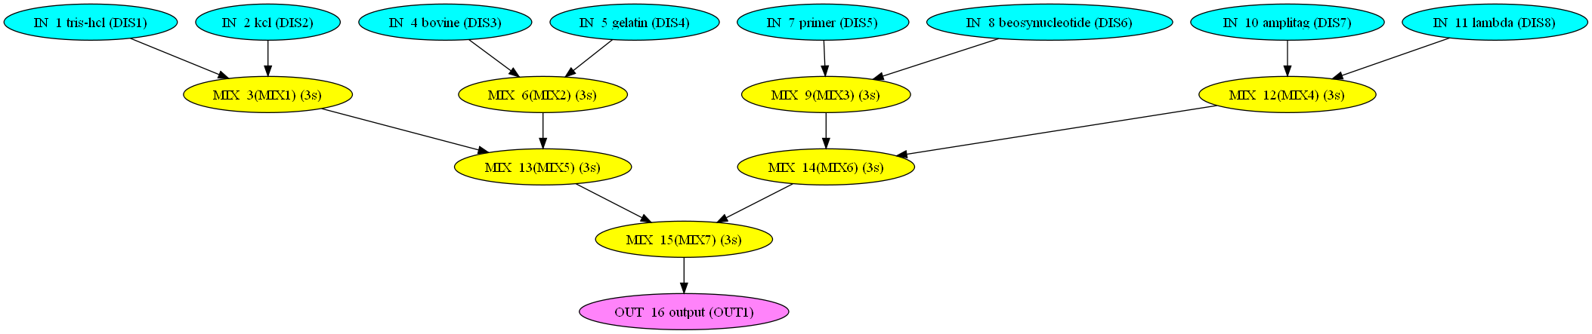
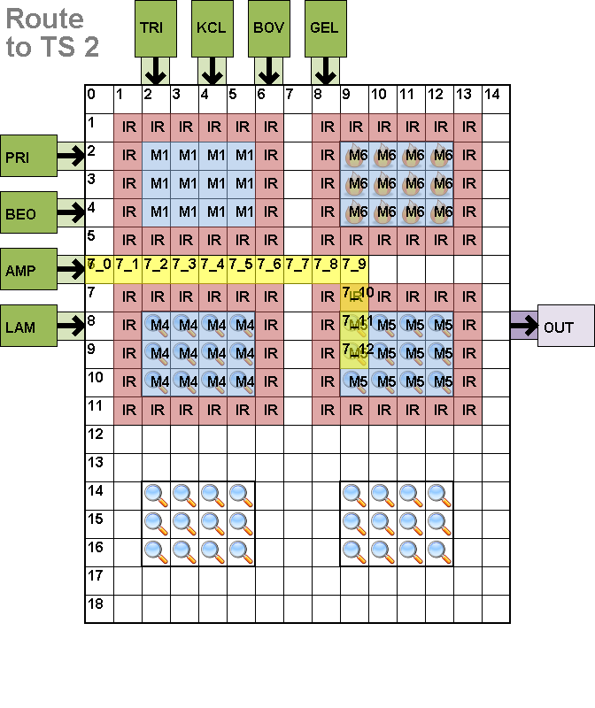
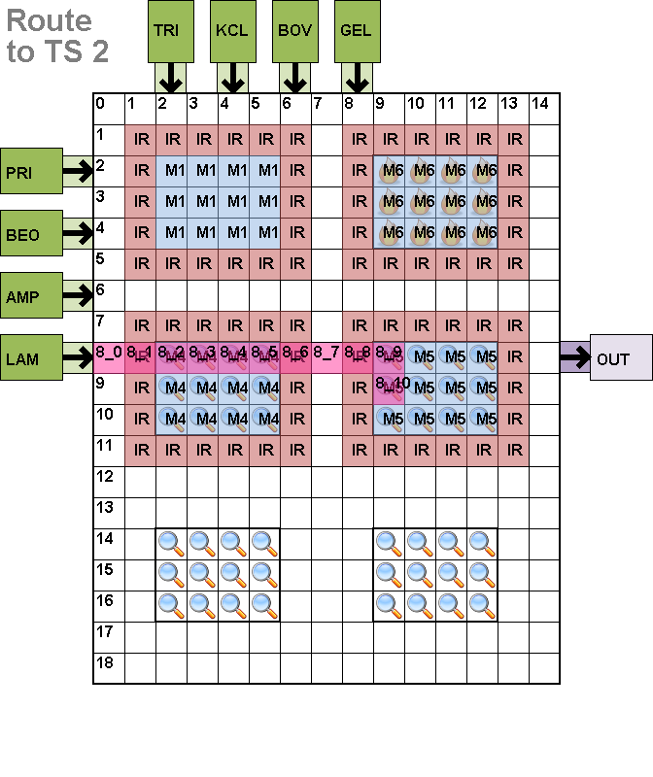
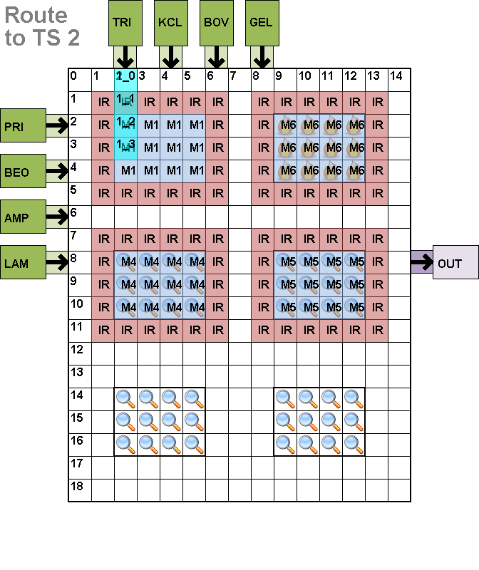
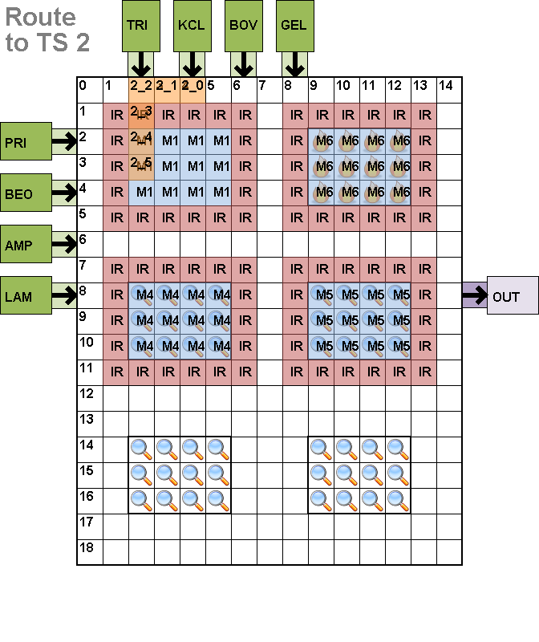
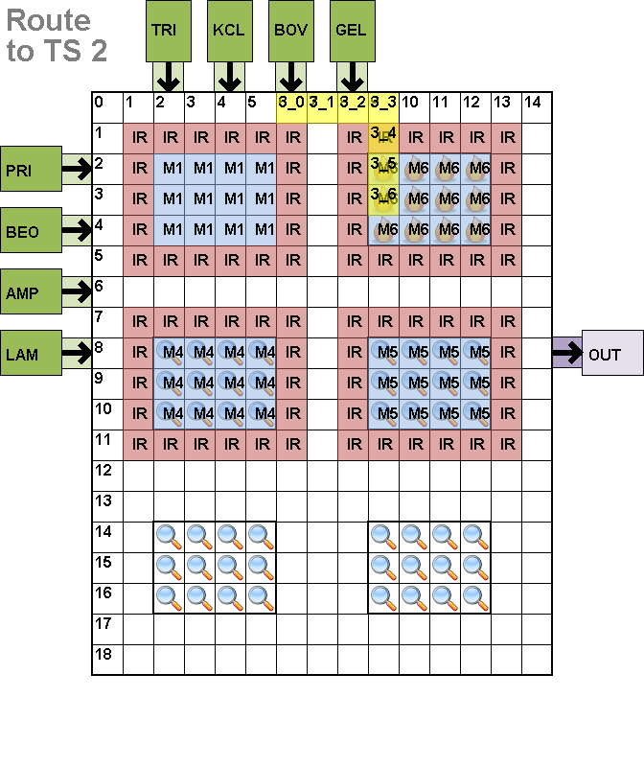
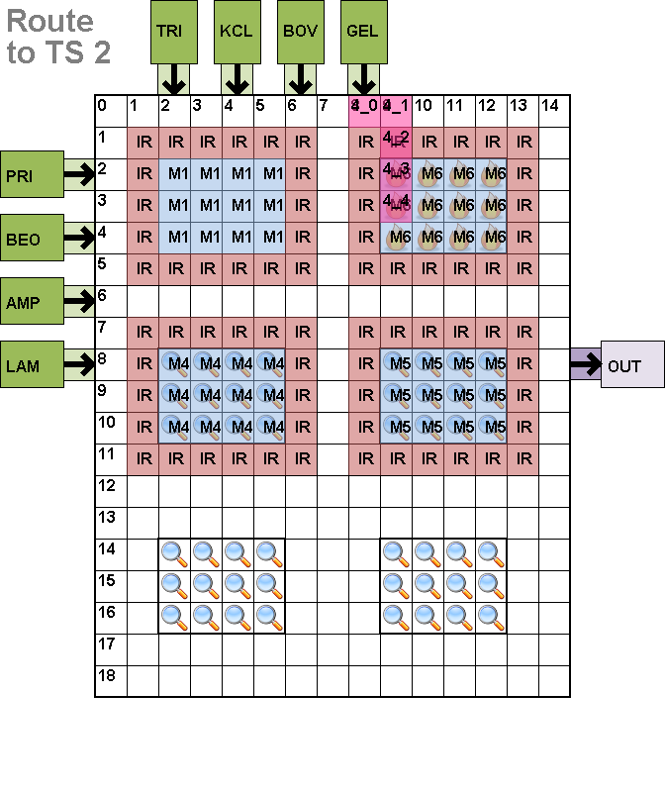
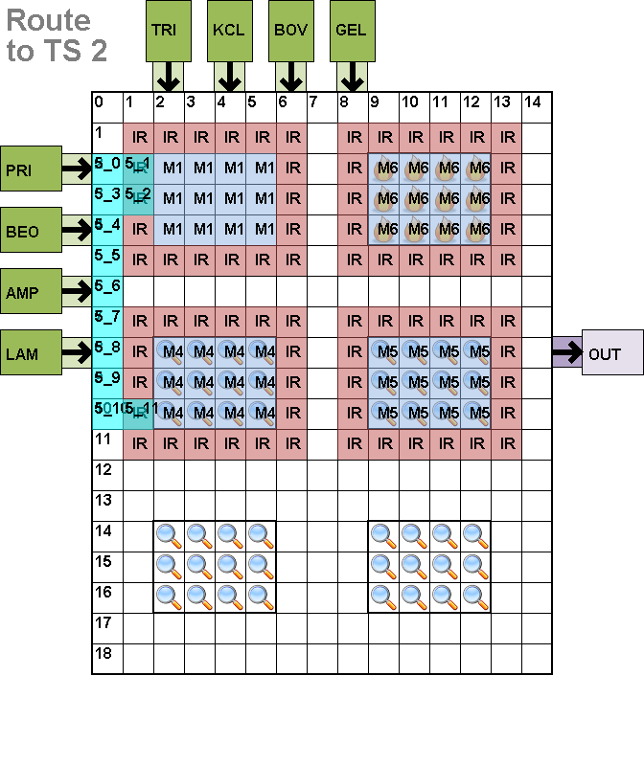
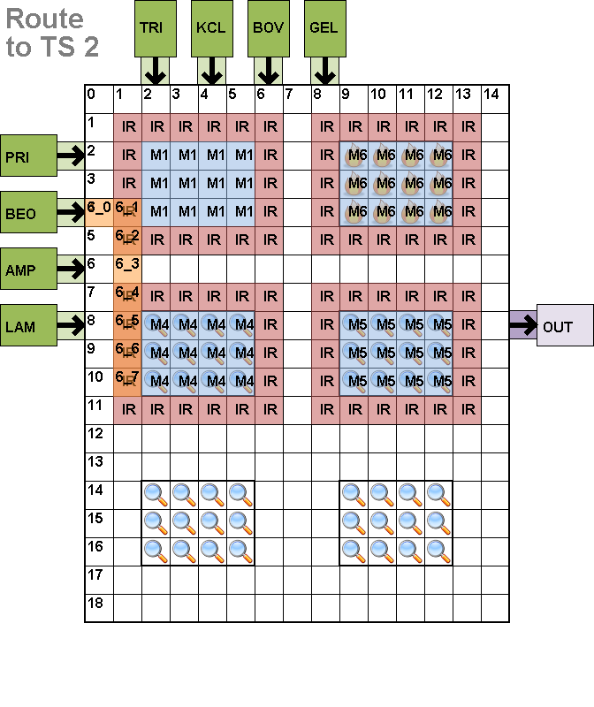
Routing
Simplified Soukup Maze Router [Roy, 2010]
  Independent routes computed for each droplet
Independent routes

Slide 16




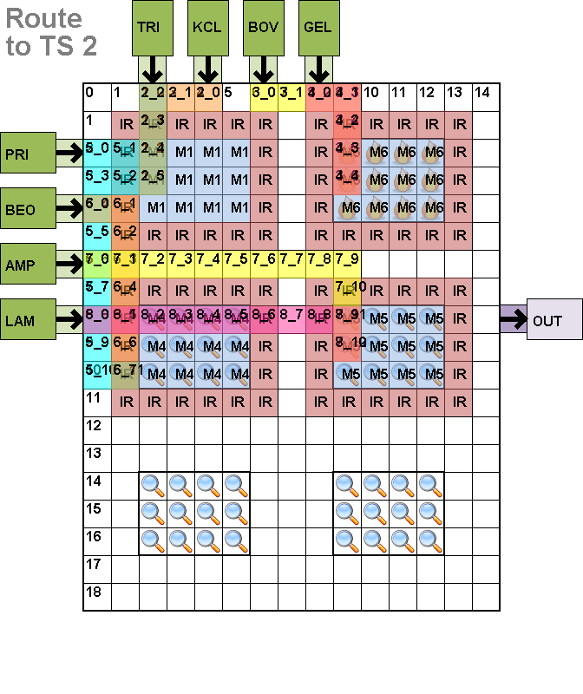
Routing (…continued)
Simplified Soukup Maze Router [Roy, 2010]
  All routes compacted; stalls added if necessary
- Droplets may collide if all start at same time

Slide 17
Routing (…continued)
Independent routes compacted
  Stalls added mid-route if possible
5
4 | S1 | 1 | 2 | 3/6 | 4/5 | 5/4 | 6/3 | 2 | 1 | S2
3 |  |  |  | 7 |  |  | 7
2 |  |  |  | 8 |  |  | 8
1 |  |  |  | T2 |  |  | T1
0 | 1 | 2 | 3 | 4 | 5 | 6 | 7 | 8 | 9 | 10 | 11
Deadlock!

Slide 18
Routing (…continued)
Independent routes compacted
  Stalls added at beginning otherwise
    Guaranteed to work because of designated module I/Os
5
4 | S1 | 1 | 2 | 3/6 | 4/5 | 5/4 | 6/3 | 2 | 1 | S2
3 |  |  |  | 7 |  |  | 7
2 |  |  |  | 8 |  |  | 8
1 |  |  |  | T2 |  |  | T1
0 | 1 | 2 | 3 | 4 | 5 | 6 | 7 | 8 | 9 | 10 | 11

Slide 19
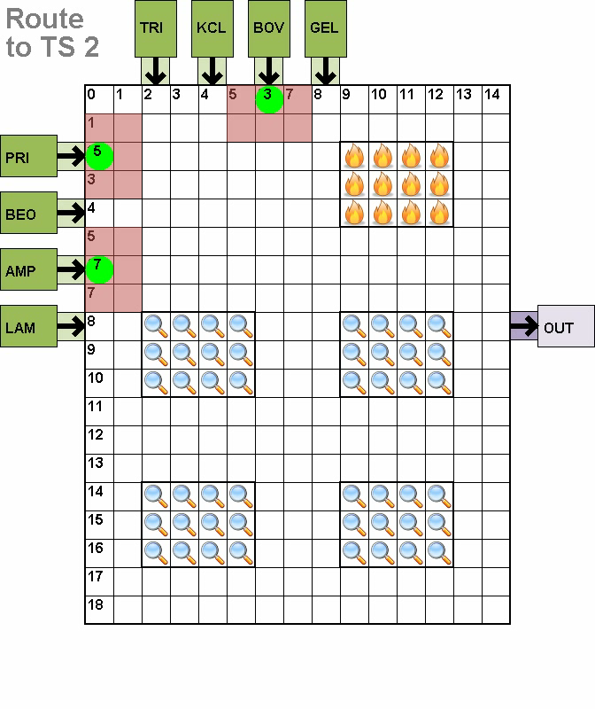
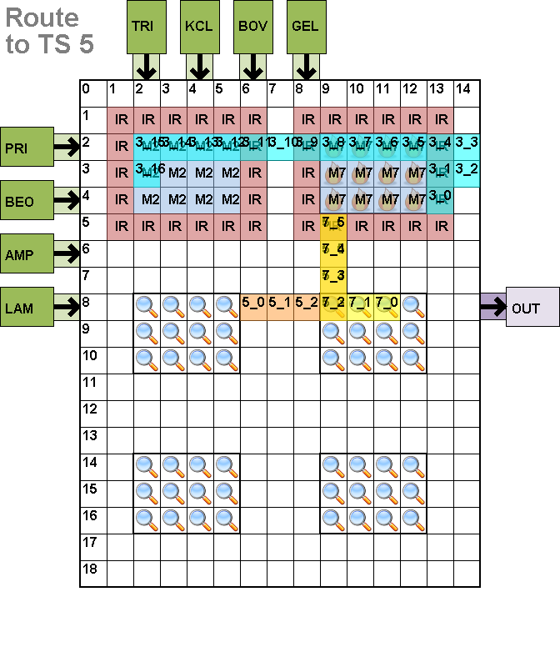
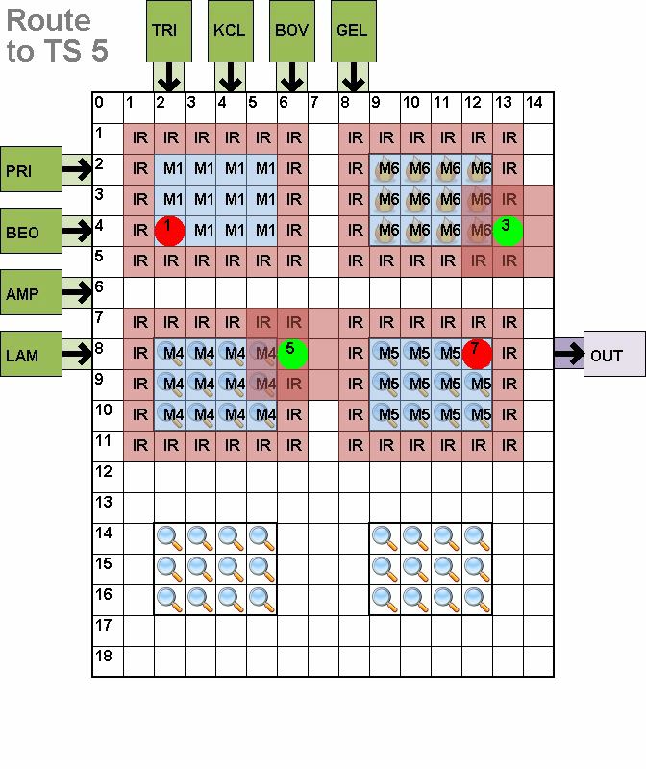
Routing (…continued)
Sub-problem 1 Compaction
Sub-problem 2 Compaction

Slide 20


Experimental Results
Compared 2 flows
  Our online:
    List Scheduler→Fixed Binding→Simplified Maze Router
  Traditional offline:
    Genetic Scheduler→Simulated Annealing Placer→Simplified Maze Router
Used high-end and low-end platforms
  2.8GHz Intel Core i7, 4GB RAM, 64-bit Windows 7
  1GHz Intel Atom, 512MB RAM, TimeSys 11 Linux

Slide 21
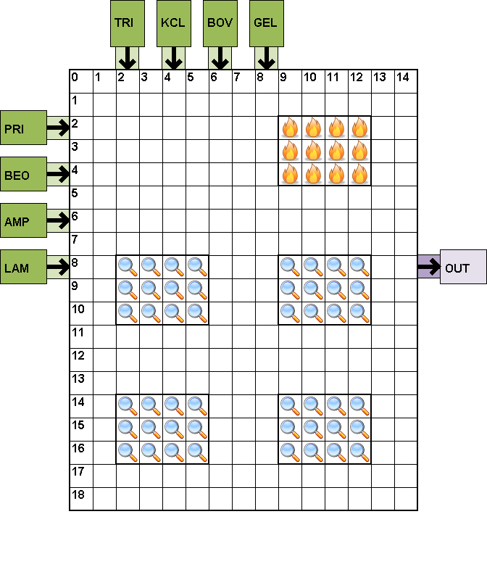
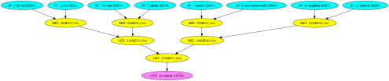
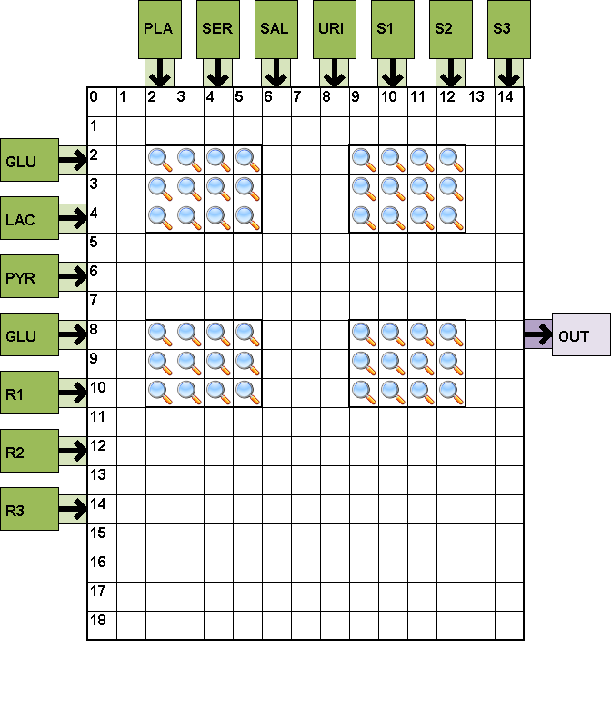
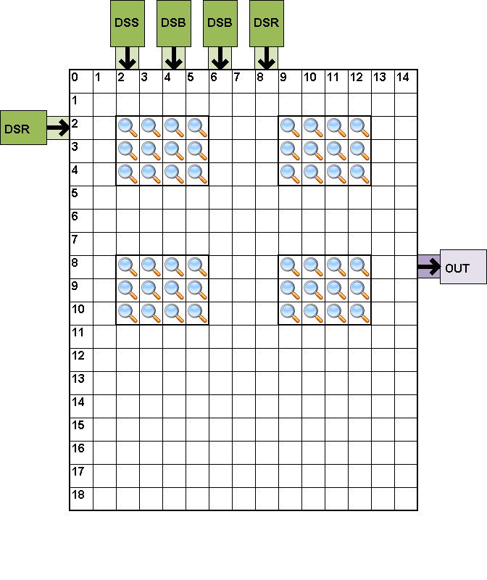
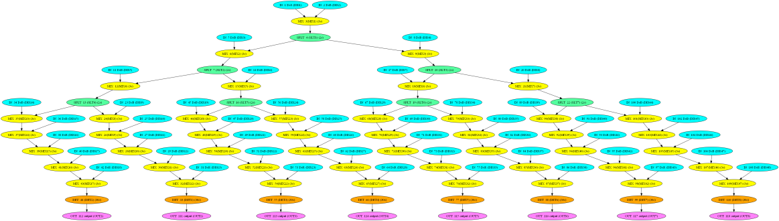
Benchmarks
PCR
In-Vitro Diagnostics
  5 different combos of samples/reagents
Colorimetric Protein

Slide 22
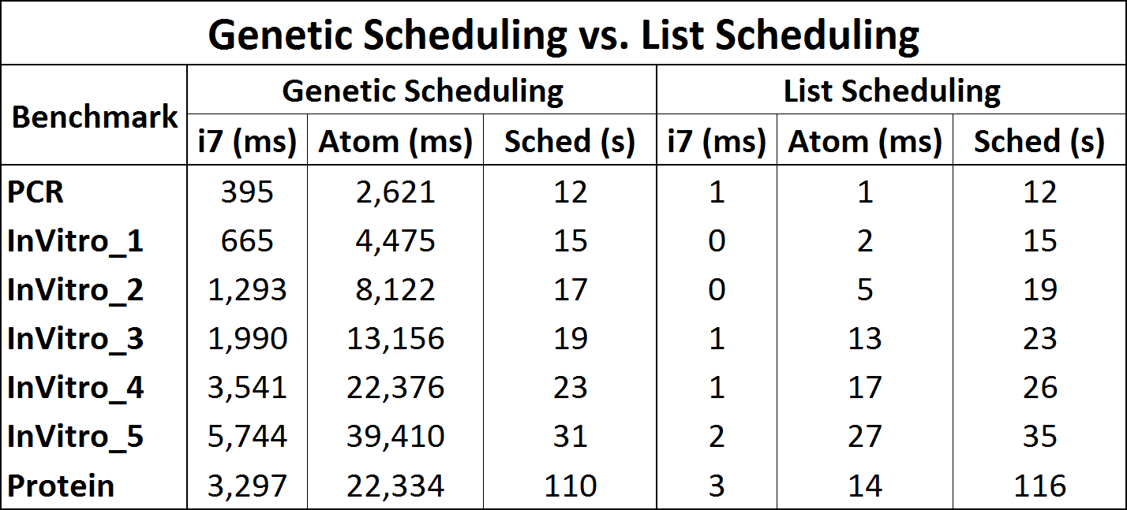
Results - Scheduling
Genetic scheduling produces comparable schedules, but takes more time

Slide 23
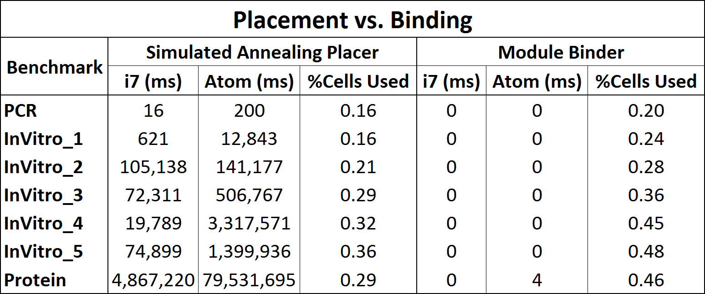
Results - Placement
Our binder uses more space, but produces valid solutions in significantly less time

Slide 24
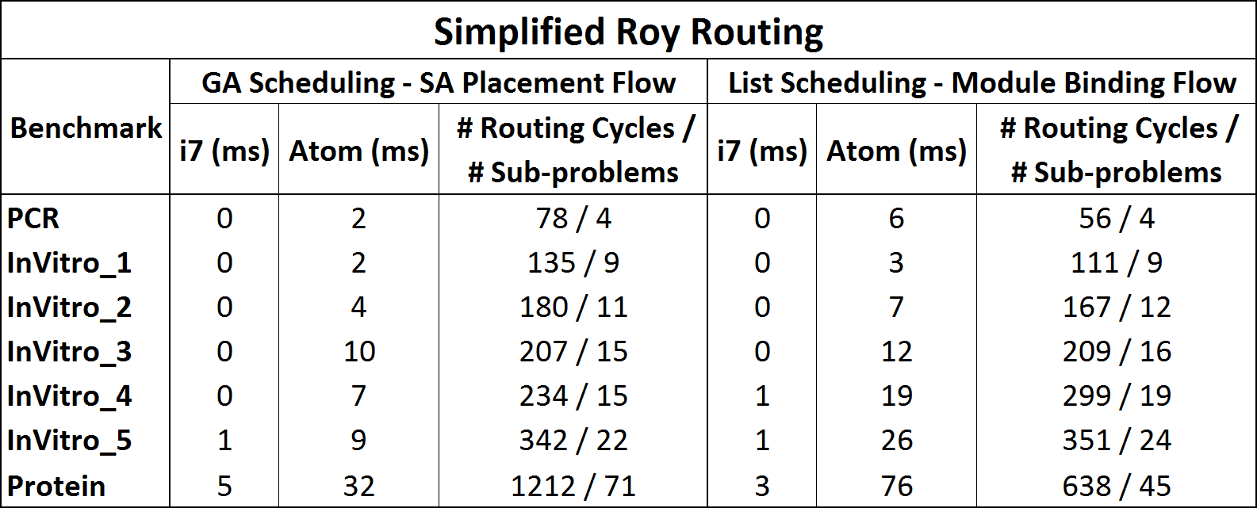
Results - Routing
Routing method is comparable for both flows

Slide 25
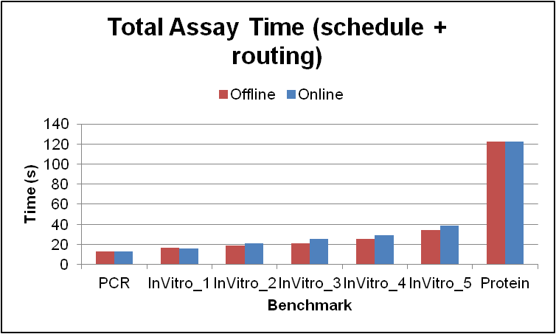
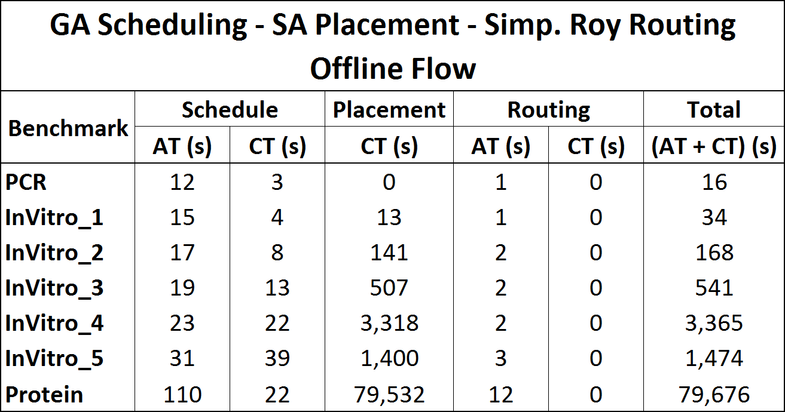
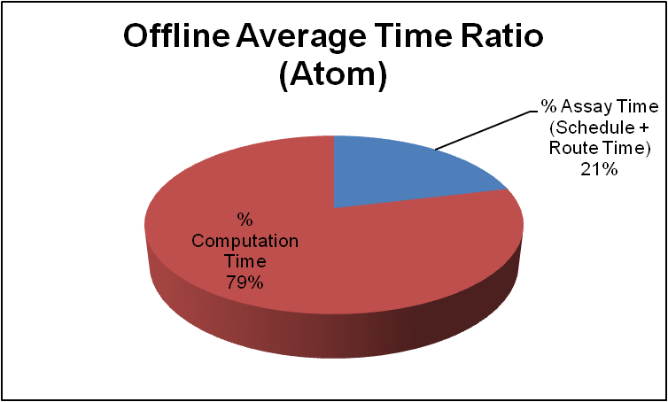
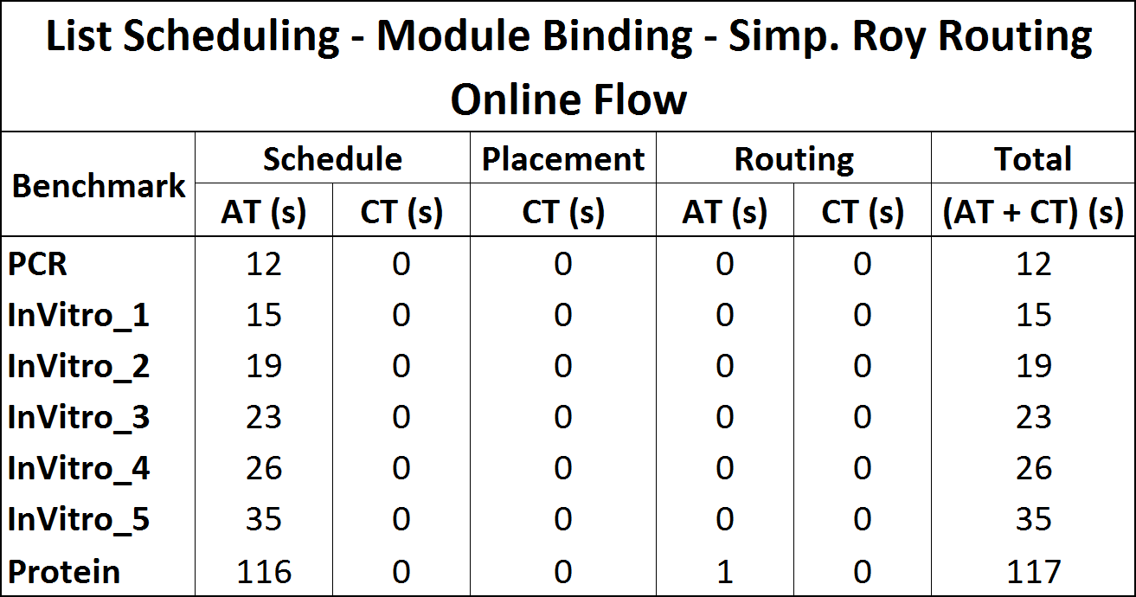
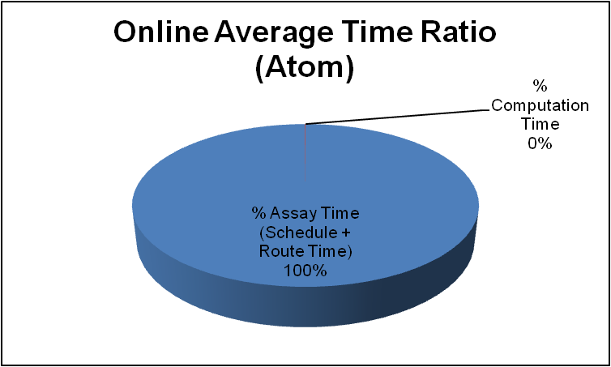
Results - Entire Flow
Assay times (solutions) comparable for online/offline
Offline spends most of time computing synthesis
Online spends almost entire time running assay

Slide 26
Conclusion
Presented a flow for online synthesis
  Scheduling, placement and routing simplified by virtual topology
    Scheduling: Know precise resource availability
    Placement: Free placement simplified to binding
    Routing: VT guarantees a deadlock-free route
  Other fast scheduler/routers can be used
    Biggest savings from fixed placement
  Produces quality synthesis solutions in ms

Slide 27
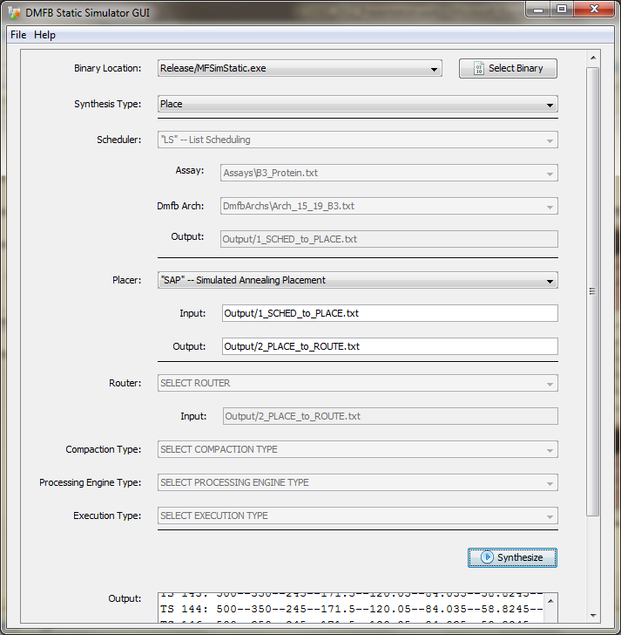
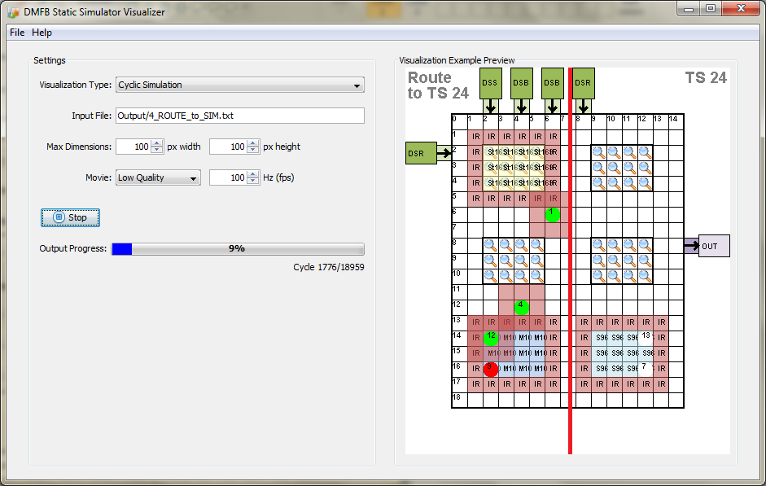
Microfluidics Simulator
Open source release
  www.microfluidics.cs.ucr.edu

Slide 28
Thank You

Slide 29

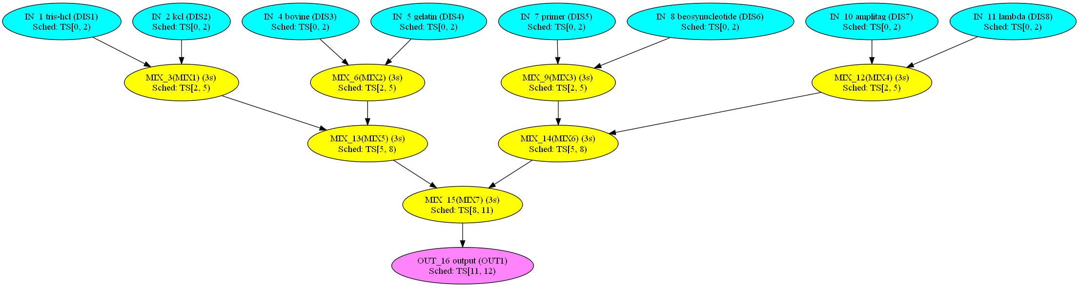
Synthesis Example: Scheduling
Input Assay (DAG)
Scheduler
DMFB Architecture
Scheduled Assay (DAG)

Slide 30
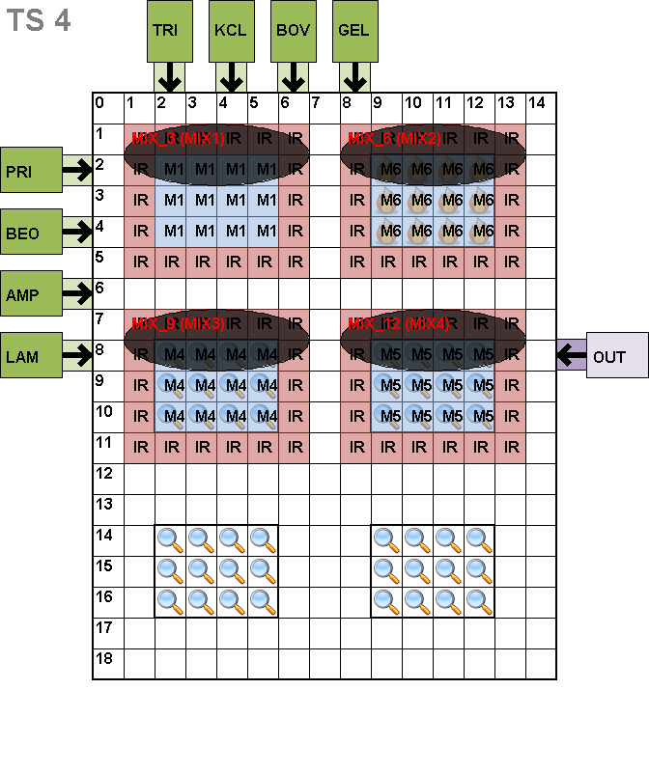
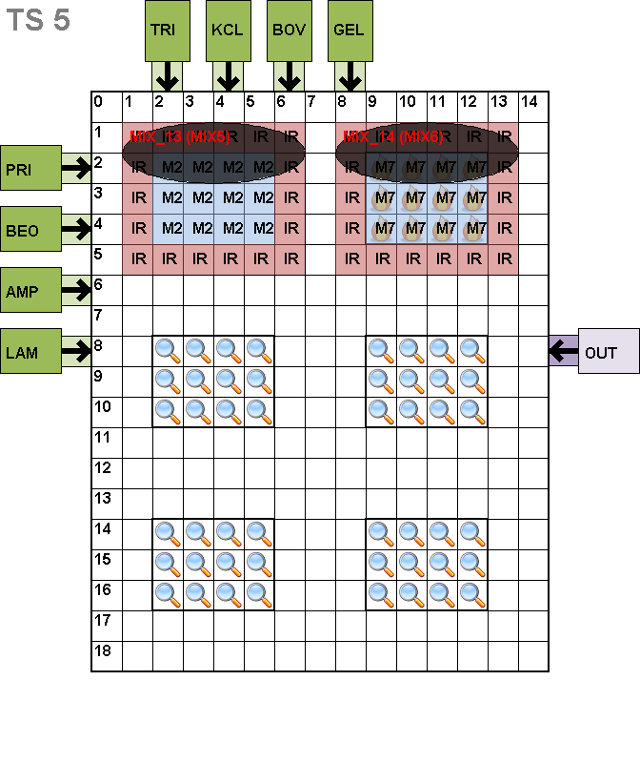
Synthesis Example: Placement
Scheduled Assay (DAG)
Placer
Placement Information

Slide 31
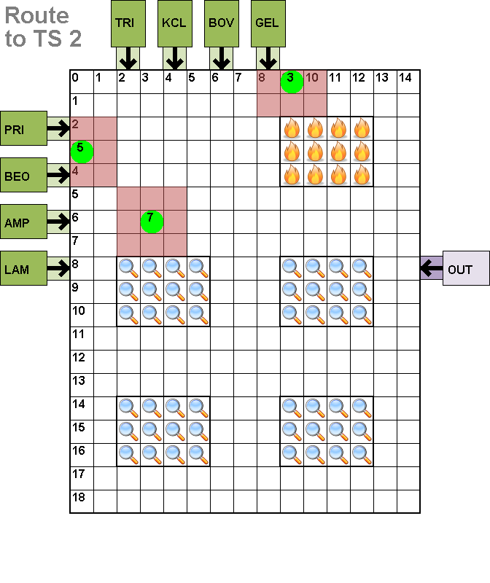



Synthesis Example: Routing
Placement
Placement
Router
Final Output

Slide 32


Scheduling (…continued)
Maximum number of droplets permitted on DMFB
  Leave a “bubble” for a droplet
  Any droplet can be isolated in any module
Results in scheduling DEADLOCK
Results in schedulable configuration

