Slide 1
Path Scheduling on Digital Microfluidic Biochips
Dan Grissom and Philip Brisk
University of California, Riverside
Design Automation Conference
San Francisco, CA, USA, June 5

Slide 2
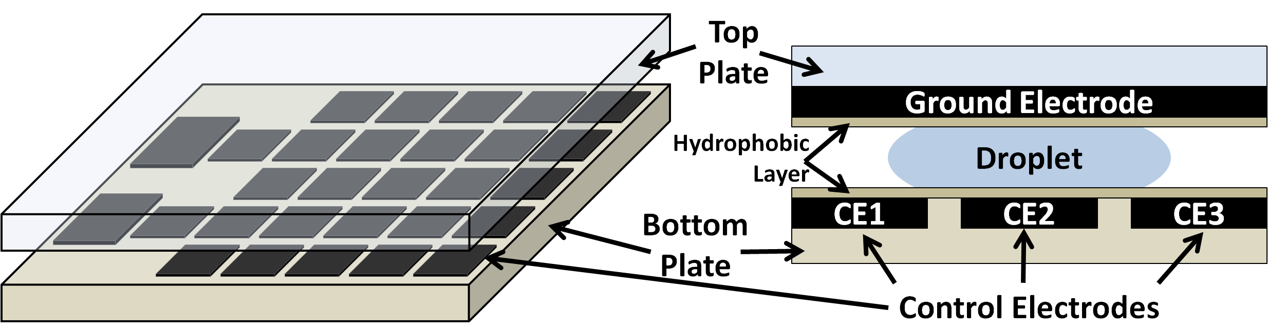
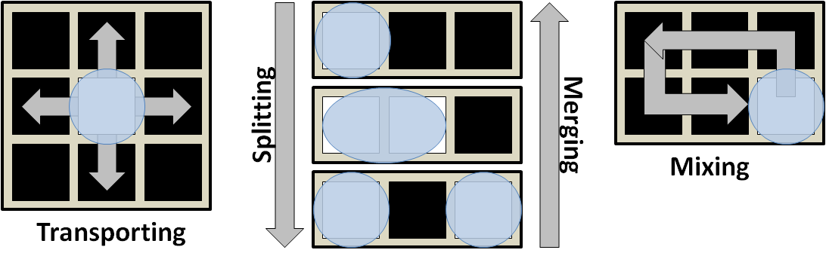
Digital Microfluidic Biochips (DMFB) 101

Slide 3
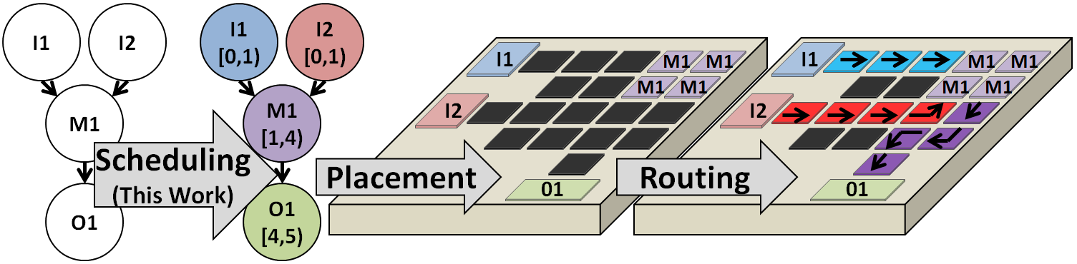
DMFB Synthesis
Resource-constrained scheduling of operations into time-steps
  Time-step ~ scheduling unit, usually 1s or 2s
Placement of operations during each time-step into modules
  Module ~ 2D group of cells where operation takes place for 1+ time-steps
Routing of droplets between operations between time-steps

Slide 4
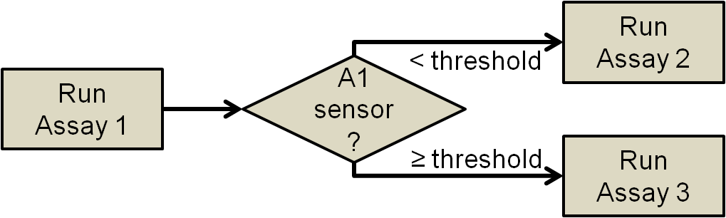
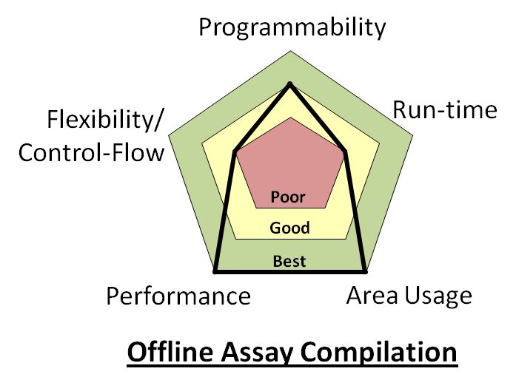
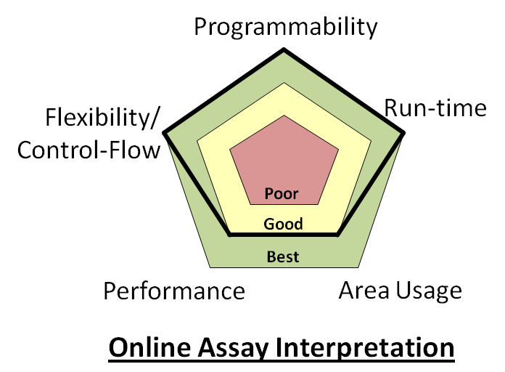
High Level Motivation
Goal: Online Synthesis
Why: Programmability, control-flow, live-feedback
Problem: Past, optimized methods are too complex
Solution: Synthesis with good results in little time
[Luo et al., DATE 2012]

Slide 5
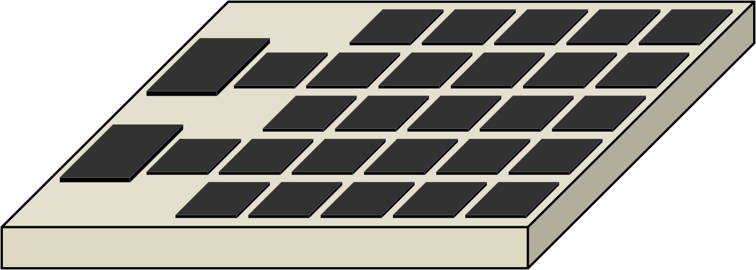
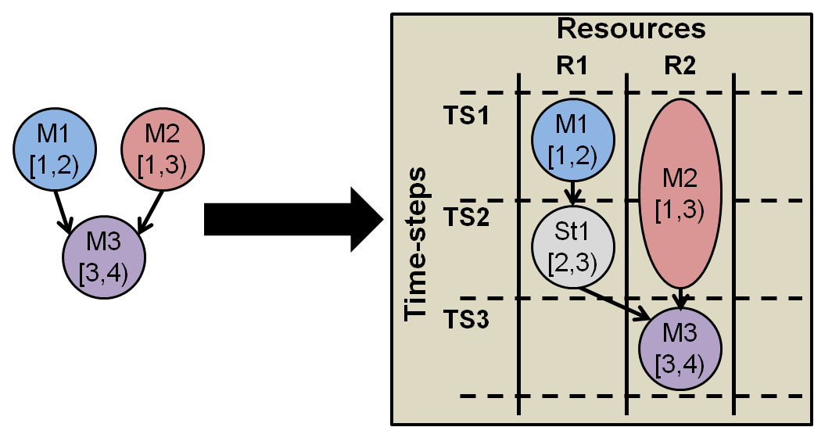
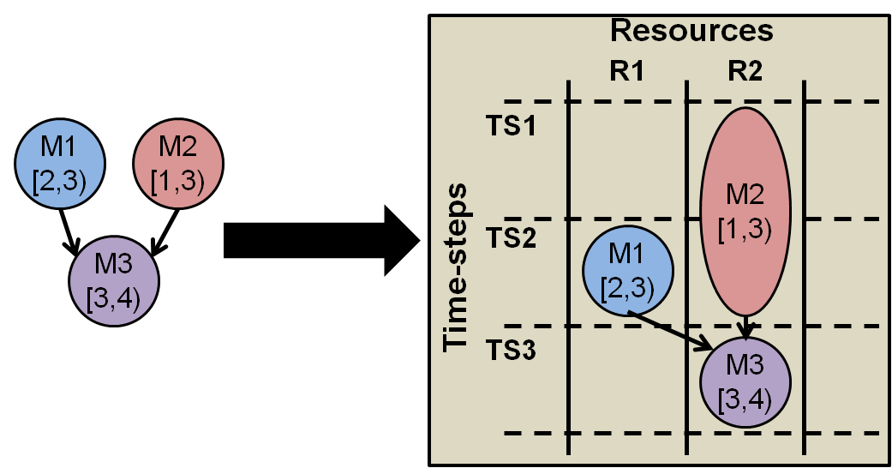
DMFB Scheduling Problem
DMFBs have limited storage
  Unlike computers, same resources used for operations and storage
Storage takes up space that can be used by useful operations
Scheduling Goal: Minimize storage
  Introduce droplets to system ALAP
  Use stored droplets ASAP to free space on array
Extra Resource
VS.

Slide 6
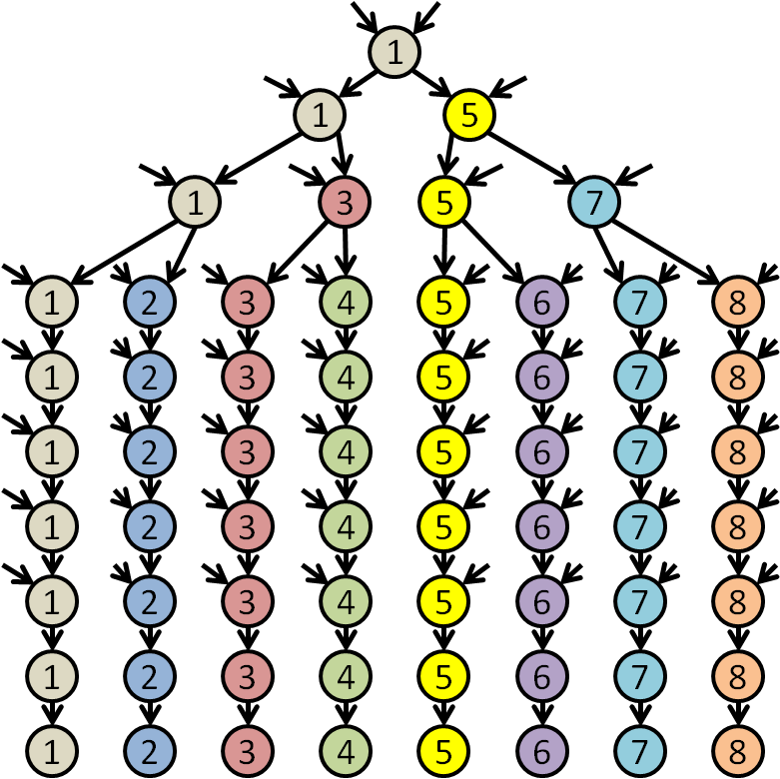
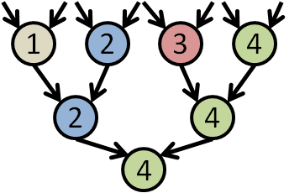
Schedule By Path
A path is a series of nodes that terminates with a mix/output
Paths are not unique
Colorimetric Protein Assay
PCR Mixing Stage Assay

Slide 7
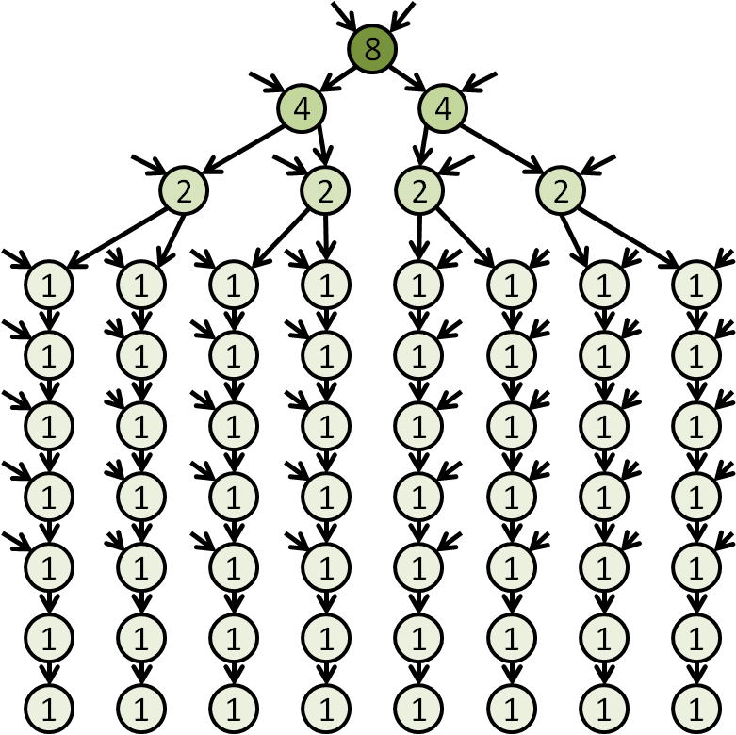
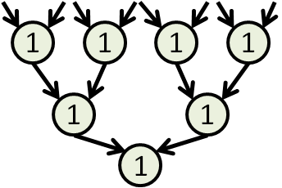
Independent Path Priority (IPP)
Defined as the cumulative number of droplets being output in a node’s fan-out
IPP helps determine which node/path to schedule next
Colorimetric Protein Assay
PCR Mixing Stage Assay

Slide 8
Scheduling Example
Legend
1
Path leader (not on current path)
1
5
Potential next-node-on-path
Fully scheduled/submitted path
1
3
5
7
1
2
3
4
5
6
7
8
1
2
3
4
5
6
7
8
1
2
3
4
5
6
7
8
1
2
3
4
5
6
7
8
1
2
3
4
5
6
7
8
1
2
3
4
5
6
7
8
1
2
3
4
5
6
7
8
Independent Path Priorities
Live Example

Slide 9
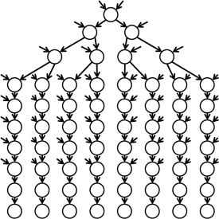
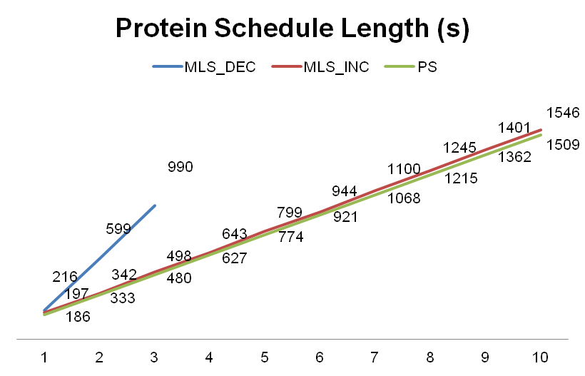
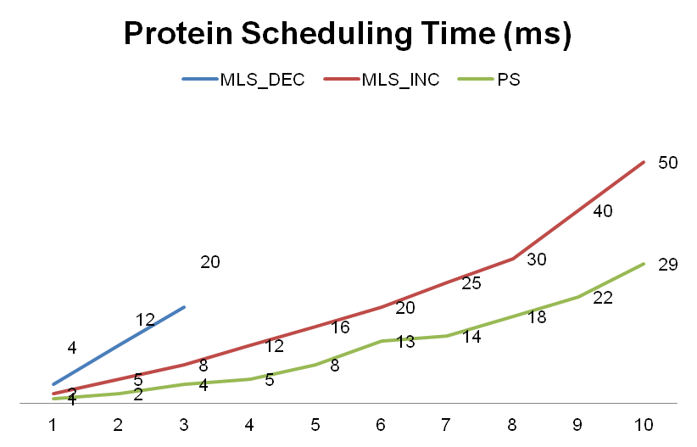
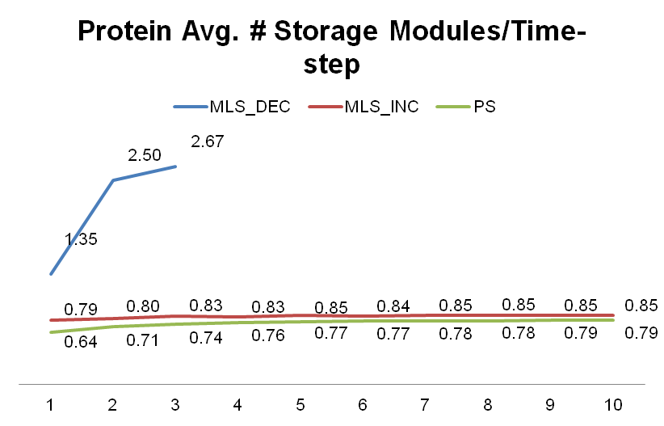
Protein Results
Implemented 3 schedulers in C++
  Path Scheduler
  List-scheduler
    Decreasing critical-path priorities (worse)
    Increasing critical-path priorities (better)
Solution Quality
Computational Complexity
Storage Usage
# Assays Concurrent Scheduled
# Assays Concurrent Scheduled
# Assays Concurrent Scheduled
Lower is better for all metrics

Slide 10
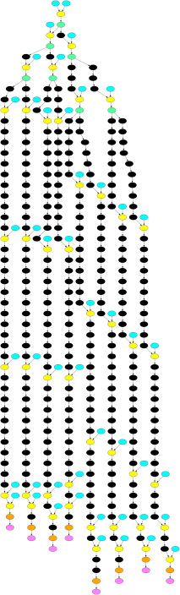
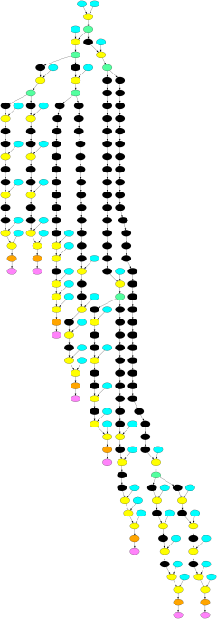
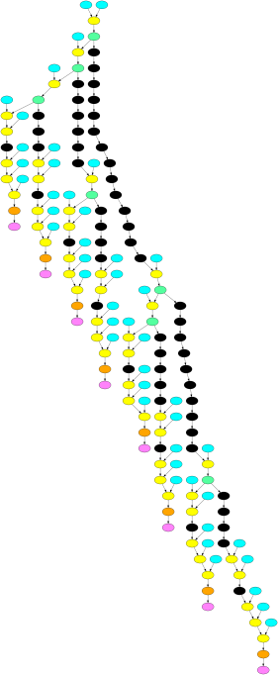
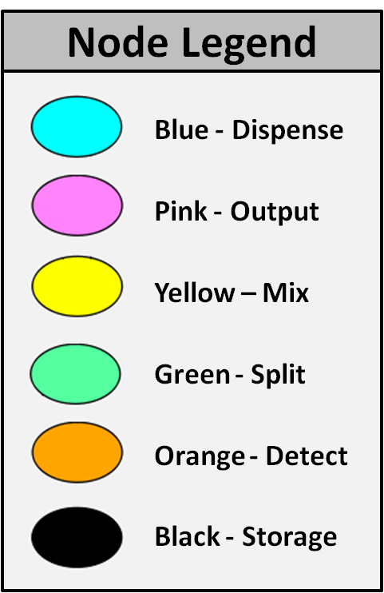
Placed Protein DAG Showing Storage
Black node = droplet being stored for a # of time-steps in 1 module
MLS_DEC
252 storage nodes
MLS_INC
119 storage nodes
PS
54 storage nodes

Slide 11
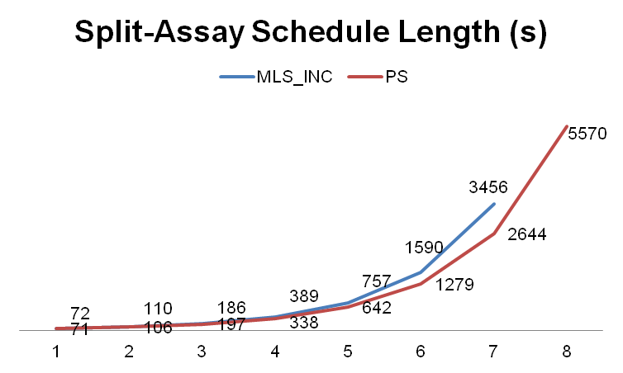
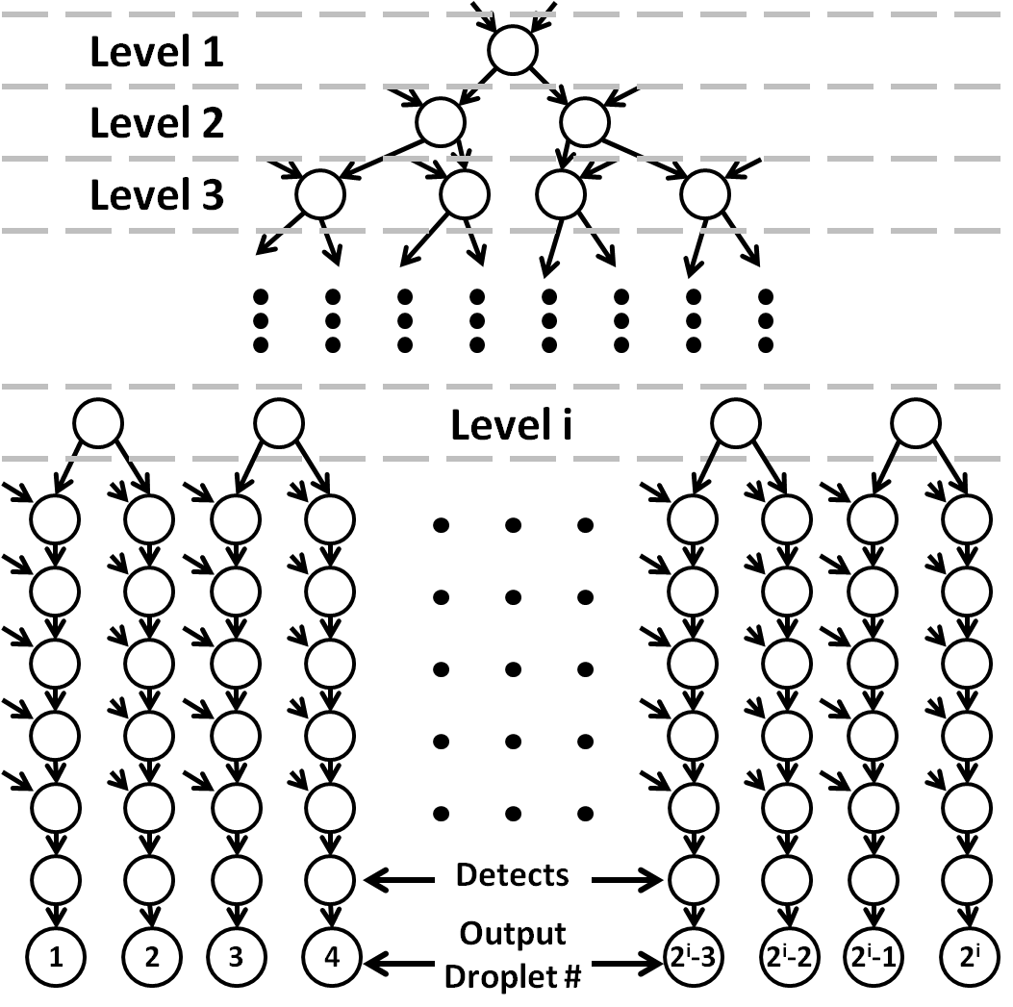
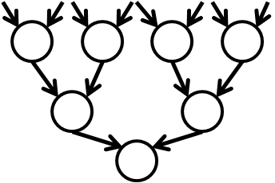
Conclusion
More results in the paper/poster
Excels at assays with high fan-out and limited resources
  Path scheduler saves 100’s of seconds
Performs well on assays w/o high fan-out
  Similar schedule quality
  Slightly shorter computation time
Viable option for online synthesis

Slide 12
Thank You

