Slide 1
Can We Improve Internet Performance?
An Expedited Internet Bypass Protocol
Dr. –Ing. Nirmala Shenoy
Professor, ISchool, School of Information
Director, Lab for Networking and Security
Golisano College of Computing and Information Sciences
Rochester Institute of Technology, Rochester, New York 14623
nxsvks@rit.edu

Slide 2
Agenda
Growing Internet Complexity
Escalating Proprietary Solutions & Infrastructure Costs
Can we improve Internet performance?
  A Cost Effective – Low Complexity Solution
  The Expedited Internet Bypass Protocol (EIBP)
Performance tested an EIBP prototype on the GENI Tested
  Compared with IP &BGP, IP&OSPF
Future work
Discussions / Questions
Notes:
The need for the protocol - To understand - look at communications over the Internet - challenges
Some Internet stats
what is the Internet routing scenario and the need for secure
what is the problem with reliable and timely deliver?
Bypass the Internet protocol!
we have a tested and evaluated prototype

Slide 3
Growing Networks and Needs
Number of Internet Users and Networks continue to grow
Current Layer 3 Protocols (IP, BGP, OSPF)
  IP to forward Internet packets, BGP and OSPF are routing protocols
  Are they addressing the growing needs?
  Challenges
    Developed decades ago – Severe Limitations
    Sluggish and unstable
The Needs – Next Slide

Slide 4
The Demand Scenario
SERVICES
Content delivery
  Growing CDN providers and networks
  High infrastructure investment
Proprietary solutions
  GAFAM
  (Google, Amazon, Facebook, Apple, Microsoft)
Private CDNs
USERS
Federal, Defense and Emergency networks..
Need secure, reliable and fast delivery of data

Slide 5
Internet Today
Internet Infrastructure – widely deployed
  Challenges
    Heavy traffic
    Security
    Reliability
  BGP Scalability
  Complex interworking OSPF, iBGP, eBGP (for inter-AS and intra-AS)

Slide 6
Internet Today (contd)
DATA travels across several networks, several tens of routers
  Routing Path through the networks defined by Routing tables
  Routing Table Size > 800,0000
  Severe Security Concerns at Layer 3
Consequences
  Non-deterministic Delays
  Unpredictable Loss of Data
  Vulnerable to security attacks
  Privacy Compromised

Slide 7
Solution?
Improve the Internet? – We are trying
Replace the Internet? ……….
Bypass the Internet – possible
  Turn on bypass services for specific IP users when needed
  The Expedited Internet Bypass Protocol (EIBP)

Slide 8
The Expedited Internet Bypass Protocol
EIBP for end to end IP packet delivery (IP Network or user)
Uses no routing protocols
  No global dissemination of routes
  No routing tables
Auto-configured addresses at routers provide routing information
  Multiple routing Paths
  Topology changes have localized impact
Extremely Fast Recovery on component Failures
A Single Protocol to route and forward
  Integrates control and data planes
  Simple and robust

Slide 9
The Expedited Internet Bypass Protocol
Expedites selected traffic –
  EIBP traffic flows below IP, hence IP traffic is avoided
  EIBP traffic bypasses layer 3 security threats
EIBP has no dependency on any Layer 3 protocol
Traffic flow at Layer 3 is not impacted
  EIBP operations are transparent to operations at Layer 3
EIBP has been coded and prototype tested (GENI testbed)
Performance compared to IP &OSPF, IP&BGP

Slide 10

The Expedited Internet Bypass Protocol
Routing Protocol
Routing Table
Routing Protocol
Routing Protocol
Routing Table
Routing Table
Internet Protocol
Internet Protocol
Internet Protocol
Bypass protocol
Bypass protocol
Bypass protocol
IP Client
IP Client
Layer 2
Layer 2
Layer 2
Layer 1
IP Packet Path
Layer 1
IP Packet Path
Layer 1

Slide 11
Routing with EIBP
EIBP routes using structures
  Physical or Virtual Structures
  Scalable and Modular
  Avoids loops
Example – Three Tier Structure in networks
Core Devices
Distribution
Distribution
Edge
Edge
Edge

Slide 12
Structed Addresses
Addresses carry routing Information
Simple address assignment – auto-configuration except in Tier 1,
Addresses updated on topology changes
  Changes are localized
Self-configuring, self-healing
Example - Autonomous System
Core Routers
1.1
1.2
TIER 1
1.3
2.1:1
2.3:1
2.3:2
2.2:1
Dist Routers
TIER 2
Dist Routers
3.1:1:1
3.3:1:1
3.3:2:1
3.2:1:1
Access Routers
TIER 3
Access Routers

Slide 13
Routing with Structured Addresses
(ANIMATED SLIDE)
Knowledge of edge router labels and networks they connect
Router 2.3:1 identifies 2.3:2 as neighbor closest to destination router 3.3:2:2 and forwards
Router 2.3:2 forwards to 3.3:2:2
Core Routers
1.1
1.2
TIER 1
1.3
2.1:1
2.3:1
2.3:2
2.2:1
EIBP at access router 3.3:1:1 captures the IP packet
Dist Routers
TIER 2
Dist Routers
Router 3.3:2:2 de-encapsulates IP
packet and sends to client 2
3.3:1:1
3.1:1:1
3.3:1:1
3.3:2:1
3.2:1:1
3.3:2:2
client 1
Access Routers
Access Routers
client 2
TIER 3
IP address 10.11.22.33
IP packet arrives at Access Router 3.1:1:1/3.3:1:1
IP address 10.22.33.11
Access Router looks up structural address of access router connecting client 2, which is 3.3:2:2
10.22.33.11 10.11.22.33 payload
IP packet from client 1 to client 2
Encapsulates IP packet in EIBP header -
3.3:1:1 3:3:2:2 10.22.33.11 10.11.22.33 payload
Identifies neighbor 2.3:1 as the next router closest to destination
Sends encapsulated packet to distribution router 2.3:1

Slide 14
Flow Chart to Route with EIBP
Decision path followed in previous example
Compare with destination address with my addresses and my neighbor addresses
Forward to the address closest to destination address
Else send to my parent
From 3.3:1:1 to 2.3:1
From 2.3:1 to 2.3:2
From 2.3:1 to 3.3:2:2

Slide 15
EIBP Implementation
Knowledge of edge router labels and networks they connect
EIBP messages carried in Ethernet frames - uses an unused type value in the protocol type field
  Captured on arrival at the sockets by EIBP
Hello Message – variable addresses- only if addresses change
Encapsulation of IP Packet
Join Request Message – lower tiers send to upper tiers
Msg Code
Number of Addresses
Length of Address 1
Address 1
Length of Address n
Address n
Msg Code
Destination Structured Address
Source Structured Address
IP PACKET
Msg Code
Tier Value

Slide 16
Bypass Protocol Implementation
Implemented as a software that operates below the Internet Protocol
  Prototype Tested for intra-AS
The EIBP code was written in C language and ported into Linux Systems (Ubuntu 16.04) in the GENI testbeds
Code Available on gitlab
http://www.rit.edu/news/story.php?id=61939

Slide 17
EIBP Implementation Flexibility
Code ported into routers – runs below IP without disrupting normal IP operation
All routers in a network must run a copy of EIBP
Turn on EIBP– WHEN NEEDED
  For specific end IP networks/hosts

Slide 18
Prototype Tests on GENI Testbed
Performance Compared with IP&OSPF and IP&BGP
What is the GENI testbed?
GENI (Global Environment for Network Innovations) provides a virtual laboratory for networking and distributed systems research and education. It is well suited for exploring networks at scale, thereby promoting innovations in network science, security, services and applications. GENI allows experimenters to:
Obtain compute resources from locations around the United States;
Connect compute resources using Layer 2 networks in topologies best suited to their experiments;
Install custom software or even custom operating systems on these compute resources;
Control how network switches in their experiment handle traffic flows;
Run their own Layer 3 and above protocols by installing protocol software in their compute resources and by providing flow controllers for their switches.
→ https://www.geni.net/about-geni/what-is-geni/

Slide 19
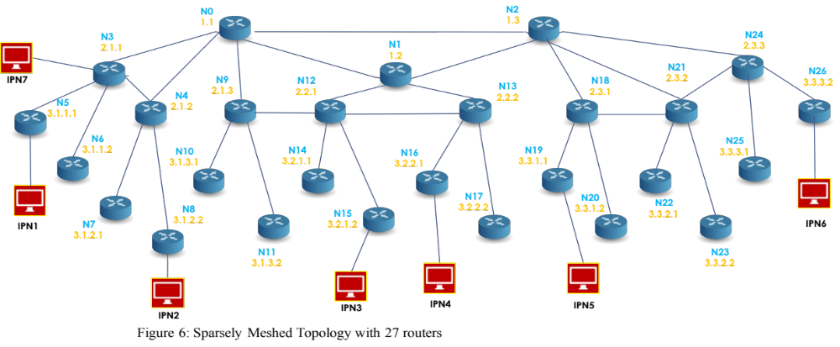
Prototype Evaluation on GENI Test Bed
17 Routers with IP Clients
Tier 1
Tier 2
X
X
X
Tier 3
17 NODE TEST TOPOLOGY ON GENI TESTBED
X – Failure Points (only one address shown)
This is one of many tests conducted. Please check Nirmala Shenoy, Shashank Rudroju and Jennifer Schneider, “ An Emergency Internet Bypass Lane Protocol”, High Performance Computing and Communications (HPCC-2018) Exeter, England, UK, 28-30 June 2018

Slide 20
Convergence Process on Failures
Convergence time = Failure detection time + Protocol recovery time
Failure Detection Time
  The node with the failed interface knows first. Node across from the failure has to miss hello messages to detect failure and take action
  Bidirectional Forwarding Detection can speed up failure detection
Protocol Recovery Time – is a true measure of a protocol’s recovery process and its robustness to failures

Slide 21
Convergence Delays Recorded
In the tests, protocol timers were used for failure detection
BGP failure detection averages to 180 seconds (60 second hello timer and 3 missing hellos) – default values
  Future tests will optimize these values
OSFP failure detection averages to 30 seconds (10 second hello timer and 3 missing hellos)
  Recent tests with BFD enabled
OSPF convergence was calculated by recording the time when updates messages stopped and Link State database stabilized after a failure
EIBP does not flood network with route changes –
  Hello timer was set to 1 sec, and in the event of failure, the next path was used
  To avoid flapping interfaces – hysteresis in reinstating an address was adopted
Convergence delays record = Failure detection + Protocol Recovery time

Slide 22
Failure Recovery and Convergence
FAILURE BETWEEN N3 AND N4
Protocol | Convergence (seconds) | Impact Ratio
BGP | FD+100 (PR) | 26/27
OSPF | FD+30 (PR) | 8/27
EIBP | 1 | 2/27
FAILURE BETWEEN N0 AND N1
BGP | FD+100 (PR) | 19/27
OSPF | FD+30 (PR) | 27/27
EIBP | 1 | 2/27
FAILURE BETWEEN N0 AND N3
BGP | FD+100 (PR) | 27/27
OSPF | FD+30 (PR) | 25/27
EIBP | 3 | 5/27
FD – Failure Detection, PR – Protocol Recovery
CONVERGENCE TIME in secs is the recovery time after a link failure.
Deducting the failure detection time BGP records > 80 seconds for its tables to stabilize
OSPF records > 30 seconds for its tables to stabilize
EIBP records 1 second.
IMPACT RATIO is the number of routers that update their routing tables on a link failure.
With BGP most routers update.
With OSPF in certain cases impact ratio is slightly below 1/3.
With EIBP less than 1/5 and in many cases less than 1/13.

Slide 23
Routing Table Sizes
Protocol | Routing Table Size
BGP | 93 | multiple backup
OSPF | 83 | at least 1 backup
EIBL | 5 | Neighbor table Size
RESULTS INTERPRETATION
ROUTING TABLE SIZE provides a measure of scalability of the protocol. For a 27 router partial meshed topology,
BGP records 93 entries,
OSPF records 83 entries and the EIBP recorded a max of 5 entries

Slide 24
Benefits
Several magnitudes in recovery time on failures
Routing simplified
  A single protocol updates routing information + forwards packets
  Integrated control and data operations
Improved Security and Privacy for data transfers
Improved Fault Tolerance
Seamless interworking of intra-AS and Inter-AS operations
Easy deployment / migration
RIT news item
  http://www.rit.edu/news/story.php?id=61939

Slide 25
Inter-AS with EIBP
1.1
1.2
Tier 1 ISP A
Tier 1 ISP B
ISPs are structured in Tiers
Auto structured address assignment within an ISP follows same principles as before
2.1.1
2.2.1
2.1.2
2.2.2
Tier 2 ISP C
Tier 2 ISP D
3.2.1.1
Core Routers
3.1.1.1
3.2.2.1
1.1
1.3
1.2
TIER 1
4.1.1.1.1
Tier 3 ISP E
2.1:1
2.3:1
2.3:2
2.2:1
Dist Routers
TIER 2
Dist Routers
3.1:1:1
3.3:1:1
3.3:2:1
3.2:1:1
Access Routers
TIER 3
Access Routers
Inter-AS forwarding next slide

Slide 26
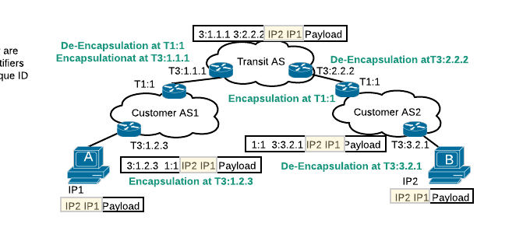
Extending to inter-AS
System A sends an IP packet to System B.
At access router T3:1.2.3 IP packet is encapsulated and sent to the core /border router as destination B’ address IP2 is not in AS1.
Packet reaches T1:1, it forwards the packet to T3:1.1.1 at the transit AS.
At the transit AS, the access routers have the AS IP addresses that the transit AS is connected to.
The access routers also have a map of the AS IP addresses (that the transit AS connects) mapped to the structured address of the access routers.
Router T3:1.1.1 will encapsulate the IP packet with new header and the packet will be delivered to router T3:2.2.2,
T3:2.2.2.2 will de-encapsulate and send to T1:1 at Customer AS2.
The packet is re-encapsulated at T1:1 at Customer AS2, and delivered to access router T3:3.2.1
Access router de-encapsulates and deliver to System B
A single protocol for intra-AS and inter-AS
No iBGP

Slide 27
Future Features
Fast failure detection and recovery without the use of BFD
  Failover with single missing hello (partly implemented)
  Send 1 byte hello messages at a high frequency
  Hysteresis based recovery when failed link/device comes up
Link Failure
  Router recognizes first
  Identifies failed addresses and disseminates
Concepts to be tested

Slide 28
Future Benefits
Efficient use of Internet infrastructure
  Leverage the current infrastructure to offer superior services
  Reduce deployment of proprietary, costly and resource intensive infrastructure
  Offer expedited services on need.

Slide 29
THANKS
QUESTIONS

