Slide 1

Adaptive Address for Next Generation IP Protocol in Hierarchical Networks
Haoyu Song, Zhaobo Zhang, Yingzhen Qu, James Guichard
Futurewei Technologies, USA

Slide 2







Motivation
Short messages
Energy sensitive
Delay sensitive
Resource limit
Header Overhead
Independent address space
Identity retention
Nondisruptive upgrade
Address Extensibility

Slide 3
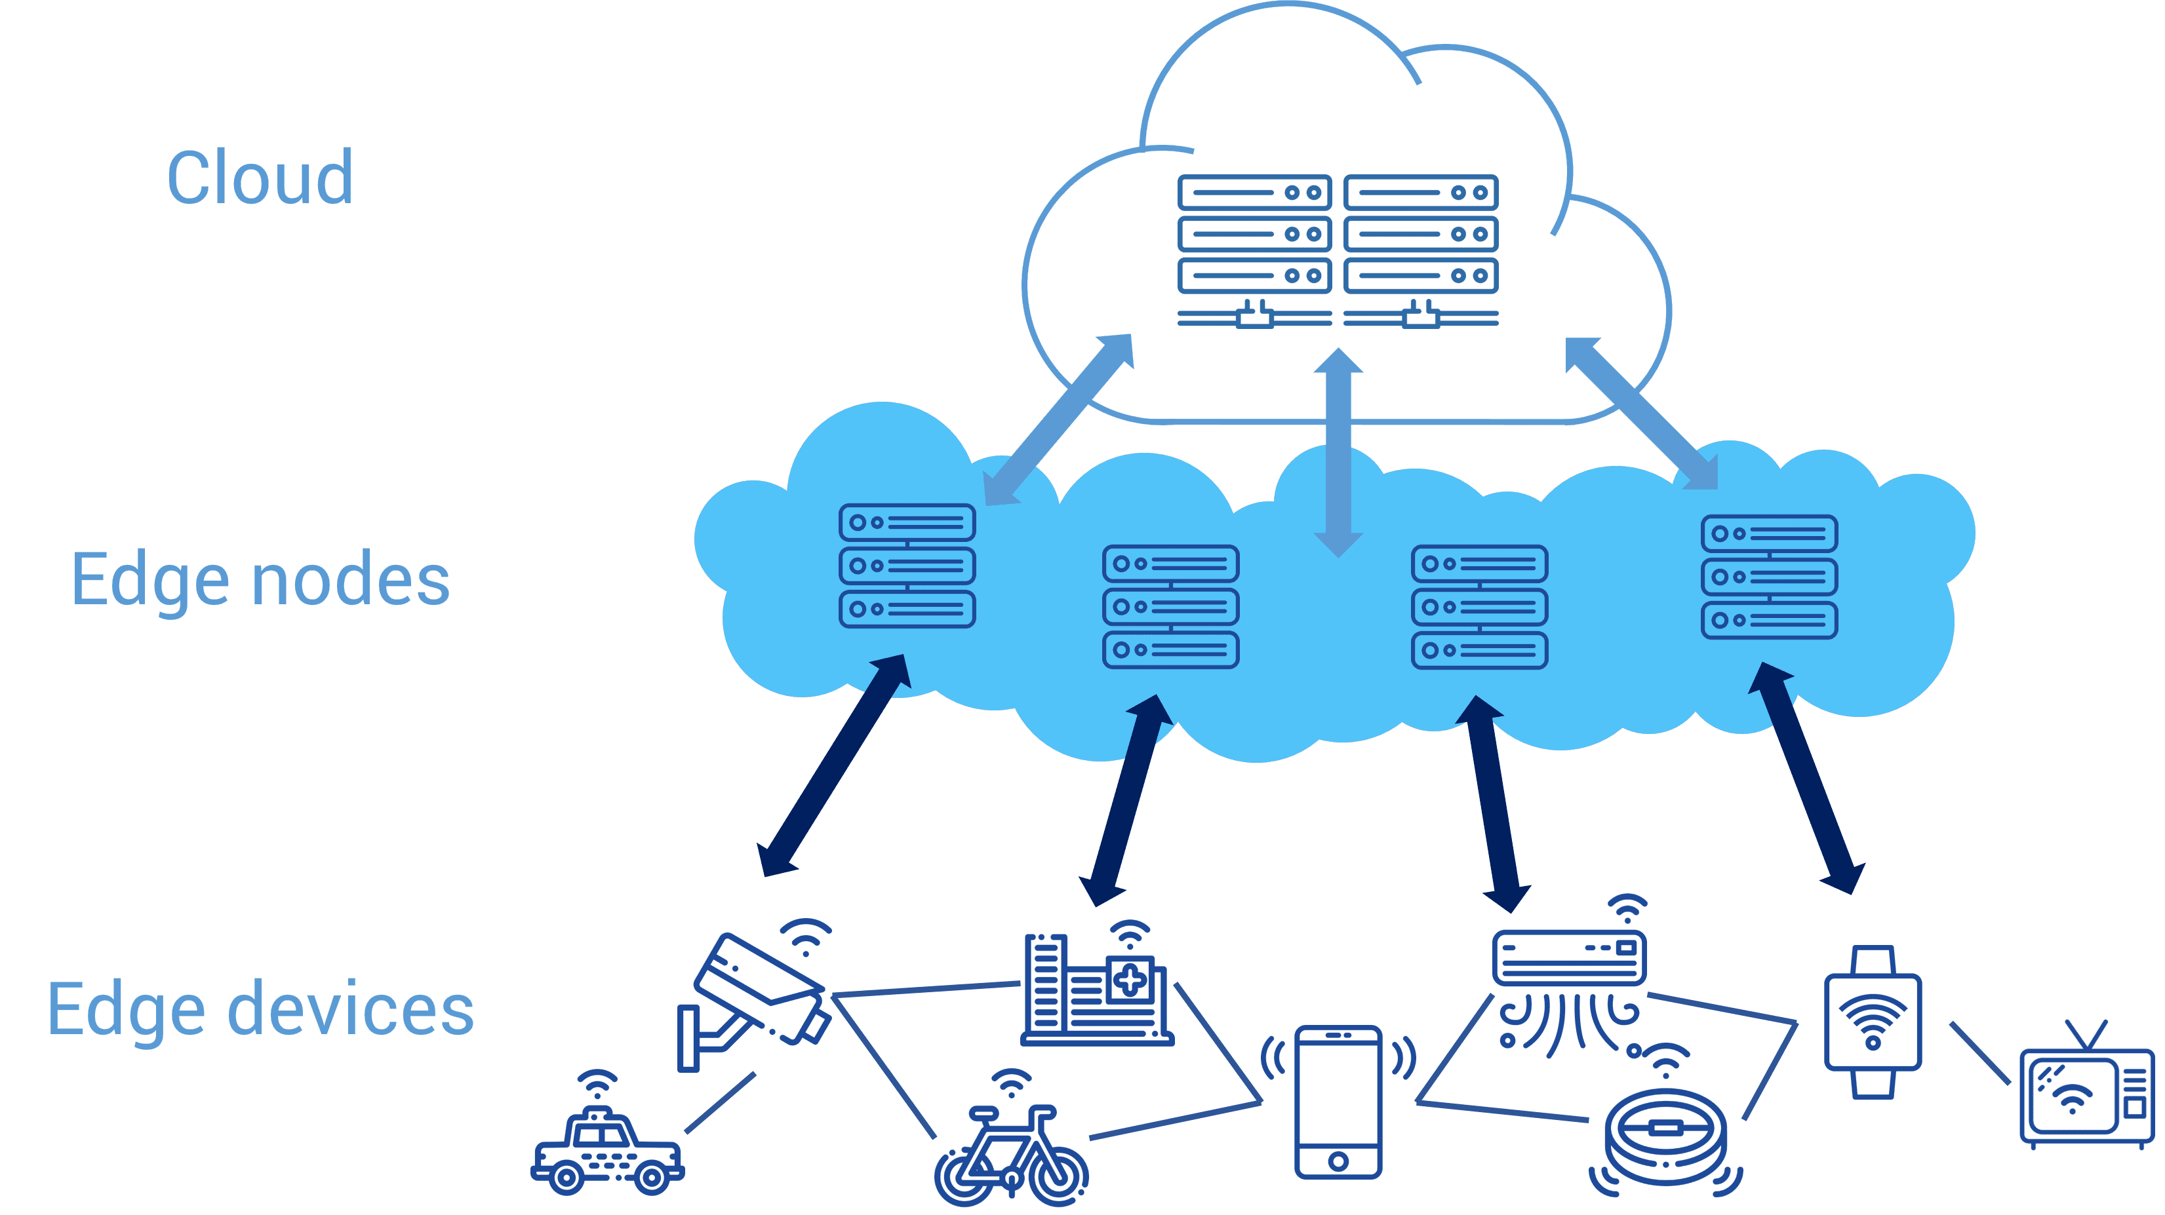
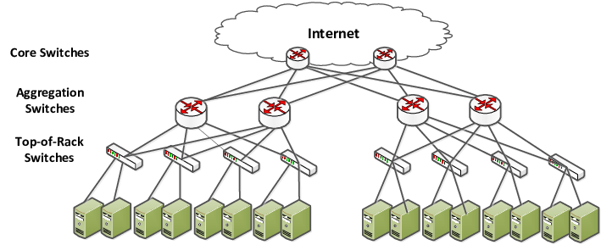
Observation
IoT Network
Data Center Network
Hierarchical network architecture
Most communication happens between adjacent entities
Communication possible if entities can be uniquely identified mutually

Slide 4
Adaptive Address in Hierarchical Networks
Entity Address = Network ID + Entity ID
Highest Level Network ID
Delegate Network ID maintenance and operation to networks
Entity only knows and uses its own Entity ID
For communication, entity only get the peer’s partial address up to the first network level they share
  E.g., in the lowest level network, entity ID is enough
Complete address
Lowest Level Network ID
Entity ID

Slide 5




USA
Other Countries
New York
California
San Jose
Los Angeles
New York City
From: 123 A Dr.
To: 456 B Rd.
From: 123 A Dr.
To: 456 B Rd.

Slide 6
USA
Other Countries
From: 123 A Dr. San Jose, CA
To: 456 C Ave. NYC, NY
From: 123 A Dr. San Jose, CA
To: 456 C Ave. NYC, NY
New York
California
From: 123 A Dr. San Jose
To: 789 C Ave. NYC, NY
From: 123 A Dr. San Jose, CA
To: 456 C Ave. NYC
San Jose
Los Angeles
New York City
From: 123 A Dr.
To: 789 C Ave. NYC, NY
From: 123 A Dr. San Jose, CA
To: 456 C Ave.

Slide 7

Address Fields in Header & Border Router’s Function
Src. Addr. Length
Dst. Addr. Length
Egress
Source Address (variable)
Destination Address (variable)
Level Gateway Router (LGR)
Ingress
LGR keeps a prefix (network ID) for the network below it
  Egress packet: add the prefix to the source address
  Ingress Packet: remove the prefix from the destination address
ILR for intra-level traffic forwarding
ILR
Lower level networks
&
Entities

Slide 8
Interface with IPv4/IPv6 Networks
IPv4/IPv6 Network as a lowest level network in IPvn
IPvn networks within IPv4/IPv6 network
IPvn Networks
IPv4/v6 Network
Lower levels of IPvn Networks
IPvn Network
Hierarchy
IPvn Network
Hierarchy
IPv4/v6
Network
IPvn with private addresses (NAT)
IPvn with assigned public address block
  LGR → IPT (IP Protocol Translator)

Slide 9
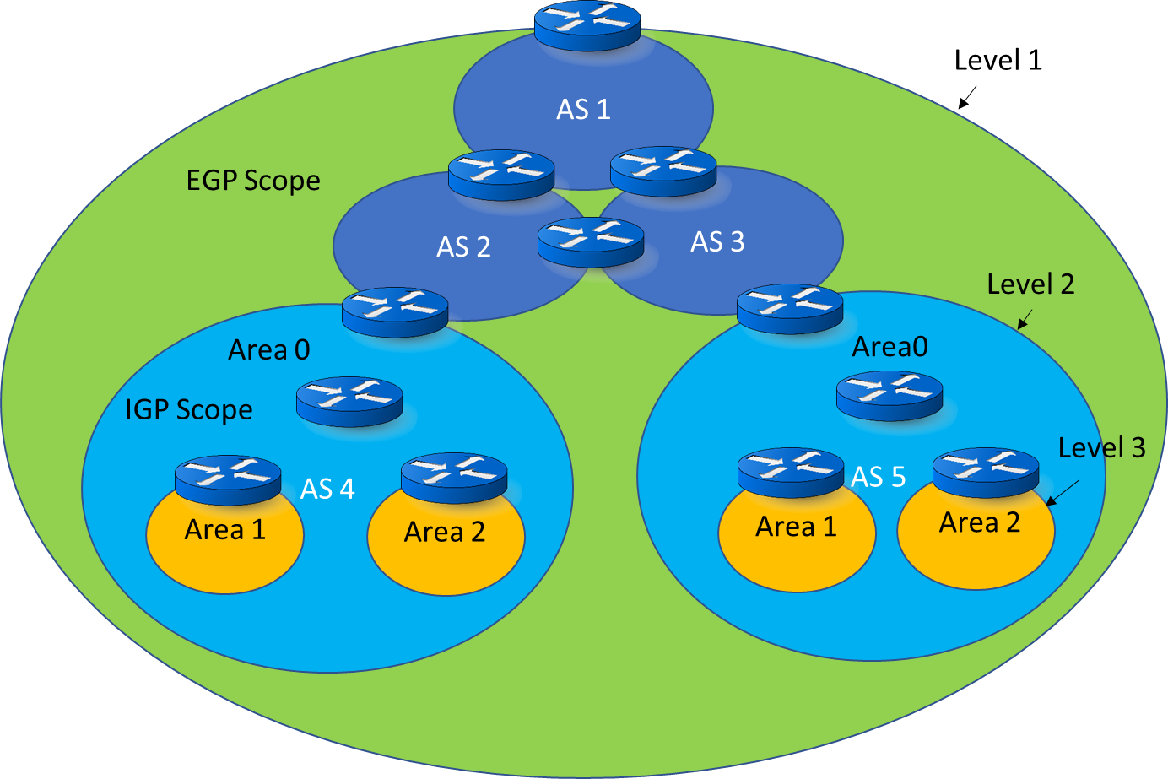
Control Plane Design
DHCP
  Entity ID assignment
DNS
  Hierarchical tree architecture
  Name scoping and name overriding
ARP/NDP
  LGR as ARP proxy for its prefix
Routing Protocol
  Low level network can be a single AS
  High level network can contain multiple ASes
    With lower level network as stub AS

Slide 10
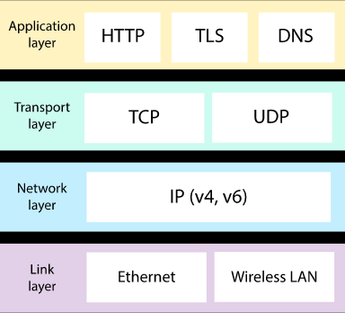
Data Plane Design
End Entity
  New IPvn socket supporting IPvn address family
  Header convertible to IPv4/IPv6
  Same L2, and L4-L7 protocol stack
Routers
  Smaller and simplified forwarding table
    No nested prefixes
    Network level address aggregation
  New functions in LGR
    Source and destination address manipulation
  New functions in IPT
    IP protocol translation
Vn

Slide 11
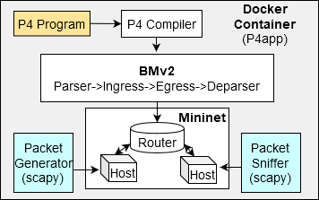
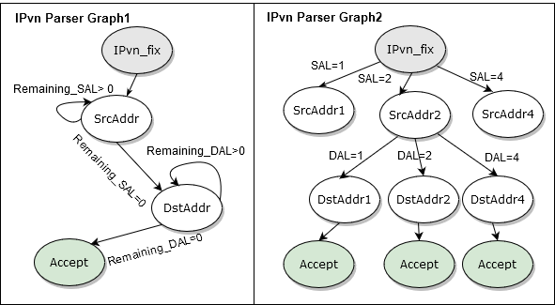
Implementation
Ver(8)
Header Length
ToS/TC
Next Header
Hop Limit/TTL
Payload Length
SAL
DAL
SA
DA
Padding
IPVn header format
Implementation and Simulation Environment
IPVn header parse graph in P4

Slide 12
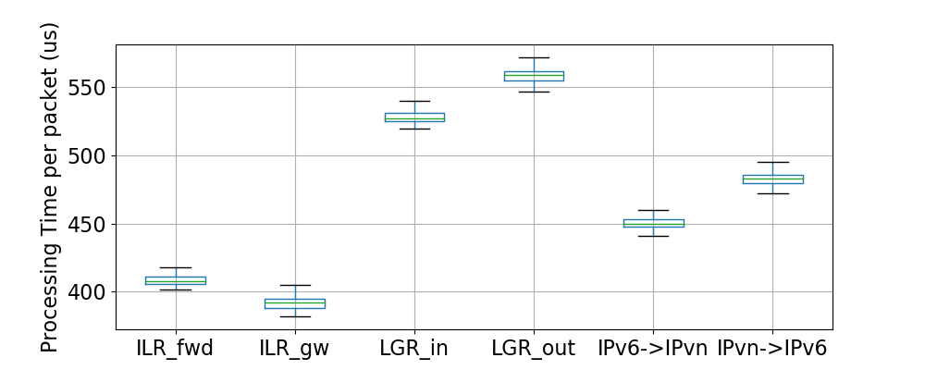
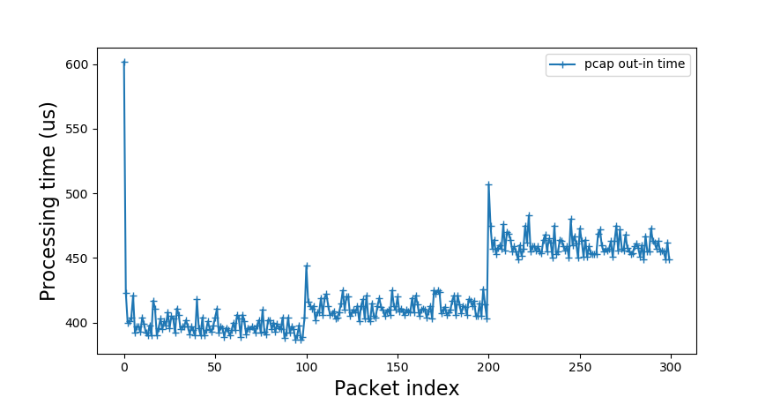
Evaluation I
IPv4
IPv6
IPvn
Per-Packet Processing Time in Different Types of Routers
Forwarding Performance Comparison
Reflect relative performance in software implementation
Insufficient support of variable length header in P4
Not consider the performance for address lookups

Slide 13
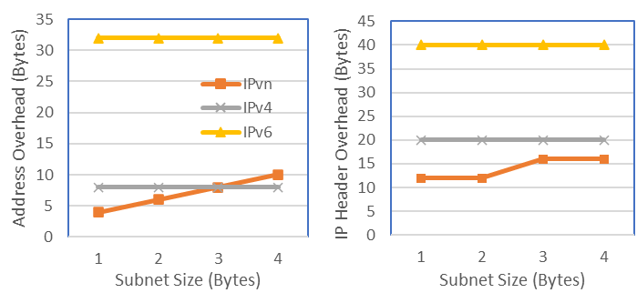
Evaluation II
Overhead Comparison
IoT Power Saving over IPv6

Slide 14
Conclusion
Efficient addressing scheme for IoT and data center networks
Future-proof extensible address space
Incrementally deployable from the edge
Fully interoperable with existing IPv4/IPv6 network and end entities
Simplified network control/data plane protocol & implementation
Open source (https://github.com/Fizzbb/ResearchPaper/tree/master/Adaptive-Addresses-for-NG-IP)

