Slide 1



Optimized Joint Unicast-Multicast Panoramic Video Streaming in Cellular Networks
Akbar Majidi and Ahmed H. Zahran
School of Computer Science and Information Technology, University College Cork, Ireland
Notes:
<number>

Slide 2

Panoramic video
I believe in innovation and that the way you get innovation is you fund research and you learn the basic facts.
– Bill Gates
The advance in Virtual reality (VR) and Augmented reality (AR) technologies fuels the popularity of panoramic media.

Slide 3
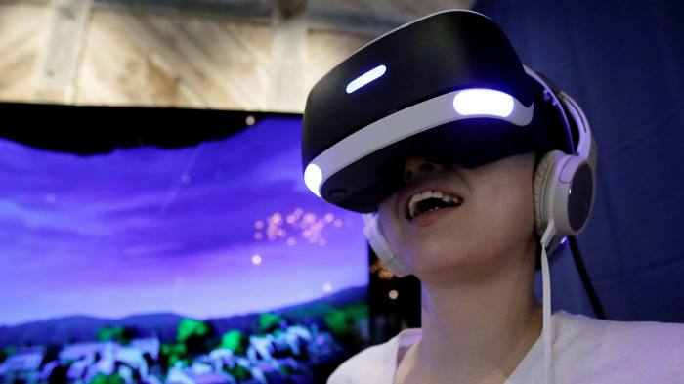
Problem Statement
Requires using Ultra-HD resolutions, e.g., 4K and above.
High data-rate requirements than traditional videos.

Slide 4
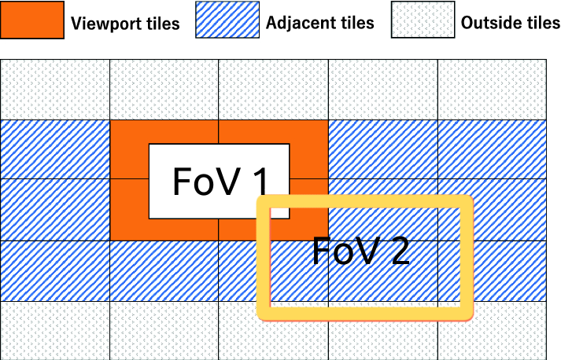
Motivation
Tiles are encoded independently
FoV is different across users
Diversity in FoV motivates to use joint unicast and multicast.
Multicasting all tiles could lead to inefficient use of resources.

Slide 5
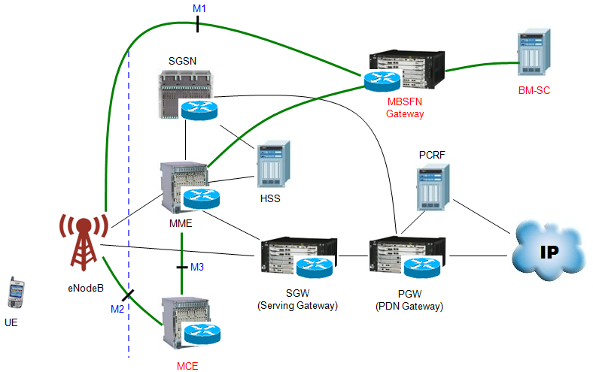
Multimedia Broadcast Multicast Service
Standardize the architecture.
The content is delivered over one or more base stations (BS) .
A Multicast Coordination Entity (MCE).

Slide 6
JUMPS Optimization
Objective => maximizing the total user experience
Const 1=>ensure resources are limited to the available resources.
Const 2 => ensure every user receives every tile only once
The objective and constraints are linear in the problem binary variables. Thus, it can be solved using integer programming solvers.

Slide 7
JUMPS Operation
Solution offers:
Multicasted tiles and their corresponding quality
Unicasted tile for every user and corresponding quality
Result:
Number of RBs would be smaller than the total number of allocated RBs.
It is expected to reduce user battery consumption as users listen to fewer RBs.

Slide 8
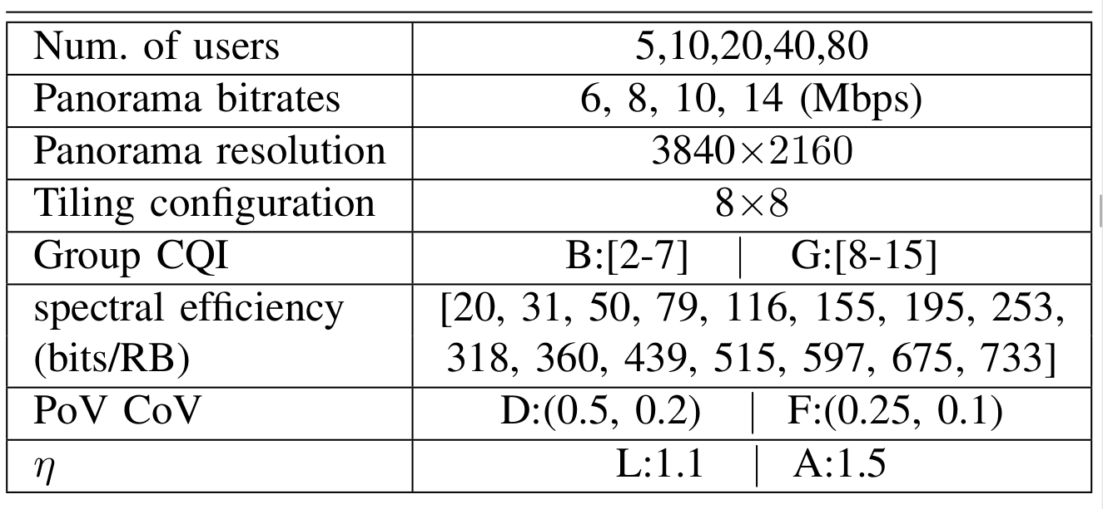
Simulation Setup
Performance evaluation is based on a custom-built using Python.
We compare JUMPS with the resource assignment algorithm of VRCast.
We solve our optimization problem with Gurobi 9.0 Solver.
Our reported results represent the outcome of 50 runs.
1) Eltobgy, Omar, Omar Arafa, and Mohamed Hefeeda. "Mobile Streaming of Live 360-Degree Videos." IEEE Transactions on Multimedia (2020).

Slide 9
Performance Evaluation Scenarios
We present the results for the following scenarios:
Users with Diversified FoV, Weak Link Condition, and Limited resource network (DWL)
Users with Diversified FoV, Good Link Condition, and Limited resource network (DGL)
Users with Diversified FoV, Weak Link Condition, and Abundant resource network (DWA)
Users with Focused FoV, Good Link Condition, and Limited resource network (FGL)

Slide 10
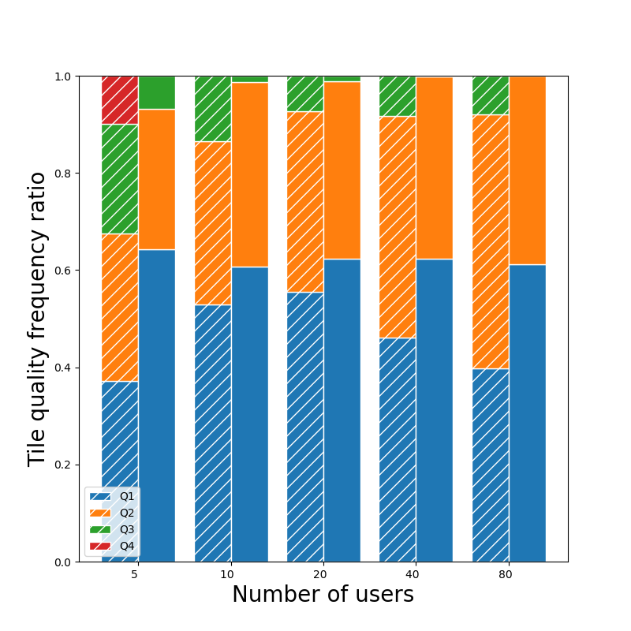
DWL Scenario Results

Slide 11
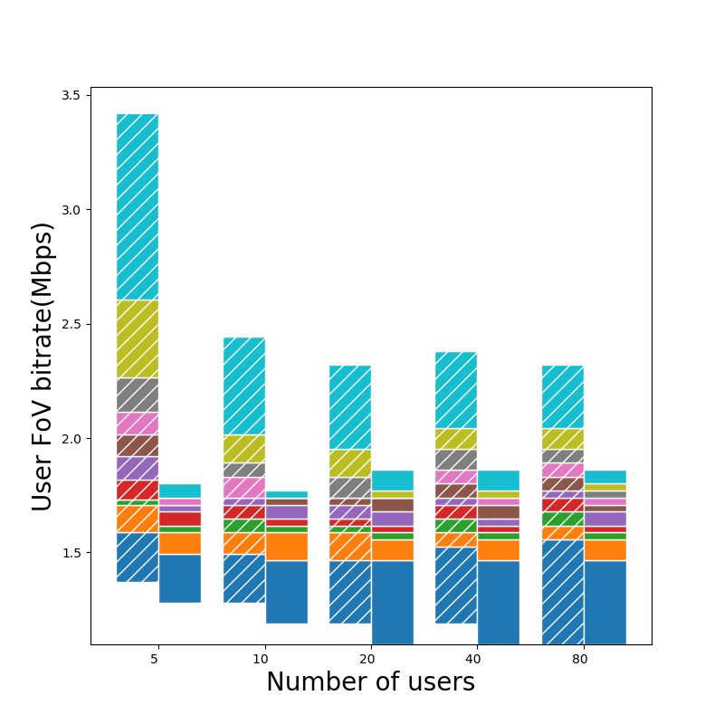
DWL Scenario Result

Slide 12
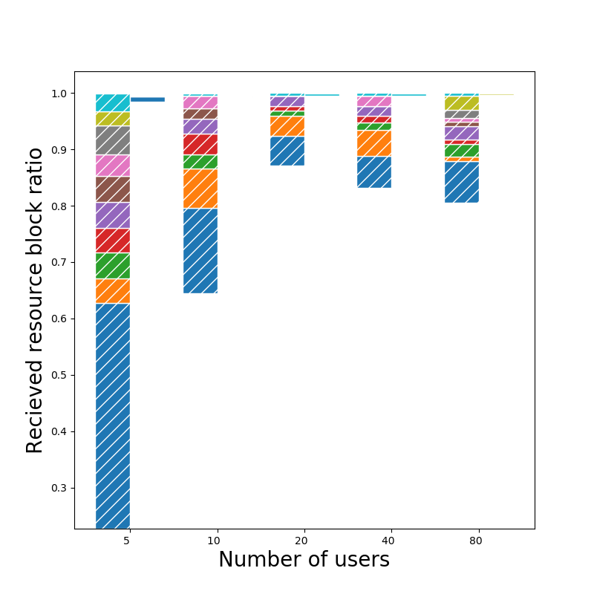
DWL Scenario Result

Slide 13
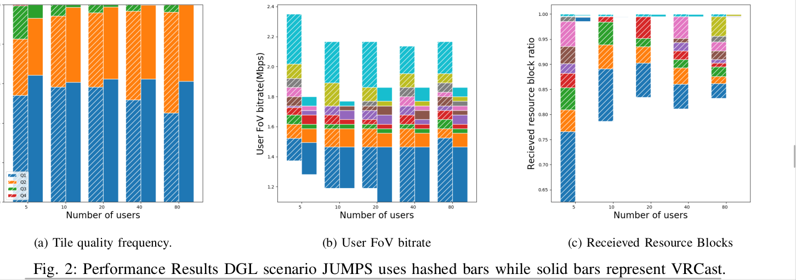
DGL Scenario Results

Slide 14
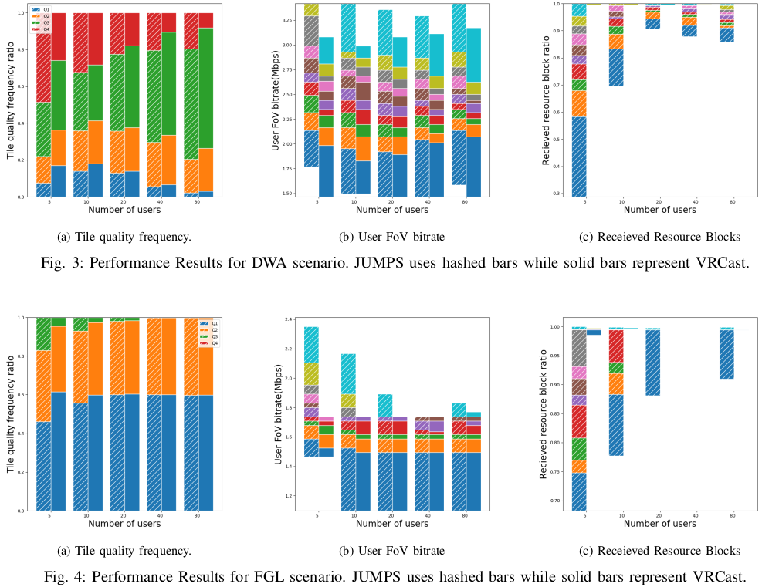
DWA and FGL Scenarios Result

Slide 15
Conclusion
A new resource management scheme for delivering popular panoramic content to user groups in cellular systems.
JUMPS exploits both unicast and multicast to improve system.
Our evaluation shows that JUMPS always significantly improves the performance
For larger groups, JUMPS maintains high-performance.
As future work, we consider generalizing JUMPS to manage cellular resources for multiple user groups and multiple base stations (SFN case).

Slide 16

Thank you !

