Slide 1
Fast Scheduling for Load Migration in Distributed Network Controllers
Sepehr Abbasi-Zadeh, MohammadAmin Beiruti, Yashar Ganjali
University of Toronto
Zhenhua Hu
Huawei Canada
IEEE ICNP, October 2020

Slide 2
Distributed SDN Control Plane
In this work we focus on the underlying protocols of a distributed control plane in Software-Defined Networks.
Using a centralized control plane raises a number of serious challenges:
  Reliability
  Scalability
  Performance
As a result, network control plane load is being distributed amongst different controller instances.
To change/maintain the load distribution, typically a migration protocol is being used.

Slide 3
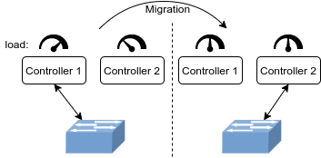
Controller Load Migration
A migration protocol, shifts the high load due to a switch from one controller to another one.
How many migrations?
Each switch constitutes a small fraction of the overall controller load.
Therefore, any significant change in load requires migrating multiple switches.
Can we migrate all the switches concurrently?

Slide 4
Can we Migrate All the Switches Concurrently?
Spoiler Alert
NO! [1]
Switch migration requires both processing and memory resources in the source and destination controllers.
Throughout each migration, network services on the switch involved in the migration will experience interruptions that impact the QoS provided to end users.
Controller constraints
QoS constraints
Therefore, not all the migrations can be performed together.
[1] M. A. Beiruti and Y. Ganjali, “Migration scheduling in distributed SDN controllers,” in IEEE 27th International Conference on Network Protocols (ICNP), 2019.

Slide 5
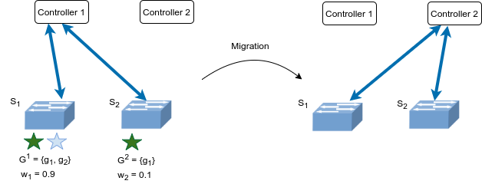
Informal Problem Statement
Controller constraints:
Each controller cannot support more than 1 unit of incoming load.
QoS constraints:
No more than 0.95 unit of load from each QoS group can be migrated together.
Finishing these 2 migrations, demands 2 separate rounds.
Question:
Minimize the number of rounds without violating any constraint.

Slide 6
Proposed Solution
Migration Vectors
m₁
m₂
Destination C₂
0.9
0.9
0.9
0.1
0.1
0
QoS group g₁
Controller constraints:
Each controller cannot support more than 1 unit of incoming load.
QoS group g₂
QoS constraints:
No more than 0.95 unit of load from each QoS group can be migrated together.

Slide 7
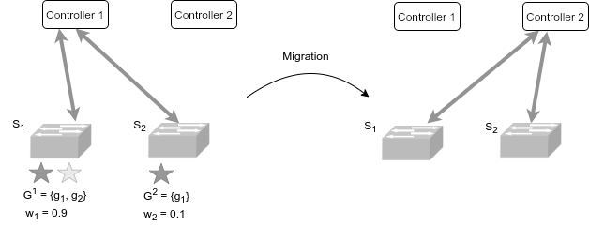
Proposed Solution
Constraint Vector
V
Destination C₂
1
0.95
0.95
QoS group g₁
Controller constraints:
Each controller cannot support more than 1 unit of incoming load.
QoS group g₂
QoS constraints:
No more than 0.95 unit of load from each QoS group can be migrated together.
Running FirstFit Algorithm on this instance:
m₂
m₁
V
Add m₂ to round 1
0.1
0.1
0
0.9
0.9
0.9
1
0.95
0.95
Adding m₁ to round 1 violates the constraints (as m₁ + m₂ > V.)
There is no other available round, so open a new round 2 and place m₁ into it.
Now that all the migrations are scheduled, return.
Round 1
Round 2
Round 1
Round 1

Slide 8

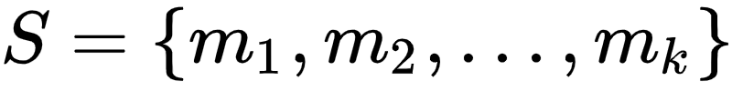
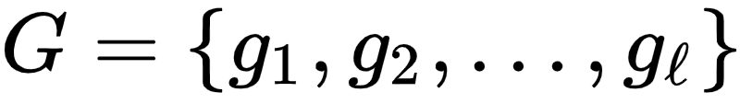


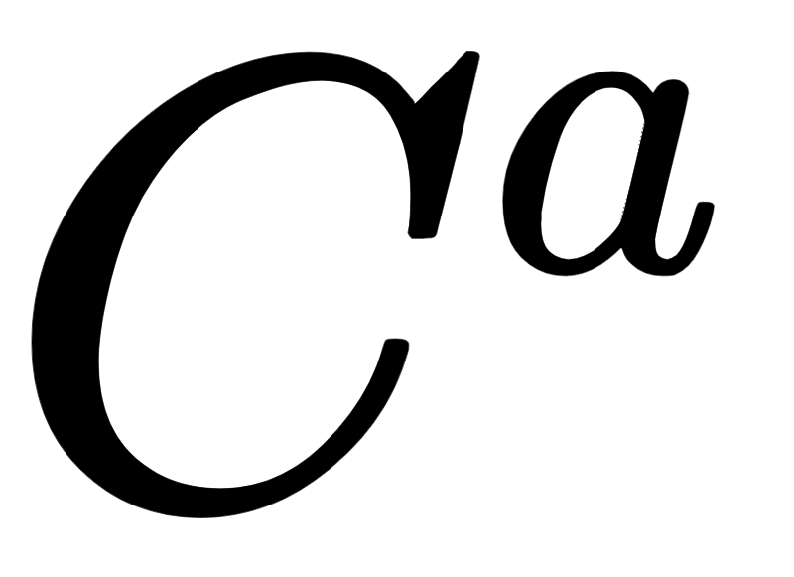
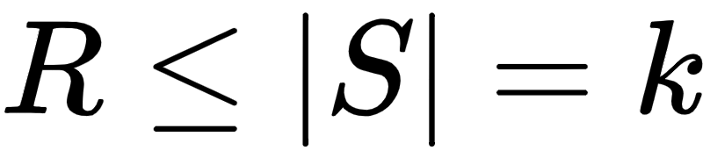


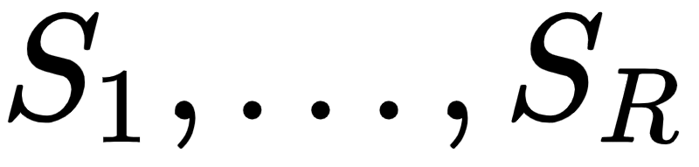
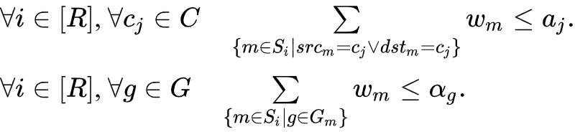
Problem Statement
Input:
A set of migrations:
given as tuples of switches and their corresponding destination controller
.
A set of QoS groups , and their corresponding constraint set .
A set of Controller constraints as well as their corresponding constraint set .
Output:
Find the minimum integer value such that there exists a partitioning of into partitions that does not violate the following constraints:
Controller Constraints
QoS Constraints

Slide 9
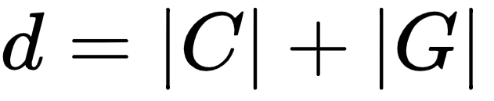
Hardness of the Problem
We have shown that even the simplified version of this problem is NP-Hard:
By relaxing the QoS constraints, we can show that any instance of the Bin-Packing problem can be reduced to the migration scheduling problem.
Therefore, we should not hope for better than an approximation algorithm. Can we obtain the approximation factor of our solution?
Theorem ([1]). The FirstFit algorithm produces a (d+1)-approximation result for the general d-dimensional Vector Bin Packing problem.
In the migration scheduling problem we have that .
Garey, Michael R., Ronald L. Graham, David S. Johnson, and Andrew Chi-Chih Yao. "Resource constrained scheduling as generalized bin packing." Journal of Combinatorial Theory, Series A 21, no. 3 (1976): 257-298.

Slide 10
Experiments

Slide 11
Dataset
100 random experiments each consisting of 30 switch migrations.
Each migration has a random destination from a set of 5 destination controllers and imposes a uniformly random load drawn from (0,1) on the controllers.
There are 20 QoS groups.
Each switch serves d random QoS groups, where d comes from a normal distribution with mean and variance of 6.
The constraint vector is chosen randomly in a way that for no migration vector m_{i} we have that m_{i} > V.

Slide 12
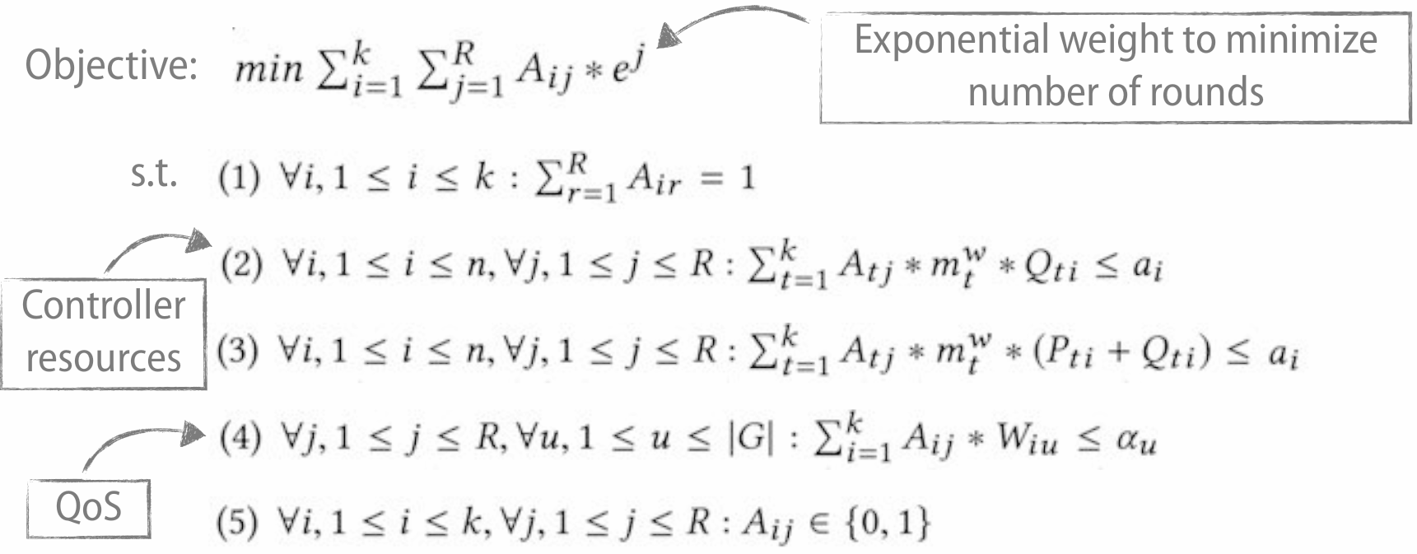
Baseline
An Integer Linear Programming formulation of the problem [1].
[1] M. A. Beiruti and Y. Ganjali, “Migration scheduling in distributed SDN controllers,” in IEEE 27th International Conference on Network Protocols (ICNP), 2019.

Slide 13
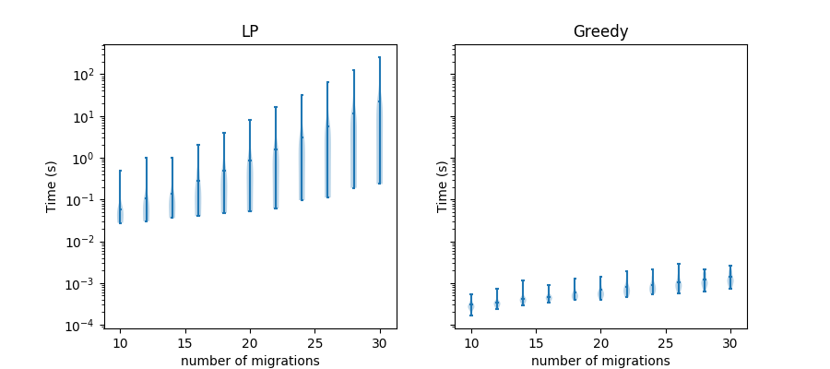
Results
We have shown that the Greedy solution is at least 3 order of magnitudes faster than the ILP formulation (if the LP terminates before a particular timeout).
At the same time, in 95% of the experiments that LP returns an equivalent answer with our Greedy solution, and in the rest of them the discrepancy in the number of rounds is not more than 1.

Slide 14
Fast Scheduling for Load Migration in Distributed Network Controllers
Question:
Minimize the number of migration rounds without violating any constraint.
Controller constraints:
Each controller cannot support more than 1 unit of incoming load.
QoS constraints:
No more than 0.95 unit of load from each QoS group can be migrated together.
at least 3 order of magnitudes faster with similar scheduling in 95% of the experiments

