Slide 1
Application-Aware Load Migration Protocols for Network Controllers
Sepehr Abbasi-Zadeh, MohammadAmin Beiruti, Yashar Ganjali
University of Toronto
Zhenhua Hu
Huawei Canada
IEEE ICNP, October 2020

Slide 2
Scalability in SDN Control Plane
It is well-established by now that we can, and need to, consider a distributed control plane to address the following concerns in a Software-Defined Network (SDN):
  Single point of failure / attack
  Scale of the network
  Geographic distribution of the nodes in the network
Various distributed control platforms are introduced in the last few years (e.g., ONOS [1])
Traffic patterns change, so the controller’s load!
To distribute the network control plane load amongst different controller instances, a migration mechanism is typically considered as the standard solution.
[1] P. Berde, M. Gerola, J. Hart, Y. Higuchi, M. Kobayashi, T. Koide, B. Lantz, B. O’Connor, P. Radoslavov, and W. Snow, “ONOS: towards an open, distributed SDN OS,” in Proceedings of the third workshop on Hot topics in software defined networking, 2014.
.

Slide 3
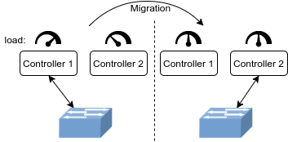
Controller Load Migration
Our goal is to design efficient protocols to
move loads between controller instances.
Load migration protocols have studied extensively in the context of software-defined networks (e.g., [2,3]).
Previous works mostly focus on changing the role of master and slave controller instances associated with a given switch.
Can we switch between other roles?
[2] A. Dixit, F. Hao, S. Mukherjee, T. V. Lakshman, and R. R. Kompella, “ElastiCon; an elastic distributed SDN controller,” in ACM/IEEE Symposium on Architectures for Networking and Communications Systems (ANCS), 2014.
[3] M. A. Beiruti and Y. Ganjali, “Load migration in distributed SDN controllers,” in IEEE/IFIP Network Operations and Management Symposium (NOMS), 2020.

Slide 4
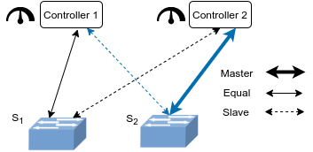
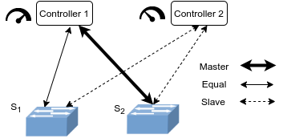
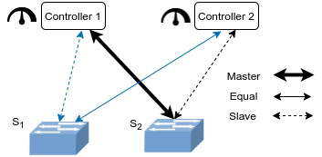
Is {Master↔Slave} role exchange enough for migration?
Consider the following scenario:
Traditional
{Master↔Slave}
Migration
Balanced ✓
Master ✗
New
{Equal↔Slave}
Migration
Balanced ✓
Master ✓

Slide 5
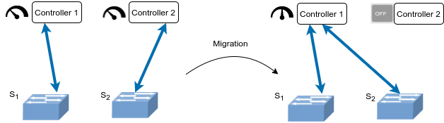
Application-aware Migration
Load balancing is not the only application which requires load migration. Other applications include:
Power saving
Security concerns (redirecting suspicious activity to specialized controllers)
Failure recovery
Network monitoring
Controller update/maintenance

Slide 6
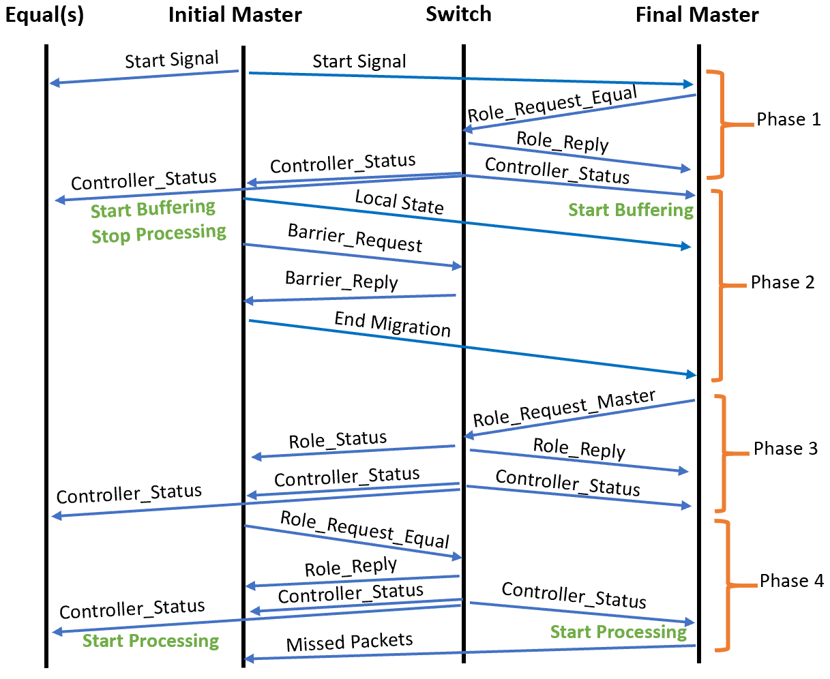
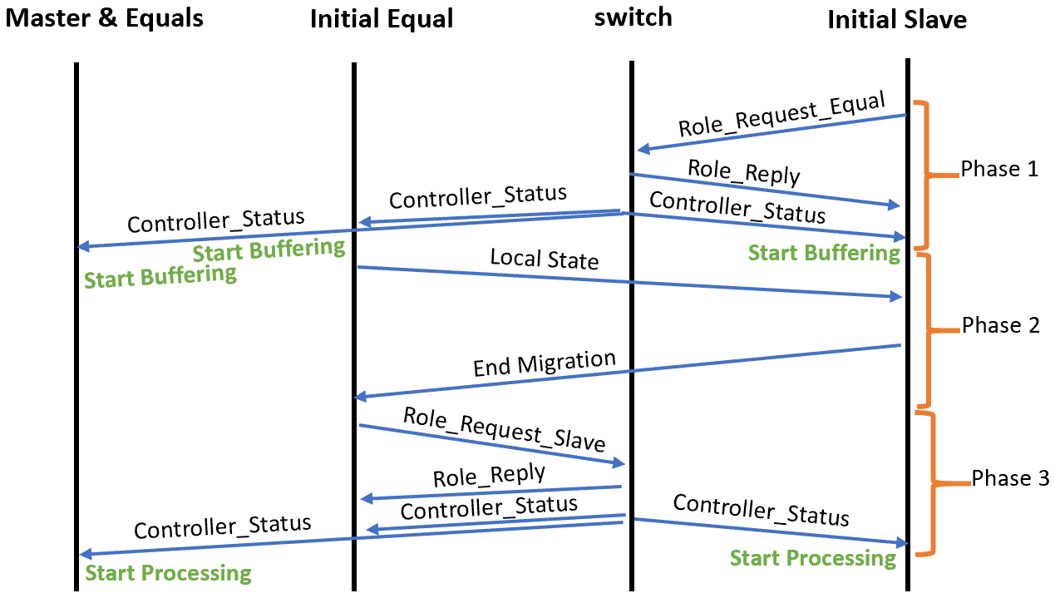
New Migration Protocols
Protocol 1
Protocol 2

Slide 7
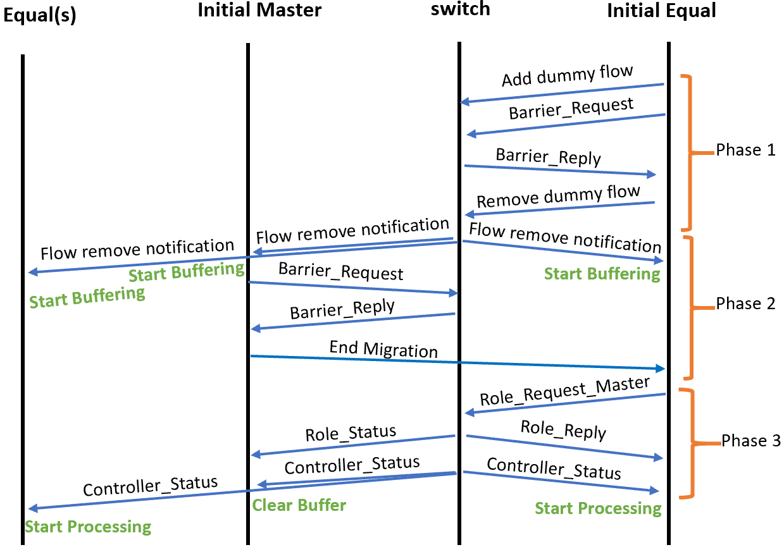
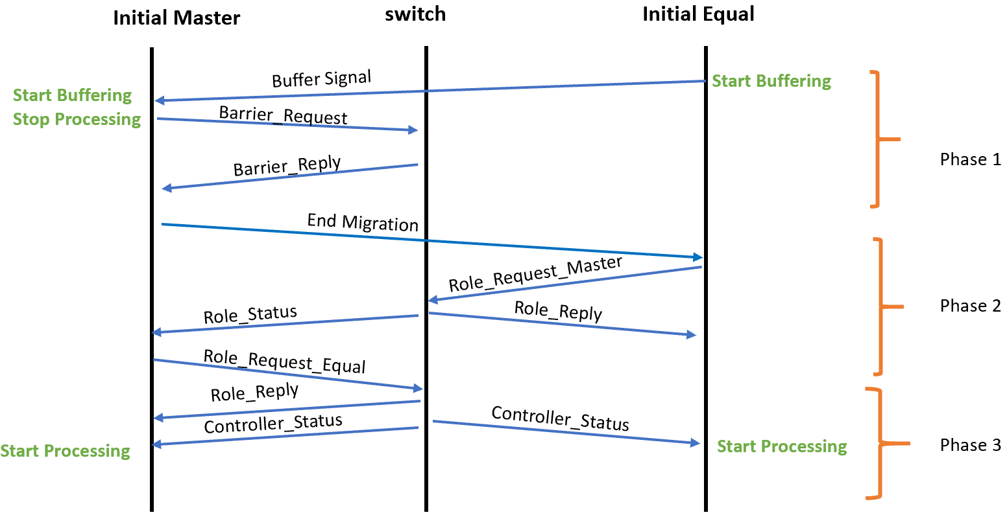
New Migration Protocols
Protocol 3
Protocol 4

Slide 8
Experiments

Slide 9
Problem
Protocol 2
Measure the performance of the proposed protocol in terms of its finishing time.

Slide 10
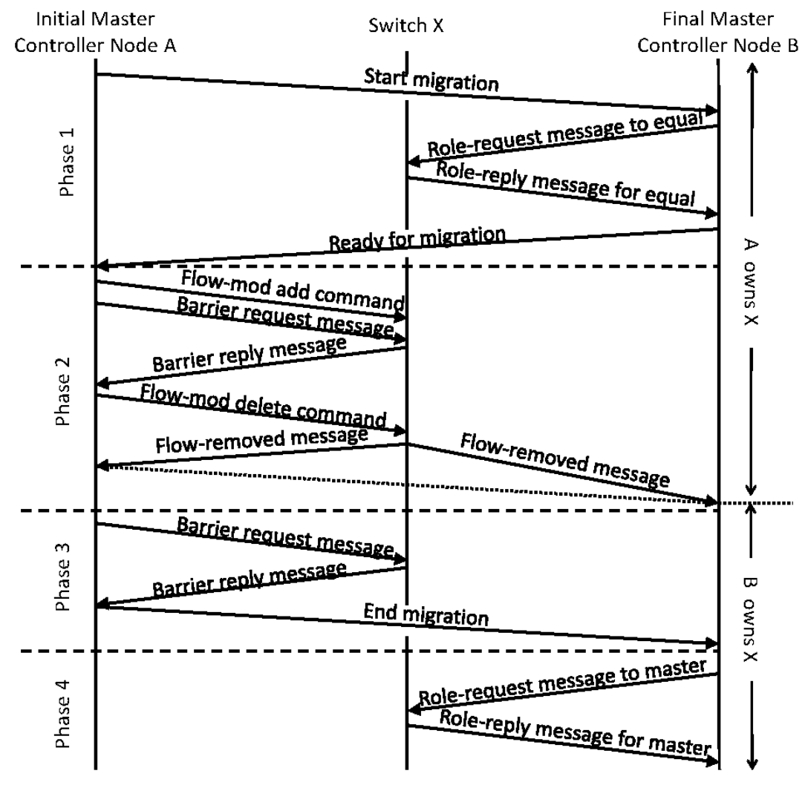
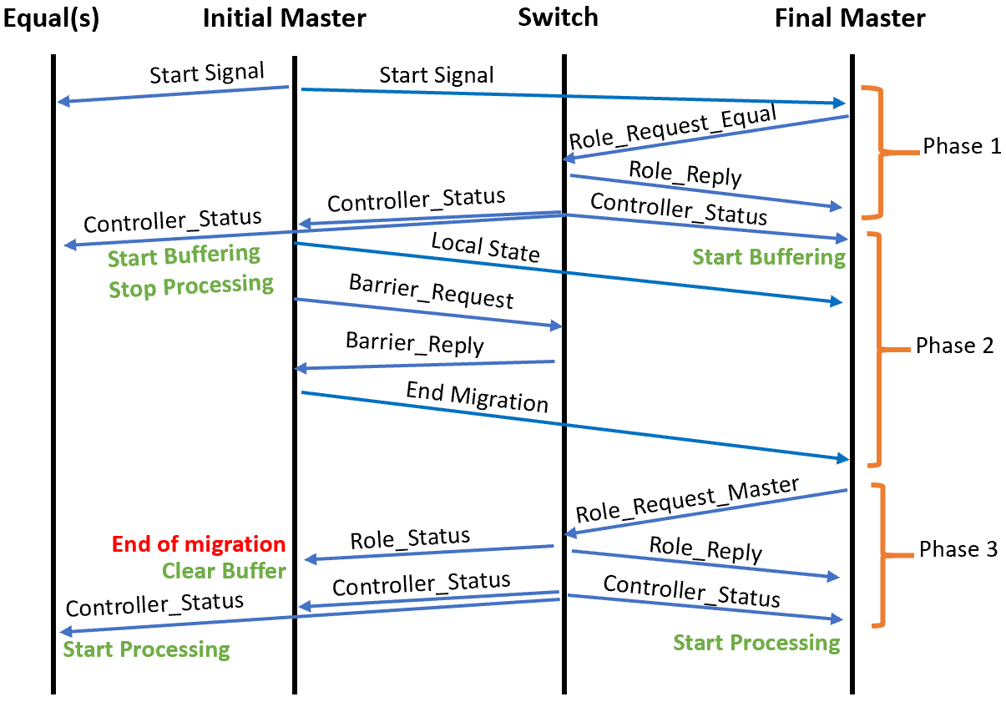
Baselines
None of these two protocols support {Equal↔Slave} migration directly, so we needed to modify a number of message protocols, without changing the structure of the protocols.
Four-Phase Protocol [2]
ERC Protocol [3]
[2] A. Dixit, F. Hao, S. Mukherjee, T. V. Lakshman, and R. R. Kompella, “ElastiCon; an elastic distributed SDN controller,” in ACM/IEEE Symposium on Architectures for Networking and Communications Systems (ANCS), 2014.
[3] M. A. Beiruti and Y. Ganjali, “Load migration in distributed SDN controllers,” in IEEE/IFIP Network Operations and Management Symposium (NOMS), 2020.

Slide 11
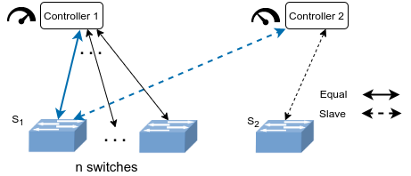
Simulation Setup
The simulation environment is implemented using Mininet.
We assume an equal traffic between each switch-controller pair.
The simulated traffic between controller and switch instances were generated using D-ITG.
The total load on the source controller is being controlled by the number of connected switches (i.e., n).

Slide 12
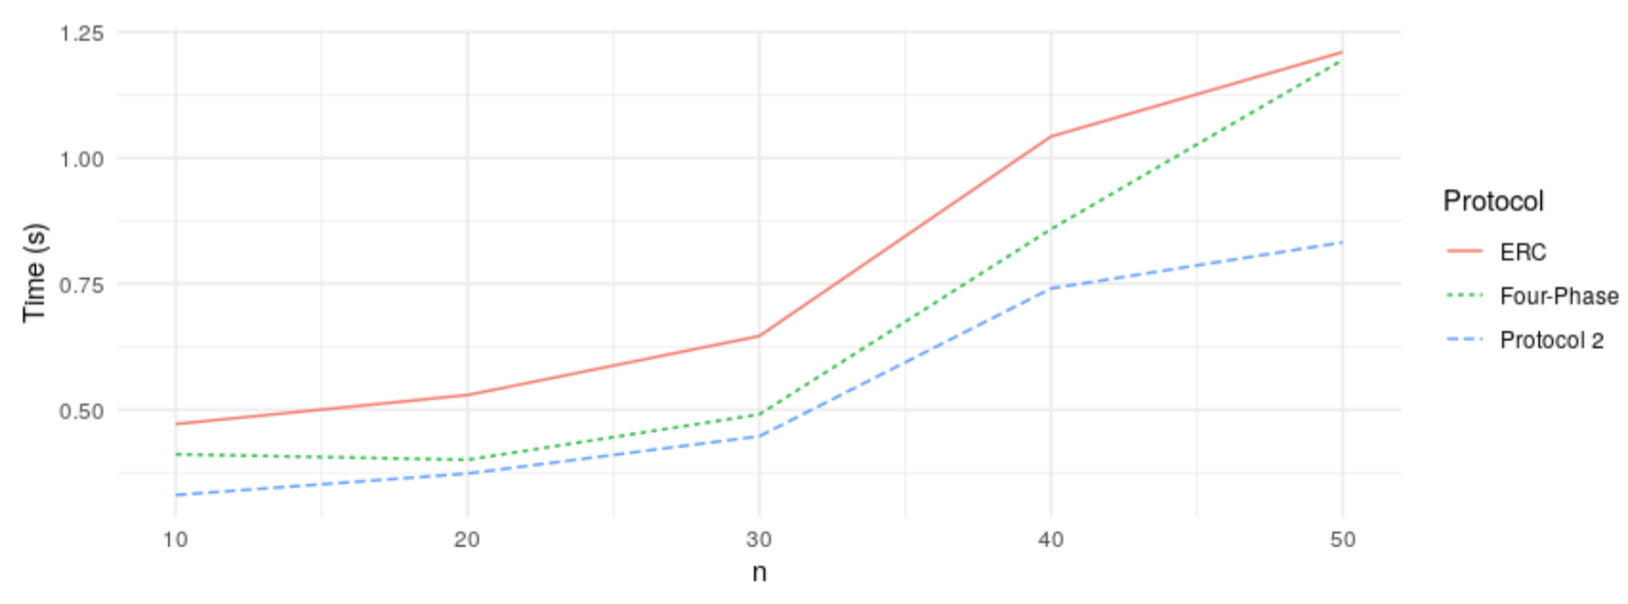
Experiment Results
20%-30% speedup in the total migration time.
This improvement supports the importance of the idea of application-aware migration protocols.

Slide 13
Application-Aware Load Migration Protocols for Network Controllers
Traditional
{Master↔Slave}
Migration
New
{Equal↔Slave}
Migration
20%-30% speedup in the total migration time.
This improvement supports the importance of the idea of application-aware migration protocols.

