Slide 1

Poster: Novel Opportunities in Design of Efficient Deep Packet Inspection Engines
Anton Chekashev (ITMO University)
Vitalii Demianiuk (Ariel University)
Kirill Kogan (Ariel University)

Slide 2
Deep Packet Inspection (DPI)
Use cases:
  Intrusion detection
  Data loss prevention
  Bandwidth management
Based on regular expressions
One of the most resource-consuming tasks

Slide 3
DPI: Speed-memory tradeoff
  Deterministic finite automaton (DFA)
    Lookup time: matching string length
    Number of states: exponential
  Nondeterministic finite automaton (NFA)
    Lookup time: matching string length * number of states
    Number of states: linear
  HybridFA : combination of NFA and DFA

Slide 4
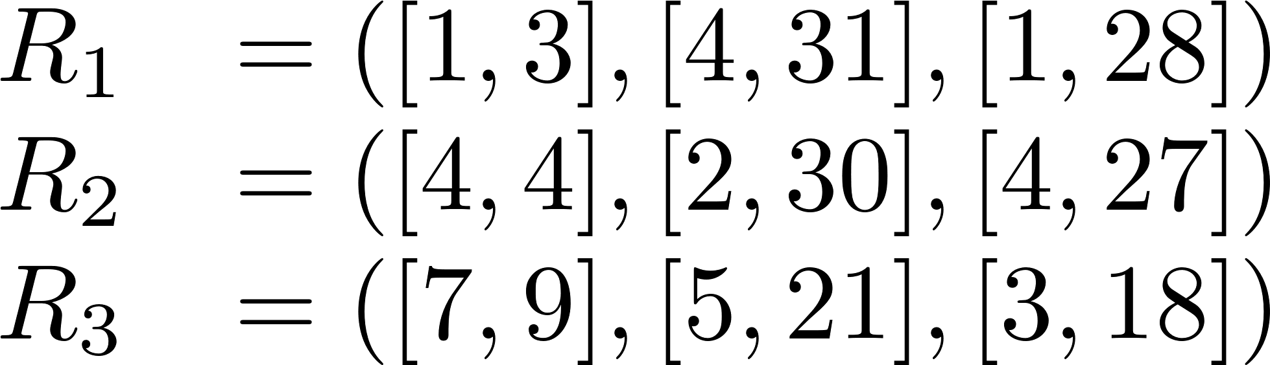
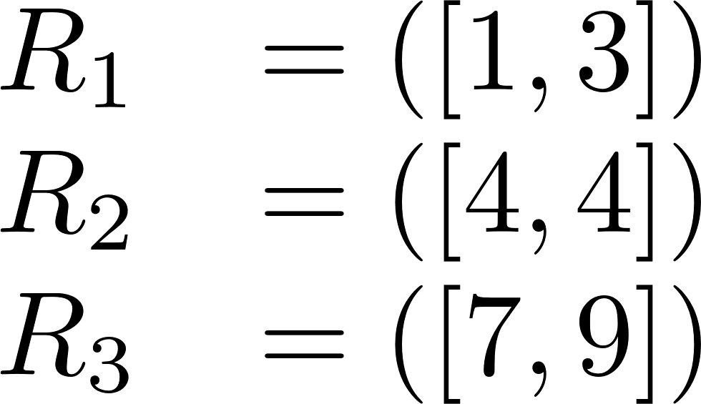
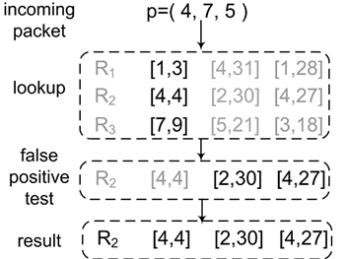
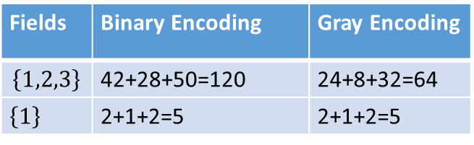
Semi-equivalent packet classifiers
Rules are disjoint if they do not match the same header.
A classifier based on a subset of fields keeping rule disjointness is semi-equivalent.
SIGCOMM’14 SAX-PAC:
Lookup is done in semi-equivalent classifier
At most one rule is matched
Complemented with false-positive check for equivalence

Slide 5
Semi-equivalent DPI representations
More complex structure
Disjoint regular expressions
  Anchored regular expressions
  Start with ‘^’ or end with ‘$’

Slide 6
Semi-equivalent DFA (seDFA)
Each regular expression has a separate terminal state
If an input string s is matched by a regular expression x:
s leads to the terminal state corresponding to x
Otherwise: s may lead to any state

Slide 7
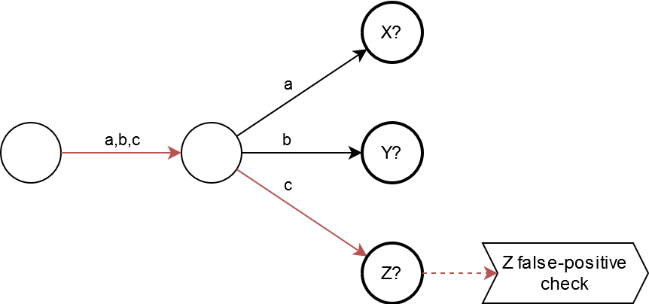

Lookup process
Matching string: acba
  X = ^aa(bb|c)
  Y = ^(a|b|c)baa
  Z = ^bc
Any method for FP-check
Combined equivalent DFA: 11 nodes

Slide 8
Constructing seDFA:
Input: Anchored disjoint set of regular expressions
  X = ^aa(bb|c)
  Y = ^(a|b|c)baa
  Z = ^bc

Slide 9
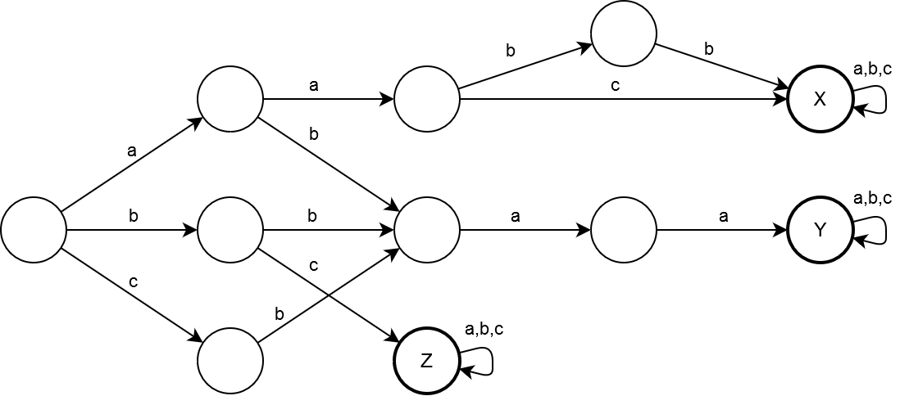
1. Construct combined DFA

Slide 10
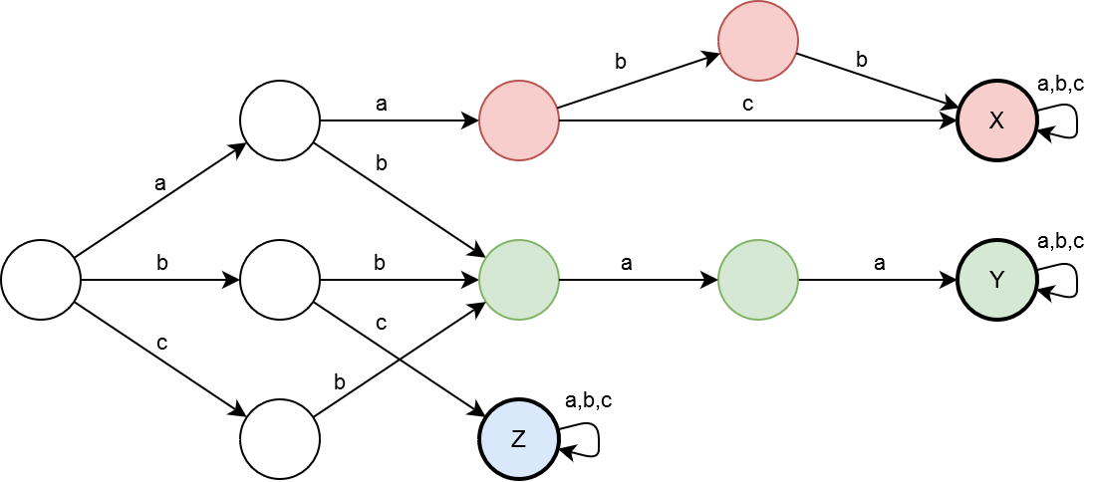
2. Shrink all states leading to the same terminal

Slide 11
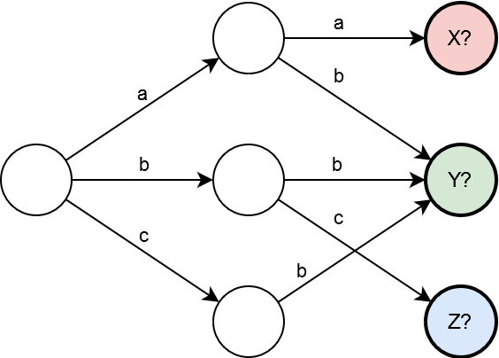
2. Shrink all states leading to the same terminal

Slide 12
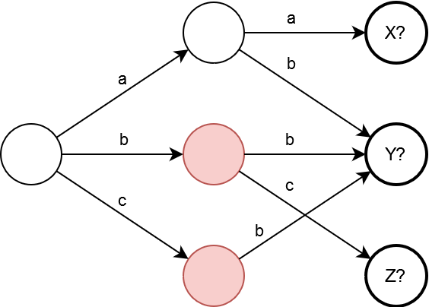
3. Find a pair of non-terminals without conflicting transitions

Slide 13
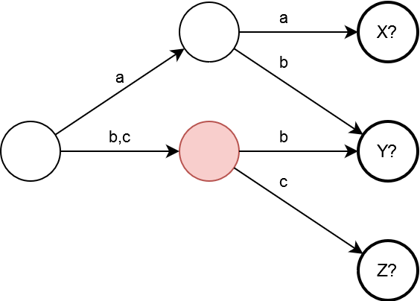
4. Shrink states in the chosen pair

Slide 14
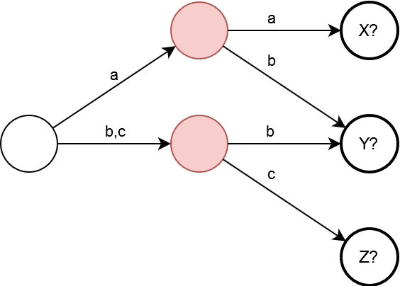
5. Repeat until there is no such pair

Slide 15
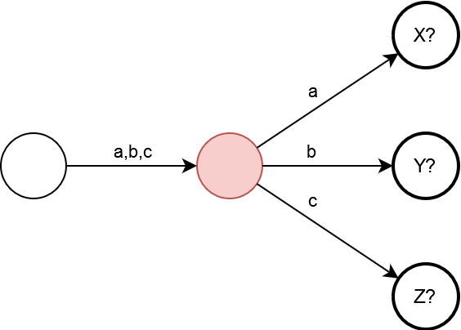
Output: seDFA

Slide 16
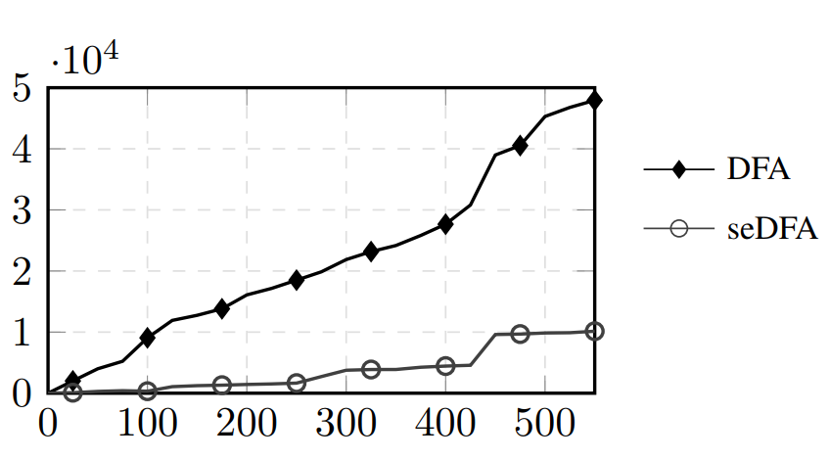
Results
Disjoint regular expressions from Snort database
No. of states
No. of regular expressions

Slide 17
Future study
More efficient heuristics constructing seDFA
Non-disjoint regular expressions
  Additional structural properties
  Multi-group representations

Slide 18
Questions

Slide 19

Thank you for your attention!
www.ifmo.ru

