Slide 1

6Fit-A-Part: A Protocol for Physical Distancing on a Custom Wearable Device
Yifeng Cao, Ashutosh Dhekne, Mostafa Ammar
Georgia Institute of Technology

Slide 2

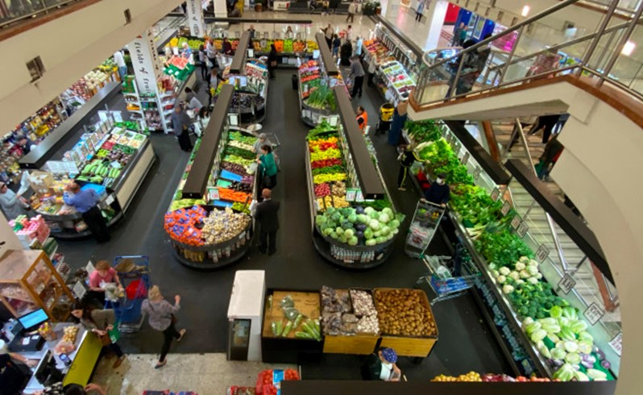
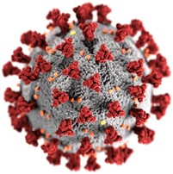
Physical Distancing
“Am I at a safe distance from others?”
Notes:
The COVID19 pandemic has increased people’s awareness of the importance of public health. One of the easiest and effective way to prevent the virus’s spread is to maintain physical distancing. (Click). However, in crowded areas such as hospitals or supermarkets, people may ask themselves, … won’t it be helpful to receive a friendly reminder if we venture too close to others?

Slide 3










Physical Distancing
6 Feet
Too close!
Notes:
In this work, we build a system, which can instantly warn a user if they get within six feet of others. An audio-visual alarm will trigger on the device in such cases.

Slide 4







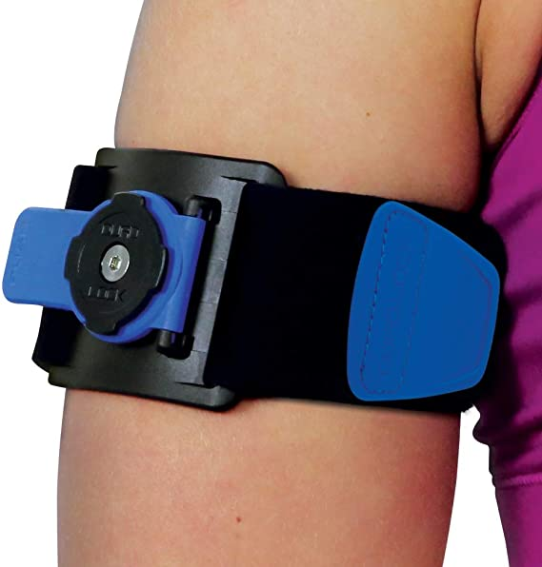
Goal
Can we embed the physical distancing function into a wearable device?
Low-cost:
  Infrastructure free: without deploying sensors in the environment
  Reconfiguration free: works even if only a subset of devices are together
Lightweight
Grocery stores
Hospitals
Factories / Warehouses
Notes:
Such a system should achieve 2 goals. (Click) Firstly, the system should be low-cost. We hope to build a system which is infrastructure free, that is, without deploying sensors in the environment, and reconfiguration free, so that it works efficiently even when only s subset of devices are together. To achieve this goal, we decide to build a distributed system on the embedded devices with low deployment and maintenance cost. (Click) Secondly, the system should be lightweight. Being lightweight makes this system easily hidden in daily items such as a shopping cart, an identity card or a smart wristband.

Slide 5
Challenges
6Fit-a-part: Challenge
Limited resources
Peer-peer ranging with dynamic participation
Realtime ranging
Complex wireless environment
Notes:
However, building this system is non-trivial. There are at least four challenges. (Click) Firstly, the computation resource is limited. We must make sure our algorithm can run smoothly on devices which only has tens of KBs memory with very limited power. (Click) Secondly, we need to achieve Peer-to-peer ranging with dynamic participation. Specifically, nodes should be able to enter and leave the network arbitrarily without interrupting the running of the algorithm. (Click) Thirdly, realtime ranging is hard. In a distributed system, if every node needs to measure the distance with every other node, the time complexity of the algorithm is inherently O(n^2). That means we have to deal with each step in the ranging process very carefully to reduce the time cost as much as possible. Finally, to deal with complex wireless environment is very hard due to the uncertainty of wireless communication.

Slide 6
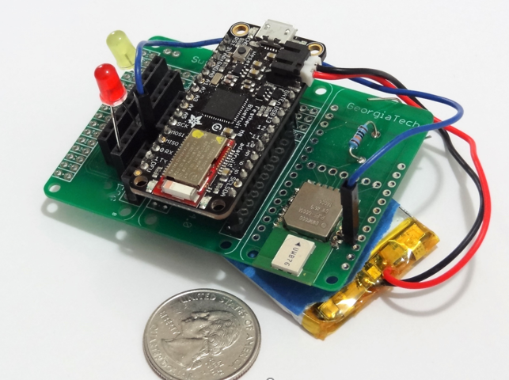

6Fit-a-part: Overview
A design for real-time physical distancing on wearable devices
On-device Functions
Ultra-wideband (UWB) Radio based ranging
P2P Protocol
Occlusion Detection
Notes:
To overcome the above challenges, we propose 6Fit-a-part. 6Fit-a-part is a physical design for real-time physical distancing on wearable devices. The prototype of 6Fit-a-part is shown on the right of the slide. 6Fit-a-part has three key on-device functions: An ultra-wideband radio based ranging algorithm, a robust and efficient P2P protocol and an occlusion detection module.

Slide 7

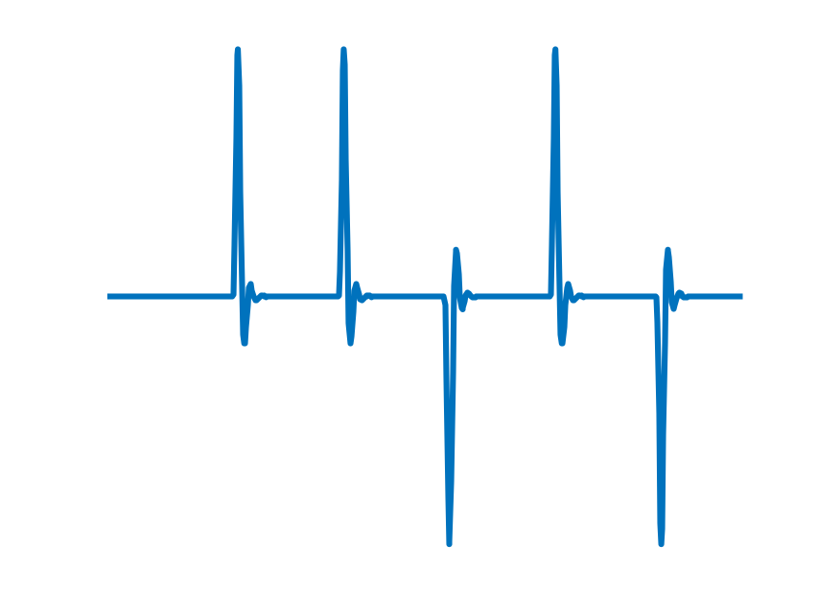
6Fit-a-part: Overview
UWB
P2P Protocol
UWB RF Module
Time Slotting
Slot Adaptation
RESP again
CIR
Packet Timings
Raw Dist.
Occlusion Detection
Feature
Extraction
Occlusion Classifier
Distance Compensation
Sanitized Distance
Storage Module
Alarm buzzer
Notes:
Here is an overview of 6Fit-a-apart. At the lowest level, the UWB module deals with the ranging algorithm. It decides what method to use for distance measurement and what information the lower level needs to provide for the upper level for analysis. Basically, this module will provide channel impulse response and the packet timings. (Click) The P2P ranging protocol will accept the packet timings from the UWB module. It provides a robust protocol for the nodes in the network to exchange packet timings which is required to compute the distance. In addition, there are three submodules in the P2P protocol to improve the time efficiency. They are a time slotting scheme, a slot adaptation algorithm, and a RESP-again scheme. These three submodules can substantially decrease the multiplicative constant of the time complexity, which makes 6Fit-a-part feasible in the real-world. (Click) Finally, we have an occlusion detection module. This module deals with the complex environments. It classifies three basic cases: LOS signal, Wall-blocking signal, and Human-blocking signal. This module reads the channel impulse response from the UWB module and the raw distances from the P2P protocol, and then extract a couple of features. These features are used to build a tree model to classify the three different types of occlusion so 6Fit-a-part can deal with them correspondingly then.

Slide 8
UWB
UWB
P2P Protocol
UWB RF Module
Time Slotting
Slot Adaptation
RESP again
CIR
Packet Timings
Raw Dist.
Occlusion Detection
Feature
Extraction
Occlusion Classifier
Distance Compensation
Sanitized Distance
Storage Module
Alarm buzzer
Notes:
I’ll firstly talk about the UWB module.

Slide 9
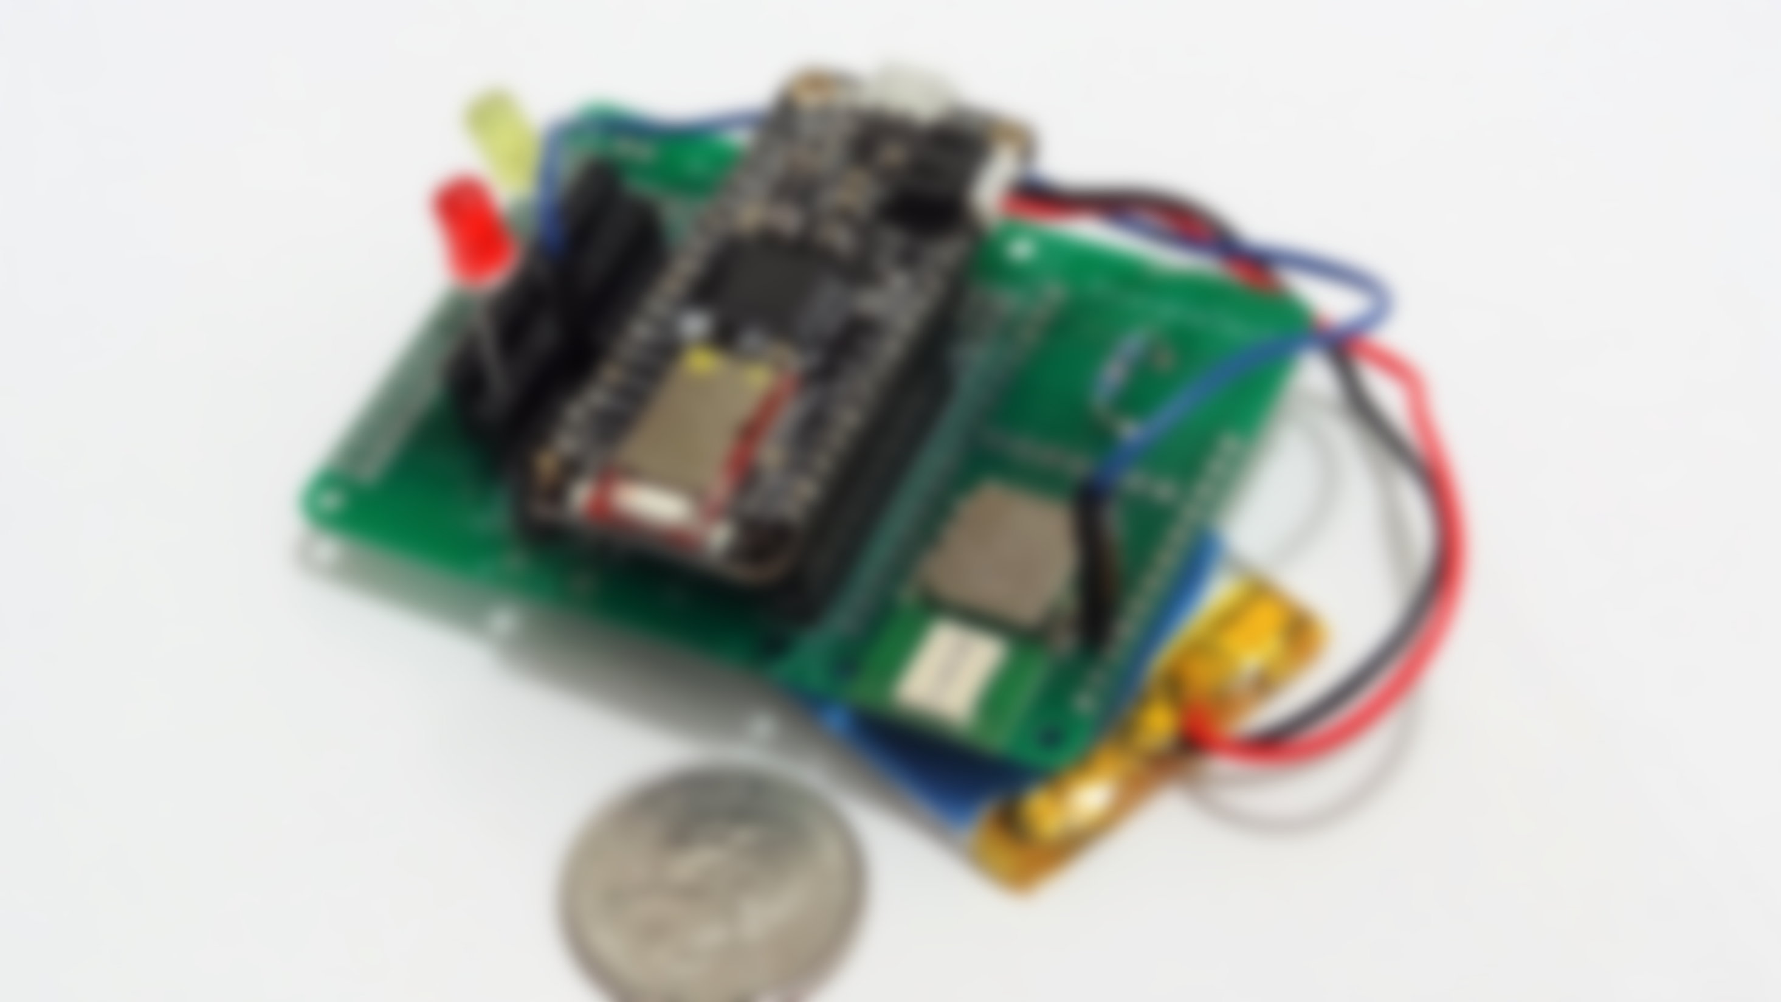

Why ultra-wideband?
Why Ultra-wideband Signal?
Accurate distance measurements
1GHz bandwidth (3.5GHz – 6.5 GHz band)
Robustness to multipath
Nanosecond time resolution (10⁻⁹ seconds)
ns level
Received signal
Notes:
We choose UWB as our basic signal for distance measurement because it has several good properties. Firstly, we can quickly get distances with tens of centimeters of error. By averaging multiple packets, this error can be reduced to 10cm, which is enough in our aimed scenario. In addition, UWB has 1 giga-hertz of bandwidth which makes it defensive to the multipath. Finally, it has nano-second time resolution, making it easy to direct compute the distance from the time-of-flight.

Slide 10
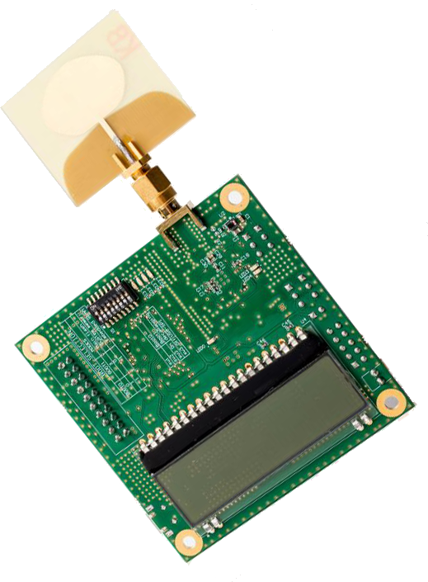
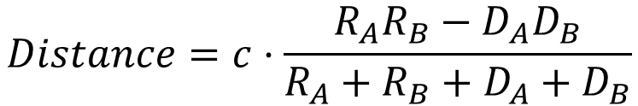

Two Way Ranging
$$Distance=c⋅ΔT$$
A
B
T_{A1}
POLL
T_{B1}
R_{A}
RESP
D_{B}
IEEE 802.15.4
T_{A2}
T_{B2}
D_{A}
FINAL
R_{B}
T_{A3}
T_{B3}
$$Distance=c⋅\frac{{R_{A}R_{B}−D}_{A}D_{B}}{R_{A}+R_{B}+D_{A}+D_{B}}$$
Dries Neirynck, Eric Luk, and Michael McLaughlin. “An alternative double-sided two-way ranging method”. In 2016 13th workshop on positioning, navigation and communications (WPNC).
Notes:
Basically, distance can be computed directly by (Click) multiplying the time-of-flight with speed of light. However, since two nodes don’t share a common clock, they are not synchronized very well and have tens of milliseconds offset in the time-of-light. This will incur huge errors. To mitigate the offset, (Click) we adopt the two way ranging standard from IEEE 802.15.4. It is a widely used protocol in time-of-flight-based localization technique. Suppose there are two nodes in the network: A and B. A first sends a POLL to node B, node B will reply with a RESP message. After A receives the RESP from B, it sends the FINAL message to B so B can compute its distance at its end. During this process, we get six packet timings, Ta1 to Ta3, Tb1 to Tb3. Then we can derive four time durations Da, Db, Ra, Rb. With these time durations, we can compute the distance directly from the formula shown in the slide. This rather non-intuitive formula has been adopted from the reference shown at the bottom of the slide.

Slide 11
Multi-user Ranging
Coordination of medium access
Time consumption
Notes:
However, what works for a device pair does not necessarily scale to multiple users. There are two problems: The first problem is the medium access coordination. In a distributed system, a node has no knowledge of which other nodes exist near it, at the very beginning. Without any coordination policy, the packet transmission will be in a mess with significant collisions because every node tries to send wireless packets arbitrarily. Secondly, if we naively preform sequential two-way rangings, it will take a long time to perform all the pair-wise distance measurements. (Click) Notice that every distance measurement needs 3 packet transmissions. If we try to perform P2P ranging, the number of packet transmissions will be huge, resulting in seconds of lag in the real-world. It is unacceptable.

Slide 12
P2P Protocol
UWB
P2P Protocol
UWB RF Module
Time Slotting
Slot Adaptation
RESP again
CIR
Packet Timings
Raw Dist.
Occlusion Detection
Feature
Extraction
Occlusion Classifier
Distance Compensation
Sanitized Distance
Storage Module
Alarm buzzer
Notes:
We will use a P2P ranging protocol to solve these two problems.

Slide 13
P2P Protocol
6Fit-a-part: Peer-peer Protocol
Opportunity: Broadcasting nature of wireless signal (POLL/FINAL)
Problem: Collision
User 1
User 2
User 3
POLL
Collision
Immediately responding to POLL incurs COLLISIONs
Notes:
Firstly, to reduce the time cost, we will use the broadcasting nature of the wireless signal. Instead of sending a POLL and FINAL independently to every other node in the network, the transmitter broadcasts POLL and FINAL to the whole network. By doing so, the number of packet transmissions can be reduced to one-third of the original. However, broadcasting brings a new problem which is collision. (Click) Because of the feature of broadcasting, every receiver will receive the message almost simultaneously. If they directly respond to this message, they will have a great chance to collide with each other.

Slide 14
P2P Protocol
Solution: Responders choose a random time slot to send RESPs
User 1
User 2
User 3
Available time slots
POLL
RESP From 3
U3
Waiting state
RESP From 2
U2
FINAL
Notes:
To mitigate this problem, 6Fit-a-part uses time-slots. At the very beginning, the transmitter will send a number indicating the number of slots within which it expects responses. After the receivers accept this POLL message, they randomly select one slot from the pool and send a RESP message. By doing so, we reduce the probability of collisions.

Slide 15
P2P Protocol
6Fit-a-part: Peer-peer Protocol
Problem: Random collision
User 1
User 2
User 3
Available time slots
POLL
COLLISION
RESP From 3
RESP From 2
U3
U2
Solution:
Allocate time slots wisely (slot adaptation)
Two-round P2P ranging
Notes:
However, simply doing so doesn’t solve the problem very well. There will always be cases when different nodes select the same time slot. In a 10-node network, the collision rate can be as high as 50% if we fail to select a good value of the number of available time slots. Basically, we propose two solutions to make the protocol more efficient. The first solution is a slot adaptation algorithm, which can dynamically select the optimal value for the number of slots in every iteration. The second solution is a two-round P2P ranging scheme, in which, nodes that collide receive a second chance at sending the response.

Slide 16
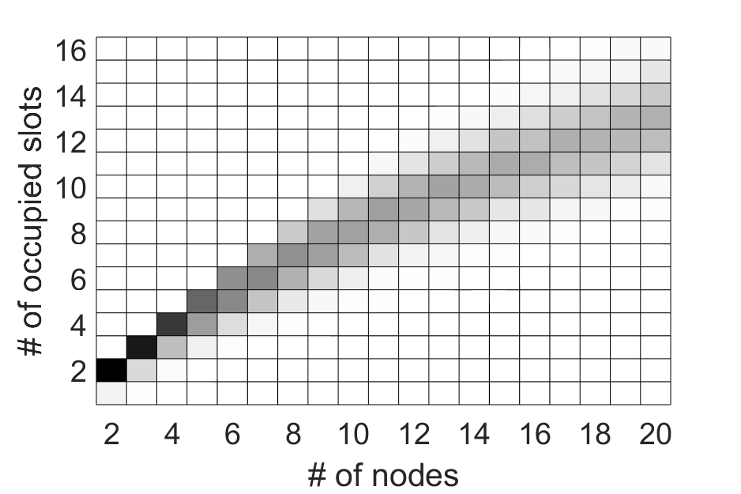
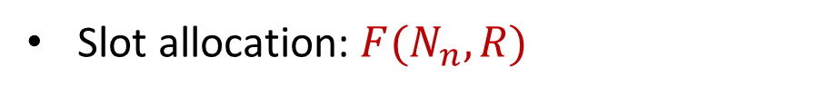
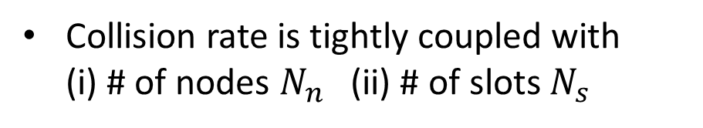
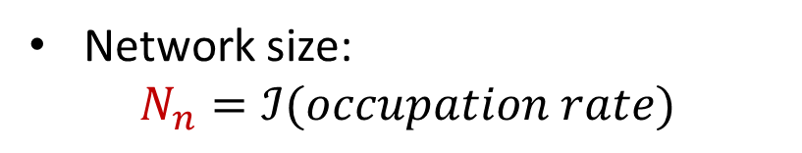
P2P Protocol
Slot adaptation: Maximize efficiency
Collision rate is tightly coupled with
(i) # of nodes $N_{n}$ (ii) # of slots $N_{s}$
Network size:
$$N_{n}=ℐ(occupation rate)$$
Slot allocation: ${F(N}_{n}, R)$
Notes:
The purpose of slot adaptation is to maximize efficiency. The number of slots should be neither too large nor too small. Probabilistically, the collision rate is coupled with the number of nodes in the network, and the number of slots we offer. That is to say, if we have an expected collision rate, and if we can somehow approximately estimate the network size. This will give us a hint as to what number of slots we should offer. So how can estimate the network size? We observe that network size can be estimated from the slot occupation rate of the received responses in the first iteration. Using this estimated network size, together with a collision rate, we can make an informed decision about the number of slots to offer in the next round.

Slide 17

P2P Protocol
Two-round ranging: RESP-again scheme
User 1
User 2
User 3
User 4
POLL
Available time slots
COLLISION
RESP From 2
RESP From 3
RESP From 4
U3
U2
U4
$$Recvd RESP=\{U_{4}\}$$
FINAL
New available time slots
U2
RESP-again From 3
RESP-again From 2
U3
FINAL-again
Notes:
The other solution to the collision problem is a RESP-again scheme. When the receivers try to send the response to the transmitter as a reply, some of the RESPs, like resp from user 4 in the slide, will be received successfully with no collision, but other RESPs will experience a collision because different receivers choose the same time slot. Whatever, the transmitter will collect all the responses which are successfully received in this round, and puts them into a receiving list. This receiving list will be attached to the FINAL message. (Click) Then the transmitter sends the FINAL message. When receivers receive this FINAL message, they will check to see if they are in the receiving list. If they are, they know they succeed in sending in the first round, and we will stop it from running and let it go to sleep for a while to save some time and computational resource. (Click) Otherwise, if they find they are not in the receiving list, they will get the second change to send a RESP-again message. After certain time, the transmitter will broadcast the FINAL-again message for these users to complete the distance measurement.

Slide 18
P2P Protocol: Summary
UWB Primer
P2P Protocol
UWB RF Module
Time Slotting
Slot Adaptation
RESP again
CIR
Packet Timings
Raw Dist.
Occlusion Detection
Feature
Extraction
Occlusion Classifier
Distance Compensation
Robust low-level algorithm and protocol
Sanitized Distance
Storage Module
Alarm buzzer
Notes:
Let’s briefly summarize what we have done for now. What we already have (Click) is a low-level ranging algorithm and a robust protocol with which we can obtain the peer-wise distance efficiently and accurately.

Slide 19

Occlusion Detection
6Fit-a-part: Overview
UWB
P2P Protocol
UWB RF Module
Time Slotting
Slot Adaptation
RESP again
Should all the distance measurements be treated equally?
CIR
Packet Timings
Raw Dist.
Occlusion Detection
Feature
Extraction
Occlusion Classifier
Distance Compensation
Sanitized Distance
Storage Module
Alarm buzzer
Notes:
However, we want to ask this question: should all distance measurements be treated equally?

Slide 20
Occlusion Detection
6Fit-a-part: Overview
UWB
P2P Protocol
UWB RF Module
Time Slotting
Slot Adaptation
RESP again
CIR
Packet Timings
Raw Dist.
Occlusion Detection
Feature
Extraction
Occlusion Classifier
Distance Compensation
Sanitized Distance
Storage Module
Alarm buzzer
Notes:
Actually it’s not true. That’s why we have our occlusion detection module. Remember that we basically classify three different kinds of occlusion: LOS which means no occlusion, Wall-blocking and human blocking.

Slide 21
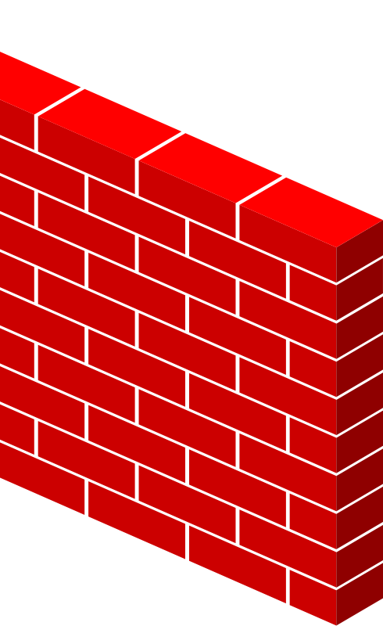
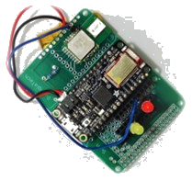
Occlusion Detection
6 Feet
LOS
Wall block
Warning should be disabled!
Notes:
In the wall-blocking case, it is very natural to think that the system shouldn’t warn the user even he is in the 6 feet range from another person on the other side of the wall because there is no risk of infection.

Slide 22
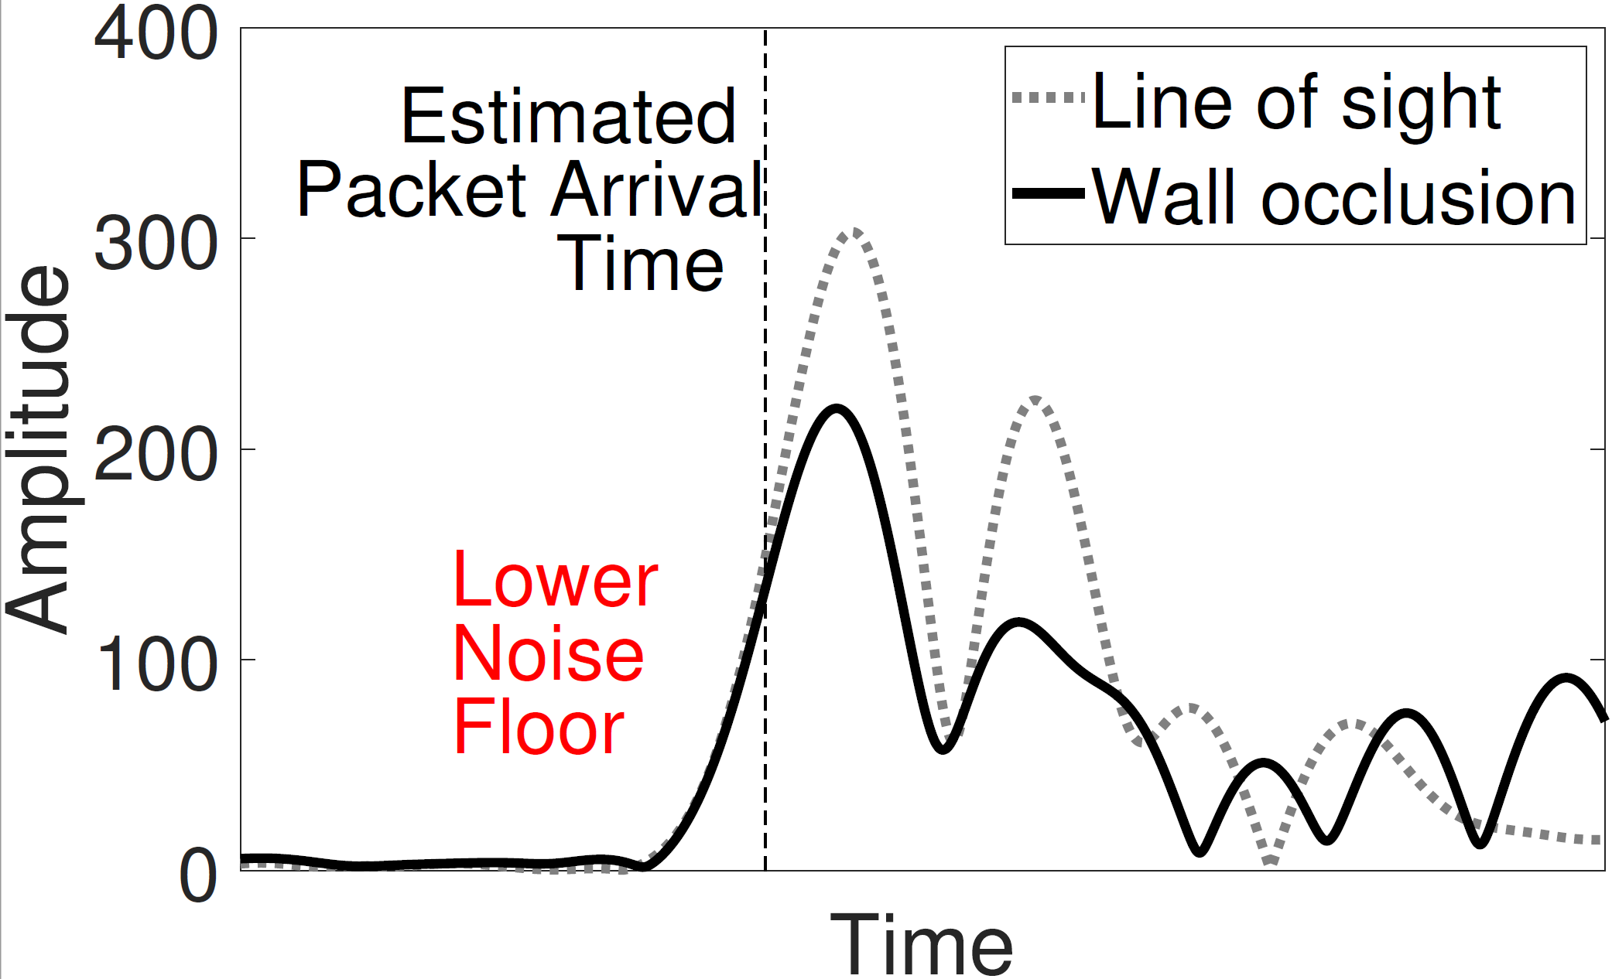
Occlusion Detection
channel impulse response
LOS CIR
Wall-blocking CIR
Difference between LOS and wall blocking CIRs
Observation 1:
Signals are attenuated significantly with blocking
Notes:
To differentiate Wall-blocking case, we observe that in the channel impulse response, the signal amplitude is much lower when there is a wall blocking. That is an important feature to distinguish it.

Slide 23
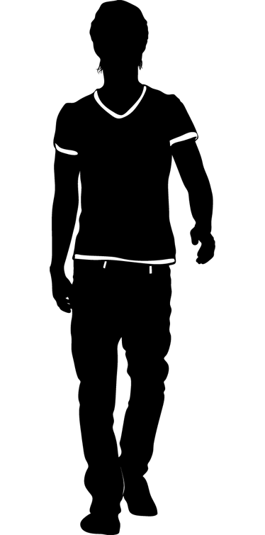
Occlusion Detection
6 Feet
LOS
Human block
Distance needs to be compensated
Notes:
In the human-blocking case, we still need to warn the user when he is too close to others. However, distance measurements are erroneous when there is occlusion. So we should compensate the distance measurement before the system gives a warning.

Slide 24
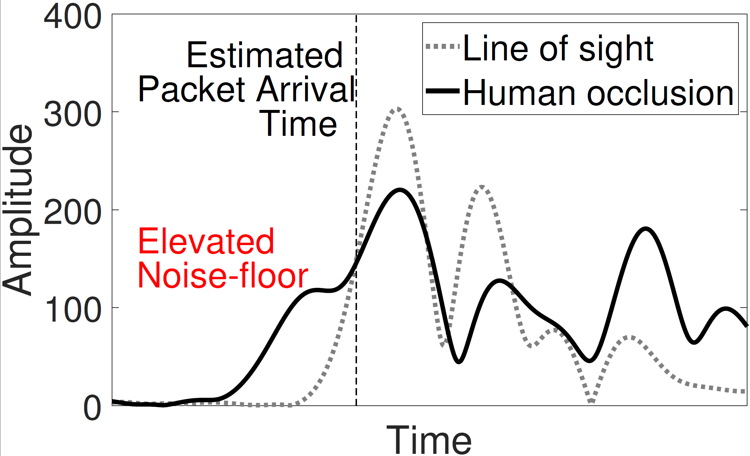
Occlusion Detection
channel impulse response
LOS CIR
Human-blocking CIR
Difference between LOS and human blocking CIRs
Observation 2:
Human blocking causes closely-coupled multipath
Notes:
Similarly, we use channel impulse response to differentiate the human-blocking case. We observe that signals in the human-blocking case not only have a lower power. Its main lobe is also distorted by some closely-coupled multipath. It’s a feature we use to distinguish the human blocking case.

Slide 25

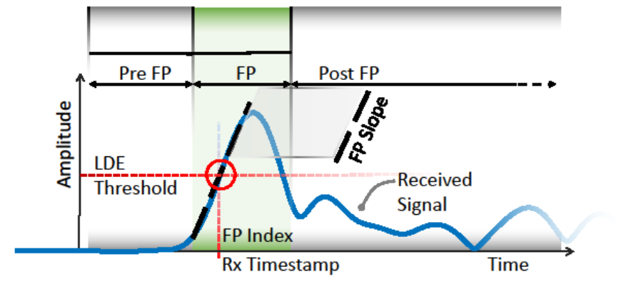
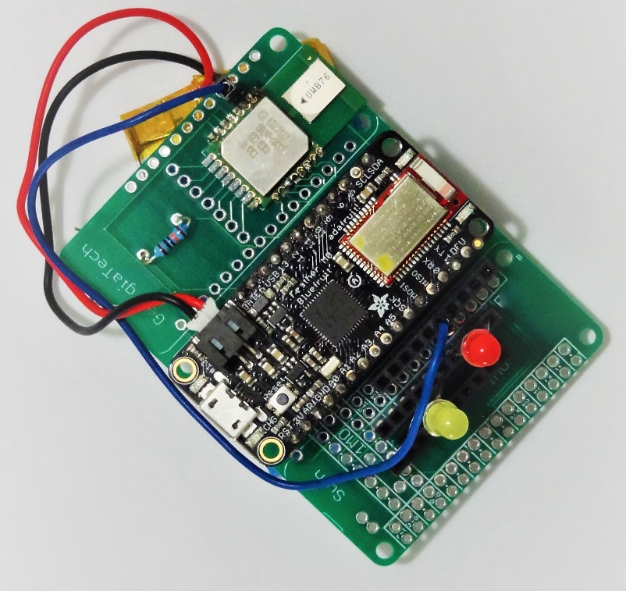
Occlusion Detection
x9
x7
x9
x8
Human
…
Wall
LoS
Decision Tree
x3
x3
x9
x5
x7
…
…
Dist1
Dist2
Regression Tree
Notes:
Based on the above observations, we firstly extract the channel impulse response in the lowest level. (Click) Then we extract a couple of features from the channel impulse response. . (Click) We use these features to build a decision tree to classify the occlusion cases, and build a regression tree to compensate for the erroneous distance. (Click) All these functions are integrated in the small embedding device, with no cloud or Internet connection.

Slide 26
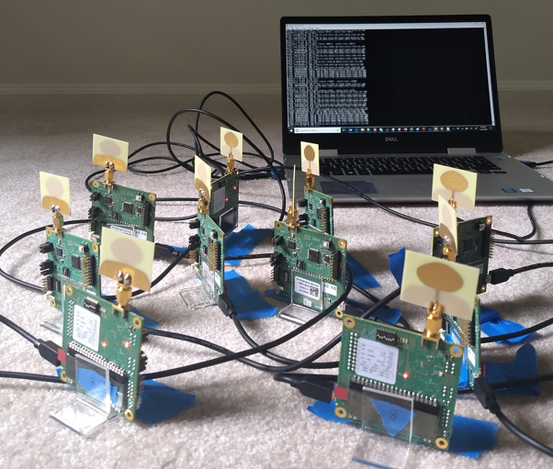
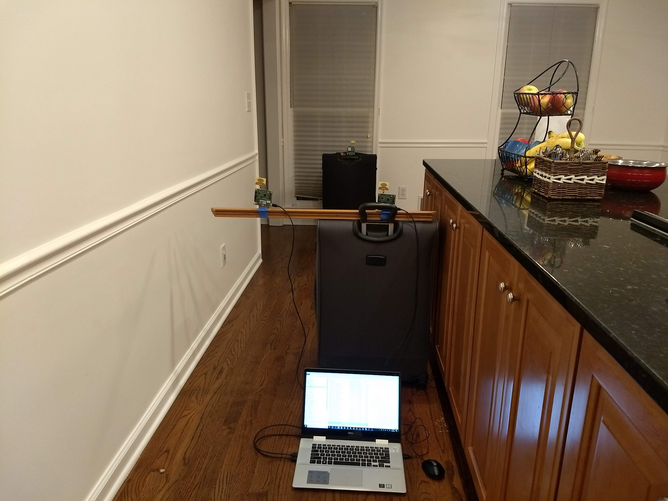
Evaluation
6Fit-a-part: Evaluation
At-home test beds used for evaluation
Experiment setup
Decawave Trek1000 Toolkit
Adafruit Feather M0 with DW1000 chip
Baseline: Modified IEEE 802.15.4 two way ranging (A-TWR)
Metrics
Percent of rangings completed
Average ranging time
Classification accuracy
Notes:
We implement and evaluate 6Fit-a-part on Decawave Trek 1000 toolkit and Adafruit Feather M0 with DW1000 chip. We use the arbitrary two way ranging as the baseline. It is the original two way ranging from IEEE 802.15.4. We focus on three metrics: percentile of rangings completed, average ranging time and classification accuracy.

Slide 27
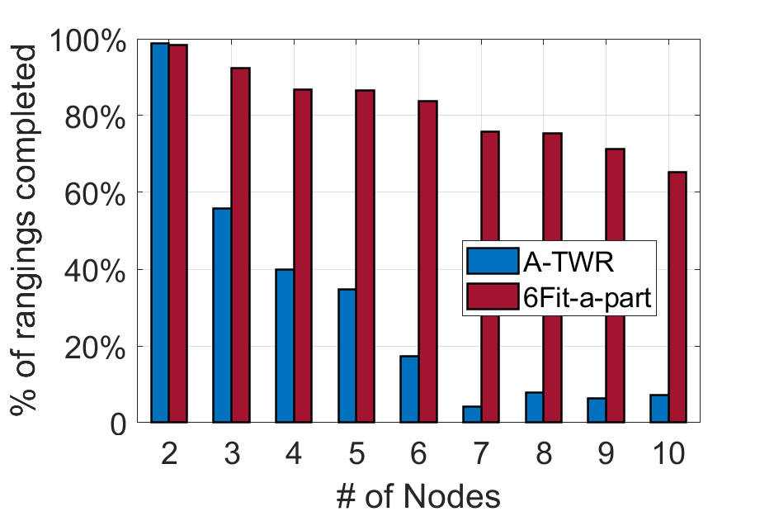
Evaluation (P2P Protocol)
6Fit-a-part: Evaluation
Basic performance: Percentile of rangings completed
Notes:
We firstly look at the percentile of rangings completed. As we can see, in a 10 node network, 6Fit-a-part can still achieve over 60% accuracy. For arbitrary TWR, it is very hard to it to do any valid distance measurements.

Slide 28
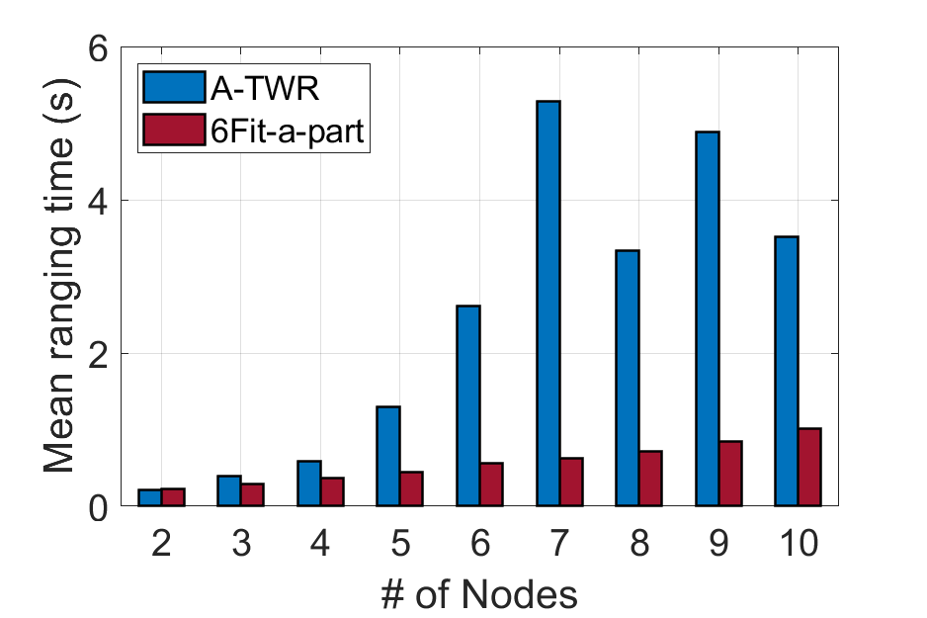
Evaluation (P2P Protocol)
6Fit-a-part: Evaluation
Basic performance: Average ranging time
10Hz ranging rate
Notes:
Then let’s look at the average ranging time. Even in a 10 node network, 6Fit-a-part can still achieve 1s ranging time on average, which means it can obtain the distance from all the other nodes in the network in one second, (Click) corresponding to a 10Hz ranging rate. As for A-TWR, the performance is much worse.

Slide 29
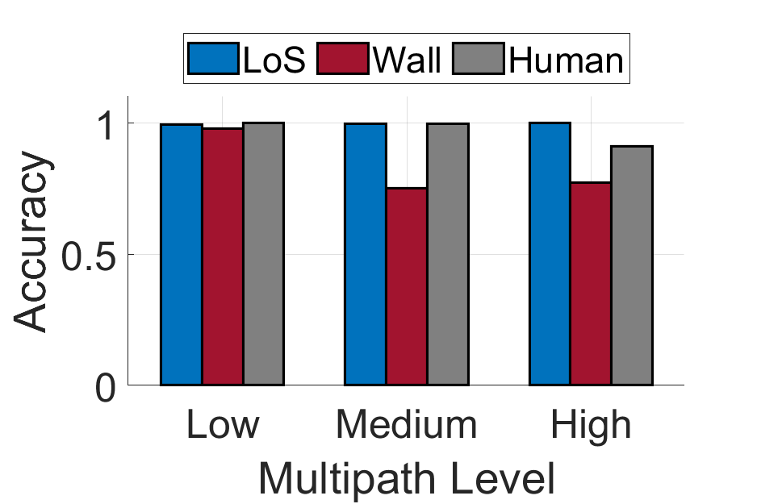
6Fit-a-part: Evaluation
Evaluation (LOS-Wall-Human Classification)
Occlusion detection: Classification Accuracy
In Different Environments
Notes:
Finally, we evaluate the classification accuracy in occlusion detection. We test in 3 different environments, corresponding to the low, medium and high multipath level. Generally, we can achieve over 85% accuracy in classification. We also observe that with increasing multipath, the accuracy degrades a bit. Most mis-classification happen between wall-blocking and human-blocking.

Slide 30
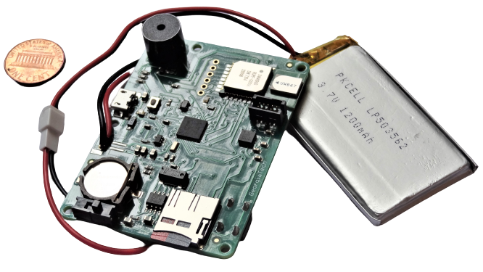
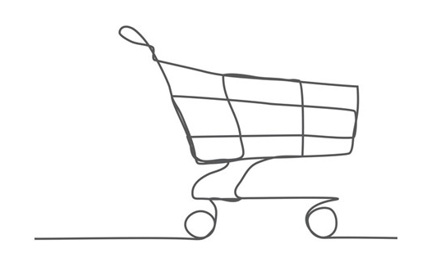
Future work
6Fit-a-part: Evaluation
Real-world deployment
- Large scale data collection for future analysis
- Exploration with more sensors
Notes:
There are some future work for 6Fit-a-part. We plan to deploy 6 Fit-a-part on a large scale in the real world such as grocery stores. We hope to collect large amounts of data to see if there would be any improvement. We also want to try with more sensors such as IMU, to see it we can make this system more user-friendly in interaction.

Slide 31
Conclusion
6Fit-a-part: Evaluation
A robust P2P ranging protocol
Occlusion differentiation
Working prototype:
low power, lightweight, small size.
Notes:
To conclude,
We design a robust P2P ranging protocol with an average rate of 10Hz; We analyze the channel impulse response to differentiate occlusion, enhancing the feasibility and generality of 6Fit-a-part. ;We design and prototype 6Fit-a-part on the embedded devices, featured by low power, lightweight and small size.

Slide 32
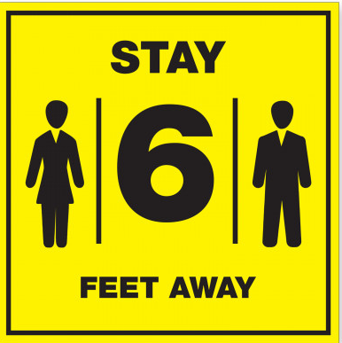
Thank you!
Notes:
Thank you, and stay safe!

