Slide 1

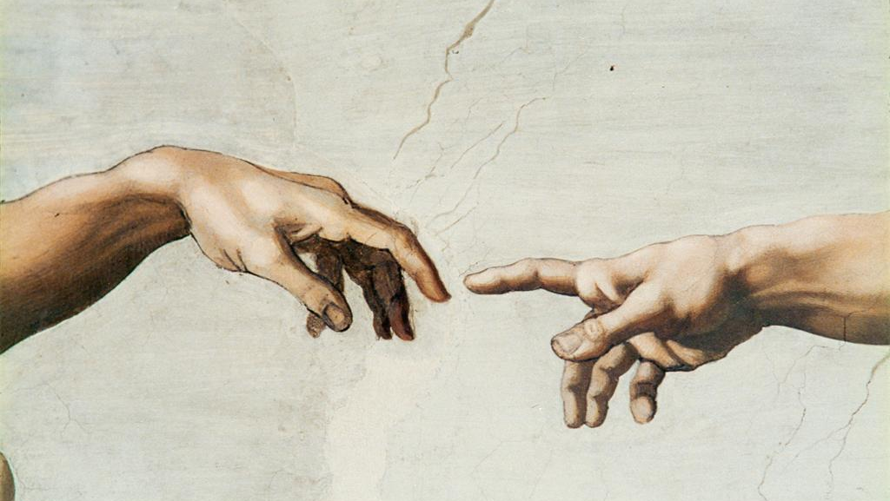


CSIscan: Learning CSI for Efficient Access Point Discovery in Dense WiFi Networks
Authors
Kunal Sankhe
(Ph.D. Graduate, Northeastern University)
Dheryta Jaisinghani
(Asst. Professor at University of Northern Iowa)
Kaushik Chowdhury
(Professor at Northeastern University)
Next GEneration NEtworks and SYStems Lab

Slide 2
Talk Outline
Preliminary Study
Performance
Evaluation
Design of CSIscan
1
2
3
4
5
6
Motivation
Conclusion
CNN based
Preamble Modification

Slide 3
Talk Outline
Preliminary Study
Performance
Evaluation
Design of CSIscan
1
2
3
4
5
6
Motivation
Conclusion
CNN based
Preamble Modification

Slide 4
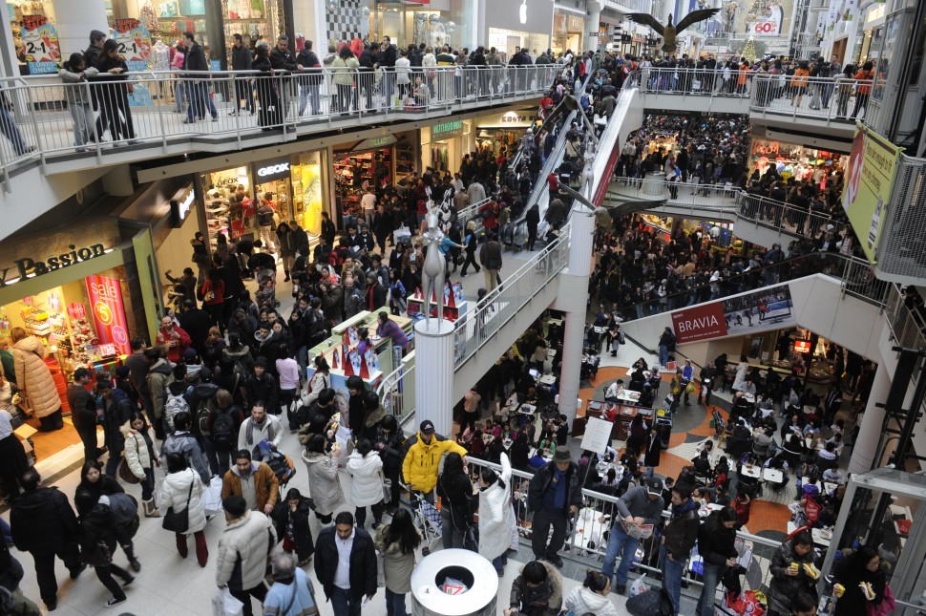
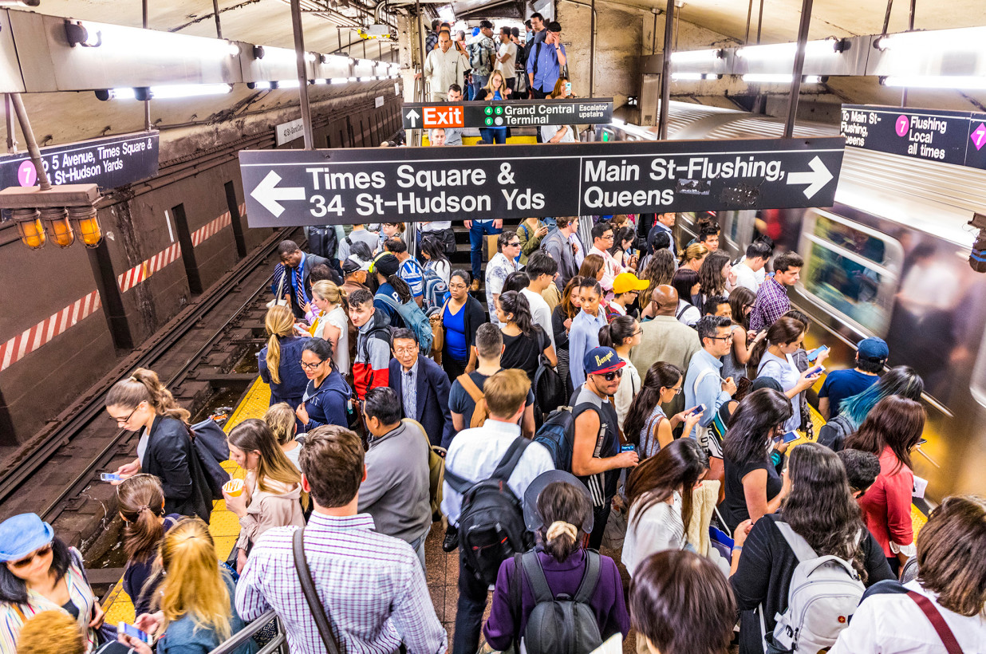
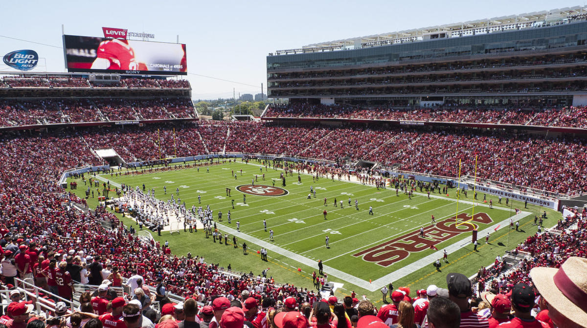
WiFi – No Longer A Luxury, But An Expectations
Shopping Mall
NYC Subway Station
Super Bowl 2020
AP Discovery – An Achilles Heel for WiFi
Notes:
WiFi is no longer a luxury, rather it is a common expectations. We expect to receive WiFi connection in Shopping malls, subway stations, but recently even in sports stadiums has established infrastructure to provide WiFi connection to their spectators. Now imagine, that you are walking into stadium and to connect WiFi access point, the first thing that we will do it to find all the available access points. This procedure is called AP discovery.

Slide 5
Talk Outline
Preliminary Study
Performance
Evaluation
Design of CSIscan
1
2
3
4
5
6
Motivation
Conclusion
CNN based
Preamble Modification

Slide 6
Talk Outline
Preliminary Study
Performance
Evaluation
Design of CSIscan
1
2
3
4
5
6
Motivation
Conclusion
CNN based
Preamble Modification

Slide 7



Preliminary Study of AP-client Discovery
1) Spectrum Wastage
2) WiFi Latency at Client
Round Trip Time
PING
Client
WiFi Hotspot
Triggers active discovery after 2 minutes
Notes:
To provide real-world evidence of the problem associated with AP discovery, we conducted to two studies in our university campus. In first study, we collected WiFi packet traces in Student Caferaria, where around 100-120 students were either using their laptops or phones to access internet over WiFi. We captured traces in both 2.4 and 5 Ghz for around 35 minutes and these are some statistics. Through the first study, we analyze the problem of Spectrum Wastage in the network 2) In second study, we study the impact on WiFi latency that is caused by AP discovery process. For that, we relied on ping utility.
In our preliminary experiment that we conducted in University campus, we observe 75% of probe responses were retry frames, and 62% probe responses reach after MaxCT. This is redundant traffic which is also sent at lower order of modulation. Thus, it occupies a significant amount of spectrum airtime, and thereby wasting the spectrum.

Slide 8



Impact of Active Discovery: Spectrum Wastage
MaxCT
Channel
Switching Delay
MinCT
Channel x
Channel x+1
Probe Request
Probe Request
Time
WiFi Client
$$…$$
Probe Responses
Probe Responses
Probe Responses
APs
in the network
Channel x
Time

Slide 9
Impact of Active Discovery: Spectrum Wastage
MaxCT
Channel
Switching Delay
MinCT
Channel x
Channel x+1
How to minimize the number of redundant probe responses?
Probe Request
Probe Request
Time
WiFi Client
Problem 1: 75% Probe Responses were retry frames
Retry Frames
$$…$$
Retry Frame
Problem 2: 62% Probe Responses reached after MaxCT
Probe Responses
Probe Responses
Probe Responses
APs
in the network
Channel x
Time
[1] X. Hu and L. Song and D. V. Bruggen and A. Striegel. Is There WiFi Yet?: How Aggressive Probe Requests Deteriorate Energy
and Throughput. In Proceedings of ACM IMC, 2015.
[2] Freudiger. How talkative is your mobile device? An experimental study of Wi-Fi probe requests. In Proceedings of ACM WiSec, 2015.

Slide 10
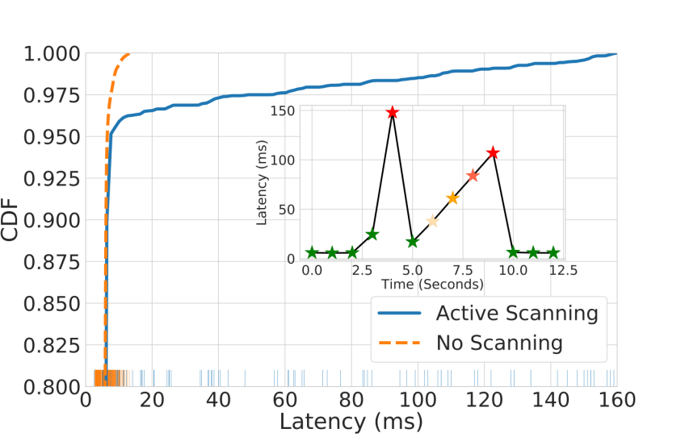
Impact of Active Discovery: WiFi Latency at Client
Problem: Long tail distribution
99th percentile: 150ms delay
2 min
Active Discovery
Triggered
Active Discovery
Triggered

Slide 11
Impact of Active Discovery: WiFi Latency at Client
“1 second of load lag time would cost Amazon $1.6 billion in sales per year”
- Amazon
Monetary
Loss
Problem: Long tail distribution
99th percentile: 150ms delay
How to minimize the WiFi latency caused by active discovery?
Long-tail WiFi latency of ~25ms → 2-3 sec slow page load [3]
“40% of users will abandon a webpage if it takes more than 3 seconds to load” [4]
Bad
User Experience
[3] K. Sui, M. Zhou, D. Liu, M. Ma, D. Pei, Y. Zhao, Z. Li, and T. Moscibroda. Characterizing and improving wifi latency in large-scale operational networks. In Proceedings of MobiSys, 2016.
[4] Storage: How ‘tail latency’ impacts customer-facing applications, Aug 2019. https://www.computerweekly.com/opinion/Storage-How-taillatency-impacts-customer-facing-applications.
Notes:
Here, we consider WiFi latency as the last-hop latency between the clients and its immediate connected AP. With ping utility, we evaluate the impact of active discovery on WiFi latency. Periodically, active discovery was triggered. While median latency is very low as 3-5 ms, it’s long tail latency (>90th percentile) is as high as >150ms. The impact of this kind of latency distribution is studied in the literature that usually results in monetary loss as well as bad user experience.

Slide 12
Talk Outline
Preliminary Study
Performance
Evaluation
Design of CSIscan
1
2
3
4
5
6
Motivation
Conclusion
CNN based
Preamble Modification

Slide 13
Talk Outline
Preliminary Study
Performance
Evaluation
Design of CSIscan
1
2
3
4
5
6
Motivation
Conclusion
CNN based
Preamble Modification

Slide 14






CSIscan: Our Vision for AP Discovery
Switching Delay
3. Find: “better” channel
Ch 1
Ch 2
$$⋯$$
Ch N
Ch k
2. Process PHY frames (only CSI) to extract discovery information
Time
Probe Request
WiFi Client
4. Follow regular AP discovery
1. Encode discovery information
$$⋯$$
$$⋯$$
$$⋯$$
$$⋯$$
$$…$$
Traffic for other connected WiFi clients
Probe Responses
APs
in the network
Time
Notes:
In our vision, we

Slide 15





$$X\left(k\right), k=−26, …, −1, 1, …,26$$
Background on L-LTF
-26 | -25 | -24 | -23
Legacy Preamble | VHT/HE Preamble | Data
1 | 1 | -1 | -1
-22 | -21 | -20 | -19 | -18 | -17 | -16 | -15
1 | 1 | -1 | 1 | -1 | 1 | 1 | 1
8 $μs$
8 $μs$
4 $μs$
-14 | -13 | -12 | -11 | -10 | -9 | -8 | -7
L-STF | L-LTF | L-SIG
1 | 1 | 1 | -1 | -1 | 1 | 1 | -1
$$⋮$$
19 | 20 | 21 | 22 | 23 | 24 | 25 | 26
1 | -1 | 1 | -1 | 1 | 1 | 1 | 1
CP | C1 | C2
IFFT
T_{GI}
T_{FFT}
T_{FFT}
C1 (=C2)

Slide 16

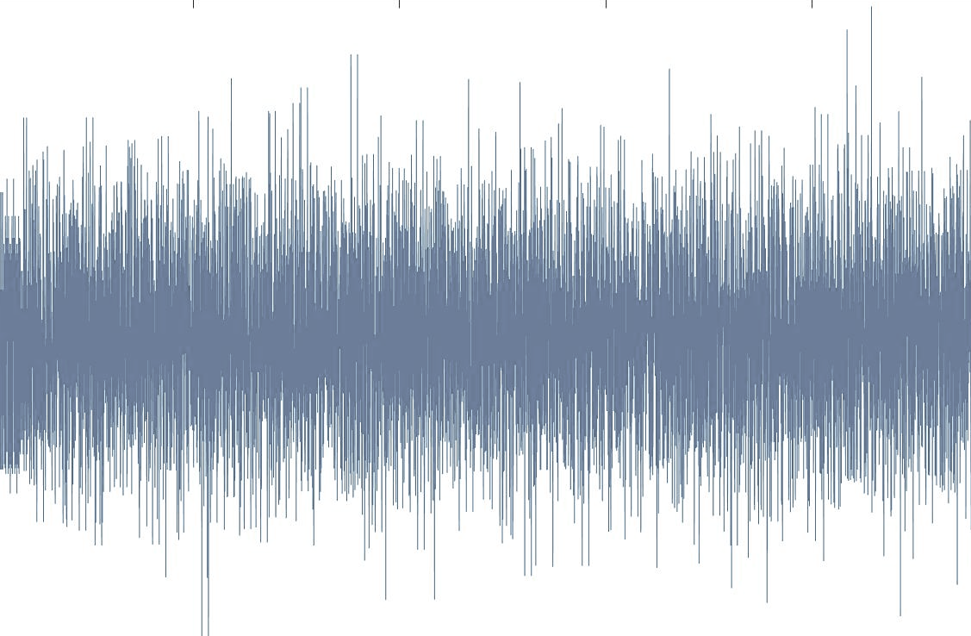







Channel Estimation using L-LTF
WiFi Packet
Transmitter
Receiver
Packet Detection
Extract Legacy Preamble
WiFi Packet
L-STF | L-LTF | L-SIG
For $k=−26, …, −1, 1, …,26$
$${\hat{H}}_{1}\left(k\right)=\frac{Y_{1}(k) }{X(k)}$$
Coarse and Fine
Freq. Sync
$${\hat{H}}_{2}\left(k\right)=\frac{Y_{2}(k) }{X(k)}$$
L-LTF Demodulation
$$Y_{1}$$ | $$Y_{2}$$
LS Channel Estimation
$$\hat{H}\left(k\right)=\frac{{\hat{H}}_{1}\left(k\right)+{\hat{H}}_{2}\left(k\right)}{2}$$
$$\hat{H}$$

Slide 17
Background on Channel State Information (CSI)
CSI Magnitude
CSI Phase
Unwraped CSI Phase
Detrending unwrapped CSI Phase

Slide 18


Background on Channel Estimation using L-LTF
CSI Phase
$$X\left(k\right), k=−26, …, −1, 1, …,26$$
-26 | -25 | -24 | -23
1 | 1 | -1 | -1
-22 | -21 | -20 | -19 | -18 | -17 | -16 | -15
1 | 1 | -1 | 1 | -1 | 1 | 1 | 1
-14 | -13 | -12 | -11 | -10 | -9 | -8 | -7
1 | 1 | 1 | -1 | -1 | 1 | 1 | -1
Processed CSI Phase
$$⋮$$
19 | 20 | 21 | 22 | 23 | 24 | 25 | 26
1 | -1 | 1 | -1 | 1 | 1 | 1 | 1
IFFT
AP
(Preamble used at Rx
for Channel Estimation)
Client
L-LTF

Slide 19
Channel Estimation using L-LTF
CSI Phase
$$X\left(k\right), k=−26, …, −1, 1, …,26$$
-26 | -25 | -24 | -23
1 | 1 | -1 | -1
-22 | -21 | -20 | -19 | -18 | -17 | -16 | -15
1 | 1 | -1 | 1 | -1 | 1 | 1 | 1
-14 | -13 | -12 | -11 | -10 | -9 | -8 | -7
1 | 1 | 1 | -1 | -1 | 1 | 1 | -1
Processed CSI Phase
$$⋮$$
19 | 20 | 21 | 22 | 23 | 24 | 25 | 26
1 | -1 | 1 | -1 | 1 | 1 | 1 | 1
IFFT
AP
(Preamble used at Rx
for Channel Estimation)
Client
L-LTF

Slide 20
Intentional modifications in L-LTF
CSI Phase
-26 | -25 | -24 | -23
1 | 1 | -1 | -1
-22 | -21 | -20 | -19 | -18 | -17 | -16 | -15
1 | 1 | -1 | 1 | -1 | 1 | 1 | 1
-14 | -13 | -12 | -11 | -10 | -9 | -8 | -7
1 | 1 | 1 | -1 | -1 | 1 | 1 | -1
Processed CSI Phase
$$⋮$$
19 | 20 | 21 | 22 | 23 | 24 | 25 | 26
1 | -1 | 1 | -1 | 1 | 1 | 1 | 1
AP
Client

Slide 21




Intentional modifications in L-LTF
CSI Phase
-26 | -25 | -24 | -23
1 | 1 | -1 | -1
-22 | -21 | -20 | -19 | -18 | -17 | -16 | -15
1 | 1 | -1 | 1 | -1 | 1 | 1 | 1
-14 | -13 | -12 | -11 | -10 | -9 | -8 | -7
1 | 1 | 1 | -1 | -1 | 1 | 1 | -1
Processed CSI Phase
$$⋮$$
19 | 20 | 21 | 22 | 23 | 24 | 25 | 26
1 | -1 | 1 | -1 | 1 | 1 | 1 | 1
${+1 ∗ e}^{j∗θ∗\frac{π}{180}}$
$$θ^{°}={40}^{°}$$
AP
$−1$
$+1$
Client

Slide 22

Intentional modifications in L-LTF
CSI Phase
-26 | -25 | -24 | -23
${1 ∗ e}^{j∗θ∗\frac{π}{180}}$
1 | 1 | -1 | -1
-22 | -21 | -20 | -19 | -18 | -17 | -16 | -15
1 | 1 | -1 | 1 | -1 | 1 | 0.70 + j0.6 | 1
-14 | -13 | -12 | -11 | -10 | -9 | -8 | -7
1 | 1 | 1 | -1 | -1 | 1 | 1 | -1
Processed CSI Phase
$$⋮$$
19 | 20 | 21 | 22 | 23 | 24 | 25 | 26
1 | -1 | 1 | -1 | 1 | 1 | 1 | 1
${+1 ∗ e}^{j∗θ∗\frac{π}{180}}$
$$θ^{°}={40}^{°}$$
AP
$−1$
$+1$
Client

Slide 23
Intentional modifications in L-LTF
CSI Phase
-26 | -25 | -24 | -23
${1 ∗ e}^{j∗θ∗\frac{π}{180}}$
1 | 1 | -1 | -1
-22 | -21 | -20 | -19 | -18 | -17 | -16 | -15
1 | 1 | -1 | 1 | -1 | 1 | 0.70 + j0.6 | 1
Are these effects channel independent?
-14 | -13 | -12 | -11 | -10 | -9 | -8 | -7
1 | 1 | 1 | -1 | -1 | 1 | 1 | -1
Processed CSI Phase
$$⋮$$
19 | 20 | 21 | 22 | 23 | 24 | 25 | 26
1 | -1 | 1 | -1 | 1 | 1 | 1 | 1
${+1 ∗ e}^{j∗θ∗\frac{π}{180}}$
$$θ^{°}={40}^{°}$$
AP
$−1$
$+1$
Client

Slide 24
Intentional modifications in L-LTF
CSI Phase
-26 | -25 | -24 | -23
${1 ∗ e}^{j∗θ∗\frac{π}{180}}$
1 | 1 | -1 | -1
-22 | -21 | -20 | -19 | -18 | -17 | -16 | -15
1 | 1 | -1 | 1 | -1 | 1 | 0.70 + j0.6 | 1
-14 | -13 | -12 | -11 | -10 | -9 | -8 | -7
1 | 1 | 1 | -1 | -1 | 1 | 1 | -1
Processed CSI Phase
$$⋮$$
19 | 20 | 21 | 22 | 23 | 24 | 25 | 26
1 | -1 | 1 | -1 | 1 | 1 | 1 | 1
${+1 ∗ e}^{j∗θ∗\frac{π}{180}}$
$$θ^{°}={40}^{°}$$
AP
$−1$
$+1$
Client

Slide 25


Intentional modifications in L-LTF
CSI Phase
-26 | -25 | -24 | -23
${1 ∗ e}^{j∗θ∗\frac{π}{180}}$
1 | 1 | -1 | -1
-22 | -21 | -20 | -19 | -18 | -17 | -16 | -15
1 | 1 | -1 | 1 | -1 | 1 | 0.70 + j0.6 | 1
Can we introduce phase distortions in more than one subcarriers?
-14 | -13 | -12 | -11 | -10 | -9 | -8 | -7
1 | 1 | 1 | -1 | -1 | 1 | 1 | -1
Processed CSI Phase
$$⋮$$
19 | 20 | 21 | 22 | 23 | 24 | 25 | 26
$$θ_{k}$$
1 | -1 | 1 | -1 | 1 | 1 | 1 | 1
${+1 ∗ e}^{j∗θ∗\frac{π}{180}}$
$$k$$
$$θ^{°}={40}^{°}$$
AP
$−1$
$+1$
Client

Slide 26












Intentional modifications in L-LTF
CSI Phase
-26 | -25 | -24 | -23
${1 ∗ e}^{j∗θ_{−16}∗\frac{π}{180}}$
1 | 1 | -1 | -1
-22 | -21 | -20 | -19 | -18 | -17 | -16 | -15
1 | 1 | -1 | 1 | -1 | 1 | 0.70 + j0.6 | 1
-14 | -13 | -12 | -11 | -10 | -9 | -8 | -7
1 | 1 | 1 | -1 | -1 | 1 | 1 | -1
Processed CSI Phase
${−1∗e}^{j∗θ_{22}∗\frac{π}{180}}$
$$⋮$$
19 | 20 | 21 | 22 | 23 | 24 | 25 | 26
$$θ_{−16}=38$$
1 | -1 | 1 | -0.93 + j0.3 | 1 | 1 | 1 | 1
$$θ_{22}=−18$$
$$k=−16$$
$$k=22$$
$$θ_{−16}={40}^{°}$$
AP
$−1$
Client
$−1$
$+1$
$+1$
$$θ_{22}={−20}^{°}$$

Slide 27
Intentional modifications in L-LTF
CSI Phase
-26 | -25 | -24 | -23
${1 ∗ e}^{j∗θ_{−16}∗\frac{π}{180}}$
1 | 1 | -1 | -1
-22 | -21 | -20 | -19 | -18 | -17 | -16 | -15
1 | 1 | -1 | 1 | -1 | 1 | 0.70 + j0.6 | 1
-14 | -13 | -12 | -11 | -10 | -9 | -8 | -7
1 | 1 | 1 | -1 | -1 | 1 | 1 | -1
After detrending unwraped CSI Phase
${−1∗e}^{j∗θ_{22}∗\frac{π}{180}}$
$$⋮$$
19 | 20 | 21 | 22 | 23 | 24 | 25 | 26
$$θ_{−16}=38$$
1 | -1 | 1 | -0.93 + j0.3 | 1 | 1 | 1 | 1
$$θ_{22}=−18$$
$$k=−16$$
$$k=22$$
$$θ_{−16}={40}^{°}$$
$−1$
$+1$
$−1$
$+1$
$$θ_{22}={−20}^{°}$$

Slide 28





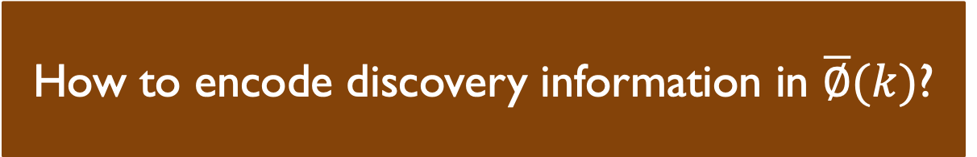



Mapping discovery information into FIR Filter coefficients
$$\overline{X}(k)$$
$$\overline{∅}(k)$$
-26 | -25 | -24 | -23
-26 | -25 | -24 | -23
1 | 1 | -1 | -1
$$∅_{−26}$$ | $$∅_{−25}$$ | $$∅_{−24}$$ | $$∅_{−23}$$
-22 | -21 | -20 | -19 | -18 | -17 | -16 | -15
-22 | -21 | -20 | -19 | -18 | -17 | -16 | -15
How to encode discovery information in $\overline{∅}(k)$?
1 | 1 | -1 | 1 | -1 | 1 | 1 | 1
$$∅_{−22}$$ | $$∅_{−21}$$ | $$∅_{−20}$$ | $$∅_{−19}$$ | $$∅_{−18}$$ | $$∅_{−17}$$ | $$∅_{−16}$$ | $$∅_{−15}$$
$$\overline{F}(k)$$
-14 | -13 | -12 | -11 | -10 | -9 | -8 | -7
-14 | -13 | -12 | -11 | -10 | -9 | -8 | -7
1 | 1 | 1 | -1 | -1 | 1 | 1 | -1
$$∅_{−14}$$ | $$∅_{−13}$$ | $$∅_{−12}$$ | $$∅_{−11}$$ | $$∅_{−10}$$ | $$∅_{−9}$$ | $$∅_{−8}$$ | $$∅_{−7}$$
$$⋮$$
$$⋮$$
19 | 20 | 21 | 22 | 23 | 24 | 25 | 26
19 | 20 | 21 | 22 | 23 | 24 | 25 | 26
1 | -1 | 1 | -1 | 1 | 1 | 1 | 1
$$∅_{19}$$ | $$∅_{20}$$ | $$∅_{21}$$ | $$∅_{22}$$ | $$∅_{23}$$ | $$∅_{24}$$ | $$∅_{25}$$ | $$∅_{26}$$
Where $∅_{k}=e^{\frac{j∗π{∗θ}^{°}}{180}}$

Slide 29






Mapping discovery information into FIR Filter coefficients
$$\overline{∅}(k)$$
$$\overline{∅}(k)$$
-26 | -25 | -24 | -23
-26 | -25 | -24 | -23
$$∅_{−26}$$ | $$∅_{−25}$$ | $$∅_{−24}$$ | $$∅_{−23}$$
0 | 1 | 2 | 3
-22 | -21 | -20 | -19 | -18 | -17 | -16 | -15
-22 | -21 | -20 | -19 | -18 | -17 | -16 | -15
Group 1
$$∅_{−22}$$ | $$∅_{−21}$$ | $$∅_{−20}$$ | $$∅_{−19}$$ | $$∅_{−18}$$ | $$∅_{−17}$$ | $$∅_{−16}$$ | $$∅_{−15}$$
0 | 1 | 2 | 3 | 4 | 5 | 6 | 7
-14 | -13 | -12 | -11 | -10 | -9 | -8 | -7
-14 | -13 | -12 | -11 | -10 | -9 | -8 | -7
Group 2
$$∅_{−14}$$ | $$∅_{−13}$$ | $$∅_{−12}$$ | $$∅_{−11}$$ | $$∅_{−10}$$ | $$∅_{−9}$$ | $$∅_{−8}$$ | $$∅_{−7}$$
0 | 1 | 2 | 3 | 4 | 5 | 6 | 7
$$⋮$$
$$⋮$$
$$⋮$$
19 | 20 | 21 | 22 | 23 | 24 | 25 | 26
19 | 20 | 21 | 22 | 23 | 24 | 25 | 26
Group 6
$$∅_{19}$$ | $$∅_{20}$$ | $$∅_{21}$$ | $$∅_{22}$$ | $$∅_{23}$$ | $$∅_{24}$$ | $$∅_{25}$$ | $$∅_{26}$$
0 | 1 | 2 | 3 | 4 | 5 | 6 | 7

Slide 30

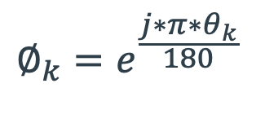
Mapping discovery information into FIR Filter coefficients
$$\overline{∅}(k)$$
-22 | -21 | -20 | -19 | -18 | -17 | -16 | -15
-26 | -25 | -24 | -23
0 | 1 | 2 | 3 | 4 | 5 | 6 | 7
0 | 1 | 2 | 3
-22 | -21 | -20 | -19 | -18 | -17 | -16 | -15
Group 1
0 | 1 | 2 | 3 | 4 | 5 | 6 | 7
-14 | -13 | -12 | -11 | -10 | -9 | -8 | -7
Group 2
0 | 1 | 2 | 3 | 4 | 5 | 6 | 7
$$⋮$$
$$⋮$$
19 | 20 | 21 | 22 | 23 | 24 | 25 | 26
Group 6
0 | 1 | 2 | 3 | 4 | 5 | 6 | 7
$$∅_{k}=e^{\frac{j∗π∗θ_{k}}{180}}$$
Fixed $θ$

Slide 31
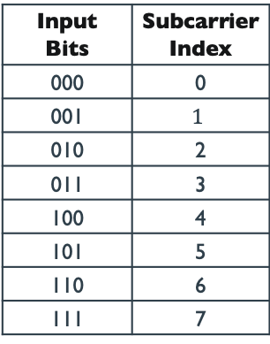
Mapping discovery information into FIR Filter coefficients
$$\overline{∅}(k)$$
-22 | -21 | -20 | -19 | -18 | -17 | -16 | -15
-26 | -25 | -24 | -23
0 | 1 | 2 | 3 | 4 | 5 | 6 | 7
0 | 1 | 2 | 3
-22 | -21 | -20 | -19 | -18 | -17 | -16 | -15
Group 1
0 | 1 | 2 | 3 | 4 | 5 | 6 | 7
Index Mapping Table
-14 | -13 | -12 | -11 | -10 | -9 | -8 | -7
Input Bits | Subcarrier Index
000 | 0
001 | $$1$$
010 | 2
011 | 3
100 | 4
101 | 5
110 | 6
111 | 7
Group 2
0 | 1 | 2 | 3 | 4 | 5 | 6 | 7
$$⋮$$
$$⋮$$
19 | 20 | 21 | 22 | 23 | 24 | 25 | 26
Group 6
0 | 1 | 2 | 3 | 4 | 5 | 6 | 7

Slide 32
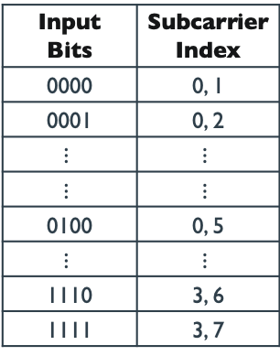
Mapping discovery information into FIR Filter coefficients
$$\overline{∅}(k)$$
-22 | -21 | -20 | -19 | -18 | -17 | -16 | -15
-26 | -25 | -24 | -23
0 | 1 | 2 | 3 | 4 | 5 | 6 | 7
0 | 1 | 2 | 3
-22 | -21 | -20 | -19 | -18 | -17 | -16 | -15
Group 1
0 | 1 | 2 | 3 | 4 | 5 | 6 | 7
Index Mapping Table
-14 | -13 | -12 | -11 | -10 | -9 | -8 | -7
Input Bits | Subcarrier Index
0000 | 0, 1
0001 | 0, 2
$$⋮$$ | $$⋮$$
$$⋮$$ | $$⋮$$
0100 | 0, 5
$$⋮$$ | $$⋮$$
1110 | 3, 6
1111 | 3, 7
Group 2
0 | 1 | 2 | 3 | 4 | 5 | 6 | 7
$$⋮$$
$$⋮$$
19 | 20 | 21 | 22 | 23 | 24 | 25 | 26
Group 6
0 | 1 | 2 | 3 | 4 | 5 | 6 | 7

Slide 33

CSIscan Encoding: Index Phase Modulation
$$x(k)$$
-26 | -25 | -24 | -23
-22 | -21 | -20 | -19 | -18 | -17 | -16 | -15
0 | 1 | 2 | 3
0 | 1 | 2 | 3 | 4 | 5 | 6 | 7
-22 | -21 | -20 | -19 | -18 | -17 | -16 | -15
0 | 1 | 2 | 3 | 4 | 5 | 6 | 7
Group 1
-14 | -13 | -12 | -11 | -10 | -9 | -8 | -7
0 | 1 | 2 | 3 | 4 | 5 | 6 | 7
Group 2
$$⋮$$
19 | 20 | 21 | 22 | 23 | 24 | 25 | 26
0 | 1 | 2 | 3 | 4 | 5 | 6 | 7
Group 6

Slide 34
Time-Sensitive Encoding
$$\overline{∅}(k)$$
-22 | -21 | -20 | -19 | -18 | -17 | -16 | -15
-26 | -25 | -24 | -23
0 | 1 | 2 | 3 | 4 | 5 | 6 | 7
0 | 1 | 2 | 3
-22 | -21 | -20 | -19 | -18 | -17 | -16 | -15
0 | 1 | 2 | 3 | 4 | 5 | 6 | 7
-14 | -13 | -12 | -11 | -10 | -9 | -8 | -7
0 | 1 | 2 | 3 | 4 | 5 | 6 | 7
$$⋮$$
19 | 20 | 21 | 22 | 23 | 24 | 25 | 26
0 | 1 | 2 | 3 | 4 | 5 | 6 | 7

Slide 35

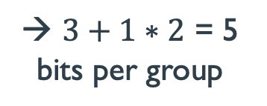



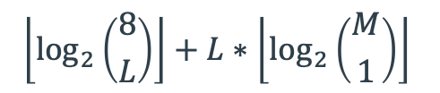

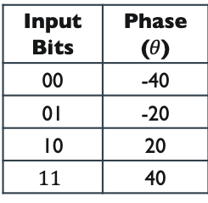
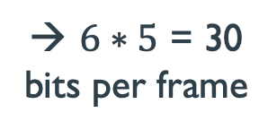
Index
Phase
CSIscan Encoding: Index Phase Modulation
$$\left\lfloor \log_{2}\left({8 \atop L}\right)\right\rfloor +L∗\left\lfloor \log_{2}\left({M \atop 1}\right)\right\rfloor$$
$$x(k)$$
-22 | -21 | -20 | -19 | -18 | -17 | -16 | -15
-26 | -25 | -24 | -23
0 | 1 | 2 | 3
$$L=1, M=4$$
0 | 1 | 2 | 3 | 4 | 5 | 6 | 7
-22 | -21 | -20 | -19 | -18 | -17 | -16 | -15
→ $3+1∗2$ = 5
bits per group
0 | 1 | 2 | 3 | 4 | 5 | 6 | 7
Index Mapping Table
-14 | -13 | -12 | -11 | -10 | -9 | -8 | -7
Input Bits | Subcarrier Index
000 | 0
001 | $$1$$
010 | 2
011 | 3
100 | 4
101 | 5
110 | 6
111 | 7
Phase Mapping Table
0 | 1 | 2 | 3 | 4 | 5 | 6 | 7
$$⋮$$
→ $6∗5$ = 30
bits per frame
Input Bits | Phase ($θ$)
00 | -40
01 | -20
10 | 20
$$11$$ | 40
19 | 20 | 21 | 22 | 23 | 24 | 25 | 26
0 | 1 | 2 | 3 | 4 | 5 | 6 | 7
$$θ=−40$$
$$θ=−20$$
$$θ=20$$
$$θ=40$$

Slide 36
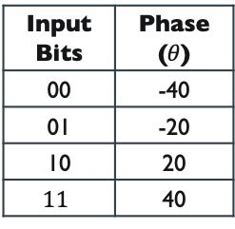
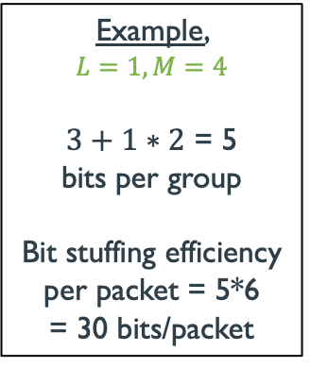
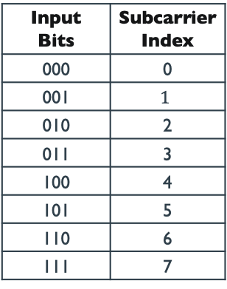






CSIscan Encoding
No. bits stuffed in each group
$$x(k)$$
$$\left\lfloor \log_{2}\left({8 \atop L}\right)\right\rfloor +L∗\left\lfloor \log_{2}\left({M \atop 1}\right)\right\rfloor$$
-26 | -25 | -24 | -23
-22 | -21 | -20 | -19 | -18 | -17 | -16 | -15
0 | 1 | 2 | 3
No. of indexes
No. of phases
0 | 1 | 2 | 3 | 4 | 5 | 6 | 7
-22 | -21 | -20 | -19 | -18 | -17 | -16 | -15
0 | 1 | 2 | 3 | 4 | 5 | 6 | 7
Example,
$$L=1, M=4$$
$3+1∗2$ = 5
bits per group
Bit stuffing efficiency
per packet = 5*6
= 30 bits/packet
Index Mapping Table
-14 | -13 | -12 | -11 | -10 | -9 | -8 | -7
Input Bits | Subcarrier Index
000 | 0
001 | $$1$$
010 | 2
011 | 3
100 | 4
101 | 5
110 | 6
111 | 7
Phase Mapping Table
0 | 1 | 2 | 3 | 4 | 5 | 6 | 7
$$⋮$$
Input Bits | Phase ($θ$)
00 | -40
01 | -20
10 | 20
$$11$$ | 40
19 | 20 | 21 | 22 | 23 | 24 | 25 | 26
0 | 1 | 2 | 3 | 4 | 5 | 6 | 7
$$θ=−40$$
$$θ=−20$$
$$θ=20$$
$$θ=40$$

Slide 37





CSIscan Decoding with CSI Phases
After detrending unwraped CSI Phase
$$x(k)$$
-26 | -25 | -24 | -23
0 | 1 | 2 | 3
-22 | -21 | -20 | -19 | -18 | -17 | -16 | -15
0 | 1 | 2 | 3 | 4 | 5 | 6 | 7
-14 | -13 | -12 | -11 | -10 | -9 | -8 | -7
0 | 1 | 2 | 3 | 4 | 5 | 6 | 7
$$⋮$$
19 | 20 | 21 | 22 | 23 | 24 | 25 | 26
0 | 1 | 2 | 3 | 4 | 5 | 6 | 7
$$θ=−40$$
$$θ=−20$$
$$θ=20$$
$$θ=40$$

Slide 38
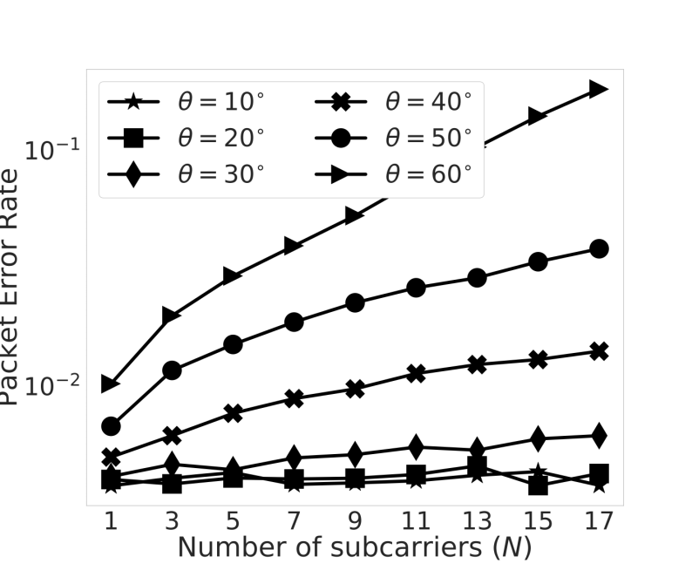
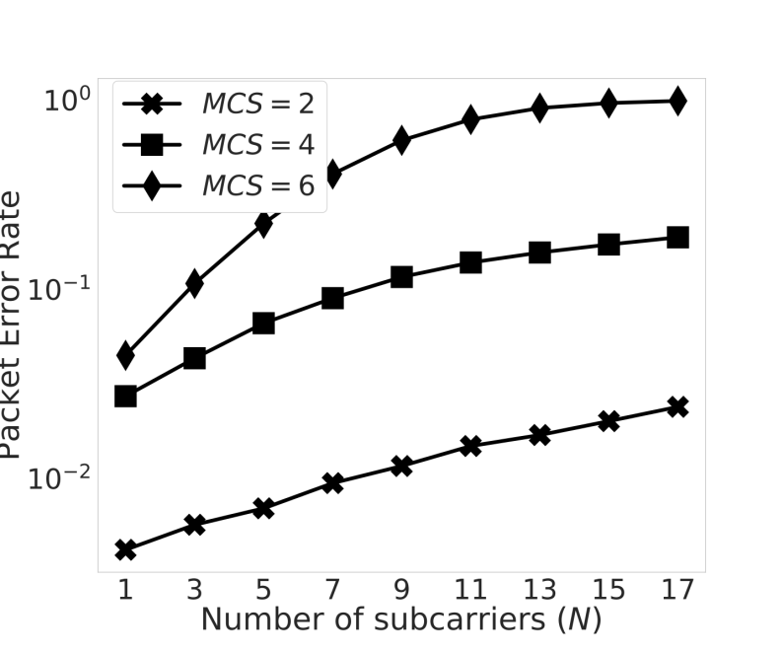

Leveraging learning of CSI
How to select upper bounds on $N, θ$ dynamically?
Phase
MCS
3 bits/packet

Slide 39
Talk Outline
Preliminary Study
Performance
Evaluation
Design of CSIscan
1
2
3
4
5
6
Motivation
Conclusion
CNN based
Preamble Modification

Slide 40
Talk Outline
Preliminary Study
Performance
Evaluation
Design of CSIscan
1
2
3
4
5
6
Motivation
Conclusion
CNN based
Preamble Modification

Slide 41
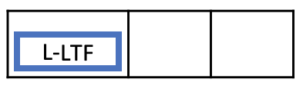
Associated Client
CSIscan Operation
Discovery Client

Slide 42
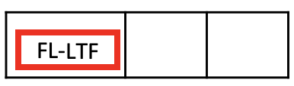
Associated Client
CSIscan Operation
Discovery Client

Slide 43

Associated Client
CSIscan Operation
Discovery Client
incoming packet
outgoing packet
Estimated CSI
Extract CSI Phase
L-LTF
FL-LTF
CSI, SNR
Phase Unwrapping
Estimated
CSIscan Encoding
$$N,θ$$
Detrending
CNN Classifier
MCS
L-LTF
CSIscan Decoding
Original outgoing packet
Discovery bits

Slide 44

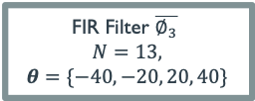


Associated Client
CSIscan Operation
No Filter $\overline{∅_{0}}$
$$N=0,$$
$$θ=\{\}$$
Discovery Client
FIR Filter $\overline{∅_{1}}$
$$N=7,$$
$$θ=\{−20, 20\}$$
incoming packet
outgoing packet
Estimated CSI
FIR Filter $\overline{∅_{2}}$
$$N=13,$$
$$θ=\{−20, 20\}$$
Extract CSI Phase
L-LTF
FL-LTF
FIR Filter $\overline{∅_{3}}$
$$N=13,$$
$$θ=\{−40,−20, 20, 40\}$$
CSI, SNR
CSI Phase
Post processing
Estimated
CSIscan Encoding
$$N,θ$$
CNN Classifier
CSIscan Decoding
MCS
L-LTF
Original outgoing packet
Discovery bits

Slide 45

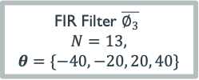



Associated Client
CSIscan Operation
FIR Filter $\overline{∅_{3}}$
$$N=13,$$
$$θ=\{−40,−20, 20, 40\}$$
Discovery Client
FIR Filter $\overline{∅_{2}}$
$$N=13,$$
$$θ=\{−20, 20\}$$
incoming packet
outgoing packet
Estimated CSI
FIR Filter $\overline{∅_{1}}$
$$N=7,$$
$$θ=\{−20, 20\}$$
Extract CSI Phase
L-LTF
FL-LTF
No Filter $\overline{∅_{0}}$
$$N=0,$$
$$θ=\{\}$$
CSI, SNR
CSI Phase
Post processing
Estimated
CSIscan Encoding
$$N,θ$$
CNN Classifier
CSIscan Decoding
MCS
L-LTF
Original outgoing packet
Discovery bits

Slide 46
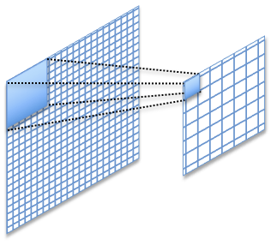
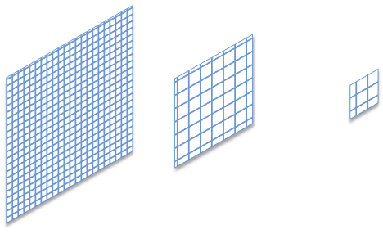
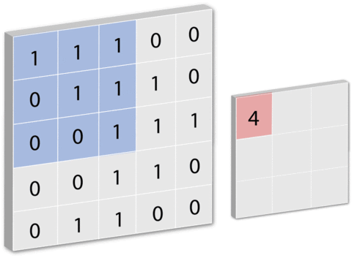
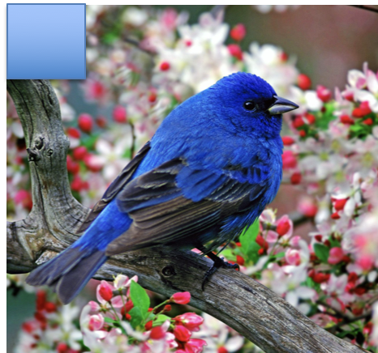
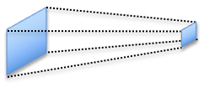
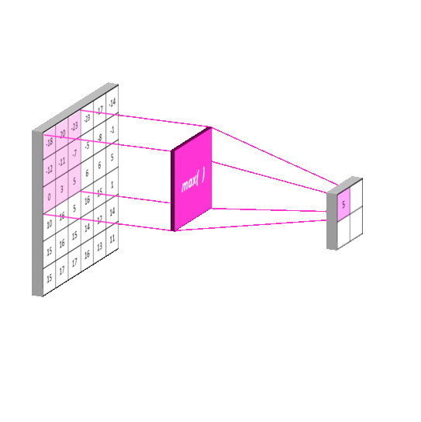
Convolutional Neural Network
Max Pooling Layer
Convolution Layer
Fewer parameters compared to fully connected network
Exploits locality in input
Conv+max pooling=Shift Invariance!!

Slide 47




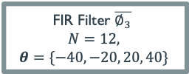





Data Collection
AP
VHT Preamble
Legacy Preamble
MAC Header and Data
802.11ac WiFi frame
L-LTF
Embed random
discovery information
No Filtering
$$∅_{0}$$
FIR Filter $\overline{∅_{1}}$
$$N=6,$$
$$θ=\{−20, 20\}$$
FIR Filter $\overline{∅_{2}}$
$$N=12,$$
$$θ=\{−20, 20\}$$
FIR Filter $\overline{∅_{3}}$
$$N=12,$$
$$θ=\{−40,−20, 20, 40\}$$
Repeat for
1M channel
realization
L-LTF
FL-LTF
FL-LTF
FL-LTF
Transmit over
identical
channel realization
$${PER}_{∅_{1}}$$
$${PER}_{∅_{2}}$$
$${CSI}_{∅_{0}}$$
$${PER}_{∅_{3}}$$
Client
$k^{th}$ training example
Input label : ${CSI}_{∅_{0}}^{(k)},{MCS}^{(k)},{SNR}^{(k)}$
Output label : $C_{0}^{(k)},C_{1}^{(k)}$, $C_{2}^{(k)}$, $C_{3}^{(k)}$
Dataset

Slide 48
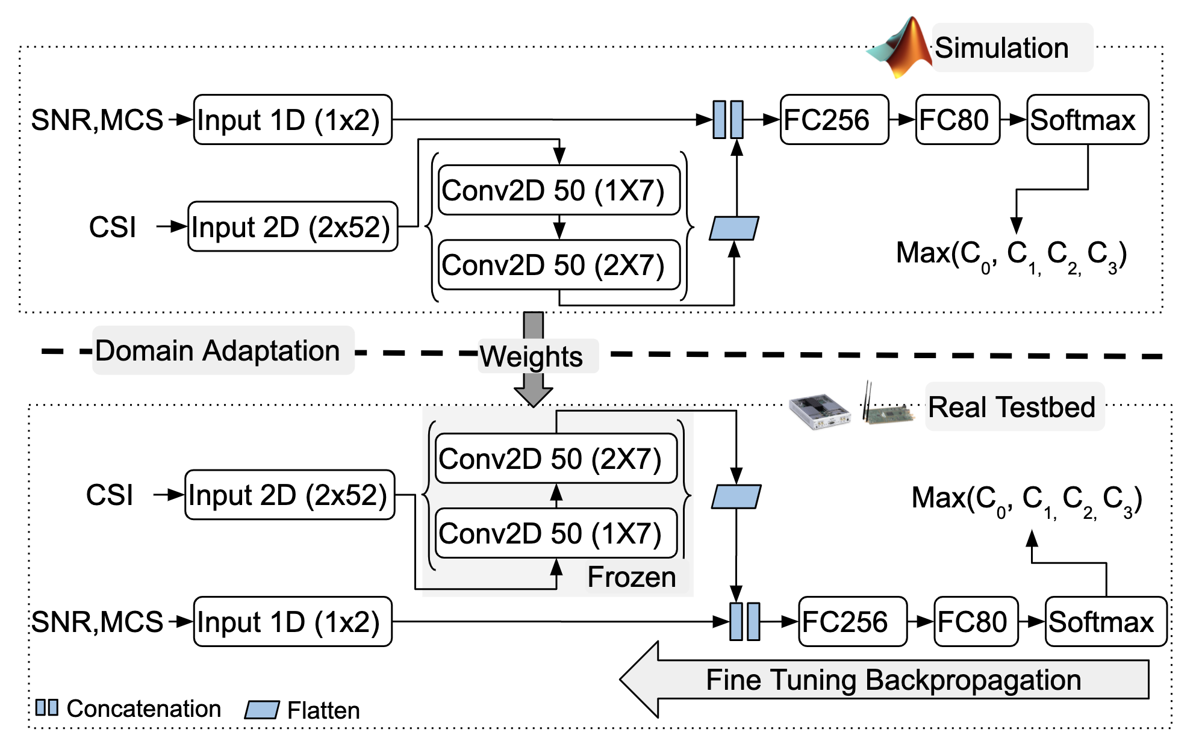
Convolutional Neural Network (CNN) Architecture

Slide 49
Supervised Domain Adaptation

Slide 50
Fine-tuning for Domain Adaptation

Slide 51
Talk Outline
Preliminary Study
Performance
Evaluation
Design of CSIscan
1
2
3
4
5
6
Motivation
Conclusion
CNN based
Preamble Modification

Slide 52
Talk Outline
Preliminary Study
Performance
Evaluation
Design of CSIscan
1
2
3
4
5
6
Motivation
Conclusion
CNN based
Preamble Modification

Slide 53
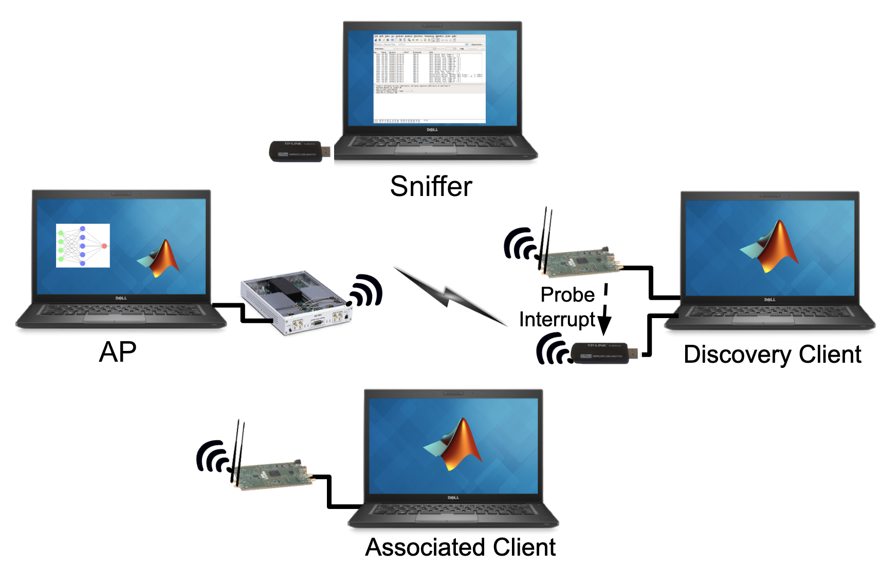
Experimental Setup
Performance Comparison
Active Discovery → Scans 39 WiFi channels
CSIscan → Scans Ch ‘x’ upon successful decoding, else scans all 39 channels
Discovery Initiation
Discovery information is encoded in periodic beacons → Aggressive Discovery
Performance Metric
Probe Responses and Latency
CNN Accuracy
Bit Stuffing Efficiency and Packet Error Rate

Slide 54
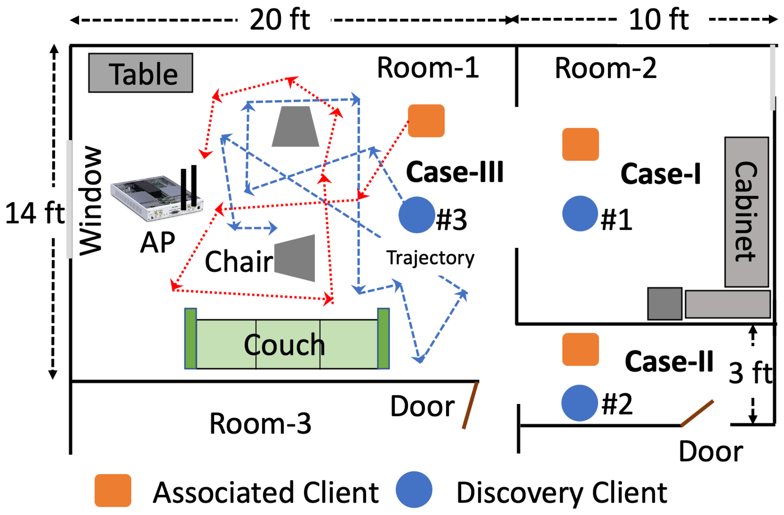
Deployment Scenarios
Case-I: Stationary, Line-of-sight (LOS)
Stationary AP
Stationary Associated Client (~16 ft from AP)
Stationary Discovery Client (~16 ft from AP)
Case-II: Stationary, Non line-of-sight (NLOS)
Stationary AP
Stationary Associated Client (~18 ft NLOS from AP)
Stationary Discovery Client (~18 ft NLOS from AP)
Case-III: Moving
Stationary AP
Moving Associated Client
Moving Discovery Client

Slide 55
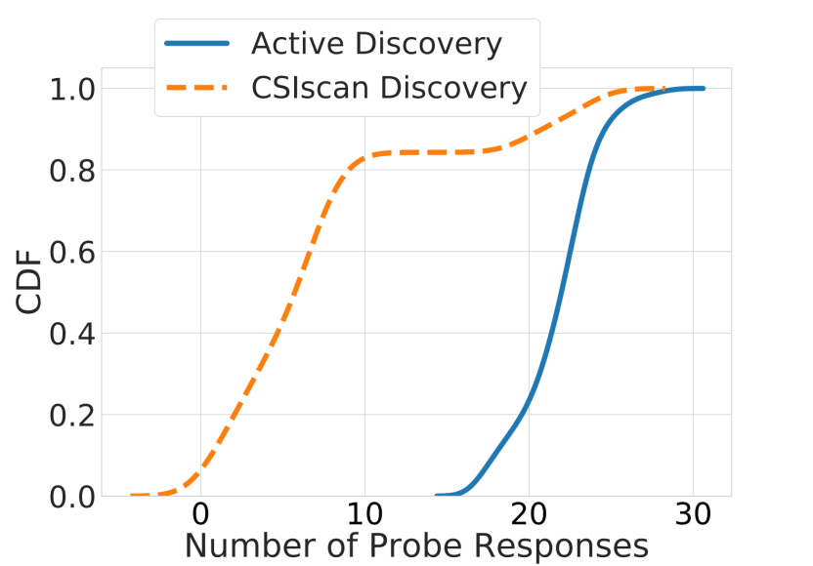
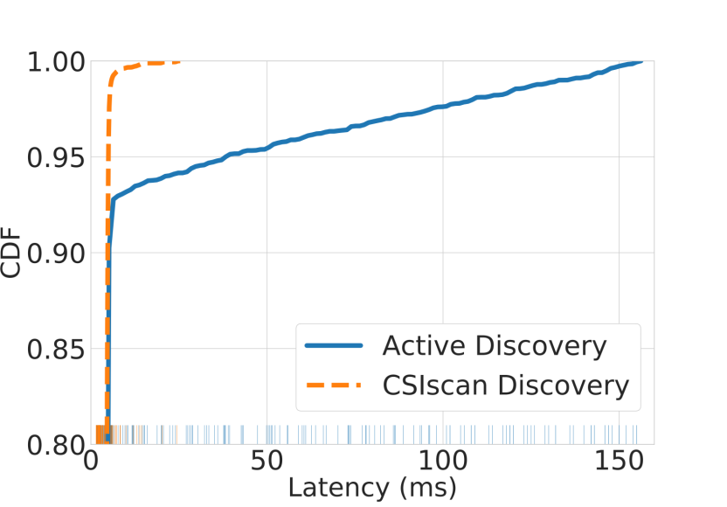
Probe Responses and Latency
long-tail latency
median
6
132
6
22
CSIscan reduces probe response by 72%
Tail (99th percentile) latency reduces
from 132ms to 6ms
Notes:
We observe 22 (median) probe responses with active discovery, whereas only 6 are present for CSIscan. Thus, CSIscan reduces probe traffic by 72%. The reduction
in probe responses reduces discovery traffic, thereby improving spectrum utilization.
While median WiFi latency for active discovery is as low as 4 ms, its 99th percentile is 132 ms. This long-tail distribution is not visible with CSIscan. The 99th percentile is 6 ms. Thus, CSIscan alleviates the problem of long-tail latency caused by frequent discovery process.

Slide 56
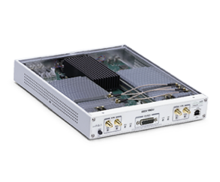
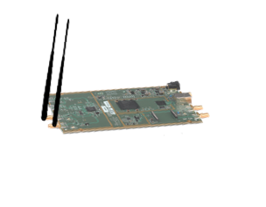

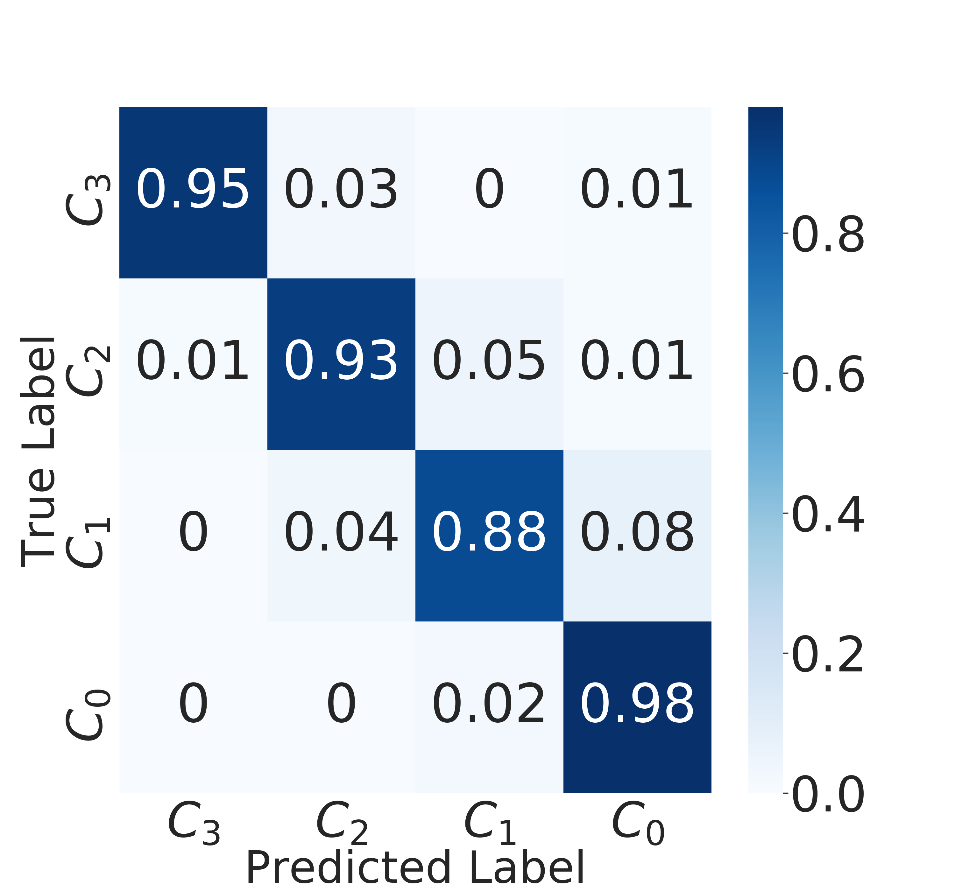
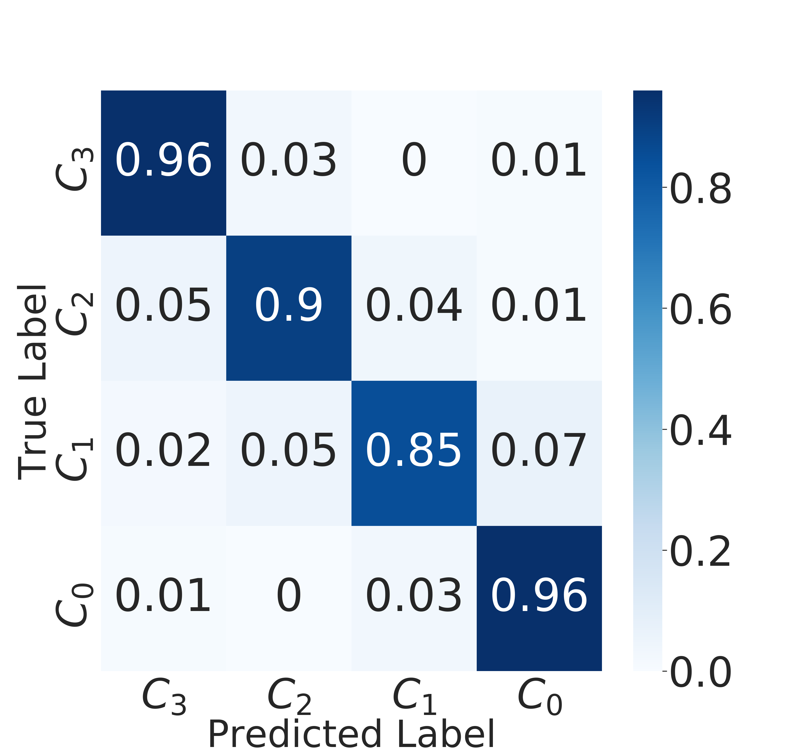




CNN Accuracy
Domain Adaptation
Simulation
Live Environment
$$\overline{∅_{3}}: N=13,$$
$$θ=\{−40,−20, 20, 40\}$$
$$\overline{∅_{2}}: N=13,$$
$$θ=\{−20, 20\}$$
$$\overline{∅_{1}}: N=7,$$
$$θ=\{−20, 20\}$$
$$\overline{∅_{0}}:No Filtering$$
~85% less data
Training examples ~ 80K
Training examples ~ 12K
Accuracy = 95.20%
Accuracy = 93.87%
Notes:
For the simulation environment, the CNN model has an accuracy of 95.20% for correctly selecting one out of four bounds. Post domain adaptation the CNN model, fine-tuned with real data, has classification accuracy of 93.87%.
For fine-tuning, we use nearly 12K examples of real data, as compared to 80K of simulation data, thus requiring only 15% of the total training data for training of the CNN model. This reduction in training data also shortens the training time by 64 ms on average.

Slide 57
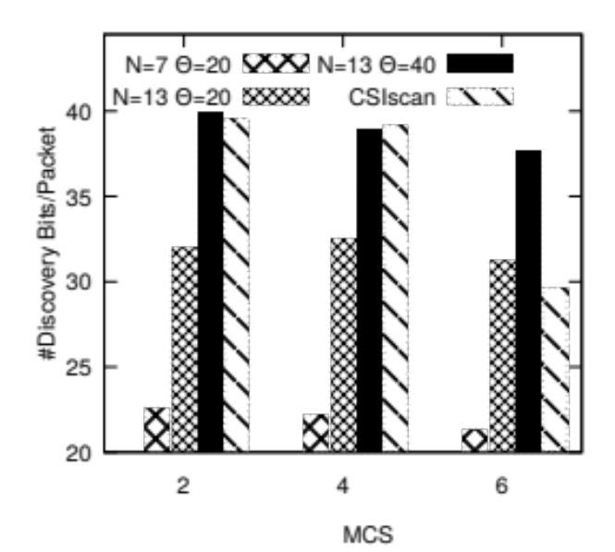
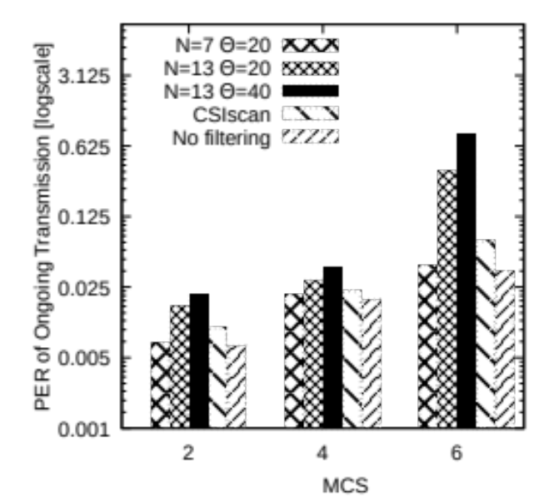
Bit Stuffing Efficiency and PER for Case-I (Stationary, LOS)

Slide 58



Bit Stuffing Efficiency and PER for Case-I (Stationary, LOS)
Overly
pessimistic
→
$$\overline{∅_{1}}: N=7,$$
$$θ=\{−20, 20\}$$
Overly
optimistic
→
$$\overline{∅_{3}}: N=13,$$
$$θ=\{−40,−20, 20, 40\}$$
→
$$\overline{∅_{2}}: N=13,$$
$$θ=\{−20, 20\}$$
Moderate
CSIscan → Dynamic Selection
Notes:
The overly pessimistic approach of always choosing
lower bound Nmax = 7 and max = 20 reduces the bit
stuffing efficiency to approximately average 22 discovery bits
for the stationary client #1

Slide 59

Bit Stuffing Efficiency and PER for Case-I (Stationary, LOS)
Overly
pessimistic
→
$$\overline{∅_{1}}: N=7,$$
$$θ=\{−20, 20\}$$
Overly
optimistic
→
$$\overline{∅_{3}}: N=13,$$
$$θ=\{−40,−20, 20, 40\}$$
→
$$\overline{∅_{2}}: N=13,$$
$$θ=\{−20, 20\}$$
Moderate
CSIscan → Dynamic Selection
Low bit efficiency
< 22 bits/packet
(Max: 24 bits/packet)
Very low PER (< 1%)
even for MCS = 6
Notes:
The overly pessimistic approach of always choosing lower bound Nmax = 7 and max = 20 reduces the bit stuffing efficiency to approximately average 22 discovery bits
for the stationary client.

Slide 60

Bit Stuffing Efficiency and PER for Case-I (Stationary, LOS)
Overly
pessimistic
→
$$\overline{∅_{1}}: N=7,$$
$$θ=\{−20, 20\}$$
Overly
optimistic
→
$$\overline{∅_{3}}: N=13,$$
$$θ=\{−40,−20, 20, 40\}$$
→
$$\overline{∅_{2}}: N=13,$$
$$θ=\{−20, 20\}$$
Moderate
CSIscan → Dynamic Selection
High bit efficiency
~ 40 bits/packet
(Max: 48 bits/packet)
PER > 85%
for MCS= 6
Notes:
The selection of higher bound Nmax = 13 and max = 40 severely impacts PER of the client at higher MCS rate. At
MCS= 6, PER is > 75% for the stationary client.

Slide 61

Bit Stuffing Efficiency and PER for Case-I (Stationary, LOS)
Overly
pessimistic
→
$$\overline{∅_{1}}: N=7,$$
$$θ=\{−20, 20\}$$
Overly
optimistic
→
$$\overline{∅_{3}}: N=13,$$
$$θ=\{−40,−20, 20, 40\}$$
→
$$\overline{∅_{2}}: N=13,$$
$$θ=\{−20, 20\}$$
Moderate
CSIscan → Dynamic Selection
Moderate bit efficiency
32 bits/packet
(Max: 36 bits/packet)
PER ~ 40% for MCS= 6
Notes:
At MCS= 6, even the moderate bound of Nmax = 13 and max = 20 results in 40% PER

Slide 62
Bit Stuffing Efficiency and PER for Case-I (Stationary, LOS)
Overly
pessimistic
→
$$\overline{∅_{1}}: N=7,$$
$$θ=\{−20, 20\}$$
Overly
optimistic
→
$$\overline{∅_{3}}: N=13,$$
$$θ=\{−40,−20, 20, 40\}$$
→
$$\overline{∅_{2}}: N=13,$$
$$θ=\{−20, 20\}$$
Moderate
CSIscan → Dynamic Selection
increase in PER < 1%
High bit efficiency
~ 40 bits/packet
(Max: 48 bits/packet)
Choose to avoid transmission if channel is not good enough
Notes:
CSIscan dynamically adjusts its bound to embed maximum discovery information while guaranteeing the increase in PER at the associated client is < 1%, as compared to PER with no filtering.

Slide 63
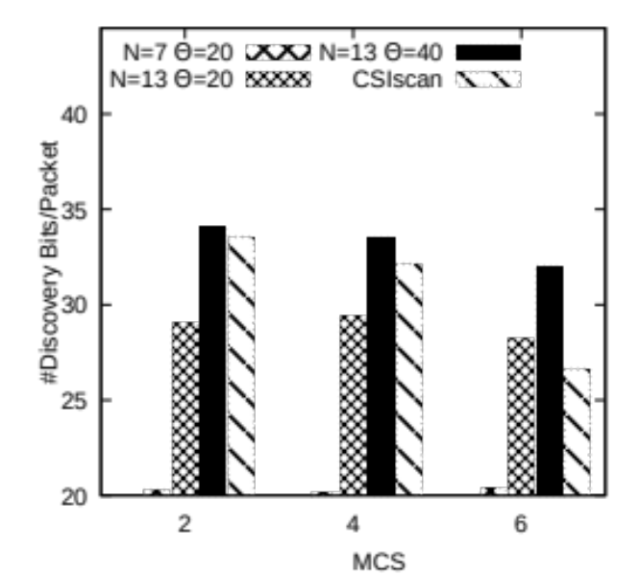
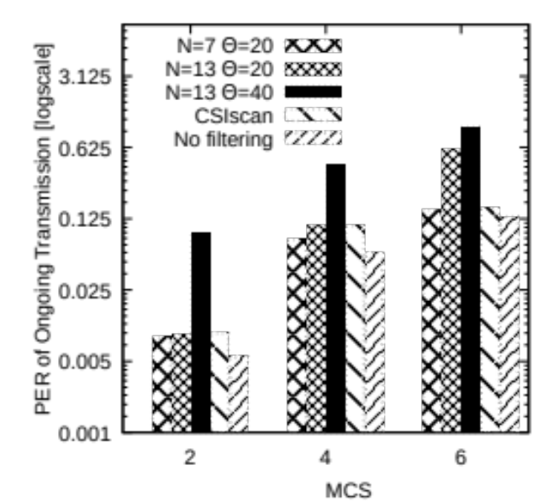
Bit Stuffing Efficiency and PER for Case-II (Stationary, NLOS)
Overly
pessimistic
→
$$\overline{∅_{1}}: N=7,$$
$$θ=\{−20, 20\}$$
Overly
optimistic
→
$$\overline{∅_{3}}: N=13,$$
$$θ=\{−40,−20, 20, 40\}$$
→
$$\overline{∅_{2}}: N=13,$$
$$θ=\{−20, 20\}$$
Moderate
CSIscan → Dynamic Selection
increase in PER < 1%
Embeds maximum information while maintaining increase in PER < 1% over no filtering

Slide 64
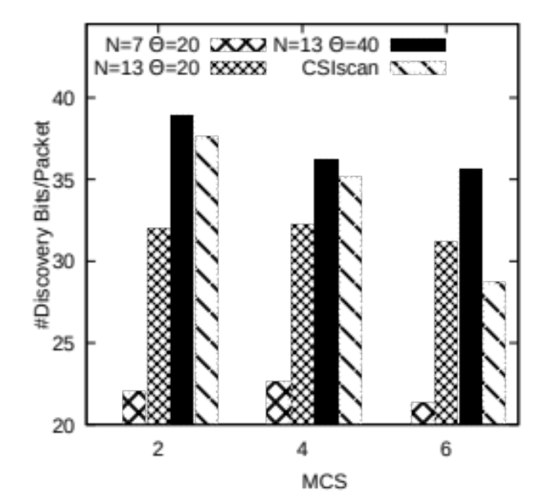
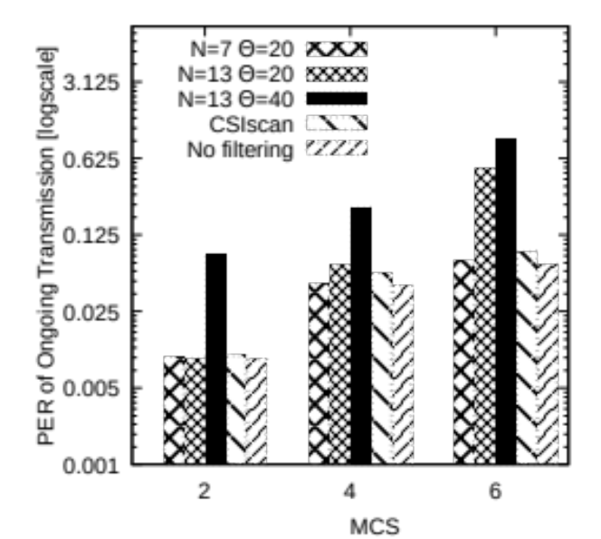
Bit Stuffing Efficiency and PER for Case-III (Stationary, Moving)
Overly
pessimistic
→
$$\overline{∅_{1}}: N=7,$$
$$θ=\{−20, 20\}$$
Overly
optimistic
→
$$\overline{∅_{3}}: N=13,$$
$$θ=\{−40,−20, 20, 40\}$$
→
$$\overline{∅_{2}}: N=13,$$
$$θ=\{−20, 20\}$$
Moderate
CSIscan → Dynamic Selection
CSIscan also works in moving scenarios ☺

Slide 65
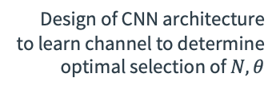
Summary
Novel AP Discovery method
(spectrum efficient, low latency)
.
Encoding to embed discovery information in WiFi preamble and decoding to extract it from CSI
Design of CNN architecture
to learn channel to determine optimal selection of $N,θ$
Proof of concept testbed using USRP based AP and client

Delivery of up to 40 discovery bits per packet in both stationary and mobile clients
Improved spectrum efficiency with 72% reduction in probe responses
Reduced a long-tail (99th percentile) WiFi latency by 95%

Slide 66
Limitations and Future work
Limitations:
  Proof of concept testbed is not end-to-end solution
  Require implementation on end-devices, such as smartphones
Future work:
  Finished extracting CSI in Android smartphones using Nexmon firmware patch
  Evaluation in dense environments
  Exploring other applications, e.g. emergency safety messages delivery (URLLC service) in Industrial IoT network

Slide 67
Thank you ☺

Slide 68
Backup Slides

Slide 69
Impact of Active Discovery: Spectrum Utilization
MaxCT
Channel
Switching Delay
MinCT
Channel 128
Channel 132
How to minimize spectrum airtime in waiting for redundant probe response?
Probe Request
Probe Request
Time
WiFi Client
Channel 128
Problem 2: Redundant wait time
$$…$$
Probe Responses
APs
in the network
Time
72% Probe Responses reached before MinCT

Slide 70

Impact of Active Discovery: Spectrum Utilization
Very high rate Data Communication
(160 MHz Bandwidth, 1024 QAM)
Probe request
sent
1 Gbps (802.11ax)
$$…$$
$$…$$
Active Discovery
Active Discovery
WiFi Client
Low rate, high priority management traffic
(160 MHz Bandwidth, BPSK modulation)
72 Mbps (802.11ax)

Slide 71
Channel Estimation using L-LTF
WiFi Packet
Transmitter
Receiver
Packet Detection
Extract Legacy Preamble
WiFi Packet
L-STF | L-LTF | L-SIG
For $k=−26, …, −1, 1, …,26$
$${\hat{H}}_{1}\left(k\right)=\frac{Y_{1}(k) }{X(k)}$$
Coarse and Fine
Freq. Sync
$${\hat{H}}_{2}\left(k\right)=\frac{Y_{2}(k) }{X(k)}$$
L-LTF Demodulation
$$Y_{1}$$ | $$Y_{2}$$
LS Channel Estimation
$$\hat{H}\left(k\right)=\frac{{\hat{H}}_{1}\left(k\right)+{\hat{H}}_{2}\left(k\right)}{2}$$
$$\hat{H}$$

Slide 72
Convolutional Neural Network
Max Pooling Layer
Convolution Layer
Fewer parameters compared to fully connected network
Exploits locality in input
Conv+max pooling=Shift Invariance!!

Slide 73
Data Collection
AP
VHT Preamble
Legacy Preamble
MAC Header and Data
802.11ac WiFi frame
L-LTF
Embed random
discovery information
No Filtering
$$∅_{0}$$
FIR Filter $\overline{∅_{1}}$
$$N=6,$$
$$θ=\{−20, 20\}$$
FIR Filter $\overline{∅_{2}}$
$$N=12,$$
$$θ=\{−20, 20\}$$
FIR Filter $\overline{∅_{3}}$
$$N=12,$$
$$θ=\{−40,−20, 20, 40\}$$
Repeat for
1M channel
realization
L-LTF
FL-LTF
FL-LTF
FL-LTF
Transmit over
identical
channel realization
$${PER}_{∅_{1}}$$
$${PER}_{∅_{2}}$$
$${CSI}_{∅_{0}}$$
$${PER}_{∅_{3}}$$
Client
$k^{th}$ training example
Input label : ${CSI}_{∅_{0}}^{(k)},{MCS}^{(k)},{SNR}^{(k)}$
Output label : $C_{0}^{(k)},C_{1}^{(k)}$, $C_{2}^{(k)}$, $C_{3}^{(k)}$
Dataset

