Slide 1


Long-Lived LoRa: Prolonging the Lifetime of a LoRa Network
Sezana Fahmida*, Venkata P Modekurthy*, Mahbubur Rahman, Abusayeed Saifullah, Marco Brocanelli
Wayne State University
CUNY Queens College

Slide 2
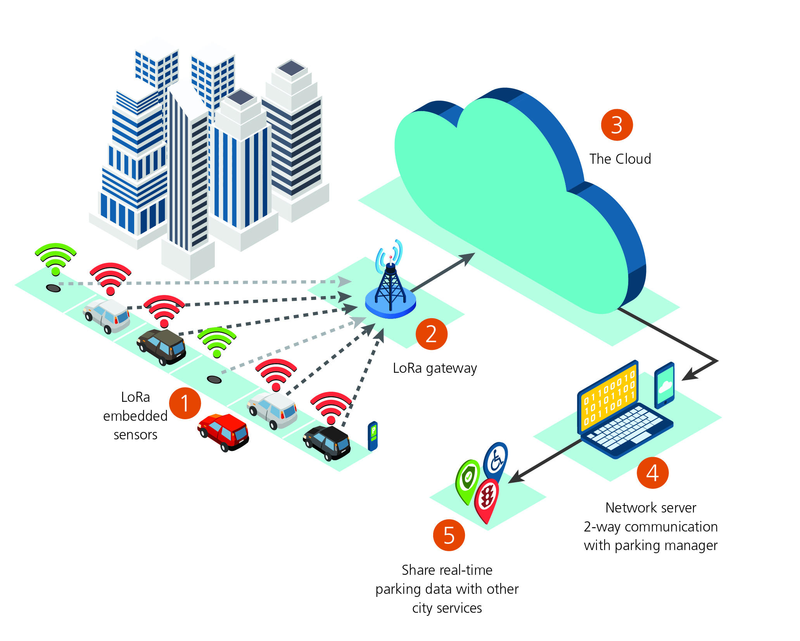
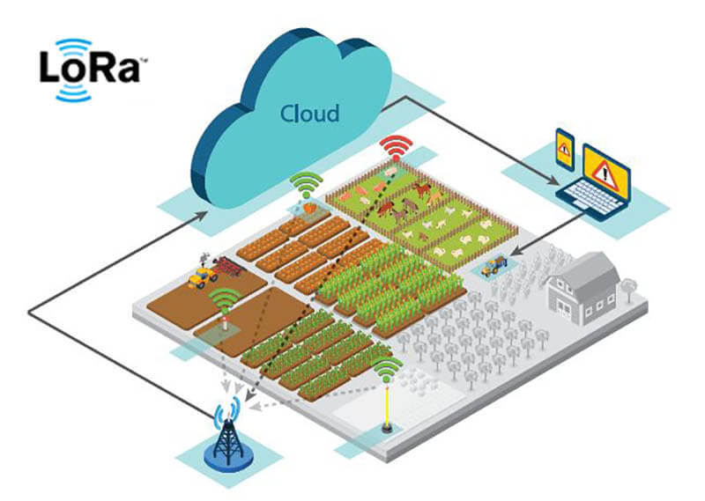
LoRa (Long-Range)
Low-Power Wide-Area Network (LPWAN) technology
  Low-power
  Long rage
  Low data rate
Thousands of end-devices
Direct connection with the gateway
Suitable for Internet-of-Things applications
  Smart Agriculture
  Smart City
  Environmental Monitoring
  Wildlife Monitoring
Figure: LoRa in IoT applications
[Courtesy: richerlink]

Slide 3
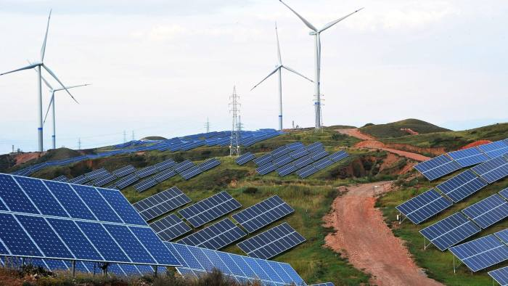
Energy Harvesting LoRa Network
Battery-powered end-devices
  Costly
  Periodic Maintenance
  High carbon-footprint
Emergence of energy-harvesting power sources
  Sustainable
  Long-term deployment
  Low carbon-footprint
Heterogenous charging of end-devices
  Weather condition
  Shadow
Figure: Green energy sources
Problem: How to maximize the network lifetime?

Slide 4
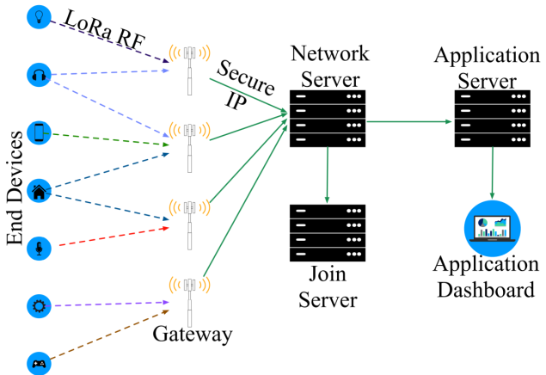
System Model
End-devices (sensor nodes)
  Battery recharged by local green energy sources
Power generated by green source
  Varies over time
  Repeats over fixed time interval
    recharge cycle
Battery budget
  Estimation of the energy generated in a cycle
Gateways
  Line-powered
Known minimum inter-arrival time between packets
Location of nodes known to gateway
Figure: LoRa network

Slide 5
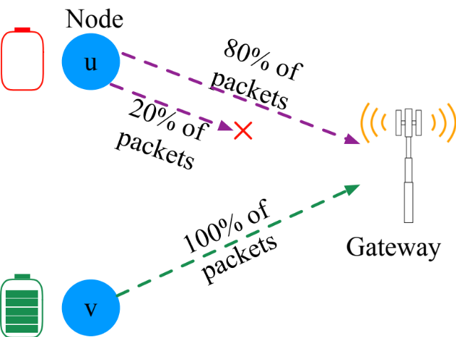
Network Lifetime
Heterogenous charging of devices
  Device u: insufficient budget
    Depleting node
  Device v: superfluous budget
    Affluent node
Device u depletes its budget
  Data collection hampered
  Unmet application requirement
Network lifetime
  Time interval until at least one node depletes budget
Figure: Affluent and Depleting nodes

Slide 6
Related Work
Increased attention in research for LoRa
  Enhancing throughput, latency & reliability [ Wang et al. ICNP’19] [Eletreby et al. SIGCOMM’17]
Energy-efficiency of LoRa studied in [Gao et al. ICDCS’19]
  General strategy for all nodes
Not effective in lifetime maximization of energy-harvesting LoRa network
Depleting node
  not harvested enough energy
  drains its battery rapidly
  Even with the most energy-efficient configuration
Our approach: Link-layer protocol to prevent such depletion

Slide 7
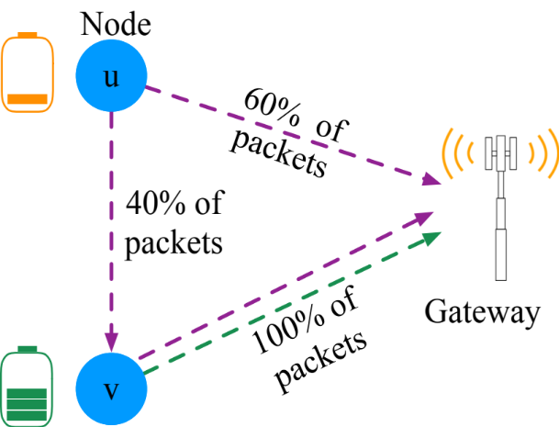
Long-lived LoRa: Overview
Dynamically enable depleting node to use residual energy of affluent nodes
Transmission to affluent node
  Adjust multiple tx parameters
  Lower energy consumption
Idea -> Packet Offloading
  Offload device u’s traffic to v
  Device v forwards u’s packet to gateway
Higher total energy consumption at node v
  Utilize residual energy at node v
Counter intuitive approach
Effective in prolonging network lifetime
Figure: Packet Offloading

Slide 8
Long-lived LoRa: Challenges
Enabling packet offloading
  Typically requires synchronization -> undesirable
  Transmission parameter synchronization
  Dynamic selection of affluent and depleting nodes
    Prevent affluent node’s budget depletion
Long lived LoRa: Light-weight MAC
  Avoids node time synchronization
  Energy-efficient parameter selection for offloading
  Heuristic algorithm for selection of affluent and depleting node
    Based on extensive energy overhead analysis

Slide 9
Long-lived LoRa: Modes of operation
3 modes of operation of nodes
  Offloading
    Offloads packets to close-by affluent node
  Lading
    Receives packet from depleting node
    Forwards packet to gateway
  Conventional
    Directly sends packet to Gateway

Slide 10
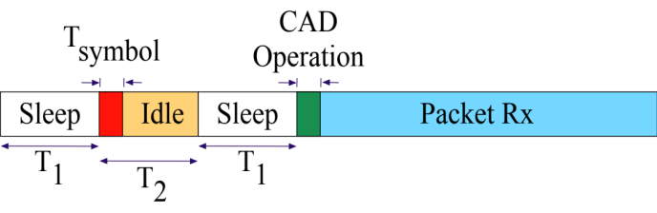
Enabling Peer to Peer Communication
Lading mode
  Adopt Carrier Activity Detection (CAD)
    Receive signals for 2 symbols
    Probes for correlation
    If packet detected, continue listening
    Else, stay in low-power Idle mode
Offloading mode
  Only wake-up to send packets
  Use reverse-IQ signal for packet Tx to affluent node
    Limit false wake-ups for affluent node
Figure: Timing diagram for CAD

Slide 11
Transmission Parameter Selection
Spreading Factor (SF)
  SF 9-10 (in US) for tx to gateway
    Enables long-range communication
  SF 7-8 for packet offloading
    Lower range, lower energy consumption
    Enables low-power communication to close-by affluent nodes
Channel Assignment
  Location-based segregation of nodes for assigning channels
  Ensure same channel for neighboring affluent-depleting nodes
Transmission Power
  Calculated based on path loss and receiver sensitivity

Slide 12
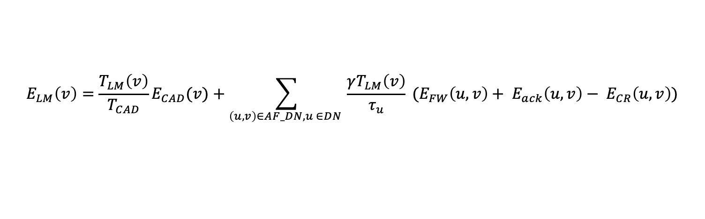
Affluent-Depleting Pair Selection
Selection of Affluent and Depleting node
  Based on estimated energy consumption in conventional mode
If Depleting node is detected
  Select affluent and depleting node pairs
  Calculate operation time in lading mode (T_{LM}) for affluent node
    Based on energy overheads in lading mode (E_{LM})
Lading mode operation time
ReTx overhead
Energy consumption in CAD
Energy consumption in forwarding
$$E_{LM}\left(v\right)=\frac{T_{LM}\left(v\right)}{T_{CAD}}E_{CAD}(v)+\sum_{\left(u,v\right)∈AF_DN, u ∈DN }{\frac{γT_{LM}\left(v\right)}{τ_{u}}} (E_{FW}\left(u,v\right)+ E_{ack}\left(u,v\right)− E_{CR}\left(u,v\right))$$
Energy correction
Period for CAD
Period for depleting node
Energy consumption for ack
Set of affluent and depleting node pairs
12

Slide 13
Affluent-Depleting Pair Selection
Selection of affluent-depleting node pair
  Optimal Pairing unknown
  Greedy heuristic based on energy overhead
Assist as many depleting nodes as possible
  Without depleting affluent node’s battery budget
For every affluent node
  Create pair with all nearby depleting nodes
  Calculate T_{LM}
    Ensure affluent node remains within battery budget
  If T_{LM} too small
  Remove pair with the highest offloading overhead
  Repeat until T_{LM} is sufficiently large to support all assigned pairs

Slide 14
Simulation Setup
Simulation in NS3 module for LoRa [Magrin et al. IoTJ’19]
Single Gateway, 1200 nodes
8 channels in 915-928 MHz (US band)
Most nodes transmit at 2-4 packets per hour
Some nodes transmit at 20-30 packets per hours
Battery budget in range 6-25 Joules
Baseline: Traditional LoRaWAN
Metrices
  Network lifetime
  Throughput
    Goal: Increase lifetime, maintain throughput

Slide 15
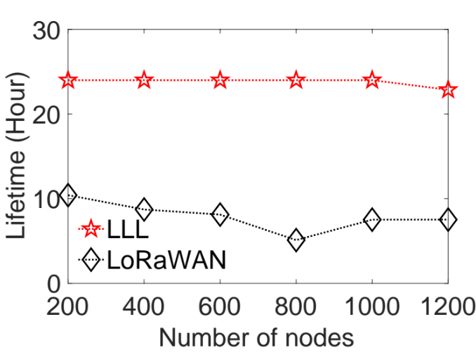
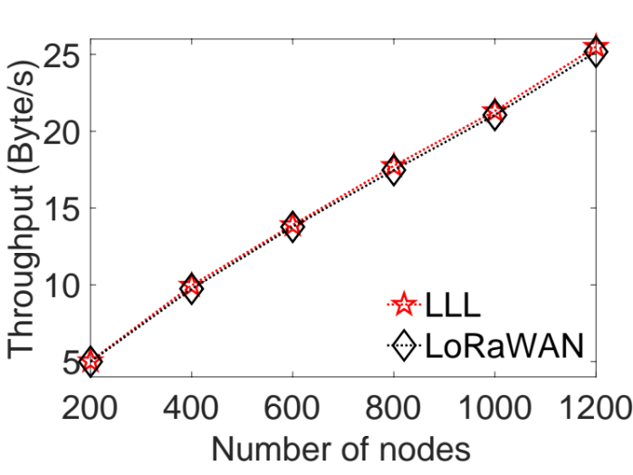
Simulation Results
a)
b)
Figure: Network lifetime and throughput under varying number of nodes
Long-lived LoRa increases lifetime up to 4 times than LoRaWAN, while keeping the same throughput

Slide 16
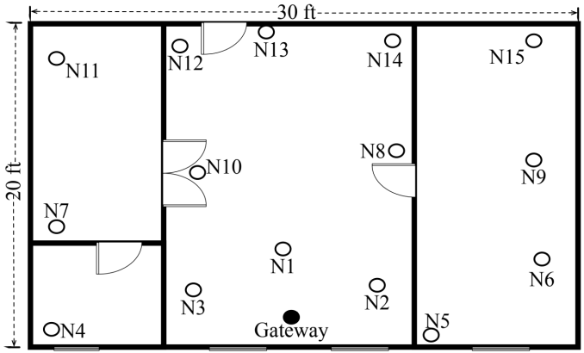
Experiment Setup
Proof-of-concept physical experiment in indoor setup
Outdoor experiments not done due to COVID-19 pandemic
15 LoRa nodes
  Dragino SX1276 LoRa transceiver HAT on Raspberry Pi 3
  Custom built LMIC 1.6 LoRa/LoRaWAN library
Single Gateway
  RAK2245 HAT on Raspberry pi 3
  Local ChirpStack LoRaWAN network server
915 MHz Frequency band
Indoor deployment of an area of (30x20) ft2
Figure: Indoor deployment

Slide 17
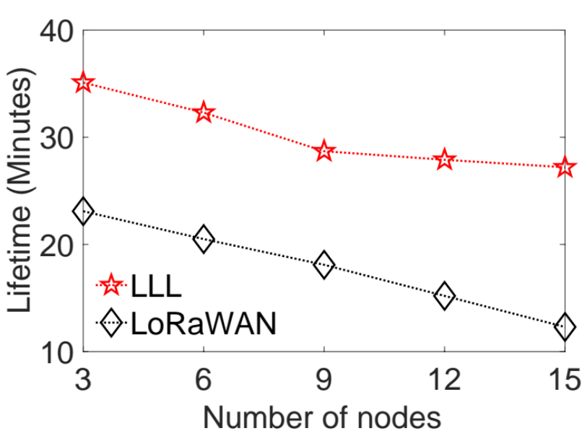
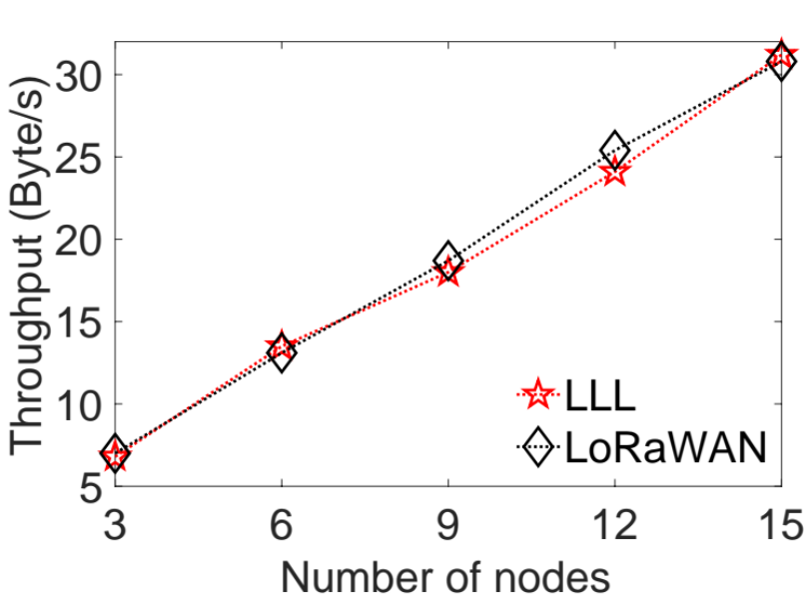
Experiment Results
a)
b)
Figure: Network lifetime and throughput under varying number of nodes
Our approach significantly increases lifetime while keeping similar throughput

Slide 18
Conclusion
Energy-harvesting LoRa network in IoT applications
Network lifetime
  Important to maintain quality-of-service of applications
Link-layer protocol to prolong network lifetime
Packet offloading mechanism
  Counter-intuitive but effective
Validated by simulations and physical experiments
  Lifetime increased up to 4times compared to LoRaWAN
Future work
  Preserving security in offloading
  Prolonging lifetime across multiple recharge cycles

Slide 19
Thank you!

