Slide 1


XFi: Cross-Technology IoT Data Collection via Commodity WiFi
Ruofeng Liu, Zhimeng Yin, Wenchao Jiang, and Tian He
University of Minnesota
ICNP 2020, Madrid
Oct 16st, 2020
Notes:
Good afternoon. My name is Ruofeng Liu. I am gonna present our work “XFi: Cross-Technology IoT Data Collection via Commodity WiFi”. This is a joint work with my colleague zhimeng and wenchao as well as my advisor Tian He.

Slide 2
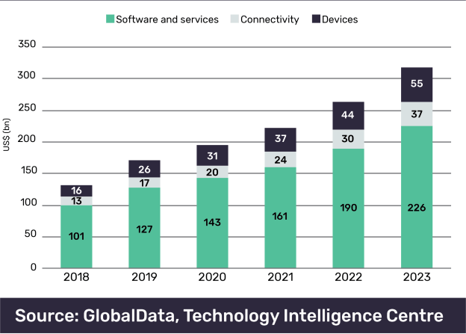


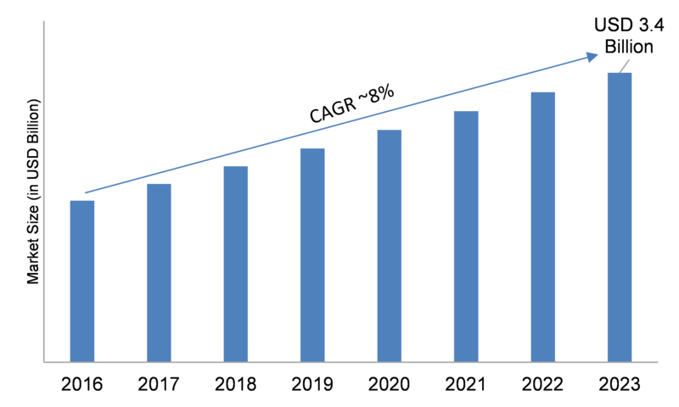
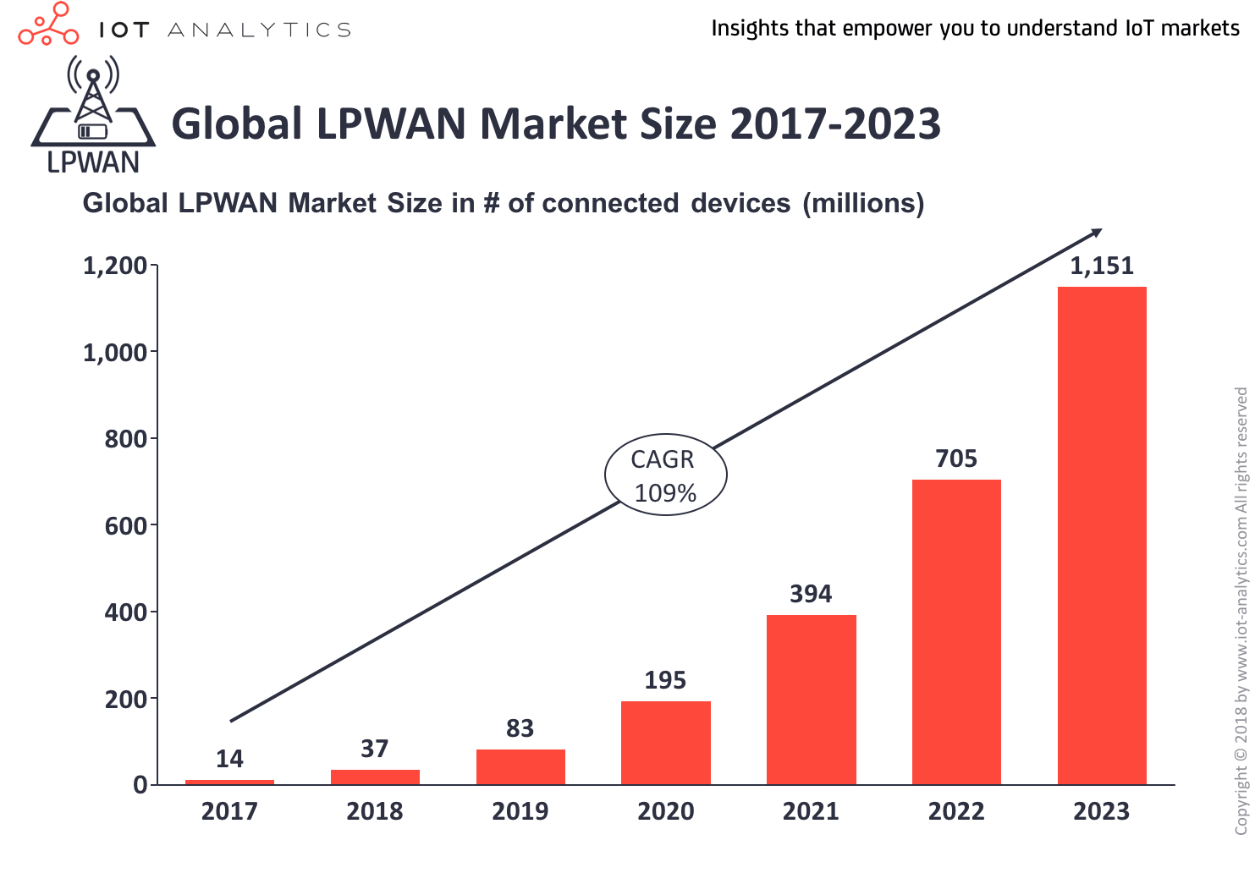
Trends of IoT Devices
The market of IoT devices
is growing fast
w/ various emerging wireless protocols.
Notes:
The IoT markets are growing really fast. At the same time, we have witnessed several emerging wireless protocols that are used by IoT devices.
ZigBee and LoRa are two representative techniques.

Slide 3
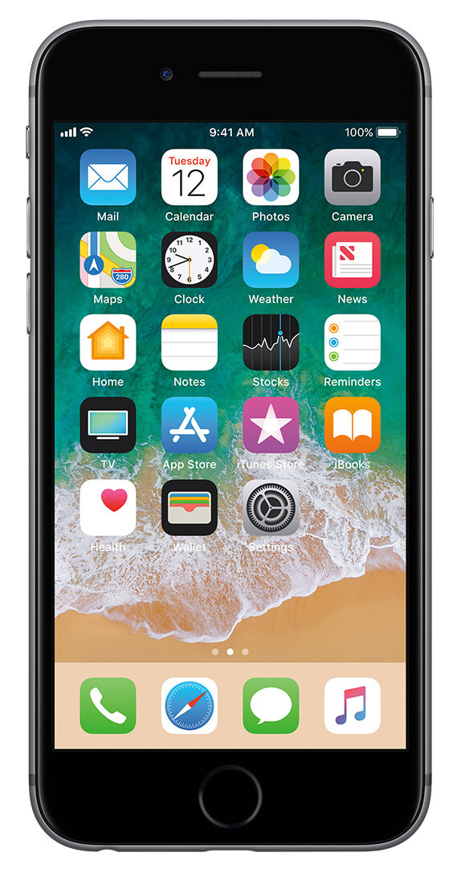
IoT Data Collection with Mobile Devices
Collecting IoT data using our mobile devices can inspire a lot of interesting applications.
IoT Data
mobile devices
Notes:
Therefor, connecting IoT devices to our mobile devices inspire a lot of interesting applications
For example, collecting IoT data using our smartphone can bring several benefits.
First, mobile devices have a big screen, it can provide a convenient user interface to iterate with IoT data, for example visualizing IoT data.
Second, mobile device has rich CPU resource, that can be leveraged to perform IoT sensor fusion and machine learning
Finally, mobile device has ubiquitous connectivity to LTE base station. It can serve as IoT gateway and provide internet connectivity

Slide 4
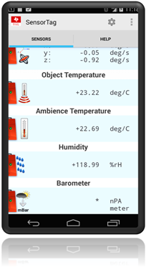
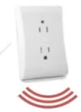
IoT Data Collection with Mobile Devices
User Interface and Data Visualization
IoT Data
Display
Notes:
First, mobile devices have a big screen, whereas IoT devices typically do not have a screen.
So smarpthone can provide a convenient user interface to iterate and visualize IoT data, for example visualizing IoT data.

Slide 5
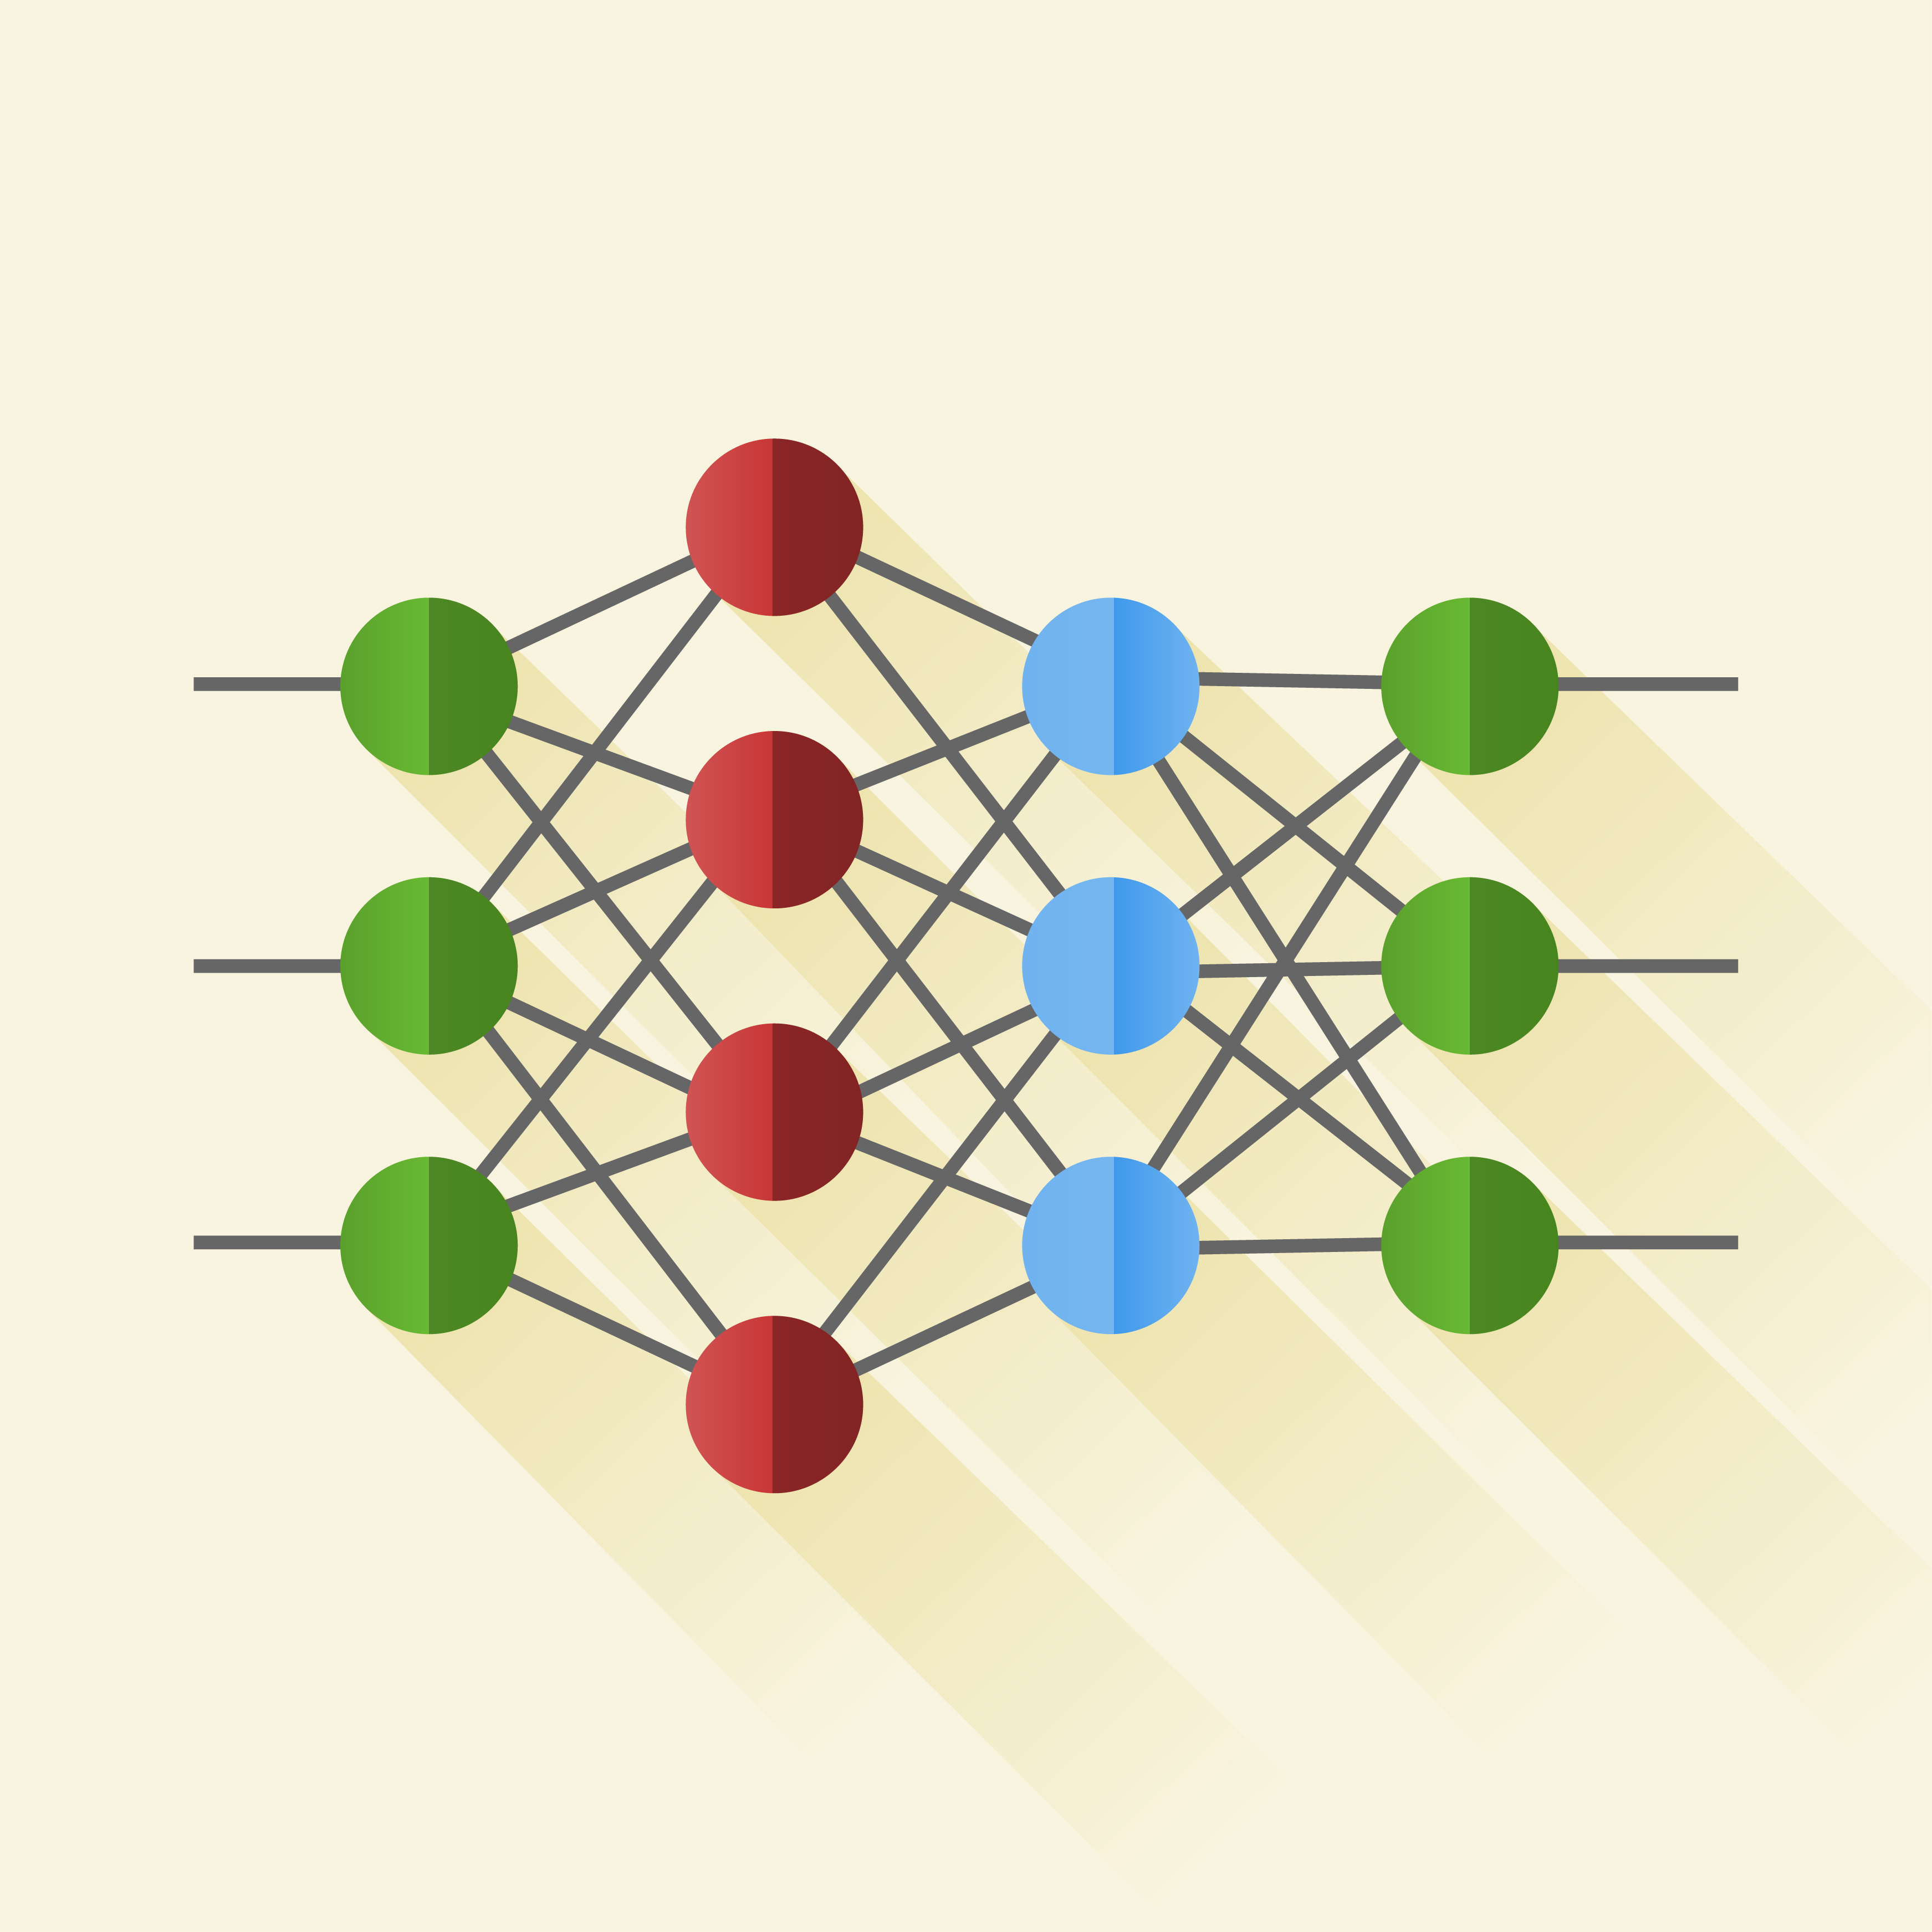
IoT Data Collection with Mobile Devices
Sensor Fusion and Machine Learning
IoT Data
mobile devices
Computation
Notes:
Second, mobile device has a powerful CPU. In contrast, IoT data are typically limited in computation resource
Mobile devices can perform IoT sensor fusion and machine learning

Slide 6

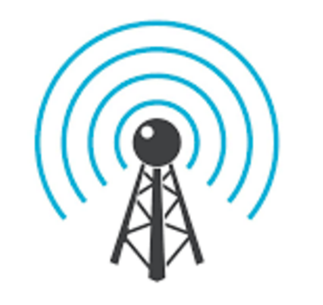
IoT Data Collection with Mobile Devices
IoT Gateway and Ubiquitous Internet Connectivity
IoT Data
Connectivity
mobile devices
Notes:
Finally, mobile device has ubiquitous connectivity to LTE base station. It can serve as IoT gateway and provide internet connectivity

Slide 7

Discrepancy of IoT Interfaces
Due to the limitations in size and complexity, mobile devices are manufactured with limited choices of wireless radios.
Incompatible
Notes:
However, due to the limitation of size of complexity, mobile devices only provided limited choices of wireless radios. Thus, they are mostly incompatible with IoT protocol e.g., ZigBee and LoRa. As a result, mobile devices cannot directly fetch data from ZigBee or LoRa devices.

Slide 8
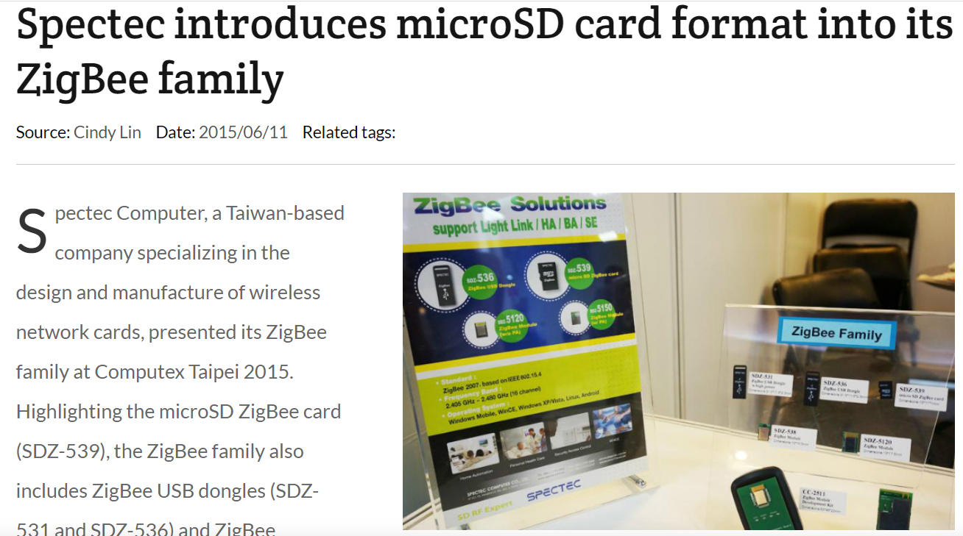
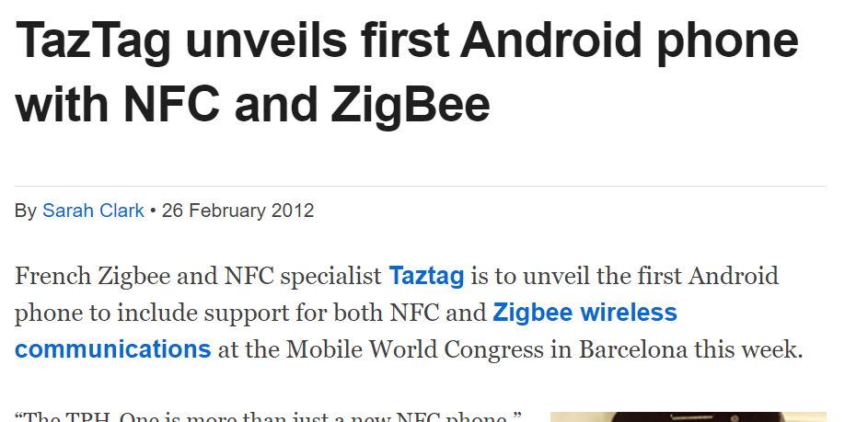
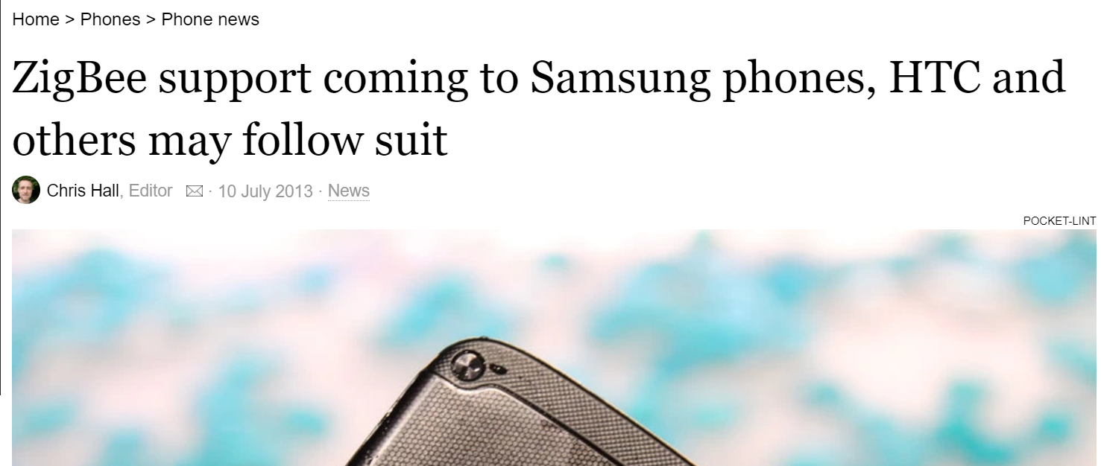
Solutions of Industry
Cramming ZigBee radio into Smartphone was not successful.
Notes:
Industry try introduce straightforward solution. Historically, there were ZigBee enabled SD cards. But most of mobile device do not have SD card interface anymore.
Also, smartphone manufacture try embedded ZigBee radio into smartphone. Although these solution are technically feasibly, they add to complexity of mobile devices and thus are not widely adopted.

Slide 9
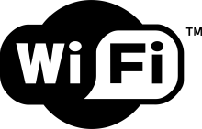
Cross-technology IoT Data Collection
Can mobile device use Wi-Fi radios to collect data from ZigBee and LoRa?
1
1. In the work, we focus on 2.4 GHz LoRa.
Notes:
In this paper, we study the possibility for cross-technology data collection. In specific, we study if mobile device can use WiFi interface to collect data from ZigBee and LoRa. Here, we only focus on IoT protocol in 2.4 GHz ISM band. So ZigBee and LoRa are both 2.4 GHz version. We will use ZigBee as an example while the same idea applies to LoRa.

Slide 10

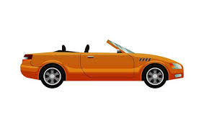
Why is it Challenging?
2 MHz ZigBee radio cannot produce 20 MHz Wi-Fi signal.
2 MHz
20 MHz
Low-Speed
250 Kbps
High-Speed
54 Mbps
Notes:
Sending data from ZigBee to WiFi is very difficult, because they have dramatically different physical layer.
More specifically, ZigBee radio only have 2 MHz bandwidth which 10 times smaller than WiFi. Therefore, it is impossible for ZigBee radio to produce signal that can be detected and understood by WiFi receiver.
We can compare ZigBee to low-speed walking person and compare WiFi to a car.

Slide 11
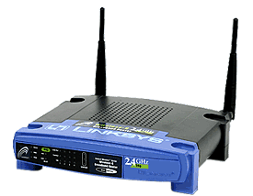
Signal Hitchhiking
ZigBee signal can hitchhike on in-the-air Wi-Fi packets.
Notes:
To address the challenge, our basic idea is signal hitchhiking. In specific, when a mobile device is receiving downlink WiFi packet. ZigBee radio send message simultaneously and create an collison at mobile device. In the way ZigBee data are piggybacked by the WiFi packet in the air and are captured by mobile devices.
Using our previous analogy, ZigBee signal is slow walking person, but our signal hitchhiking allows it can hitchhike on the high-speed WiFi traffic.

Slide 12
How to Retrieve ZigBee Data?
W(Fixed Wi-Fi Data)
R= W ＋ Z
Z(Hitchhiking ZigBee Data)
Z = R - W
Require Raw I/Q signal (Z) -> Not applicable
Surviving wifi
interference in low power zigbee networks.
(Sensys’ 10)
Interference alignment by motion.
(Mobicom’13)
Chiron: Concurrent high throughput communication for iot devices.
(Sensys’18)
Notes:
But the critical question is how can we obtain ZigBee data. Intrusively, the received signal is a summation of WiFi signal plus hitchhiking ZigBee data.Then, we can simply subtract WiFi signal from the received signal and obtain ZigBee signal.
If we can do this, then the problem is reduced to the interference cancellation that have been well-addressed in the literature.
However, these previous work is not applicable in Xfi because all of them require raw I/Q signal.

Slide 13
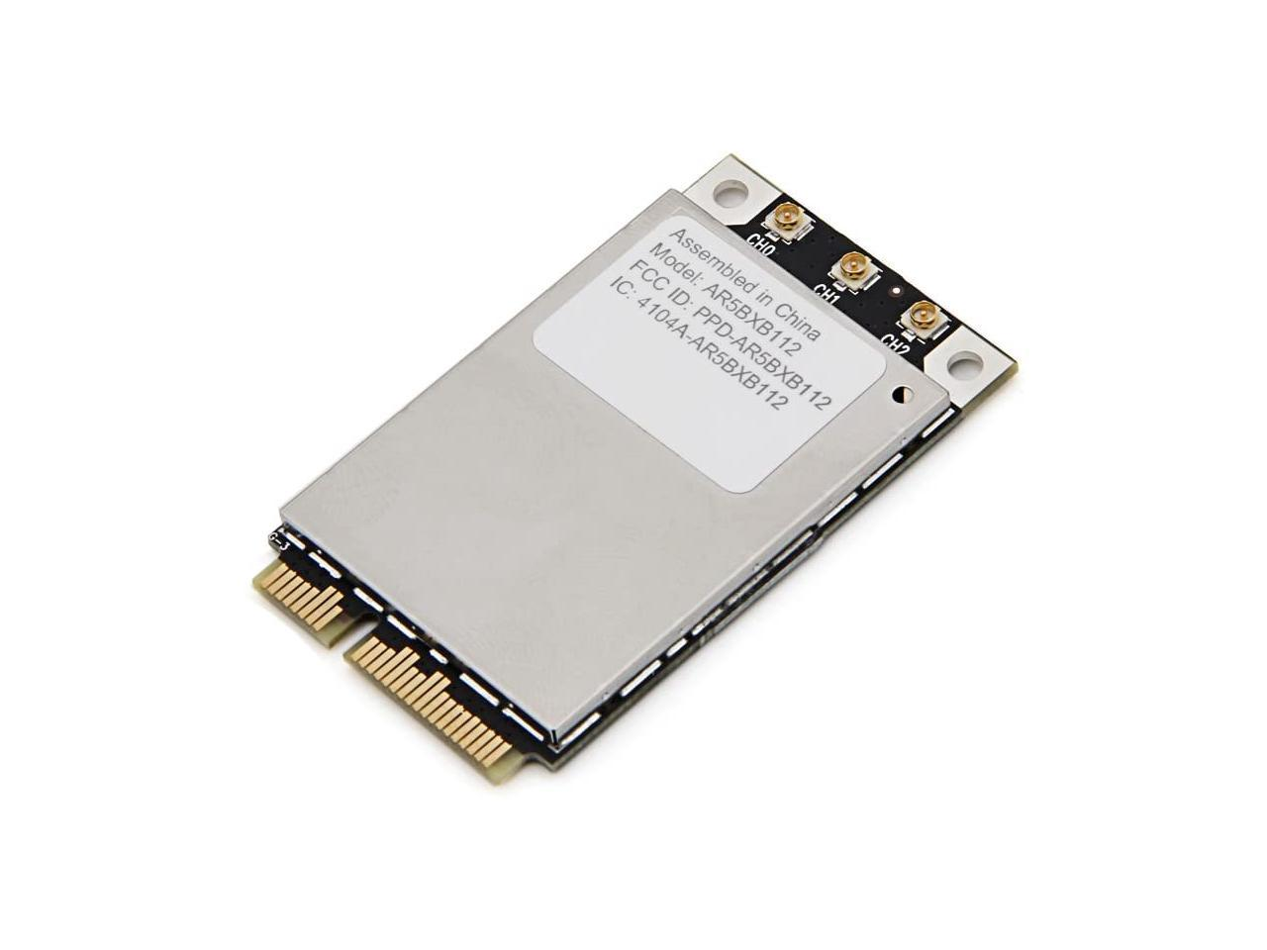
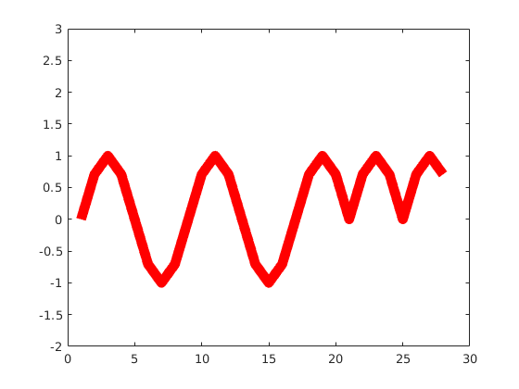
Raw I/Q is not Available
Commodity Wi-Fi hardware only provides the decoded payload.
In other word, XFi has no access to the raw I/Q signal.
010100101
010101011
010110 ….
Decoded
WiFi Payload
WiFi hardware
mobile software (XFi)
Notes:
However, Commodity WiFi hardware does not provide any raw signal to WiFi software. Instead it only return the decoded WiFi payload to software.

Slide 14
Gap between Raw I/Q and Payload
Wi-Fi Demodulation leads to information loss
Raw I/Q Signal
WiFi Demodulation
Information
loss
CP
Removal
FFT
QAM-Demapping
Channel
Decoder
010100101
010101011
010110 ….
Decoded
WiFi Payload
Notes:
Then problem is that when the WiFi hardware demodulate raw signal into the payload, there are all kind of information loss.

Slide 15
Gap between Raw I/Q and Payload
We study how to recover raw signal from decoded payload.
Raw I/Q Signal
How much raw signal
can be recovered
from decoded payload?
010100101
010101011
010110 ….
Decoded
Wi-Fi Payload
Notes:
And thus, the key question we need to answer is how much raw signa lcan be recover from decoded payload? Are they enough for retrieving the ZigBee data.

Slide 16
Challenge #1 – Error Correction
Channel decoder attempts to eliminate the interference (i.e., hitchhiking ZigBee signal).
WiFi Packet
w/ interference
Error-free
WiFi Packet
Channel Decoder
010100110
101010100
101010 ….
010100110
101101100
101010 ….
Eliminate Noise = Lose Hitchhiking ZigBee Signal
Notes:
To fill the gap, we has several challenges. Today, I am gonna focus the most interesting on.
WiFi packet are protected with channel coding/decoding against wireless interference. The hitchhiking ZigBee signal are be considered as interference.
In other word, the error correction function of channel decoder will try to get rid of hitchhiking IoT signal.

Slide 17
Challenge #1 – Error Correction
Wi-Fi packets protected by channel coding/decoding against the wireless interference (i.e., ZigBee signal).
WiFi Packet
Parity bits
0101001001010101011010101
Data bits
WiFi Packet
w/ ZigBee
Interference
0101010110010101011010101
ZigBee signal embedded in Corruption
After channel
decoding
0101001001010101011010101
Error-free packet
Notes:
To fill the gap, we has several challenges. Today, I am gonna focus the most interesting.
WiFi packet are protected with channel coding/decoding against wireless interference. The hitchhiking ZigBee signal are be treated as interference.
As the toil example show, the the WiFi data bits are appended by extra parity bits for redundancy. Hitchhiking ZigBee interfere with some WiFi bits. And we desire to reconstruct ZigBee signal from these corrupted bits.
However, the channel decoder will try to get ride of these error and return an error free to WiFi software. If this happens, the decoded payload will lose the information of ZigBee signal.

Slide 18
Observation
Channel decoding (error correction) algorithm in commodity Wi-Fi chipsets has an error correction capacity.
010100110
101010100
101010 ….
010100110
101101100
101010 ….
Within
Correction
Capacity
Channel Decoder
Errors are eliminated
Beyond
Correction
Capacity
010100101
010101011
010110 ….
010100101
010101011
010110 ….
Channel Decoder
Errors are retained
Notes:
The key observation is that channel decoding algorithm in the WiFi radio has a error correction capacity.
When the number of error are within the capacity of the decoder the channel decoder can eliminate the errors.
In contrast, when the number of errors are beyond the capability. The channel decoder will not be able to correct the errors and as a result it keep the received data bits almost intact. And thus errors are retained and cannot used to obtain ZigBee data.

Slide 19
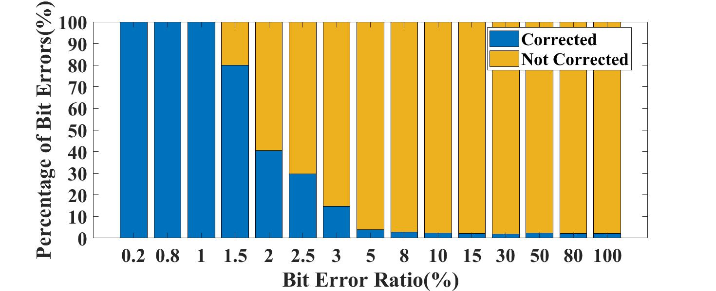
Observation
Empirical Experiment shows channel decoder is ineffective when bit error > 5%.
Bit Errors
after correction
Bit
Errors
Wi-Fi (RTL8812Au)
2%
Notes:
To figure out the capacity, we conduct an empirical experiment with commodity WiFi chipset.
In the experiment, we generate WiFi packets with Matlab and USRP, which we deliberately create certain number of bit errors. Then the signal is decoded by commodity Wi-Fi chipset. We gradually increase the bit errors rate and examine the decoded payload to see when the channel decoder will break down.
The figure below should the results. When the bit error ratio is below 1%, decoder can correct 100% the error. However, when the bit error ratios further increase above 5%, only 2% errors can be corrected. According to our experiment, ZigBee and LoRa signal is sufficient to make the channel decoder ineffective.

Slide 20
Waveform Reconstruction
010100101
010101011
010110 ….
010100101
010101011
010110 ….
Corrupted
WiFi Payload
Corruption
Subcarrier
Mapping
ZigBee in
Frequency
Domain
IFFT
ZigBee in
Time Domain
Notes:
Based on this key observation, we propose waveform reconstruction. We first extract the corruption from the payload by comparing the received data with the original data.
We map the corrupted bits to subcarriers in the frequency domain, which obtain the frequency domain representation of the hitchhiking ZigBee signal. Finally, XFi perform an inverse fourier transform to obtain the ZigBee signal in the time domain.
In the way, we can reconstruct the hitchking ZigBee signal from WiFi payload.

Slide 21
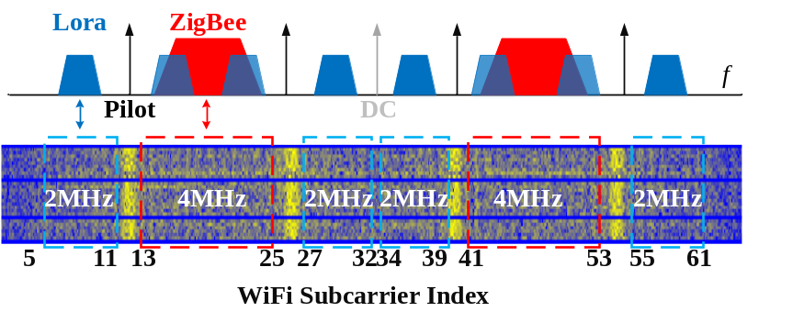
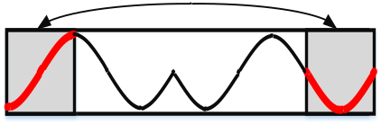
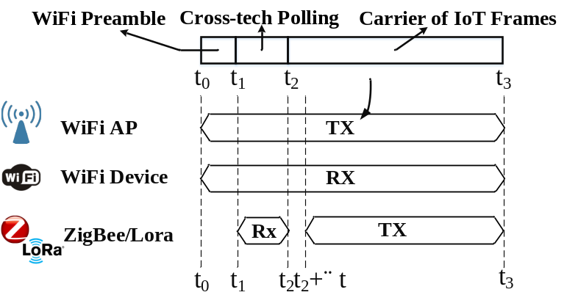

Other Challenges
XFi also needs to address other critical issues (Please refer our paper for more details)
ZigBee
Symbol
Wi-Fi Power Control
Wi-Fi
receiver
Lost
Signal Erasure
Synchronization
Notes:
Xfi also address other critical issues such signal erasure, WIFi power contron and time synchronization . Please refer our paper for the details.

Slide 22
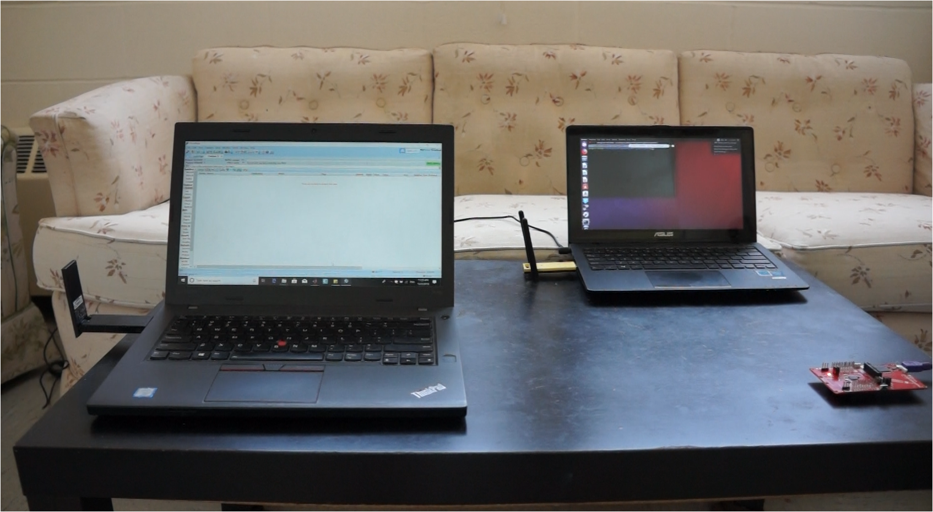
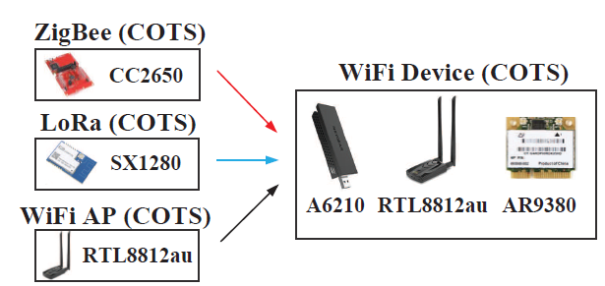
Implementation
XFi is implemented on Linux Wi-Fi driver and evaluated with several commodity WiFi chipsets
WiFi Hardware: RTL8812au
AR9380
A6210
(we modify WiFi driver to obtain the corrupted WiFi packets)
ZigBee: CC2650
LoRa: SX1290
Notes:
We implement Xfi on Linux WiFi driver. To examine the generality of our method , we evaluate Xfi with WiFi chip from qualcomm Atheros, mediatek and Realtek,etc.

Slide 23
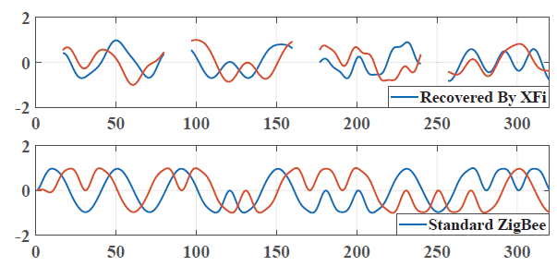
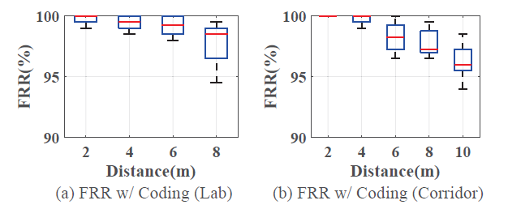
Evaluation (ZigBee)
Reconstructed
ZigBee Signal
Decoded ZigBee
Packets
Notes:
The emulation demonstrate the reconstructed Zigbee approximate the standard signal well except for the sections are erased. This demonstrate that waveform reconstruction is very effective.
ZigBee data can be successfully decoded from the reconstructed signal. The results shows Xfi can reliably obtain ZigBee data under varying scenarios.

Slide 24
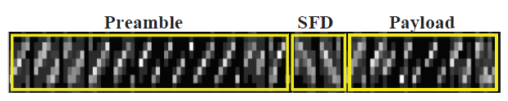
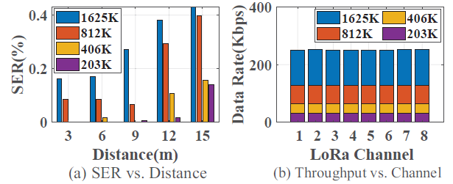
Evaluation (LoRa)
Reconstructed
LoRa Signal
Decoded LoRa
Symbols
Notes:
To demonstrate the generality of our method, we also evualte it with LoRa.

Slide 25
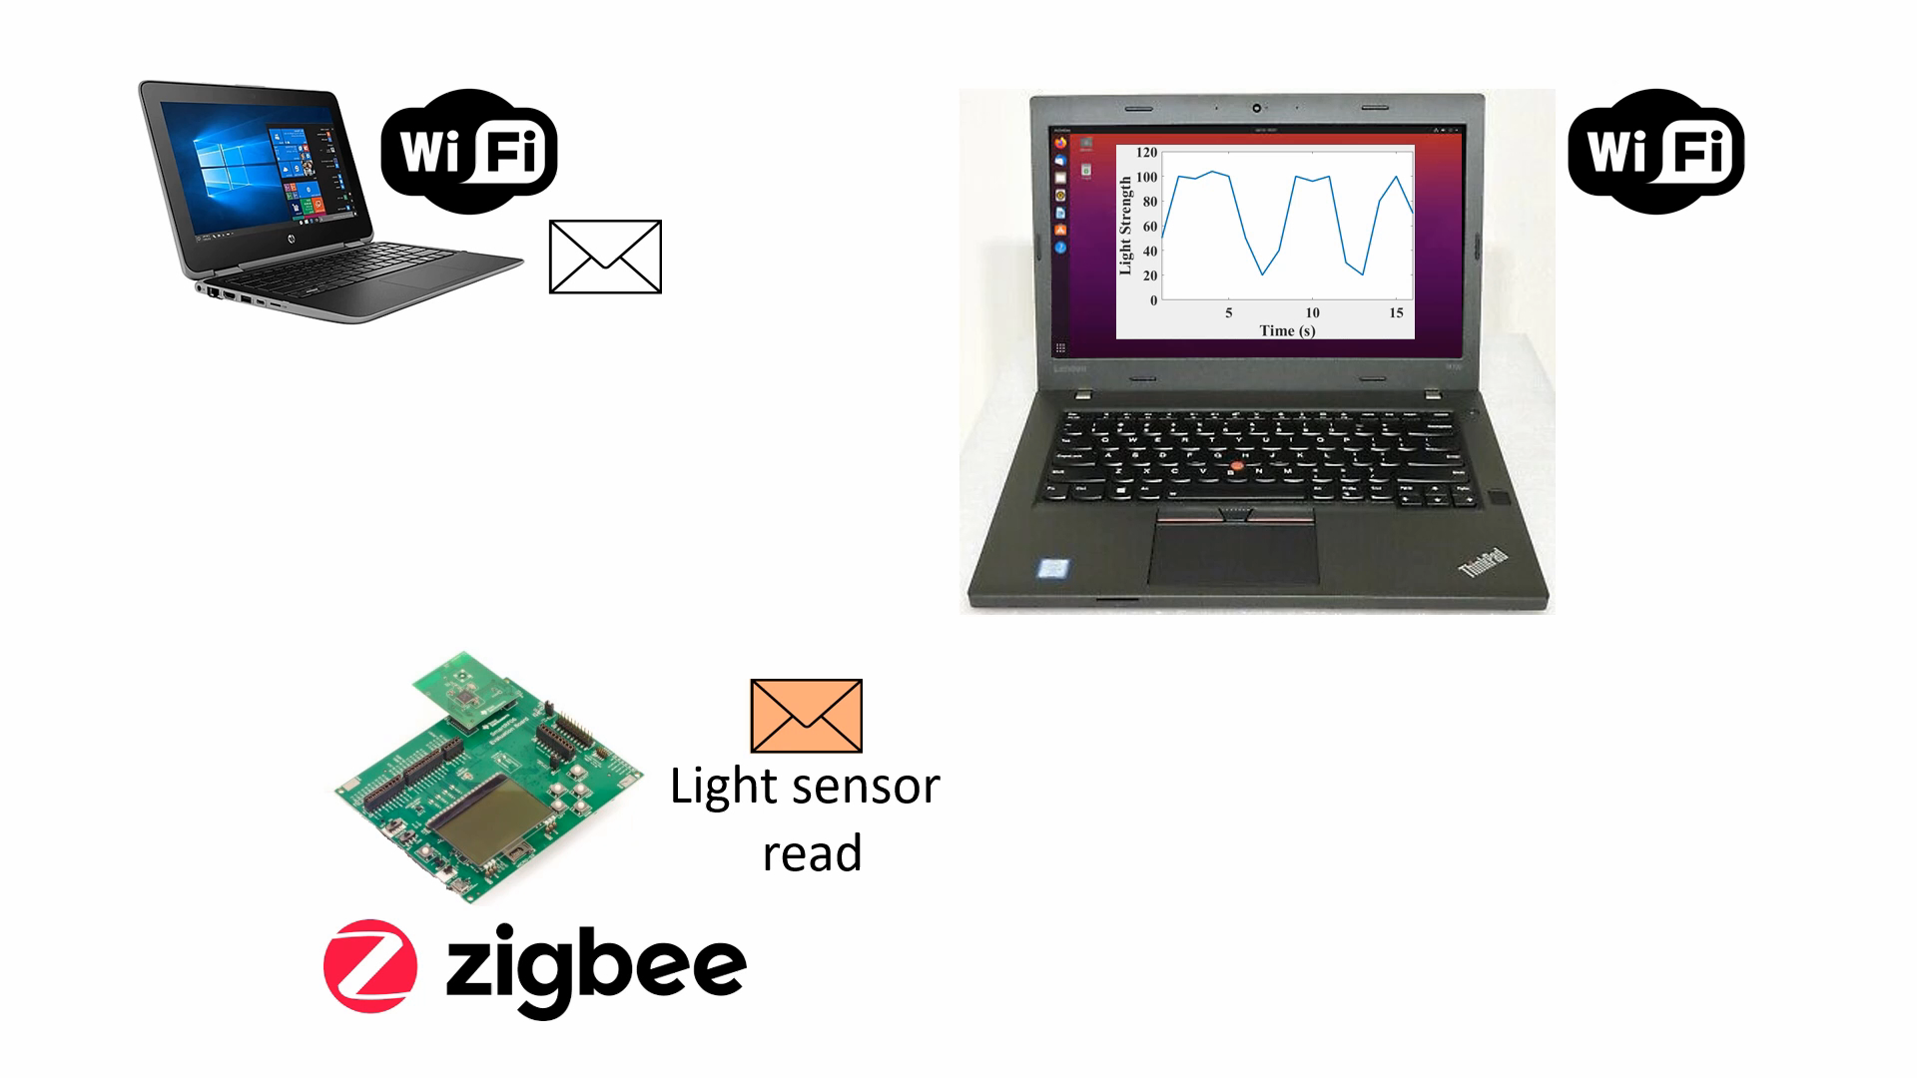
Demo
Notes:
Finally, we showcase Xfi with a demo. Commodity WiFi can collect light sensor reading from a zigbee lighter sensor.

Slide 26
Conclusion
XFi is the first cross-technology communication design from narrowband IoT devices to commodity WiFi.
XFi proposes a general method that reconstructs raw signal from corrupted WiFi payload.
We evaluate XFi with two representative IoT techniques, e.g., ZigBee and LoRa.

Slide 27
Q & A

