Slide 1
Misconfiguration Checking for SDN: Data Structure, Theory and Algorithms
Heng Pan, Zhenyu Li, Penghao Zhang (ICT/CAS)
Kave Salamatian (University of Savioe, France)
Gaogang Xie (CNIC/CAS)

Slide 2

Background
SDN
Separation
  Open Southbound APIs
    e.g. OpenFlow
Benefits
  Simplify network management
  Enable innovation
    Control plane
    Data plane
APP 1
APP 2
……
APP n
Control Platform
Open Southbound APIs
Cisco
Juniper
Huawei
Huawei
Network
H3C

Slide 3

Background
Compositional SDN
Modular & agile deployment
Cooperative management
Load Balancing
Monitoring
Routing
Repository
Operators
+
>>
+
TCP
DPI
NS
DPI
OAM
CGN
>>
Control Platform
$⊳$
Southbound APIs
SFC
LB
IO
...
Network
FW
Route

Slide 4
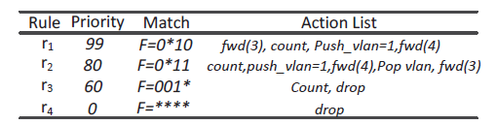

Compositional SDN is error-prone!
Individual SDN Policy is complex
One or more flow tables
  A prioritized list of flow entries (a.k.a rules)
  Bitmask-based match pattern
  e.g. 0*11
Various behaviors
  Set/drop/fwd/count/…
  An sequence of actions
Intra-policy misconfigurations
Why I cannot count any packet?

Slide 5
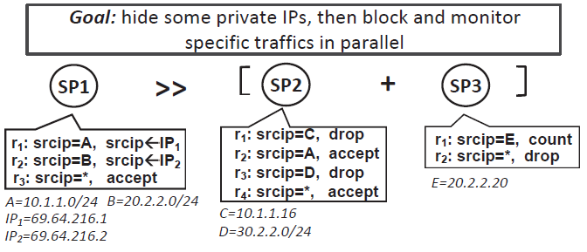
Compositional SDN is error-prone!
Diverse compositional operators
Parallel operator (+)
Sequential operator (>>)
Override operator ( )
…
Inter-policy misconfigurations
I have the highest priority in SP3, but I cannot count any packet !

Slide 6
Limitations of the prior arts
SDN verification tools
HSA[NSDI’12], Veriflow[NSDI’13], PGA[SIGCOMM’15]
Checking network-wide invariants (e.g. Black holes)
Failing to check network conflicts and deployment inefficiency
Access control policy detection
Checking prefix-based rules with simple actions
Failing to check (compositional) SDN polices

Slide 7
Our work: PMM
PMM: Policy Misconfiguration Management
From data plane side
Detecting inter- and intra- policy misconfigurations
Compositional configurations
SP 1
SP 1
Compositional policy detection
Individual policy detection
SP 2
SP 2
SP n
SP n
PMM
Inter-policy misconfigurations
Intra-policy misconfigurations

Slide 8
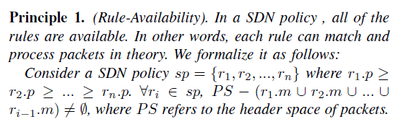
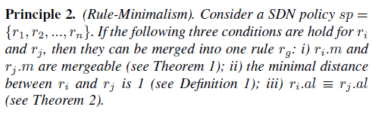
What Are Misconfigurations?
Two principles
Any rule in one policy is useful.
There are no rules that can be merged.
Two types of misconfigurations
Function conflicts
Deployment inefficiency

Slide 9
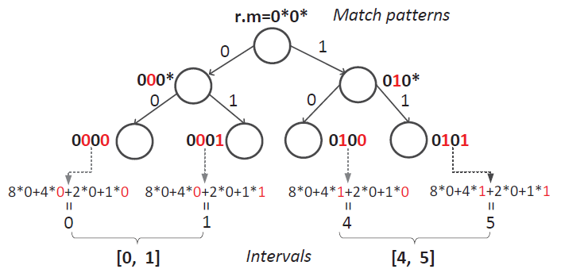
Minimal Interval Set (I)
Interval generation
Bitmask-based match patterns → Binary bit sequences
Binary bit sequences → Decimal numbers
Decimal numbers → intervals

Slide 10
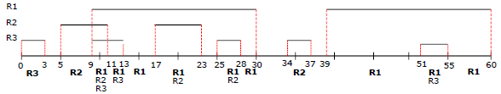
Minimal Interval Set (II)
One policy: minimal interval set
Non-overlapping between different sets
Rules in one set are ordered by their priority
For policy SP, SP.mis refers to the match space of SP
  e.g. SP.mis = {[0,3]; [5,30]; [34,37]; [39, 60]}
One rule may belong to multiple sets
One set contains one or more rules

Slide 11
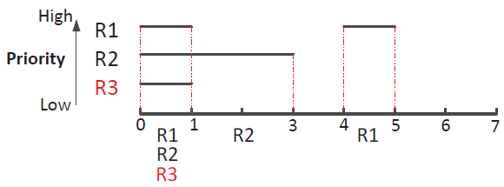
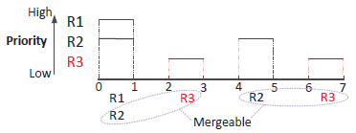
Checking Misconfigurations (I)
Checking intra-policy misconfigurations
Checking principle I
Any rule should associate one set at least where it has the highest priory!
Checking principle II
No two or more rules are mergable!

Slide 12


Checking Misconfigurations (II)
Checking inter-policy misconfigurations
Consider SP1 and SP2. With the all input space, both SP1 and SP2 contain no misconfiguration.
1. Parallel operator (+): SP1 + SP2
SP1.mis =? SP2.mis
2. Sequential operator (>>): SP1 >> SP2
After SP1 operated, the input space of SP2 may be changed.
Does SP2 contain misconfigurations?
3. Override operator ( ): SP1 SP2
$$△$$
$$△$$
The rules of SP2 are viewed as the default rules for SP1, and then we check SP1 again.

Slide 13
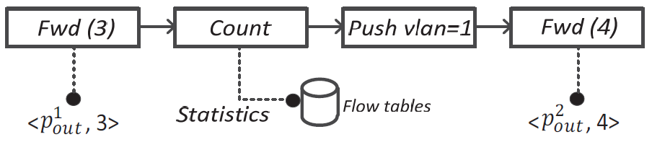
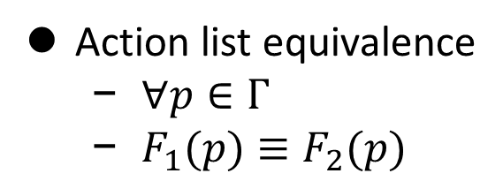

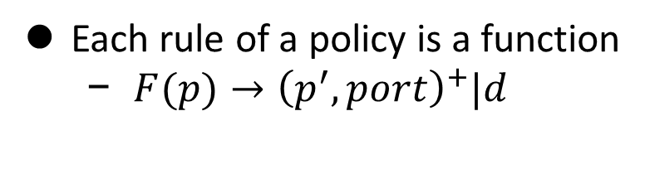
Action List Equivalence
Each rule of a policy is a function
  $F(p)→{\left(p^{′},port\right)}^{+}|d$
Forwarding pair
Statistics data
Packet Pair – $(p,port)$
  Packet $p$appears on port port
Action list equivalence
  $∀p∈Γ$
  $F_{1}(p)≡F_{2}(p)$

Slide 14
Evaluation
Experimental platform
Integrated with CoVisor
Server: Intel Core(TM) i7-8700CPU, clocked at 3.2GH
Two types rulesets
D1 – synthetic rulesets
  Generated by ClassBench
D2 – random rulesets
  Different types of actions

Slide 15
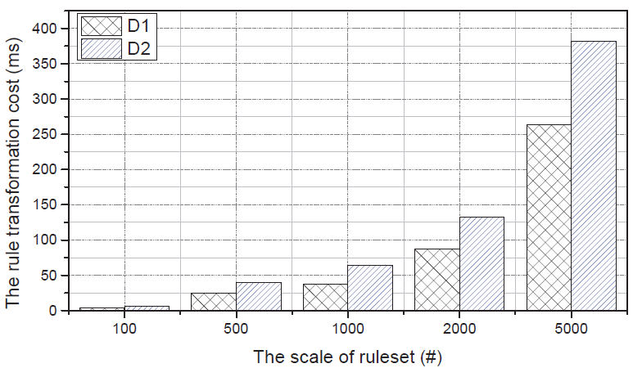
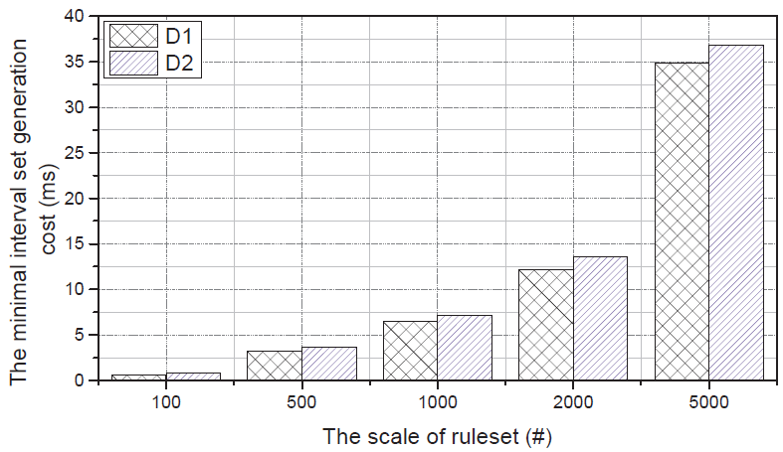
Evaluation
Breakdown checking intra-policy misconfigurations
Interval generation
Minimal Interval generation

Slide 16
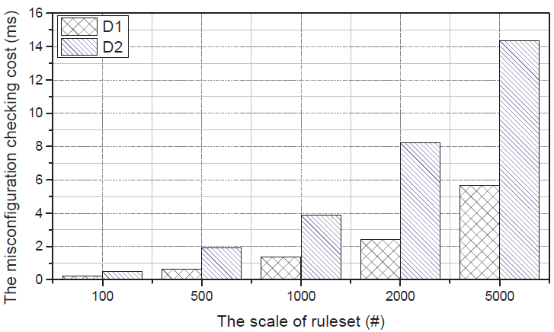
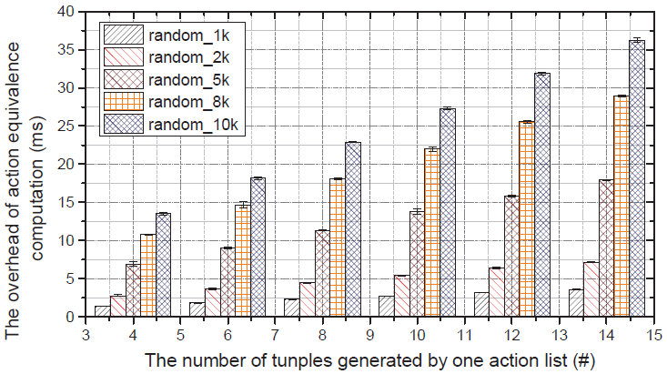
Evaluation
Breakdown of checking intra-policy misconfigurations
Checking misconfigurations
Action equivalence computation

Slide 17
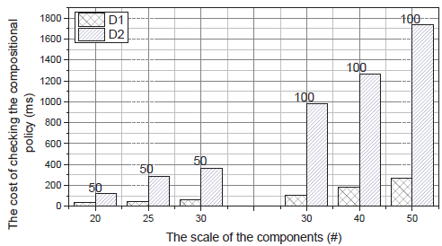
Evaluation
Evaluation of checking inter-policy misconfigurations

Slide 18
Conclusion
We consider intra- and inter-policy misconfigurations
Propose two principles for misconfiguration checking
Design minimal interval set to simplify ruleset representation
Implement misconfiguration checking algorithms

Slide 19
Thank you!

