Slide 1


Trading off Charging and Sensing for Stochastic Events Monitoring in WRSNs
Yu Sun*, Chi Lin*, Haipeng Dai†, Qiang Lin‡, Lei Wang*, and Guowei Wu*
*School of Software Technology, Dalian University of Technology, Dalian 116023, China
†State Key Laboratory for Novel Software Technology, Nanjing University, Nanjing 210024, China
‡Dalian University of Science and Technology, Dalian 116052, China

Slide 2
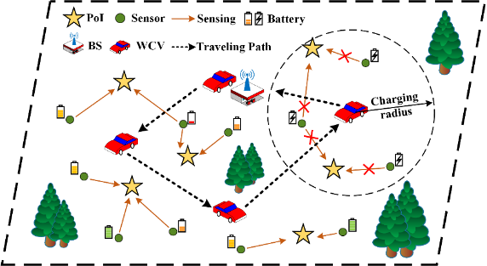
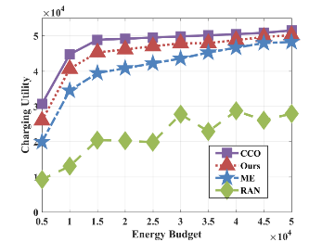
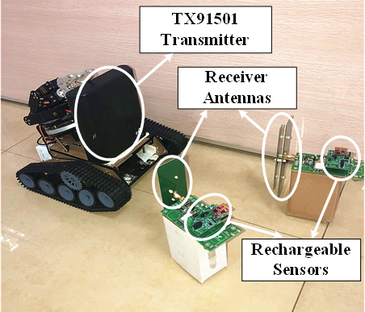
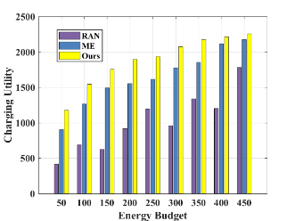
Background：Wireless Rechargeable Sensor Networks (WRSNs)
Problem:
Hardware
Constraints
Performance Loss
Ideal Assumptions
Conflicts
Charging Exclusivity
Motivation
目录
Our Work：
Charging scheduling scheme optimization :
Optimizing charging utility
Trading off charging and sensing
Reducing the performance loss
Avoid the serious consequences
CONTENTS
ABSTRACT
Conclusions:
Simulation: the performance of the proposed scheme is 19.7% higher than baseline algorithms;
Realistic experiments indicates the feasibility and superiority in real scenes.
Notes:
首先，对本文工作进行简要介绍。
本文研究的主要问题是：仿真理想状态下的假设和实际实验中的设备约束产生难以避免的冲突，从而引发充电排他性问题，该问题会导致充电调度算法产生性能损失，甚至产生严重后果。
本文所做主要工作为：
通过实验可以证明本文工作提升网络性能XXX

Slide 3
Part 01
Background
Part 02
Model
目录
Part 03
Solution
CONTENTS
Part 04
Theoretical Analysis
CONTENTS
Part 05
Experiments
Notes:
接下来，我将从以下五个方面具体介绍我的工作

Slide 4
－ Background－
－ Model－
－ Solution－
－ Analysis－
－ Experiments－
PART 01
Background
Notes:
第一部分为研究背景介绍

Slide 5
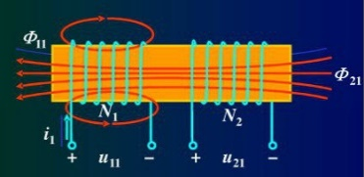
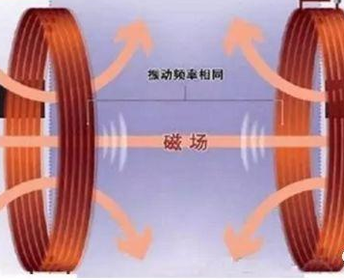
Energy bottleneck of traditional Internet of Things
Limited batteries
Deployment difficulties
Maintenance difficulties
Limited application
－ Background－
－ Model－
－ Solution－
－ Analysis－
－ Experiments－
Wireless Power Transfer
Wireless charging technology realizes the remote and reliable supply of large amounts of electric energy, which provides a new solution to solve the energy bottleneck problem of wireless sensor networks.
On this basis, Wireless Rechargeable Sensor Network is generated.
Notes:
物联网应用在日益发展的过程中，面临着能量瓶颈问题，具体表现为以下四点。而无线充电技术的出现为传统物联网能量瓶颈问题提供新的解决方案，无线充电传感器网络应运而生。

Slide 6
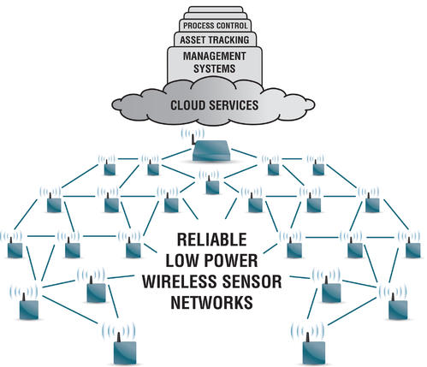
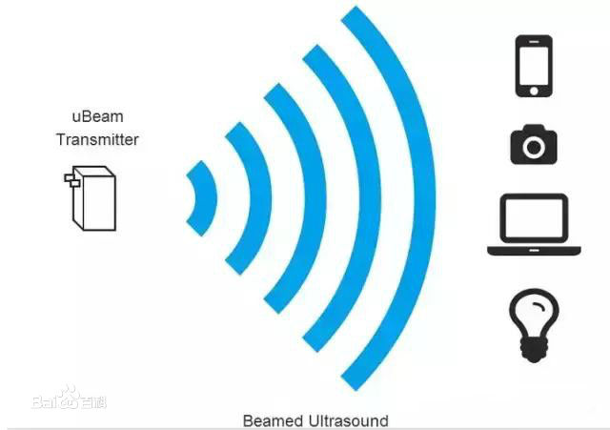

Wireless Rechargeable Sensor Networks
－ Background－
－ Model－
－ Solution－
－ Analysis－
－ Experiments－
Wireless Sensor Network
Wireless Power Transfer
Wireless Rechargeable Sensor Network
Rechargeable Sensors
Wireless Charging Vehicle (WCV)
Super capacitor
Sensing surrounding environment
Equipped with wireless charger
charging panic sensors
At present, the research of WRSN is mainly based on simulation environment.
Notes:
无线充电传感器网络是搭载无线充电技术的一种新型无线传感器网络。
在这种网络中，传感器节点搭载可充电设备，并进行传感工作；
并配备一移动充电车在网络中巡游，为传感器节点以无线充电的方式补充能量。
近年来，众多学者对无线充电传感器网络的研究主要基于仿真实验环境。

Slide 7
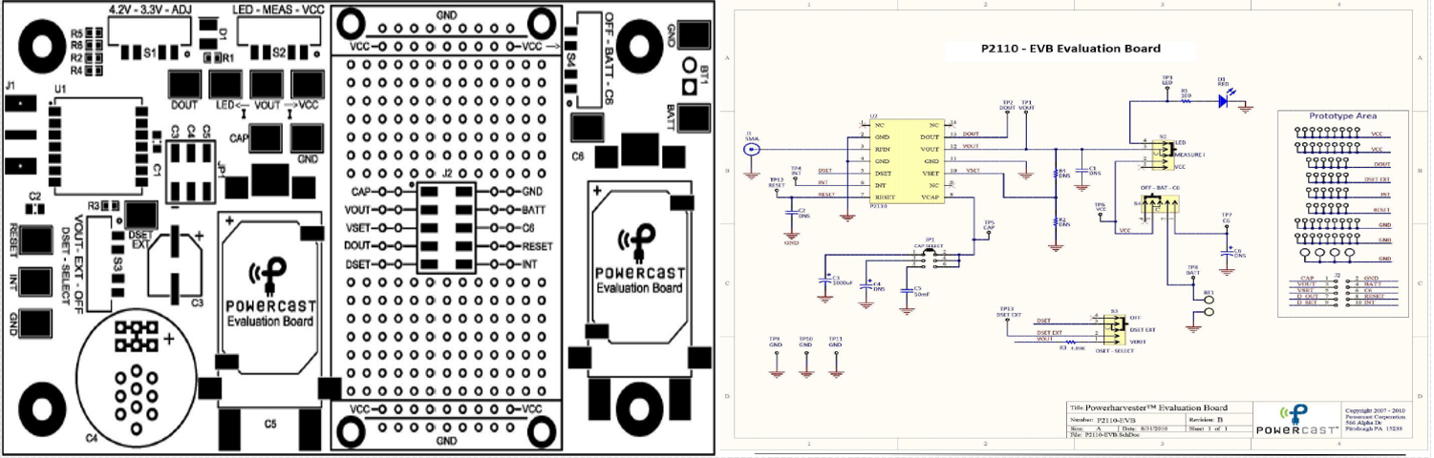
Experimental phenomena
In the actual scene experiment, the phenomenon often occurs that the sensor node cannot work when being charged.
Existing problem: Charging Exclusivity
The charge and discharge states of supercapacitors cannot co-exist.
The sensor node has simple structure and no power control circuit.
Charging and sensing cannot be conducted at the same time.
Sensor being charged → Sensing is suspended → Important events may be missed → Serious consequences are caused.
－ Background－
－ Model－
－ Solution－
－ Analysis－
－ Experiments－
Main circuit structure of sensor node energy capture module
Notes:
然而在实际环境中部署网络进行实验测试时，我们发现，传感器节点在被充电时处于无法工作的状态。这一现象引发思考。
通过对传感器节点结构进行研究发现，由于XXX
因此对节点进行充电时，可能会导致事件丢失从而引发严重后果。

Slide 8
Motivation
A serious conflict between experimental phenomena and simulation assumptions.
Simulations ignored charging exclusivity.
Existing charging scheduling is unreasonable.
Possibly causing serious consequences.
－ Background－
－ Model－
－ Solution－
－ Analysis－
－ Experiments－
We propose a scheme which is not only suitable for simulation theoretical analysis, but also has excellent performance in practical applications.
Challenges
It is non-trivial to quantitatively leverage the utility gain vs. utility loss yielded by the charging behavior of WCV.
The solution space of solving this problem is infinite.
Constructing traveling path of WCV is equivalent to solving a TSP.
The objective function of this problem is non-linear and hard to analyze its properties.
Notes:
目前WRSN的研究主要基于仿真试验环境进行测试。
而充电排他性现象说明仿真实验中的假设与实际设备条件产生冲突，这一冲突导致性能缺失、调度不合理，甚至会引发农田病虫害、森林火灾等严重后果。
为解决这一问题，本文提出XXX
在解决这一问题的过程中，我们面临如下挑战：

Slide 9
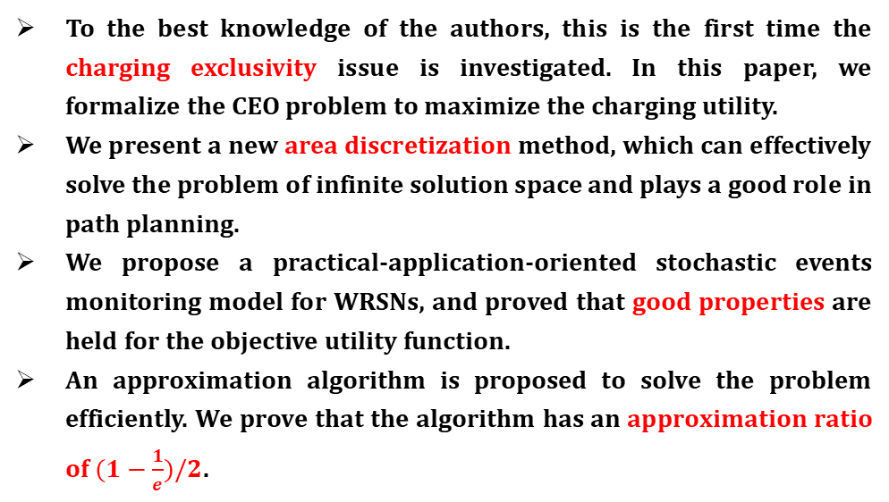
Contributions
To the best knowledge of the authors, this is the first time the charging exclusivity issue is investigated. In this paper, we formalize the CEO problem to maximize the charging utility.
We present a new area discretization method, which can effectively solve the problem of infinite solution space and plays a good role in path planning.
We propose a practical-application-oriented stochastic events monitoring model for WRSNs, and proved that good properties are held for the objective utility function.
An approximation algorithm is proposed to solve the problem efficiently. We prove that the algorithm has an approximation ratio of $(1−\frac{1}{e})/2$.
－ Background－
－ Model－
－ Solution－
－ Analysis－
－ Experiments－
Notes:
在解决上述问题后，本文主要贡献可归纳为以下四点：
首次提出并定义了充电排他性下效用最大化问题，分析并处理充电排他性的影响；
使用符合实际情况的随机事件监测模型，并在此情况下证明了目标函数的性质；
提出一种新型空间离散化方法，有效解决解空间无限的问题，并为路径规划提供良好条件；
提出近似算法高效解决问题，理论证明其具有可靠的近似率。

Slide 10
－ Background－
－ Model－
－ Solution－
－ Analysis－
－ Experiments－
PART 02
Model
Notes:
接下来我将具体介绍本文的研究内容

Slide 11

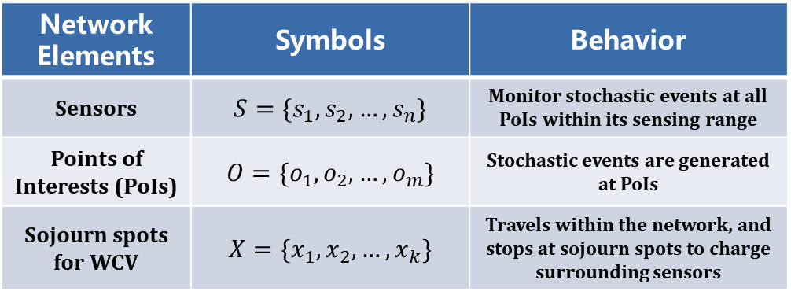
Network model
－ Background－
－ Model－
－ Solution－
－ Analysis－
－ Experiments－
Network Elements | Symbols | Behavior
Sensors | $$S=\{s_{1},s_{2},…,s_{n}\}$$ | Monitor stochastic events at all PoIs within its sensing range
Points of Interests (PoIs) | $$O=\{o_{1},o_{2},…,o_{m}\}$$ | Stochastic events are generated at PoIs
Sojourn spots for WCV | $$X=\{x_{1},x_{2},…,x_{k}\}$$ | Travels within the network, and stops at sojourn spots to charge surrounding sensors
Notes:
在本文的网络模型中，共有三种重要的网络元素：
传感器节点不断监测
随机事件在兴趣点处产生
充电车在停靠点处执行充电任务

Slide 12
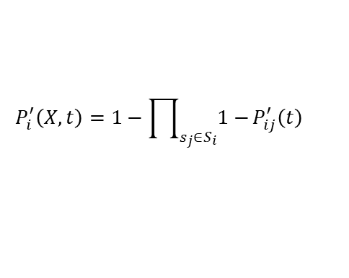
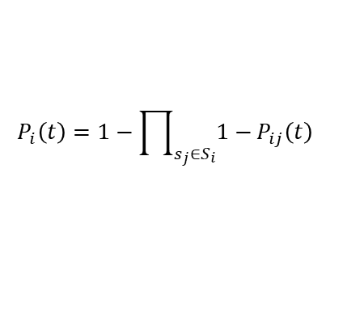
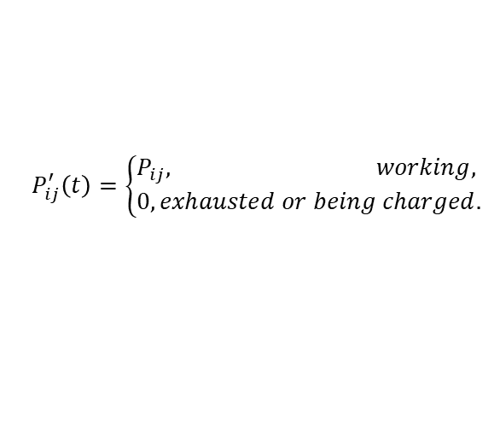
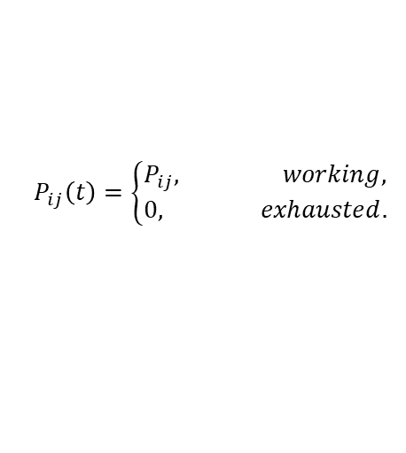
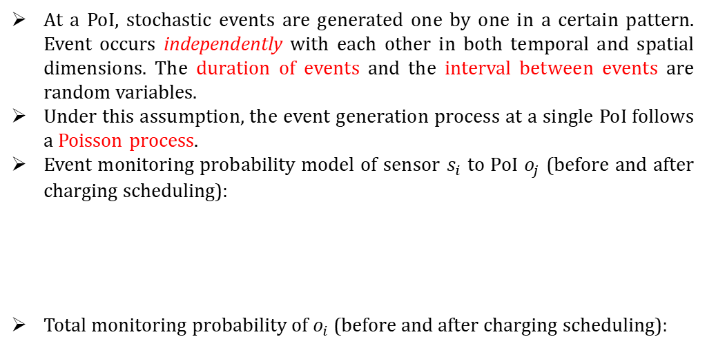
Event model
At a PoI, stochastic events are generated one by one in a certain pattern. Event occurs independently with each other in both temporal and spatial dimensions. The duration of events and the interval between events are random variables.
Under this assumption, the event generation process at a single PoI follows a Poisson process.
Event monitoring probability model of sensor $s_{i}$ to PoI $o_{j}$ (before and after charging scheduling):
Total monitoring probability of $o_{i}$ (before and after charging scheduling):
－ Background－
－ Model－
－ Solution－
－ Analysis－
－ Experiments－
$$P_{ij}\left(t\right)=\left\{\begin{aligned}&P_{ij}, working, \\ &0, exhausted.\end{aligned}\right.$$
$$P_{ij}^{′}\left(t\right)=\left\{\begin{aligned}&P_{ij}, working, \\ &0,exhausted or being charged.\end{aligned}\right.$$
（due to charging exclusivity）
$$P_{i}\left(t\right)=1−\prod_{s_{j}∈S_{i}}{1−}P_{ij}\left(t\right)$$
$$P_{i}^{′}\left(X,t\right)=1−\prod_{s_{j}∈S_{i}}{1−}P_{ij}^{′}\left(t\right)$$
（due to charging exclusivity）
Notes:
下面介绍本文中的事件监测模型
本文中事件产生模式为泊松过程，具体的随机事件模型为泊松分布，公式如下。
随机事件的持续时间也是一随机变量。
传感器节点对兴趣点的事件监测概率视为一受环境及设备影响的常数，在传感器节点能量耗尽后，该数值归零。
在被充电时，由于充电排他性，节点无法工作，从而概率也为零。
根据概率公式，兴趣点事件被监测的总概率可计算如下：

Slide 13



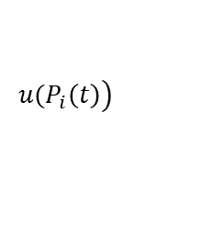
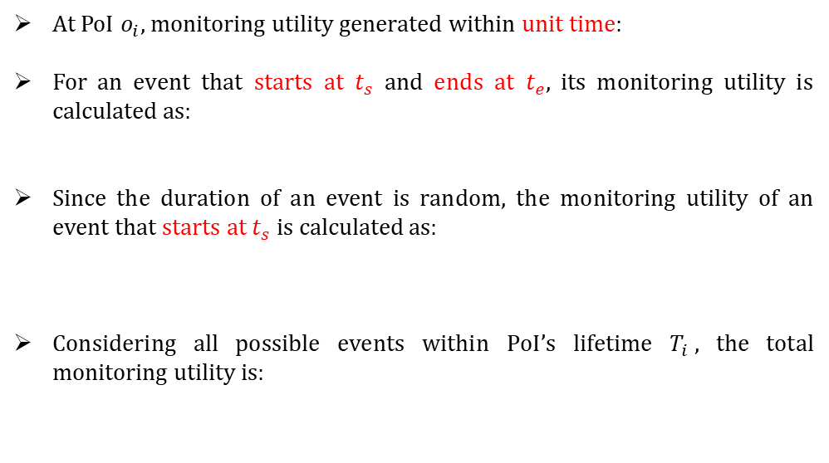
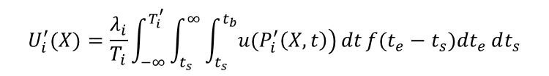
Monitoring utility computation
$$\left.u(P_{i}\left(t\right)\right)$$
At PoI $o_{i}$, monitoring utility generated within unit time:
For an event that starts at $t_{s}$ and ends at $t_{e}$, its monitoring utility is calculated as:
Since the duration of an event is random, the monitoring utility of an event that starts at $t_{s}$ is calculated as:
Considering all possible events within PoI’s lifetime $T_{i}$, the total monitoring utility is:
$$\int_{t_{s}}^{t_{b}}{\left.u(P_{i}\left(t\right)\right)}dt$$
－ Background－
－ Model－
－ Solution－
－ Analysis－
－ Experiments－
$$\int_{t_{s}}^{∞}{\int_{t_{s}}^{t_{b}}{\left.u(P_{i}\left(t\right)\right)}dt}f(t_{e}−t_{s})dt_{e}$$
$$U_{i}=\frac{λ_{i}}{T_{i}}\int_{−∞}^{T_{i}}{\int_{t_{s}}^{∞}{\int_{t_{s}}^{t_{b}}{\left.u(P_{i}\left(t\right)\right)}dt}f(t_{e}−t_{s})dt_{e}}dt_{s}$$
Before charging：
$$U_{i}^{′}(X)=\frac{λ_{i}}{T_{i}}\int_{−∞}^{T_{i}^{′}}{\int_{t_{s}}^{∞}{\int_{t_{s}}^{t_{b}}{\left.u(P_{i}^{′}\left(X,t\right)\right)}dt}f(t_{e}−t_{s})dt_{e}}dt_{s}$$
After charging：
（due to charging exclusivity）
Notes:
随机事件被传感器监测从而产生监测效用。单位时间监测效用被视为监测概率的函数。
对于一起止时间确定的随机事件，其产生的监测效用可以通过积分求得
考虑到随机事件持续时间随机，因此只确定起始时间的事件效用可通过对所有持续时间做积分求得
进一步，由于事件发生时间也是随机的，考虑到兴趣点生存时间内的所有可能事件，总监测效用可计算为最下方的公式。

Slide 14
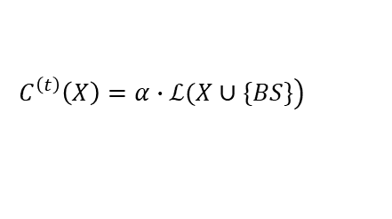
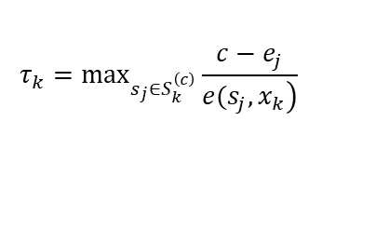

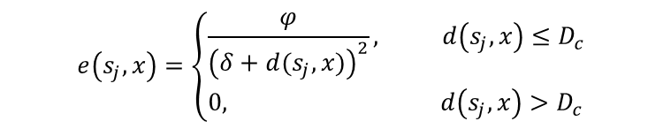
Charging model
The power transmission model is as follows:
$$e\left(s_{j},x\right)=\left\{\begin{aligned}&\frac{φ}{{\left(δ+d(s_{j},x)\right)}^{2}}, d\left(s_{j},x\right)≤D_{c} \\ &0, d\left(s_{j},x\right)>D_{c}\end{aligned}\right.$$
－ Background－
－ Model－
－ Solution－
－ Analysis－
－ Experiments－
Charging cost:
（Consumption of charging sensors）
$$C_{k}^{\left(c\right)}=β∙τ_{k}$$
Energy consumption of WCV
where
$$τ_{k}=\max_{s_{j}∈S_{k}^{\left(c\right)}}\frac{c−e_{j}}{\left.e(s_{j},x_{k}\right)}$$
Traveling cost:
（Consumption of traveling）
$$\left.C^{\left(t\right)}\left(X\right)=α∙ℒ(X∪\{BS\}\right)$$
Notes:
下面介绍充电模型，随着充电车与传感器节点间距离的增长，充电功率呈平方反比下降趋势，当间距超出最大充电范围时，充电功率视为0
充电车的能量消耗主要分为两部分：充电消耗和路径消耗，分别与充电时间和移动距离成正比

Slide 15
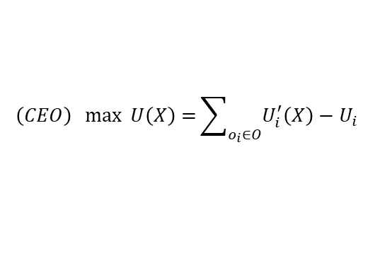
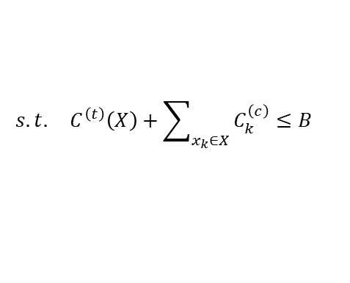
Problem Formulation
Charging Exclusivity Optimization（CEO）Problem
How to select the appropriate sojourn spots set X for WCV to charge surrounding sensors such that the total charging utility of the network under charging exclusivity is maximized.
－ Background－
－ Model－
－ Solution－
－ Analysis－
－ Experiments－
$$\left(CEO\right) \max{ U\left(X\right)=}\sum_{o_{i}∈O}{U_{i}^{′}\left(X\right)−U_{i}}$$
$$s.t. C^{\left(t\right)}\left(X\right)+\sum_{x_{k}∈X}{C_{k}^{\left(c\right)}}≤B$$
Difficulty Analysis
Infinite solution space
Non-intuitive nature
Introduction of TSP
The CEO problem is the coupling of multiple challenging problems that has high computational complexity.
Notes:
在上述网络模型、事件模型与充电模型确定后，我们形式化地定义充电排他性下效用最优化问题，即
公式化描述如下
为简化描述，之后用CEO问题作为该问题的简称
那么通过对CEO问题的形式化建模和分析，我们明确表示了充电排他性下充电行为在充电排他性影响下产生的充电效用，从而解决了本文的第一个挑战。
之后，我们分析CEO问题复杂性，发现它具有以下特点：

Slide 16
－ Background－
－ Model－
－ Solution－
－ Analysis－
－ Experiments－
PART 03
Solution
Notes:
接下来，我将介绍本文具体的解决方案。

Slide 17
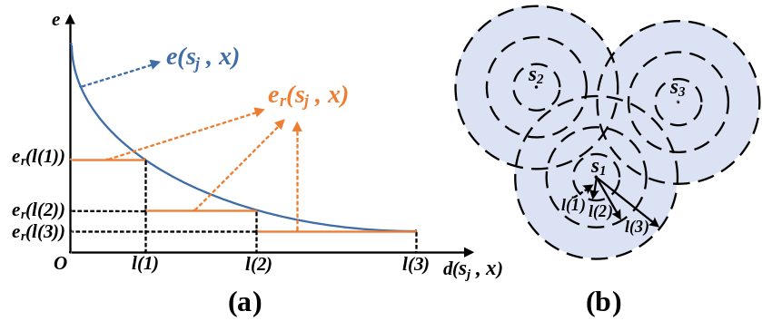
Area Distretization: Circular Discretization
In order to reduce infinite solution space into a finite set, the continuous network area is divided into several subareas through area discretization:
－ Background－
－ Model－
－ Solution－
－ Analysis－
－ Experiments－
Area discretization: (a) Charging power discretization; (b) Draw concentric circles
Discretization Process:
Piecewise constant function
Draw concentric circles
Uniform within each subarea
Notes:
首先，为解决解空间无限的问题，我们采用区域离散化方法，分割连续网络区域
通过将充电功率函数近似表示为分段常数，我们可以根据这一分段方式用一系列同心圆将

Slide 18
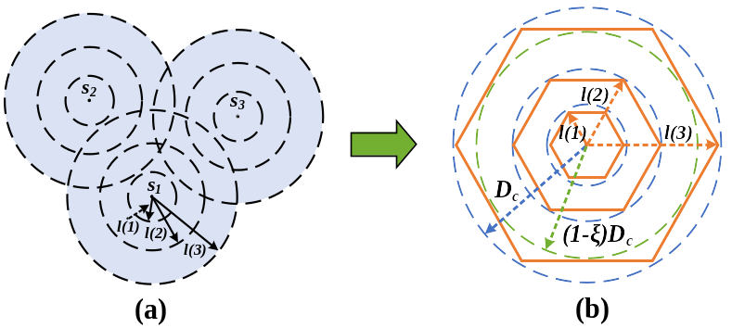
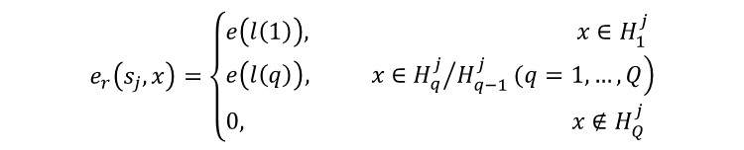
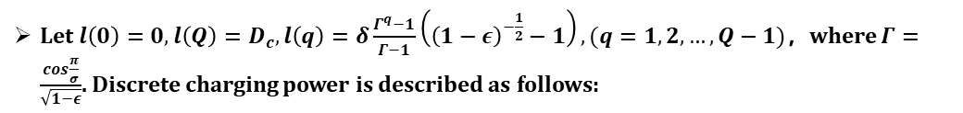
Area Distretization: Polygonal Discretization
The curved polygon subareas formed by circular discretization brings difficulties to the following path planning problems. We propose polygonal discretization to modify them:
－ Background－
－ Model－
－ Solution－
－ Analysis－
－ Experiments－
Replacing each concentric circle with an inscribed regular polygon inside it.
Let $l\left(0\right)=0, l\left(Q\right)=D_{c}, l\left(q\right)=δ\frac{Γ^{q}−1}{Γ−1}\left({\left(1−ε\right)}^{−\frac{1}{2}}−1\right), (q=1, 2, …, Q−1)$，where $Γ=\frac{\cos{\frac{π}{σ}}}{\sqrt{1−ε}}$. Discrete charging power is described as follows:
$$e_{r}\left(s_{j},x\right)=\left\{\begin{aligned}&e\left(l\left(1\right)\right), x∈H_{1}^{j} \\ &\left.e\left(l\left(q\right)\right), x∈{H_{q}^{j}}/{H_{q−1}^{j}}(q=1,…,Q\right) \\ &0, x∉H_{Q}^{j}\end{aligned}\right.$$
Notes:
为解决上一步离散化对后续路径规划问题带来的困难，我们进行进一步离散
我们用圆内接正多边形代替圆，进而将原来的离散子区域变为一系列多边形子区域。
通过合理设置参数，我们可将离散后的充电功率函数表示为下列公式

Slide 19
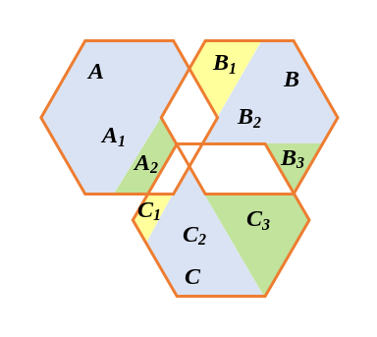
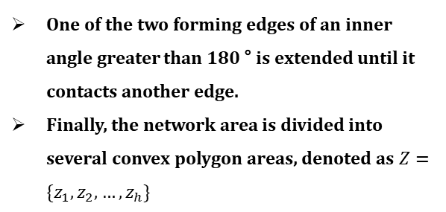
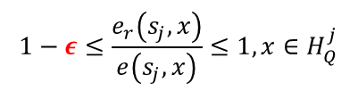
Convex Polygonal Discretization
With the aforementioned parameter settings, the approximation error of area discretization is bounded to:
$$1−ε≤\frac{e_{r}\left(s_{j},x\right)}{e\left(s_{j},x\right)}≤1,x∈H_{Q}^{j}$$
－ Background－
－ Model－
－ Solution－
－ Analysis－
－ Experiments－
The polygonal subareas are not all convex areas, further modification:
One of the two forming edges of an inner angle greater than 180 ° is extended until it contacts another edge.
Finally, the network area is divided into several convex polygon areas, denoted as $Z=\{z_{1},z_{2},…,z_{h}\}$
Dividing subareas into convex polygons
Notes:
当近似充电功率函数的参数设置如前文所述时，可以得出近似充电功率和离散化网络区域造成的误差可被限制为$ε$，即最差情况下近似功率不会低于真实功率的1-$ε$倍。相对误差可被限制为1-$ε$
我们将大于180°的内角进行分割，例如图中
A划分为A1和A2；
B划分为B1、B2和B3
最终连续网络区域被分割为若干凸多边形子区域，用集合Z表示

Slide 20
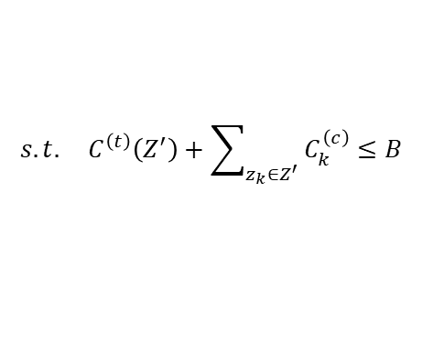
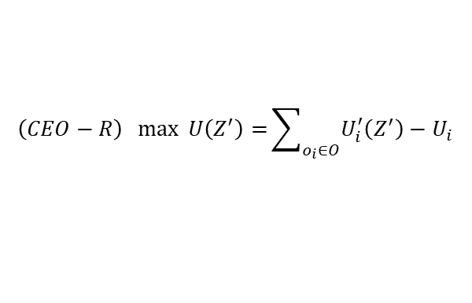
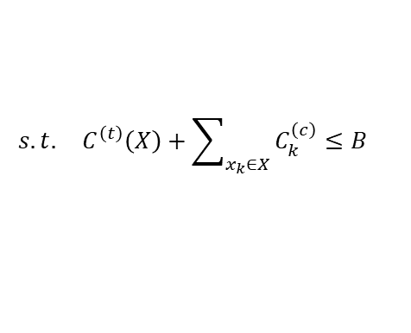
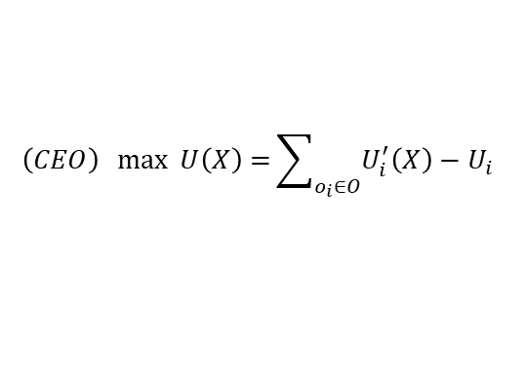
Problem Reformulation
When the solution space is reduced from infinite set to finite set, CEO problem can be transformed into CEO-R problem:
$$\left(CEO\right) \max{ U\left(X\right)=}\sum_{o_{i}∈O}{U_{i}^{′}\left(X\right)−U_{i}}$$
$$s.t. C^{\left(t\right)}\left(X\right)+\sum_{x_{k}∈X}{C_{k}^{\left(c\right)}}≤B$$
－ Background－
－ Model－
－ Solution－
－ Analysis－
－ Experiments－
$$\left(CEO−R\right) \max{ U\left(Z^{′}\right)=}\sum_{o_{i}∈O}{U_{i}^{′}\left(Z^{′}\right)−U_{i}}$$
$$s.t. C^{\left(t\right)}\left(Z^{′}\right)+\sum_{z_{k}∈Z^{′}}{C_{k}^{\left(c\right)}}≤B$$
The transformed CEO-R problem is a nonlinear combinatorial optimization problem, which is still difficult to solve.
Notes:
在进行离散化后，解空间被降为有限集，进而可将CEO问题转化为CEO-R问题，
至此，我们解决了本文的第二点挑战，即解空间无限性
但转化后的CEO-R问题是一个非线性组合优化问题，解决仍有难度

Slide 21
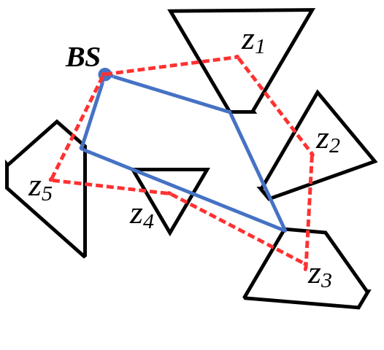
Traveling Path Construction
CEO Problem
Traveling path
TSP among spots
of WCV
CEO-R Problem
Traveling path
Touring among areas
of WCV
－ Background－
－ Model－
－ Solution－
－ Analysis－
－ Experiments－
Circular Discretization
Polygonal Discretization
（non-convex→NP-Hard ）
Convex Polygons
Touring among convex polygon areas^{[1]}
Touring among convex polygons
[1] X. Tan and B. Jiang, “Efficient algorithms for touring a sequence of convex polygons and related problems,” in TAMC, 2017, pp. 614–627.
Notes:
接下来介绍充电车路径构建问题的解决方法。
原CEO问题中，需要解决的路径规划问题可规约为TSP问题；
而转化后的CEO-R问题中的路径规划则被转化成求解遍历多区域的路径问题。
在第一步的圆形区域离散化后，对于产生的曲边多边形子区域，没有好的办法可以求得最优路径；
因此我们进行了下一步的多边形区域离散化。然而对于产生的非凸多边形子区域，求最优路径时NP难的；
从而我们将非凸区域转化为凸区域后，该路径问题变为多项式时间内可解。我们可利用巡游多边形问题的有效算法求得最优路径。
至此，我们解决了本文的第三个挑战。

Slide 22
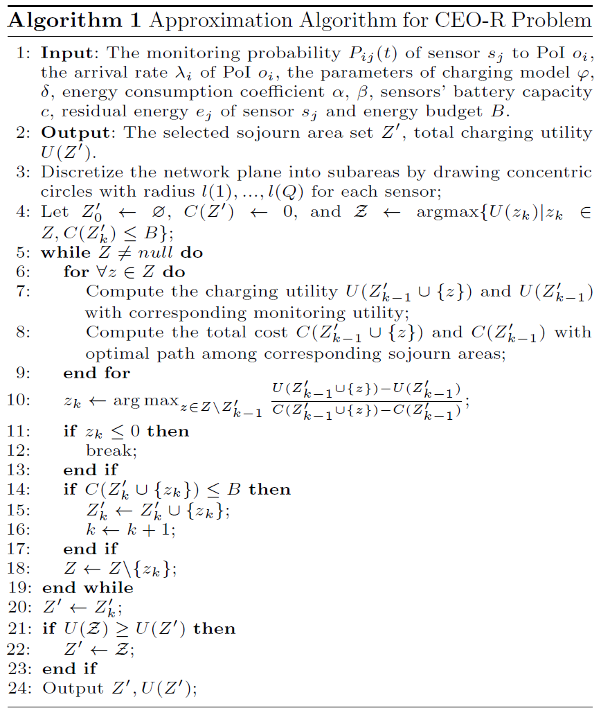
Approximation Algorithm
To solve the CEO-R problem, we propose an efficient approximation algorithm:
Considering area selection and path construction at the same time.
Different selection lead to different traveling path.
01
－ Background－
－ Model－
－ Solution－
－ Analysis－
－ Experiments－
Cost-Benefit Ratio is utilized to evaluate sojourn areas.
Cost-Benefit Ratio is defined as the ratio of marginal benefit growth and marginal cost growth.
Iterative selection according to greedy strategy.
02
When Cost-Benefit Ratio is negative, selection terminated.
Negative Cost-Benefit Ratio indicates no marginal benefit growth.
03
Notes:
之后，为解决CEO-R问题，本文设计了一种高效的近似算法，简要步骤如下：
由于选区域问题与路径问题互相耦合，因此本算法同时着手两个问题，进行两方面的同步计算；
通过计算成本收益比，评价各子区域的优劣，采用贪心策略进行选择；
若成本收益比为0或负，则跳出循环；

Slide 23
Approximation Algorithm
Select until budget is exceeded.
For each newly selected area, recalculate corresponding charging utility and WCV traveling path.
04
－ Background－
－ Model－
－ Solution－
－ Analysis－
－ Experiments－
Select suboptimal solution when the optimal one exceeds the budget.
When any selection will exceed the budget, jump out of the iteration.
05
Compare with the baseline value.
Output set is compared to the set with a single element which has the maximum marginal benefit growth. The one with larger utility is output as the result set.
06
Notes:
4. 在每次选择元素后，更新路径规划与路径消耗；
5. 当某次迭代的最优选择超出约束时放弃，选择满足约束条件的次优解直至能量预算分配完；
6. 将选择结果与基准对比值比较后输出。

Slide 24
PART 04
－ Background－
－ Model－
－ Solution－
－ Analysis－
－ Experiments－
Theoretical Analysis
Notes:
第四部分中，通过理论分析和证明来评估本文方案的性能。

Slide 25
NP Hardness
CEO Problem
Simplified
Ignore the path planning
NP-Hard
Select elements with maximum benefit under budget constraints
－ Background－
－ Model－
－ Solution－
－ Analysis－
－ Experiments－
can be reduced to
Budgeted maximum coverage problem
NP-Hard
NP-Hard
To solve the CEO problem, general algorithms cannot obtain the optimal solution in acceptable time, so it is necessary to reduce the difficulty of solving the problem through problem transformation and approximation algorithm.
Notes:
首先给出CEO-R问题的NP难解性证明。
忽略路径相关问题，简化后的CEO-R问题可被规约为预算约束下的最大化覆盖问题，这一问题是经典的NP-Hard问题；
另一方面，路径相关问题涉及TSP，也是NP-Hard。因此，CEO问题本质是多个NP-Hard问题的耦合，亦为NP-Hard。
因此，设计问题转化与近似算法是必要且有效的。
必要、有效

Slide 26
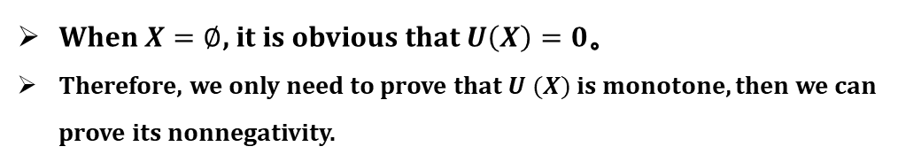
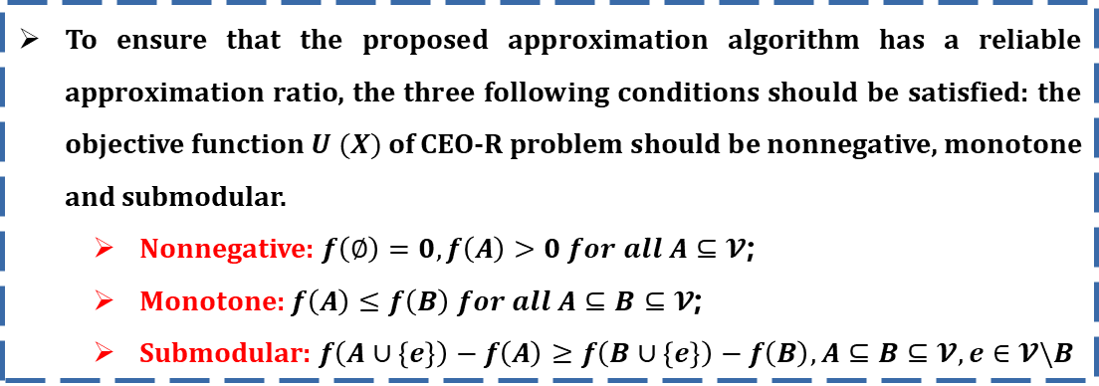
Properties of objective function
To ensure that the proposed approximation algorithm has a reliable approximation ratio, the three following conditions should be satisfied: the objective function $U (X)$of CEO-R problem should be nonnegative, monotone and submodular.
  Nonnegative: $f\left(∅\right)=0, f\left(A\right)>0 for all A⊆𝓥$;
  Monotone: $f\left(A\right)≤f\left(B\right) for all A⊆B⊆𝓥$;
  Submodular: $f\left(A∪\left\{e\right\}\right)−f\left(A\right)≥f\left(B∪\left\{e\right\}\right)−f\left(B\right),A⊆B⊆𝓥, e∈𝓥\backslash B$
－ Background－
－ Model－
－ Solution－
－ Analysis－
－ Experiments－
Nonnegativity
When $X=∅$, it is obvious that $U\left(X\right)=0$。
Therefore, we only need to prove that $U (X)$ is monotone, then we can prove its nonnegativity.
Notes:
本文提出的近似算法在目标函数具有非负、单调、次模性时才具有可靠的近似率，因此，我们对目标函数U(X)是否具有这三种性质进行证明。
证明过程较为繁琐，具体细节在此略过。

Slide 27
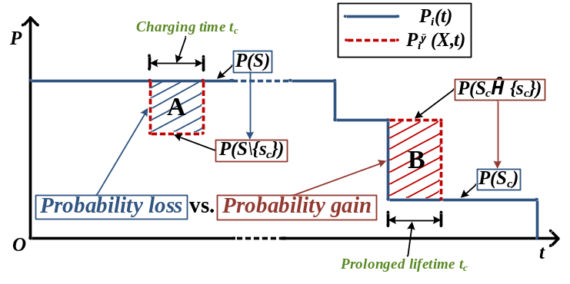

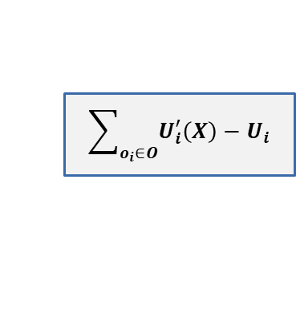
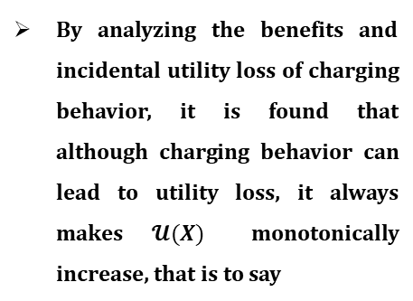





Monotonicity
$$U\left(X\right)$$
$$\sum_{o_{i}∈O}{U_{i}^{′}\left(X\right)−U_{i}}$$
$$U_{i}^{′}\left(X\right)−U_{i}$$
Transitivity of monotonicity
and submodularity
$$h(𝓤(X))$$
$$U_{i}^{′}(X)$$
－ Background－
－ Model－
－ Solution－
－ Analysis－
－ Experiments－
By analyzing the benefits and incidental utility loss of charging behavior, it is found that although charging behavior can lead to utility loss, it always makes $𝓤(X)$ monotonically increase, that is to say
Probability gain and probability loss in different time periods.
$$𝒰(X∪\{x_{k}\})≥𝒰(X)$$
Therefore, $U\left(X\right)$ is monotone.
Notes:
在单调性证明中，我们利用上述三种性质的可传递性，将U(X)进行转化，转化为更容易分析的形式，并通过分析比较充电行为产生的收益和由充电排他性引起的附带损失，并对充电行为导致的不同时间段内的监测概率增益与损失进行评估，证明了目标函数的单调性。

Slide 28
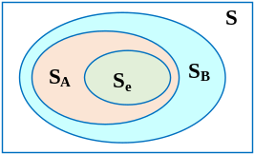
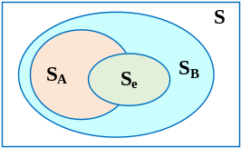
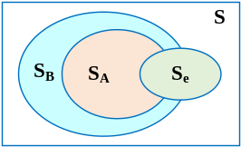
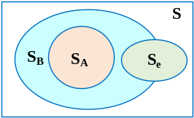
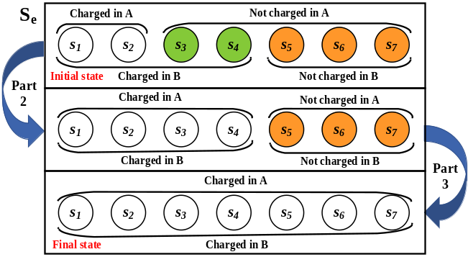
Submodularity
To prove the submodularity, the four possible relationships among charged, to-be-charged and uncharged sensor sets in two different situations A and B are classified, and the marginal benefit growth of newly added elements in these cases are analyzed.
－ Background－
－ Model－
－ Solution－
－ Analysis－
－ Experiments－
Possible relationships of charged, to be charged, and uncharged sensor sets
By analyzing the specific charging process under various relationships, the charging utility increment under the conditions A and B is quantitatively compared, and the submodularity is proved.
Specific charging process
With a slightly relaxed budget, the output of our proposed scheme is better than $(1−1/e)/2$ of the optimal solution to CEO problem with a smaller charging radius $(1−ξ)D_{c}$.
Notes:
在次模性证明中，对多种不同情况下的被充电、待充电、未充电节点集间的所有可能关系进行分类讨论，并对每种情况下的充电效用增量进行计算推导，最终证明了目标函数次模性成立。
因此，我们证明了本文近似算法具有可靠的近似率。同时，也解决了本文的最后一项挑战。

Slide 29
－ Background－
－ Model－
－ Solution－
－ Analysis－
－ Experiments－
PART 05
Experiments
Notes:
最后，通过大量的实验，我们验证了本文提出方案的性能。

Slide 30
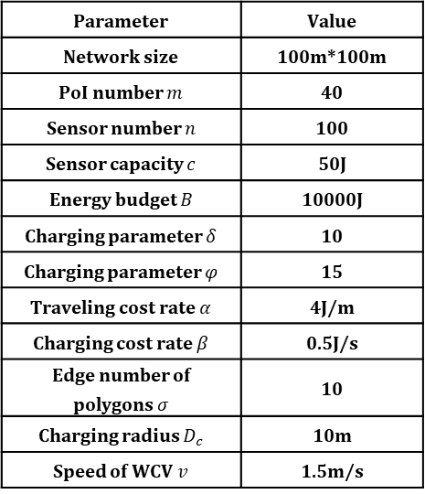
Simulation Setup
Simulation parameters
Parameter | Value
Network size | 100m*100m
PoI number $m$ | 40
Sensor number $n$ | 100
Sensor capacity $c$ | 50J
Energy budget $B$ | 10000J
Charging parameter $δ$ | 10
Charging parameter $φ$ | 15
Traveling cost rate $α$ | 4J/m
Charging cost rate $β$ | 0.5J/s
Edge number of polygons $σ$ | 10
Charging radius $D_{c}$ | 10m
Speed of WCV $v$ | 1.5m/s
In this experiment, we simulate the effect of charging exclusivity, and set sensors to stop working until the charging is completed.
－ Background－
－ Model－
－ Solution－
－ Analysis－
－ Experiments－
Baseline Setup
ME: Maximizing energy received by sensors;
CHASE^{[1]}: State-of-the-art algorithm;
CEO: Our scheme;
CCO: Our scheme in ideal simulation assumption (without charging exclusivity);
CHASE-C: CHASE without charging exclusivity.
[1] H. Dai, Q. Ma, X. Wu, G. Chen, D. K. Y. Yau, S. Tang, X. Li, and C. Tian, “CHASE: charging and scheduling scheme for stochastic event capture in wireless rechargeable sensor networks,” IEEE Transactions on Mobile Computing, vol. 19, no. 1, pp. 44–59, 2020.
Notes:
在仿真实验中，为了避免生成的随机事件具有伪随机性，本实验采用来自医疗机构统计的癫痫病人的真实发病数据作为随机事件数据源。
设置三个对比算法与本文方案进行性能比较。

Slide 31
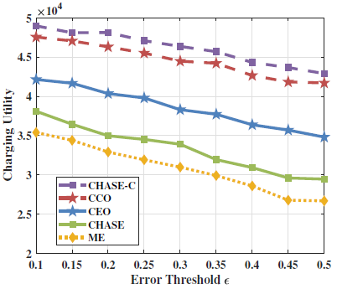
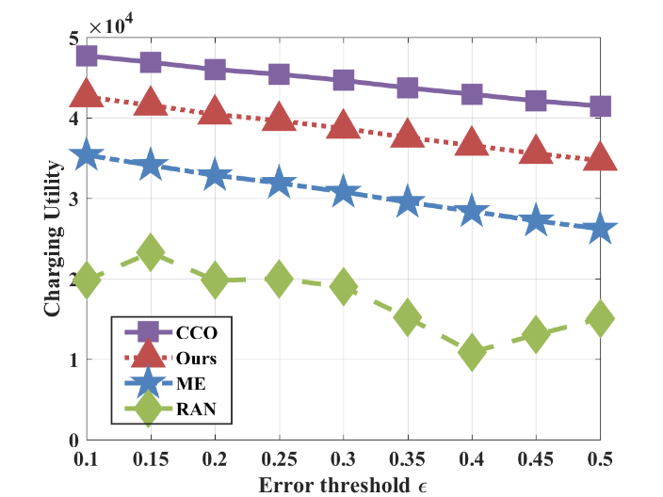










Charging utility in different settings
－ Background－
－ Model－
－ Solution－
－ Analysis－
－ Experiments－
Error threshold $ε$
Energy budget $B$
Edge number of polygons $σ$
Event arrival rate $λ$
Under different parameter settings, the performance of our scheme is 21.3% higher than other baseline algorithms on average.
Notes:
仿真过程中，通过改变各种网络参数设置，将不同算法的相应的充电效用做对比，可以发现，在不同参数改变的情况下，本文方案明显优于对比算法。

Slide 32


Charging equipment
in realistic scenario
Diagram of experiment scene
－ Background－
－ Model－
－ Solution－
－ Analysis－
－ Experiments－
In the actual scene experiment, the WRSN is deployed by simulating the fire monitoring network.
10 monitoring points are set in different positions in an open area, which are regarded as PoIs, 25 sensors are deployed around these PoIs to monitor events.
The local temperature is used as the benchmark for monitoring extreme temperature events.
Notes:
在仿真实验的基础上，我们在实际场景设置了相应的实验验证算法的实际可行性。我们的实际实验设备如图所示，在一块空旷区域中模拟温度监测网络，以气温统计值作为基准对比量，监测极端气温事件。

Slide 33


Experiments vs. simulations vs. theoretical results
Utility vs. Budget
－ Background－
－ Model－
－ Solution－
－ Analysis－
－ Experiments－
There is a gap of 3-15% between the theoretical value, experimental value and simulation value. Our simulation and experimental results fit well with theoretical analysis.
When energy budget rises from 50 to 450, our proposed algorithm apparently outperforms other two baseline algorithms.
Through realistic experiments, numerical results demonstrate the feasibility and superiority of our proposed scheme.
Notes:
通过将实际实验数据与仿真实验数据和理论计算值进行对比，发现实际值较理论值和仿真值偏低，变化趋势一致，说明实验结果契合理论分析。
右图表示，通过与基线算法的对比，在改变网络参数设置的过程中，本文算法始终明显优于其余对比算法。
综合来说，本文方案在实际场景中的应用具有可行性和优越性。

Slide 34
Thanks for listening!
Trading off Charging and Sensing for Stochastic Events Monitoring in WRSNs
Yu Sun*, Chi Lin*, Haipeng Dai†, Qiang Lin‡, Lei Wang*, and Guowei Wu*
*School of Software Technology, Dalian University of Technology, Dalian 116023, China
†State Key Laboratory for Novel Software Technology, Nanjing University, Nanjing 210024, China
‡Dalian University of Science and Technology, Dalian 116052, China

