Slide 1

Time-efficient Range Detection in Commodity RFID Systems
Jia Liu, Xingyu Chen, Haisong Liu, Hualin Gong, Yanyan Wang, Lijun Chen
Notes:
Hello，everyone. I am Xingyu Chen, a Ph.D student from Nanjing university.
In this talk, I will introduce an efficient method to do range detection in a commercial off-the-shelf RFID system.

Slide 2

01
Background
CONTENT
02
System design
03
Evaluation
04
Conclusion
Notes:
Here is the outline of this talk, including four parts.
Background, system design, evaluation, and conclusion.

Slide 3
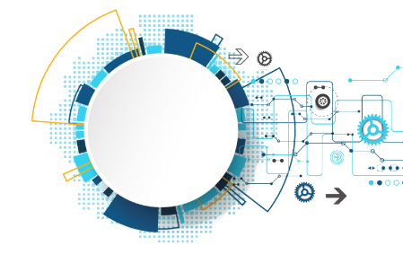
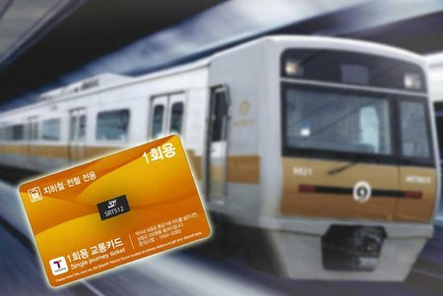
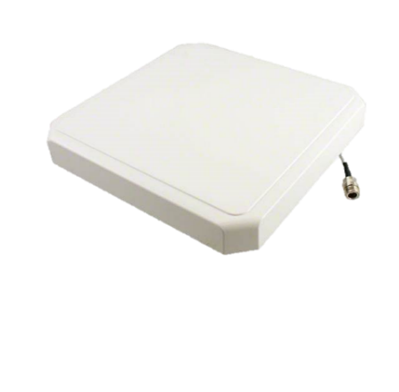

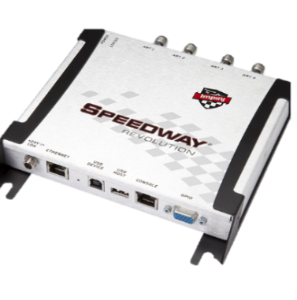
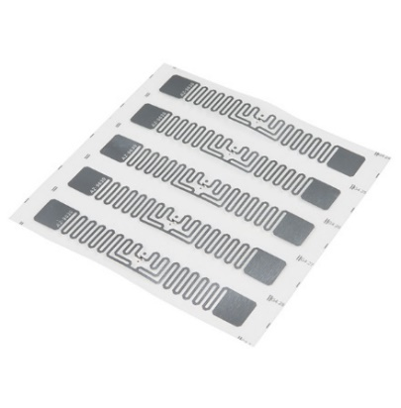

Background
What is RFID?
01
RFID System
Antenna
Access Control
Computer
Reader
Tag
Supply Chain
Notes:
RFID plays an important role in IoT applications. A typical RFID system consists of four components: the computer, the reader, the antenna, and the tag. Since a tag is cheap and battery-free, it is a good choice for many applications in our daily lives, including our ID card and supply chain.

Slide 4

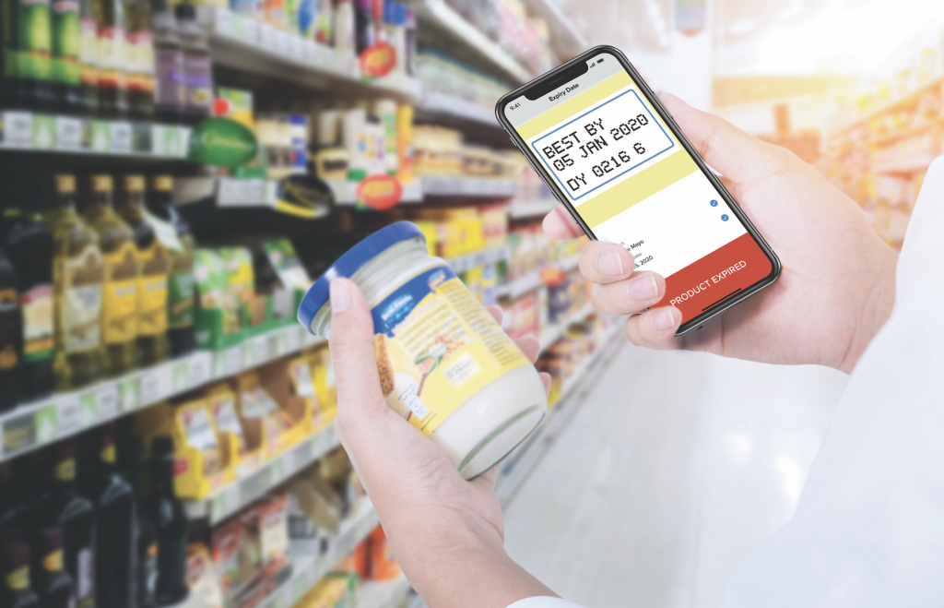

Background
Range Detection
01
Collect tags with data between an upper and lower boundary
Tag information:
ID ：FFFE 2131
Tag
Expiration date：06\05\2020
Detect products past their expiration date.
Notes:
In this work, we study the problem of range detection in RFID systems. So what is range detection？It means ”to collect RFID tags with data between an upper and lower boundary.” It can be used in some practical applications. For example, in a supermarket, the staff may need to do the live query for checking whether there are expired products by collecting the sell-by date from tags.

Slide 5
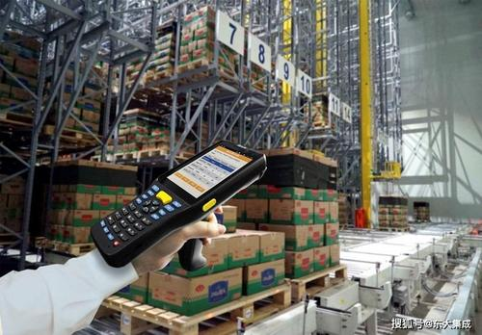

Background
Range Detection
01
Collect tags with data between an upper and lower boundary
Tag information:
62℃
ID ：F2FE 2001
Temperature：62℃
23℃
Detect unusual temperature levels.
24℃
27℃
Notes:
Consider a chilled food storage chamber, where each food is affixed with a tag equipped
with a thermal sensor. If the temperature data of a tag is higher than a threshold, an advance warning should be activated to protect people and products. From the above examples, we know that range detection is important.

Slide 6

Background
Problem definition
01
d1
d2
d3
d4
dn
…
T:
n tags
d1’
d2’
dm’
T’
…
T′ ={ di |di∈ T, τL≤di≤ τR}
m tags
Notes:
Formally, we give the definition of the problem of range detection.
Given a tag set T which has n tags. We need to find a subset T’ of T that consists of m target tags. The target tag means the tag with data in a certain range.

Slide 7
Background
Existing Solution
01
Notes:
For example, there are 18 tags

Slide 8
Background
Existing Solution
01
Notes:
and the reds tags are the target.

Slide 9
Background
Existing Solution
01
Notes:
In traditional way, we need to collect each tag exclusively; one at a time.
We collect the first tag, the second, third, and the last.

Slide 10
Background
Existing Solution
01
Notes:
In traditional way, we need to collect each tag exclusively; one at a time.
We collect the first tag, the second, third, and the last.

Slide 11
Background
Existing Solution
01
Notes:
In traditional way, we need to collect each tag exclusively; one at a time.
We collect the first tag, the second, third, and the last.

Slide 12
Background
Existing Solution
01
Notes:
After collecting data from all tags, we know which tags are the target.

Slide 13
Background
Existing Solution
01
Exclusive Collection (EC) : Time consuming,
especially in a large RFID system.
Notes:
This kind of collection is referred to as exclusive collection.
This works but is not efficient, especially in a large RFID system.

Slide 14

System design
Basic Idea
02
Silence the tag that is not the target
Notes:
The low time efficiency of exclusive collection is due to
the fact that the reader has to communicate with each tag,
even though the tag is not the target. If we can silence most
of these tags, a great deal of communication overhead can
be avoided.

Slide 15

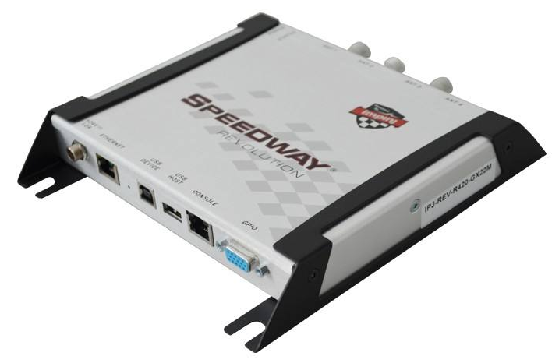
System design
Selective Query (SQ)
02
Target tags: Date between 06\05\2020 and 06\15\2020
06\01\2020
Silence
06\06\2020
06\10\2020
06\18\2020
Notes:
Based on this idea, we propose selective query. Selective query divides the collection into rounds. In each round, the reader deals with a group of tags that have the same data. If a group contains target tags, the reader will collect tags in it one by one. Otherwise, the reader will silence this group and move to the next round. In this case, the reader can avoid collecting tags in group 1 and 4 and thus saves a lot of times.

Slide 16
System design
Selective Query (SQ)
02
Target tags: Date between 06\05\2020 and 06\15\2020
06\01\2020
Silence
06\06\2020
Collect
06\10\2020
Collect
06\18\2020
Silence
Notes:
Based on this idea, we proposed selective query. Selective query divides the collection into rounds. In each round, the reader deal with a group of tags that have the same data. If a group contains target tags, the reader will collect tags in it one by one. Otherwise, the reader will silence this group and move to the next round. In this case, the reader can avoid collecting tags in group 1 and 4 and thus it can save a lot of time.

Slide 17

System design
Gen2 Protocol
02
Related functions in EPCglobal Gen2 standard (Gen2) ^{[1]} :
F1: Select Command.
F2: Query Command.
[1] GS1 EPCglobal. EPC radio-frequency identity protocols generation-2 UHF RFID version 2.0.1, 2015.
Notes:
Now, I introduce how to implement this process in practice. Gen2 is the widely used RFID standard. It defines the physical and logical interfaces between readers and tags. In this work We use two related functions in Gen2 protocol to silence the tag that is not target. The first function is the select command and the second function is the query command.

Slide 18
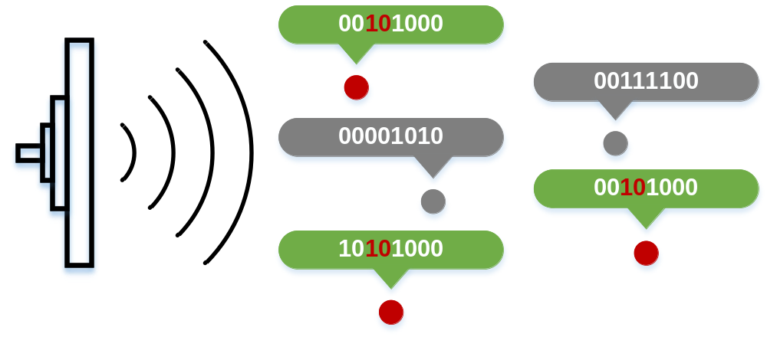
System design
Select Command
02
Fields of Select command:
Session
Action
Bit mask
Reader
Tags
Select
Target = 1
Action = 4
MemBank = 1
Pointer = 2
Length = 2
Mask = 10
B
A
A
B
B
Set inventory flags to either A or B
Notes:
I first introduce the select command. This command allows a reader to choose a subset of tags to reply. The select command has six fields. The first is Target. It indicates which flag to be used. A tag has four inventory flags. In this example, target is equal to 1, so the first inventory flag is used. The second field is action. It shows how can we set the inventoried flag. The last four fields determine which tags are matching. If the string stored in the tag’s memory is the same as the bitmask, then the tag is matched. In this example, the red tags are matching due to the bitmask `10’. Their flags are set to B while others are set to A.

Slide 19
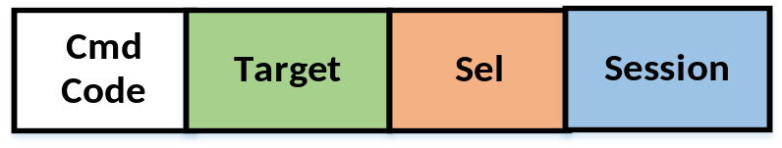
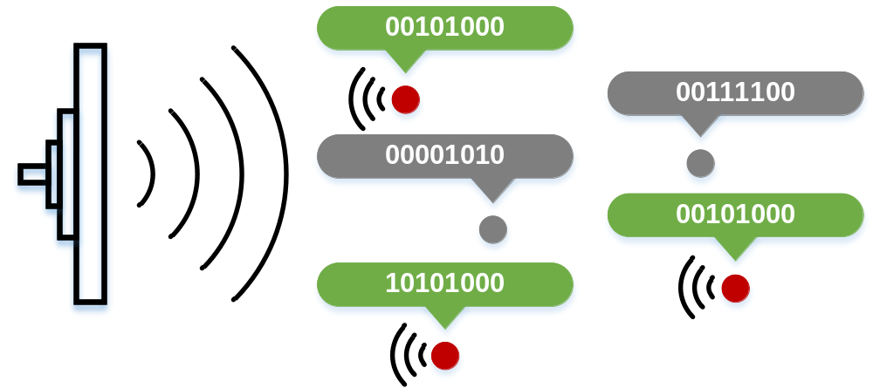
System design
Query Command
02
Fields of Query command:
Inventoried flag A (0) or B (1)
Reader
Tags
Query
B
Target = 1
Session = 1
Sel = 0
A
A
B
B
The tags with Target state B will reply to the reader
Notes:
The second function is the query command. By using this command, we can let tags with state A or B reply to the reader. Query command has three fields. The field session means which inventory flag to be used. The field Target determines which tags will respond, where 0 means the state A and 1 means state B. In this example, all tags with flag B will reply to the reader.

Slide 20
System design
Selective Query (SQ)
02
Command: Flag = AB：S(2, 0, 3, 0, 0, 0)
A
A
A
06\01\2020
A
A
06\06\2020
A
A
06\10\2020
A
A
06\18\2020
Notes:
Then, we introduce how to realize SQ with the above two functions. The RFID reader first sets all tags’ flags to A with a select command.

Slide 21
System design
Selective Query (SQ)
02
Command: Flag = AB：S(2, 0, 3, 0, 0, 0)
Target = 2: Select flag 2
Action = 0: Matching tag to A, nonmatching tag to B
Bitmask = (3,0,0,0): All tags are matching
A
A
A
06\01\2020
A
A
06\06\2020
A
A
06\10\2020
A
A
06\18\2020
Notes:
In this select command, the action field is set to 0. So the matching tags are set to A while the no-matching tags are set to B. The bitmask is empty. So all tags are matching tag and their inventory flags will be set to A.

Slide 22
System design
Selective Query (SQ)
02
Command: Query A：Q(0, 2, 0)
A
A
A
06\01\2020
A
A
06\06\2020
A
A
06\10\2020
A
A
06\18\2020
Notes:
After that, the reader randomly collects an A tag through a query command. In this case, the reader is collecting data from the first tag.

Slide 23
System design
Selective Query (SQ)
02
Command: Flag = B-：S(2, 5, 3, p1, l1, d1)
B
B
B
06\01\2020
Silence
A
A
06\06\2020
Collect
A
A
06\10\2020
Collect
A
A
06\18\2020
Silence
Notes:
Since it is not the target tag. The reader silences all tags in its group by setting their flags to B. One select command is used to do this job.

Slide 24
System design
Selective Query (SQ)
02
Command: Flag = B-：S(2, 5, 3, p1, l1, d1)
Target = 2: Select flag 2
Action = 5: Matching tag to B
Bitmask = (3,p1,l1,d1): Tags in the first group are matching
B
B
B
06\01\2020
Silence
A
A
06\06\2020
Collect
A
A
06\10\2020
Collect
A
A
06\18\2020
Silence
Notes:
In this select command, the action field is 5. It means if a tag matches the bitmask, its flag will be set to B, otherwise its flag will keep unchanged. We use the data of the first tag as the bitmask. So all tags in the first group are matching and their flags will be set to B.

Slide 25
System design
Selective Query (SQ)
02
Command: Query A：Q(0, 2, 0)
B
B
B
06\01\2020
Silence
B
A
06\06\2020
Collect
A
A
06\10\2020
A
A
06\18\2020
Notes:
After that, the reader starts a new round and queries the fourth tag.

Slide 26
System design
Selective Query (SQ)
02
Command: Query A：Q(0, 2, 0)
B
B
B
06\01\2020
Silence
B
B
06\06\2020
Collect
A
A
06\10\2020
A
A
06\18\2020
Notes:
Since the fourth tag is a target tag. The reader will do nothing and collects the fifth tag, the sixth, and the seventh.

Slide 27
System design
Selective Query (SQ)
02
Command: Query A：Q(0, 2, 0)
B
B
B
06\01\2020
Silence
B
B
06\06\2020
Collect
B
A
06\10\2020
Collect
A
A
06\18\2020
Notes:
Since the fourth tag is a target tag. The reader will do nothing and collects the fifth tag, the sixth, and the seventh.

Slide 28
System design
Selective Query (SQ)
02
Command: Query A：Q(0, 2, 0)
B
B
B
06\01\2020
Silence
B
B
06\06\2020
Collect
B
B
06\10\2020
Collect
A
A
06\18\2020
Notes:
Since the fourth tag is a target tag. The reader will do nothing and collects the fifth tag, the sixth, and the seventh.

Slide 29
System design
Selective Query (SQ)
02
Command: Flag = B-：S(2, 5, 3, p2, l2, d2)
B
B
B
06\01\2020
Silence
B
B
06\06\2020
Collect
B
B
06\10\2020
Collect
B
B
06\18\2020
Silence
Notes:
Since the eighth tag is not a target, its group will be silenced.
After all tags have been set to B, the reader terminates the collection process. As we can see, through selective query, the four red target tags in the second and third groups have been collected successfully.

Slide 30
System design
Selective Query (SQ)
02
Number of readings = 1 + 2 + 2 + 1 = 6 < 9 (EC)
B
B
B
06\01\2020
1
B
B
06\06\2020
2
B
B
06\10\2020
2
B
B
06\18\2020
1
Notes:
In this case, the selective query uses 6 readings to collect four target tags, three unnecessary readings of the non target tags can be avoided.

Slide 31
System design
Selective Query (SQ)
02
B
B
B
06\01\2020
2 unnecessary readings
B
B
06\06\2020
B
B
06\10\2020
B
B
06\18\2020
Notes:
Although Selective query is very efficient, it’s still worth noting that selective query still needs two redundant readings when silencing the tags in group 1 and group 4. If we can remove the two tags from the collection process, the time efficiency will be further improved.

Slide 32
System design
Range Query (RQ)
02
Set tags in the target range to A while others to B
B
B
B
06\01\2020
A
A
06\06\2020
A
A
06\10\2020
Query A
B
B
06\18\2020
Notes:
To achieve this goal, we propose Range Query. The basic idea of RQ is setting the target tags to A while other tags to B.
After that, the reader can solely collect these red target tags with a query A command.

Slide 33
System design
Range Query (RQ)
02
Task: Collect tags with data ≤ 73
0~73 → A
Bit vector of data
Solution:
0
1
0
0
1
0
0
1
= 73
(Right boundry)
Mask String:
0
0
0
0
1
0
0
1
Find 1st 1
Commands:
① Flag = AB：S(2, 0, 3, 0, 2, “00”)
00000000₂(0)~00111111₂(63) → A
Notes:
Instead of searching all passive value in the target range, Range query uses the left several bits as the bitmask to choose multiple values together. For example, suppose we want the collect tag with data below 73. The bit vector of the upper boundary is given as follows.
We take the left 1 bit before the first A, together with a ‘0’ as the bit mask to choose tags ranging from 0 to 63.

Slide 34
System design
Range Query (RQ)
02
Task: Collect tags with data ≤ 73
0~73 → A
Bit vector of data
Solution:
0
1
0
0
1
0
0
1
= 73
(Right boundry)
Mask String:
0
1
0
0
0
0
0
1
Find 2nd 1
Commands:
① Flag = AB：S(2, 0, 3, 0, 2, “00”)
00000000₂(0)~00111111₂(63) → A
② Flag = A-：S(2, 1, 3, 0, 5, “01000”)
01000000₂(64)~01000111₂(71) → A
Notes:
After that we take the left 4 bits before the second 1, together with a ‘0’ as the bit mask to choose tags with data between 64 and 71. Finally, we take the left 7 bits as the bit mask to choose 72 and 73. Then, the target tags can be collected with Query A command. Following this pattern, we can set tags below the lower boundary to the state B and thus collect tags with data between an upper and lower boundary.

Slide 35
System design
Range Query (RQ)
02
Task: Collect tags with data ≤ 73
0~73 → A
Bit vector of data
Solution:
0
1
0
0
1
0
0
1
= 73
(Right boundry)
Mask String:
0
1
0
0
1
0
0
1
Find 3rd 1
Commands:
① Flag = AB：S(2, 0, 3, 0, 2, “00”)
00000000₂(0)~00111111₂(63) → A
② Flag = A-：S(2, 1, 3, 0, 5, “01000”)
01000000₂(64)~01000111₂(71) → A
③ Flag = A-：S(2, 1, 3, 0, 7, “0100000”)
01001000₂(72)~01001001₂(73) → A
Notes:
Finally, we take the left 7 bits as the bit mask to choose 72 and 73. As we can see, all target tags have been included.

Slide 36
System design
Range Query (RQ)
02
Task: Collect tags with data ≤ 73
0~73 → A
Bit vector of data
Solution:
0
1
0
0
1
0
0
1
= 73
(Right boundary)
Mask String:
0
1
0
0
1
0
0
1
No more 1s
Commands:
① Flag = AB：S(2, 0, 3, 0, 2, “00”)
00000000₂(0)~00111111₂(63) → A
② Flag = A-：S(2, 1, 3, 0, 5, “01000”)
01000000₂(64)~01000111₂(71) → A
③ Flag = A-：S(2, 1, 3, 0, 7, “0100000”)
01001000₂(72)~01001001₂(73) → A
④ Query A：Q(0, 2, 0)
Collect tags with flag = A
Notes:
And we can collect them with a Query A command. If the range also has a lower boundary, 32 in this case. By using the method I introduced before, we first set tags with data below 73 to A and then set tags with data below 32 to B. Then all target tags are set to A and we can collect them through a query a command.

Slide 37
System design
Range Query (RQ)
02
Task: Collect tags with data ≤ 73
0~73 → A
0~73 → A, 0~32 → B (32, 73]
Bit vector of data
Solution:
0
1
0
0
1
0
0
1
= 73
(Right boundary)
Mask String:
0
1
0
0
1
0
0
1
No more 1s
Commands:
① Flag = AB：S(2, 0, 3, 0, 2, “00”)
00000000₂(0)~00111111₂(63) → A
② Flag = A-：S(2, 1, 3, 0, 5, “01000”)
01000000₂(64)~01000111₂(71) → A
③ Flag = A-：S(2, 1, 3, 0, 7, “0100000”)
01001000₂(72)~01001001₂(73) → A
④ Query A：Q(0, 2, 0)
Collect tags with flag = A
Notes:
And we can collect them with a Query A command. If the range also has a lower boundary, 32 in this case. By using the method I introduced before, we first set tags with data below 73 to A and then set tags with data below 32 to B. Then all target tags are set to A and we can collect them through a query A command.

Slide 38
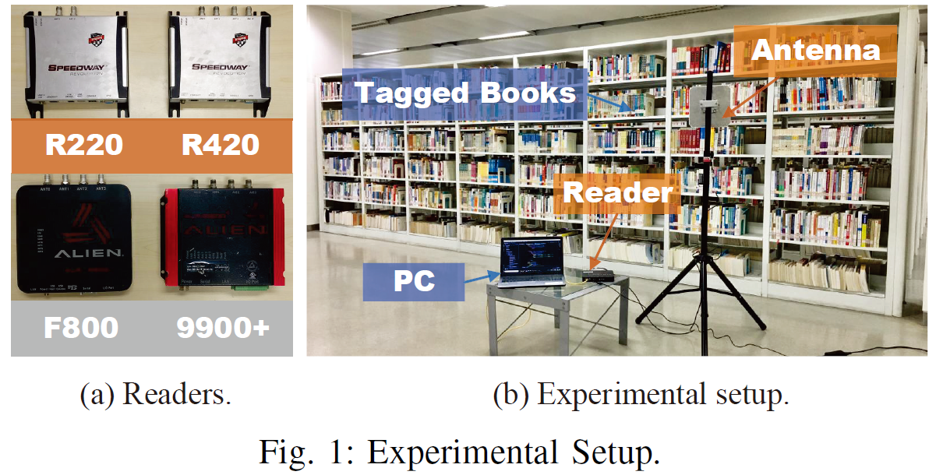
Evaluation
Experimental setup
03
Notes:
We setup a prototype of range detection. This is the experimental settings. As shown in Fig. 1(a), four models of RFID readers are used. To better mimic a real RFID system and study the performance of our protocol in practice, we set up the experiments in a library, where up to 1000 commodity tags are used, which is shown in the right figure.

Slide 39
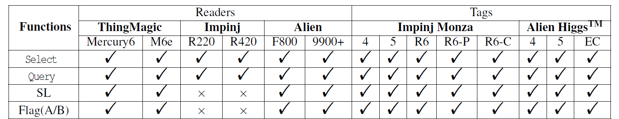
Evaluation
Compatibility
03
Table 1: Gen2-compatibility on Readers and Tags.
RQ functions properly on ALL reader models + ALL tag models

Slide 40
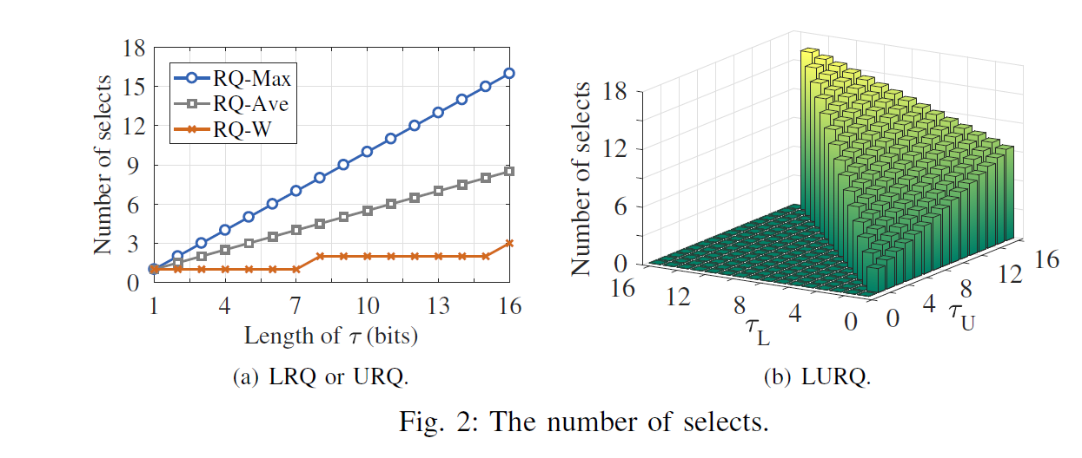
Evaluation
Number of selects
03
Figure 2: The number of selects.
Notes:
Here, we test how many select commands does RQ need to collect the target tags. In the experiment, we vary the length of data from 1 bit to 16 bits. As we can see, the number of select commands increases linearly with the length of data.
The maximal number of selects is sixteen. This small number well indicates that RQ is time-efficient.

Slide 41
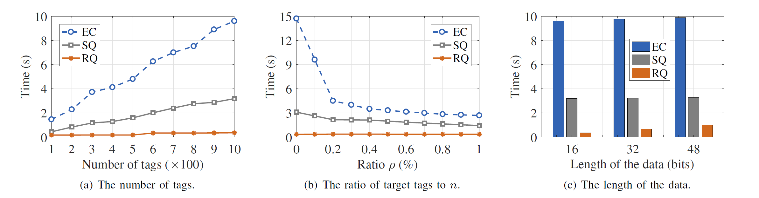
Evaluation
Time efficiency
03
SQ achieves 24× performance gain on average
Figure 3: The comparison of time effieciency.
Notes:
In this experiment, we evaluate the time efficiency. Since there is no existing work that studies range detection, we compare the execution time of range query with exclusive collection and selective query. Three factors are taken into account, including the number of tag, the ratio of target tags to all tags, and the length of the data. Clearly, rang query is more time-efficient than the other two methods. For example, in the case with 1000 tags, the execution time is reduced from 4.8s, to 0.2s.
The performance gain is 24 times. This is a great performance boost.

Slide 42
04
Conclusion
We propose an efficient solution to the practically important problem of check whether there are any tags with the data between an upper and lower boundary in a large RFID system.
01
Our protocol exploits two functions defined in Gen2. With a carefully designed series of commands, it is able to collect tags with data in the target range instead of collecting all tags in the field of view.
02
03
We implement a prototype of RQ with 1000 tags. The experiment results show that RQ can improve the time efficiency of range detection by an order of magnitude.

Slide 43

THANK YOU

