Slide 1



A Case for Temperature-Aware Scheduler for Millimeter-Wave Devices and Networks
Moh Sabbir Saadat, Sanjib Sur, Srihari Nelakuditi
(cse.sc.edu/~msaadat/)
University of South Carolina
The 28th IEEE International Conference on Network Protocols (IEEE ICNP 2020), Madrid, Spain, 2020

Slide 2
Outline
Why Millimeter-Wave for 5G?
Device overheating under Millimeter-Wave
Thermal characterization
Aquilo : A multi-antenna scheduler
Summary and Conclusions

Slide 3
Why Millimeter-Wave for 5G?

Slide 4

5G: Growth in wireless data demand
1.9 Billion
Number of 5G subscriptions
1.3 Billion
~10x
Source: Statista, 2020-2024
190 Million
2020
2023
2024

Slide 5






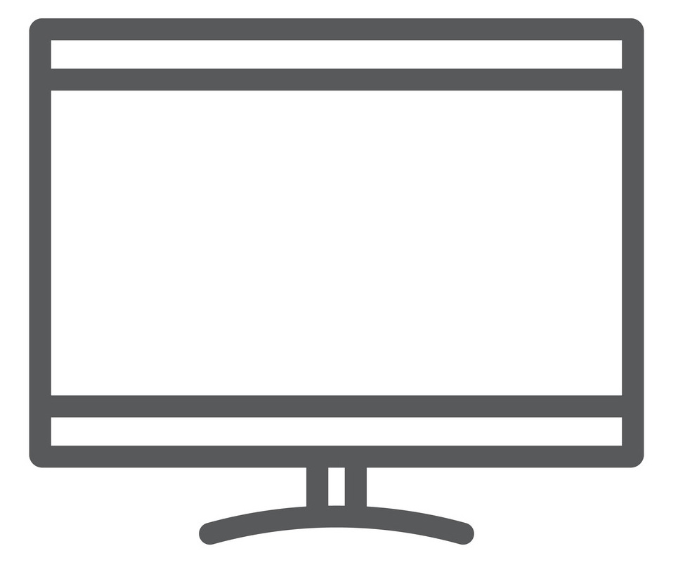
New technology for 5G: The IoT reality
Internet
of
Things (IoT)

Slide 6
New technology for 5G: The IoT reality
Multi-Gbps Throughput
Large Bandwidth
Ultra-Low Latency

Slide 7
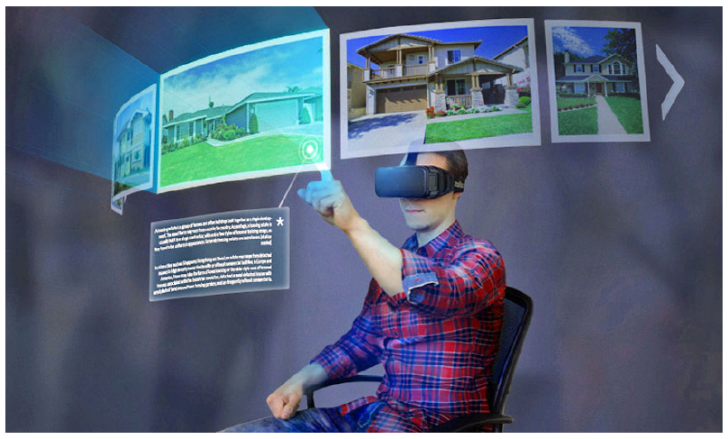
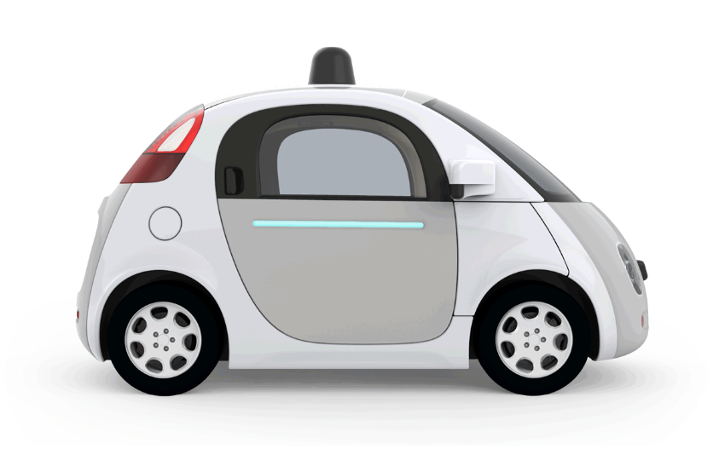
New technology for 5G: high requirements
Immersive VR/AR
Autonomous car
5 ~ 6 Gb/s wireless speed with sub-10 millisecond latency
Locally generates more than 10 Gb/s *
* https://datacenterfrontier.com/autonomous-cars-could-drive-a-deluge-of-data-center-demand/

Slide 8
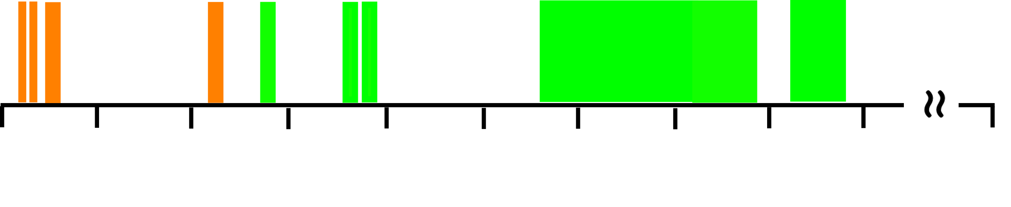
New technology for 5G: Millimeter-Wave
LTE & WiFi: Bandwidth sufficient for 4G
mm-Wave: Manyfold increase in bandwidth, several Gbps throughput
0 GHz 10 GHz 20 GHz 30 GHz 40 GHz 50 GHz 60 GHz 70 GHz 80 GHz 90 GHz 300 GHz
60 GHz unlicensed band under IEEE 802.11ad

Slide 9
Device overheating in Millimeter-Wave networks

Slide 10
Millimeter-Wave challenges
Challenges with Millimeter-Wave connectivity
High propagation loss
Sensitivity to blockage
Beam alignment latency
Device overheating

Slide 11
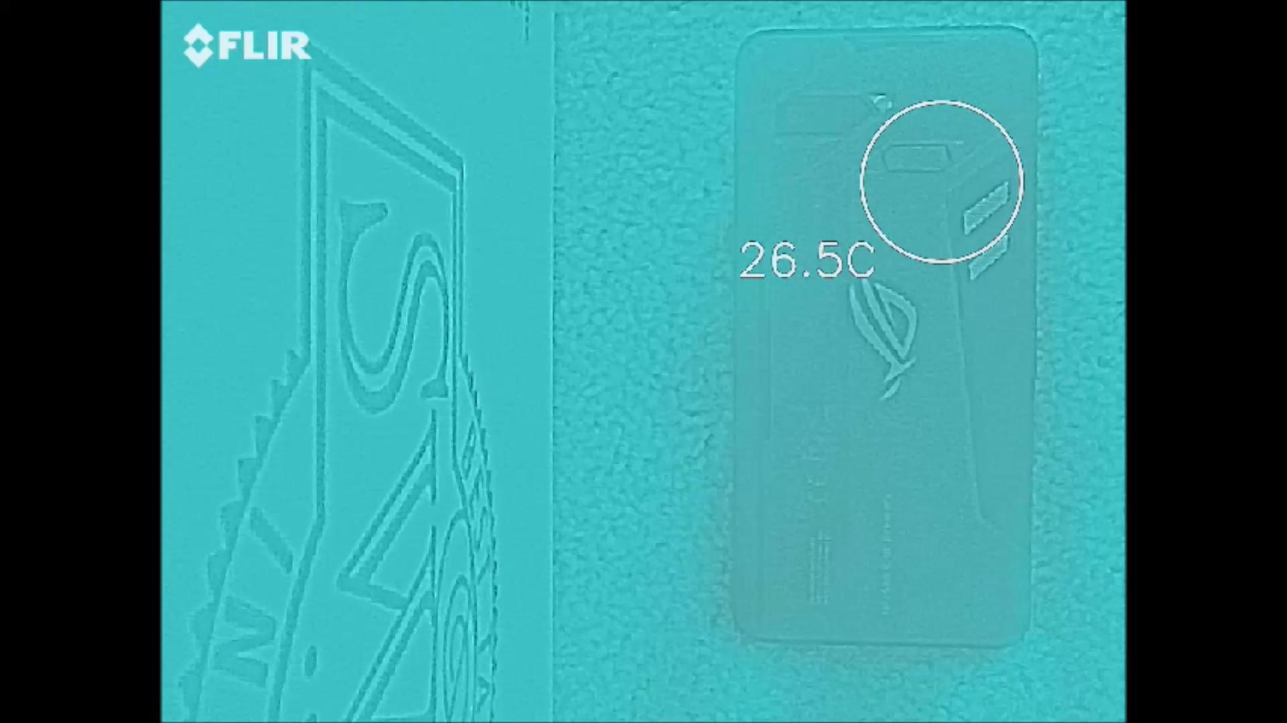
Overheating in
Millimeter-Wave devices
60 GHz Antenna
Reel from a thermal camera
Sped up by 30X,
Total duration ~ 300 s
60 GHz ROG Smartphone

Slide 12
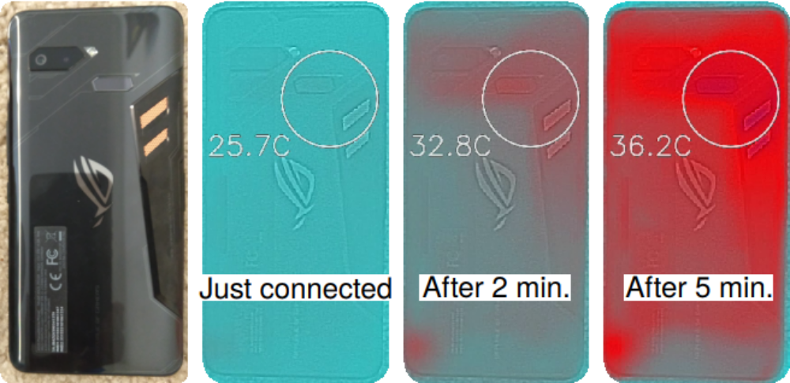
60 GHz ROG smartphone overheating

Slide 13
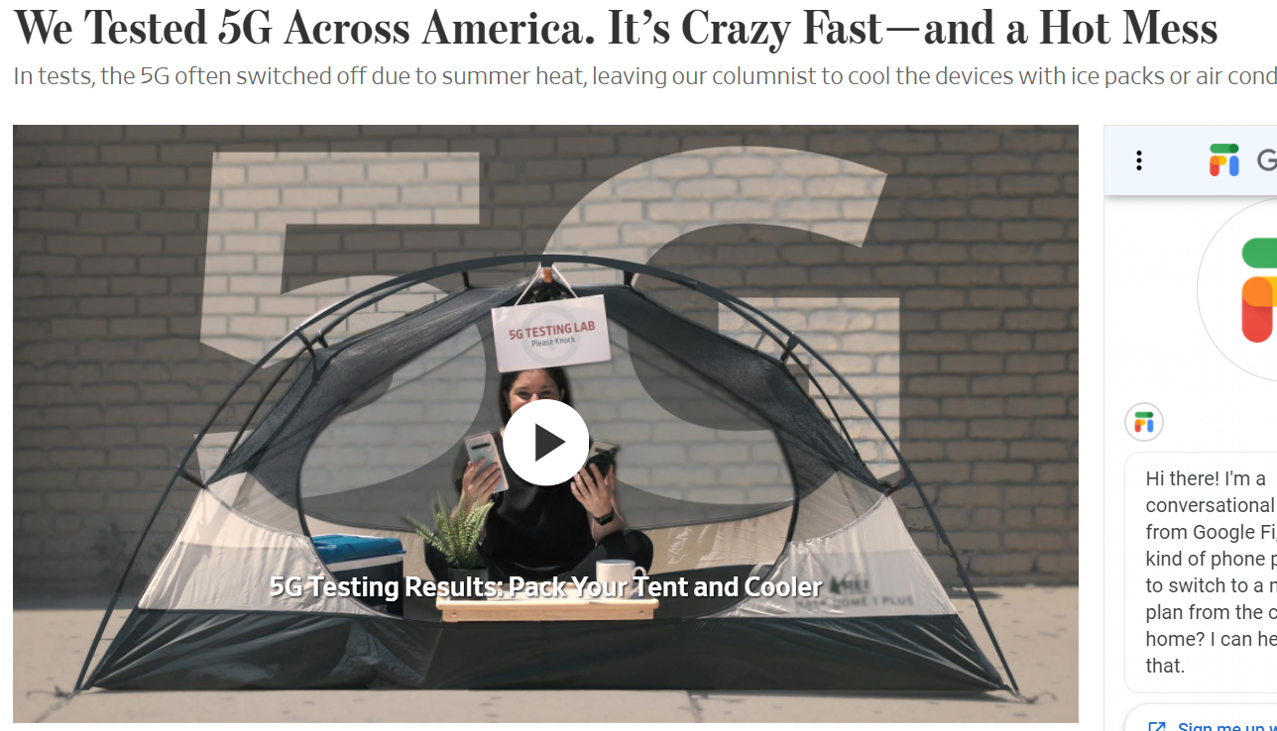
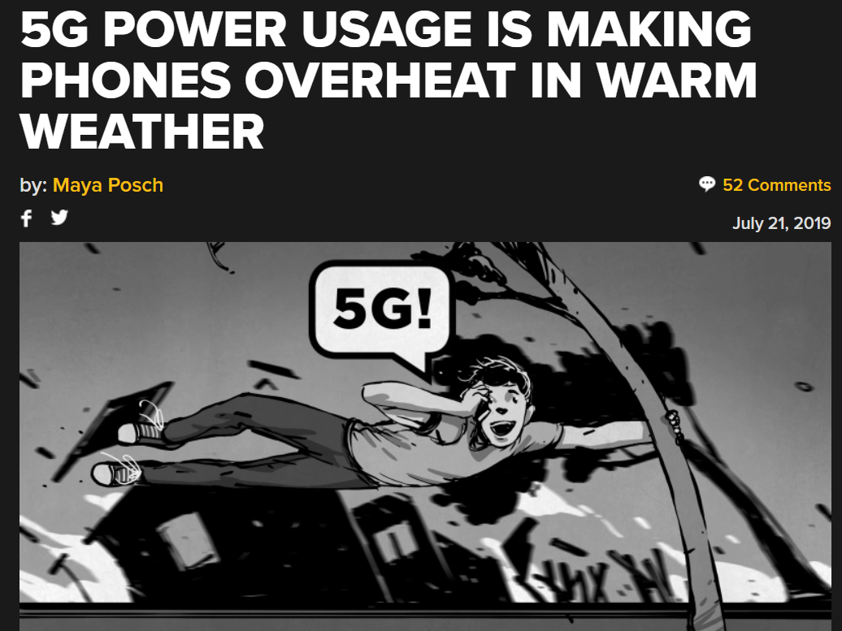
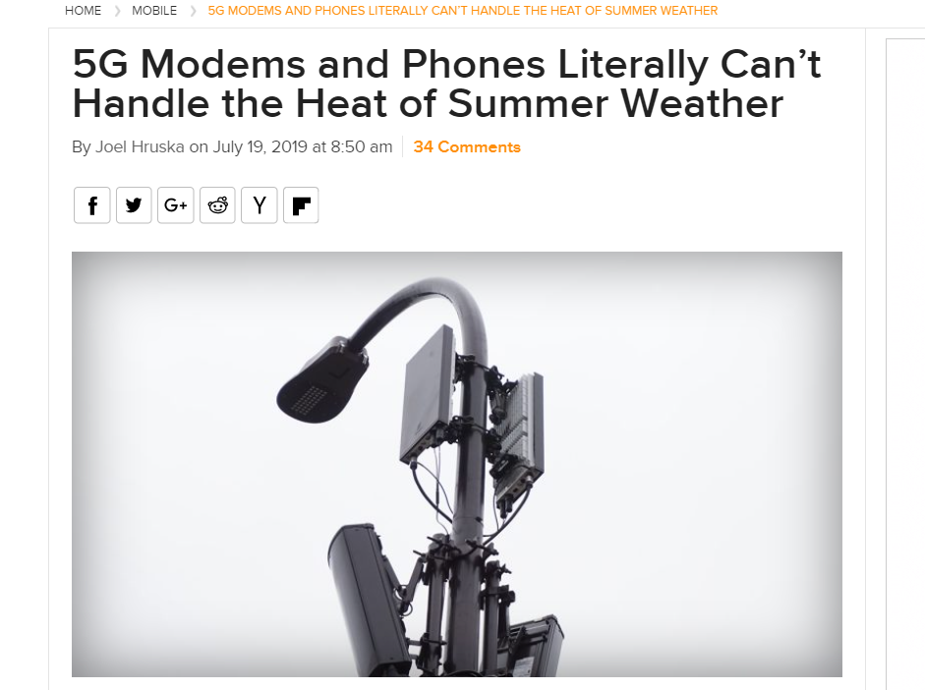
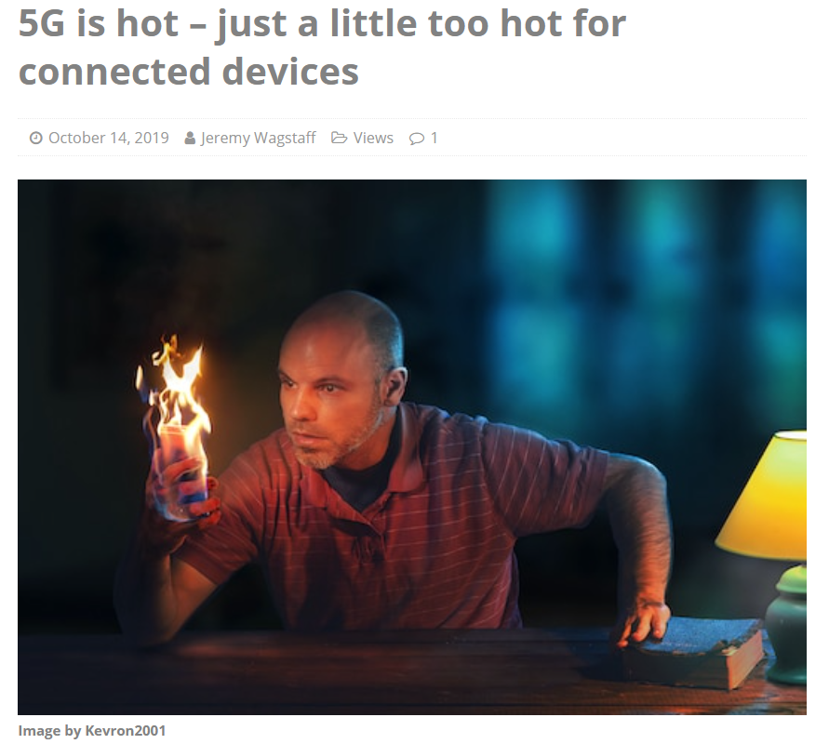
Reports of mmWave device overheating

Slide 14
Device overheating:
discomfort and network degradation
Devices used near face & brain,
e.g. Smartphone, VR
High temperature
high noise and leakage current
Potential health hazards
User discomfort
Fluctuation in throughput
Degraded network

Slide 15
Thermal characterization of Millimeter-Wave devices

Slide 16
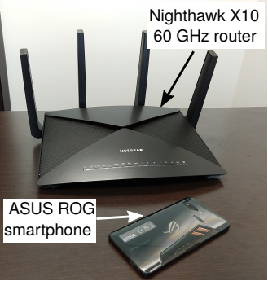
60GHz measurement testbed
Nighthawk X10 60 GHz AP
ASUS ROG 60 GHz Smartphone
Device Features:
IEEE 802.11ad compliant
32-element phased array antenna
2.16 GHz bandwidth
4.62 Gbps peak bit-rate

Slide 17
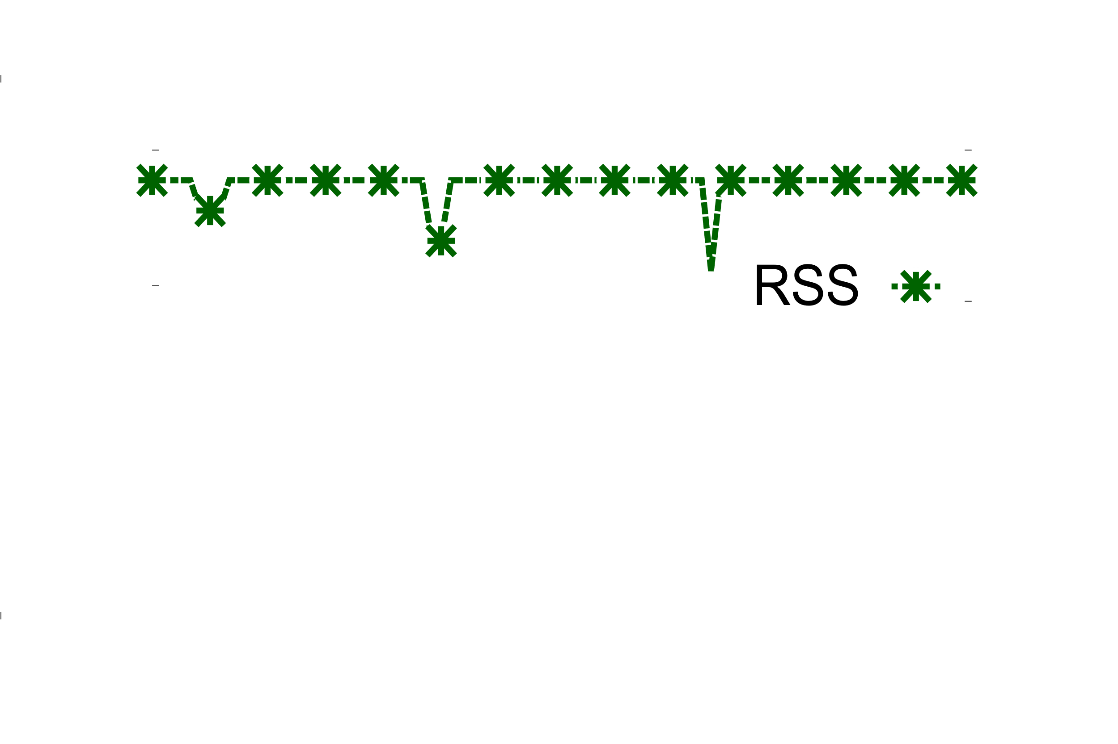
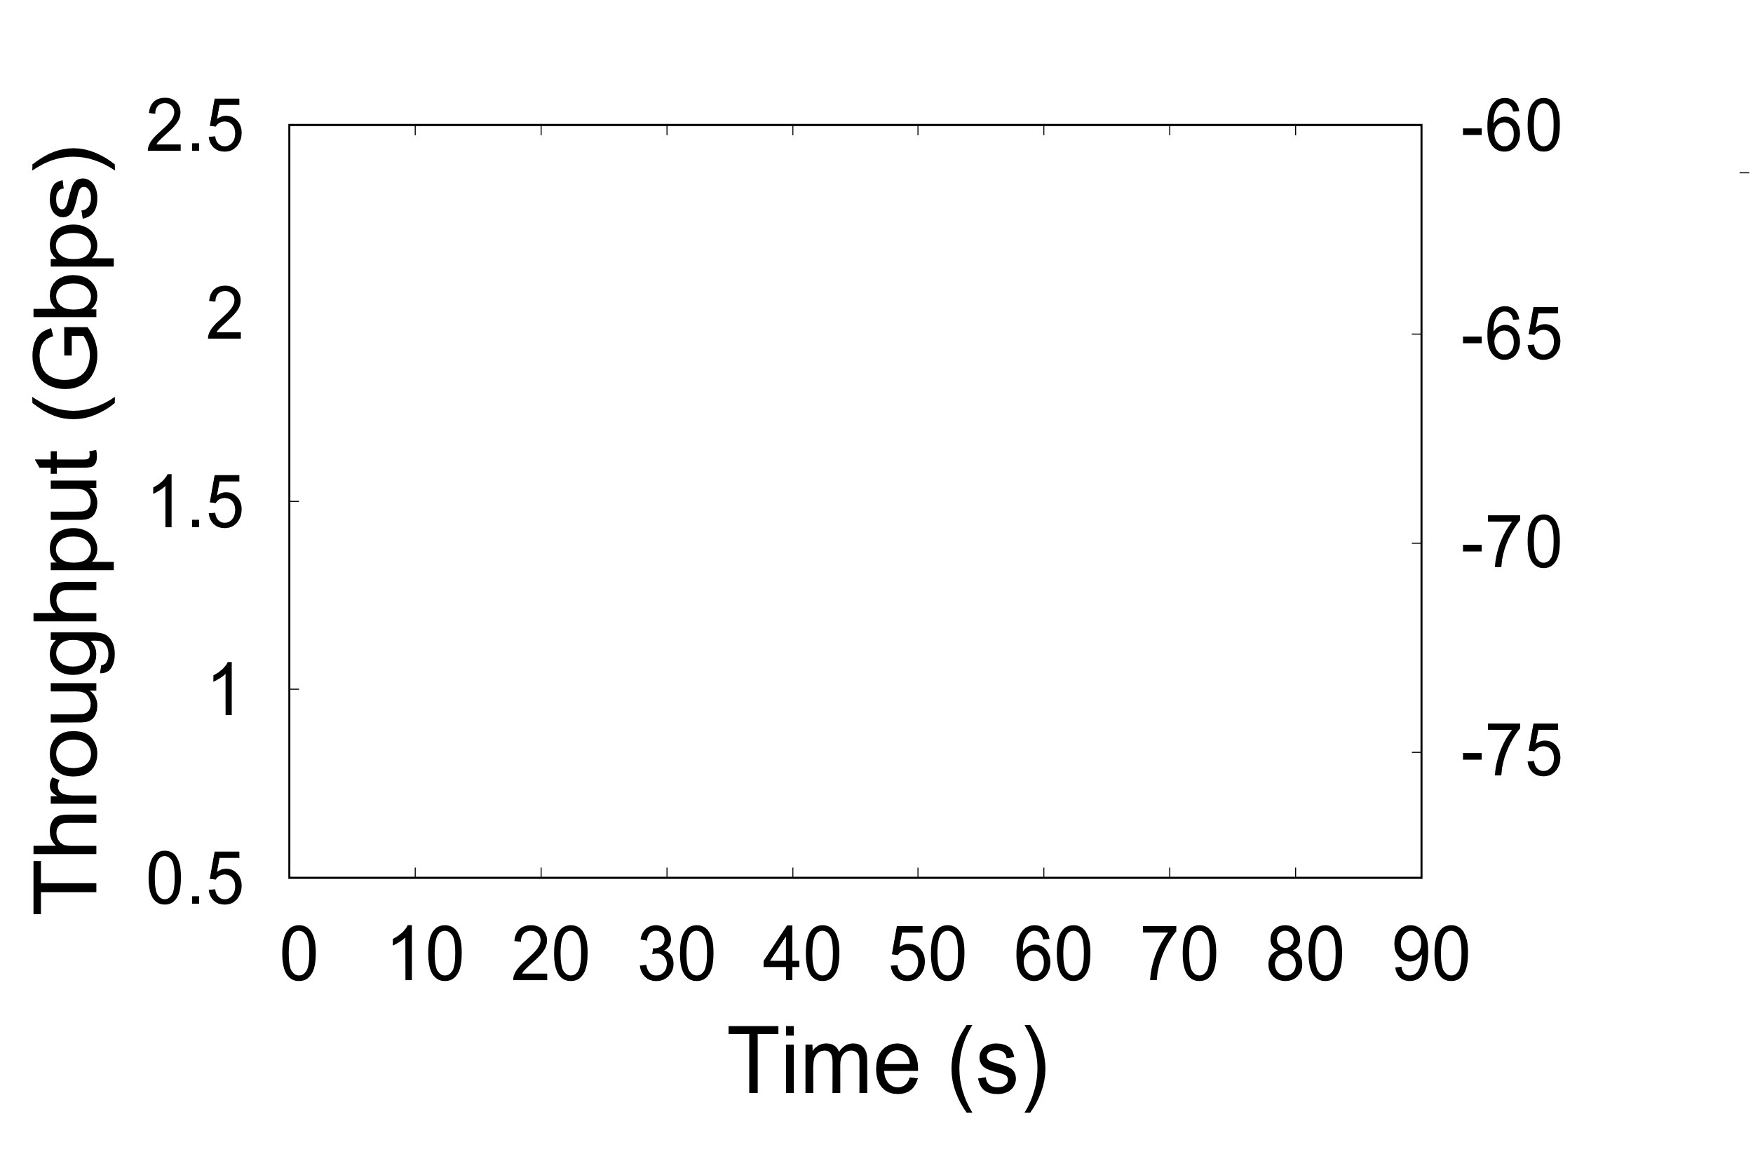
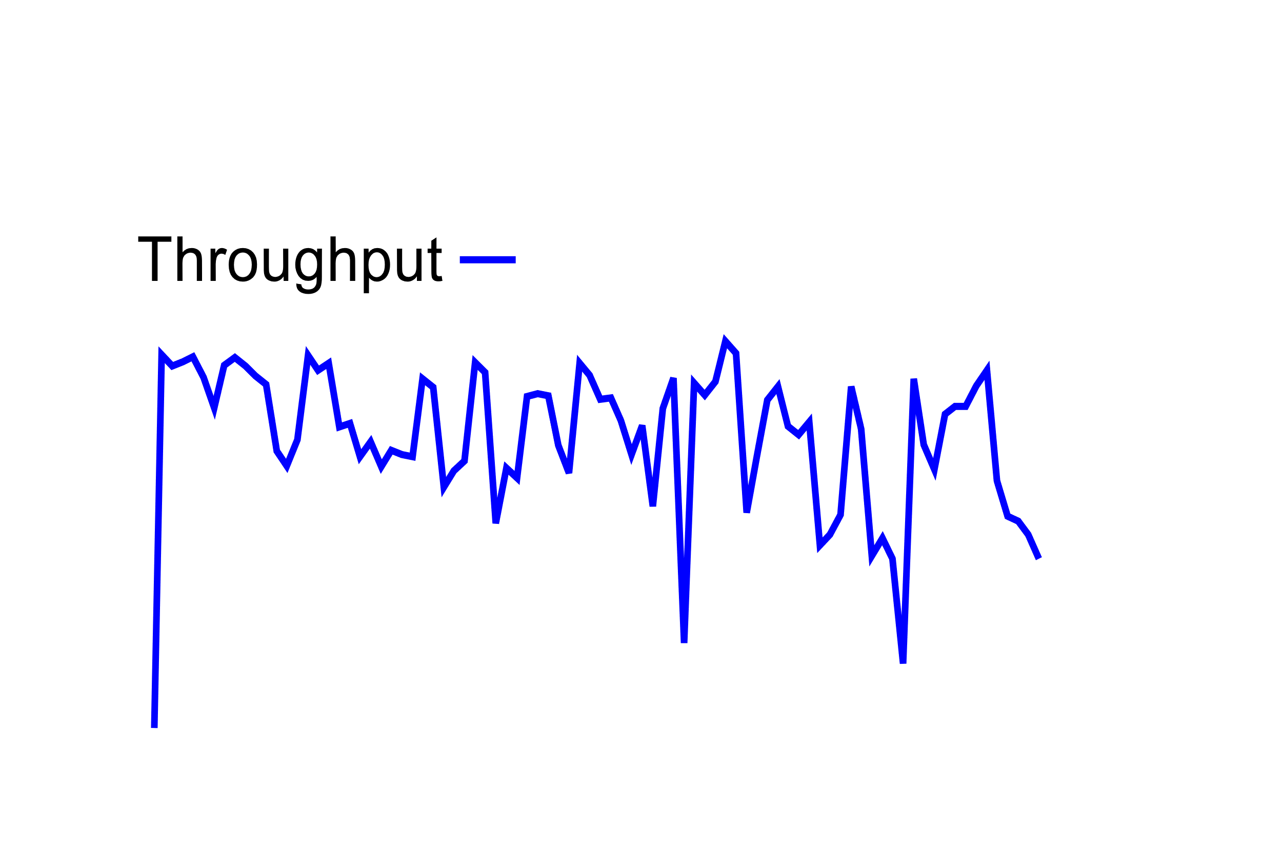

Performance degradation under temperature
Steady network strength at -64 dB
Highly fluctuating throughput, standard deviation 240 Mbps

Slide 18
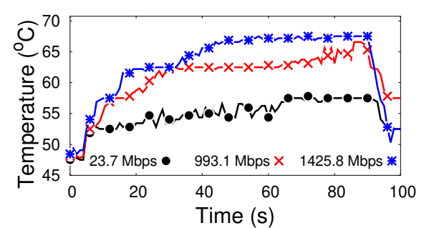
Temperature increase in active state
1425.8 Mbps
993.1 Mbps
23.7 Mbps

Slide 19
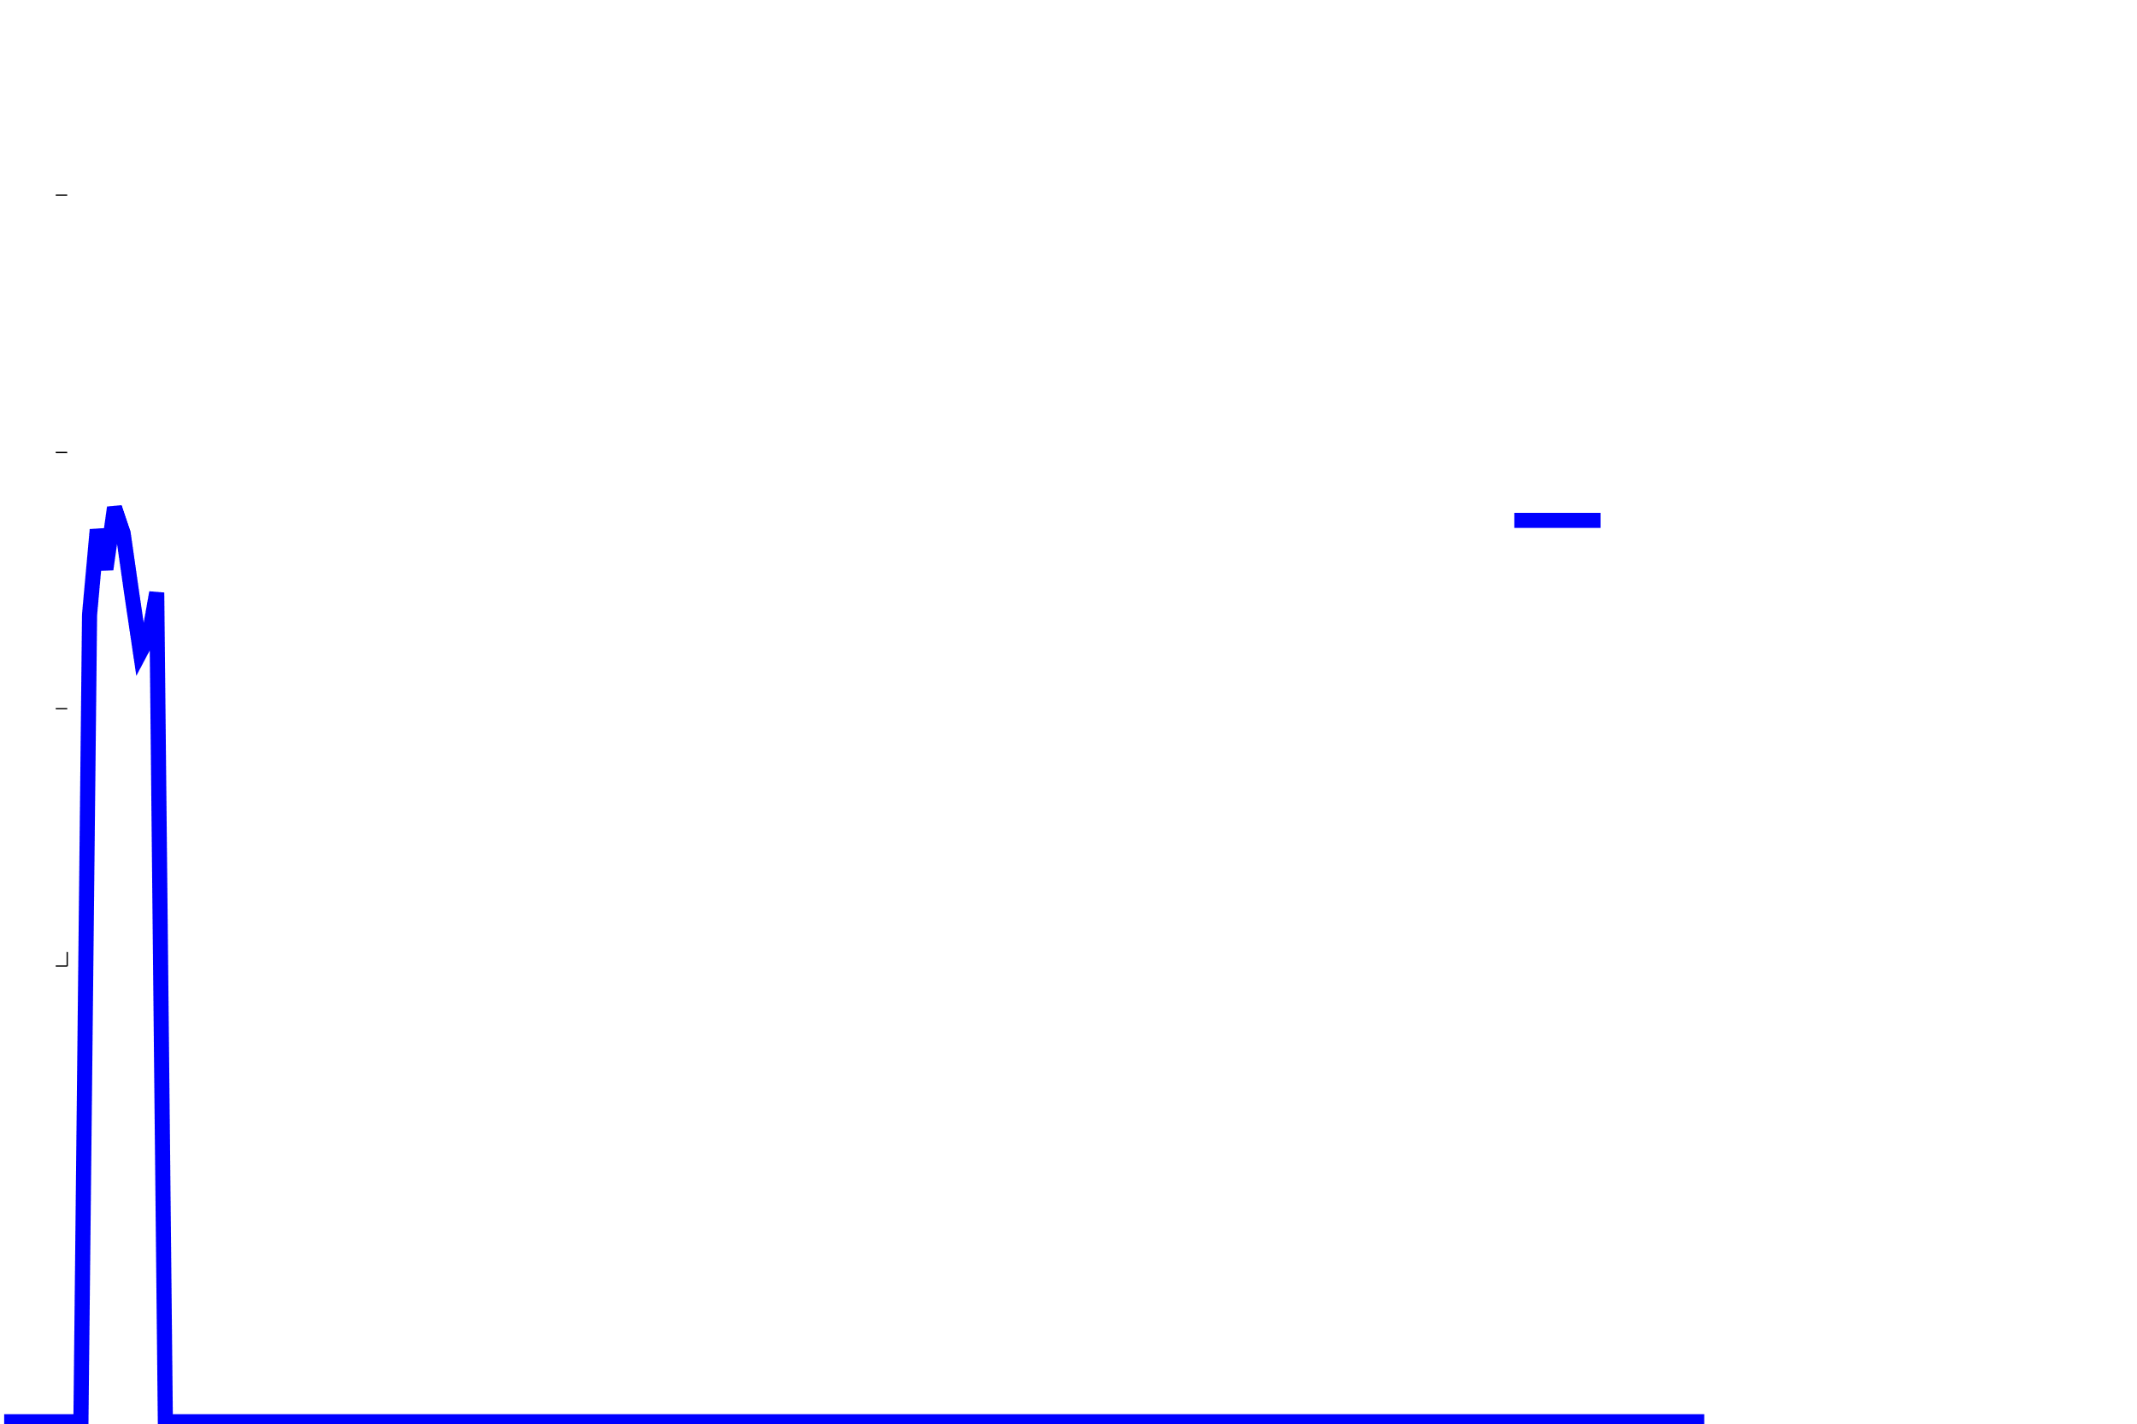
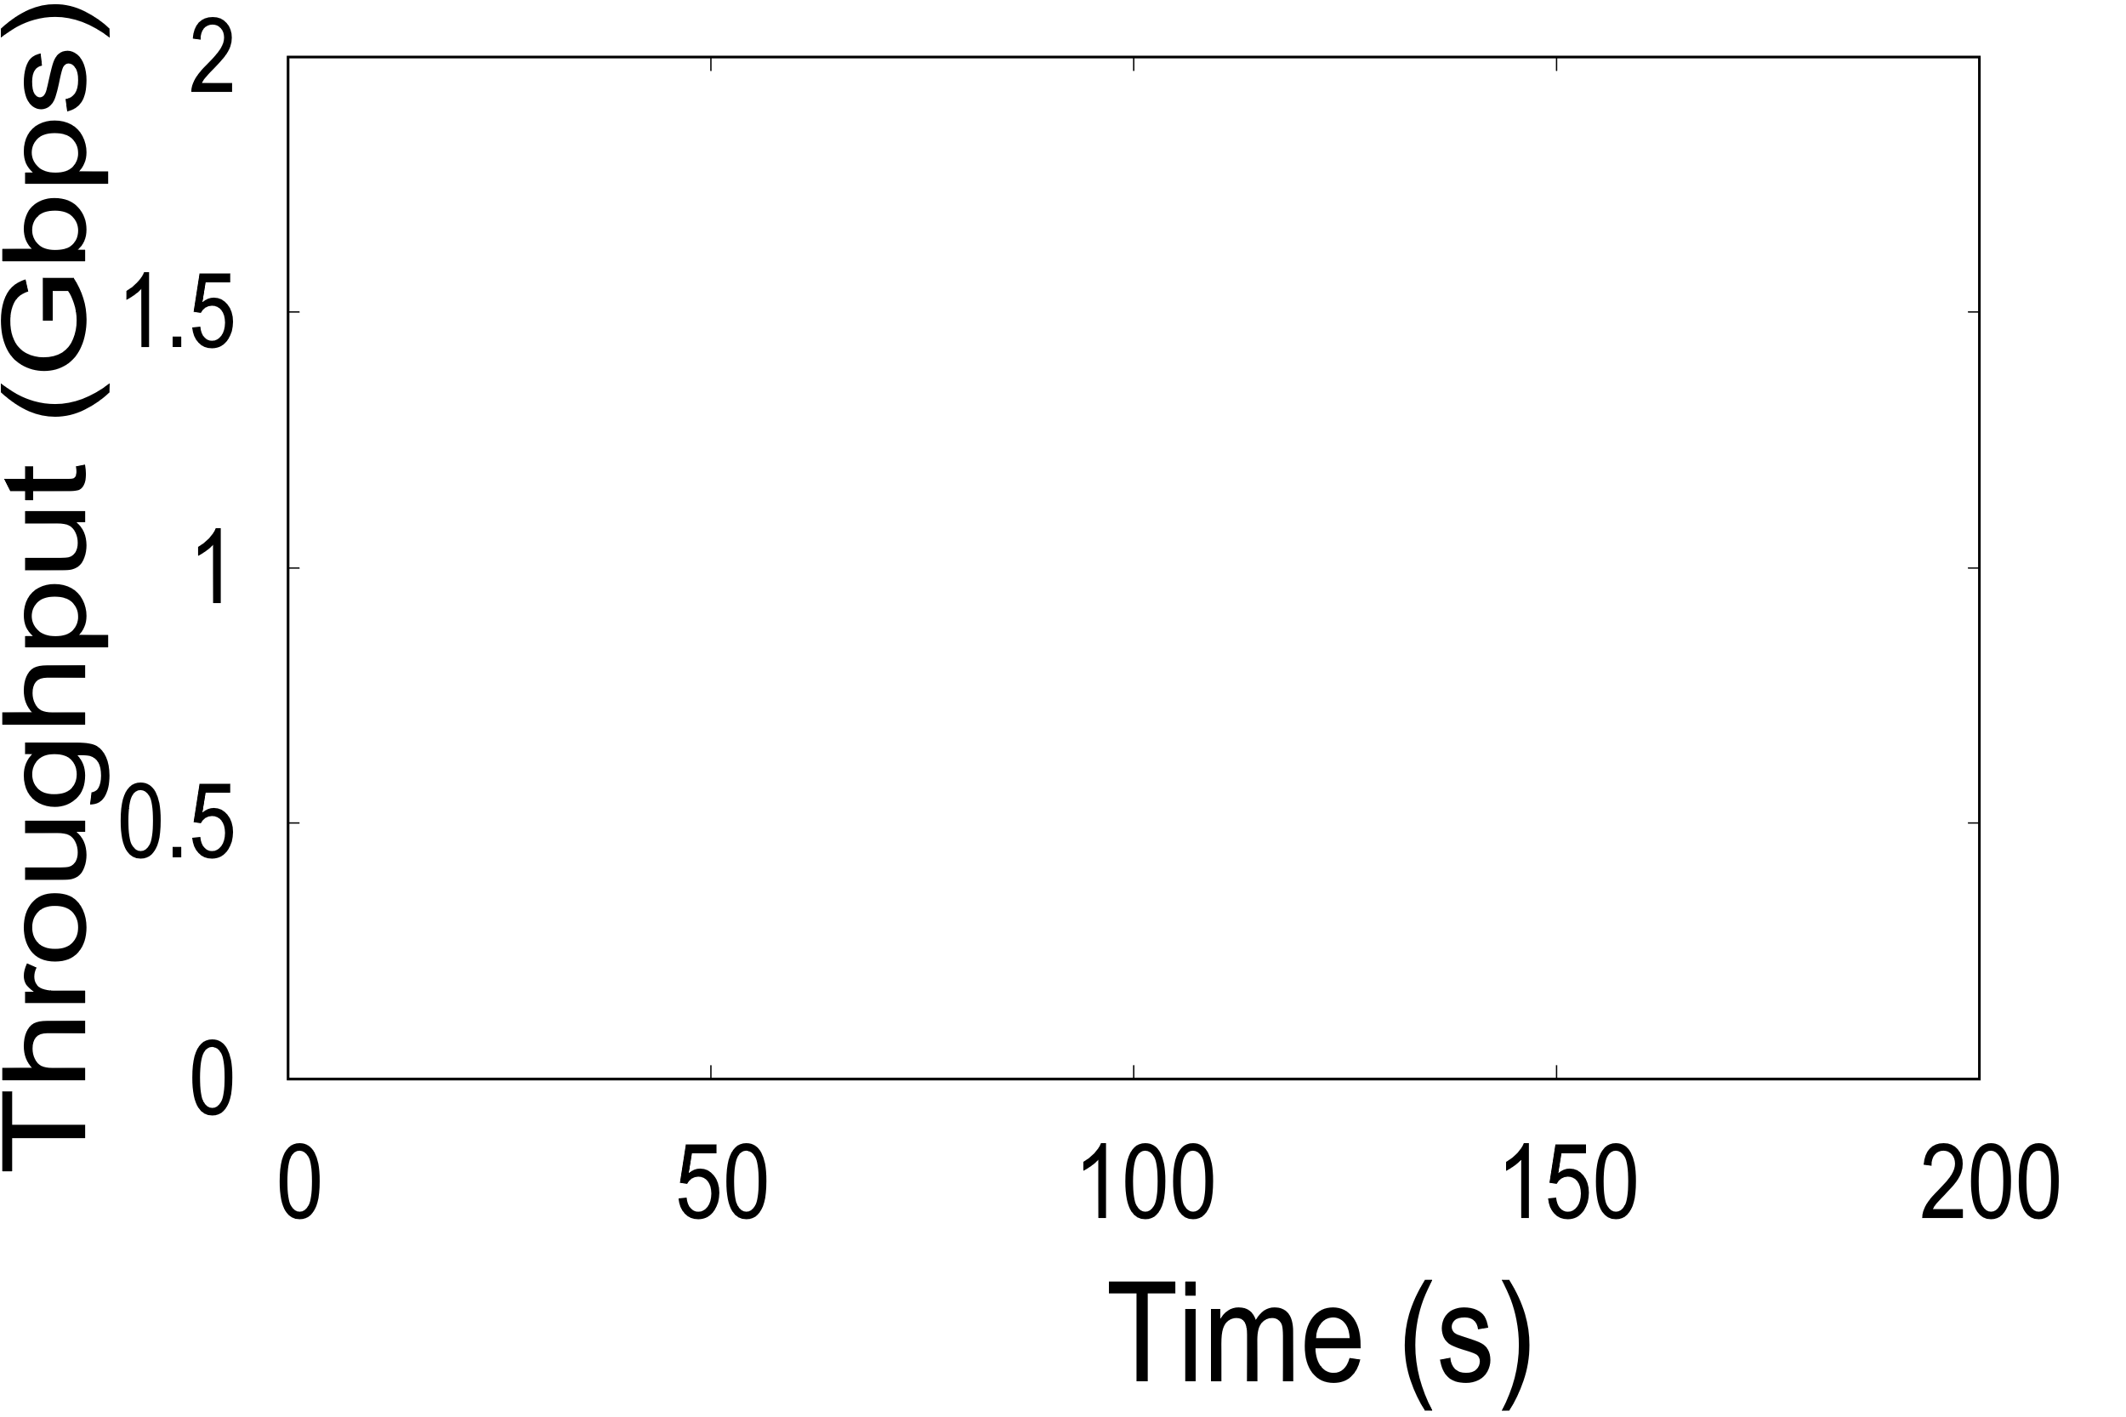
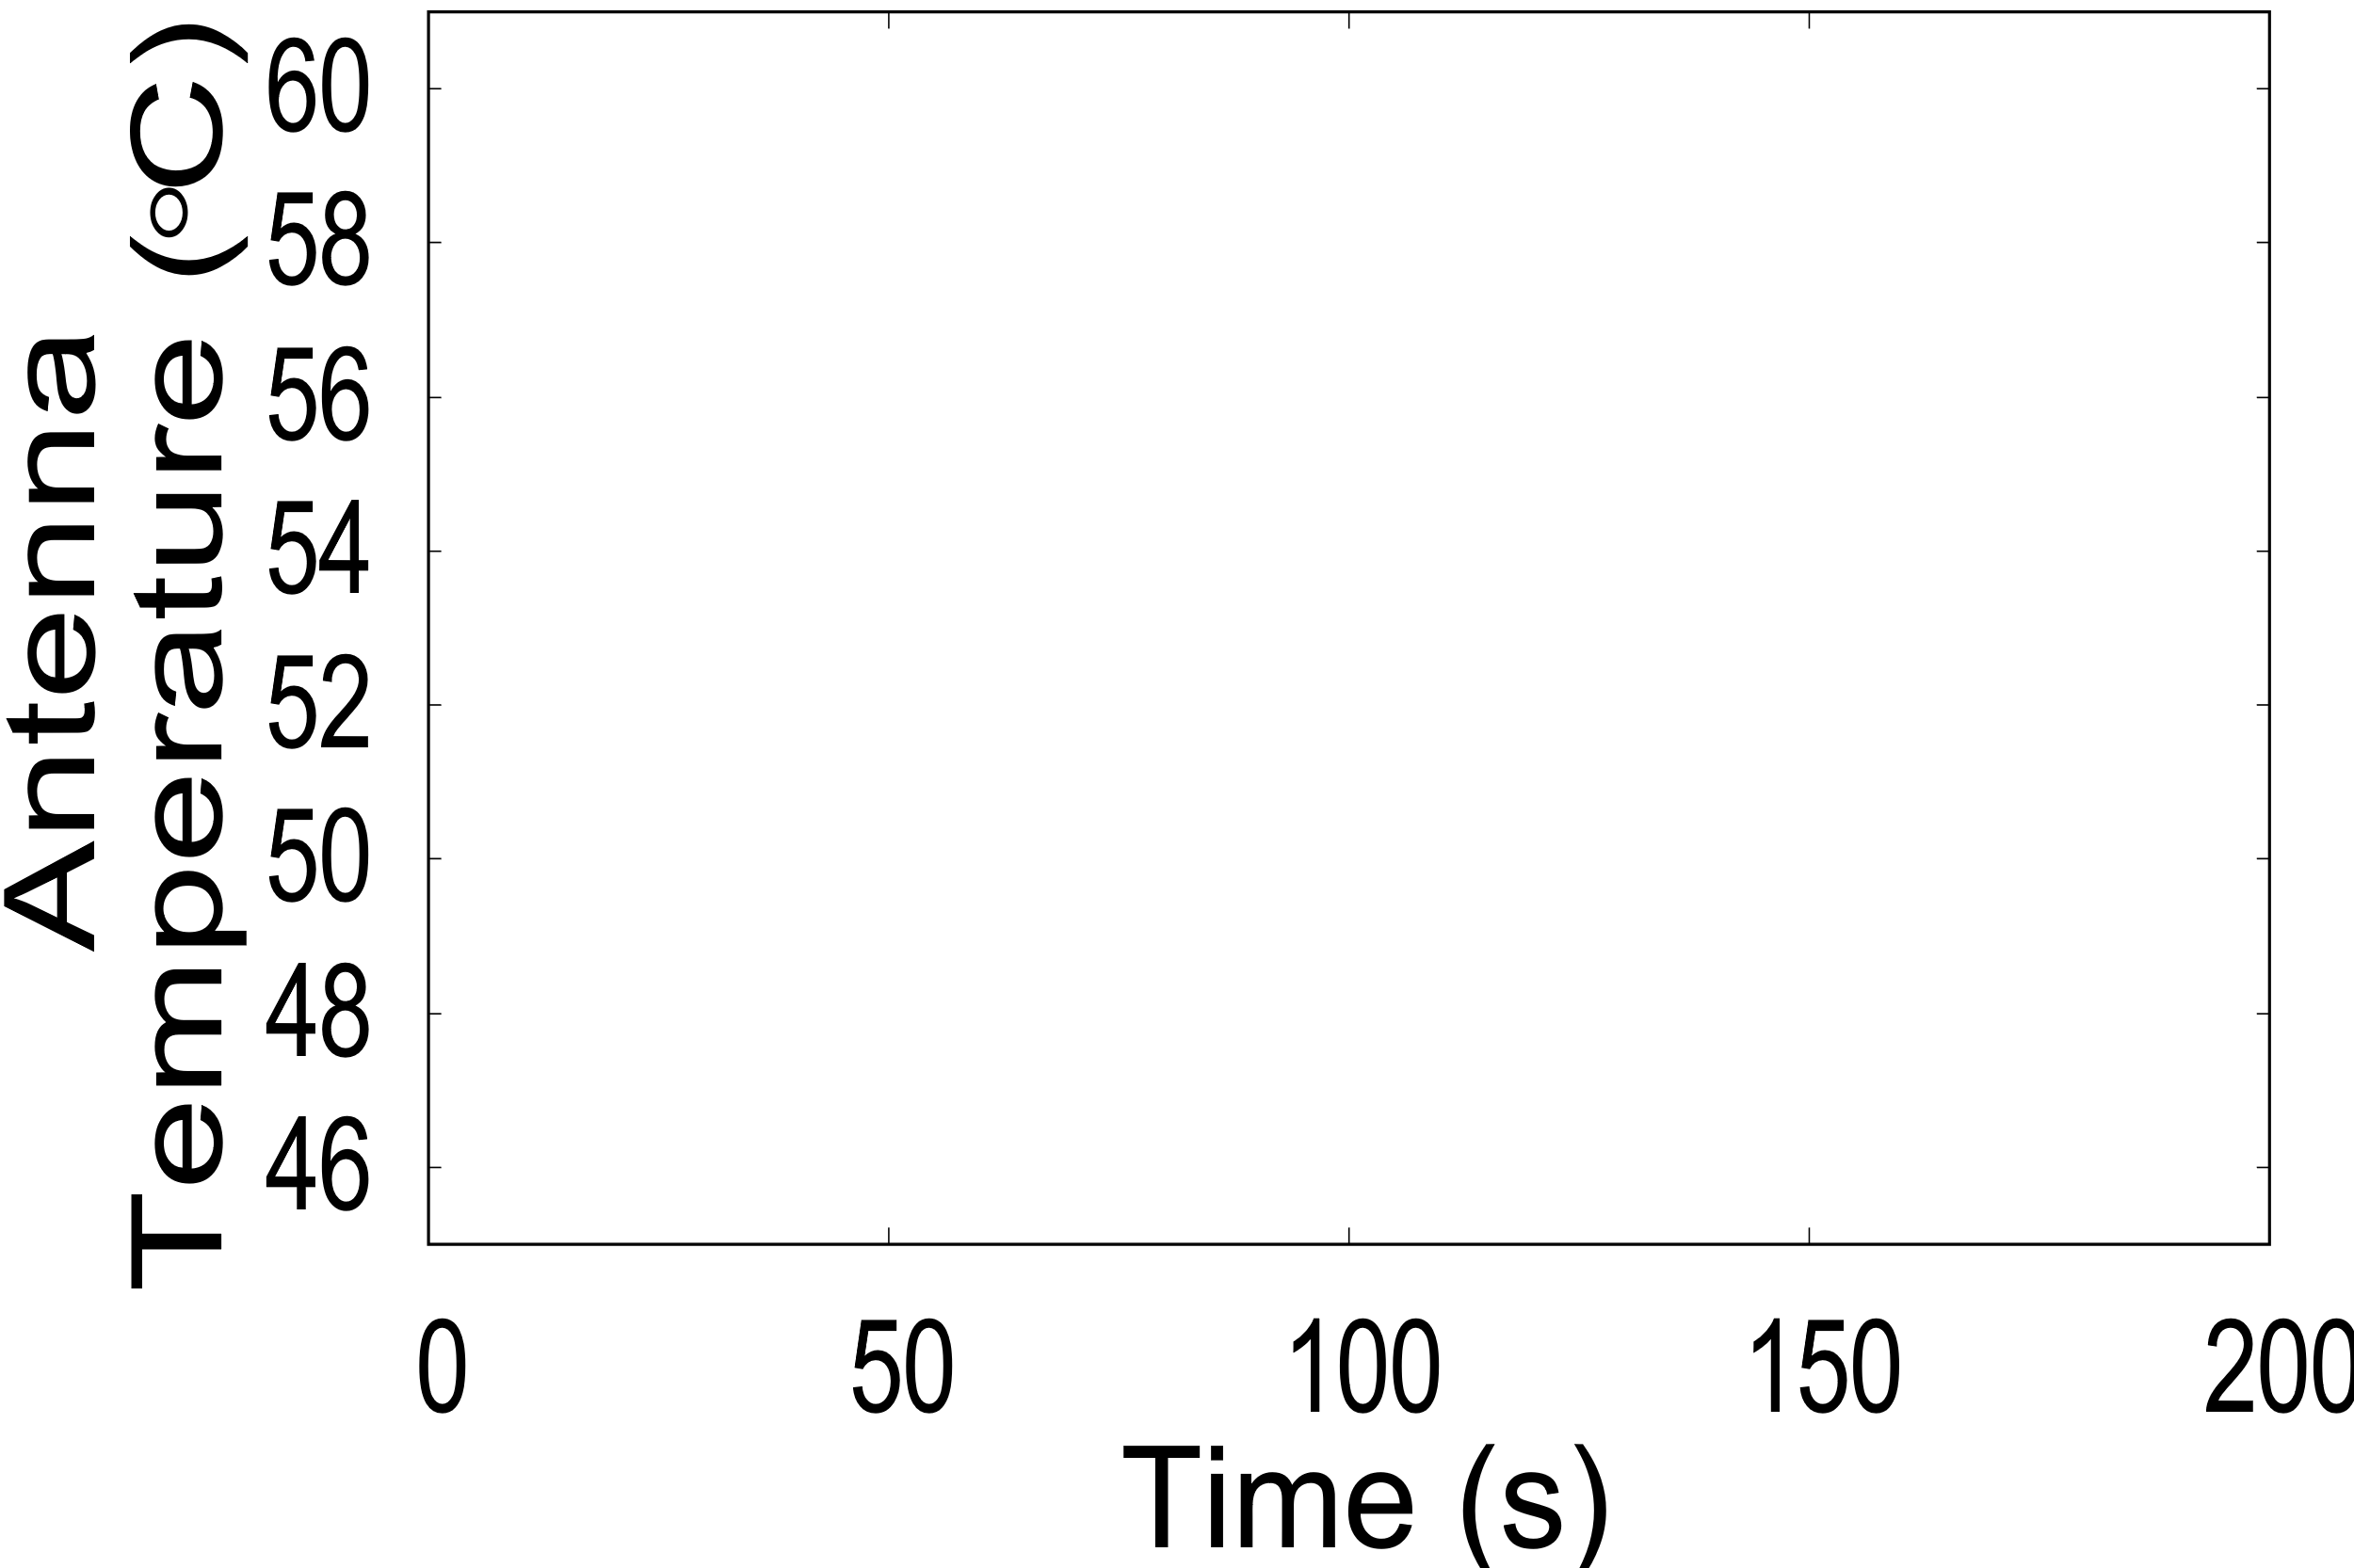
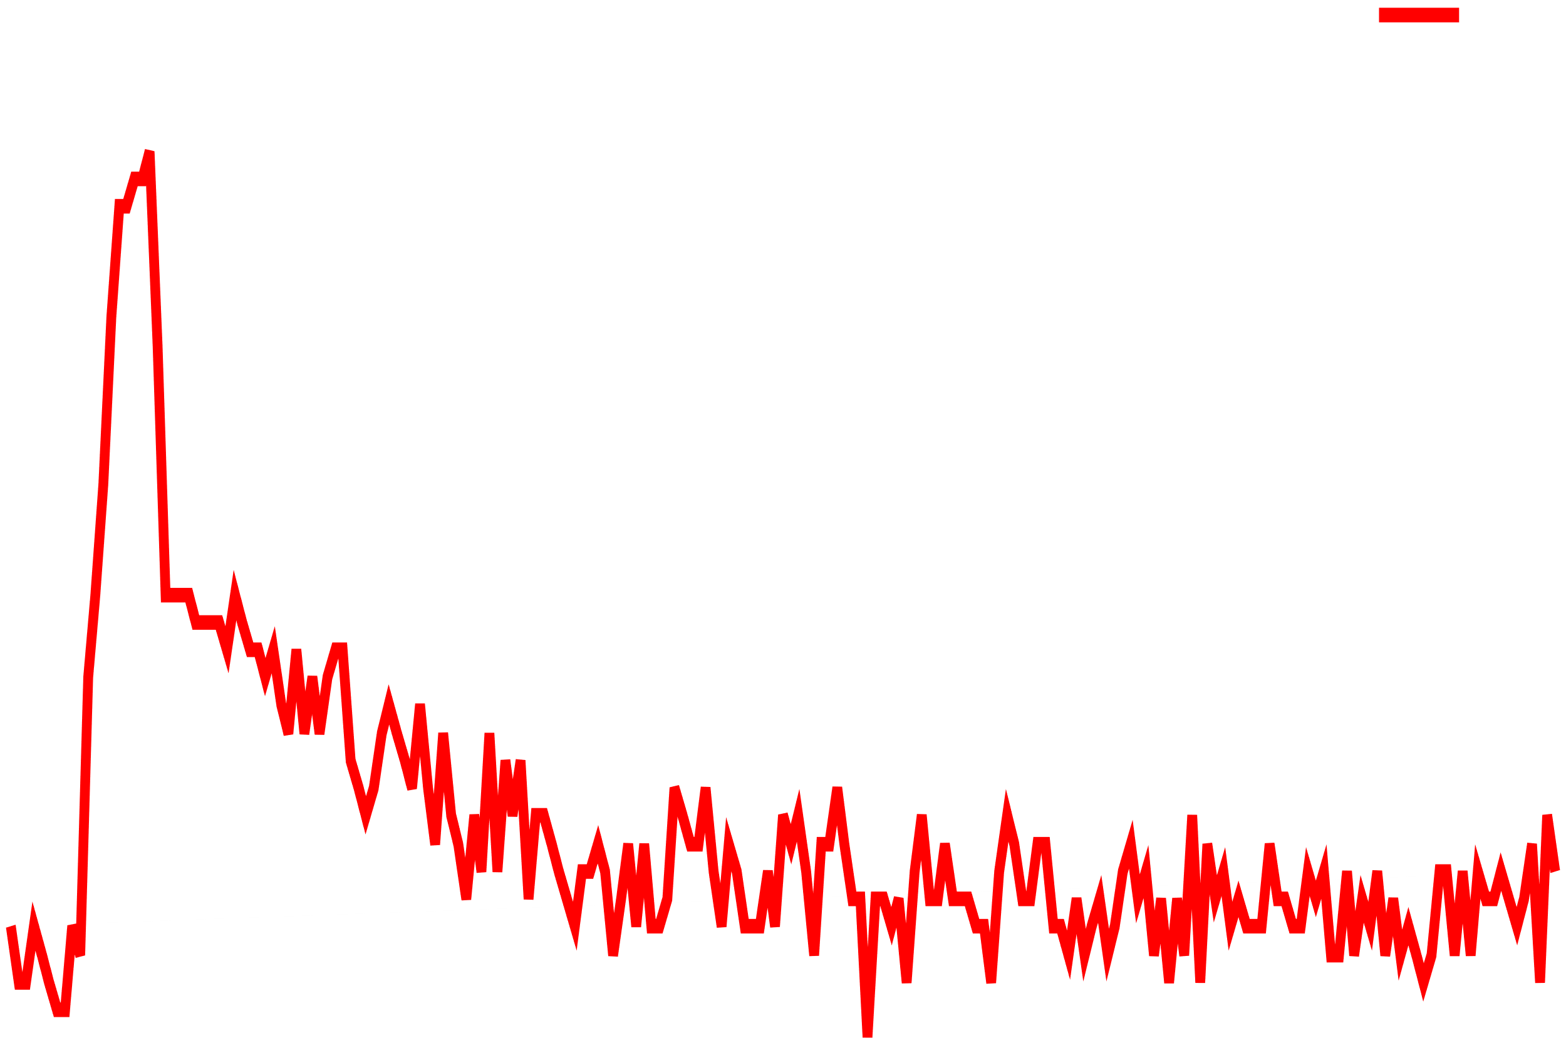


Study of heat dissipation
Dissipation time almost 70 s
Time (s)
Time (s)
Transfer for 10s
10 s of Data Transfer
70 s Heat Dissipation

Slide 20
Aquilo: Scheduler for multi-antenna devices

Slide 21
Inducing periodic idleness
Temperature
Increases
Temperature
Decreases
Temperature
Increases
Temperature
Decreases
Transfer On
Transfer Off
Transfer On
Transfer Off
Time

Slide 22
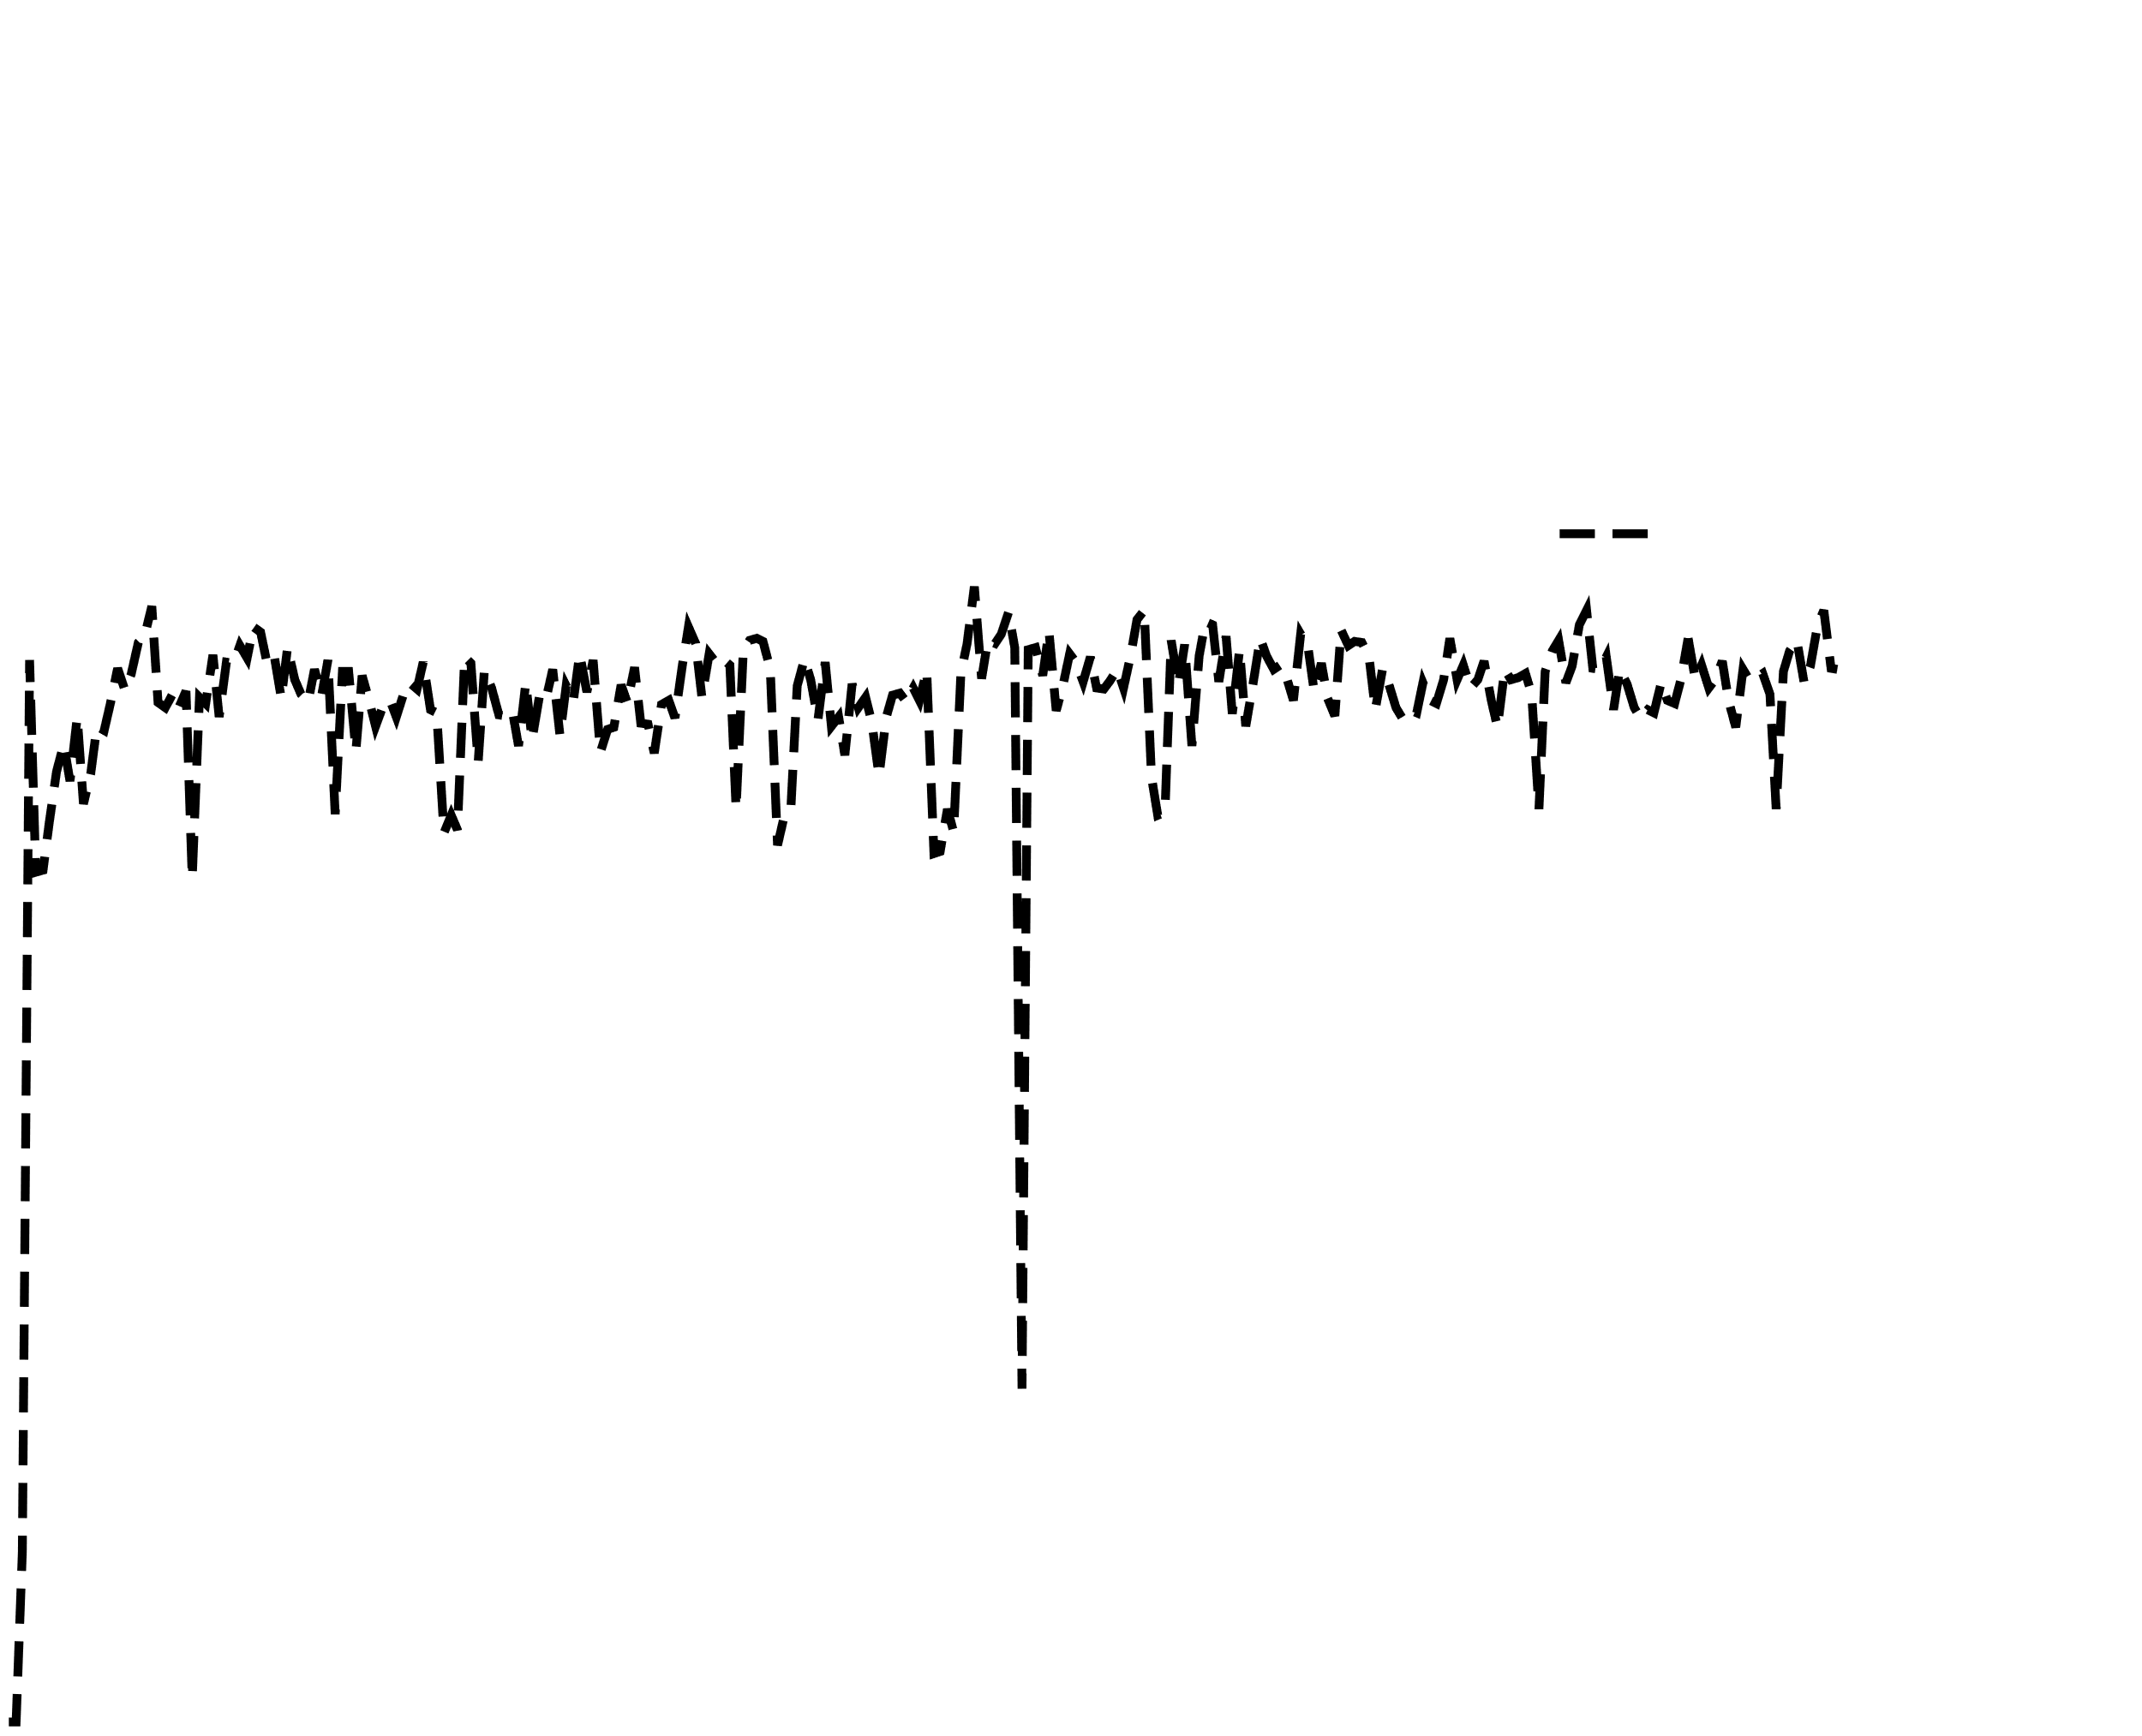
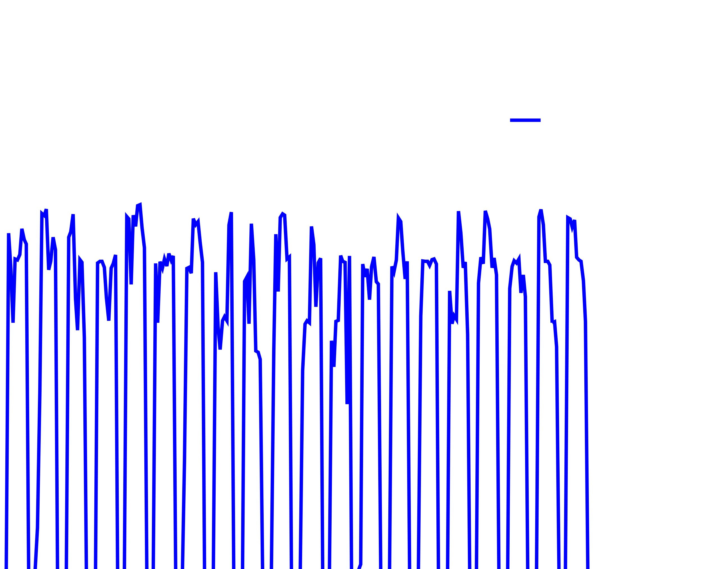
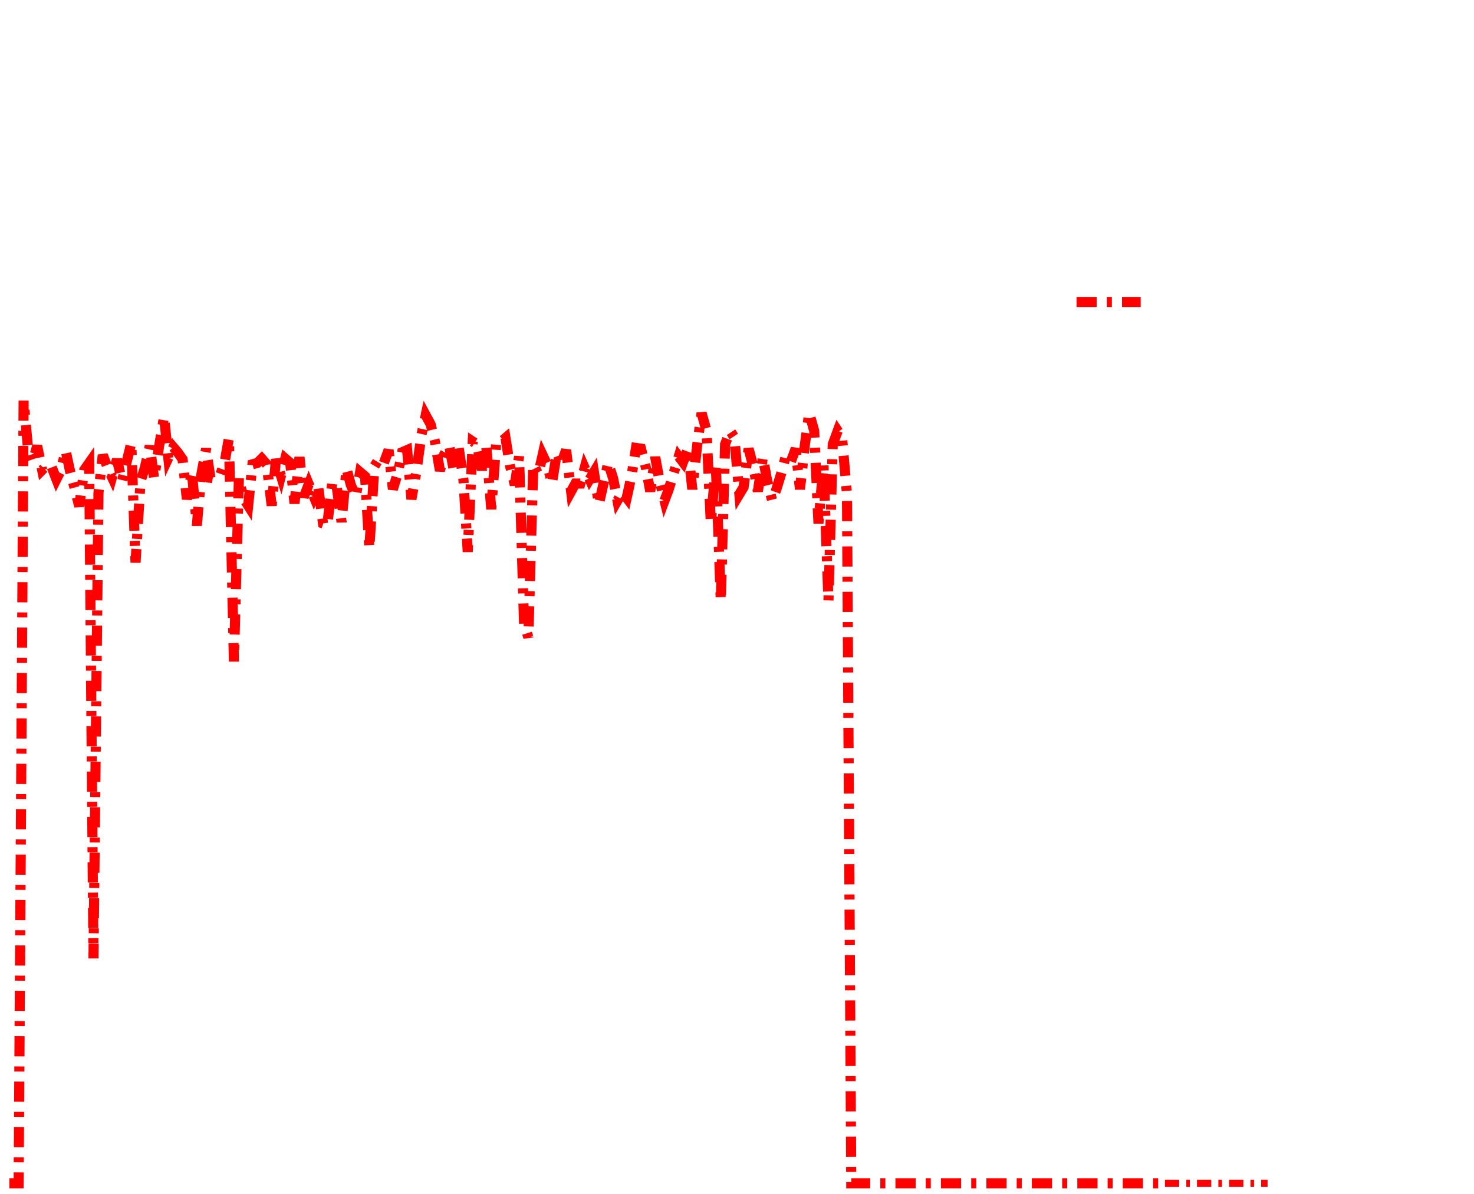
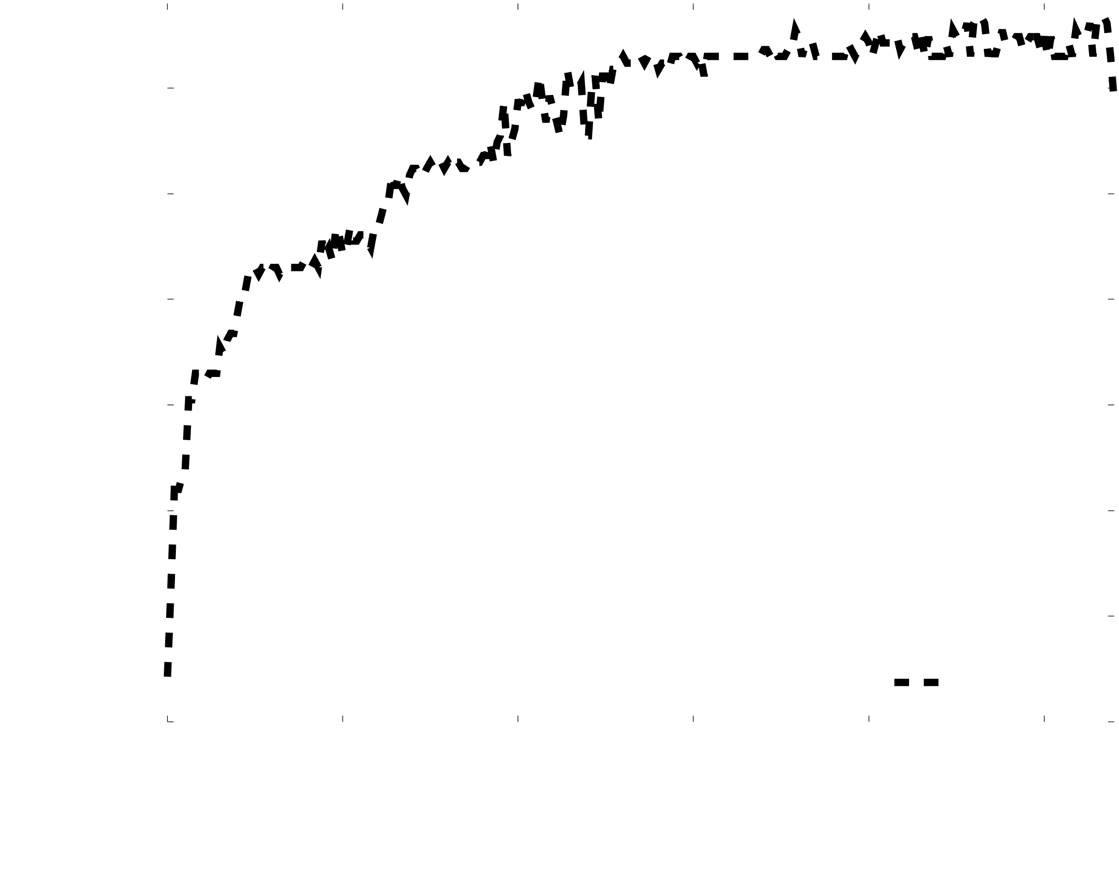
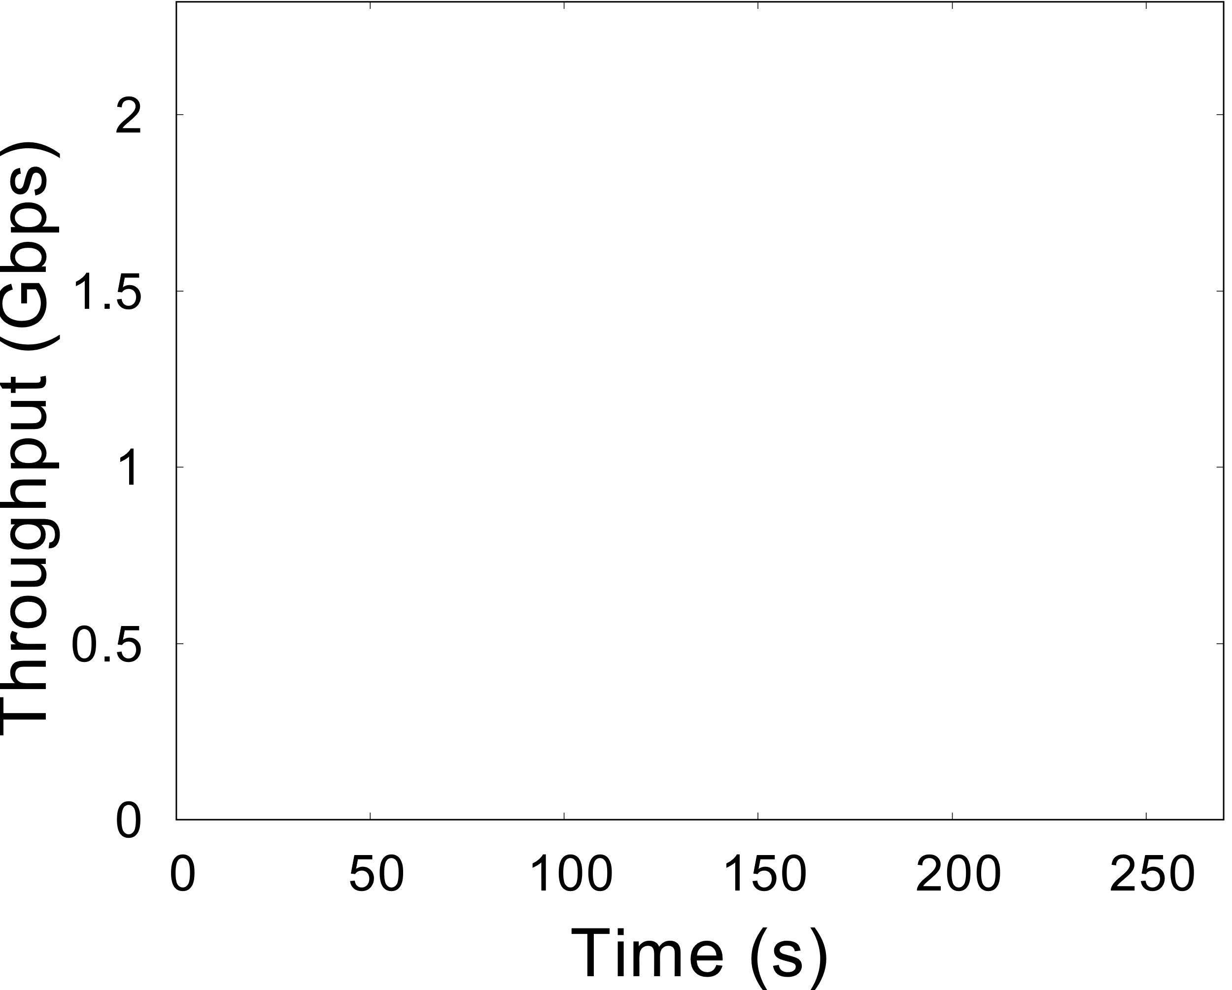
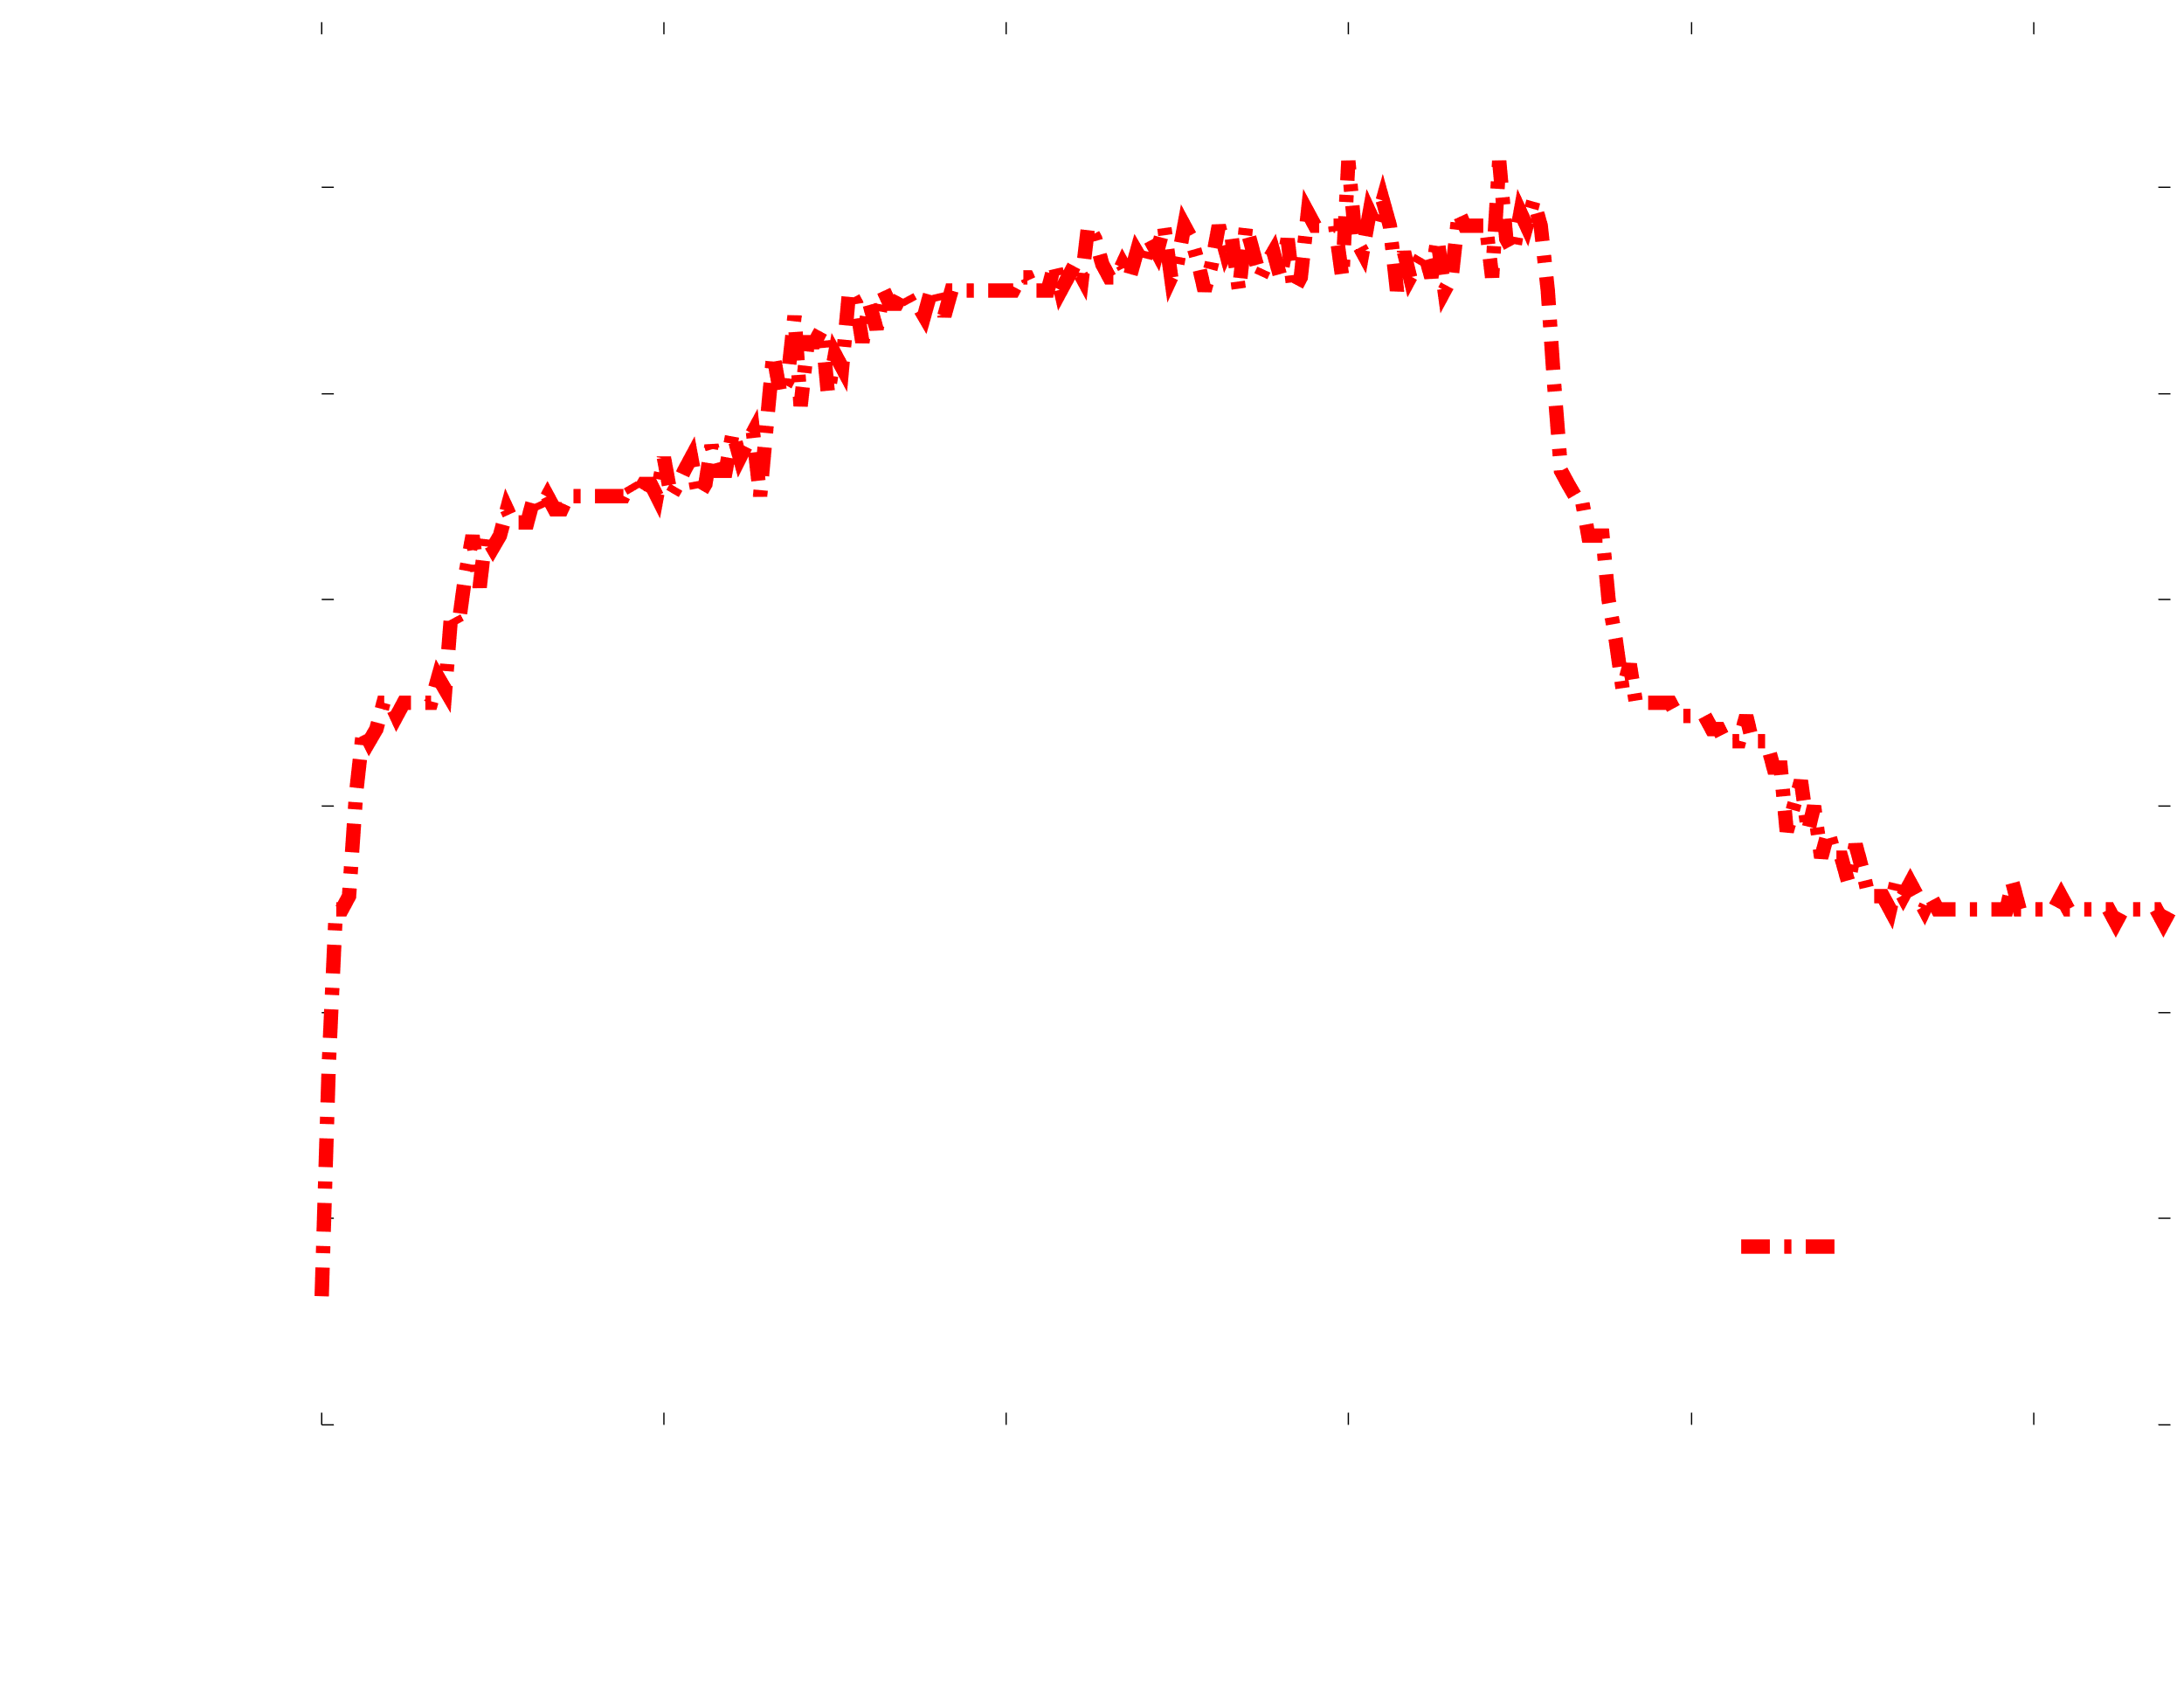
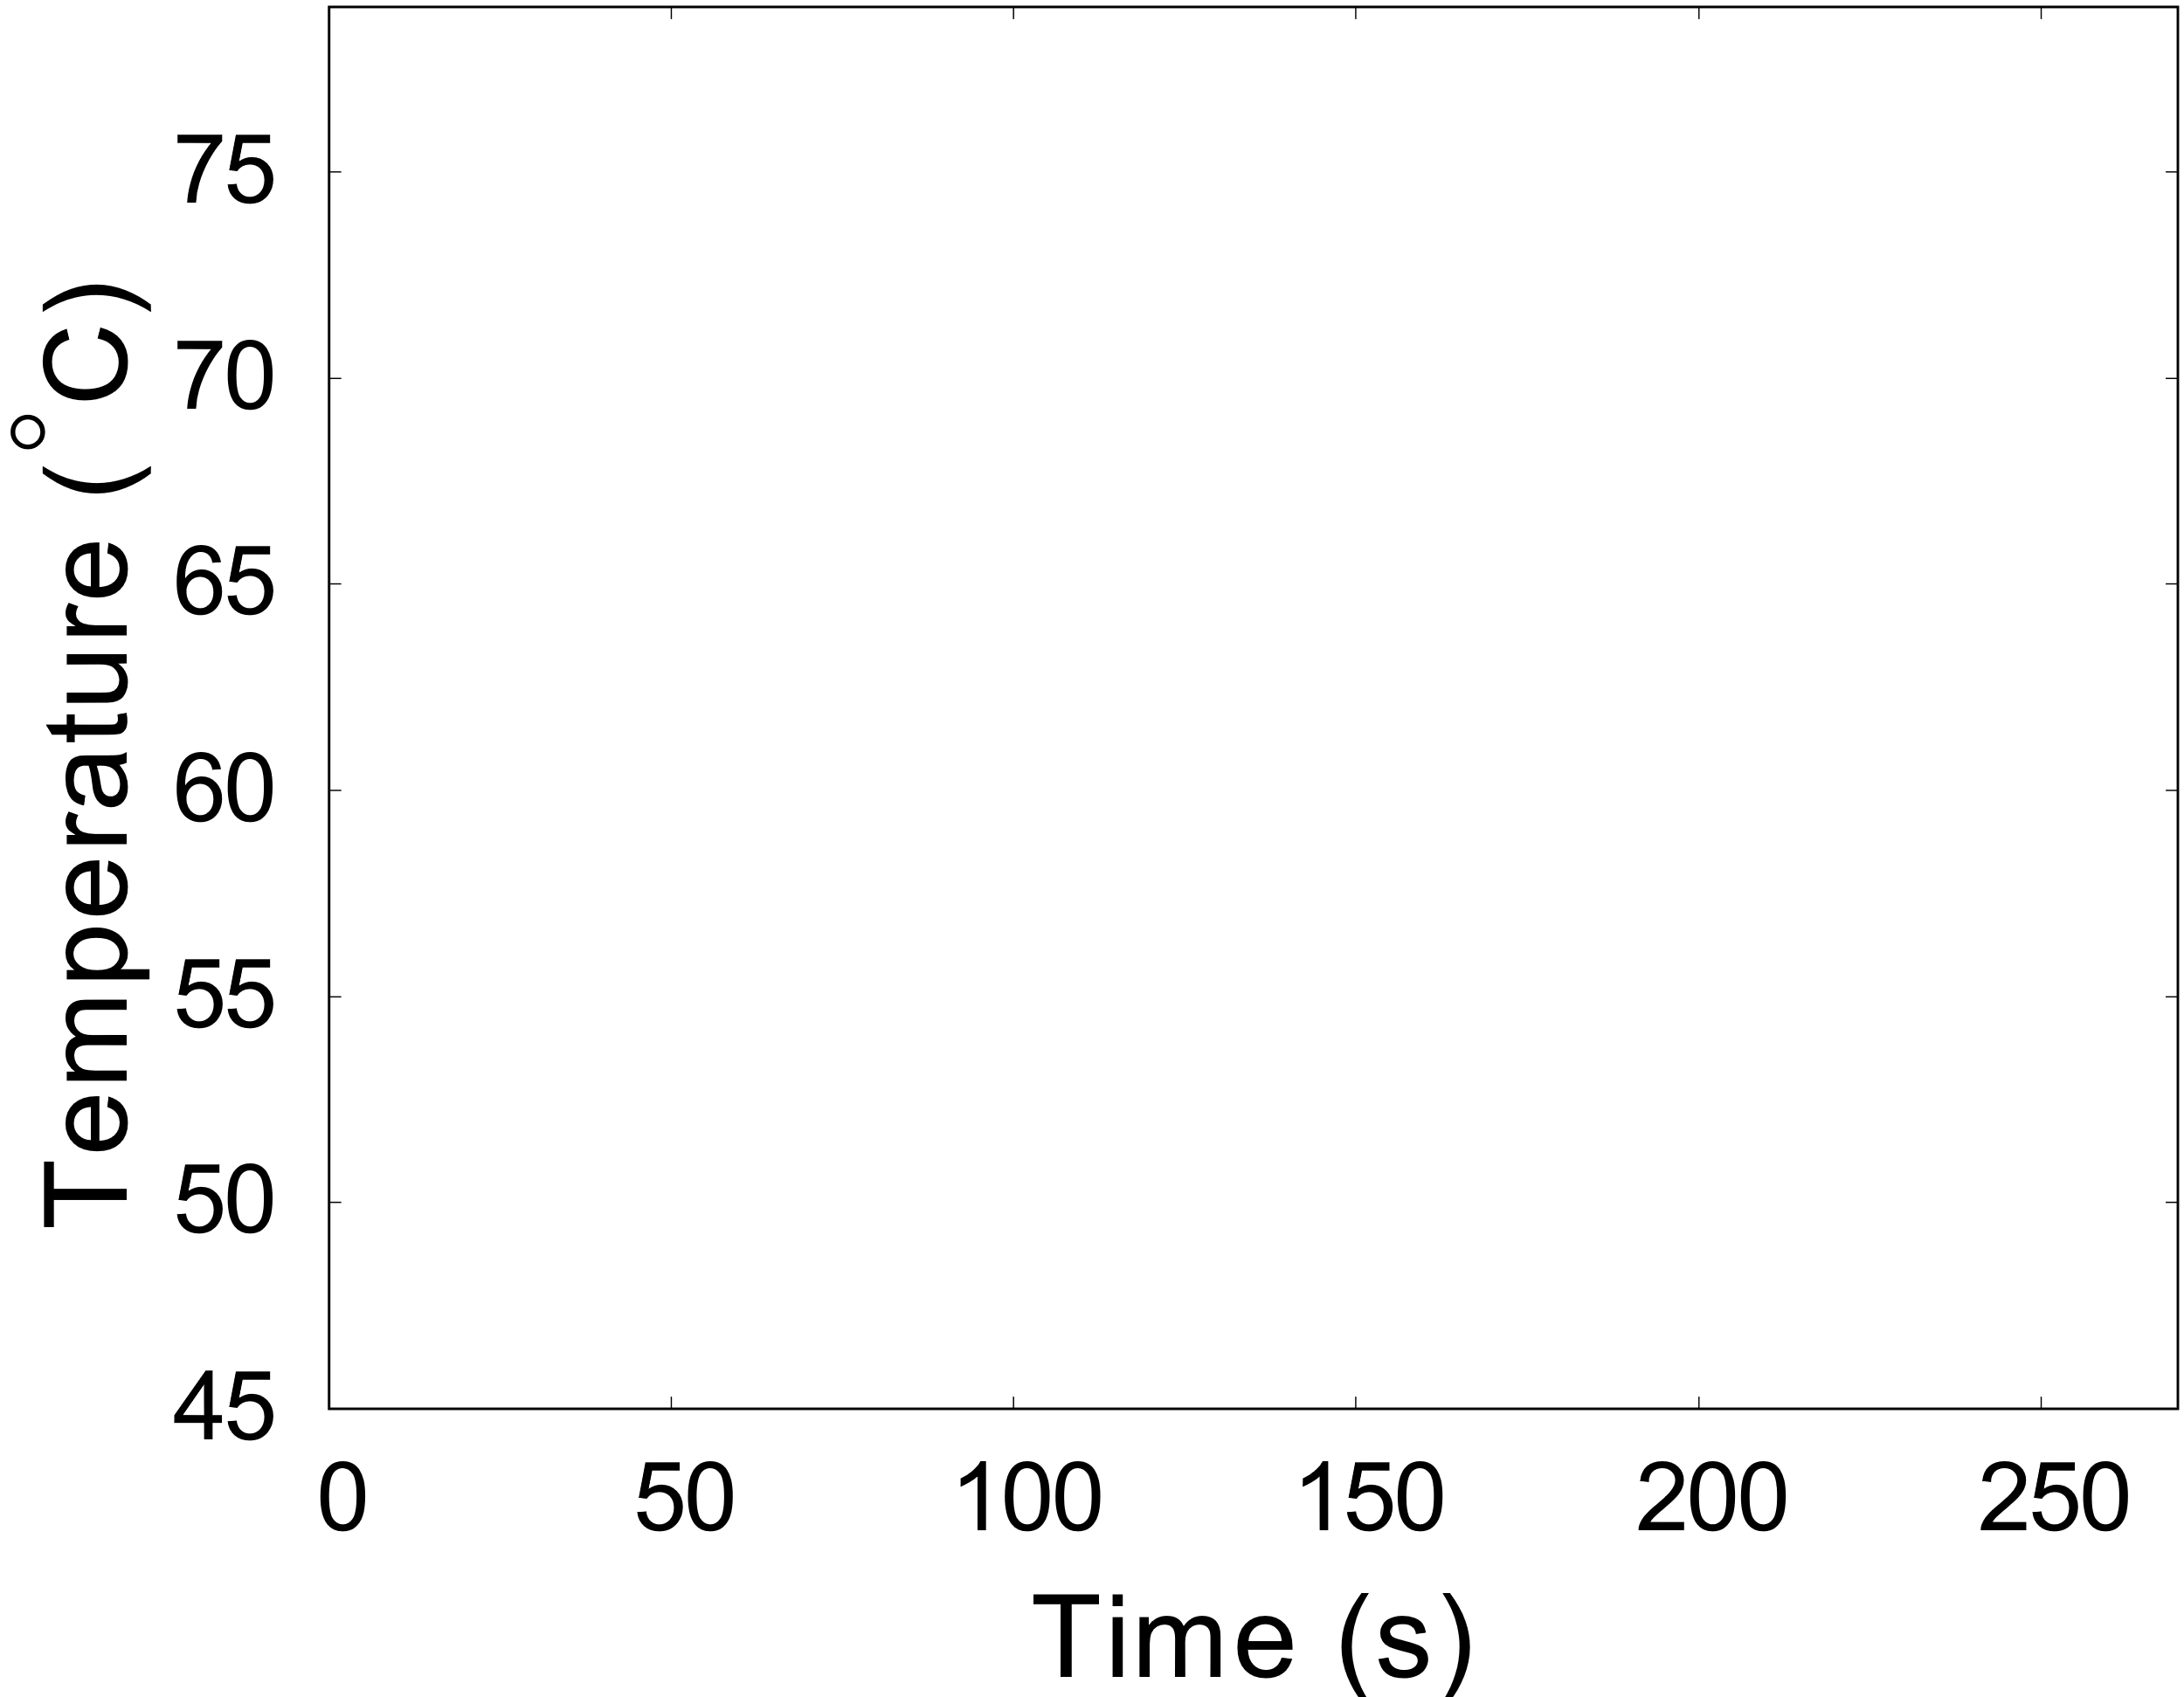
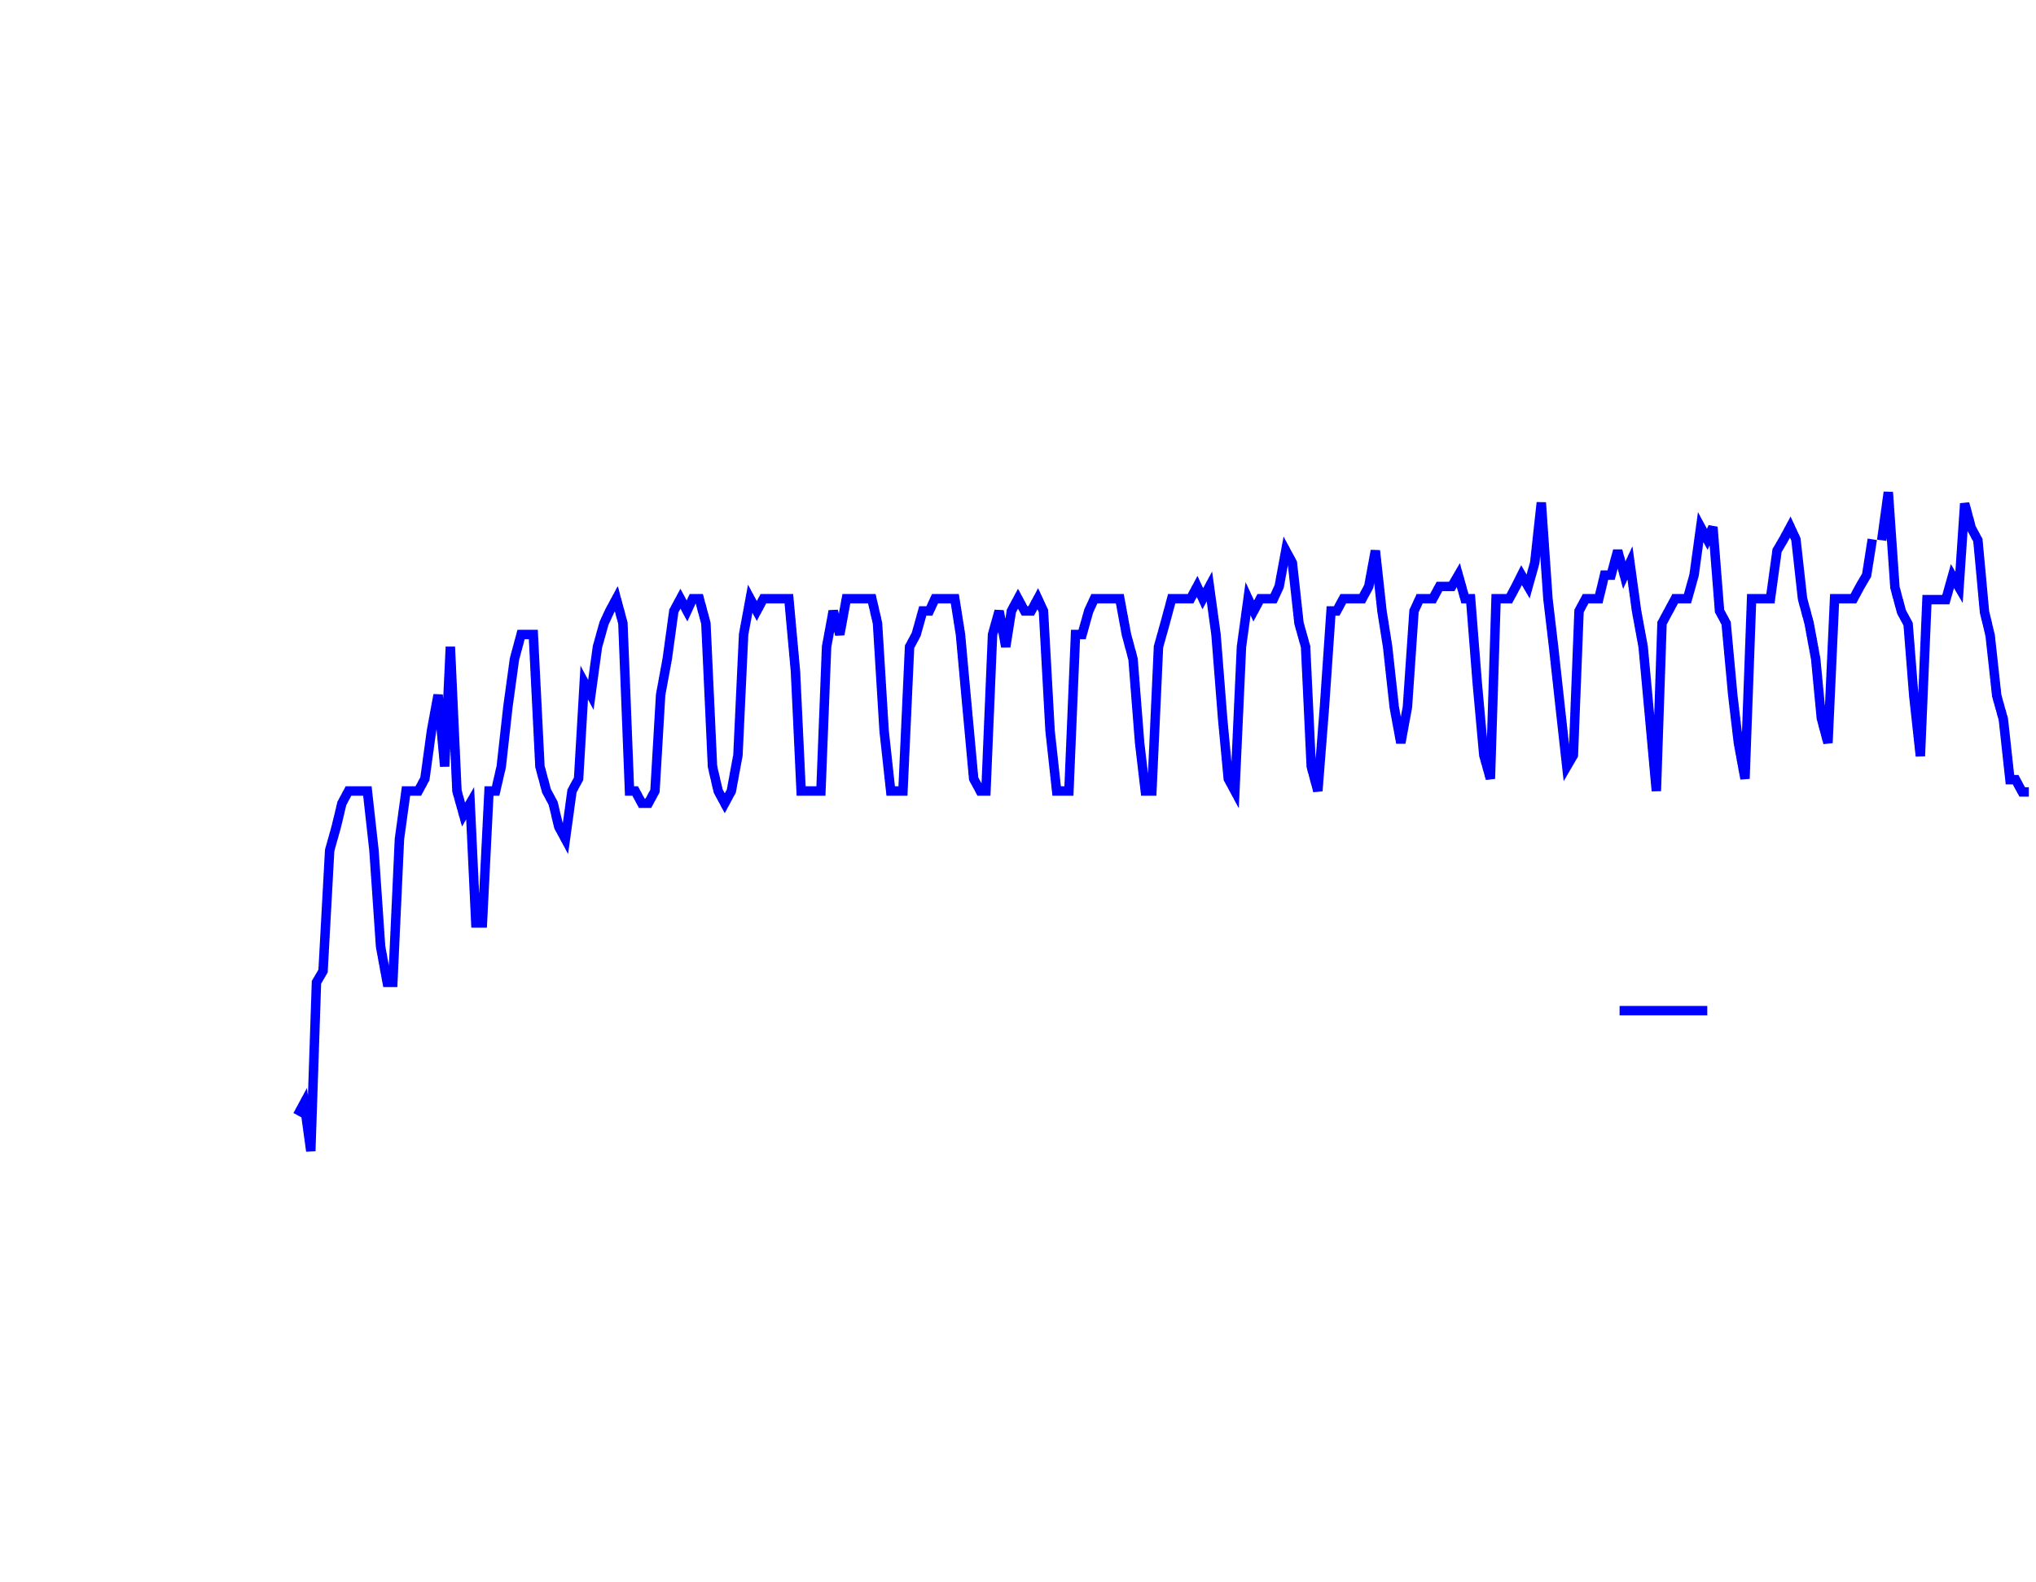
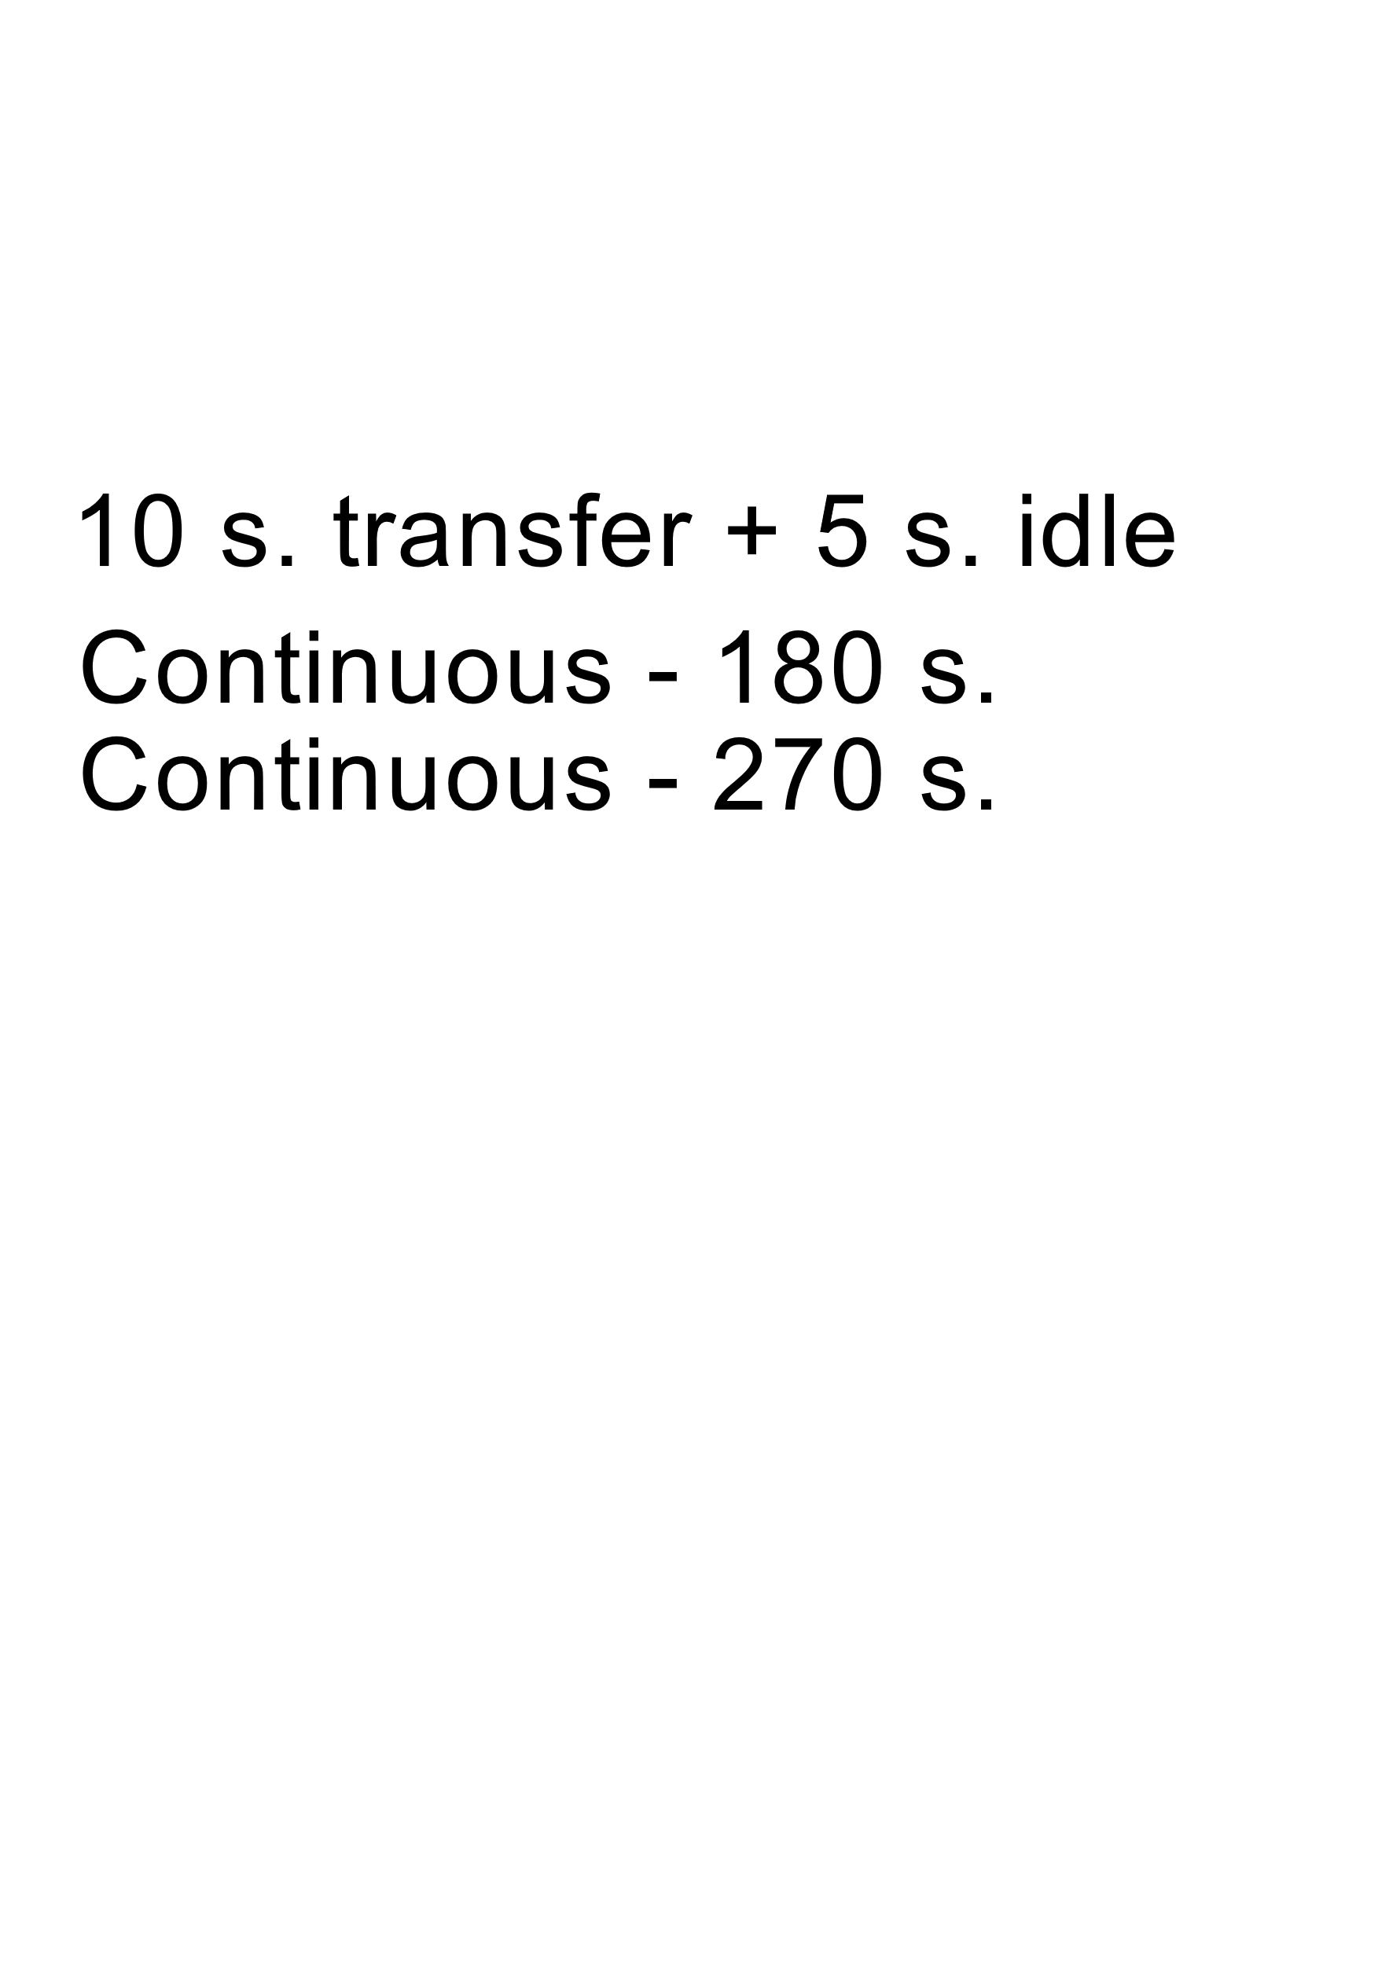
Inducing periodic idleness

Slide 23
Inducing periodic idleness
65 ̊̊C

Slide 24
Latency and throughput requirements
Applications | Max. Latency (ms) | Min. Throughput (Mbps)
Virtual Reality | 1 - 3 | 900 - 1100
Augmented Reality | ~1 | 700-800
Real Time Gaming | 10 | 10
Tactile Internet | ~1 | >1000
Source: L. Xu, “Context Aware Traffic Identification Kit (TriCK) for Network Selection in Future HetNets/5G Networks”,
2017 International Symposium of Networks, Computers and Communications (ISNCC)

Slide 25
Multi-Antenna design
Millimeter-Wave Network
Vulnerable to Rampant Signal Outage
Multi-Antenna Design improves network reliability
Switch antenna based on temperature-awareness
Antenna 1
Antenna 2
Smartphone
Antenna 4
Antenna 3

Slide 26

Antenna switching over time
Antenna 1
Antenna 2
Time Slot: 1
Antenna: 1
Antenna 4
Antenna 3

Slide 27
Antenna switching over time
Antenna 1
Antenna 2
Time Slot: 2
Antenna: 4
Antenna 4
Antenna 3

Slide 28
Antenna switching over time
Antenna 1
Antenna 2
Time Slot: 3
Antenna: 3
Antenna 4
Antenna 3

Slide 29
Simple antenna switching
Random Switching
Throughput Maximization

Slide 30
Antenna switching challenges

Slide 31


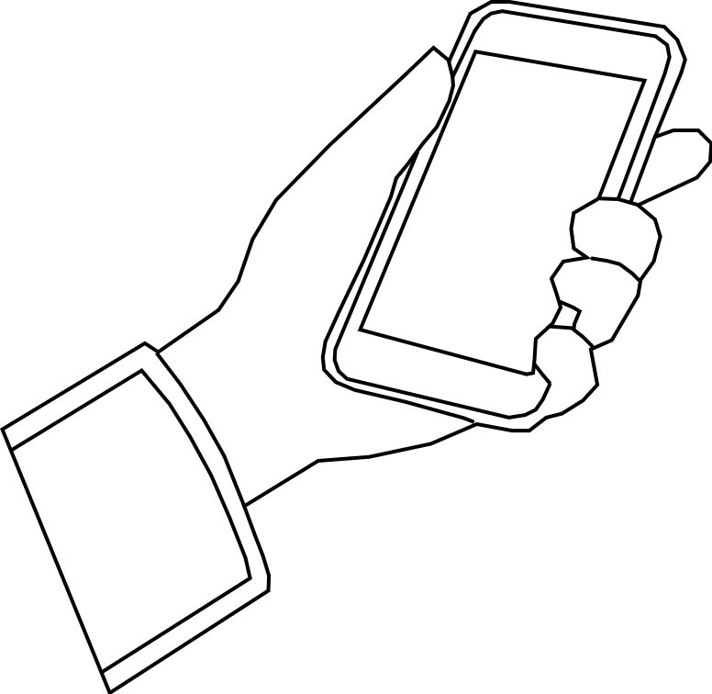
Millimeter-Wave link: Very unreliable
No guaranteed link at any antenna at all times
X

Slide 32
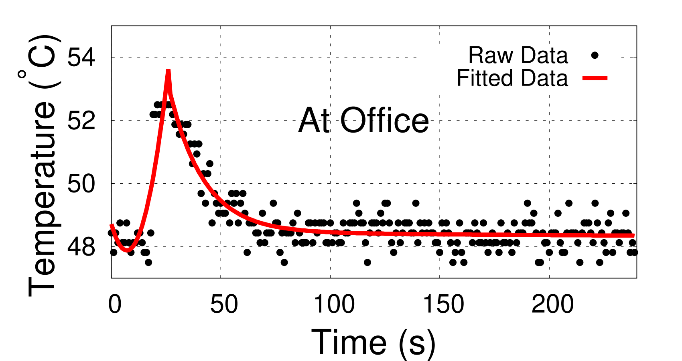
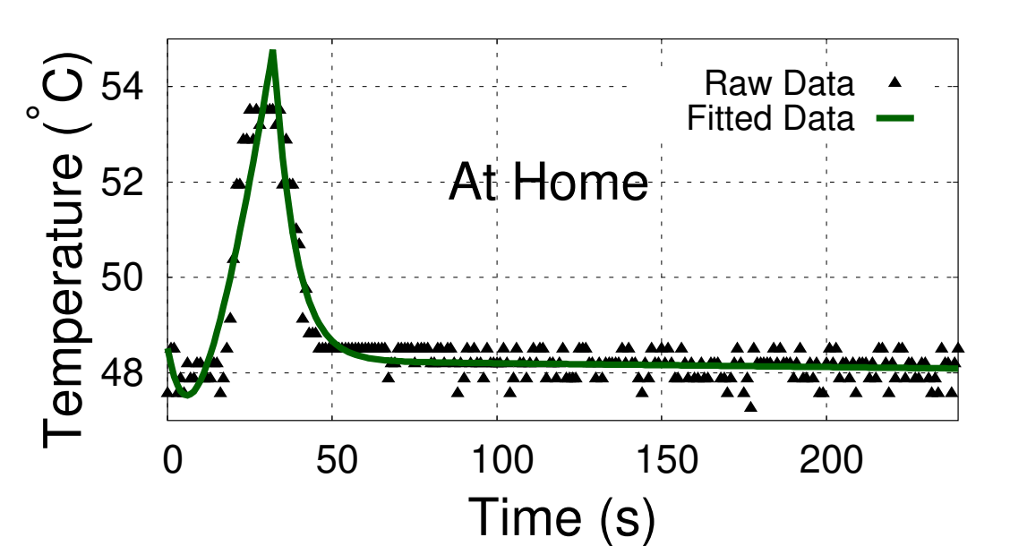
Temperature profile: Varies in space-time
No pre-determined temperature rise and fall model
Exponential Rise
Exponential Fall
Dissipation after a 10 s transmission

Slide 33
Design components of Aquilo
Online thermal profile estimation
Generating look-ahead schedules

Slide 34
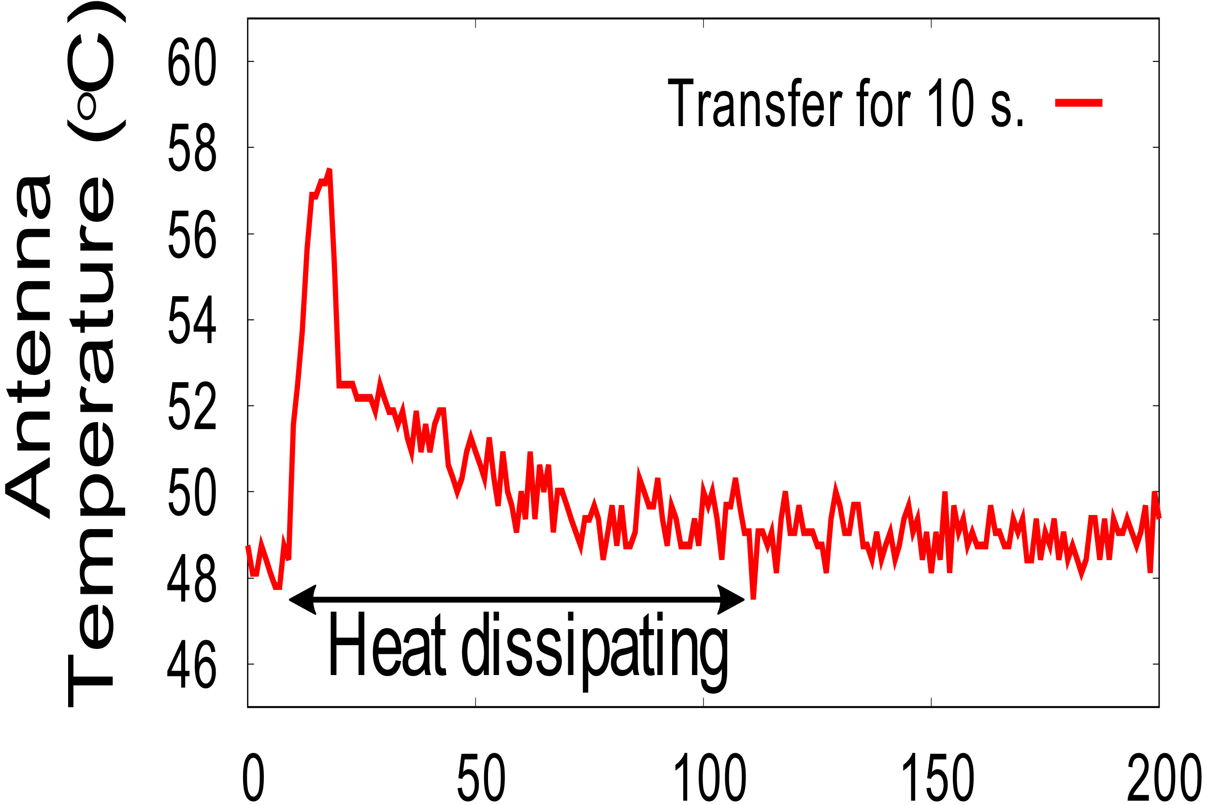

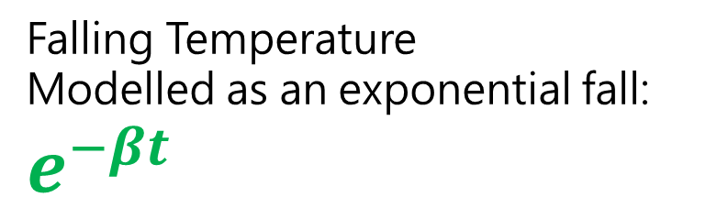
Online thermal profile estimation
⁰C
Model parameters α and β are derived from online measurements
Rising Temperature
Modelled as an exponential gain: $e^{αt}$
Antenna Temperature (⁰C)
Falling Temperature
Modelled as an exponential fall: $e^{−βt}$
Time (s)
Time (s)

Slide 35
Generating look-ahead schedules
Schedule No | Schedule | Peak Temperature (⁰C)
1 | {2, 3, 1, 4} | 59
2 | {1, 2, 1, 4} | 62
3 | {2, 1, 4, 3} | 54
… | … | …

Slide 36
Aquilo antenna execution sequence
Sort Schedule generated in frame 1
Frame 1
Frame 2
Frame 3
Frame 4
Time
Update schedule,
probe and switch antennas
Transfer can continue
Slot 1
Slot 2
Slot 3
Slot 4
. . . . . .
Time

Slide 37


Non-Adjacency Criteria
3 Slot System
Antenna Schedules:
  (3, 2, 4)
  (1, 3, 4)
  (2, 3, 3)
  (2, 4, 1)
No antenna can be scheduled in consecutive time slot

Slide 38
Performance Evaluation

Slide 39
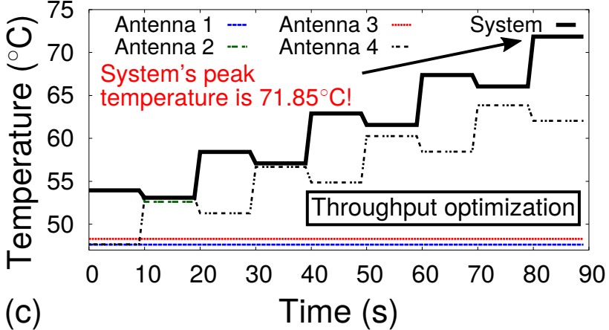
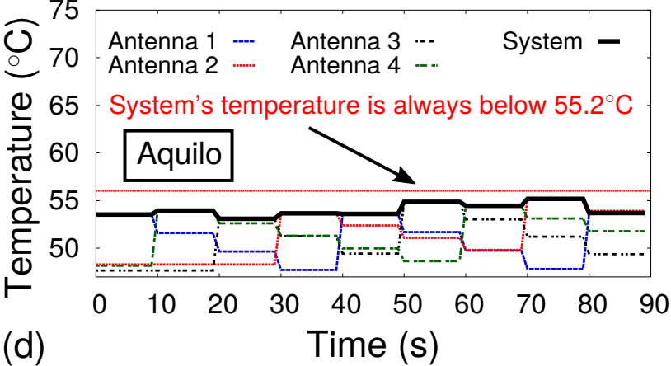
Throughput Optimization vs. Aquilo

Slide 40
Evaluate Throughput Optimization

Slide 41
Throughput Optimization vs. Aquilo

Slide 42
Evaluate Aquilo

Slide 43
Throughput Optimization vs. Aquilo

Slide 44
Comparative schemes with Aquilo
Best Case: Achieves the best temperature performance
Random: An antenna is selected at random
Random with NAC: Random with Non-Adjacency Criteria
Throughput Opt.: Achieves the maximum throughput

Slide 45
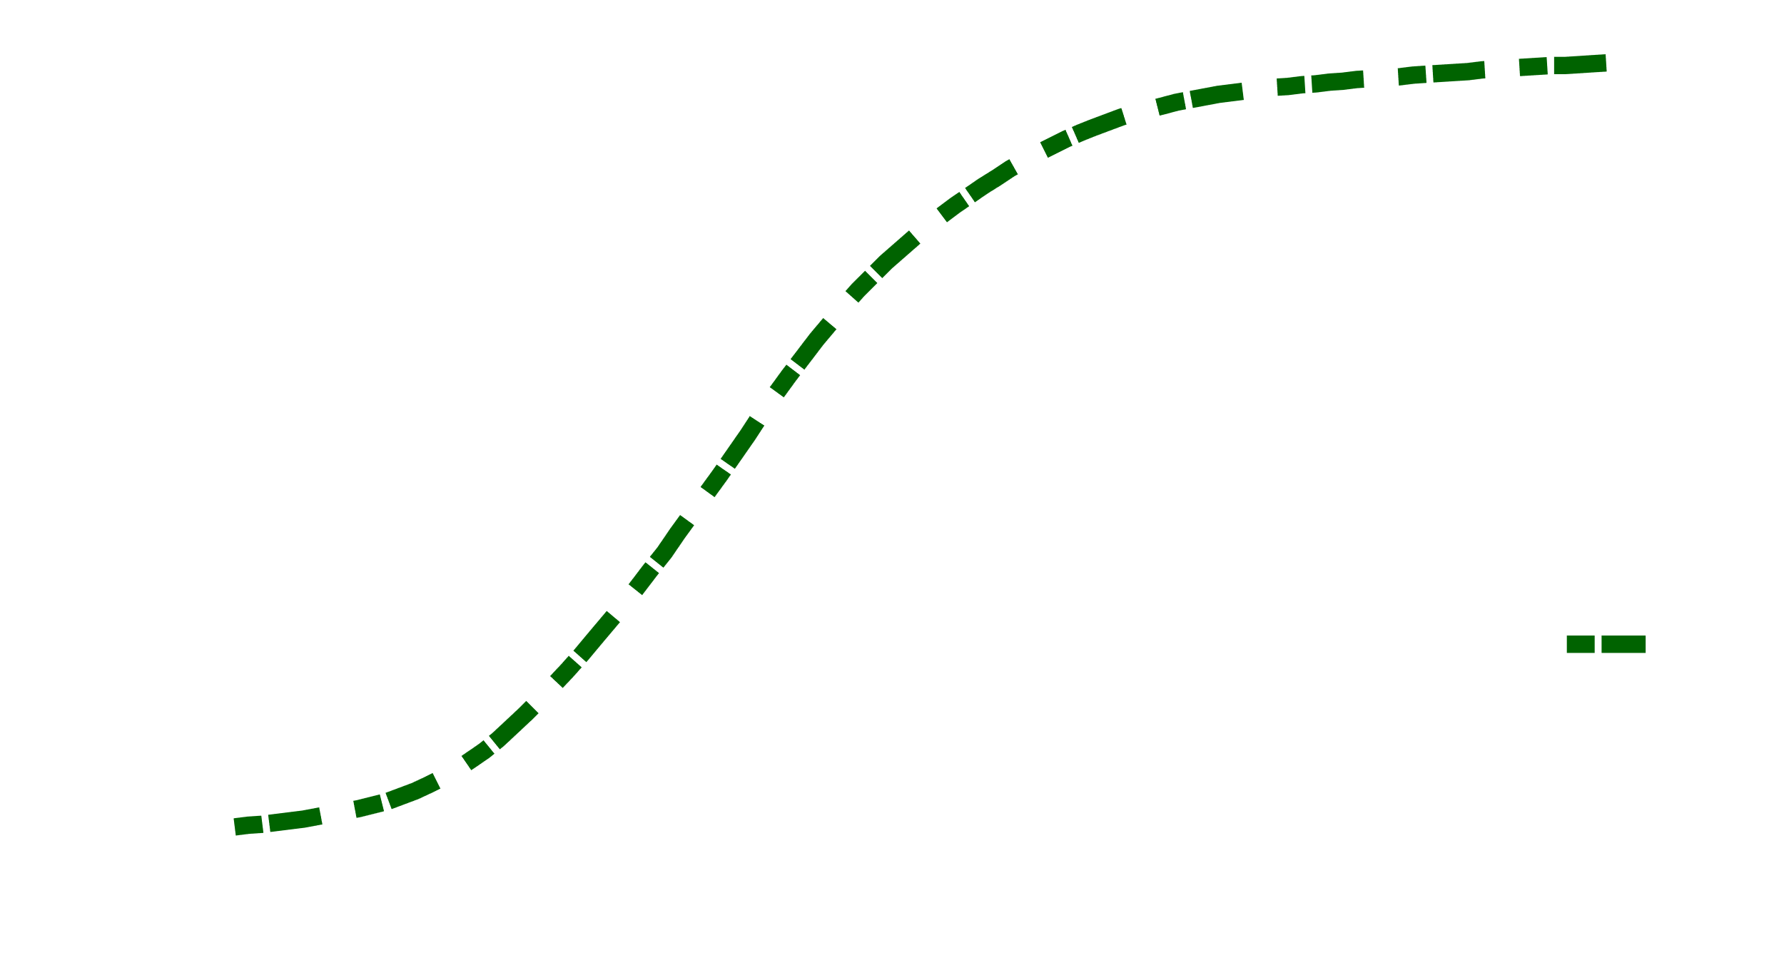
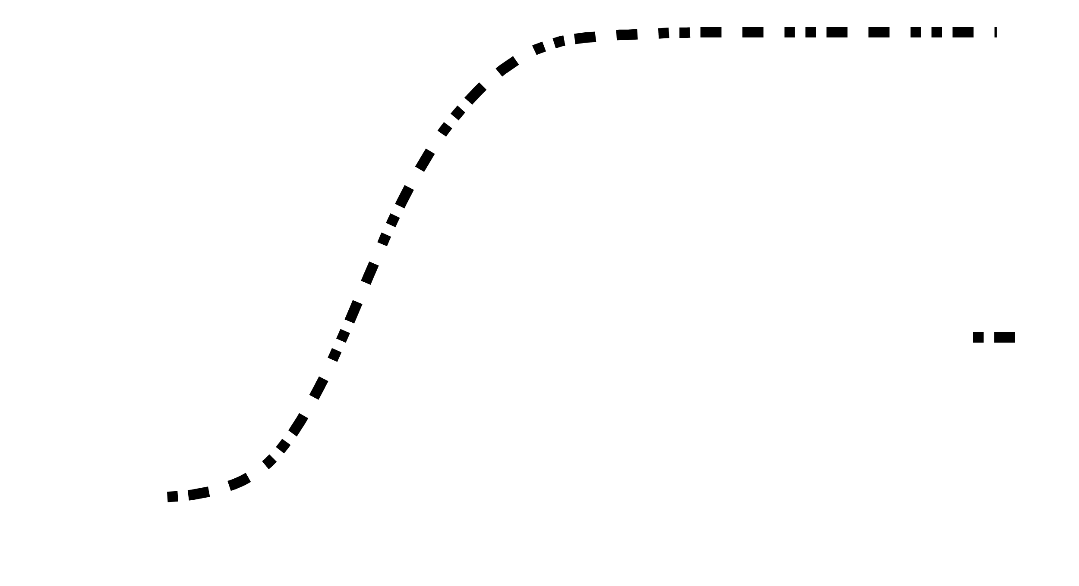
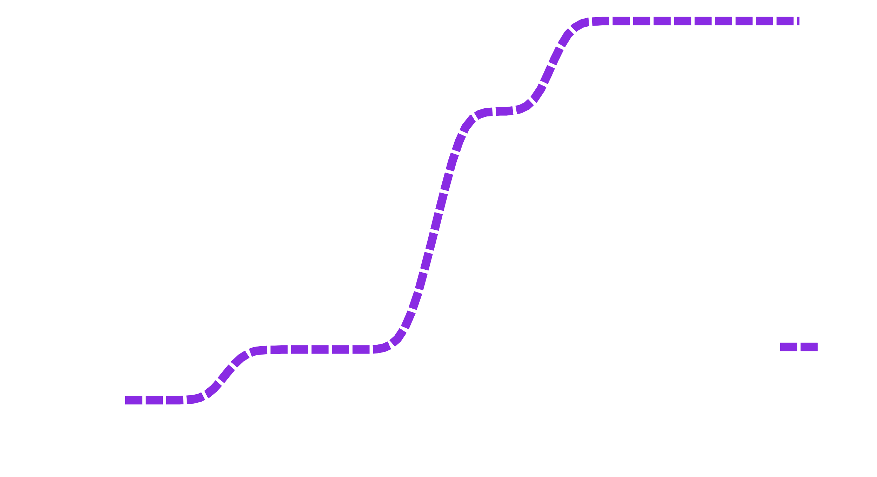
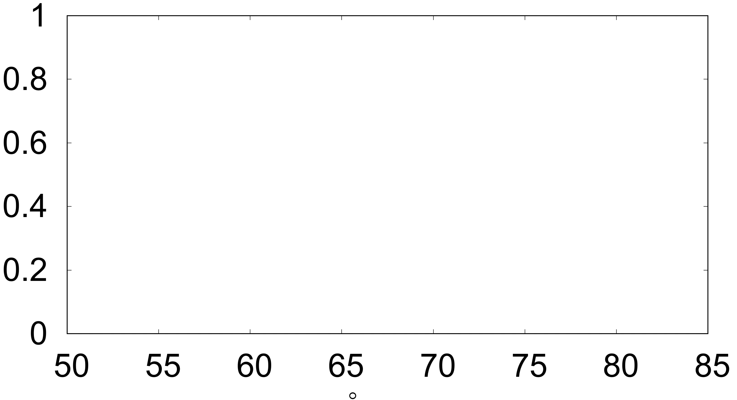
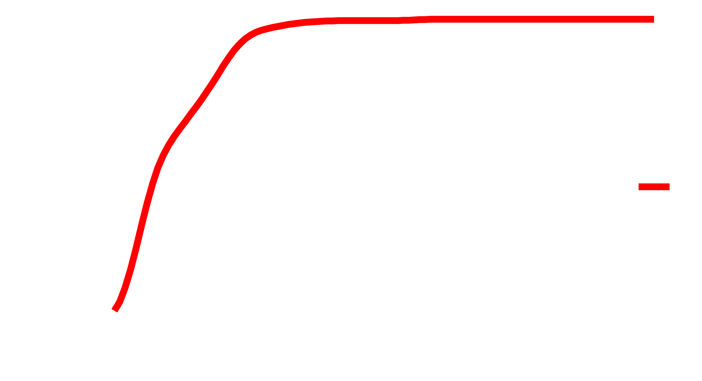
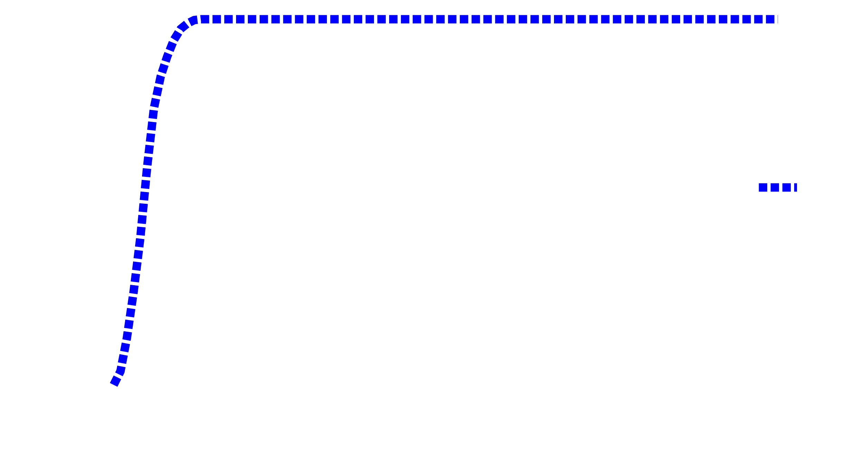
Temperature performance
within ~1⁰C
Best Case Temp.
CDF
Aquilo
Random w/ NAC
Random
Throughput Opt.
Peak Antenna Temperature (⁰C )

Slide 46
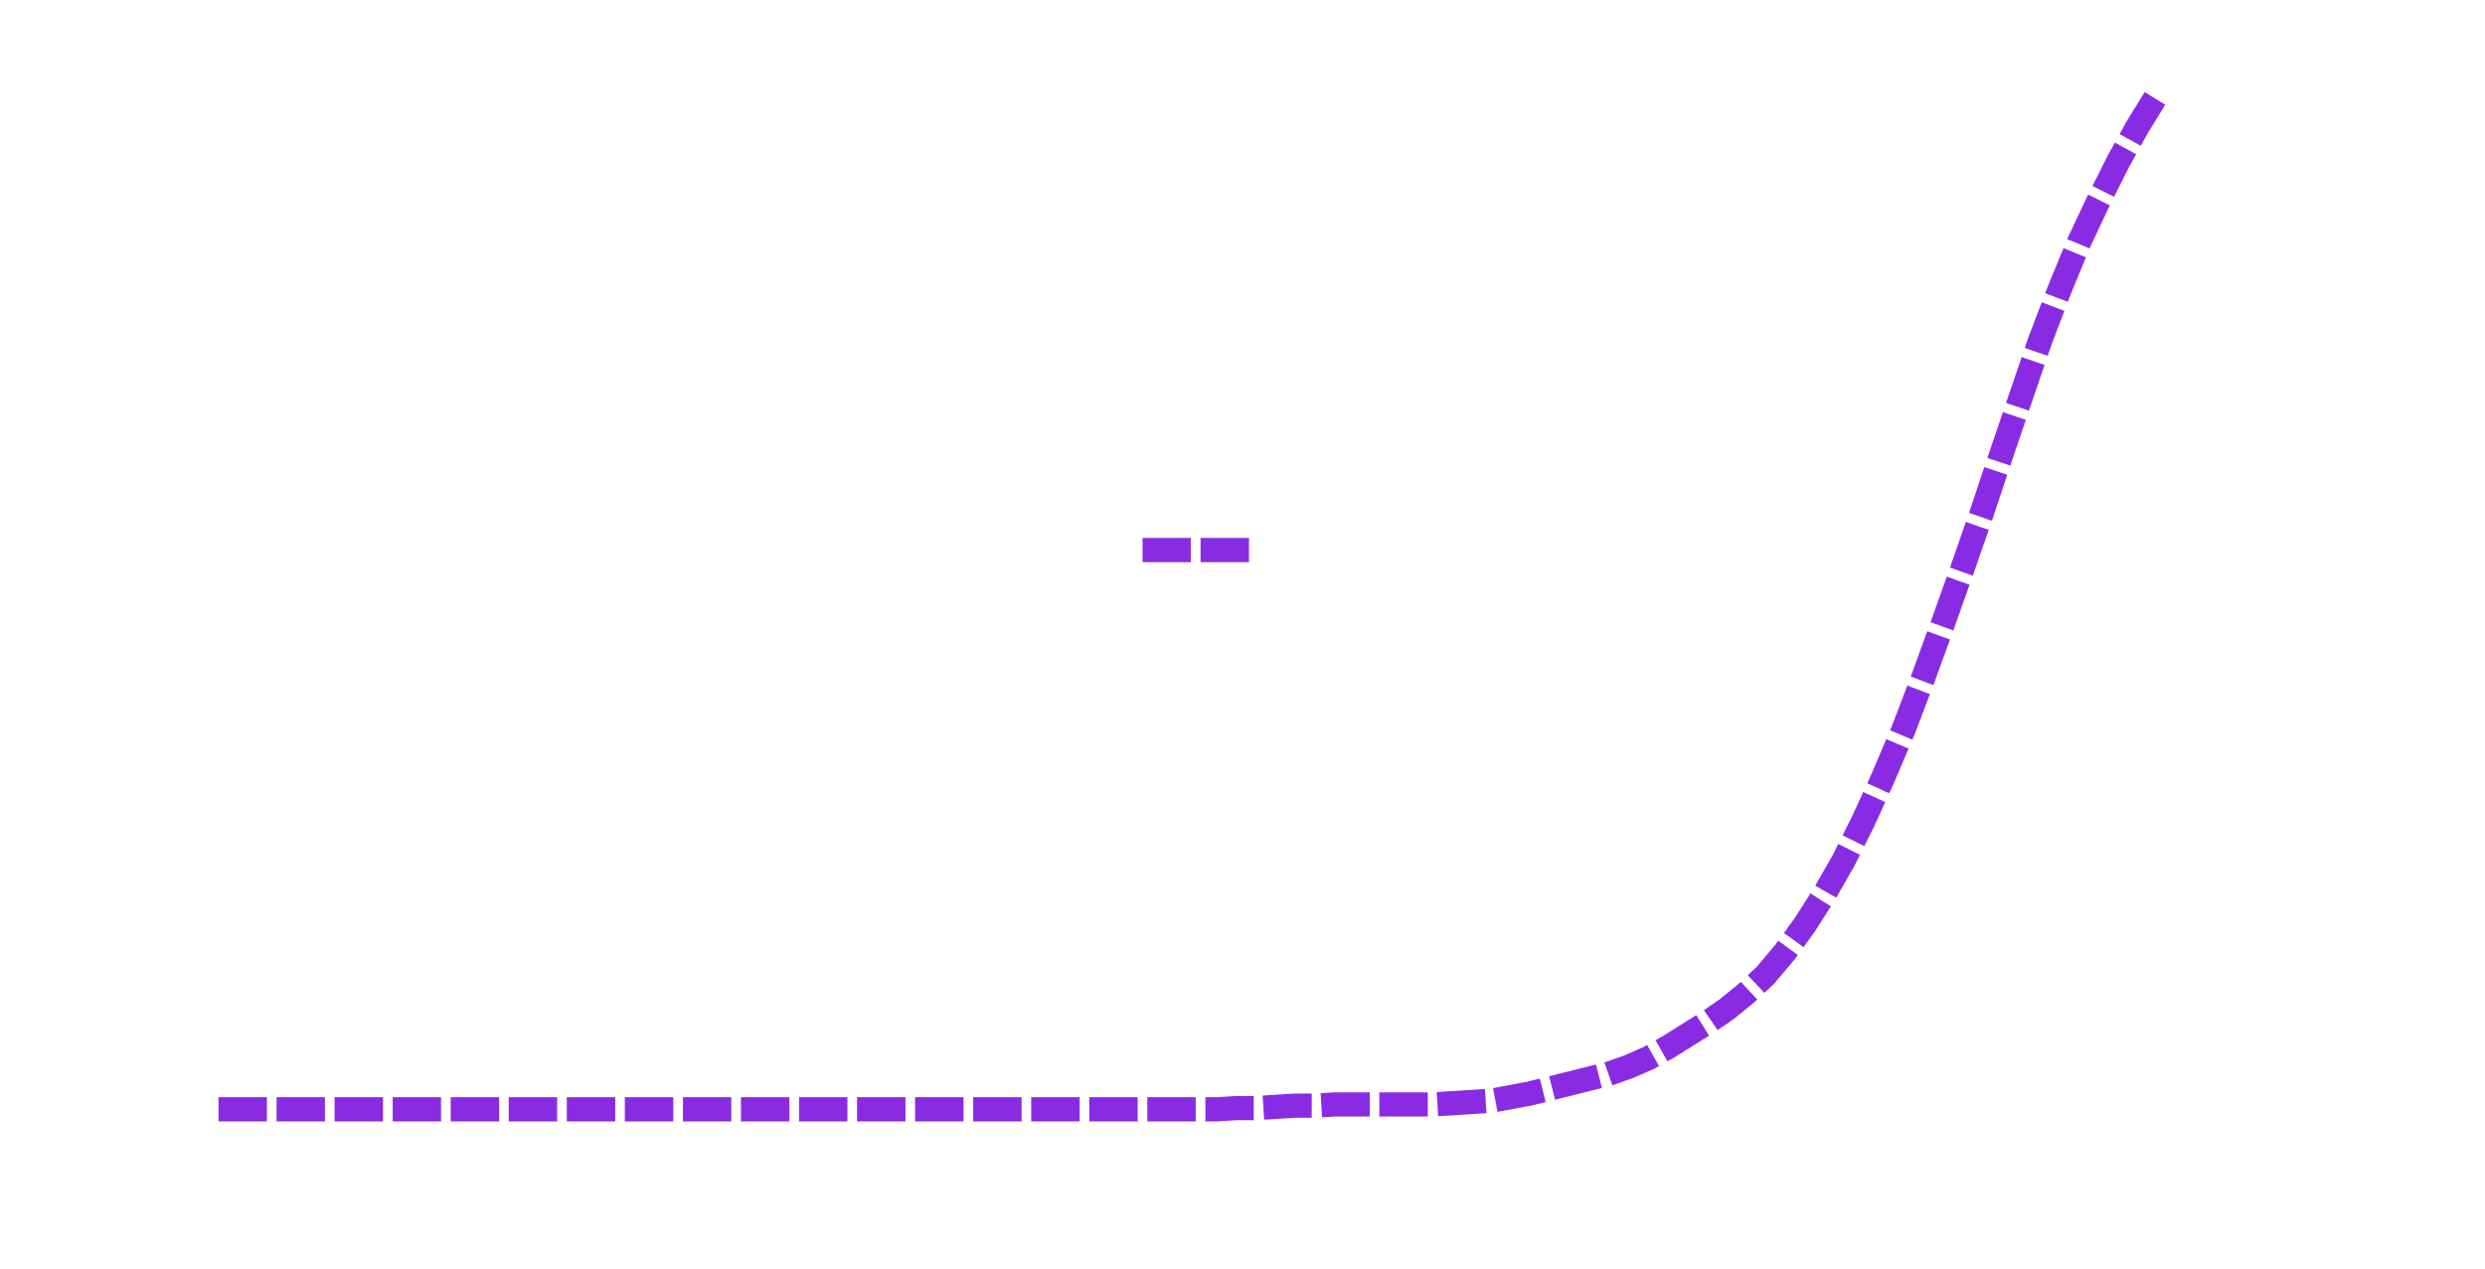
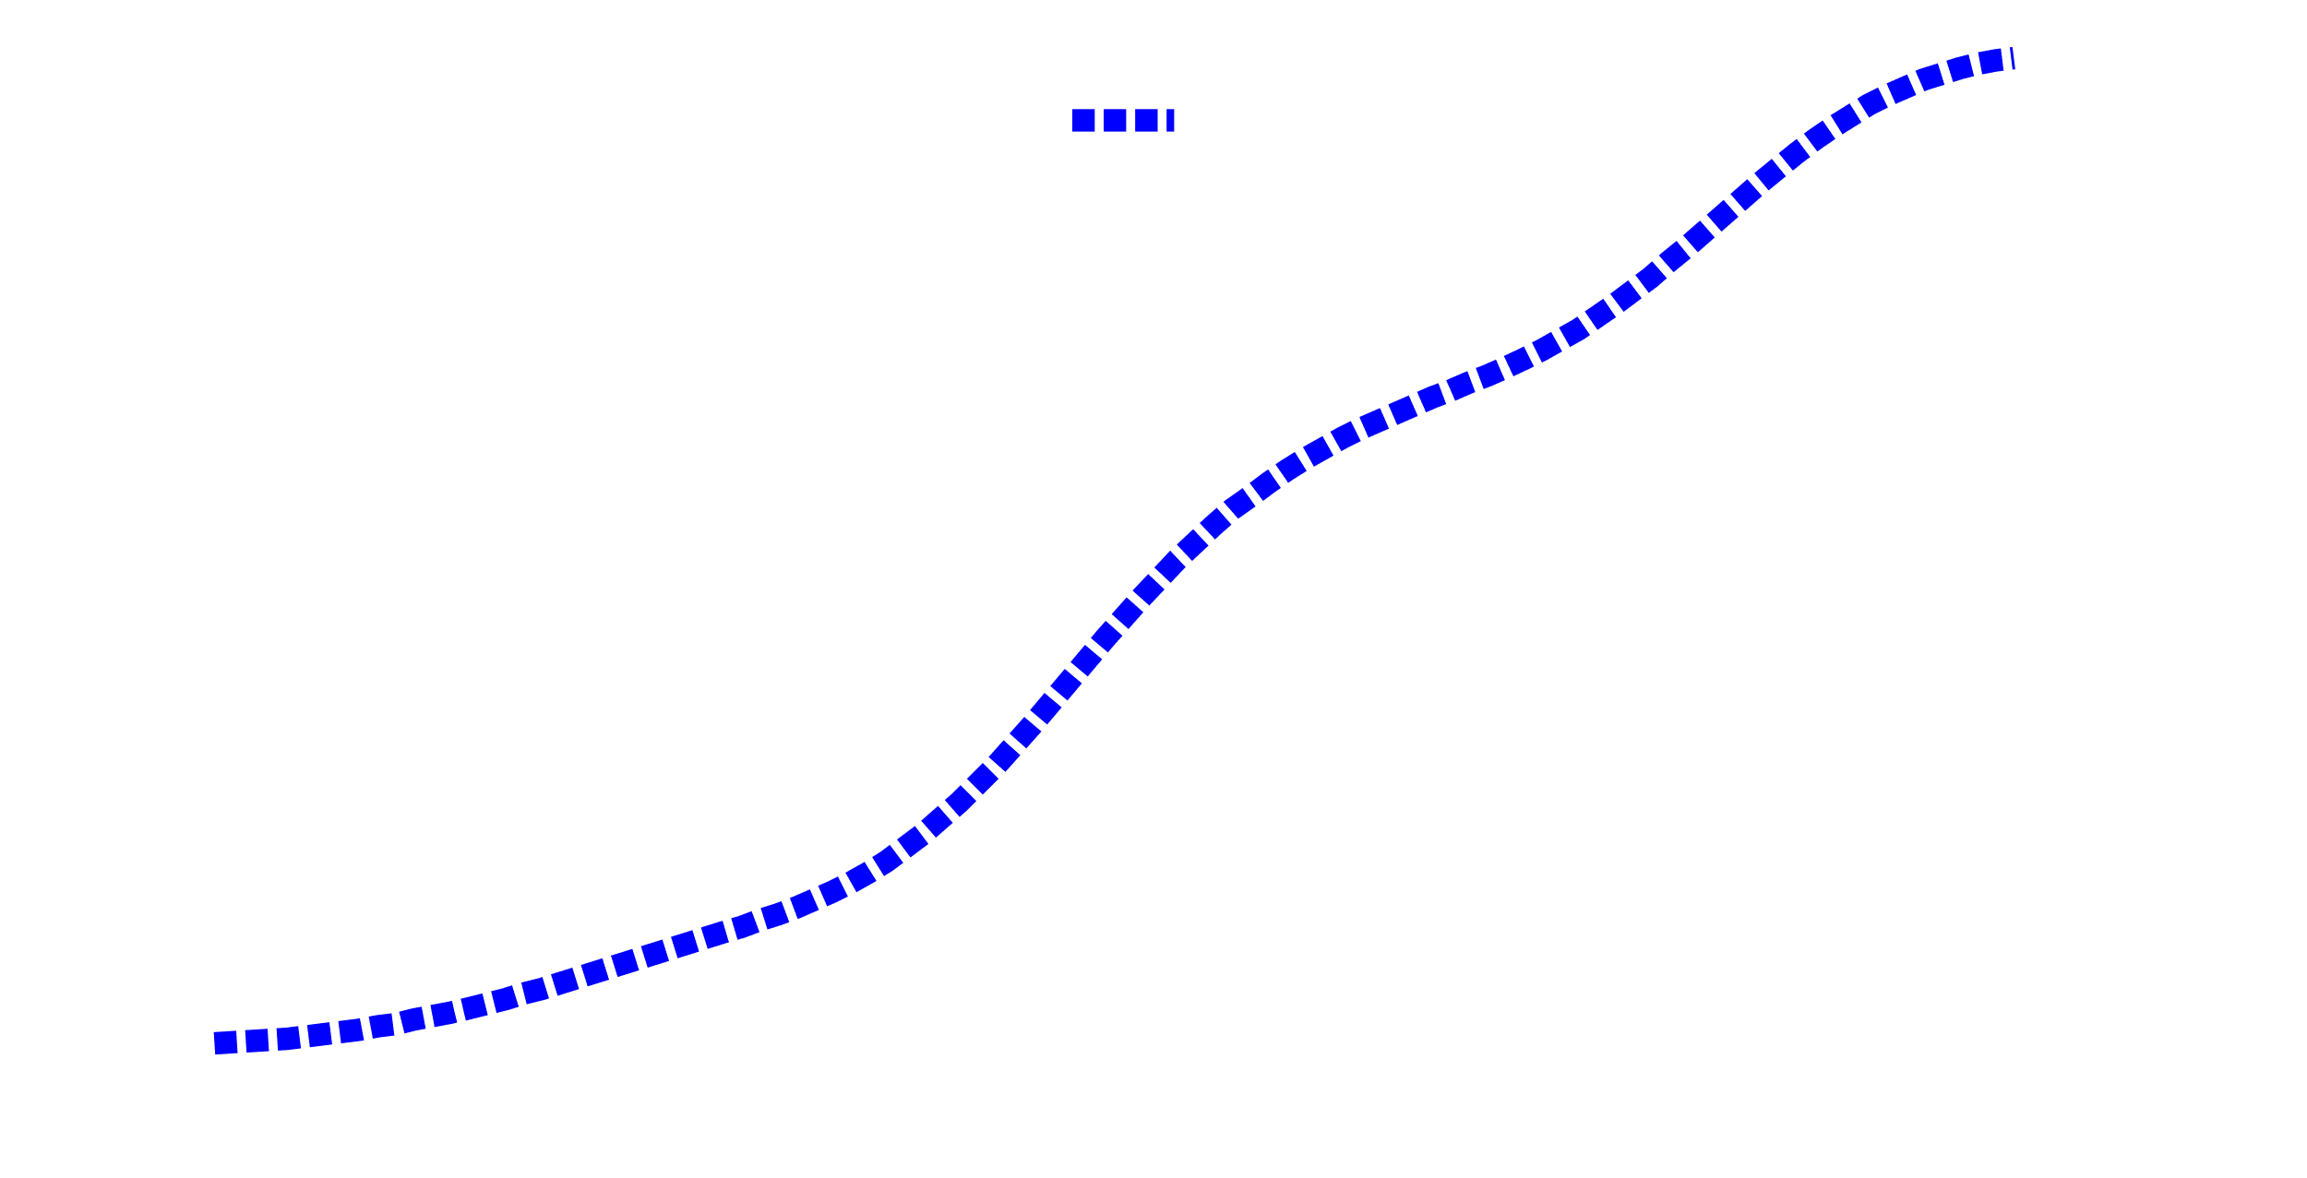
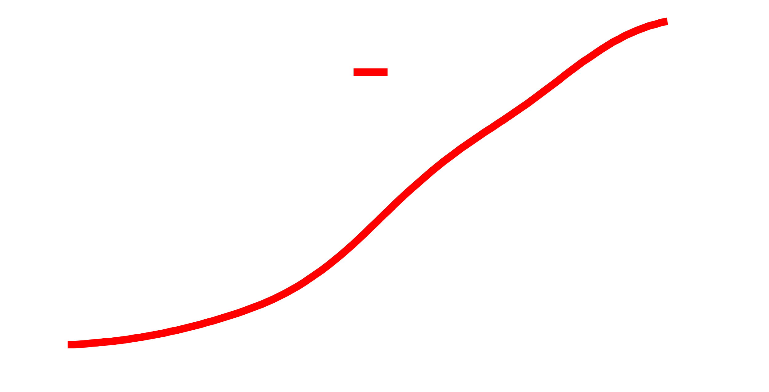
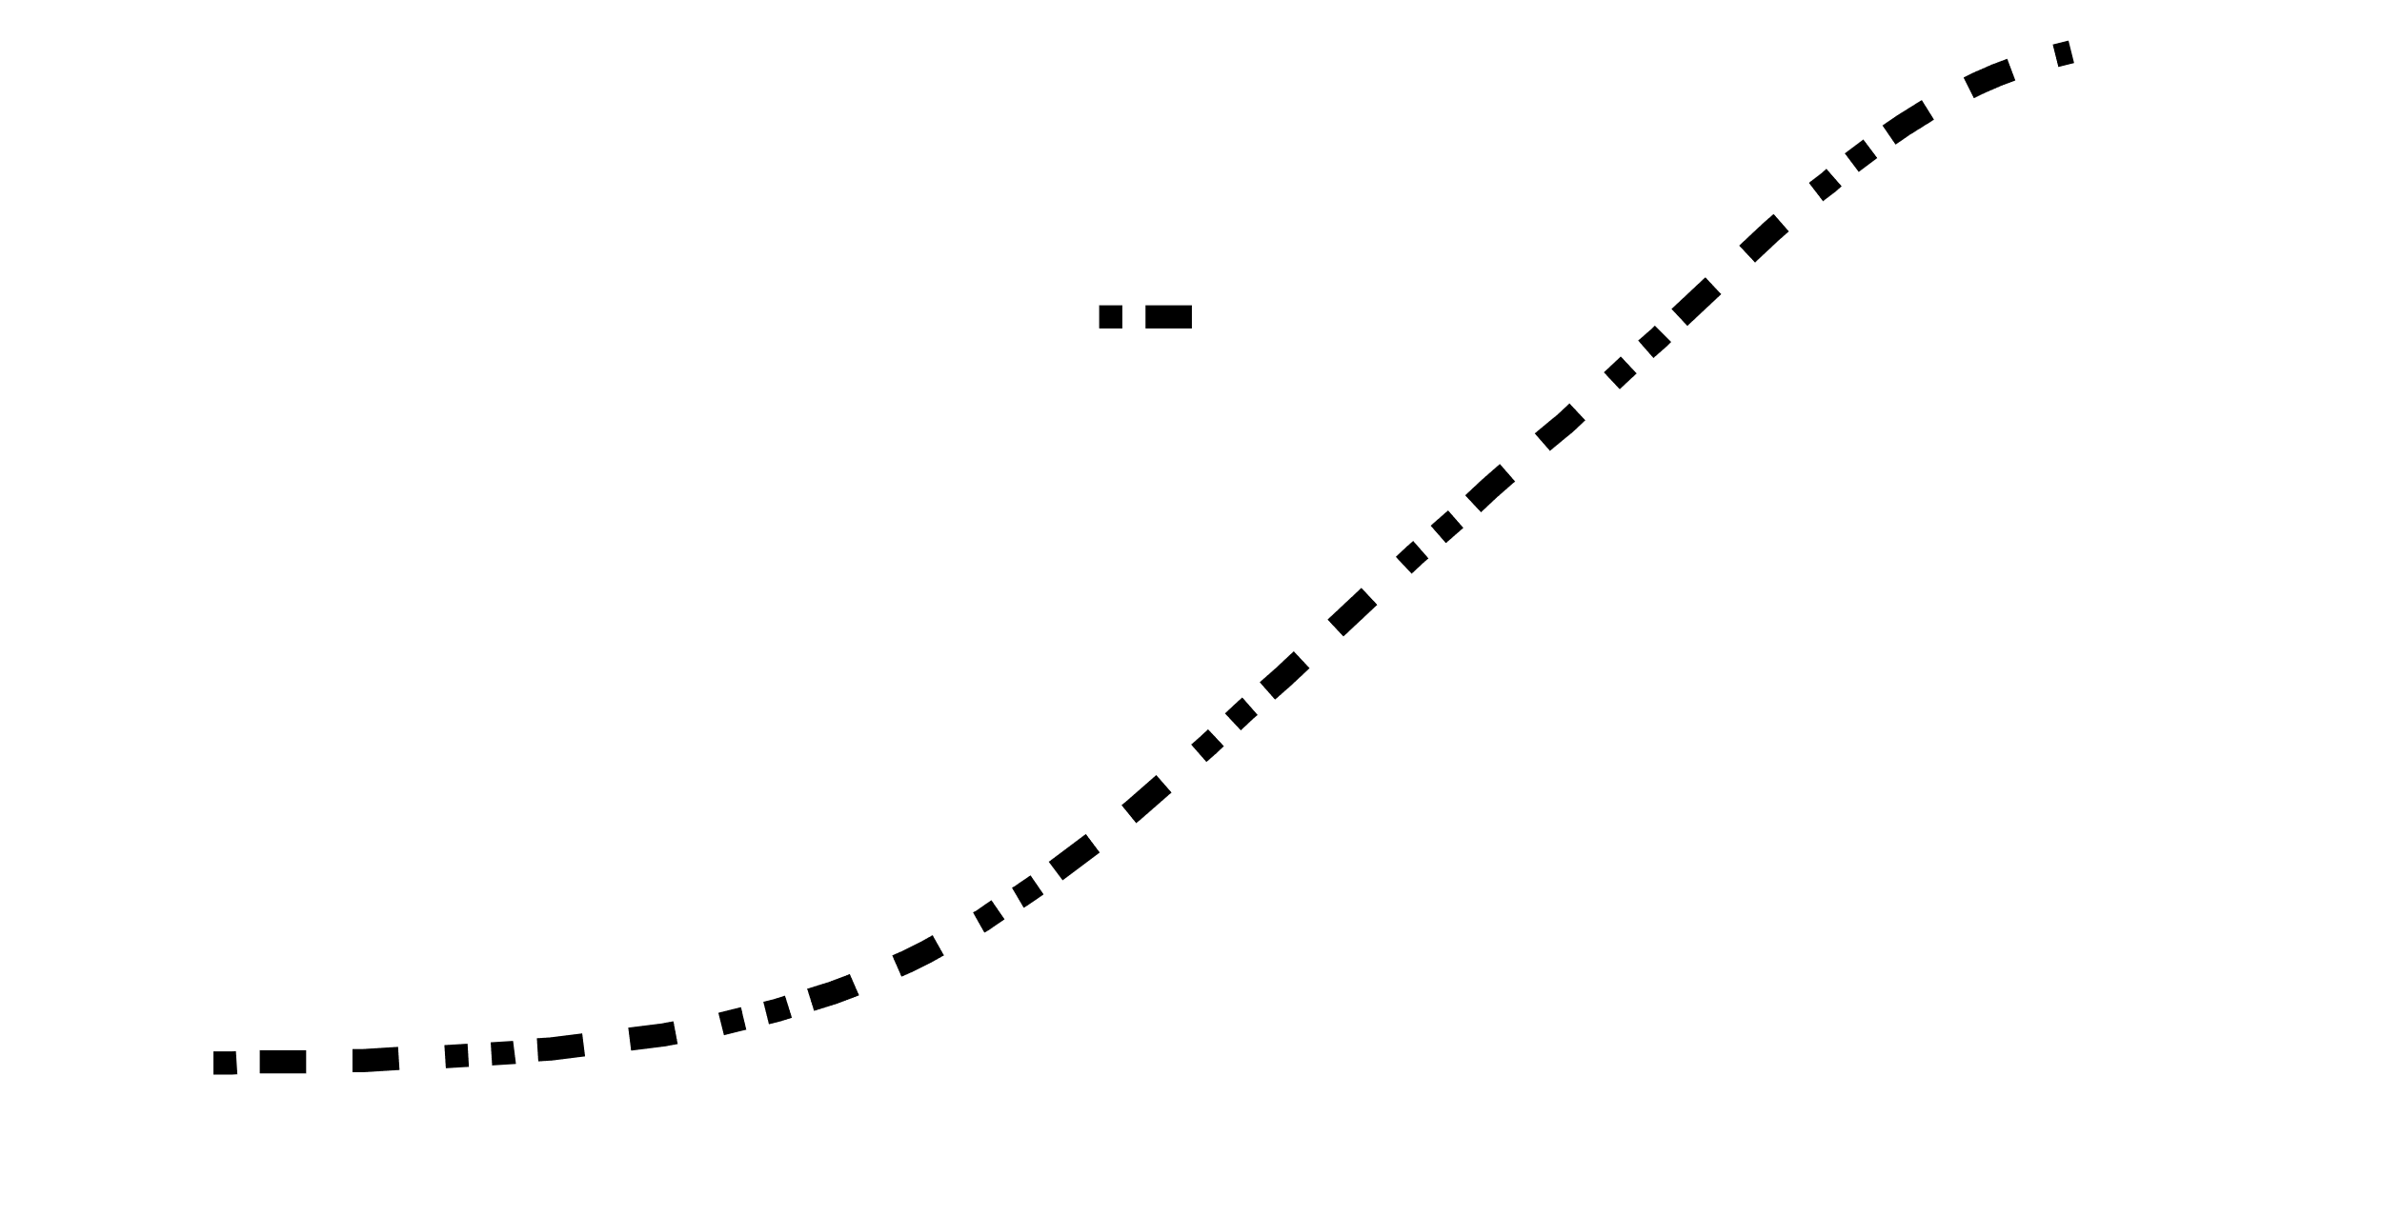
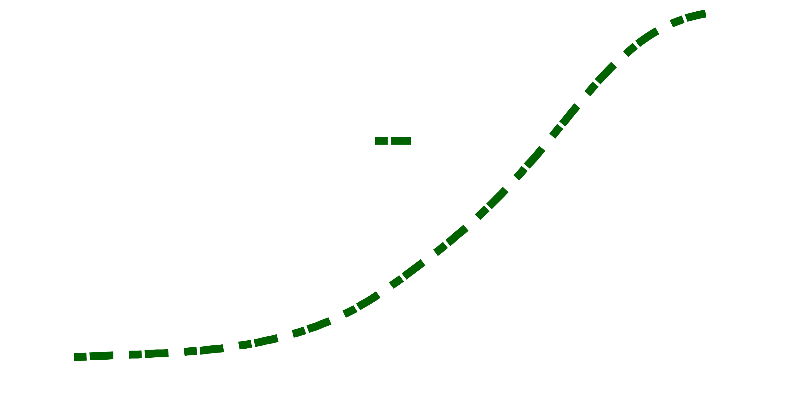
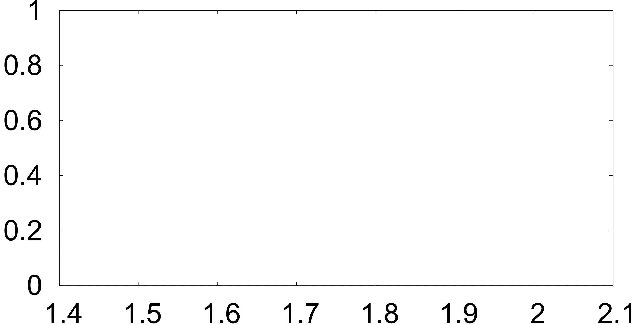
Throughput performance
~10% loss
Best Case Temp.
Aquilo
Random w/ NAC
Random
Throughput Opt.
CDF
Throughput (Gbps)
Notes:
At the same time, we computed how much throughput is achieved by each of the schedulers –
<click>
First, Aquilo’s throughput is compared with an throughput optimization scheme –
<click>
We see that the sacrifice in throughput by Aquilo is only 10%
<click>
Then we compared Aquilo’s throughput with those obtained from the other schedulers –
We see that Aquilo’s throughput very much matches the throughput with the other schedulers

Slide 47
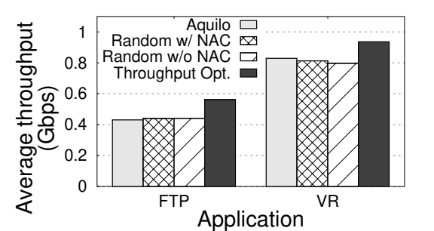
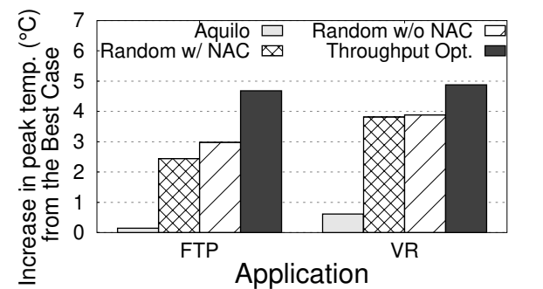
Field trial of Aquilo

Slide 48
Field trial: Throughput performance

Slide 49
Field trial of Aquilo

Slide 50
Field trial: Temperature performance
~4.2 ⁰C
~4.6 ⁰C

Slide 51
Field trial of Aquilo
~4.2 ⁰C
~4.6 ⁰C

Slide 52
Summary and Conclusions
Problem and challenges
Device overheating in mmWave poses health hazards and cause poor network performance
Design is challenging – unreliable network connectivity and non-deterministic temperature model
Aquilo Summary
Thermal characterization of mmWave network: first-of-its-kind
Aquilo: A scheduler for multi-antenna devices based on temperature-awareness
Aquilo achieves chip temperature within 1⁰C of best temperature case while sacrificing only 10% throughput

Slide 53

A Case for Temperature-Aware Scheduler for Millimeter-Wave Devices and Networks
Moh Sabbir Saadat, Sanjib Sur, Srihari Nelakuditi
(cse.sc.edu/~msaadat/)
University of South Carolina
The 28th IEEE International Conference on Network Protocols (IEEE ICNP 2020), Madrid, Spain, 2020
Our work is sponsored by NSF,
under grant no.: CNS-1910853

