Slide 1
Fair Initial Access Design for mmWave Wireless
Suresh Srinivasan
Portland State University
Xi Yu
Portland State University
Alireza Keshavarz-Haddad
Shiraz University
Ehsan Aryafar
Portland State University

Slide 2
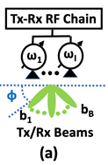
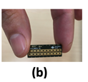
Initial Access Design in mmWave Communication
Omnidirectional antenna
Directional beams & antenna
Beam forming techniques are adopted
  Combat pathloss and extend range of communication.
Initial Access: Clients need beam training to select an apt beam
  Near-far problem: Near clients' power dominate with far clients resulting in an unfair Initial Access.
Notes:
mmwave communication is one of the essential components of next generation wireless networks
Mmwave usually operates in the range of 25GhZ to 300Ghz and the conventional omni-direction wireless communication
suffer high path loss, high noise power and susceptibility to blockages.
To combat these shorting comings, mmwave adapts directional beams for communication
With use of directional beams, Clients need beam training to select an optimal beam.
When multiple clients train their beam simulatnesously during an IA
Near clients power dominate the far clients resulting in an unfair Initial Access.

Slide 3
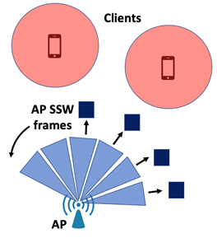
IEEE 802.11ad/ay: Random Training Beam Slots
AP sequentially sends sector sweep (SSW) frames across its sectors
  Client records signal strength of the received beams.
Clients perform their SSW in a random beam training slot
  Fail to address Near-far problem resulting in an unfair Initial Access.
Notes:
Existing standards such as IEEE 802.11 ad/ay perform Beam Training procedure during the IA.
Directional beams are bound to a sector, and the TX needs to perform 360 sweep to cover all the direction
During IA, AP sequentially sends SSW frames across its sectors and client records the signal strength of the received beam.
After AP beam training, clients perform their SSW training at a random training slot.
Since clients pick a random slot to train their beams they can result performing training in the same slot.
Nearer clients end up being deaf to the far clients and result in an unfair initial access

Slide 4
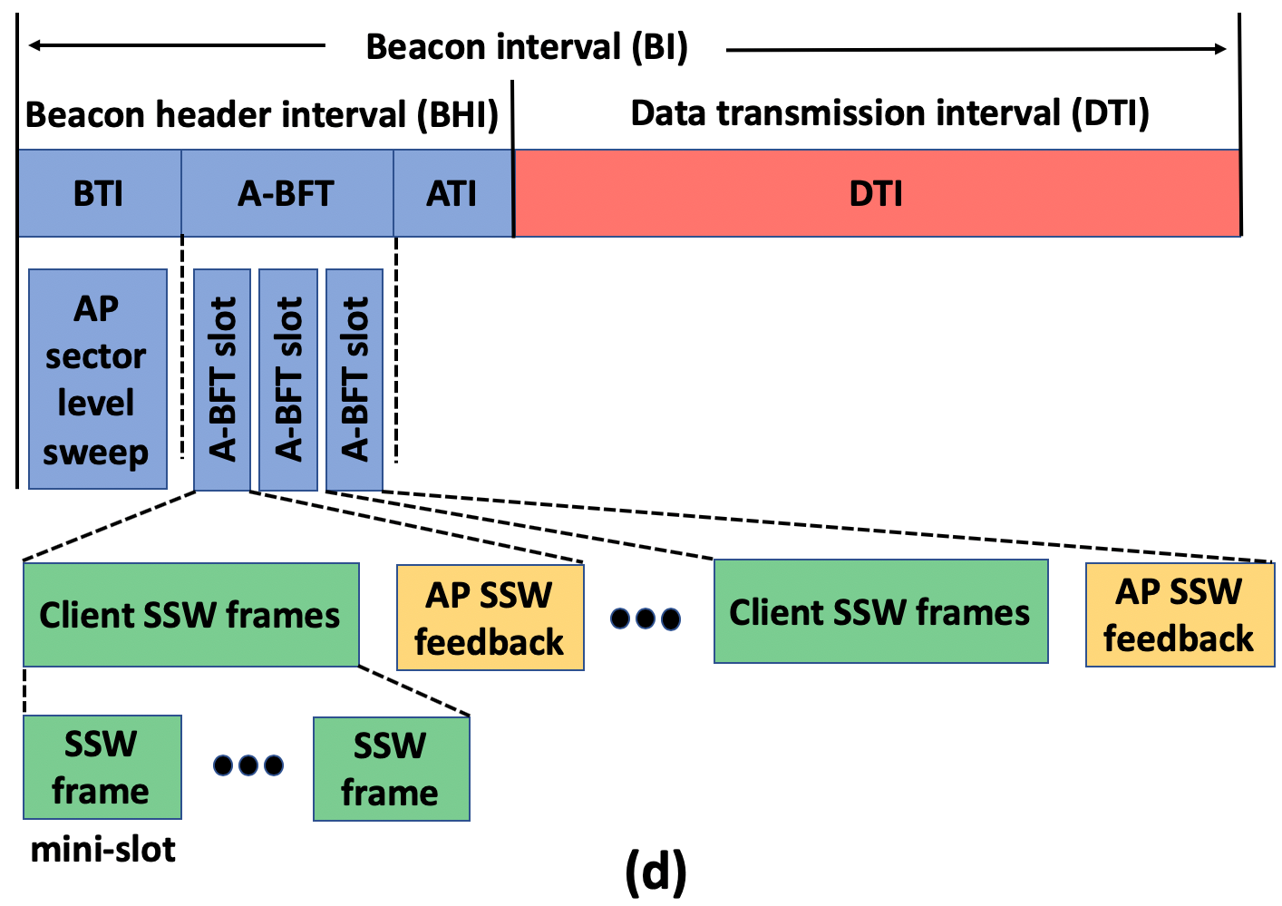
IEEE 802.11ad/ay overview
BI has two subintervals intervals:
  Beacon Header Interval (BHI) – helps with AP discovery, beam training, control and management information exchange.
  Data Transmission Interval (DTI) – used for data communication and supports different types of medium access protocols.
Notes:
IEEE 802.11 ad/ay defines a Beacon Interval (BI), which is split into two
Beacon Header Interval and Data Transmission Interval
During BHI, AP discovery, beam training, control and management information are exchanged.
And DTI is used for data communication and supports different types of medium access protocols such as Time division multiplexing or collision sense multiple access (CBAP)

Slide 5
IEEE 802.11ad/ay: BHI and subslots
  Beacon Transmission Interval (BTI)
    AP sector sweep - AP transmits multiple beacon frames sequentially on different sector in all possible directions.
  Association Beamforming Training (A-BFT)
    Clients train their sectors for communication with the AP.
  Announcement Transmission Interval (ATI) – AP exchanges management information with the associated and beam trained clients.
Notes:
Further Beacon Header Interval (BHI) is split into Three subslots: Beacon Transmission Interval (BTI), Association Beamforming Interval ( A-BFT) and Announcement Transmission Interval(ATI)
During BTI, AP performs its sector sweep, wherein AP transmits beacon frames sequentially on different sectors in all directions
During A-BFT, Clients perform their beam training on different sectors in all directions.
And During ATI, Ap exchanges management information with the trained clients such as optimal beam ID, DTI mode of communication etc.,

Slide 6
Outline
Background
Motivation
Design of JPOC
Performance Evaluation
Related Work and Summary

Slide 7
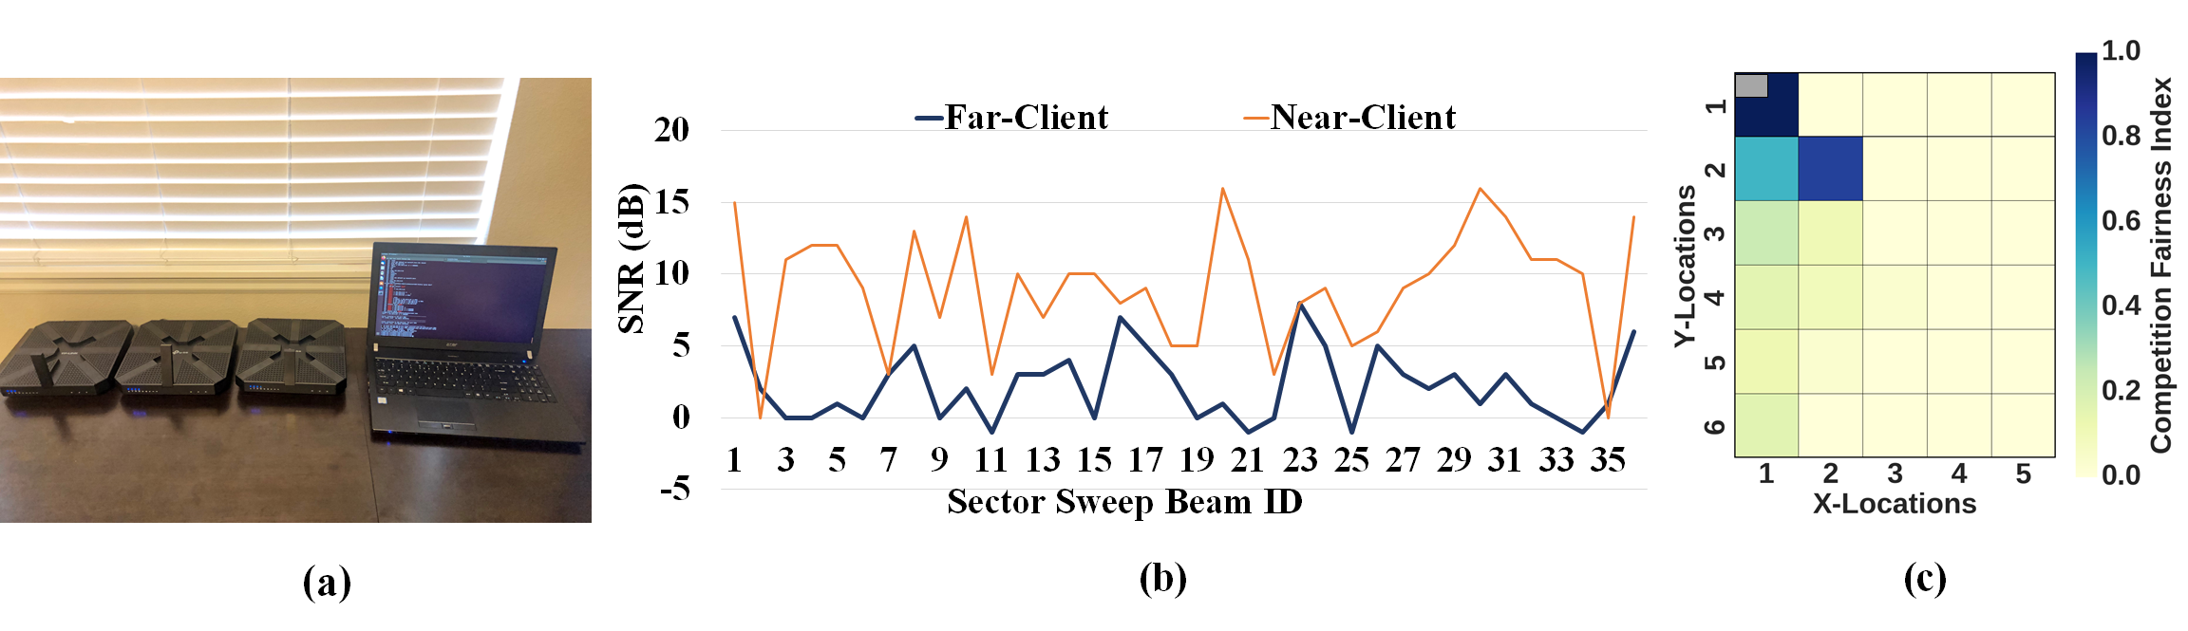
Prevalence of Contention Imbalance
Mmwave LAN with COTS 802.11ad devices
  Talon AD-7200 router, Talon AD-7200 client and Acer Travel-Mate laptop
  AD-7200 router firmware modified using Netmon Framework
  AD-7200 client and Travelmate uses 36 beams with a beam-width of 10º
Notes:
To Study the effect of contention imbalance, we setup an mmwave LAN with the CTOS devices like Talon AD-7200 router and Travel Mate laptop.
The LAN had one AD-7200 as an AP and another one as near client, and we setup Travel-Mate as a far client moved at various locations.
The default firmware of AD-7200 neither report or dump A-BFT SNR dump, to enable these features we modified the default firmware of the router using Netmon framework.
Both AD-7200 and Travelmate uses 36 beams with a beamwidth of 10degrees, A typical variation of the BEAM SNR is shown in the figure(b)

Slide 8
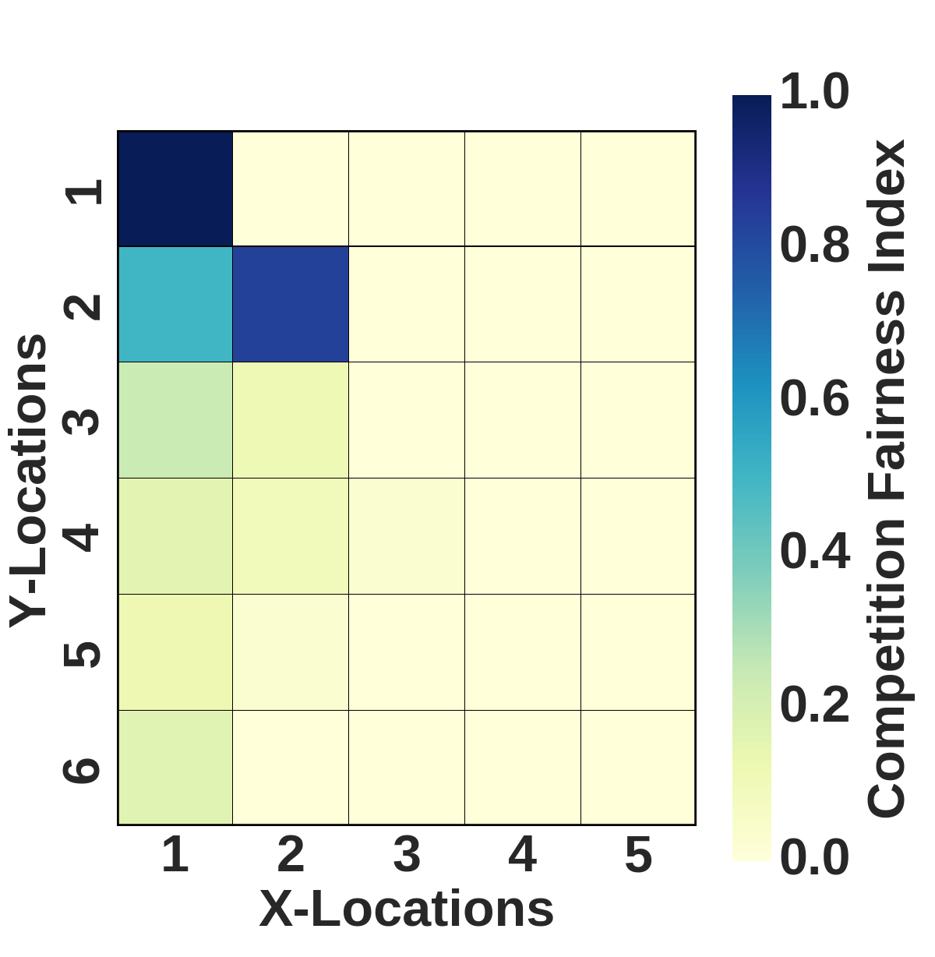





Competition Fairness Index
Competition fairness index at other client location j:
Where,
is the total number of beams for which
is the total number of beams for which
  is the near-client SNR value for beam index i
  is the SNR value for beam index i of the other client at location j
Notes:
We Quantify the effect of Near-Far clients contention unfairness using Competition Fairness Index.
For which, we place the AP at location (1,1) at the grey box and AD-7200 as a client at location (1,1) and let it connect to the AP and record beam SNR values.
We next place the second client in every other (x,y) location, allow it to connect to the AP and record the beam SNR values.
Then We compute the fairness index at other client location j given by Sother(j)/Snear
Snear is the total number of beams for which ……
SNRnear (i)……
SNRother(i)…….

Slide 9

Frequency of Client Participation in A-BFT
BS1
.
BS2
.
.
.
.
.
.
.
BS1 with mmwave
BS2 with mmwave
Degree of throughput unfairness
  depends on the frequency of clients participation in the A-BFT
Prominent causes of client participation in A-BFT
  Mobility
  Blockages
  Sporadic Traffic
  Association to a New AP
Notes:
Degree of throughput unfairness depends on the frequency of clients participation in the A-BFT
Suppose we assume that there is a single A-BFT slot, one near and far client.
And if the near client participates in A-BFT in each beacon interval then the far client will continuously loose.
We have conducted several experiments to characterize what can re-trigger client participation in A-BFT.
To summarize some of the prominent causes:
Mobility, blockages etc.,,,,, from the slides.

Slide 10
Outline
Background
Motivation
Design of JPOC
Performance Evaluation
Related Work and Summary

Slide 11
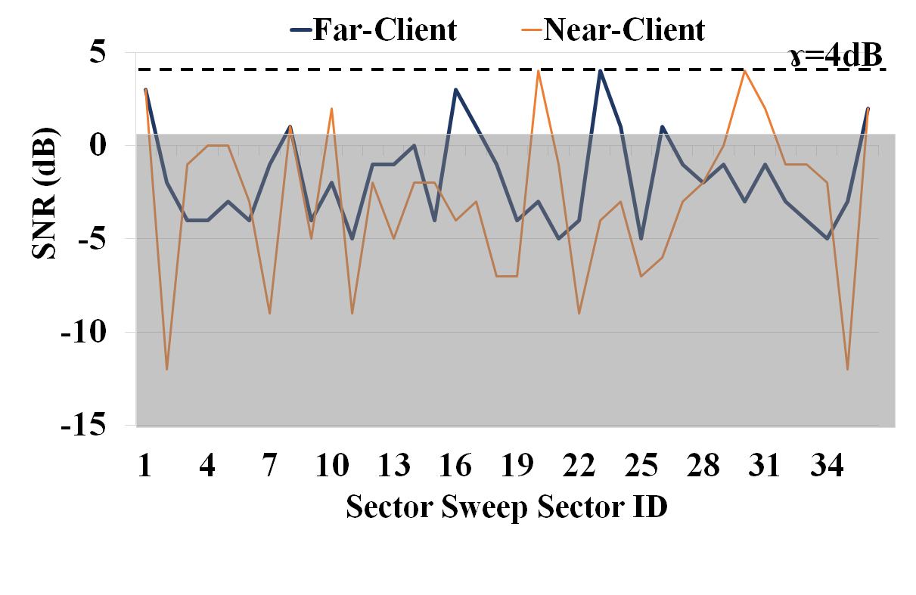
Joint Power cOntrol Contention adaptation protocol (JPOC) summary
Goal: Allow clients to scale down its power
  Fewer good beams are received at the AP
Gains of JPOC- Algorithm:
  Lowers Interference between Far and Near clients.
  Increases IA fairness.
  Decreases no of mini slots required.
Notes:
To improve IA fainess and Contention Adaptation Protocol Optimization we propose Joint Power Control Contention adaptation protocol (JPOC) algorithm
To summarise JPOC:
Allow clients to scale down its power so that fewer good beams are received the AP.
3) As a result, when near and far clients simultaneously perform their sector sweeps, far client would not be drawn in the interference by the the near client as shown in fig
4) Advantages of JPOC is:
1) Lowers interference between far and near clients and increases IA fairness
2) decreases no of mini-slots required

Slide 12


JPOC: Desired SNR at the AP
  Goal: Clients with PC algorithm will transmit their beams at most desired maximum power.
  Suppose γ (dB) is the desired SNR at the AP, then we have:
  Then the desired maximum signal strength that the clients can transmit their SSW frames is given by:
  where, is the desired maximum signal strength at AP and is the noise power at the AP.
Notes:
JPOC goal is to select the client transmit power such that its best beam achieves a desired signal strength at the AP.
BUT note that the best beam is not known prior to sector sweep.
Suppose gamma is the desired SNR of the clients best beam at the AP, then we have equation.
Therefor for a desired gamma, all the clients has to do is to select a transmit power such that RxPmax equation

Slide 13







JPOC: Max Client’s TX and RX power
  Clients can transmit their beams with a maximum power given by the following path loss equation:
  The maximum beam power received at the client during AP sector sweep is given by path loss equation:
  Where,
  , are the AP and client transmission power.
  , are the AP and client beamforming gain with i and j as their beam index.
  , are the AP’s and client’s receive beamforming gain.
  is the pathloss component between AP and client
Notes:
Now we talk about how each client can choose it’s transmit power such that its Max received power at the AP is equal to RxP(AP)Max.
Consider a client (CLT) and let i denote the client beam index that achieves the Max received power at the AP. Then from the path equation we have:
Talk about equation(3)
Next, consider the preceding AP sector sweep and let j denote the AP beam index that achieved the higest SNR at the client. Then we have
Talk about equation(4).

Slide 14
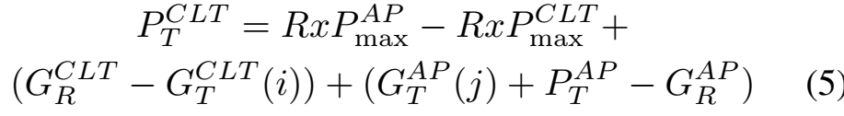



JPOC: Client TX power estimation
  Client derives its transmission power with the following equation, and uses maximum transmit power if the estimated power exceeds the possible transmit power.
  Where,
  can be approximated as the array gain.
  is the maximum array/beamforming gain of the APs antenna array.
  AP adds information in each of it’s SSW frames during BTI.
Notes:
RxPmax(CLT) is a known value at the client and by subtracting eq4 from eq3 and removing common PL terms we get PT(CLT) shown in eq 5
Where talk about two params
Clients dervies its transmission power with equation 5 and uses maximum power if the estimated power exceeds the possible transmit power
AP adds G(T)AP(J) information in each of its SSW frames during BTI

Slide 15
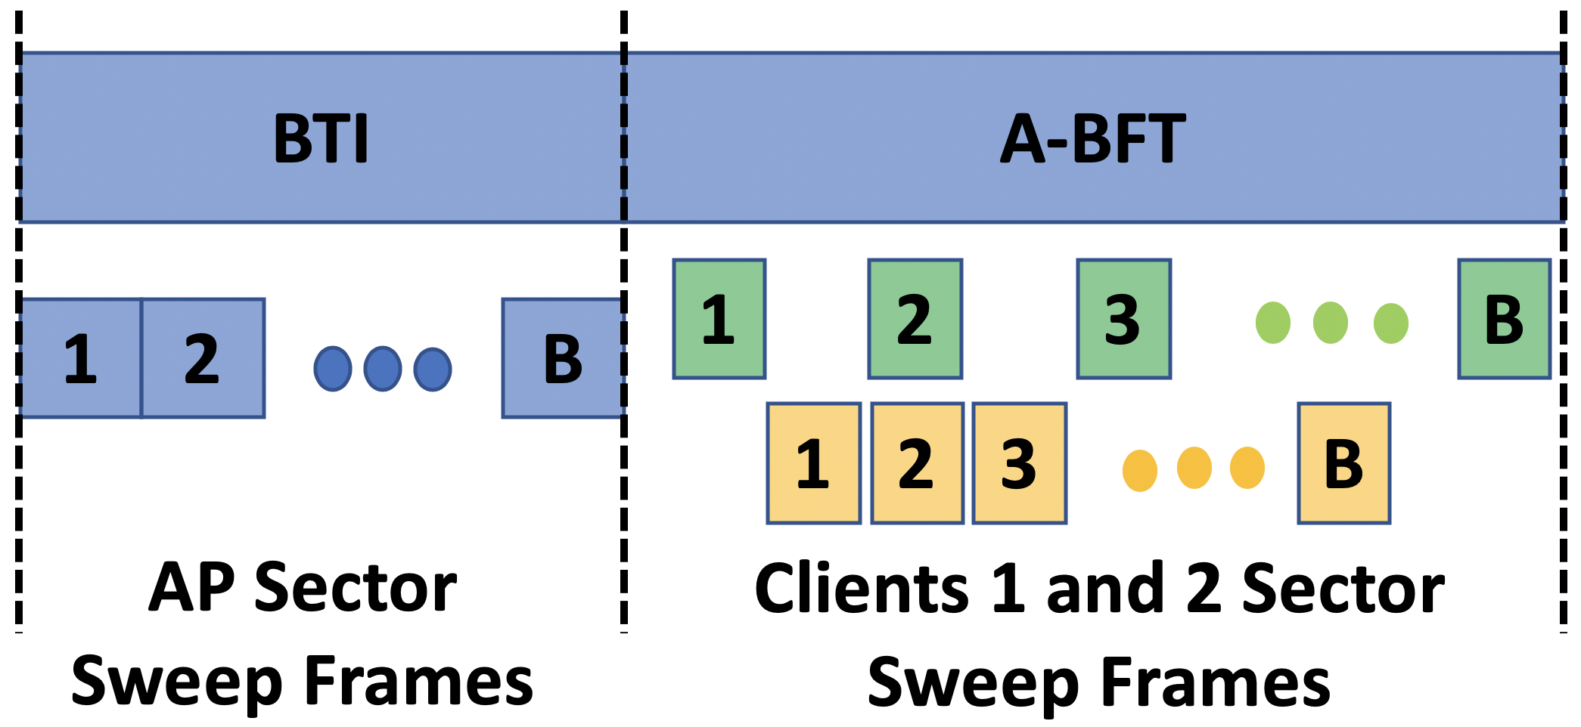
JPOC: New A-BFT Design
  JPOC proposes to use mini slots only
    Determines the no of mini slots dedicated to A-BFT
    Announces no of mini slots during BTI interval
Notes:
As discussed in background section, IEEE 802.11 ad/ay standard divide the A-BFT time into slots and mini-slots, which can unnecessarily increase A-BFT overhead.
In JPOC, we propose to use mini-slots only, and determines the number of mini slots that would be dedicated to A-BFT interval.
And announces that during its sector sweep i.e BTI interval.
Let M denote the number of mini-slots and B the number of client beams.
Then, during A-BFT, each client randomly selects B out of these M mini-slots and transmits on a different beam during each mini-slot as shown in fig.

Slide 16
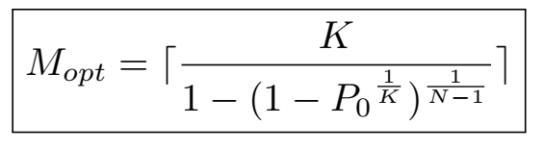
JPOC: Optimal Mini-Slot Number Estimation
Where ,
Mopt = optimal mini-slots
K = no of good beams
N = no of clients contending during A-BFT
P0 = denote the targeted failure probability that a client that participate in A-BFT cannot establish connection with the AP
and our goal is to maintain,
Notes:
One of the Important task of JPOC is to determine the optimal number of mini-slots.
Let k denote the number of good beams and
N the number of clients that are contending during A-BFT.
Assuming K is the same across all the clients and assume that non good-beams do not collide with the good beams at the AP
For a given client, the transmission probability of this good-beam
TO BE COMPLETED

Slide 17
Outline
Background
Motivation
Design of JPOC
Performance Evaluation
Related Work and Summary

Slide 18
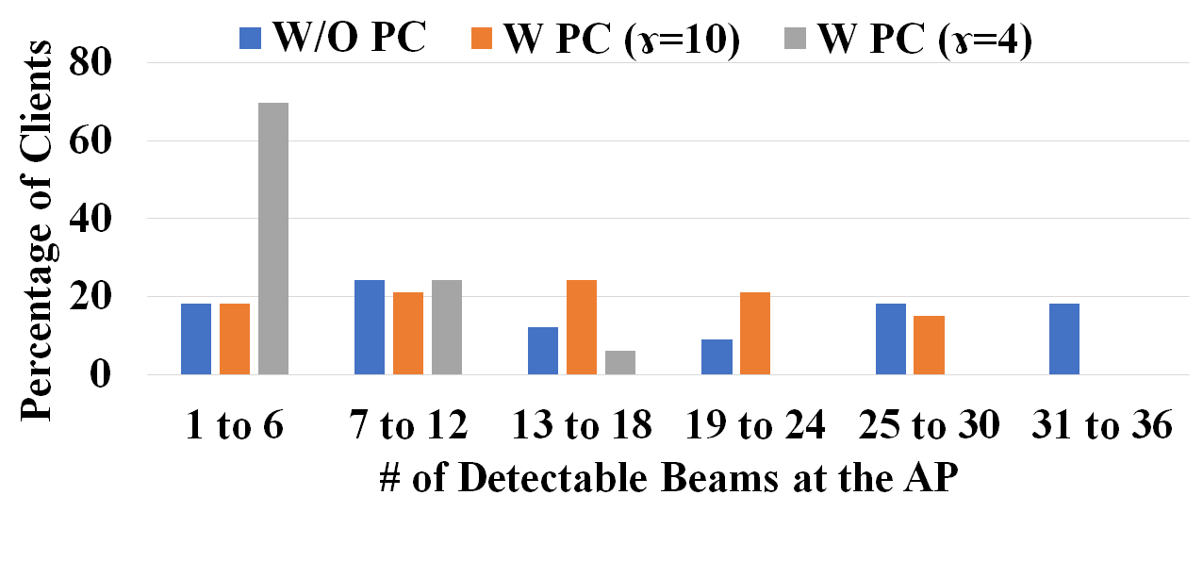
Impact of JPOC on the Number of Good Beams
  For a given location & orientation, we obtain SNR for three cases – W/O PC, (W) PC and γ=10 and (W) PC and γ=4.
  W/O PC: The number of good beams across the clients varies from as high as 31-36 to as low as 1-6.
  With PC: The number of good beams decreases as γ decreases.
Notes:
We first study how client-side PC impacts its number of beams with the detectable SNR at the AP.
We consider the indoor mmwave LAN setup, and take the samples in each-grid with different orientation, we obtain the SNR dump of all the client’s beams for three different
power control mechanisms: 1) without (W/O) PC 2) with PC and gamma=10 3) with PC and gamma=4
Gamma denotes the desirable SNR at the AP.
Each client adjusts its transmission power such that the resulting SNR of the best beam at the AP is equal to gamma.
The bar chart above shows the distribution of the all the good beams across all the experiments.
We divide the number of good beams into 6 brackets from 1to6 ….. 31 to 36
We observe that without PC, clients are almost equally distributed across all the brackets. Further, clients could have as high as 31-36 or as low as 1-6 good beams.
When PC is employed, the number of good beams depends on gamma and as gamma is reduced, the number of good beam is reduced. And similarity in the number of good beams across client increases.
With gamma=10, the number of good beams lies between 1 to 24, and about 45% of the clients would have 7-18 beams.
With gamma=4, more than 90% of the clients would have 1-12 good-beams and no client would have more 18 or more good-beams.
Our results show that PC has the potential to increase the contention fairness among clients, and similarity in the number of good-beams increases across the clients as PC is employed.

Slide 19
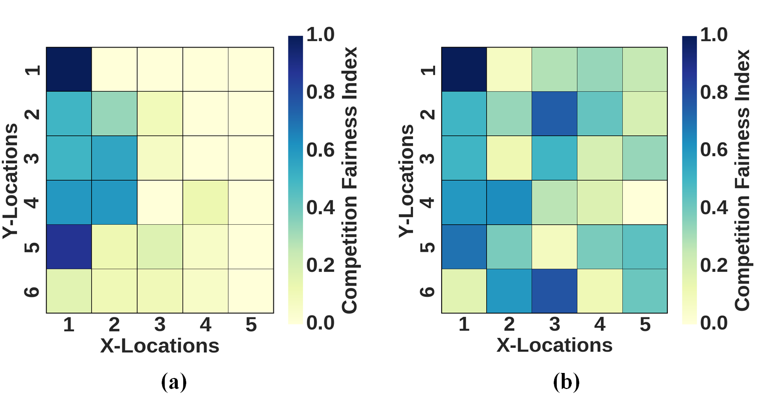
JPOC - Fairness Enhancement
  Fairness compared with the near client cell location (1,1)
    W/O PC : Near clients dominate Far clients and creates an unfair scenario as shown in Figure-a
    (W) PC: PC drastically improves fairness specifically with smaller γ as shown in figure b & c.
Notes:
M

Slide 20
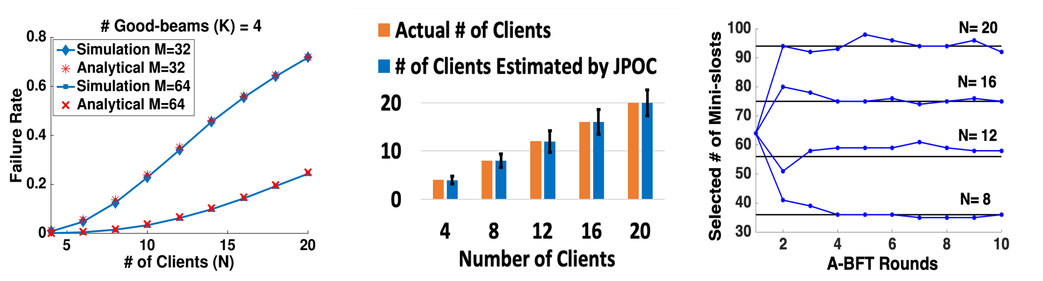
JPOC- Contention Adaptation Protocol Optimization
  Failure rate prediction
    Clients failing to connect to the AP for a given K, N, M
  Accuracy in determination of the no of clients
    No of actual competing clients versus the value estimated by our model
  Temporal Evolution of the no of mini-slots
    M_{opt} for four different and fixed client
Notes:
Mmwave communication if one of the essential components of next generation wireless networks
Unlike omni-direction wireless communication

Slide 21
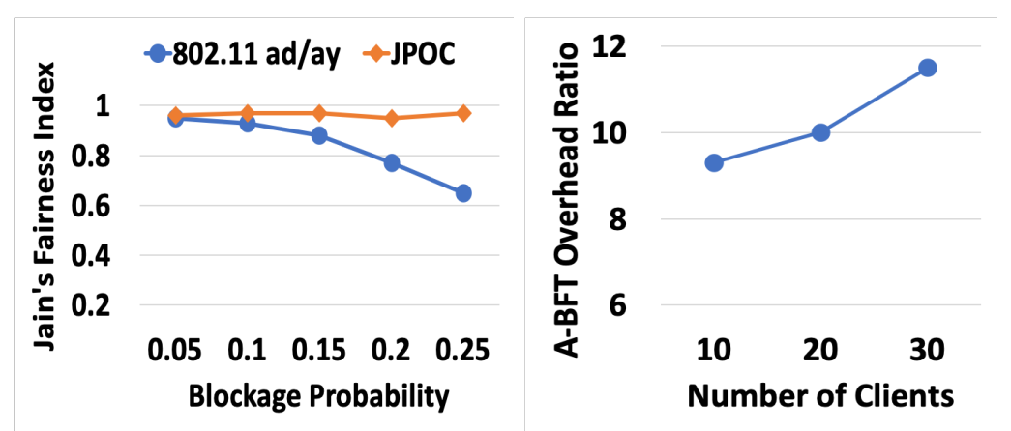

Fairness Comparison btw JPOC & 802.11ad/ay
  Fairness Definition: We compare both JPOC and 802.11ad/ay using jain’s fairness index defined as
  Protocol Overhead
    Targeted failure rate is set to 10% and blockage probability of 10%
    JPOC has 9 - 12 times lesser overhead than 802.11ad/ay
Notes:
Mmwave communication if one of the essential components of next generation wireless networks
Unlike omni-direction wireless communication

Slide 22
Related Work
Optimal Beam Selection
Beam Search
Techniques
Out-Of-Band Beam Selection
Pro-Active Beam Adaptation
Environmental Sensing
Zheng ACM17
Wei USENIX17
Widmer INFOCOM15
Ma IFOCOM17
Sur USENIX16
Aryafar MOBICOM19
Payami ICC15
JPOC: ICNP’20
JPOC is designed for fair Initial access design

Slide 23
In Summary
We showed that as clients train their beams, there exists a sever power imbalance coupled with IEEE802.11ad/ay poor contention protocol design resulting in an IA unfairness.
Proposed an open loop Joint Power Control and Contention Adaptation Protocol (JPOC) to address the unfairness problem.
We showed through experiments and simulations that compared to 802.11 ad/ay, JPOC substantially increases the fairness and reduces the contention overhead by 9-12X.

