Slide 1
LB-SciFi: Online Learning-Based Channel Feedback for MU-MIMO in Wireless LANs
†
Pedram Kheirkhah Sangdeh, Hossein Pirayesh, Aryan Mobiny, and Huacheng Zeng
Michigan State University University of Houston
*
*
*
*
†
The 28th IEEE International Conference on Network Protocols (ICNP 2020)
10/15/2020

Slide 2

Wi-Fi for Everything, Wi-Fi for Everyone
Exabytes per month
Exponential traffic growth
Cellular offloading
Mission-critical voice and IoT
Ubiquitous hotspots
400
300
200
100
How does Wi-Fi keep up with the growing traffic demands?
0
Wi-Fi traffic trend for 2017-2022*
* Cisco VNI global traffic forecast

Slide 3
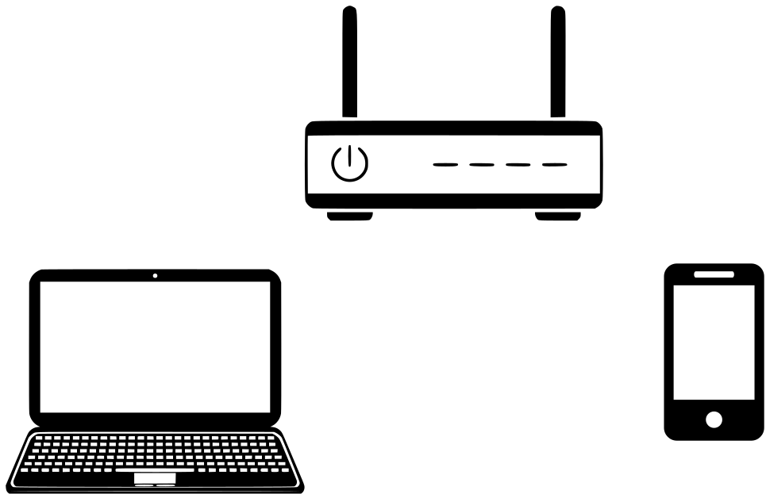
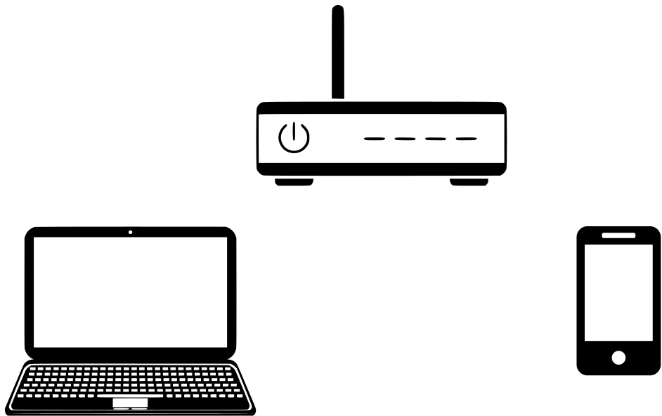



Multi-User Multiple Input Multiple Output (MU-MIMO)
vs. MU-MIMO communications
Point-to-point
High latency
Low capacity
High capacity
Need of spatial side information

Slide 4
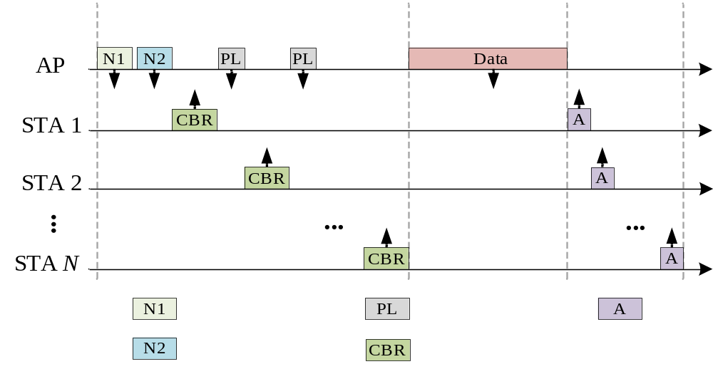
MU-MIMO Transmissions in Wi-Fi Networks
Sounding phase: Channel acquisition
Large overhead
Throughput degradation
How can we reduce
sounding time?
Sounding phase
Data
transmission
NDPA
Poll
ACK
NDP
Compressed CSI

Slide 5
Current State of Knowledge
Sounding parameters
  Impacts of sounding parameters
Adaptive sounding frequency
  Sounding upon CSI expiration
Hybrid sounding
  Implicit feedback on subset of stations
Implicit sounding
  Uplink CSI for DL MU-MIMO
Limited progress so far on compressing CSI itself

Slide 6
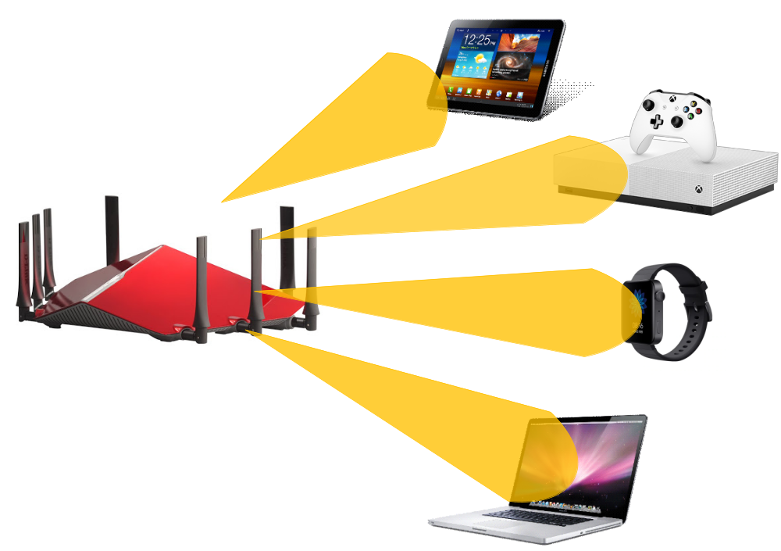
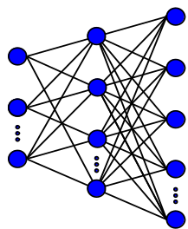
Our Approach: Training Phase
DNN-based autoencoder (DNN-AE) is used for CSI compression
Encoder
Encoder
Decoder
Encoder
Encoder
The AP trains DNN-AE for CSI compression
AP broadcasts encoder when possible.
The AP/STA uses decoder/encoder.
AP continues improving DNN-AE.

Slide 7
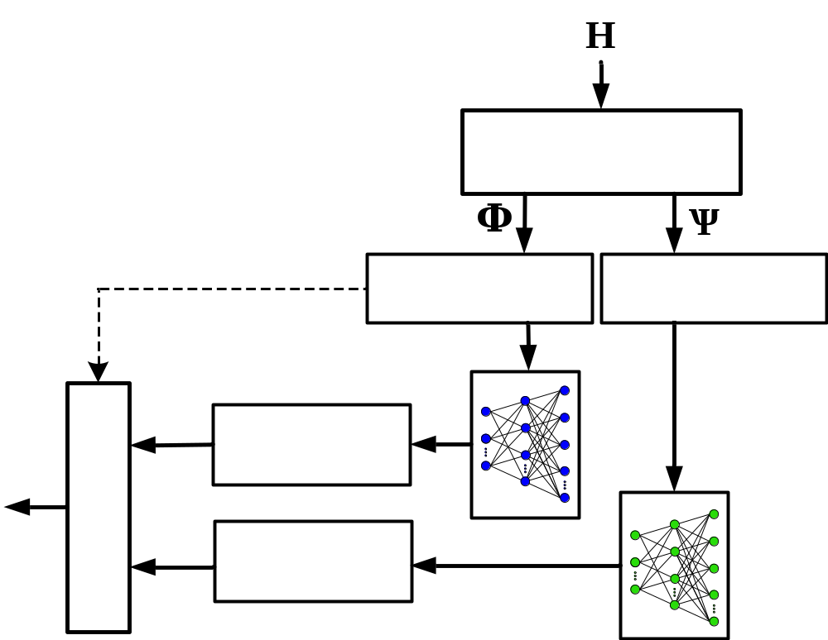
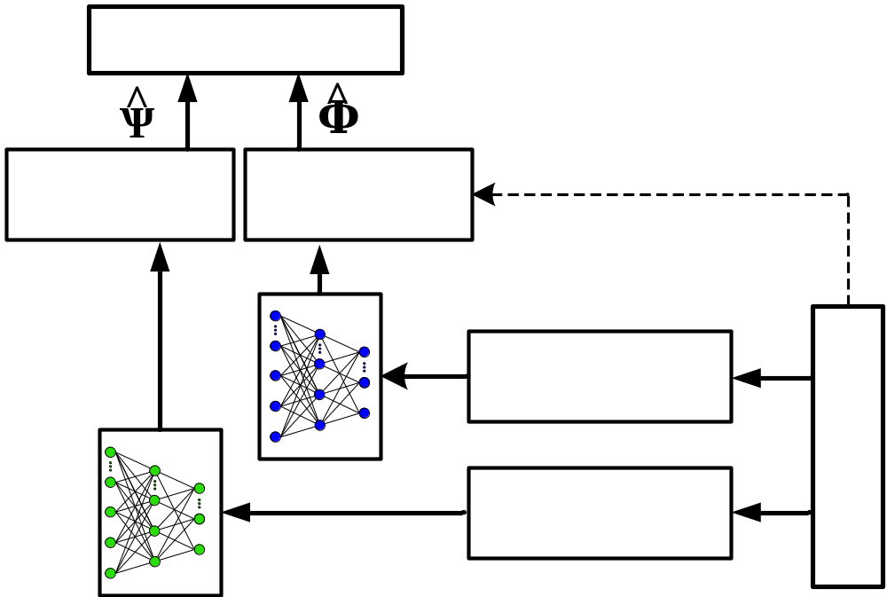
Our Approach: Exploitation Phase
AP and STAs in exploitation phase
Complex-valued channel
Beamforming
Givens’ rotations
real-valued angles
Preprocessing overhead
Post processing
Post processing
Pre-processing
Pre-processing
De-quantization
Quantization
Frame recovery
Frame assembly
De-quantization
Quantization
AP
STAs

Slide 8
Challenges and Design Objectives
No need to human intervention
Full responsibility of AP from data collection to exploitation
Transparency of scheme to stations
Affordable computational complexity

Slide 9
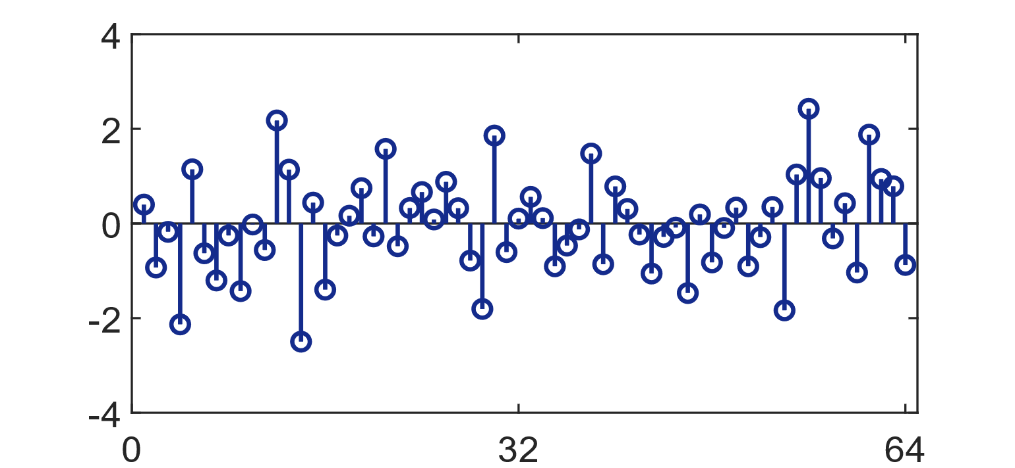
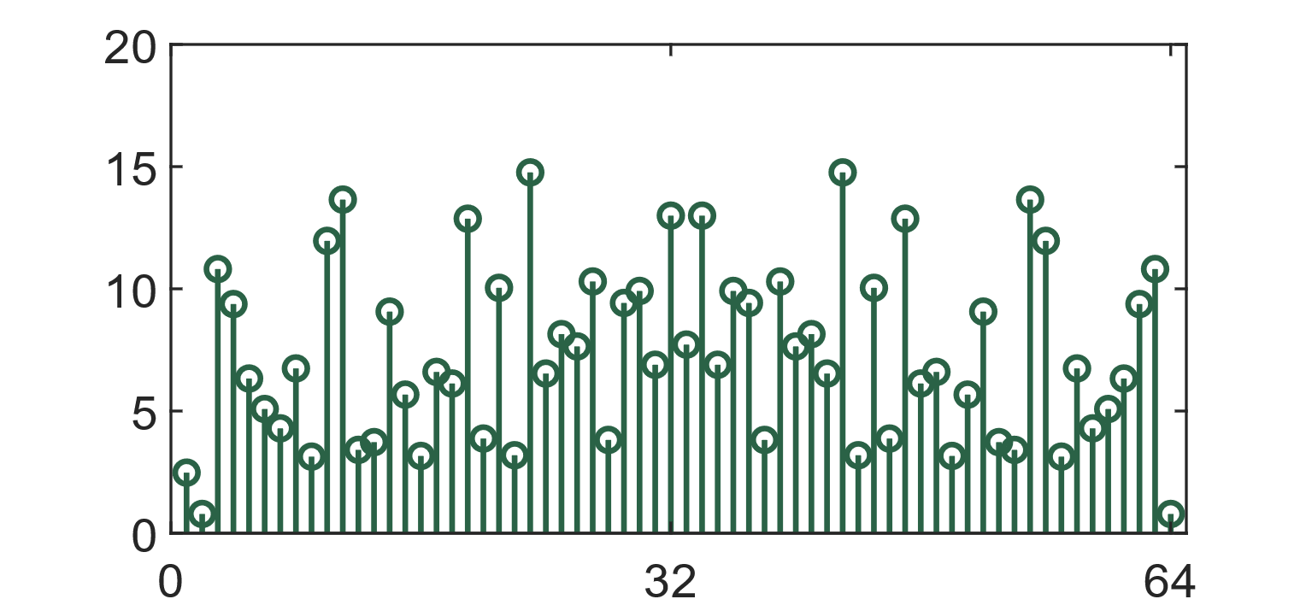
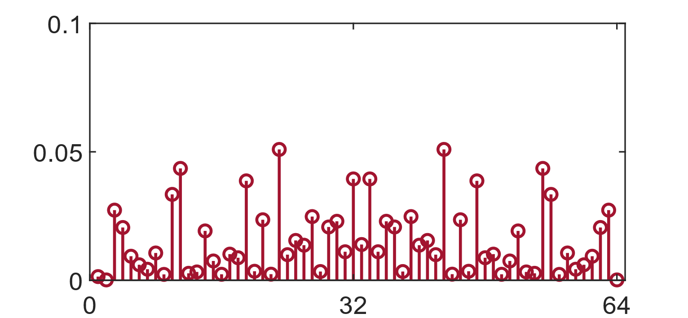


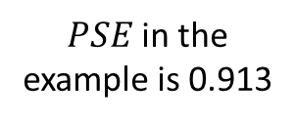
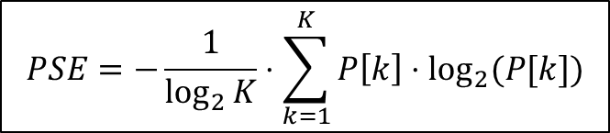

Data Collection: Power Spectral Entropy
Two challenges
How to detect garbage samples.
How to prepare a balanced data set.
Power Spectral Entropy (PSE)
$x\left[n\right]:$Input sequence
$X\left[k\right]:$Spectrum
$P\left[k\right]:$Normalized PSD
$$PSE=−\frac{1}{\log_{2}{K}}⋅\sum_{k=1}^{K}{P\left[k\right]⋅\log_{2}{(P[k])}}$$
$PSE$in the
example is 0.913

Slide 10
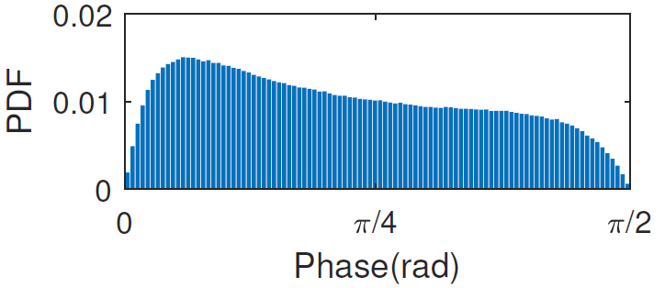
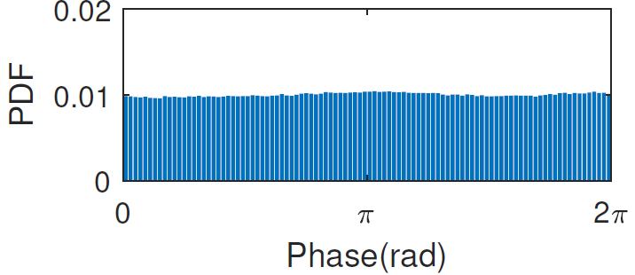
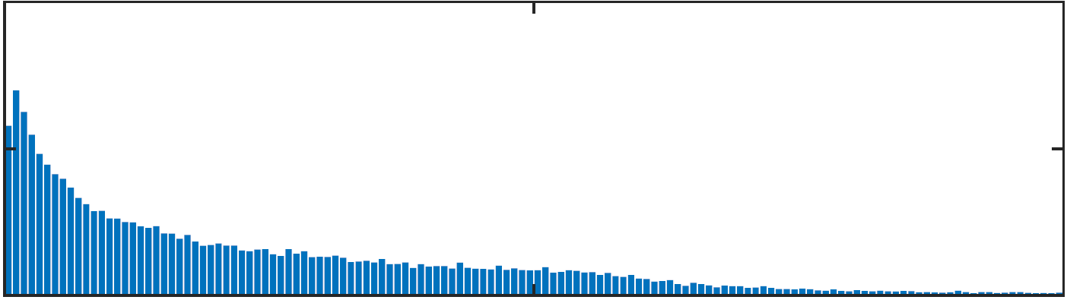
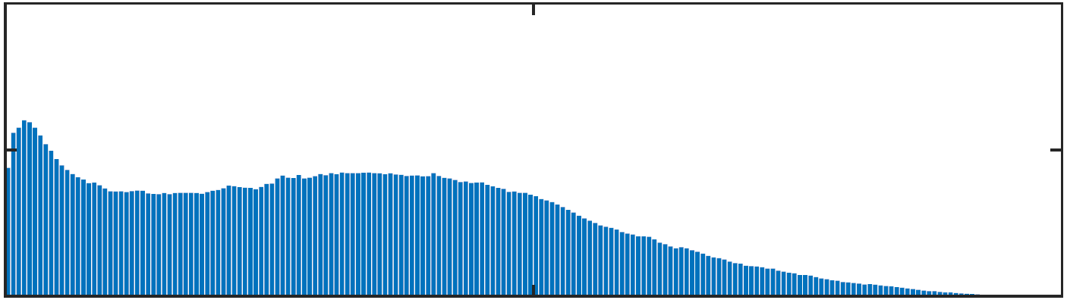
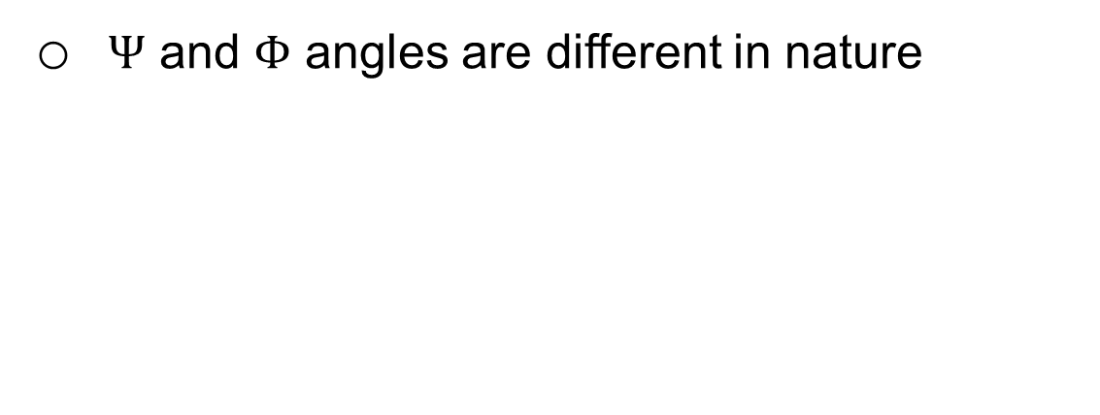
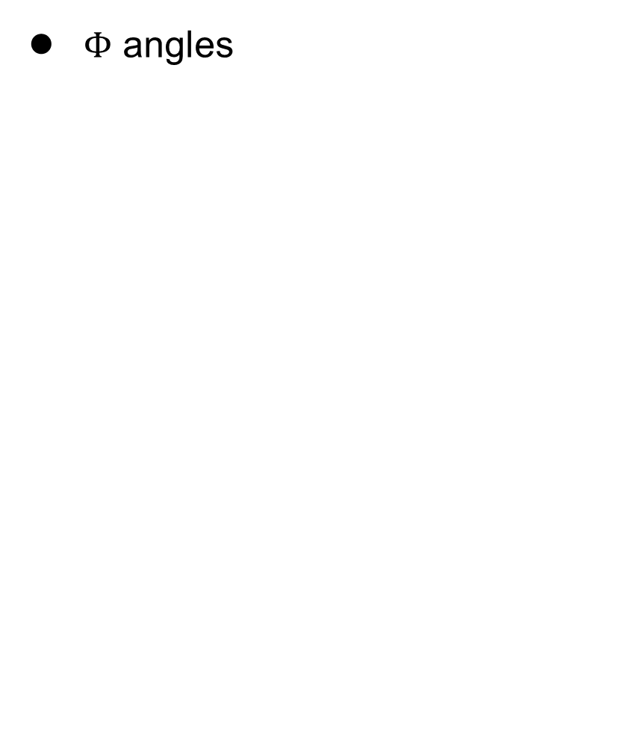
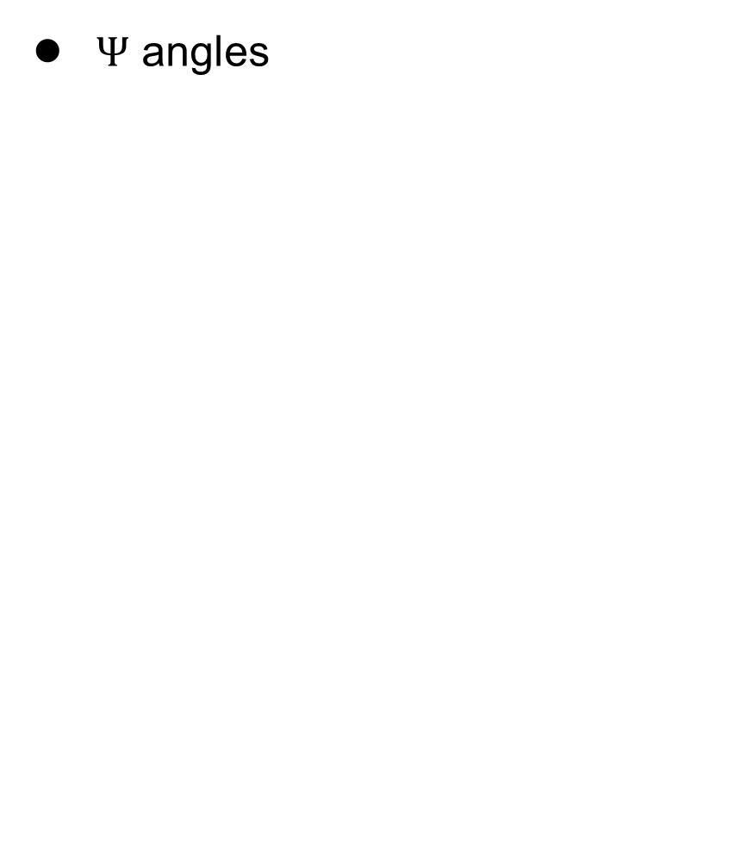
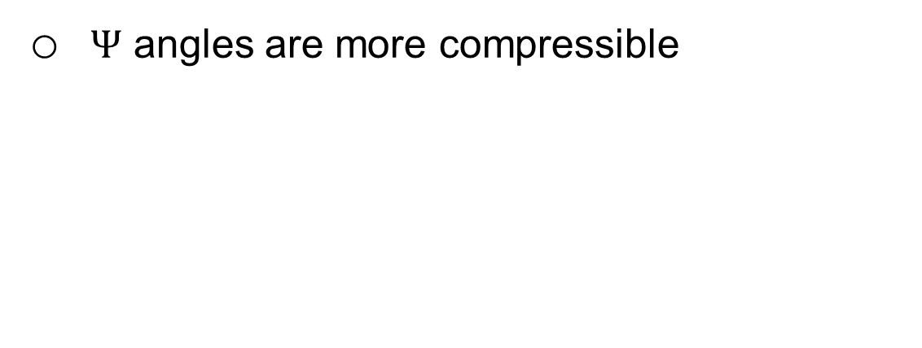
Statistics of CSI
$Ψ$ angles
$Φ$ angles
0.06
0.02
PDF
PDF
0.01
0.03
0
0
0.6
0
0.15
0.3
0
0.3
PSE
PSE
$Ψ$ and $Φ$ angles are different in nature
$Ψ$ angles are more compressible

Slide 11
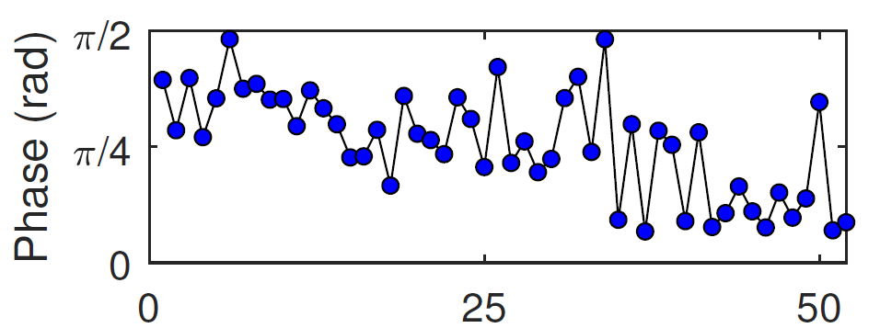
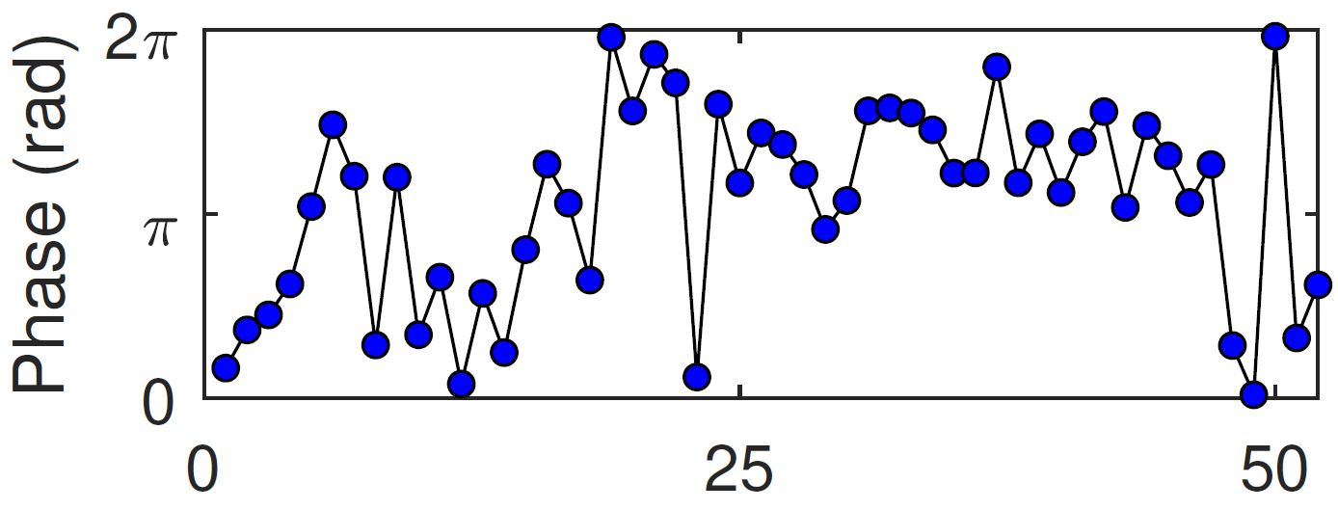


Online Training: Clearing Dataset
Garbage samples
Failure in synchronization
Data corruption
Common properties
Noise-like behavior
High PSE
Detection
Blockage by PSE thresholds
A garbage sample of $Ψ$ angles.
A garbage sample of $Φ$ angles.

Slide 12
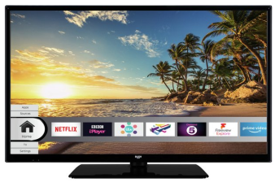
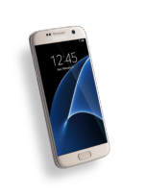
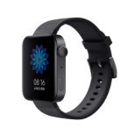
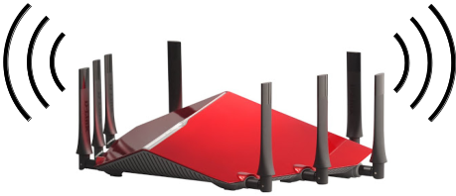

Online Training: Balancing Dataset
Static stations
Static stations over-represent themselves
Correlated CSI
Balancing dataset
PSE range will be divided into bins
Prevent over-population of a bin
Preprocessing
Zero-mean samples
Uniform variance

Slide 13
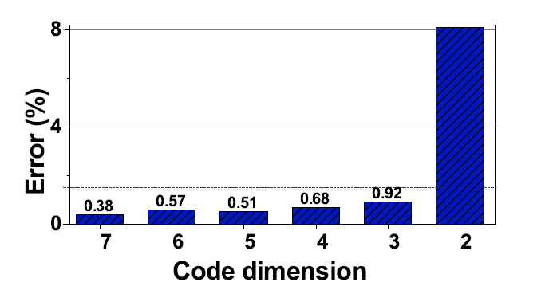
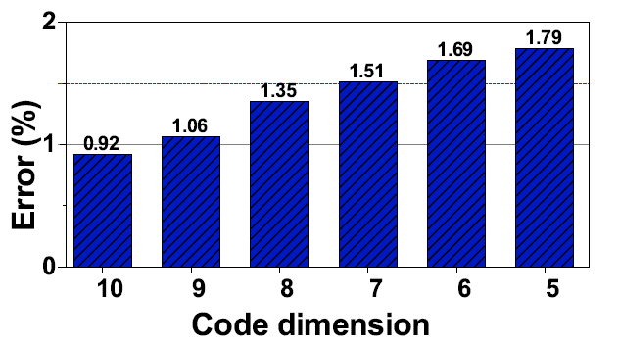
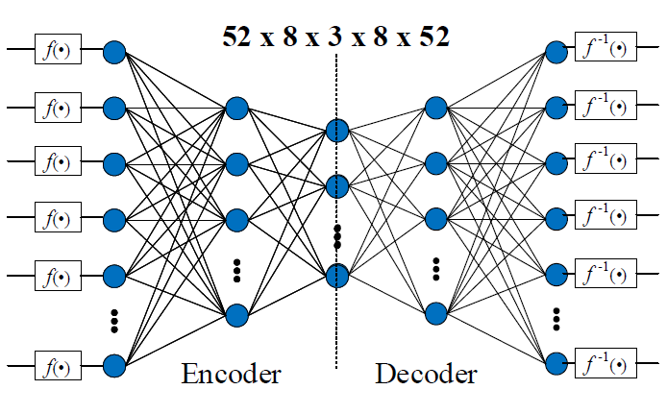
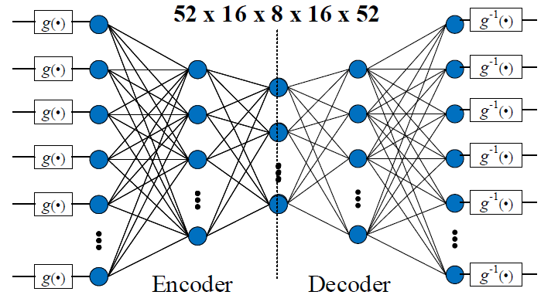
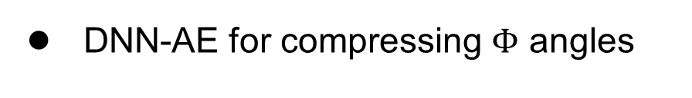
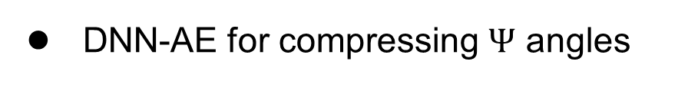
Real-Time Exploitation: CSI Compression
DNN-AE for compressing $Ψ$ angles
DNN-AE for compressing $Φ$ angles
7300 samples until readiness
13100 samples until readiness

Slide 14
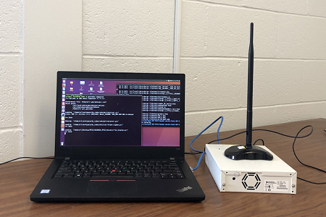
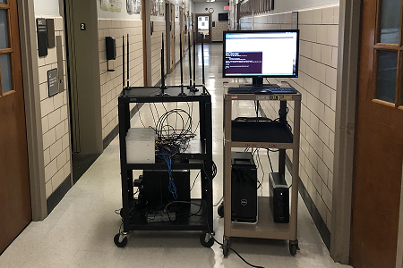
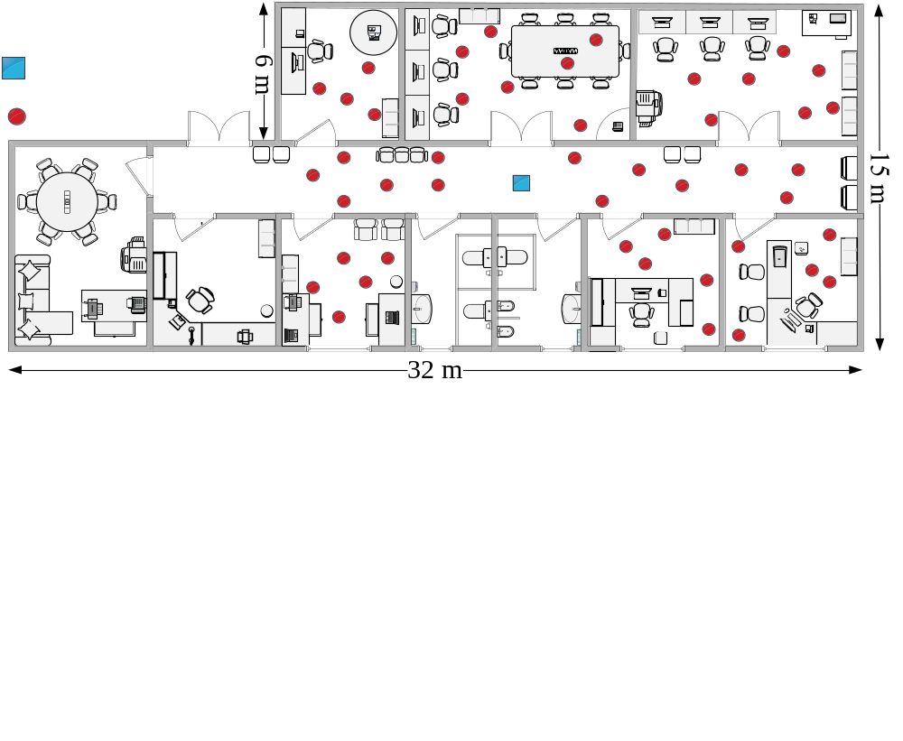
Wireless Testbed
Specifications
  Sampling rate: 20 MSps
  Carrier freq.: 2.4 GHz
Equipment
  USRP N210
  OctoClock-G CDA-2990
  10GbE-switch
  PCs and laptops
Metrics
  EVM
  Gross throughput
  Net throughput
AP
STA

Slide 15
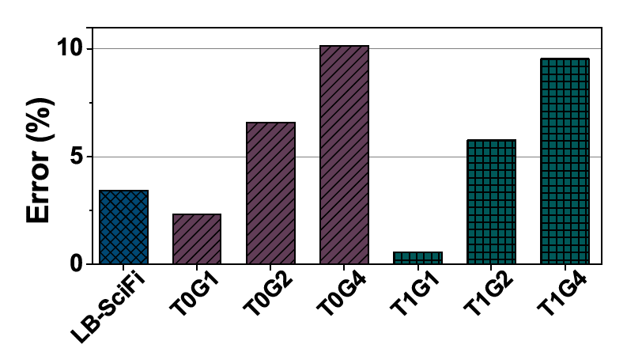
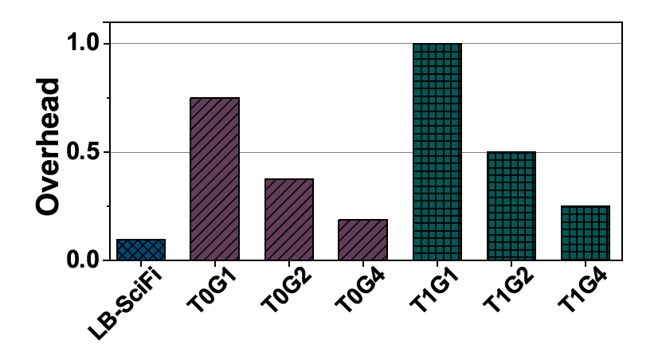
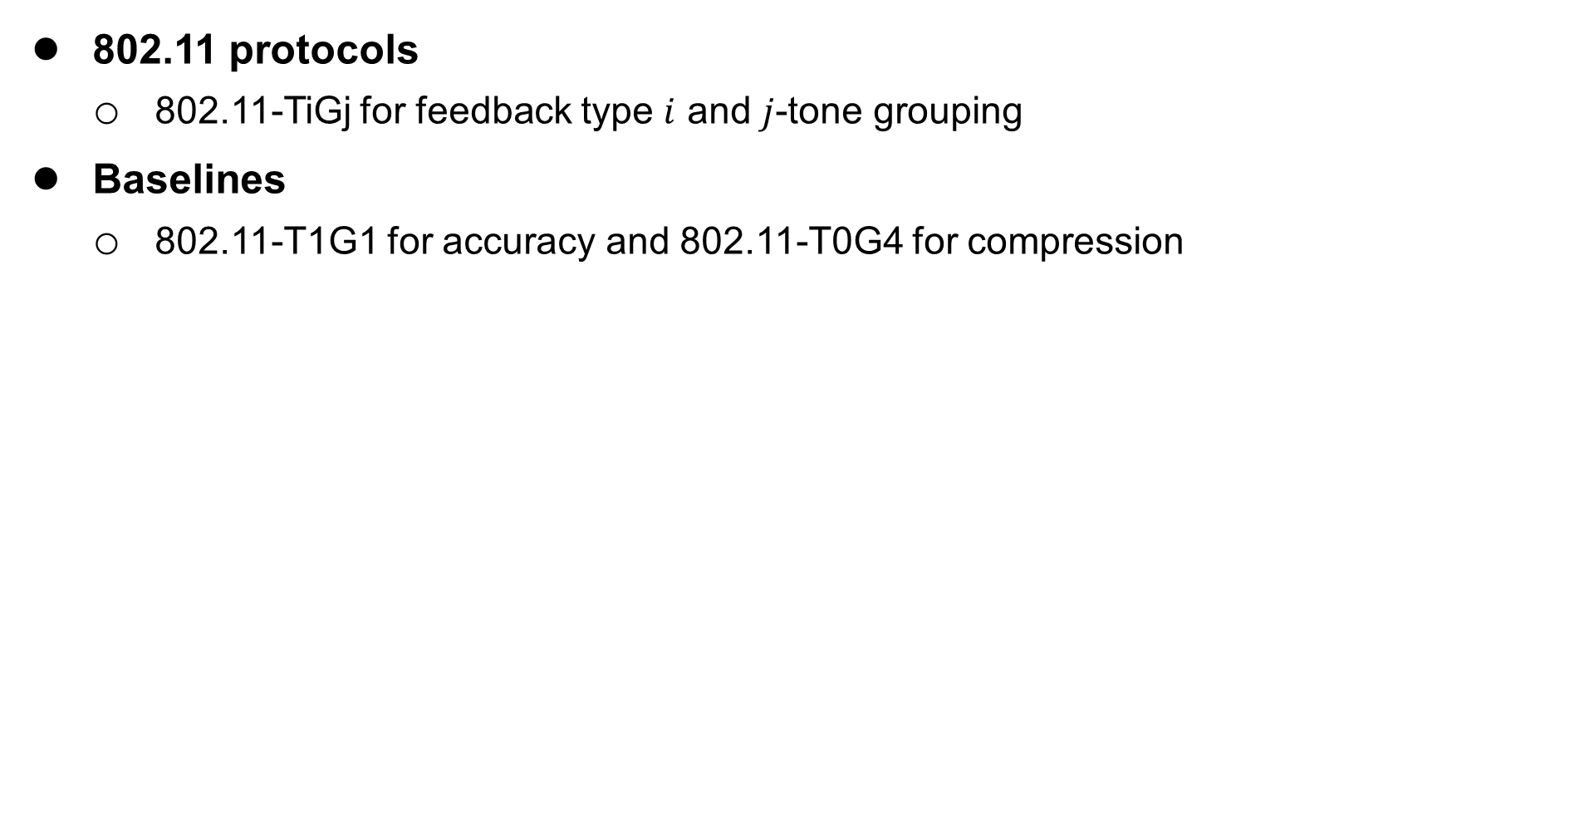
Compression Performance
802.11 protocols
  802.11-TiGj for feedback type $i$ and $j$-tone grouping
Baselines
  802.11-T1G1 for accuracy and 802.11-T0G4 for compression
More accurate than any 802.11 compression protocols
Lower overhead than all 802.11 protocols

Slide 16
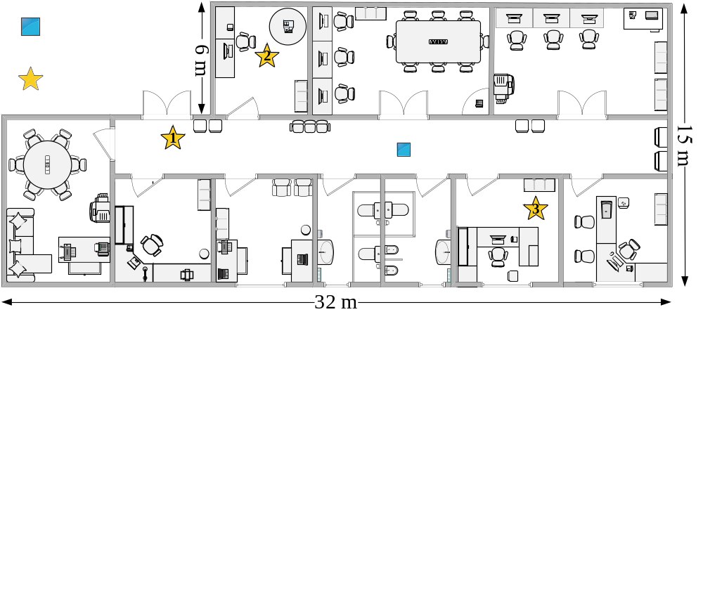
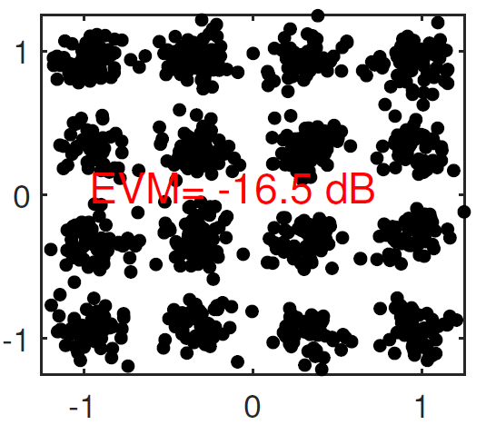
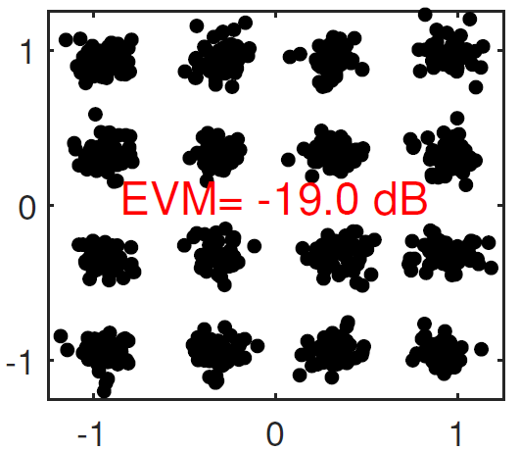
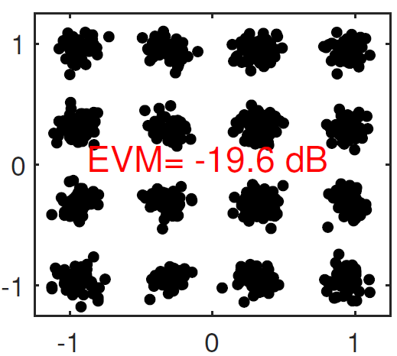
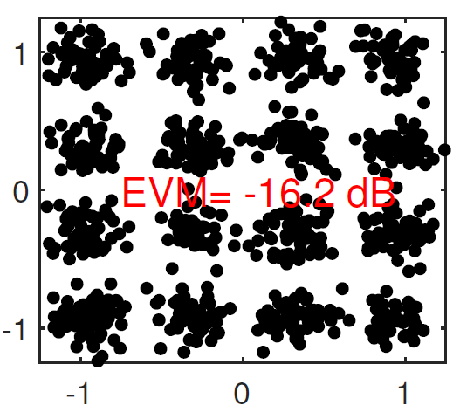
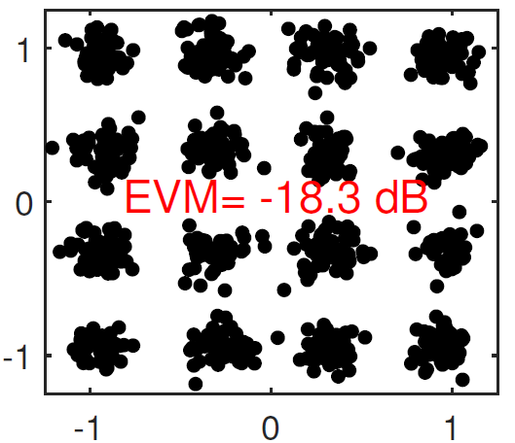
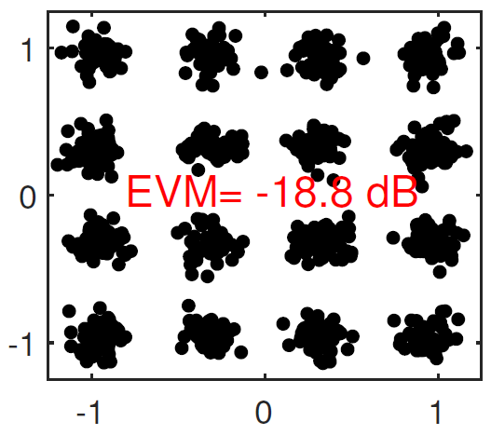
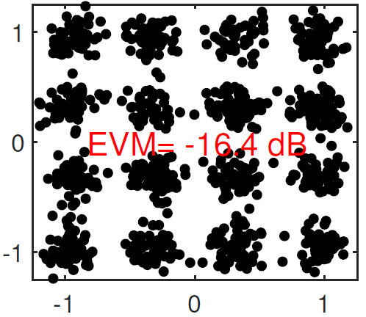
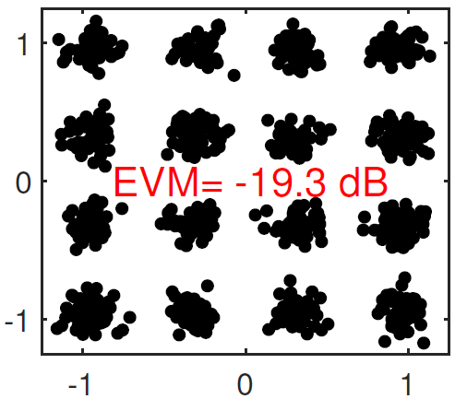
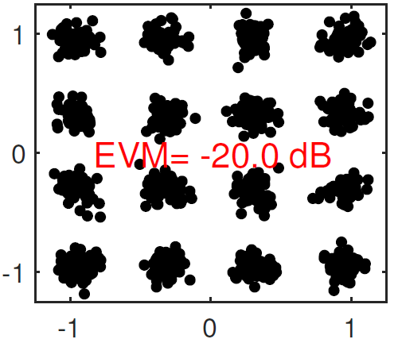
A Case Study
STA 1
STA 2
STA 3
AP
STA
LB-SciFi
802.11-T0G4
Average EVM:
  LB-SciFi: -18.4 dB
  802.11-T0G4: -17.8 dB
  802.11-T1G1: -18.6 dB
802.11-T1G1
T0G4: Overhead baseline
T1G1: Accuracy baseline

Slide 17
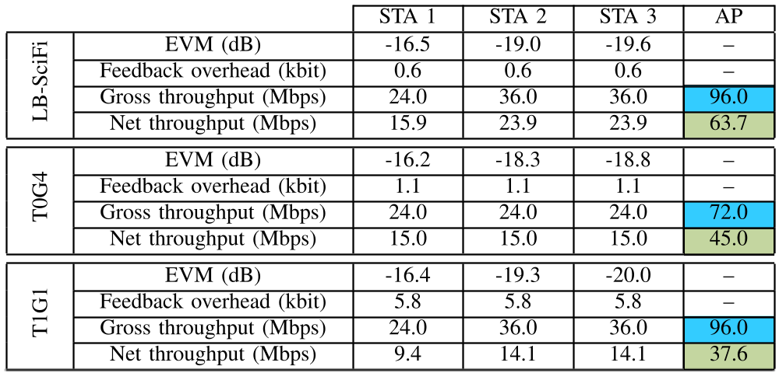
Case study
Throughput (Mbps)
Micro performance for case study
  41.7% throughput gain over 802.11-T0G4 and 68.8% over 802.11-T1G1.
100
75
50
25
0
T0G4: Overhead baseline
T1G1: Accuracy baseline

Slide 18
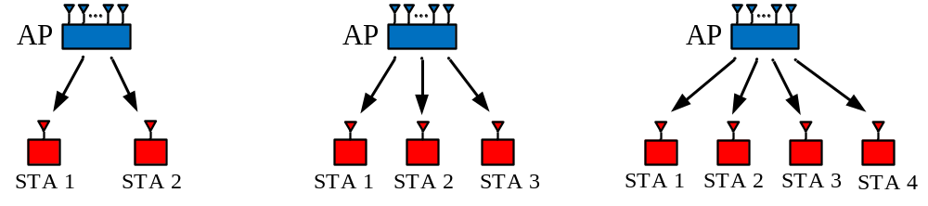

Three-User MIMO
Throughput (Mbps)
An 8-antenna AP serves three STAs
40
30
20
10
0
LB-SciFi offers 25.7% net throughput gain over 802.11-T0G4 and 116.8% gain over 802.11-T1G1.
T0G4: Overhead baseline
T1G1: Accuracy baseline

Slide 19

Four-User MIMO
Throughput (Mbps)
An 8-antenna AP serves four STAs
40
30
20
10
0
LB-SciFi offers 28.9% net throughput gain over 802.11-T0G4 and 117.3% gain over 802.11-T1G1.
T0G4: Overhead baseline
T1G1: Accuracy baseline

Slide 20
Summary
LB-SciFi
is a generic framework and needs several tunings.
is a low-overhead learning-based sounding protocol for WLANs.
is fully agnostic to human.
outperforms 802.11 protocols in terms of compression rate.
is more accurate than 802.11 compression protocols.
showed 26%~111% net throughput gains in our experiments.

Slide 21
Thank you!

