Slide 1
HOLNET: A Holistic Traffic Control Framework for Datacenter Networks
Zhijun Wang, Akshit Singhal, Yunxiang Wu, Chuwen Zhang, Hao Che, Hong Jiang
Bin Liu and Constatino Lagoa
The University of Texas at Arlington
Presentation on IEEE International Conference on Network Protocols (ICNP) 2020

Slide 2
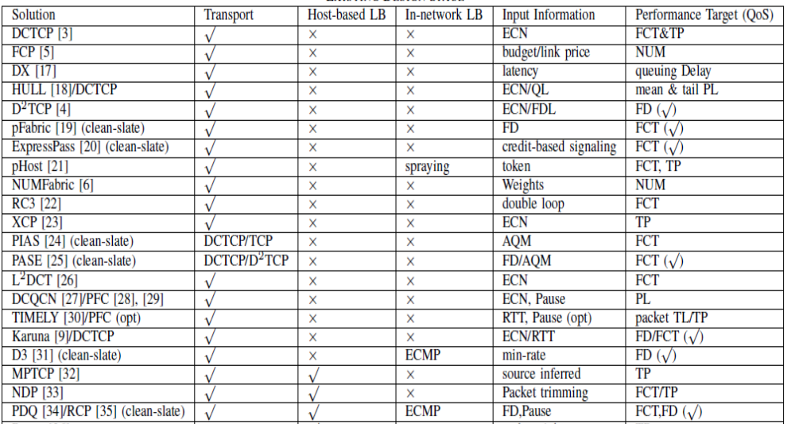
Existing datacenter traffic control solutions

Slide 3
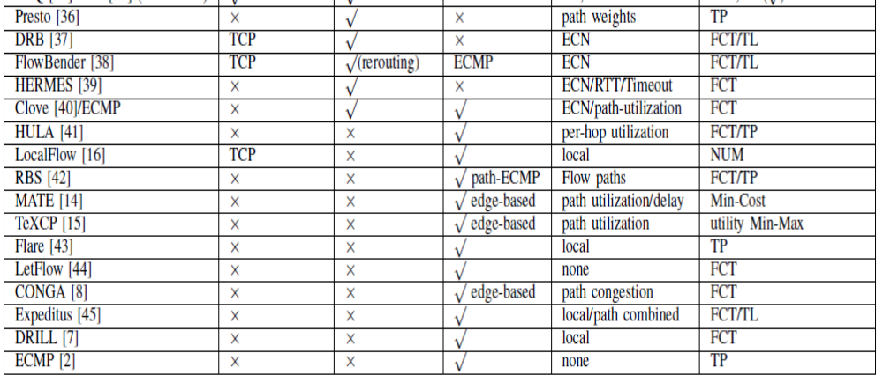
Existing datacenter traffic control solution

Slide 4
Problems for existing solutions
Point solutions by design: focus on one aspect only.
e.g., single-path or multipath congestion control
in-network loading balance
Problem: A point solution has to coexist with other point solutions, resulting in suboptimal or unexpected performance or even network instability
Empirical design: most protocols are designed empirically
Problem: Convergence, stability and optimality are not proven

Slide 5
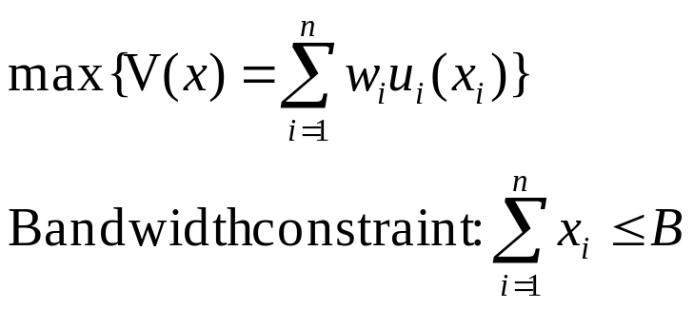
Network utility maximization (NUM)
Traditional NUM solution: for n active flows share a link with bandwidth B, flow x_{i} with a concave utility function u( x_{i})
Traditional NUM solution is simply to maximize the overall social welfare without fairness criteria.

Slide 6
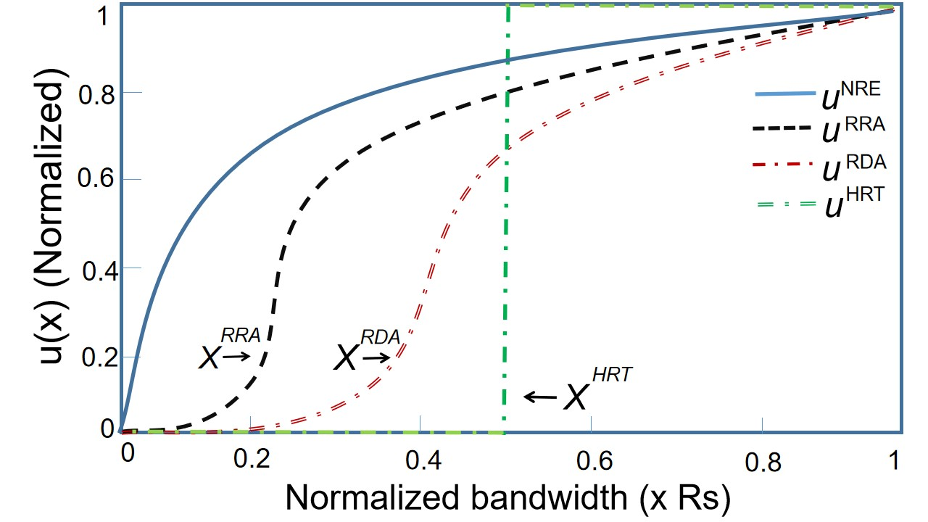
Four classes of user utility functions
User utility: the first order of quality of experience, determines the degree of user satisfaction.
NRE: Non-Realtime Elastic service
RRA: Realtime Rate Adaptive service
RDA: Realtime Delay Adaptive service
HRT: Hard RealTime service.
RRA, RDA and HRT have minimum rate requirement.
The rate below the minimum rate, the utility quickly drops to zero.

Slide 7
Drawbacks of traditional NUM
No minimum rate guarantee
Hard to deal with more than one distinct user utilities or even a single utility with different saturated rates
Saturated rate is the flow rate that maximizes the user utility.
e.g., the highest video/audio encoding rate, maximum link rate
Saturated rate: video flow 1Mbps with minimum rate 200kbps
audio flow: 200kbps with minimum rate 50kbps
Both have the same utility function, share 280kbps link
Equally share the bandwidth

Slide 8
Motivation of HOLNET
Need a principled and systematic framework
Allowing fully integrated congestion control and in-network load balancing to be developed
All protocols under the framework enjoy provable convergence, stability and optimality properties by design
Need a new NUM (HOLNET NUM) method
Provide minimum rate guarantee
Deal with different user utilities

Slide 9

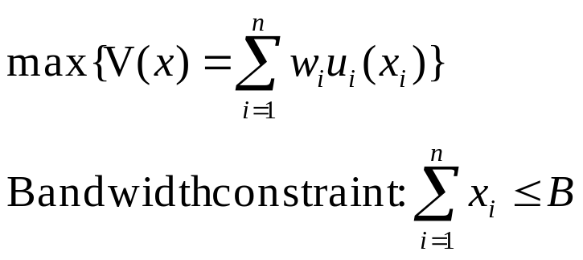
HOLNET NUM
Minimum user utility guarantee
HOLNET NUM allows minimum flow rate (θ) as a flow rate constraints, .

Slide 10


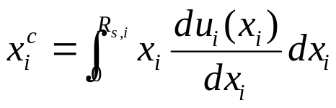
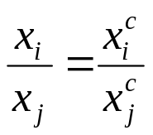
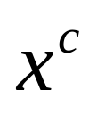
HOLNET NUM
Center-of-Utility fairness to deal with distinct user utilities
Center-of-utility rate for a utility function for flow i with saturated rate is defined as
Center-of-utility fair flow rate allocation
Center-of-utility
Center-of-mass
utility
Rate
Rate
Rate
Rate
Rate

Slide 11
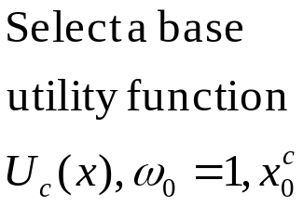
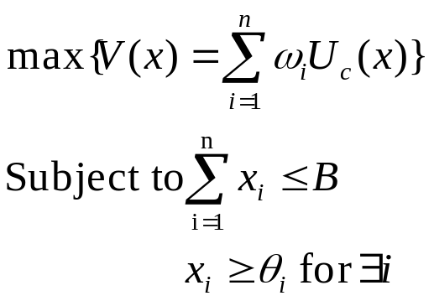
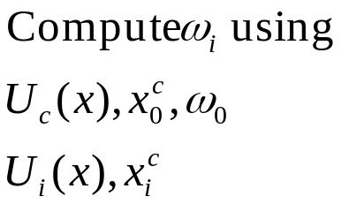
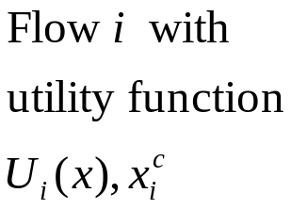
HOLNET NUM
HOLNET NUM
HOLNET NUM is to achieve center-of-utility fair flow rate allocation by providing that the minimum flow rates to sustain the minimum user utilities are satisfied.

Slide 12
HOLNET NUM
Saturated rate: video flow 1Mbps minimum rate 200kbps
audio flow: 200kbps minimum rate 50kbps
center-of-utility rate: video flow 500Kbps
audio flow: 100kbps
cent-of-utility fairness rate allocation ratio: 5:1
Share a 280Kbps link
Traditional NUM: video flow 140Kbps
audio flow: 140kbps
HOLNET NUM : video flow 230kbps
audio flow: 50kbps
Rate
Rate
Rate
Rate

Slide 13
HOLNET design space
Solution | Host-based | Host-based LB | In-network LB | Mul-CoS | Comments
CC | yes | no | no | no | Elastic congestion control(CC)
MCC | yes | yes | no | no | Multipath CC (MCC)
CC-CoS | yes | no | no | yes | CC and multi-Class of Service(CoS)
MCC-Cos | yes | yes | no | yes | Multipath CC-CoS
Distributed end-to-end congestion control solutions

Slide 14
HOLNET design space
Solution | Host-based | Host-based LB | In-network LB | Mul-CoS | Comments
CC-LB | yes | no | yes | no | CC with in-network load balancing (LB)
MCC-LB | yes | yes | yes | no | Multi-next-hop CC-LB
CC-CoS-LB | yes | no | yes | yes | CC-CoS with LB
MCC-CoS-LB | yes | yes | yes | yes | MCC-CoS with LB
Distributed and integrated congestion control and in-network loading balancing solutions
Need hop-by-hop feedback (binary information: congested or not)

Slide 15
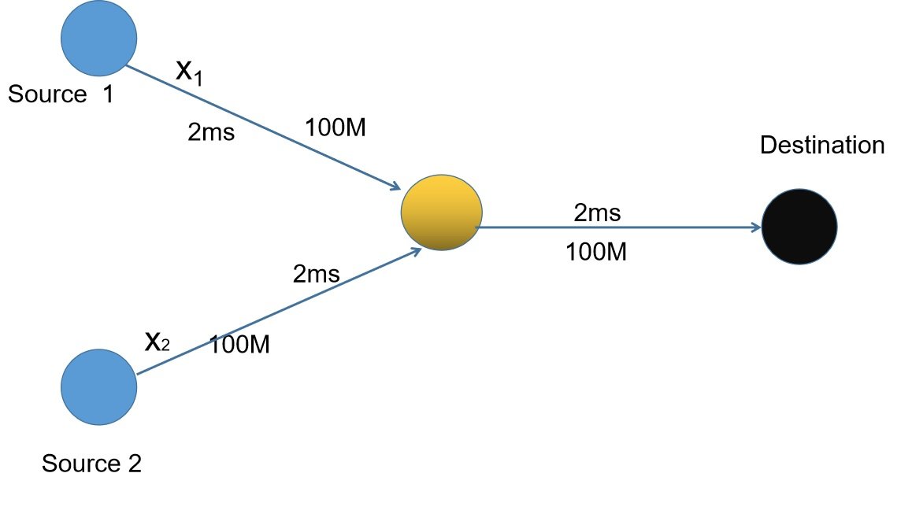
Case study
A family of CC/CC-CoS
Two flows share a 100 Mpbs link.

Slide 16
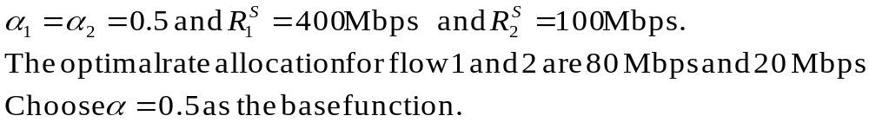
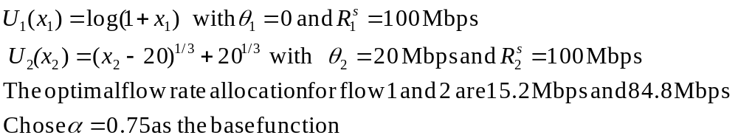
Case study
A family of CC/CC-CoS
Case 1:
Case 2:

Slide 17
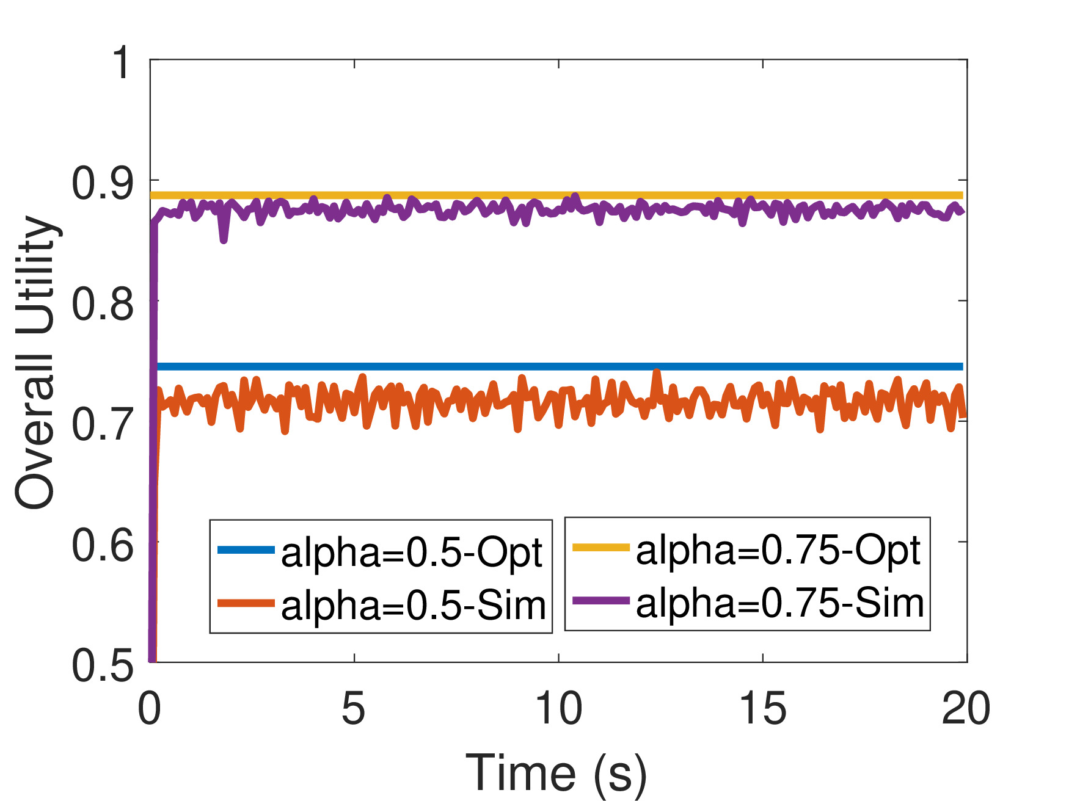
Case study
Simulated vs optimal utility

Slide 18
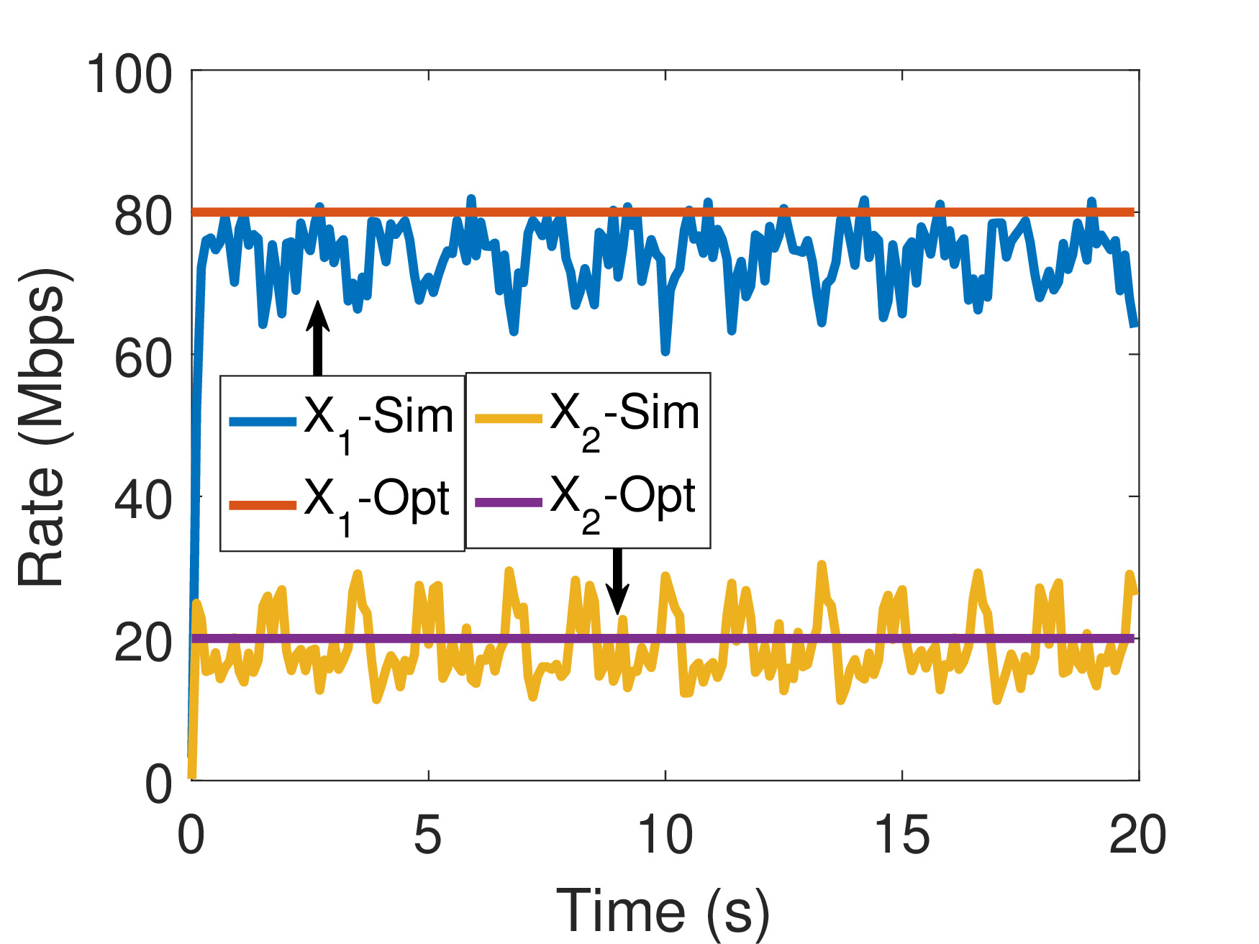
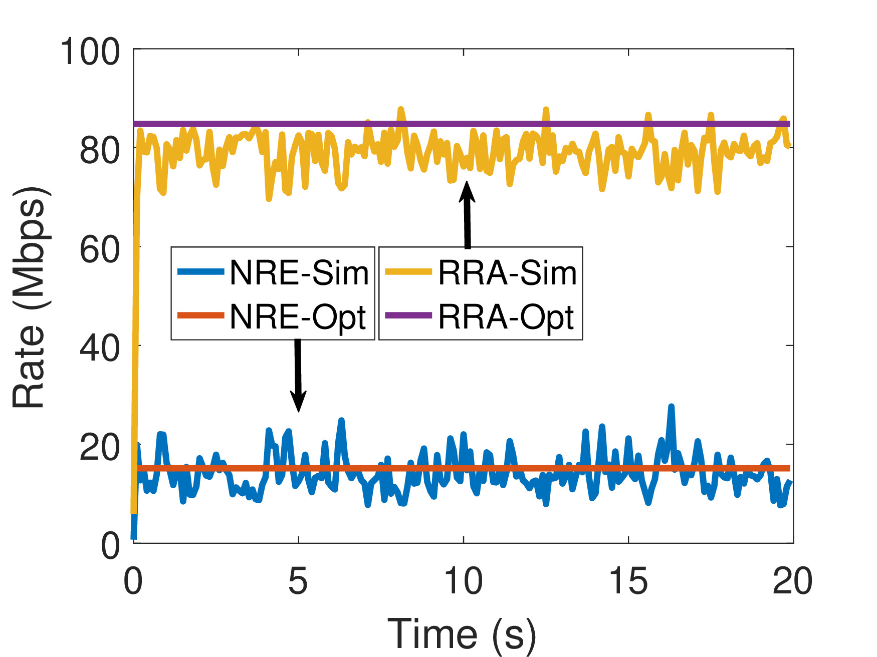
Case study
Case I
Case II
Simulated vs optimal rate allocation

Slide 19
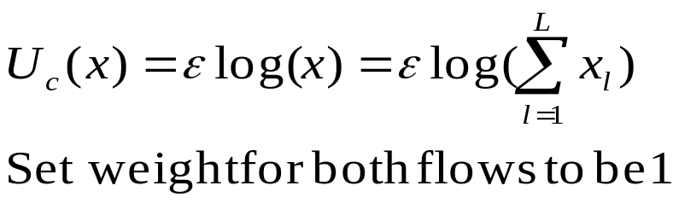
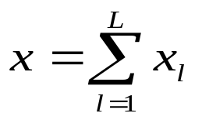

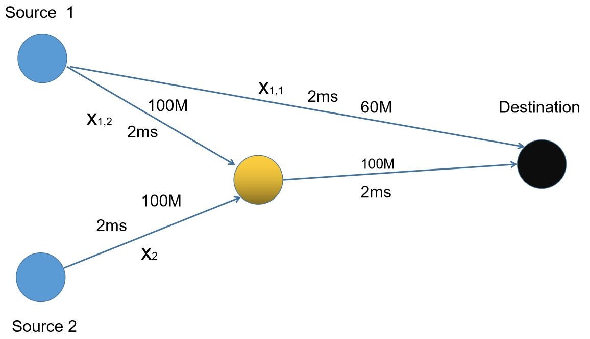
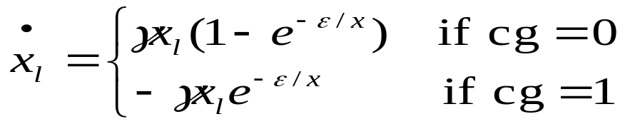
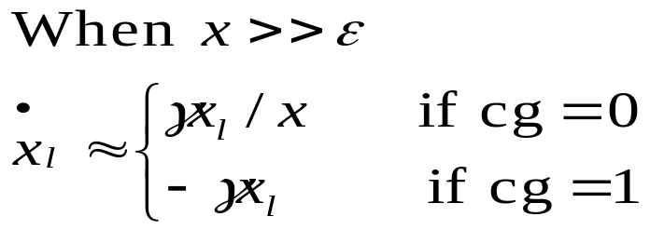
Case study
MCC: Multipath Congestion control
Case 3:

Slide 20
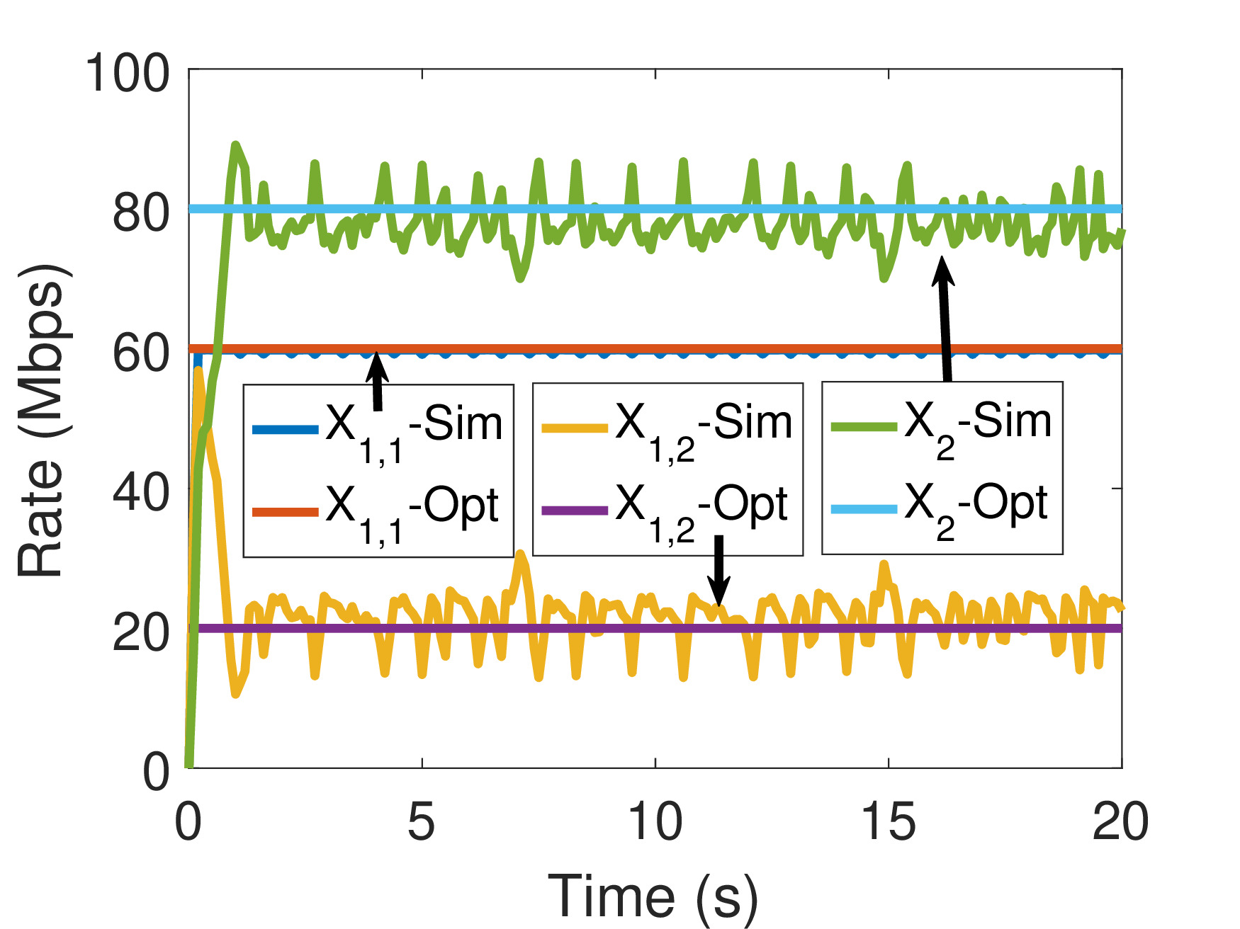
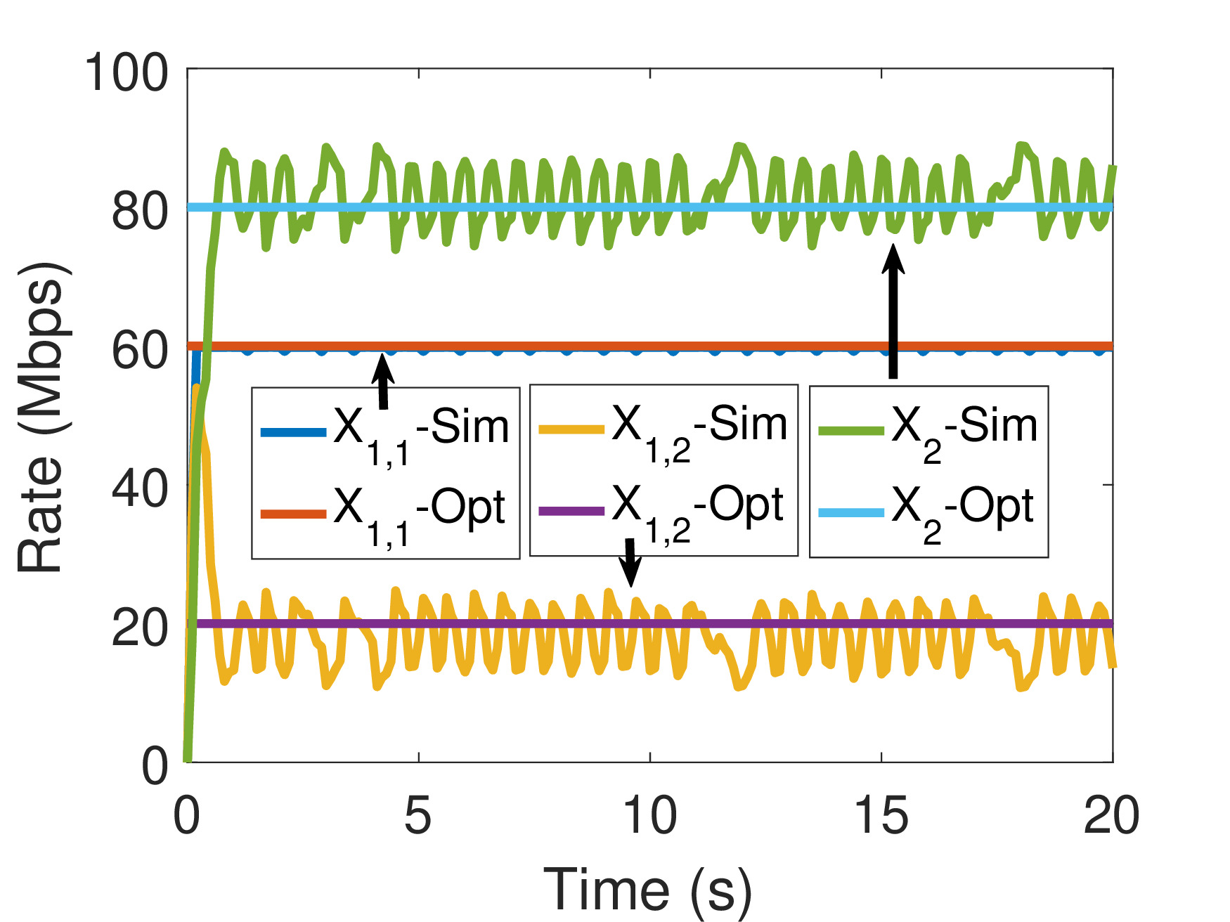
Case study
HOLNET MCC
MPTCP
Simulated vs optimal rate allocation

Slide 21

HOLNET-UTA
HOLNET traffic controller with Utility-of-TCP-based flow rate Allocation
Apply TCP utility function , , as the base utility
TCP friendly
Fully integrated congestion control and in-network load balancing solution

Slide 22
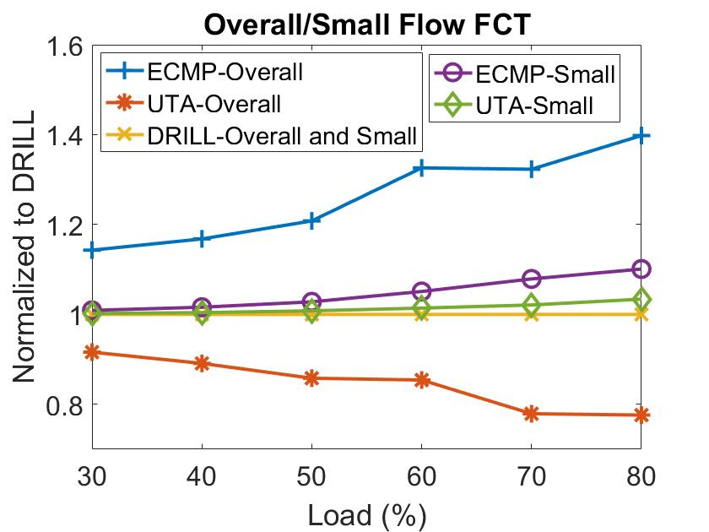
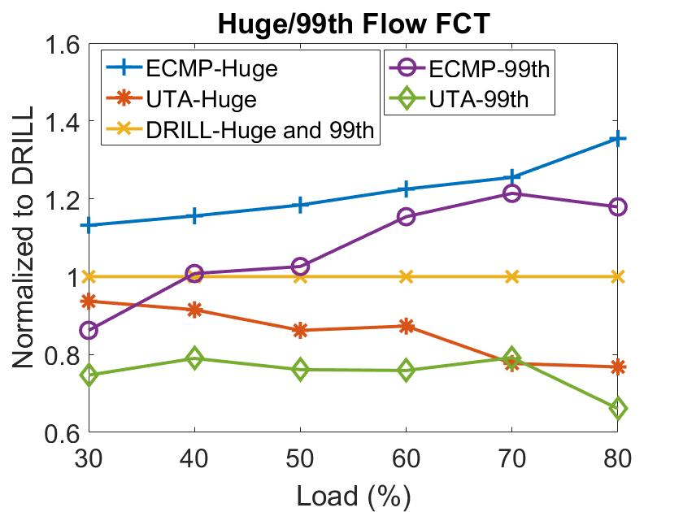
HOLNET-UTA performance comparison
ECMP: DCTCP+ECMP
DRILL: DCTCP+DRILL
FCT: flow completion time

Slide 23
Conclusion
Propose a new traffic control framework-HOLENT
Develop HOLNET NUM
Enabling minimum user utility guarantee
Center-of-utility fairness

Slide 24
Question??

