Slide 1
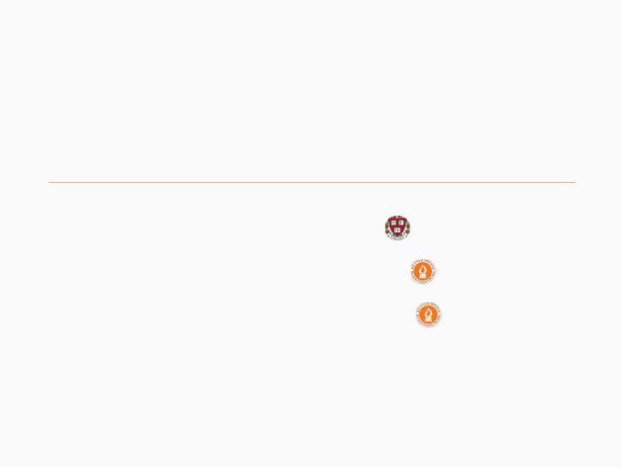
Cooperative Flow Selection
Ran Ben Basat
Gil Einziger
Bilal Tayh
Harvard University
Ben-Gurion University
Ben-Gurion University

Slide 2
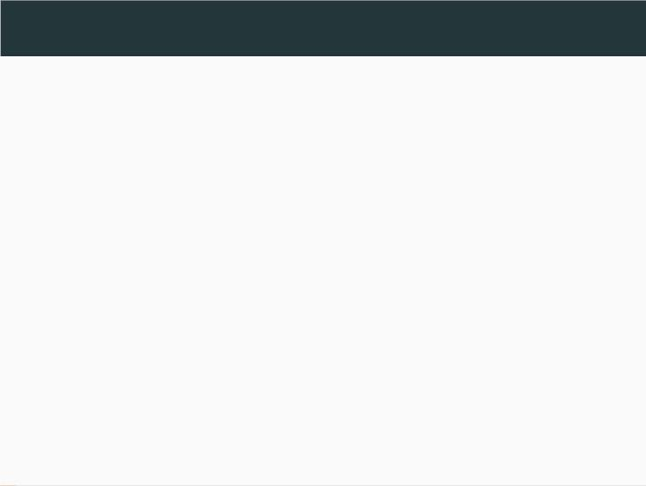
Network Wide Flow Measurement
• Identifying attacks.
• Detecting load imbalance.
• Fine-grained trafﬁc analysis.
• Routing.
1/42

Slide 3
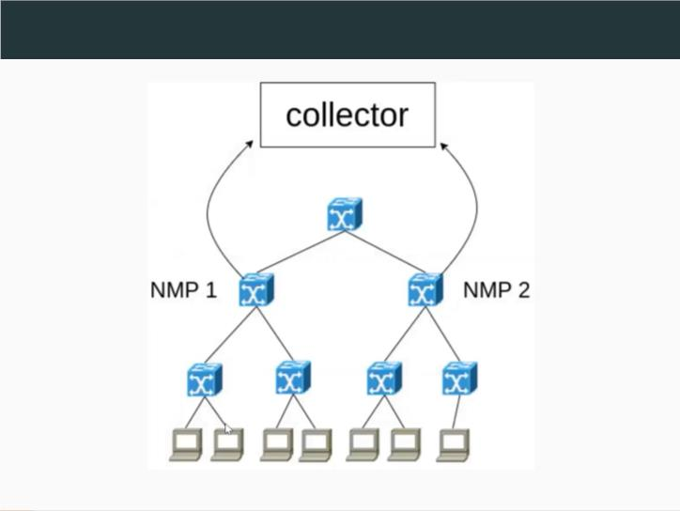
Flow Measurement Architecture
2/42

Slide 4
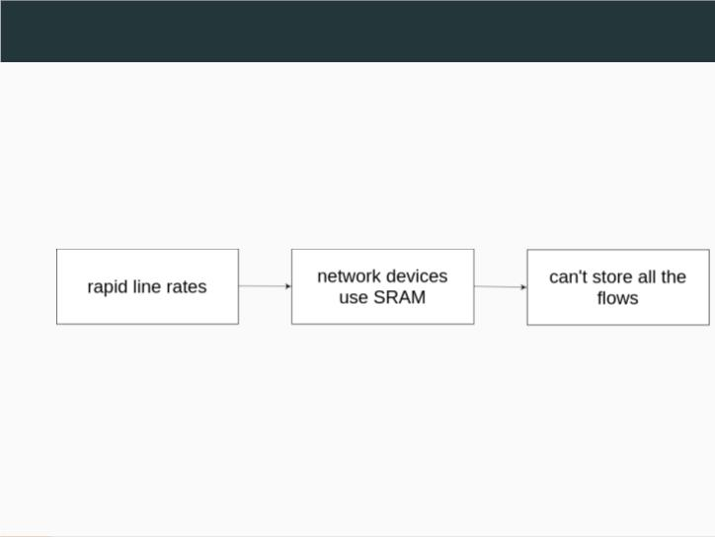
Challenges
3/42

Slide 5
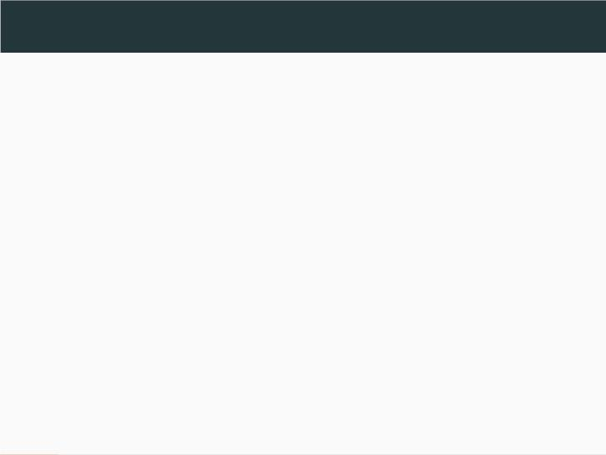
Current Solutions
• Works that pursue some form of
communication between the NMPs.
• Works that don’t require communication
between the NMPs.
4/42

Slide 6
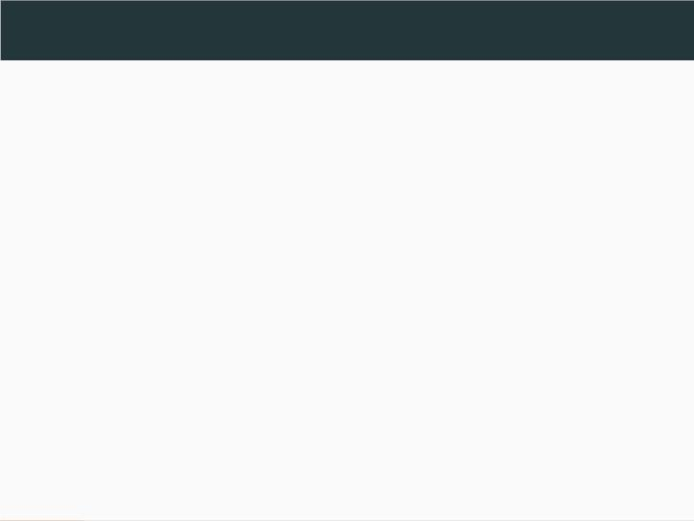
Current Solutions
Our work belongs to:
• Works that don’t require communication
between the NMPs.
5/42

Slide 7
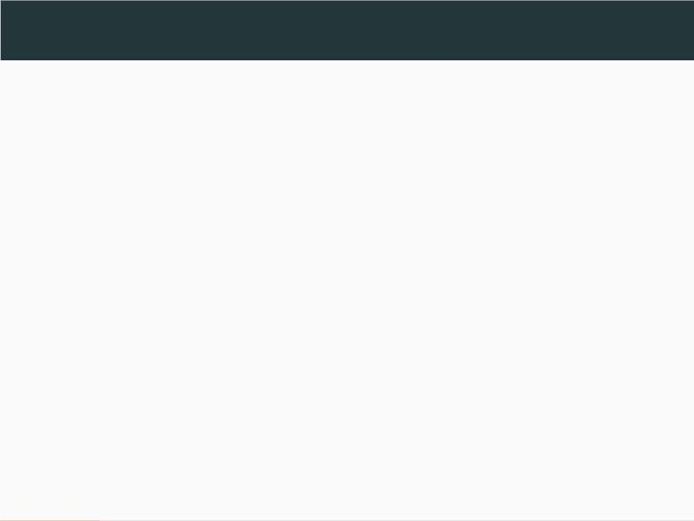
Our Contribution
We suggest the Cooperative Flow Selection
(CFS) and (CFS-FR) algorithms that achieve
near-optimal ﬂow coverage.
6/42

Slide 8

The Experiment
We evaluated CFS and CFS-FR and explored
their beneﬁts and limitations compared to prior
works.
7/42

Slide 9
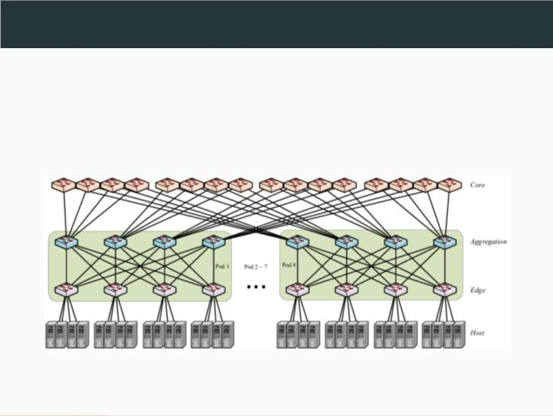
Network Topology
We evaluate our algorithms on Fat Tree
topology with parameter k=8.
8/42

Slide 10
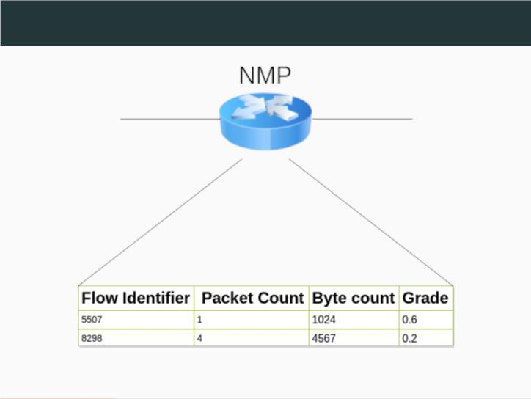
NMP Structure
9/42

Slide 11
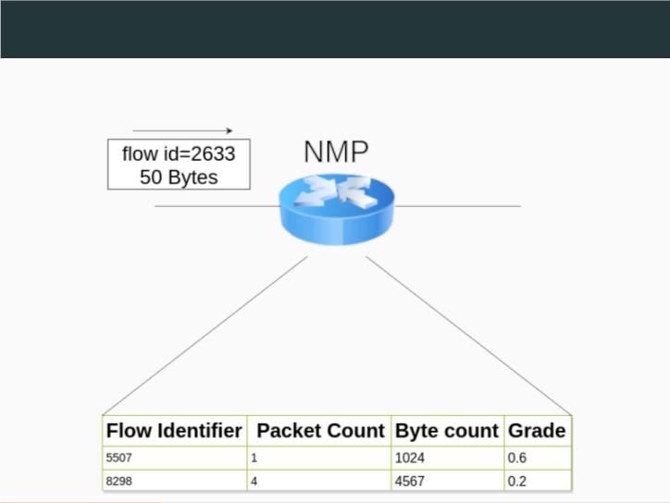
NMP Structure
NMP Grade(2633) is 0.3
10/42

Slide 12
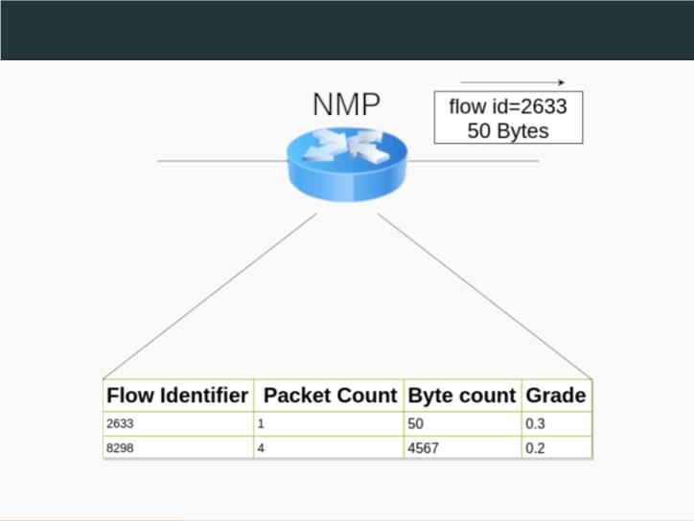
NMP Structure
11/42

Slide 13
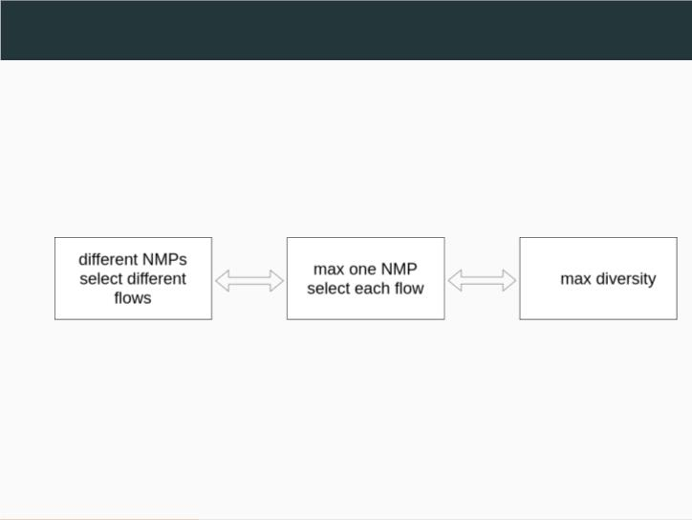
Determining Which Flows to Select in Each NMP
12/42

Slide 14
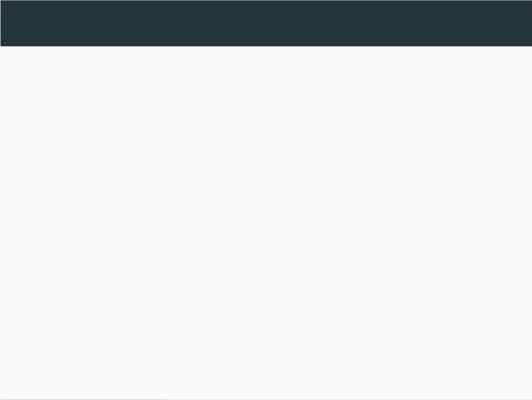
Calculating the Grade
• We assign each ﬂow x with Hash Value h(x)
within the unit circle (0,1).
• We assign a Target Value for each possible
TTL value.
• The grade of a ﬂow in a NMP is the distance
between the Hash Value and the Target
Value.
13/42

Slide 15
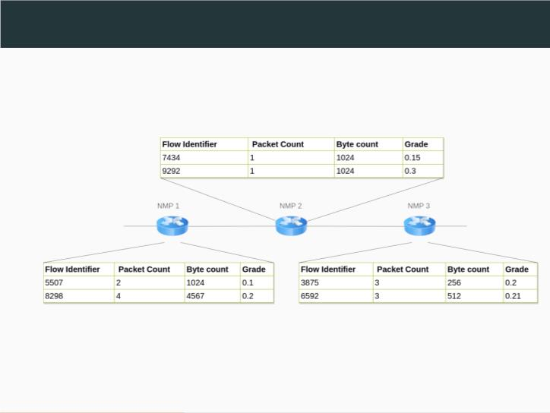
Calculating the Grade - Example
14/42

Slide 16
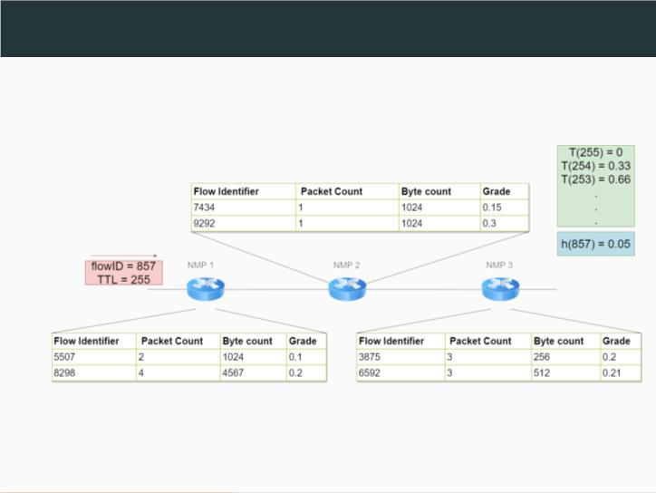
Calculating the Grade - Example
15/42

Slide 17
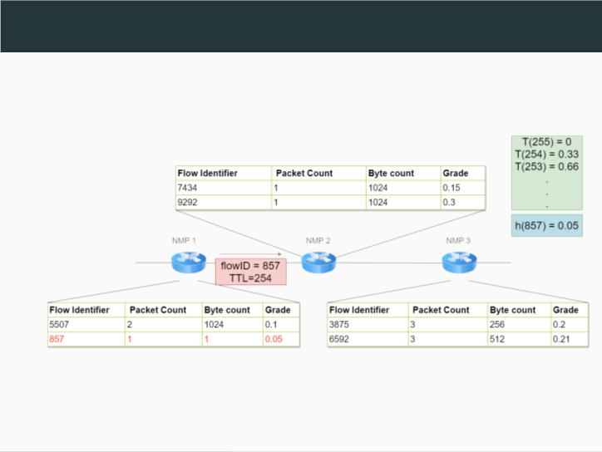
Calculating the Grade - Example
16/42

Slide 18
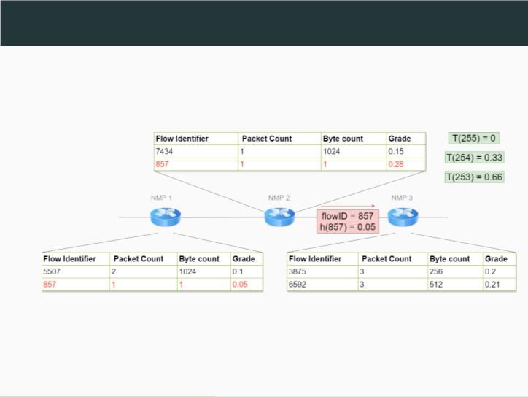
Calculating the Grade - Example
17/42

Slide 19
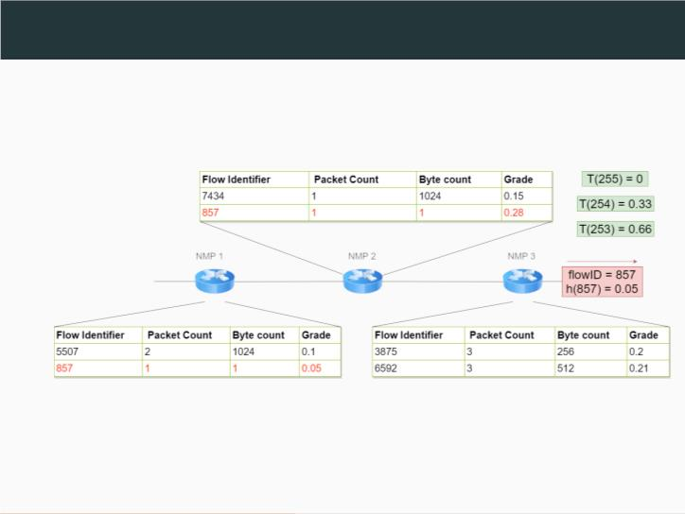
Calculating the Grade - Example
18/42

Slide 20
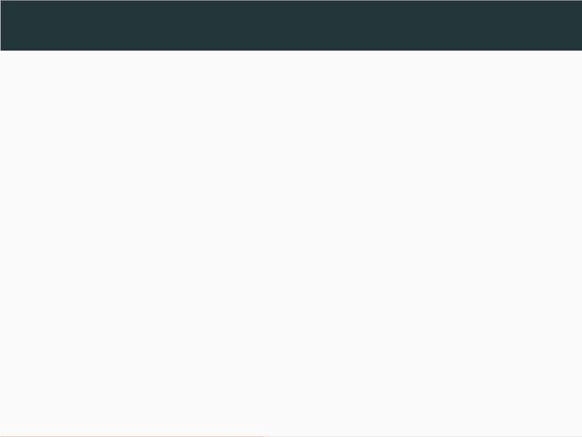
Determining the Target Value
We suggest two approaches for determining the
target values:
• The Greedy approach.
• The Folding approach.
19/42

Slide 21
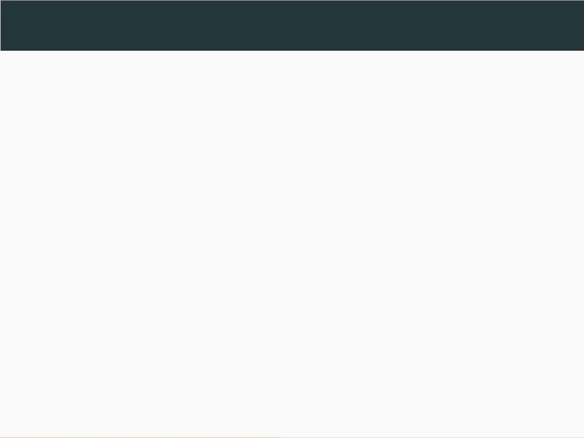
The Greedy approach
We propose the following algorithm:
• Arbitrary select a value for T(255).
• We determine T(254) to be the point with
maximal distance from T(255).
• We choose T(253) the point that maximize
the minimal distance to T(255) and T(254).
If there is multiple such points we choose one
of them.
20/42

Slide 22
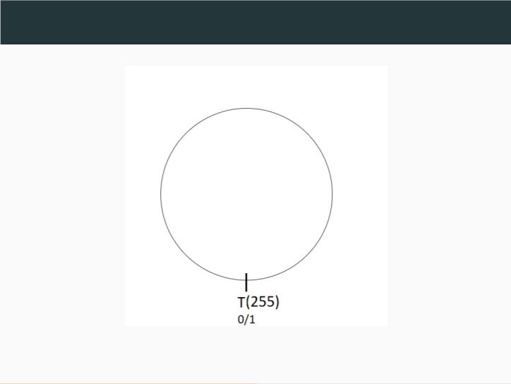
The Greedy approach - Example
21/42

Slide 23
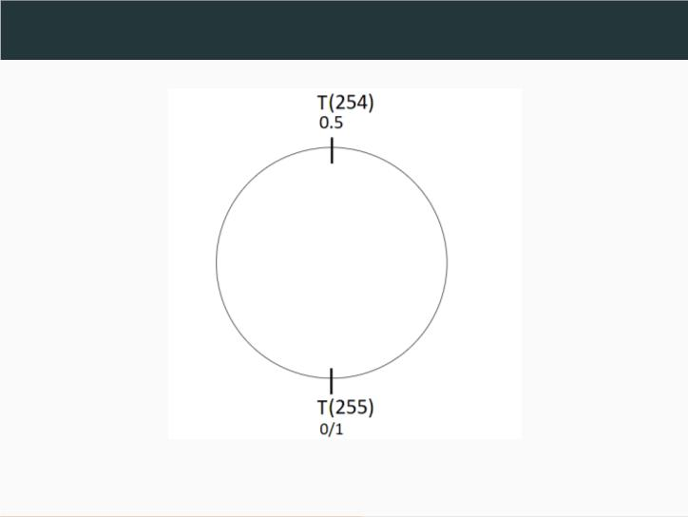
The Greedy approach - Example
22/42

Slide 24
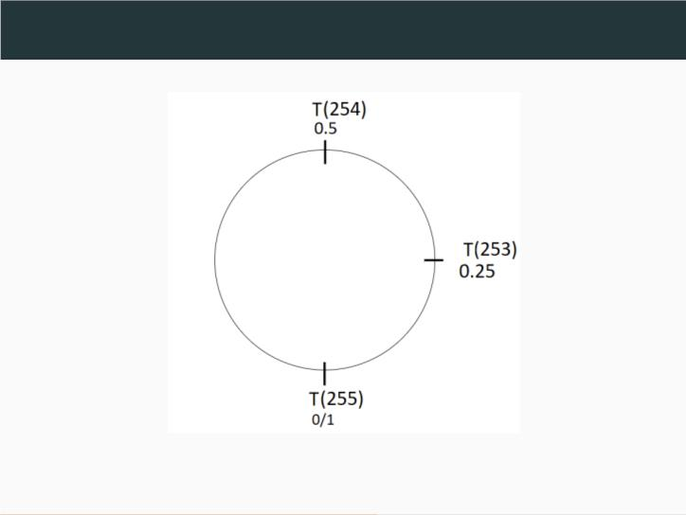
The Greedy approach - Example
23/42

Slide 25
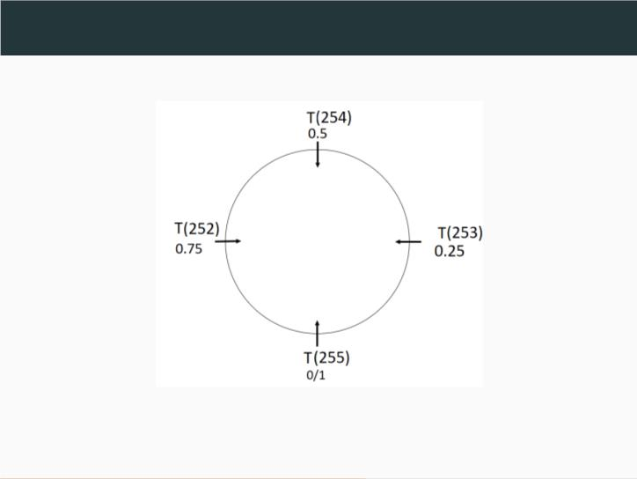
The Greedy approach - Example
24/42

Slide 26
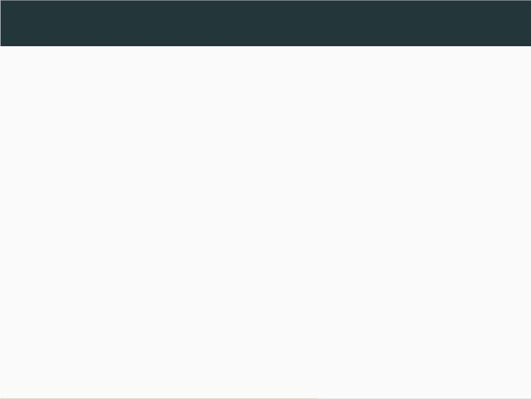
The Folding approach
We propose the following algorithm:
• Arbitrary select a value for T(255).
• We determine T(254) to be all the points
with maximal distance from T(255).
• We choose T(253) to be all the points that
maximize the minimal distance to T(255) and
T(254).
25/42

Slide 27
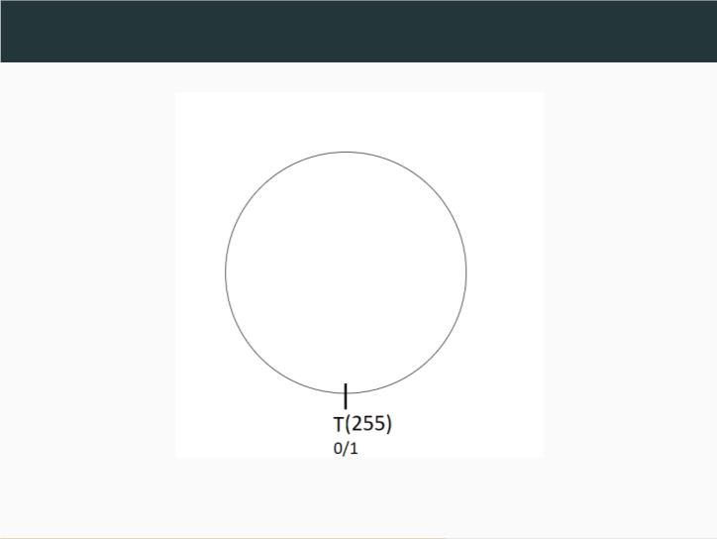
The Folding approach - Example
26/42

Slide 28
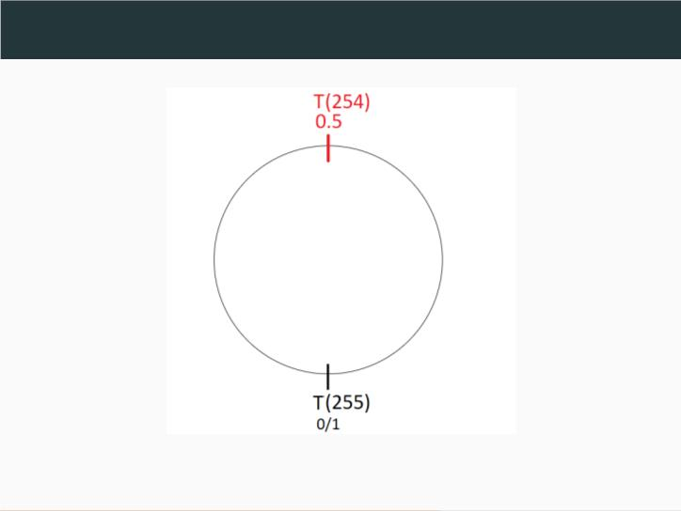
The Folding approach - Example
27/42

Slide 29
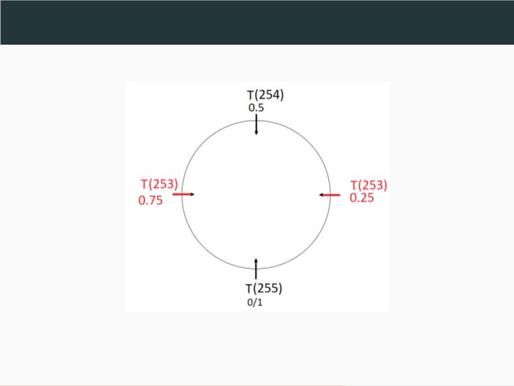
The Folding approach - Example
28/42

Slide 30
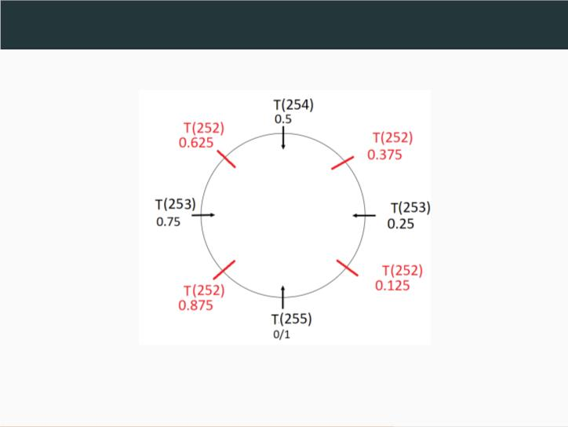
The Folding approach - Example
29/42

Slide 31
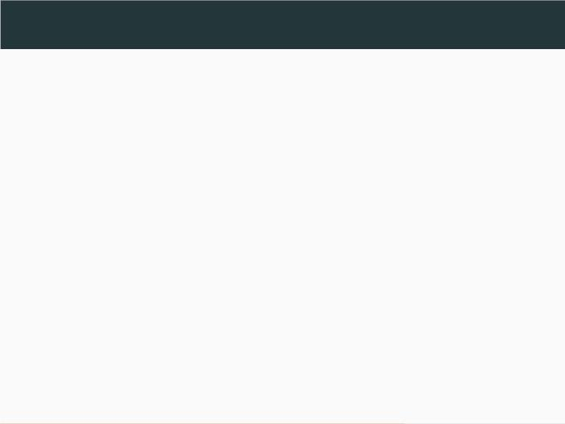
Folding
The downside of this approach is that the
number of values of the target multiplies by 2
each time the TTL decreases by 1.
To solve this we suggest calculating the
distance between the targets and the hash
using folding.
30/42

Slide 32
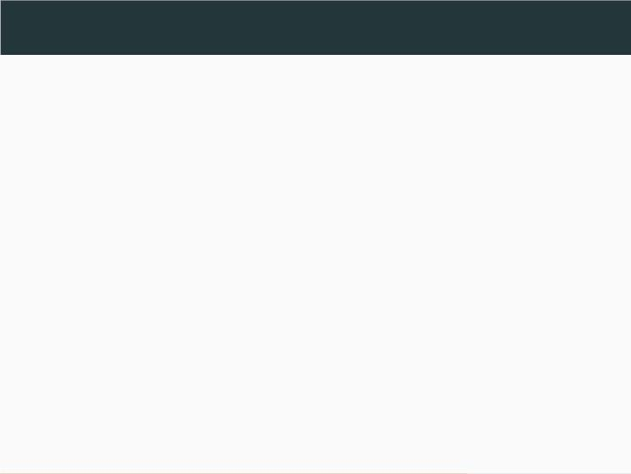
Folding
We will look at the unit circle as a plane.
• When the TTL is 255 we will calculate the distance
between the target and the hash directly.
• For the TTL 254 we will calculate the distance
between the hash and the middle of the plane.
• TTL 253 we will fold the plane and calculate the
distance between the hash on the folded plane and
the middle of the plane.
• To calculate the TTL 252 we will fold the plane again
and calculate the distance between the hash and the
middle.
31/42

Slide 33

Folding - Re-scaling
The hash of ﬂows with smaller TTL is more likely
to be closer to the target from the hash of ﬂows
with a higher TTL because the plane is folded.
So each time we fold the plane we scale it back
to 1 to enable a fair comparison of ﬂows that
visit the NMP with different TTL values.
32/42

Slide 34
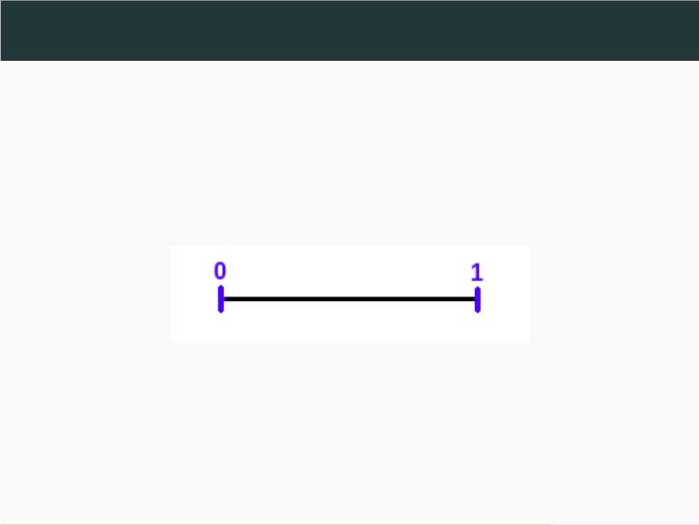
Folding - Example
T(255)=0=1
33/42

Slide 35
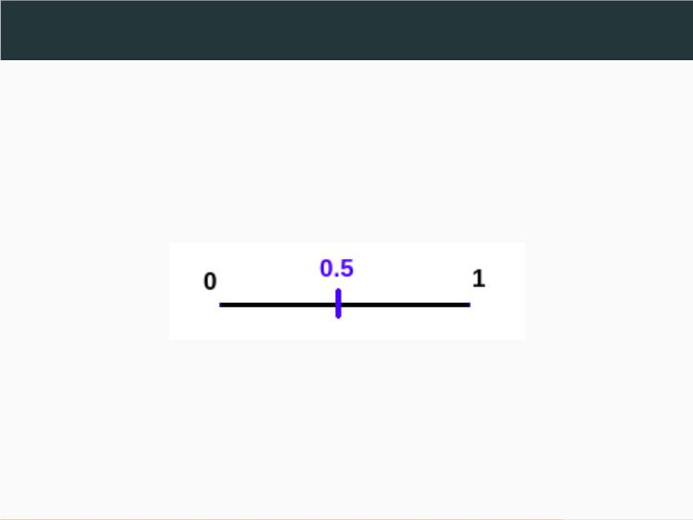
Folding - Example
T(254)=0.5
34/42

Slide 36
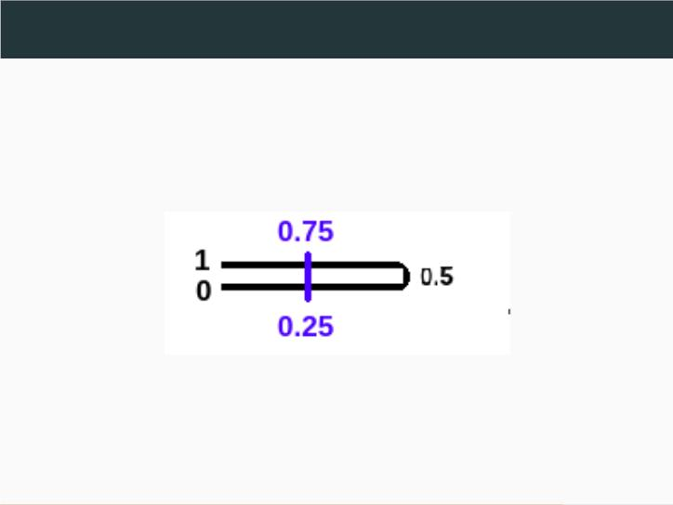
Folding - Example
T(253)=0.75,0.5
35/42

Slide 37
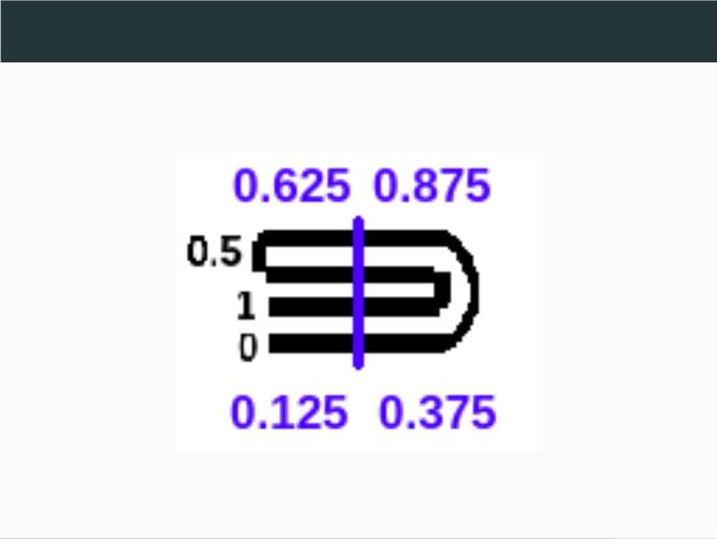
Folding - Example
T(252)=0.125,0.375,0.625,0.875
36/42

Slide 38
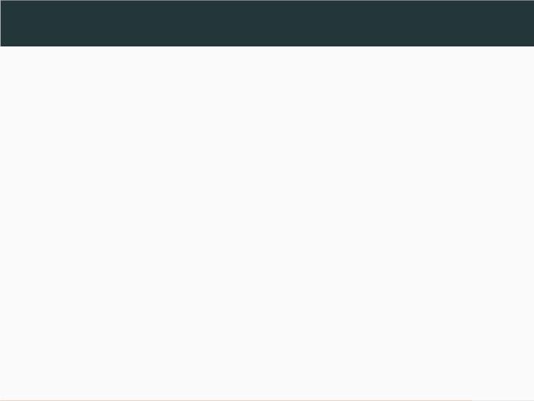
Limitation of CFS
Through initial exploration we discovered:
CFS is almost optimal until we reach high ﬂow
coverage values (eg. 0.95),
but ineffective in moving from 0.95 to full
coverage.
37/42

Slide 39
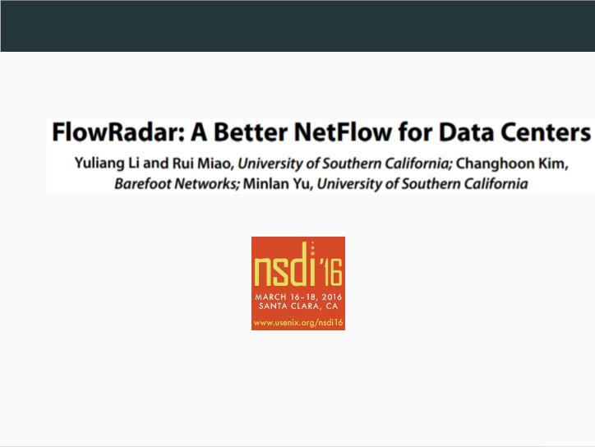
Flow Radar
.
38/42

Slide 40
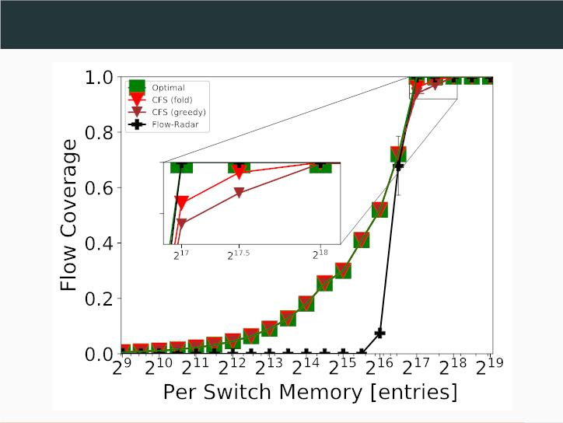
Limitation of CFS - Graph
39/42

Slide 41
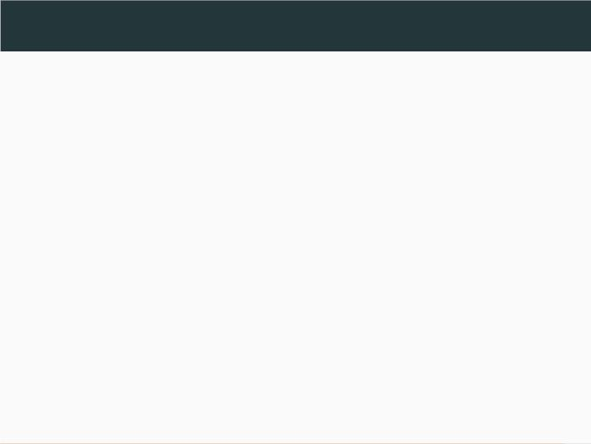
CFS-FR
We run ﬂow-Radar and CFS in Parallel:
we assign part of the NMP memory to CFS and
part to ﬂow-Radar.
ﬂow-Radar run on the ﬂows that were not
captured by CFS.
40/42

Slide 42
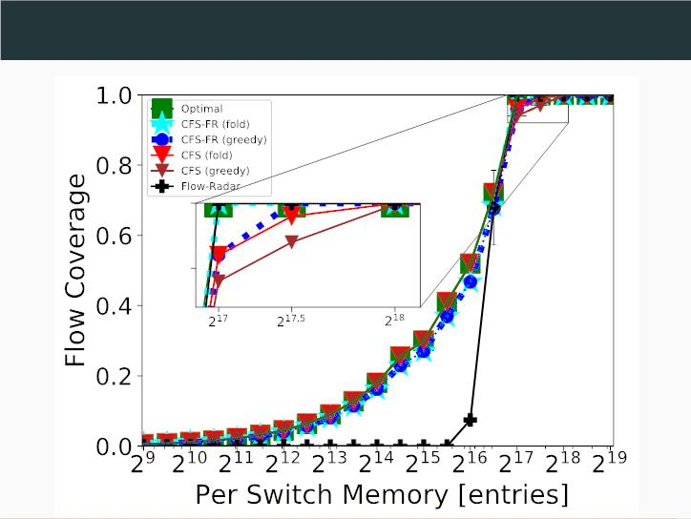
CFS-FR - Graph
41/42

Slide 43
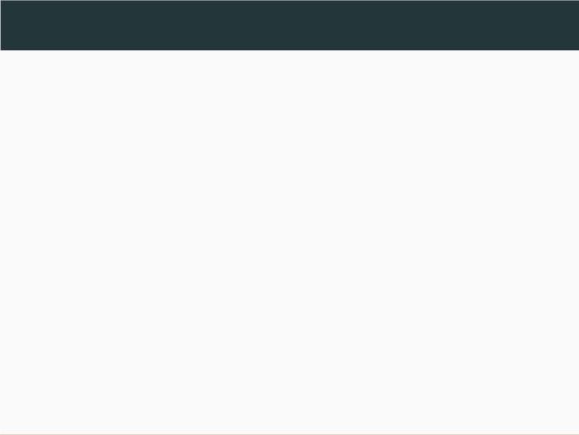
Conclusion
• We saw a way for NMPs to cooperate without
communicating with them.
• We saw that this method achieve a great
result until reaching a high coverage( 90%).
• By combining it with ﬂow radar it achieves
great result also from high coverage to full
coverage.
42/42

Slide 44

Thank you!
Q&A?
42/42

