Slide 1


Legilimens:
An Agile Transport for Background Traffic in Cellular Networks
Muhammad Usama Chaudhry, Shibin Mathew, Shanyu Zhou,
Vijay Gopalakrishnan, Emir Halepovic, Hulya Seferoglu, and Balajee Vamanan
All presented information does neither reflect nor imply an actual business case for AT&T and associated companies.
They are generalized data used to assess performance of the algorithms only.

Slide 2

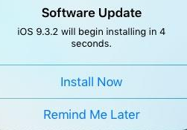
Large background transfers
Cellular networks increasingly used by apps such as cloud data sync and software updates
→ transfer large data in background
  Degrade performance of regular, foreground (e.g., web browsing) apps
  Interfere with neighboring cells
Worse when using fair-share protocols → background and foreground traffic equally share capacity
Need mechanisms that efficiently handle background data transfers without affecting foreground traffic

Slide 3
Existing approaches
In-network approaches
QoS class identifiers (QCI)
  Layer 2 mechanism → inflexible
  Must be provisioned a priori by operators
End-system approaches
Low Priority Transport (LPT) protocols
  LEDBAT, TCP-LP → delay-based
  Highly variable delays + per-device queues + in-network scheduler
  → delay is not a good measure of congestion
Existing in-network and end-system approaches
do not address this problem

Slide 4
Our contributions
Legilimens is a low-priority transport for cellular downlinks
Novel capacity and load inference algorithm
  Overcomes and leverages PF schedulers
  Robust to sender- and receiver-side optimizations
Sender-side implementation → no changes to network infrastructure
Real implementation + evaluation in a live LTE network
Improves throughput of background flows by
3x on average (up to 5x)
over existing LPT protocols without hurting foreground flows

Slide 5
Outline
Introduction
Background
Evaluation
Conclusion
Legilimens

Slide 6





Cellular networks vs. wired/Wi-Fi
Key differences
Varying capacity and delay
Per-device queues in the base station
Scheduler to arbitrate among per-device queues
  Proportional Fair schedulers commonly used
Delay is not a good measure of congestion.
Internet
scheduler

Slide 7
Proportional Fair Scheduler
Commonly used by cellular operators
Balance utilization and fairness
Scheduler allocates resource blocks to the client that
maximizes capacity / recently_achieved_throughput
Winning client gets all resource blocks if there is enough data to send
Provides opportunity to clients with bad signal && high throughput to clients with good signal
PF scheduler is the de facto standard scheduler on mobile broadband data bearers for downlinks

Slide 8
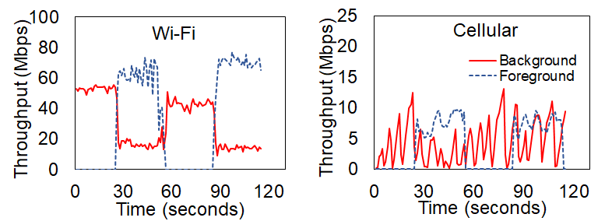
Existing LPT protocols in cellular
Existing LPT protocols use one-way delays to estimate congestion
Simple experiment with two flows
  On-off foreground flow (CUBIC), always-on background flow (TCP-LP)
Varying delays, per-device queues, scheduler → one-way delay is a not a good measure of congestion (load)

Slide 9
Outline
Introduction
Background
Evaluation
Conclusion
Legilimens

Slide 10
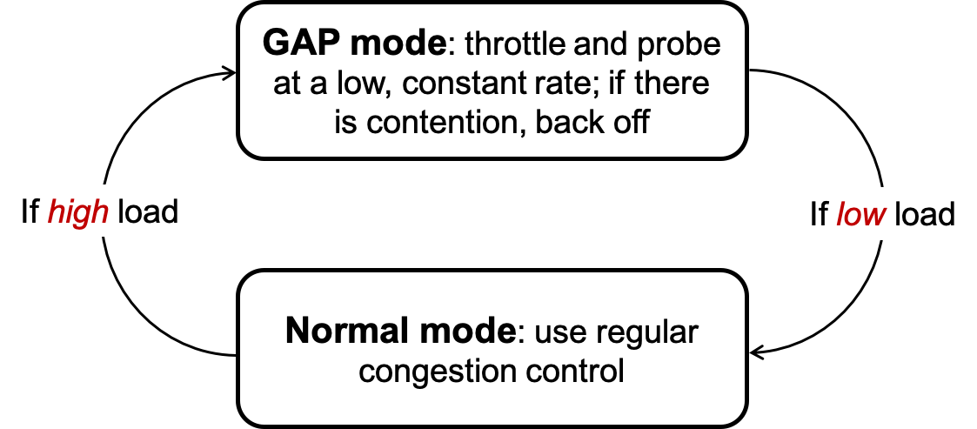
Legilimens: High-level idea
Two modes of operation
Gradually Aggressive Probing (GAP): probe using small bursts first and graduate increase burst size
Key requirement: need a robust algorithm to detect if the base station is busy (i.e., busyness)

Slide 11
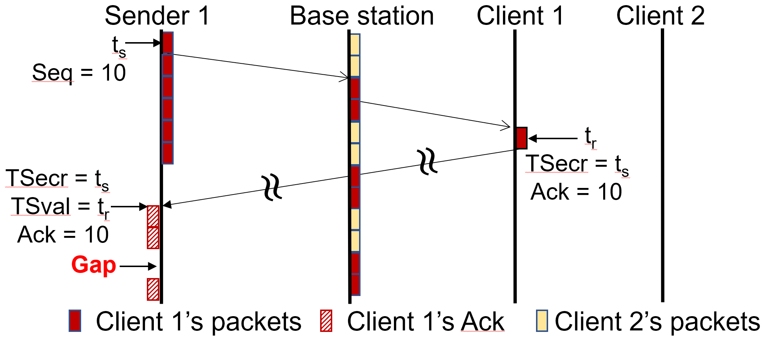
Legilimens: Estimating busyness
Key insight: Exploit PF scheduler to detect busyness!
  When foreground flows join, scheduler will provide opportunity
    Causes gaps in ACKs
  Works most of the time because cellular link is the bottleneck
  But not so simple with delayed ACKs and batching

Slide 12
Legilimens: Estimating busyness (cont.)
Delayed ACKs and batching produce gaps in time stamps
→ how to detect busyness with delayed ACKs and batching?
Key idea: Estimate capacity, in addition to detecting gaps
  if ~gap || gap && throughput == capacity => network is idle
Attempt to recreate schedule at sender with minimal information
Not so simple: must filter outliers, account for PF scheduler params
see paper for complete algorithm
Normal mode: Can use any loss-based CC algorithm
Random (exponential) back-off guarantees fairness

Slide 13
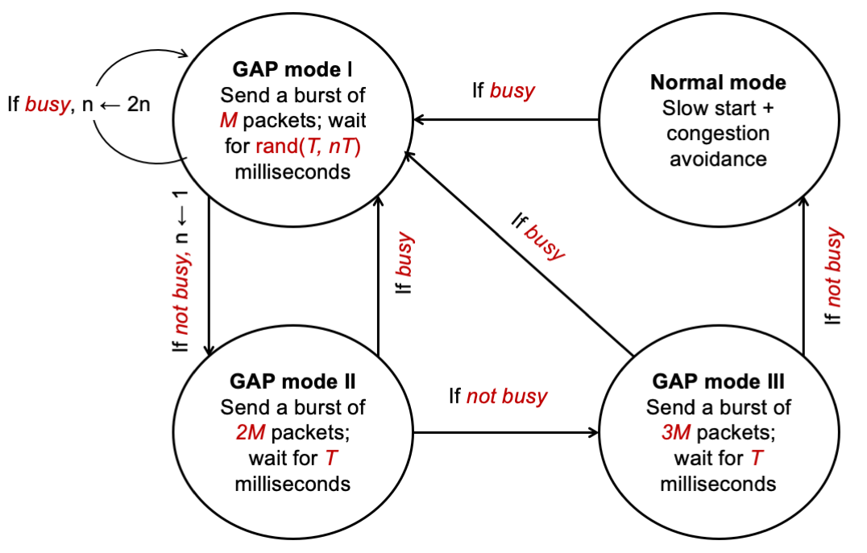
Legilimens: Congestion control
Implementation uses three GAP modes for robustness
Normal mode: Can use any loss-based CC algorithm
Random (exponential) back-off guarantees fairness

Slide 14
Outline
Introduction
Background
Evaluation
Conclusion
Legilimens

Slide 15
Evaluation methodology
Testbeds
  Real implementation on a real network → during idle and busy hours
  Real implementation on PhantomNet → isolated from external traffic
  Simulation → scalability, queue length, fairness, sensitivity
Kernel implementation
Implementation in Linux’s modular congestion control framework
  300 lines of code, uses TCP timestamp option
6 Android phones band-locked, 10 MHz carrier
Each experiment lasts 4–8 hours
  transfers 100 GB of data

Slide 16
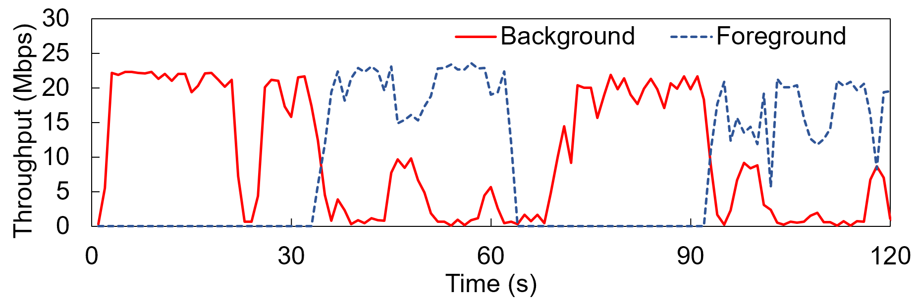
Proof of concept
One on-off foreground flow → uses CUBIC
one always-on background flow → uses Legilimens
Throughput averaged every second

Slide 17
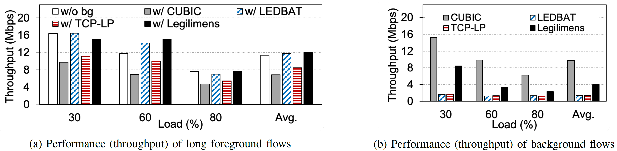
Performance under realistic workload
Real smartphones during quiet time on the network
Foreground flows achieve throughput as if no background traffic exists or if existing best LPT (LEDBAT) used for background
Background flows achieve much higher throughput than existing LPTs

Slide 18
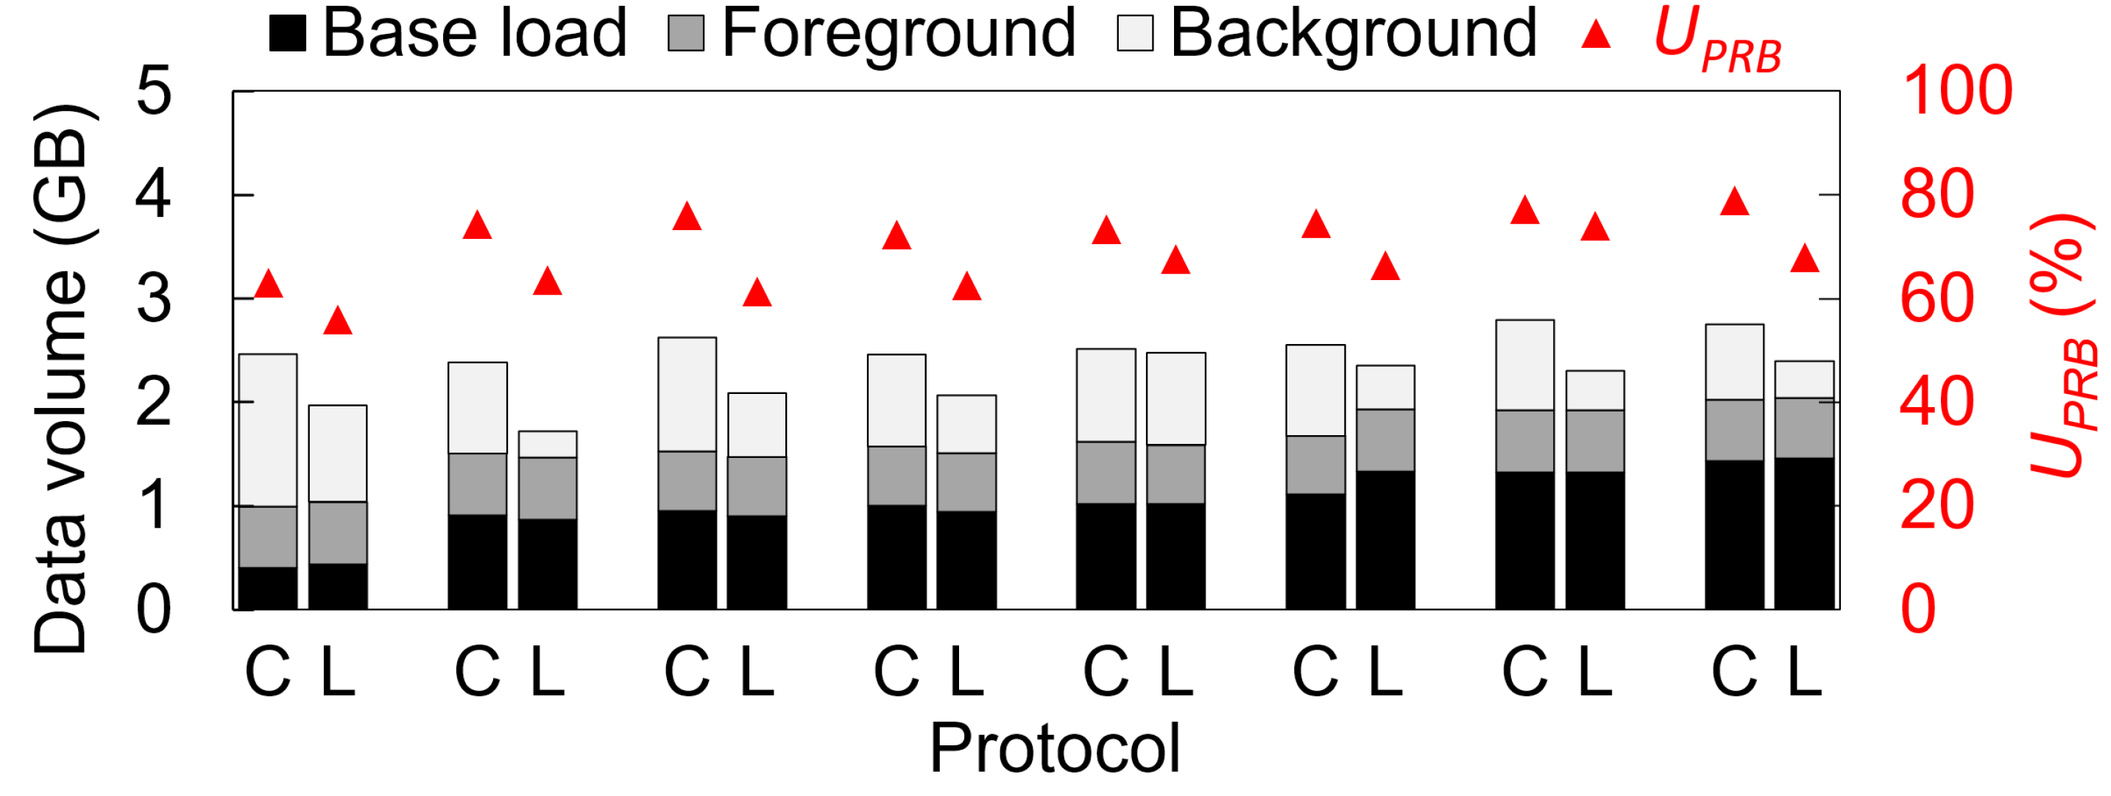
Resource utilization during busy hours
Different base loads (ambient user traffic) and constant foreground loads
Legilimens consistently consumes less data than CUBIC
  CUBIC creates the same traffic regardless of underlying network load
Legilimens results in overall lower utilization (14%)

Slide 19
Concluding remarks
Legilimens is a low priority transport optimized for cellular networks
  Low complexity
  No change to infrastructure
  Maximizes background throughput without affecting foreground traffic
Balances needs of
  users (foreground apps)
  content providers (background apps)
  Network operators (resource utilization)
Future work: Extend Legilimens to uplinks

