Slide 1






Martini: Bridging the Gap between Network Measurement and Control Using Switching ASICs
Shuhe Wang¹, Chen Sun^{1,2}, Zili Meng¹, Minhu Wang¹, Jiamin Cao¹, Mingwei Xu¹, Jun Bi¹, Qun Huang³, Masoud Moshref⁴, Tong Yang³, Hongxin Hu⁵, Gong Zhang⁶
¹Tsinghua University, ²Alibaba Group, ³Peking University, ⁴Barefoot Networks, ⁵Clemson University, ⁶Huawei Technologies
Notes:
Hello everyone, I’m shuhe wang from Tsinghua University. Today I’m going to present Martini, a network management framework that bridges the gap between network measurement and network control with programmable switching ASICs. This is a joint work with multiple institutes including peking university, clemson unviersity, alibaba group, barefoot networks and huawei technologies.

Slide 2
Traditional network management
Decision
(anomly detection, route optimization, fault localization…)
Control Plane
Statistics Decoding
Statistics Analyze
Rule Generation
Switches
Control
(reconfigure link weight, access control lists, load balancing…)
Measurement
(heavy hitter, super spreader, flow size distribution, blackhole…)
sketches
hash
tables
counters
Date Plane
packets
forwarding fabrics
Notes:
First we peek into how traditional network management organizes. Traditionally, the network management is composed of three aspects: measurement, decisions on measurement statistics, and control actions based on decisions. There are a lot of applications in each aspect, for example, ($) in measurement there are detections on : heavy hitter, super spreader, flow size distribution, blackhole, packet loss, etc. ($)The decision, based on all the collected statistics, may do analysis on anomaly detection, route optimization, fault localization etc. ($) Based on the decisions, the Control will reconfigure the network, for example, adjust link weights and access control lists, redo the load balancing, etc.
However, we can see from above currently these aspects are separately implemented. From above, ($)we can see that data are collected in the underlying distributed switches, while ($)Controller periodically pull, or ($)switches regularly report them to the controller. Data are analyzed in the centralized controller, after which network control is finally issued to switches.

Slide 3
Control loop breakdown
Control decision making
Latency Envelope
Controller
Seconds to
Minutes
← Statistics transmission
Rule issuing→
Switch CPU
Milliseconds
←Statistics uploading
Rule installation →
Switch Pipeline
Milliseconds
Measure
Delayed
Control
Milliseconds
to Seconds
← Switch report interval
sketches
Notes:
However, this inevitably leads to a long untimely control loop. We show the common control loop from first measurement to final control. ($) First switches will periodically report to the controller, and the report interval usually takes milliseconds to seconds. For example, OpenFlow reports flow counters every few seconds. ($) Then, when begin reporting, The switch pipeline first sends statistics to the switch CPU, which then communicates with the controller, while the returned flow rules follow the inverse path. This part could reach tens of milliseconds. ($) Next, statistics and control rules are transmitted between the switch CPU and the controller, and this also takes milliseconds to microseconds. ($) Finally, in order to reduce the communication latency and save bandwidth, switches always send encoded data to the controller, so there should be a process to decode data and make decisions based on them. ($) In our setting, we use sketches for measurement, and ($)controllers will use techniques like reversible sketch, group testing and so on to retrieve all the flow keys, but this will take seconds to minutes to accomplish.

Slide 4


Scenarios for timely management
Task 1: Timely Heavy Hitter Control
Threshold
Controller
Flow Counters
packets
Notes:
In summary, traditional centralized control plane for control decision introduces a long control loop. However, modern networks need to quickly react to measurement results for timely control, and we list two representative scenarios. First is the timely heavy hitter control, whose goal is to drop large-sized flows in the network. ($) Each network node will maintain counters of each flow. ($) Once the packet volume exceeds a threshold, this flow is considered as a heavy hitter. ($) We require to quickly detect this heavy hitter, and ($) control it with adaptive rerouting, ($) rate limiting or any other ways. However, current centralized implementation reports flow counters to the collector at fixed time point, which may be unresponsive when heavy hitters appear.

Slide 5
Scenarios for timely management
Task 2: Timely Video Congestion Control
Delayed control
Controller
Determine the states
Issue control commands
The I frame is randomly dropped
No frame
I passed
I dropped
∅
I frame passed
0
I frame dropped
1
P or B arrived
I frame dropped
P or B arrived
I frame passed
I frame passed
Notes:
Another example is in video congestion control. When congestion happens and an I frame is dropped, all its subsequent P and B frames become useless and should be dropped. But in current implementation, to maintain the state machine of the task, the controller needs to identify the current network state and issue commands. The delay in the control loop may cause unnecessary frames to buffer or drop correct packets.

Slide 6
Existing work…
Measurement
Decision
Control
Enhancement on switches
Controller on local switch CPU
Detect events directly on data plane
No generality!
Long ASIC redesign cycle!
Control loop not eliminated!
Only poll statistics at fixed intervals!
Events still need reporting!
metadata
Programmable
Switch
Match-Action
Unit
Match-Action
Unit
Match-Action
Unit
Main problem: the controller is still in need to do decisions generally, so the loop cannot be eliminated
Key Observation: a large portion of tasks require only local measurement results in a switch for decision
header
Match Table
Match Table
Match Table
Output Queue
Action
Action
Action
packet
parser
deparser
…
payload
Notes:
So the long control loop has indeed impaired many latency-sensitive management tasks. Existing works try to address the gap. One group of studies propose to enhance switching ASICs with more functions towards specific tasks, ($) but this not only lacks generality but also needs long development cycle to redesign the ASICs. Another direction is to place the controller in local switch CPU. ($) However, most parts of the control loop are still not eliminated, and the controller can only poll statistics at fixed intervals, unable to monitor the data plane at any time. There are also studies that enable the data plane to directly detect network events based on measurement, ($) but the events still need to be handed over to the controller.
($)The main problem is that we still need a controller to make decisions in general conditions. But we also observe that a large portion of tasks require only local measurement results for decision. Therefore, if the switches can automatically carry out different control actions based on measurement, the decisions can be moved to the data plane and a controller is no more in need. ($) With the use of current programmable switches, We can flexibly design all the measurement and control we want the switches to execute, and dynamically do the decisions to map them together. ($) So we propose martini, to offload management tasks entirely to the switch data plane, and provide a general framework for users to manage all kinds of tasks.

Slide 7

Martini Overview
Management Task Description
Controller
Network-wide Placement
Compiler
Switch Pipeline
Packet
Measurement
Local Decision
Timely Control
Negligible control loop
Component Library
Notes:
Maritini provides a complete framework from top to bottom. First, it provides a set of high-level management task description primitives for operators to easily describe and assemble all three management phases. Second, Martini presents an innovative network-wide task placement mechanism to exploit resources of all network switches for massive management tasks. Finally, Martini provides a library of measurement and control components and a compiler which automatically composes them to generate programs on programmable switching ASICs.

Slide 8
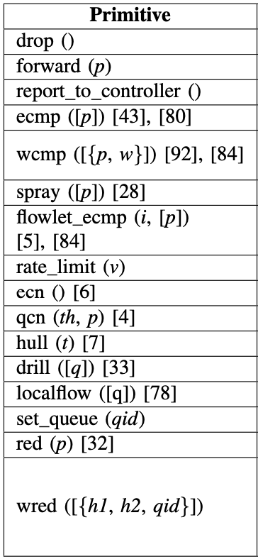
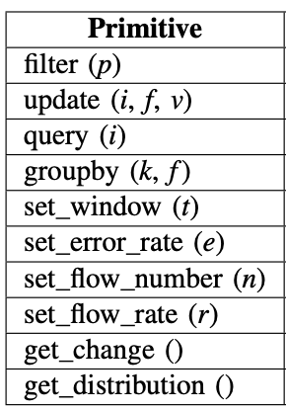
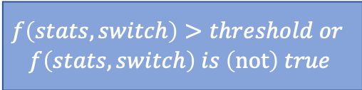
Management task description
Challenge: give descriptions for the contents and connections of all phases in one management task.
Key idea: Modular primitives for reusability and extensibility
Measurement
Decision
Control
①
Update
Filter
$$f\left(stats,switch\right)>threshold or$$
$$f\left(stats,switch\right) is \left(not\right) true$$
Packets
②
Query
or Group
Decision
Control
Measurement
Decision
Control
Packets
Update + Query or Group
Decision
Control
Notes:
However, here comes the first challenge in task description: although recent studies have proposed languages for either measurement or control, they are not considered collectively. How to use an easy and unified scheme to describe the whole task? ($) We propose to use modular primitives to just describe each phase separately and stitch all phases in a line.
($) In measurement, most tasks can be reduced to composition of several basic primitives such as filter, update, query, groupby, and temporal primitive like window. ($) In control, since it span across multiple different fields such as scheduling, routing, congestion control, etc, we simply encapsulate common ones into modular primitives, and users can add new primitives for new control at any time. ($) For decision, since it detects network events based on measurement statistics, we can simply use conditional expressions to express the phase.
However, there exists another problem that traditional measurement primitives update and query in a row. But for example, in DNS reflection attack defense, we should maintain records when receiving DNS requests, and separately query the records when receiving DNS responses. ($) Therefore, we decouple update and query, and add an additional filter stage to lead one set of packets to update the record only, and the others to query or group the records only. For other detailed explanations of the primitives, please refer to our paper.

Slide 9
Management task description
Example Case: DNS reflection attack defense
Attacker
victim
Spoofed DNS requests
Large volume of DNS responses
DNS server
.set_window(w)
.filter(udp.dstPort==53)
.update(i=[srcIP,dstIP,transaction ID],f=set,v=1)
.filter(udp.srcPort==53)
.query(i=[srcIP,dstIP,transaction ID])
.detect(stats!=1).drop().report()
Task description
Notes:
So here we give an example of the task description using the DNS reflection attack defense that we have just mentioned before. We can see that with simply six lines of code, the user can clearly define the whole scope of the task, and leave the implementation detail to Martini.

Slide 10
Component Library
Challenge: realization for various types of measurement and control tasks
Constraints: limited resources (SRAM, SALU, pipeline stages…)
Key idea: use sketches for measurement
  Project high-demensional data to small register arrays
  Per-packet update with hash functions group
  Guarantee error bound with limited space
Suitable to implement on programmable switches!
Notes:
To convert the high-level description into concerte implementation on switches, the underlying realization for each modular measurement or control task should be clearly specified. Our second challenge is to implement all the different types of tasks onto programmable switches. Since the swtiches have limited resources such as SRAM and stateful ALU, and measurement tasks just require a summary instead of the whole statistics, and they don’t require 100% accuracy, ($) we can therefore use sketches as the underlying data structures. Sketches are esentially register arrays that project high-demensional data to small subspaces. It can be updated with a group of hash functions in a per-packet way, and always guarantees error bound with given memory space. ($) These features imply that sketches are suitable to implement on programmable switches.

Slide 11
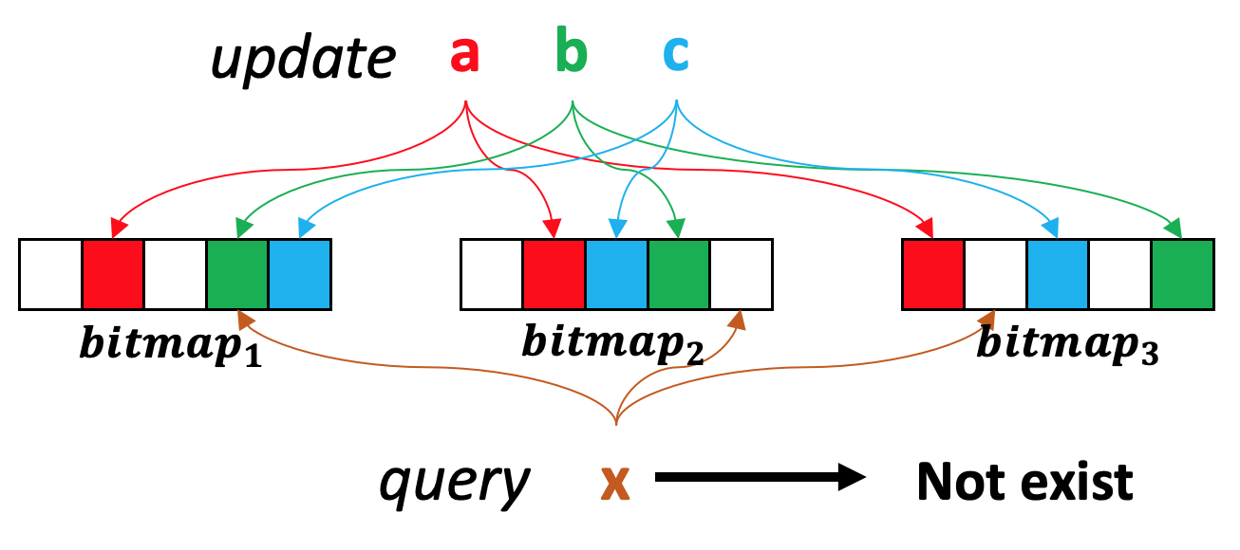
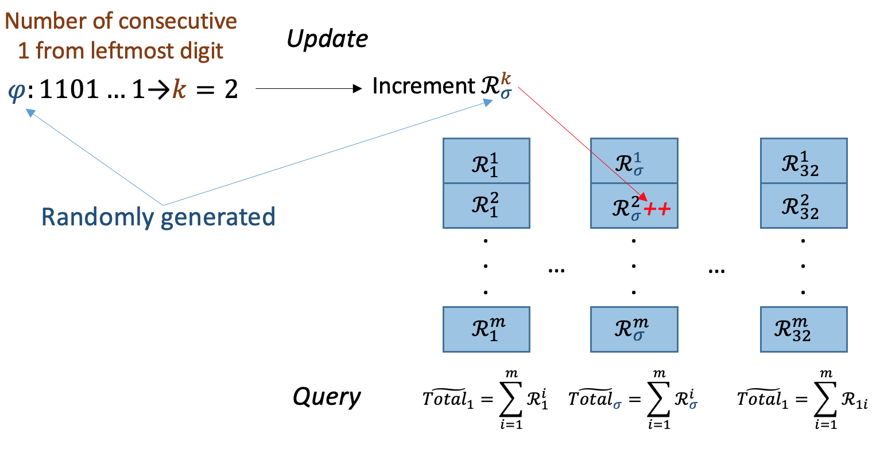
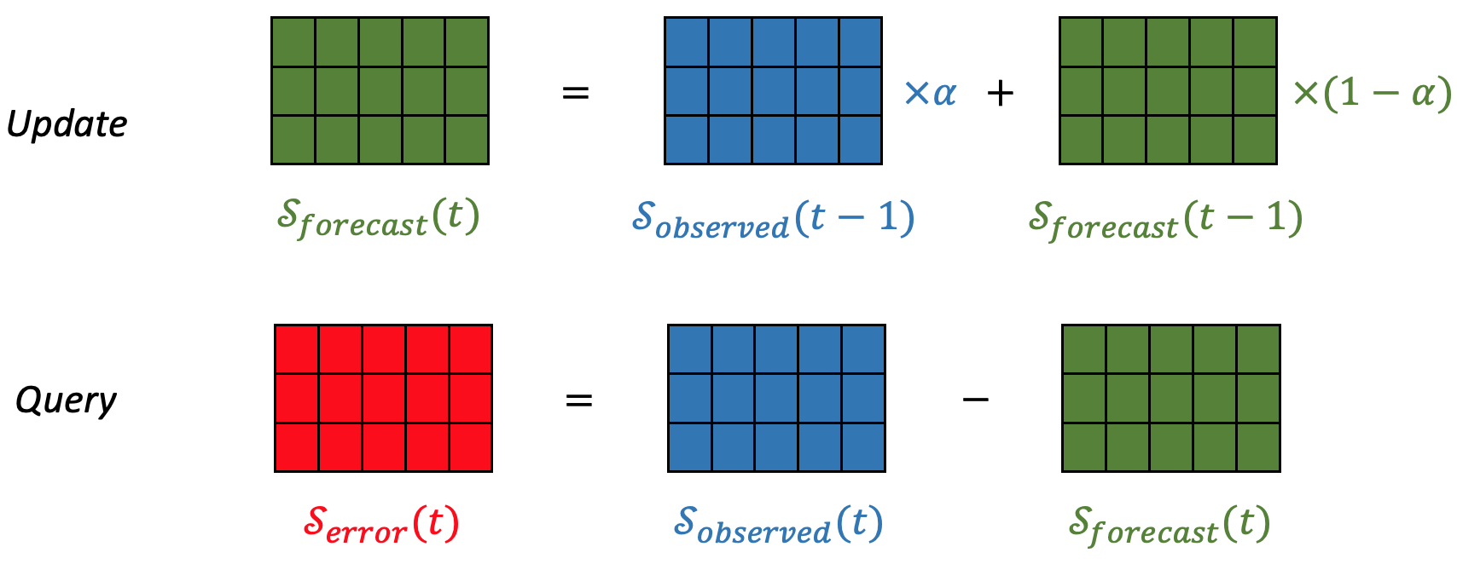
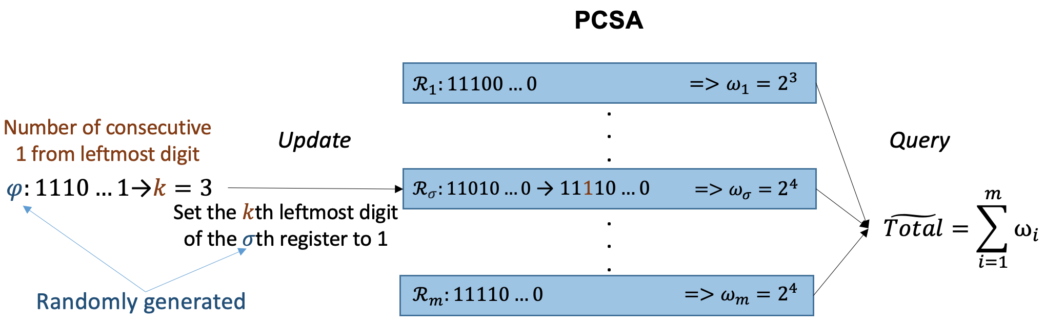
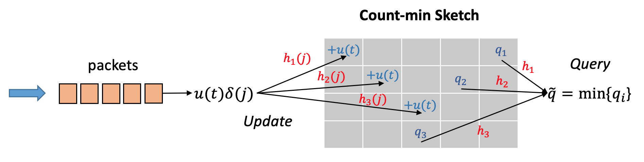
Component Library
Commonly used sketches (OpenSketch [NSDI’13])
  Bitmap
  Count-min Sketch
  K-ary Sketch
  PCSA
  Multi-resolution Classifier
  …
Notes:
Refering to prior work like Opensketch, we have implement all the sketches that are commonly used in current measurement, for example: ($)the bitmap that holds the existance of flows; ($) the count-min sketch that holds upper bound of the number of flows; ($) the K-ary sketch that estimates the difference between two intervals; ($) the PCSA that uses a bunch of small registers to estimate the flow size roughly; and ($) the Multi-resolution classifer that holds the flow size distribution of multiple flows. ($) and there are more of them. We will open source the code later and you can refer to our code to see their implementation tricks.

Slide 12
Component Library
Counter Array
1 Byte
4 Bytes
Round-based measurement window
controller
.
.
.
Local Round Indicator
Window Length
（L）
cur_round
cur_time
timestamp
delta = timestamp - cur_time
delta > L
cur_time += L
cur_round += 1
packet
Y
N
Output
round = cur_round
ct_value = 0
cur_round > round
Read Counter Array
Y
N
Main data flow
Register access
Control flow
round
ct_value
Notes:
Here we introduce one implementation trick that is generally used among all kinds of sketches. It is a common operation to aggregate statistics within a time window in measurement. However, current switch programming languages such as P4 don’t support timer or batch clearance for counter arrays.
Therefore, we use the round-based mechanism to approximate the window primitive. We set each round as a fixed-time interval, and counters are cleared across different rounds. In the switch, ($) we store the current round and its start time in local round indicator. Once the difference between the ingress packet timestamp and the start time of current round exceeds the window length, we move to the next round. We also append each counter with a separate last-time-updated round. If it is below current round, it is reset to current and the related counter gets cleared.
In our implementation, ($) the counters are usually 4 bytes wide. To save as many switch resources as possible, ($) we set the round to be 8 bit wide so the resource overhead will only be 25%. However, an 8-bit round covers at most 256 consecutive intervals. If the difference of the rounds of two consecutive packets is multiple of 256, they will have the same current round due to wrap-around and cause mistakes. Nevertheless, we will later show in evaluation that the error rate of this technique is extremely low.

Slide 13
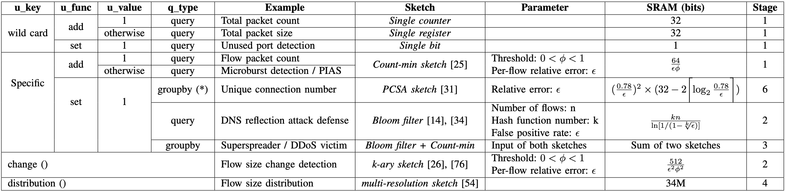
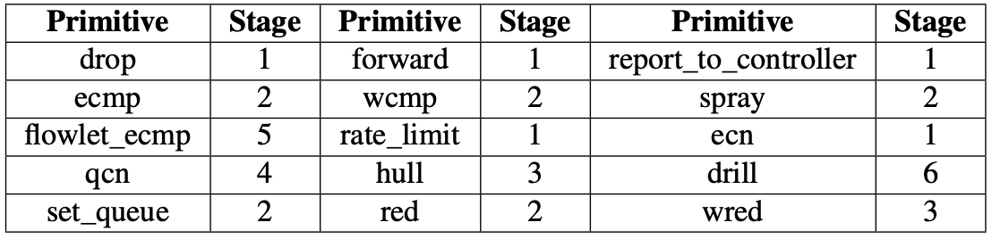
Compiler: Resource Estimation
Measurement
Control
Notes:
Next we discuss how to establish the mapping from high-level primitives to user-agnostic low-level implementation. To do the compilation, we should first know how many resources does each primitive consume. Since the primitives are modular, we can separately estimate each single phase. ($)First, we map the common composition of measurement primitves into the sketches we implement, and calculate the resources they take. ($)We can see from the table that flow size, error rate and threshold all have influences on resource consumption. Next, the decision phase only occupies one pipeline stage and negligible SRAM resources as a single conditional expression.($) For control actions, we examine their implementations and find that the pipeline stage is the critical resource.

Slide 14
Compiler: Placement
Partition
Computation Partition
Data Partition
Measure
Control
Subflow 1
Measure (1/2)
Measure (2/2)
Management Task
Subflow 2
Server 1
Server 2
Switch 1
Switch 2
Switch 3
Notes:
As the previous slide shows, measurement and control may consume many SRAM and pipeline stages, and one single switch may not be sufficient to provide all the resources. ($) Fortunately, we observe that a flow may go through multiple switches before reaching its destination. Therefore we can split the tasks into subtasks and distribute them onto the switches alongside the flow forwarding path to to correctly manage the flow.
We use two ways to partition tasks. ($) One is computation partition, which splits tasks according to its execution phases, while reserving their orders. Also, we couple measurement and decision, since decision consumes almost no resources and can directly based on measurement to detect events, which saves lots of bandwidth rather than sending all the measured statistics to control.
($) Another way is to do data partition, which uses multiple instances of the same task, ($) and equally divide the flows into individual instances. As the resource usage is related to flow size, this will release the burden for one switch to monitor all the flows.

Slide 15
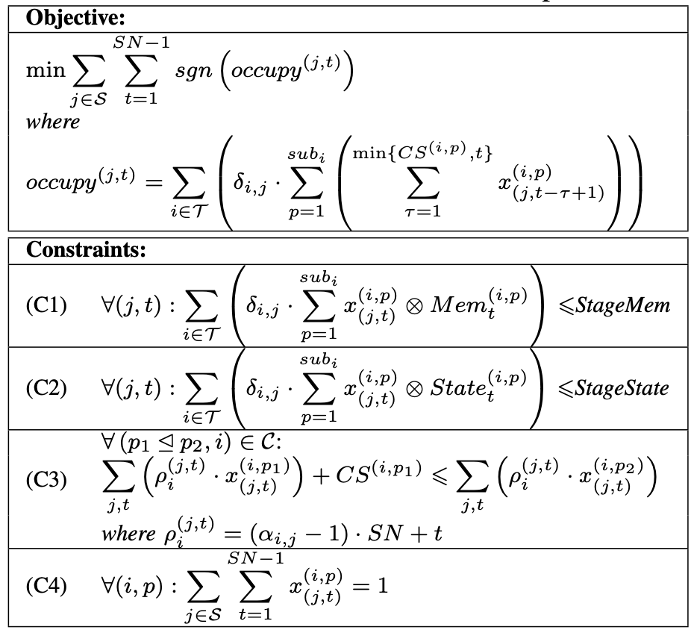
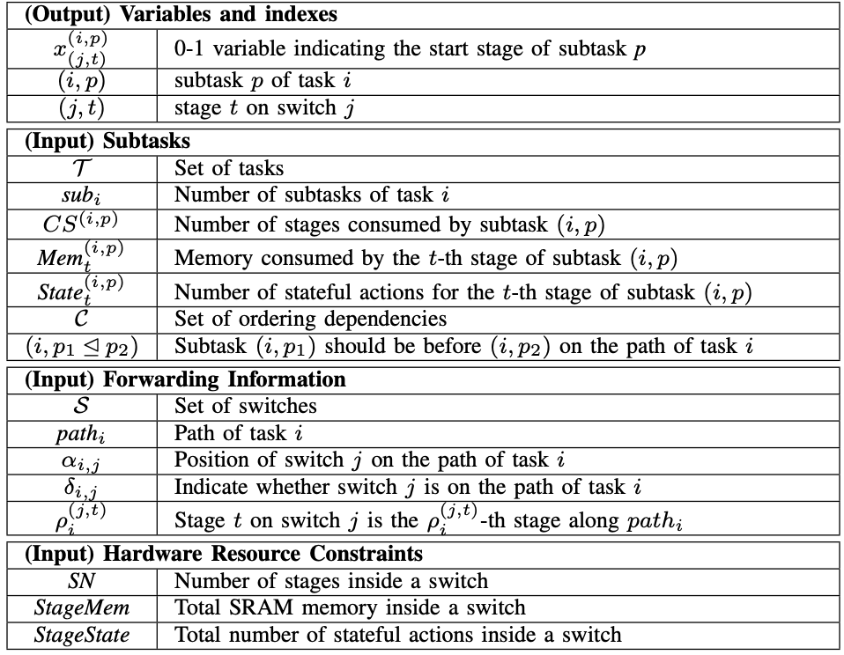
Compiler: Placement
ILP Formalization
Distribute
Notations
Resources
Ordering
Notes:
Given the partitoned tasks, the network topologies, and all the resource estimation, we can model the placement problem into an Integer Linear Programming problem, as there already exist many mature ILP solvers. To form this problem, our intuition is that management tasks should occupy minimal switch resources. Since subtasks can share a pipeline stage if the other resources within this stage are sufficient, ($) we choose to use stage occupancy as the optimization goal. ($) We formalize the resource constraints and the ordering constraints between tasks, and with the model’s output, all the subtasks can get distributed along their forwarding paths.

Slide 16
Compiler: Code Generation
Event transmission for computation partition
Switch 1
Switch 2
VLAN
payload
VLAN
payload
VLAN
VLAN
Measurement
Decision
detach
append
Event
Control
Event
detect
handle
Notes:
Finally, the compiler can generate concerte low-level P4 code to the switches. Here we introduce one technique, for other tricks please refer to our paper and codes. Under computation partition, events should transmit between phases. If the two phases are placed in different switches, we can modify the packet headers for event delivery between switches. However, adding new header fields may hurt the goodput. So we exploit unused bits in current headers such as VLAN Identifier Field, to append the detected events. As it is 12 bit wide, at most 4096 types of events can get encoded in theory, which is enough for our management.

Slide 17

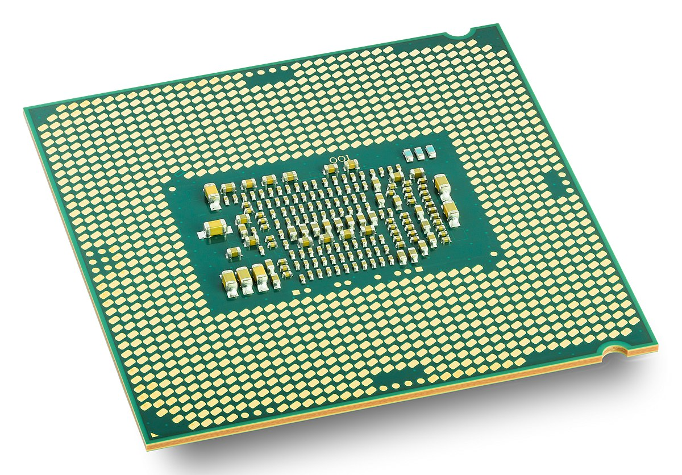
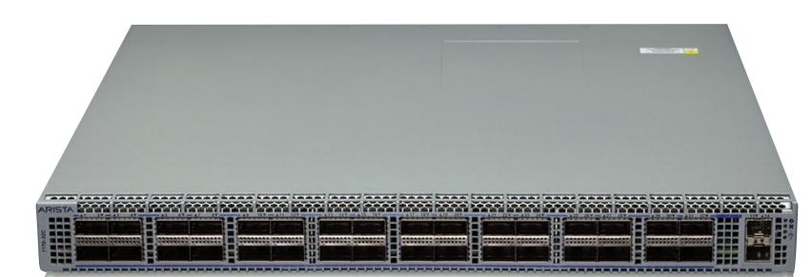

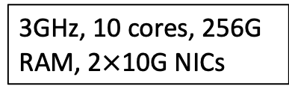
Evaluation
Experiment setting
RC
Switch CPU
LC
Martini-2
Martini-1
33$×$10GbE Tofino Switch
3GHz, 10 cores, 256G RAM, 2$×$10G NICs
Notes:
We evaluate Martini on a real testbed, in which each Tofino switch is connected with multiple servers and two switches are directly connected. We have realized four schemes including two strawman solutions, which separately ($) perform control decisions in remote CPU and ($) in local switch CPU, and two Martini implementations, ($) separately on a single switch or ($) span across two switches.

Slide 18
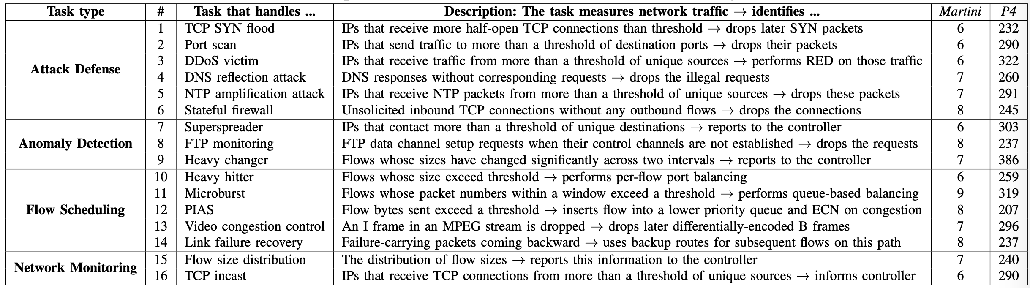
Evaluation
Enabled management tasks
Notes:
Under the four schemes, we implement 16 common management tasks in roughly 4 task types. Martini makes it easier to describe management tasks by composing primitives. ($) It takes less than 10 lines of code to describe a task, while requiring around 30 fold lines of code in P4.

Slide 19
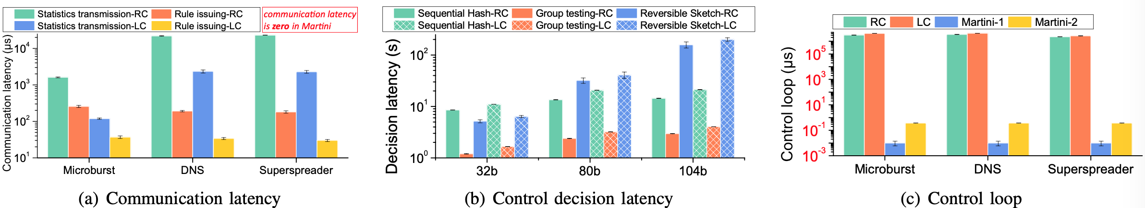
Evaluation
Control loop reduction
Notes:
We choose three representative tasks, and measure the latency of each components in the control loop. As shown in Figure (a), the communication latency takes at least millisecond-level delay. In comparison, Martini completely avoids this latency. As shown in Figure (b), the controller needs to decode sketches to make decisions, ($) and this can take as long as 3 minutes. Since Martini implements entirely in the data plane, it avoids the key deriving part. In Figure (c), we present the total control loop in traditional and Martini patterns. The control loop of the traditional patterns is 2 to 4 seconds. ($) For the Martini one-switch case, the control loop is within a single pipeline stage and takes around 10 nanoseconds. ($) For the Martini two-switches case, the control loop grows to around 370 nanoseconds due to event queuing and wire transmission latency.

Slide 20
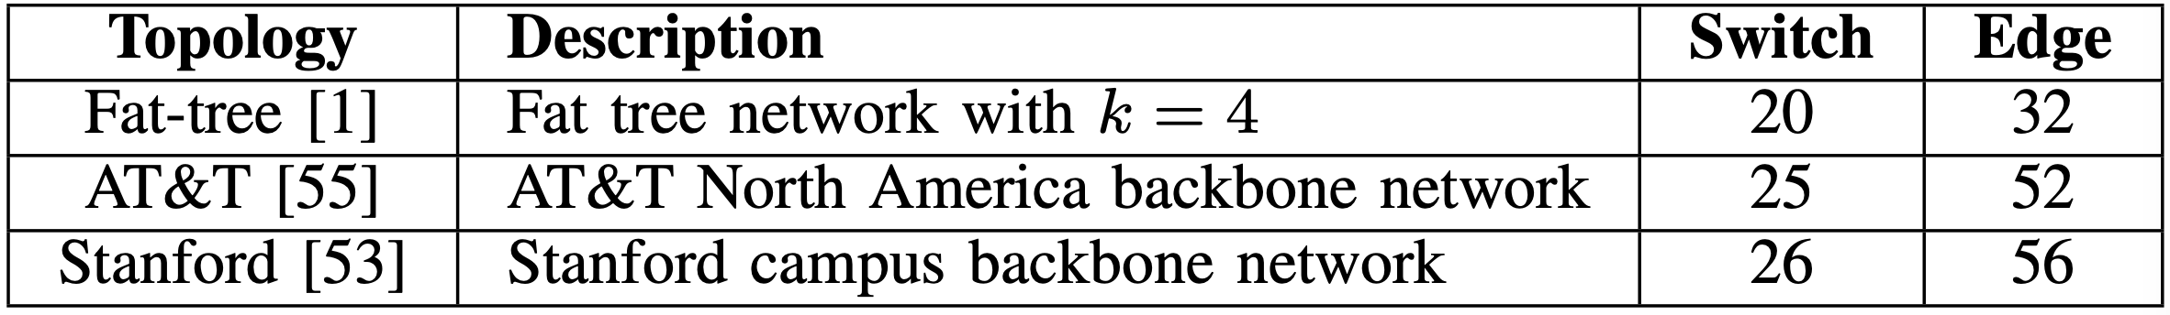
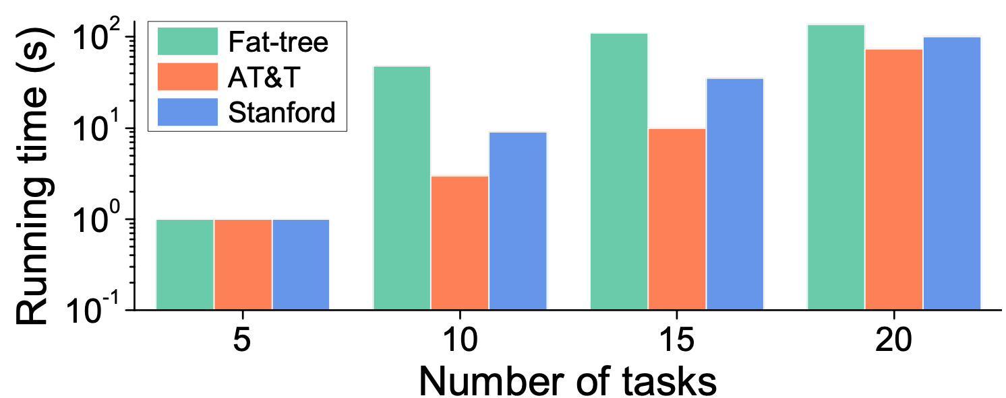
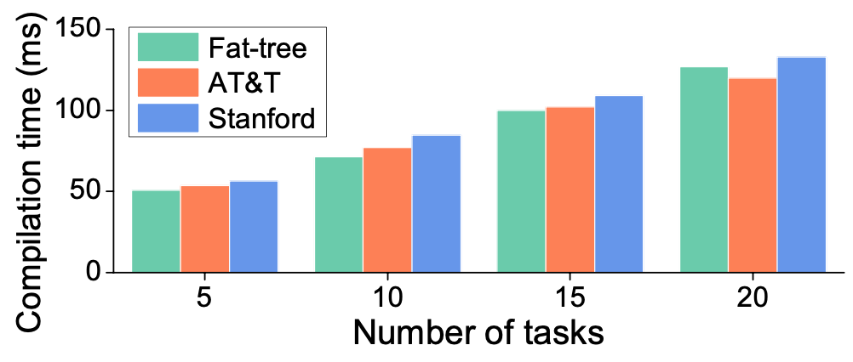
Evaluation
Compiler’s efficiency
Placement running time
Code generation time
Notes:
To test compiler’s efficiency, we implement the algorithms in a server and simulate the topologies of three real-world networks in the above table. The offline compilation time is mainly composed of two parts ($): placement running time and code generation time. We perform two processes in all three topologies. ($) Results show that both times increase linearly with task numbers, and with as much as 20 tasks, both times are still within one second. So martini’s compiler is able to run within reasonable time.

Slide 21
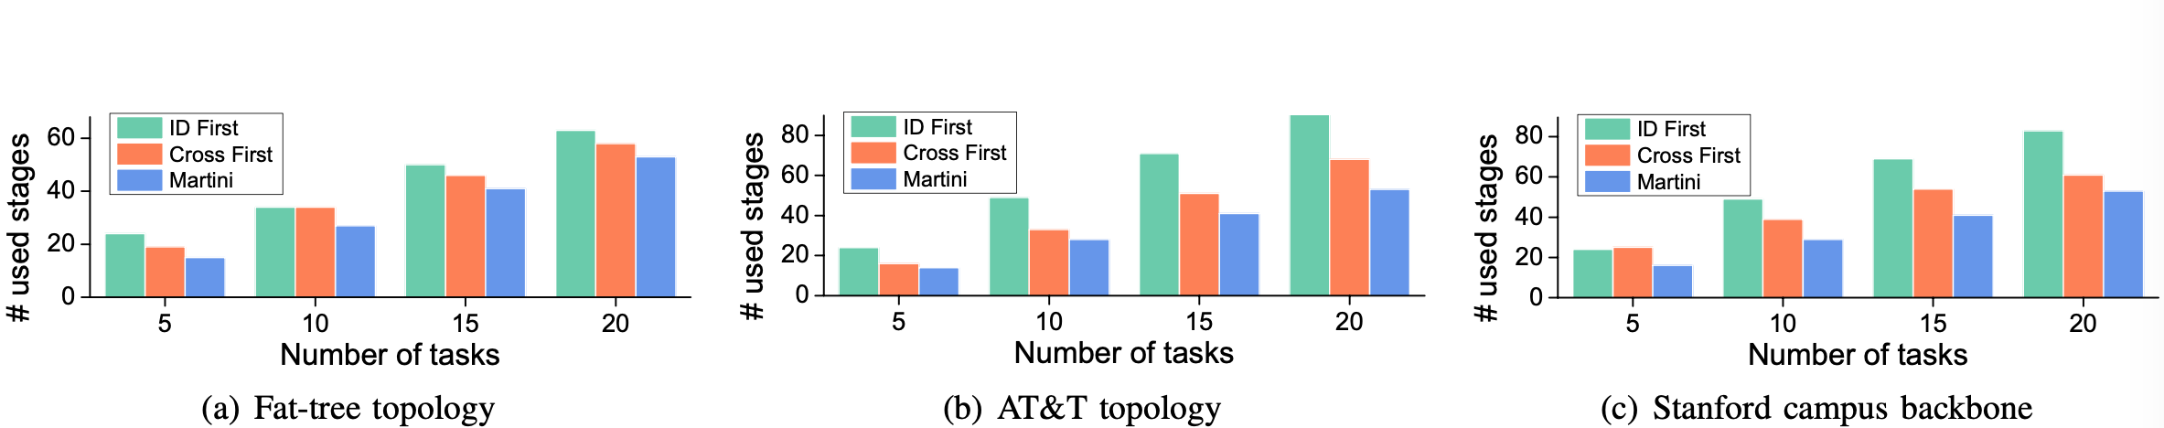
Evaluation
Compiler’s optimality
√
ID First
√
Cross First
5 tasks
10 tasks
Notes:
To demonstrate that our placement algorithm can yield the best resource usage, we compare it with two strawman solutions, ($) namely ID first, which always places the next subtask to the next available switch in the forwarding path, ($) and cross first, which always places the next subtask to the switch with the most number of tasks in the forwarding path. ($)We can see that compared with the two solutions, Martini always uses the least number of pipeline stages, and the more tasks there are, the more benefits Martini can have.

Slide 22
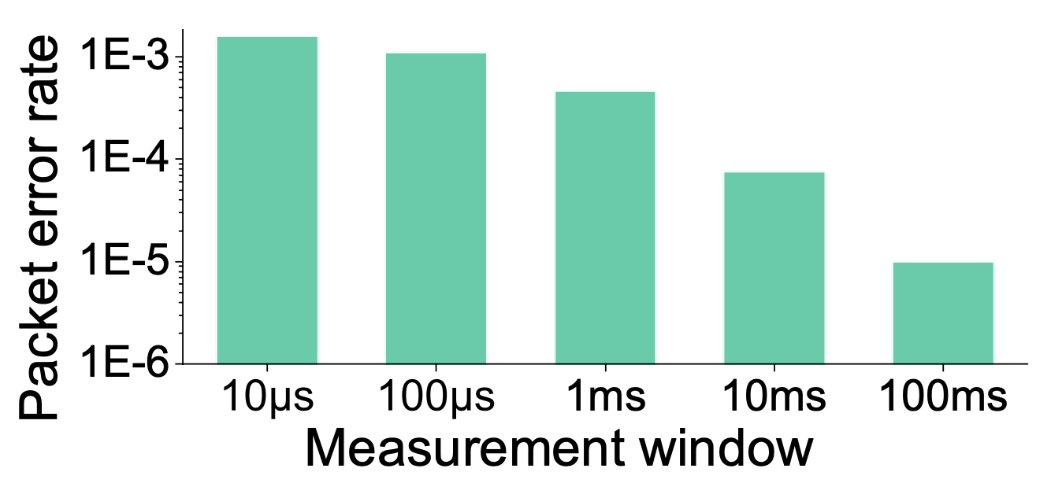
Evaluation
Error Caused by Round Based Timing
Notes:
Finally, we demonstrate that the trick to implement round-based measurement window is practical to use in real world cases. Here we evaluate the percentage of faulty counters by varying measurement window and count packets that cannot trigger correct counter clearance by identifying packet pairs whose rounds difference are multiples of 256 measurement windows. The result shows that the percentage of packets that cause error increases as the measurement window decreases, and even if with small window as 10 microseconds, the error rate is only 0.2%. This is already acceptable in our setting.

Slide 23
Conclusion
We realize Martini, a measurement-based timely management framework on programmable switches.
Our task description primitives and hardware component library provide simplicity, modularity and flexibility.
Our placement algorithm take the best use of global-wide network resources for management tasks.
Evaluation shows Martini can reduce control loop from seconds to nanoseconds.
Notes:
In conclusion, we have realized a general framework for timely network management on programmable switches. We provide task description primitives and a code library for common measurement and control components for users to use in a simple and flexible way. Our network-wide task placement deploys management tasks into the entire network with high resource efficiency. Finally, evaluation shows Martini can reduce control loop from seconds to nanoseconds.

Slide 24
Thank you!
wangshuh18@mails.tsinghua.edu.cn
Notes:
And that’s all. Thank you

