Slide 1


TurboNet: Faithfully Emulating Networks with Programmable Switches
Jiamin Cao (Tsinghua University)
Yu Zhou (Tsinghua University), Ying Liu (Tsinghua University),
Mingwei Xu (Tsinghua University), Yongkai Zhou (UnionPay)

Slide 2
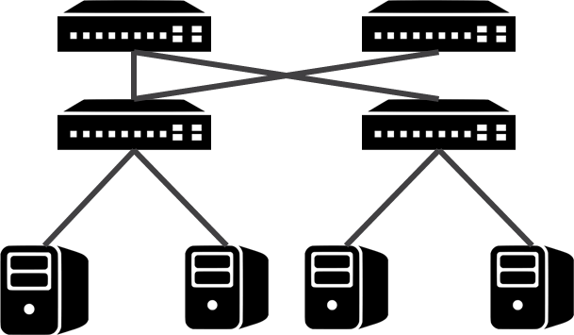
To conduct network experiments
Simulators？
Emulators？
Test-beds？
Congestion control Topologies
Routing
IPv4/IPv6
…
Network experiments platforms should satisfy:
High Fidelity: like realistic hardware environment
High Flexibility: topologies, properties (link delay, packet losses, link bandwidth, …)
High Scalability: easily scale to meet increasing network bandwidth and sizes

Slide 3



Simulators
Use CPU to model networks as simulated events
Virtual Time
+
Models
Links
Switches
Ports
NICs
Applications
…
Fidelity Concerns

Slide 4
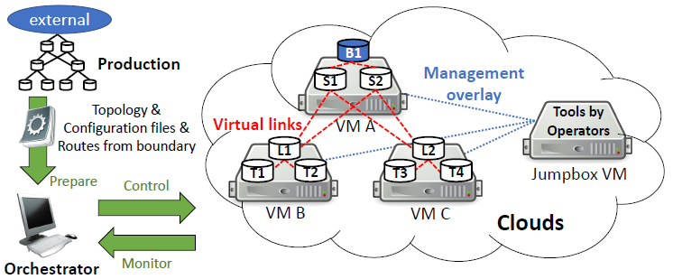

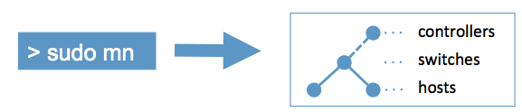
Emulators
Run the same code on CPU as real platforms with interactive network traffic
Cannot provide accurate performance results for large and high-speed networks
10Gbps networks?
100Gbps networks?
CrystalNet [SOSP 17]
Fidelity & Scalability Concerns
Mininet

Slide 5
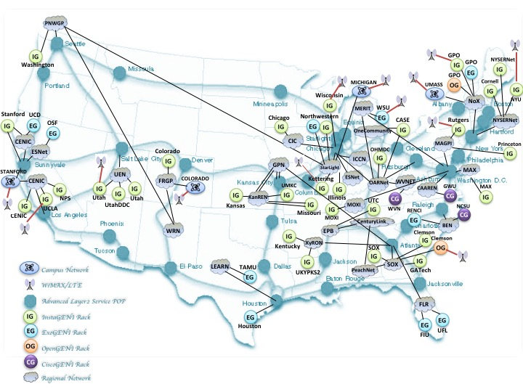
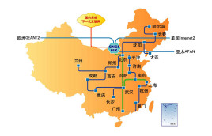
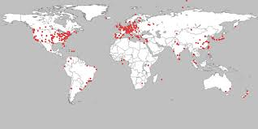


Test-Beds
GENI
CERNET2
PlanetLab
Experiments with real-world settings
Can guarantee fidelity
Lack customizability for topologies, forwarding behaviors, metrics (link delay, link loss, …)
Costly to scale and upgrade
Scalability & Flexibility Concerns

Slide 6
To conduct network experiments
Congestion control Topologies
Routing
IPv6
…
 | Simulator | Emulator | Test-Bed
Fidelity | ✖️ | ✖️ | ✔️
Flexibility | ✔️ | ✔️ | ✖️
Scale | ✔️ | ✖️ | ✖️

Slide 7
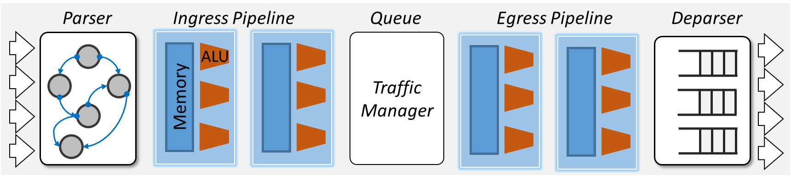
Our Approach
TurboNet: emulating various networks with one programmable switch.
Why programmable switch?
Re-configurable packet processing
High bandwidth (Tbps)
Enable agile customization of various networks with high bandwidth
Our Goal:
Faithfully emulate both network data plane and control plane.
Data Plane: topology, metrics (delay, loss)
Control Plane: routing (static/dynamic)
[RMT@SIGCOMM’13]

Slide 8
Talk Outline
Motivation
1. TurboNet Overview: architecture and workflow
2. Data Plane Emulation
3. Control Plane Emulation
4. Some Evaluation Results
5. Conclusion

Slide 9
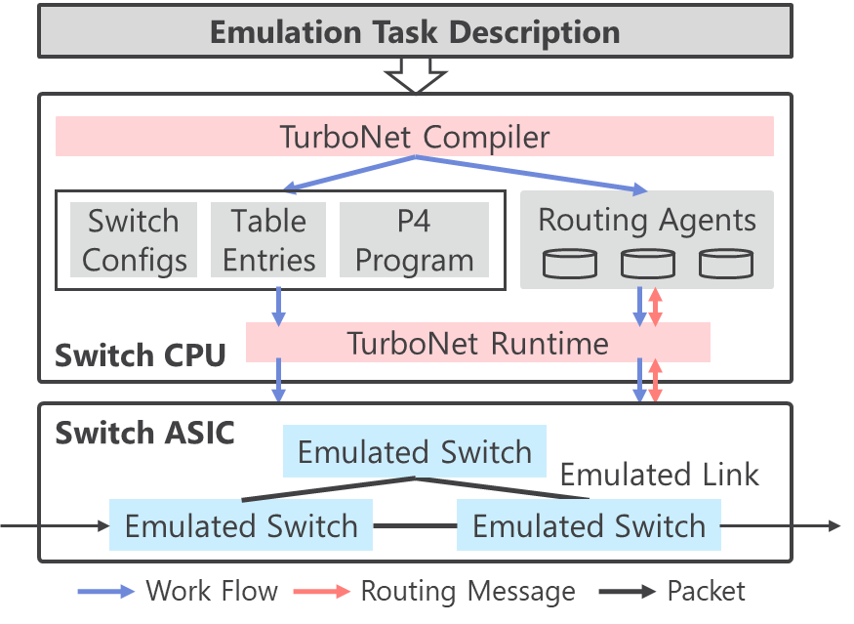
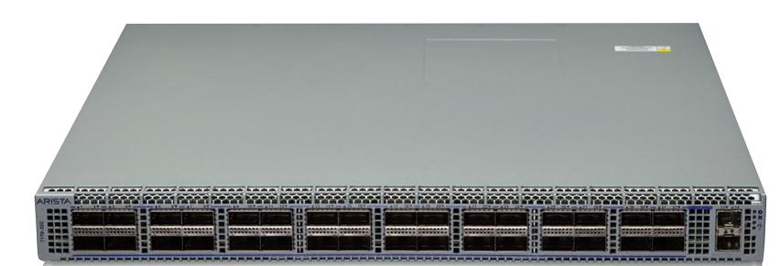

TurboNet Overview
TurboNet Architecture
A programmable switch deployed with TurboNet

Slide 10
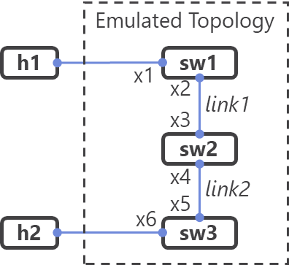


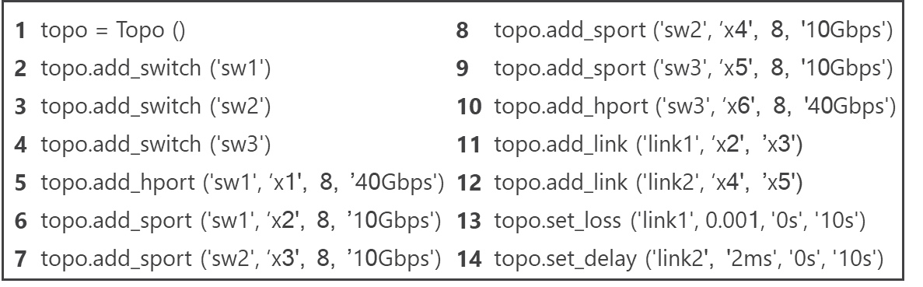
TurboNet Overview
TurboNet Workflow
1. Emulation Task Description
TurboNet Architecture
A programmable switch deployed with TurboNet

Slide 11
TurboNet Overview
TurboNet Workflow
1. Emulation Task Description
TurboNet Architecture
2. Configuration Generation
A programmable switch deployed with TurboNet

Slide 12
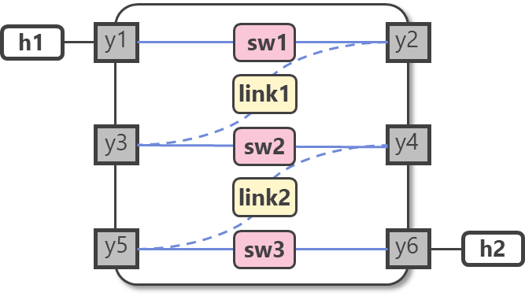
TurboNet Overview
TurboNet Workflow
1. Emulation Task Description
TurboNet Architecture
2. Configuration Generation
A programmable switch deployed with TurboNet
3. Experiment Conduction

Slide 13
TurboNet Overview
TurboNet Workflow
TurboNet Architecture
How?

Slide 14
Talk Outline
Motivation
1. TurboNet Overview
2. Data Plane Emulation
3. Control Plane Emulation
4. Some Evaluation Results
5. Conclusion

Slide 15
Data Plane Emulation
Forwarding packets in a network with specified performance
Topology Emulation: flexibly emulate various topologies in a programmable switch
Metric Emulation: make the emulated network behave like real networks
  e.g., link loss, link delay, …

Slide 16
Data Plane Emulation
Forwarding packets in a network with specified performance
Topology Emulation: flexibly emulate various topologies in a programmable switch
Metric Emulation: make the emulated network behave like real networks
  e.g., link loss, link delay, …

Slide 17
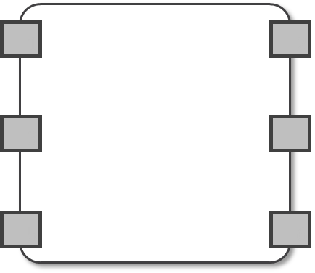
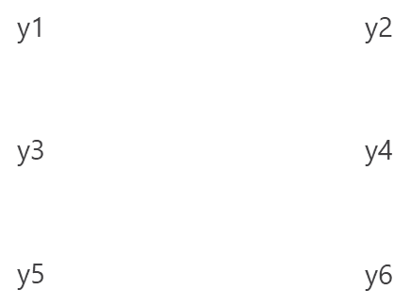
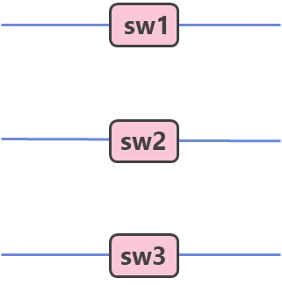
Topology Emulation
Key Idea: Split one programmable switch into multiple emulated switches.
Port Mapper
Map each port in the input topology to an individual port on the programmable switch ( x1~x6 -> y1~y6)
Switch Emulation

Slide 18


Topology Emulation
Key Idea: Split one programmable switch into multiple emulated switches.
Port Mapper
Ingress Pipeline
Traffic Manager
Egress Pipeline
y1
y2
x1
sw1
x2
Map each port in the input topology to an individual port on the programmable switch ( x1~x6 -> y1~y6)
Switch Emulation

Slide 19
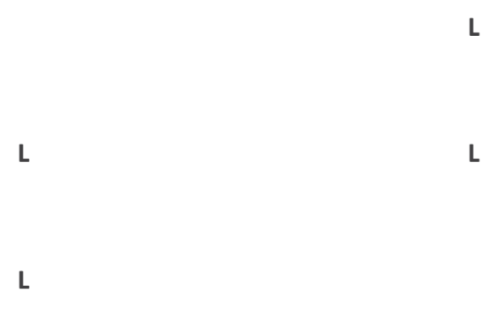
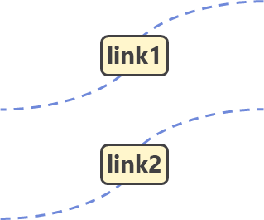
Topology Emulation
Key Idea: Split one programmable switch into multiple emulated switches.
Port Mapper
Ingress Pipeline
Traffic Manager
Egress Pipeline
y1
y2
x1
sw1
x2
Map each port in the input topology to an individual port on the programmable switch ( x1~x6 -> y1~y6)
Switch Emulation
Link Emulation
Cables
Loopback

Slide 20


Topology Emulation
Key Idea: Split one programmable switch into multiple emulated switches.
Port Mapper
Ingress Pipeline
Traffic Manager
Egress Pipeline
y1
y2
x1
sw1
x2
loopback
y2
y4
x3
sw2
x4
(y3)
Map each port in the input topology to an individual port on the programmable switch ( x1~x6 -> y1~y6)
Switch Emulation
Link Emulation
Cables
Loopback

Slide 21
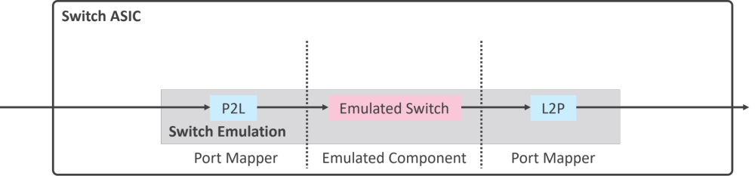
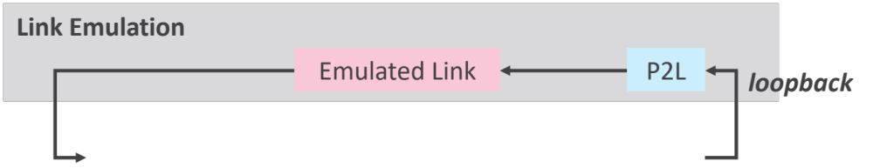
Topology Emulation
Key Idea: Split one programmable switch into multiple emulated switches.
Port Mapper

Slide 22
Topology Emulation
Key Idea: Split one programmable switch into multiple emulated switches.
Port Mapper
At most 64*4 ports?
Barefoot Tofino switch
64 100Gbps port groups
A port group:
  1x100G, 2x40G, 4x25G, 4x10G ports

Slide 23
Topology Emulation
Key Idea: Split one programmable switch into multiple emulated switch.
Port Mapper
At most 64*4 ports?
Challenge: How to emulate larger networks?
Queue Mapper!
At most 64*32 queues!
Barefoot Tofino switch
64 100Gbps port groups
A port group:
  1x100G, 2x40G, 4x25G, 4x10G ports
  32 queues

Slide 24
Topology Emulation
Key Idea: Split one programmable switch into multiple emulated switch.
Port Mapper
At most 64*4 ports?
Challenge: How to emulate larger networks?
Queue Mapper!
At most 64*32 queues!
Problem: How to perform port/queue mapping?
0-1 ILP problem

Slide 25
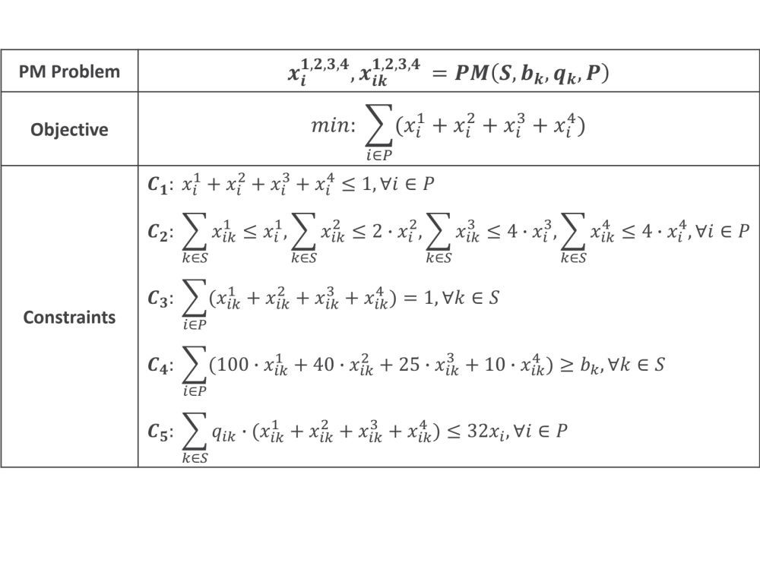
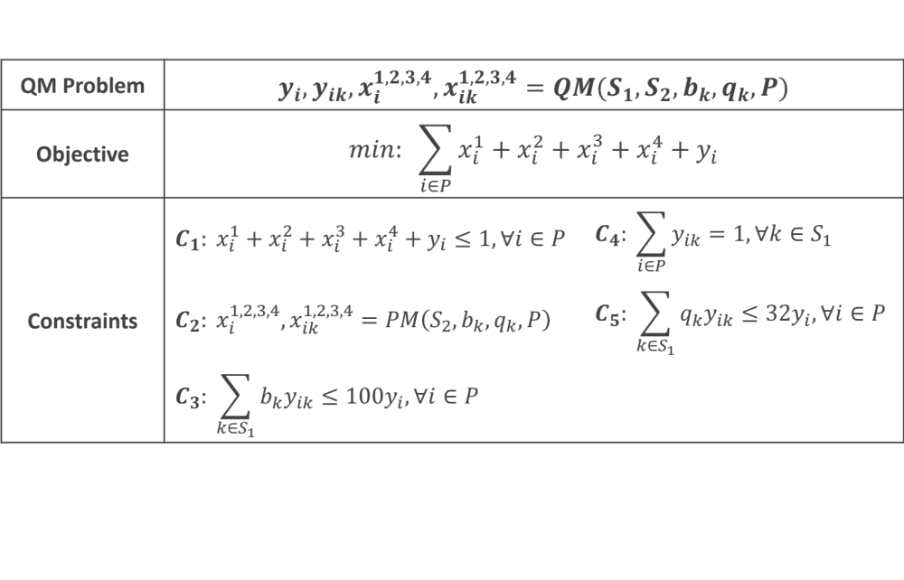
Topology Emulation
Key Idea: Split one programmable switch into multiple emulated switch.
Port Mapper
At most 64*4 ports?
Challenge: How to emulate larger networks?
Queue Mapper!
At most 64*32 queues!
Problem: How to perform port/queue mapping?
0-1 ILP problem
Ports
Bandwidth
Queue number
Input
(See more in our paper)

Slide 26
Data Plane Emulation
Topology Emulation
Metric Emulation: make the emulated network behave like real networks
  Link loss
  Link delay
  Background traffic

Slide 27

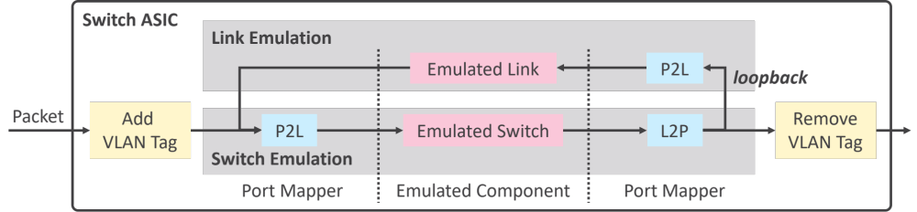
Link Loss Emulation
Link Metric Emulation

Slide 28
Link Loss Emulation
Generate a random number v
P4 primitive: modify_field_rng_uniform
Compare v with threshold θ
θ is decided by given loss rate r: P(v > θ) = r
Drop if v > θ
Drop packets according to a probability
Link Loss Emulation

Slide 29
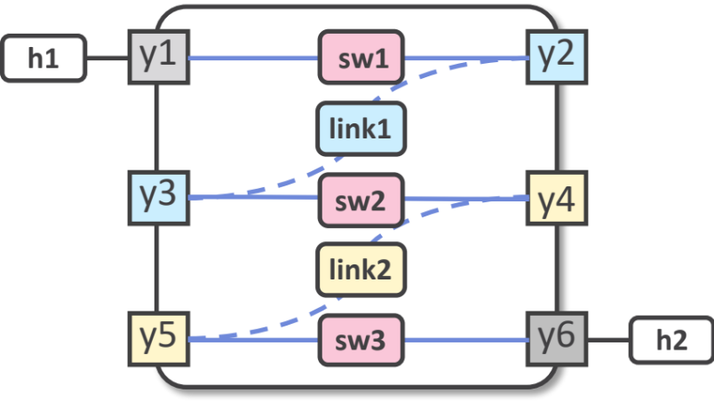
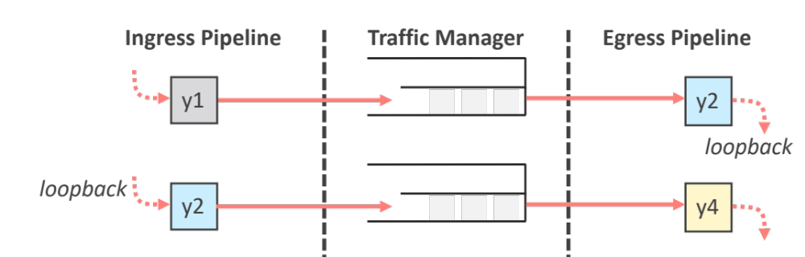
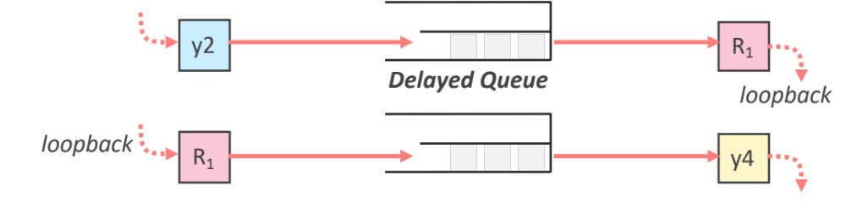

Link Delay Emulation
Challenge: How to keep packets in programmable switch?
Observation: queuing time is in proportion to queue depth.
To achieve target queuing time, maintain queue depth!
Implement delayed queues with desired queuing time
Send packets to delayed queues to emulate target delay
sw1
sw2
Insert delay for link1

Slide 30
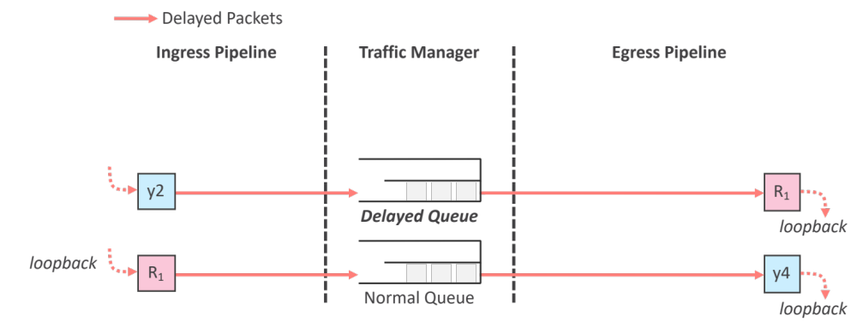
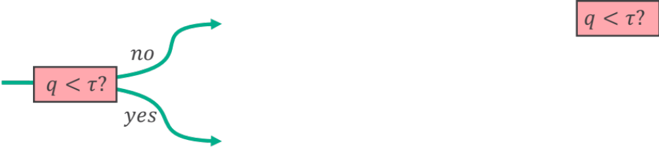
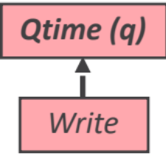
Link Delay Emulation
1. Implement delayed queues with desired queuing time
  dynamically inject packets

Slide 31
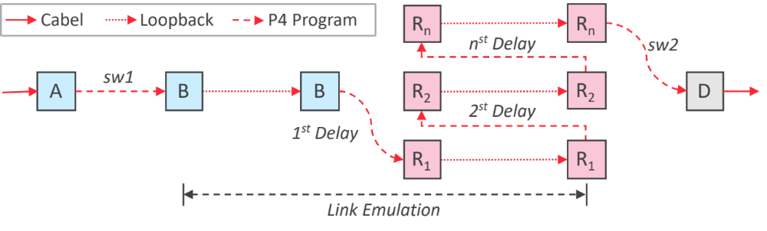
Link Delay Emulation
1. Implement delayed queues with desired queuing time
  dynamically inject backup packets
2. Send packets to delayed queues to emulate target delay
More details (resource, accuracy) in our paper

Slide 32
Talk Outline
Motivation
1. TurboNet Overview
2. Data Plane Emulation
3. Control Plane Emulation
4. Some Evaluation Results
5. Conclusion

Slide 33
Control plane emulation
Static Routing
Dynamic routing
Routing Tables

Slide 34
Control plane emulation
Static Routing
Dynamic routing
Routing Tables

Slide 35
Control plane emulation
Static Routing
Dynamic routing
  Distributed routing
  Centralized routing

Slide 36
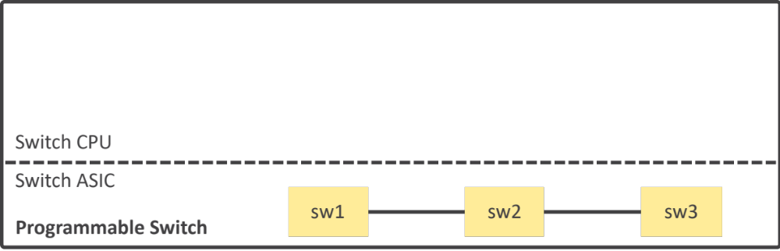

Control plane emulation
Static Routing
Dynamic routing
  Distributed routing
  Centralized routing
Distributed Routing

Slide 37
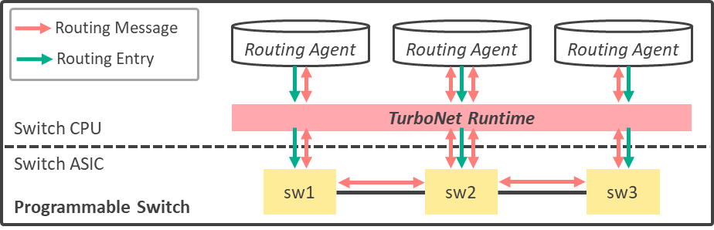
Control plane emulation
Static Routing
Dynamic routing
  Distributed routing
  Centralized routing
Distributed Routing

Slide 38

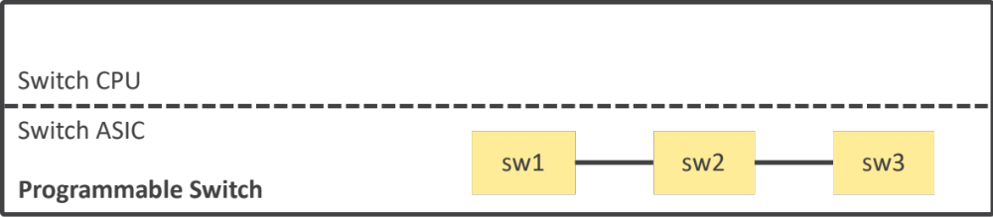
Control plane emulation
Static Routing
Dynamic routing
  Distributed routing
  Centralized routing
Distributed Routing
Centralized Routing

Slide 39
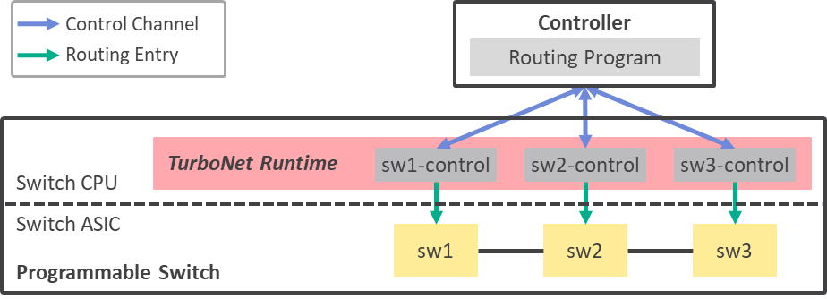
Control plane emulation
Static Routing
Dynamic routing
  Distributed routing
  Centralized routing
Distributed Routing
Centralized Routing

Slide 40
Talk Outline
Motivation
1. TurboNet Overview
2. Data Plane Emulation
  Topology Emulation
  Metric Emulation: Background Traffic, Link Loss, Link Delay
3. Control Plane Emulation
4. Some Evaluation Results
5. Conclusion

Slide 41
Evaluation Setup
Test-bed
One Barefoot Tofino Switch
  Intel Pentium 4-core 1.60GHz CPU
  8GiB memory
  2 pipelines (3.2Tbps)
Two servers
  12-core Intel Xeon E5-2620 2.40GHz CPU
Programmable Switch
Emulated Topology
Intel XL710
(40Gbps)
Intel 82599ES *2
(10Gbps)
Server 1
Server 2

Slide 42
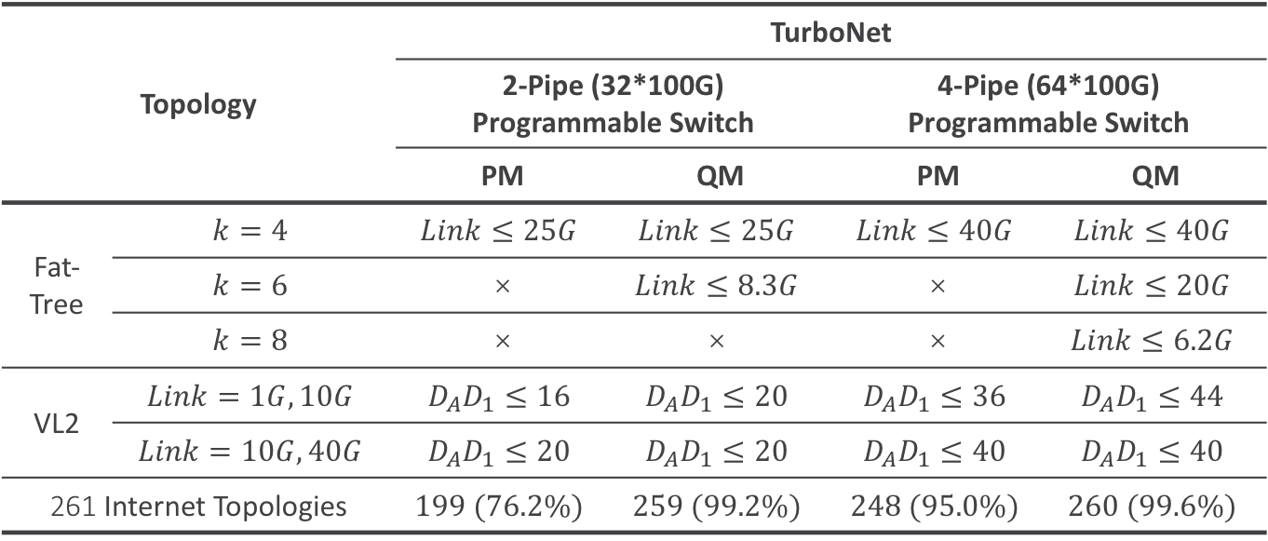
Topology Emulation Capability
Topology |  | TurboNet
 |  | 2-Pipe (32*100G) Programmable Switch |  | 4-Pipe (64*100G) Programmable Switch
 |  | PM | QM | PM | QM
Fat-Tree | $$k=4$$ | $$Link≤25G$$ | $$Link≤25G$$ | $$Link≤40G$$ | $$Link≤40G$$
 | $$k=6$$ | × | $$Link≤8.3G$$ | × | $$Link≤20G$$
 | $$k=8$$ | × | $$\text{×}$$ | × | $$Link≤6.2G$$
VL2 | $$Link=1G,10G$$ | $$D_{A}D_{1}≤16$$ | $$D_{A}D_{1}≤20$$ | $$D_{A}D_{1}≤36$$ | $$D_{A}D_{1}≤44$$
 | $$Link=10G,40G$$ | $$D_{A}D_{1}≤20$$ | $$D_{A}D_{1}≤20$$ | $$D_{A}D_{1}≤40$$ | $$D_{A}D_{1}≤40$$
261 Internet Topologies |  | $$199 (76.2\%)$$ | $$259 (99.2\%)$$ | $$248 (95.0\%)$$ | $$260 (99.6\%)$$
PM VS. QM
Fat-tree: k=4 for PM, k=8 for QM
Note: A k-ary fat-tree has k³/4 host-ports and k³ switch-ports

Slide 43
Topology Emulation Capability
Topology |  | TurboNet
 |  | 2-Pipe (32*100G) Programmable Switch |  | 4-Pipe (64*100G) Programmable Switch
 |  | PM | QM | PM | QM
Fat-Tree | $$k=4$$ | $$Link≤25G$$ | $$Link≤25G$$ | $$Link≤40G$$ | $$Link≤40G$$
 | $$k=6$$ | × | $$Link≤8.3G$$ | × | $$Link≤20G$$
 | $$k=8$$ | × | $$\text{×}$$ | × | $$Link≤6.2G$$
VL2 | $$Link=1G,10G$$ | $$D_{A}D_{1}≤16$$ | $$D_{A}D_{1}≤20$$ | $$D_{A}D_{1}≤36$$ | $$D_{A}D_{1}≤44$$
 | $$Link=10G,40G$$ | $$D_{A}D_{1}≤20$$ | $$D_{A}D_{1}≤20$$ | $$D_{A}D_{1}≤40$$ | $$D_{A}D_{1}≤40$$
261 Internet Topologies |  | $$199 (76.2\%)$$ | $$259 (99.2\%)$$ | $$248 (95.0\%)$$ | $$260 (99.6\%)$$
PM VS. QM
Fat-tree: k=4 for PM, k=8 for QM
Internet topology: 60 more for QM
Note: A k-ary fat-tree has k³/4 host-ports and k³ switch-ports

Slide 44
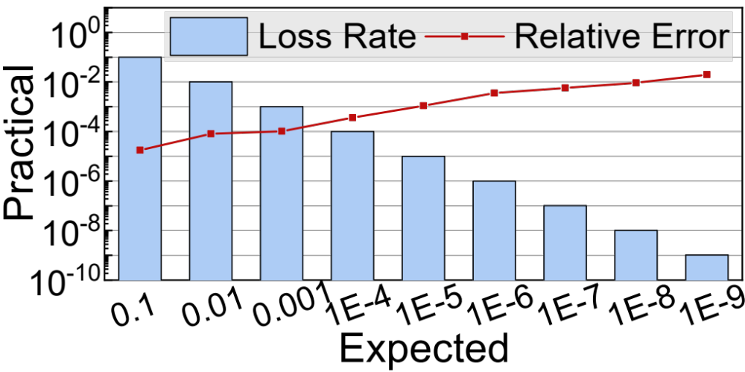
Link Loss Accuracy
Expected loss rate changes from 0.1 to 10⁻⁸
Relative error < 1%
Link loss accuracy
(32-bit random number generation)

Slide 45
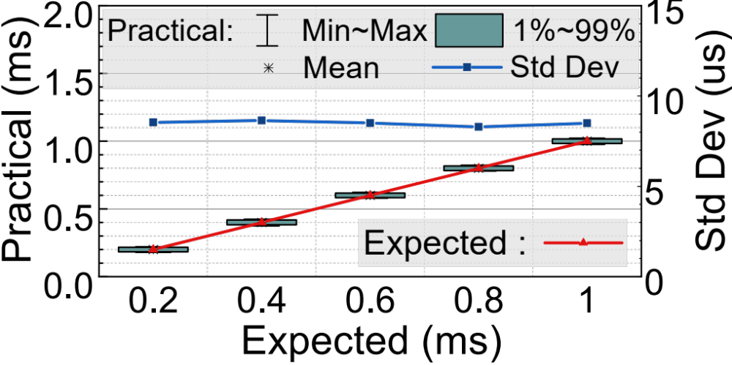
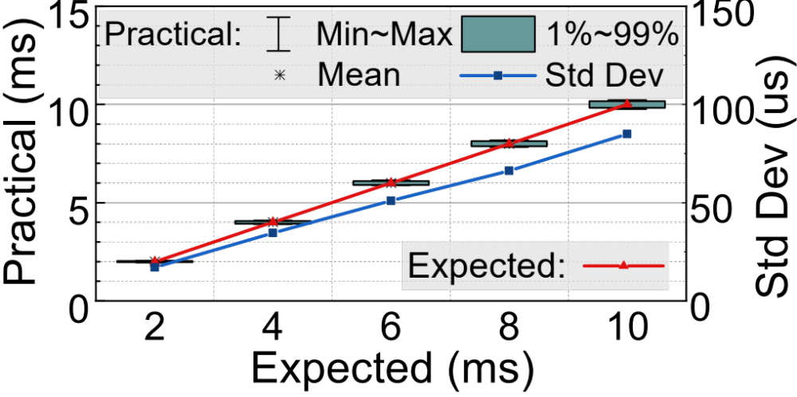
Link Delay Accuracy
One-pass link delay
Multi-pass link delay
(A 10Gbps delayed queue)
(A 1ms delayed queue)
Expected delay ranges from 0.2ms to 1ms
Standard deviation < 9µs
Expected delay ranges from 2ms to 10ms
Relative standard deviation < 0.9%

Slide 46
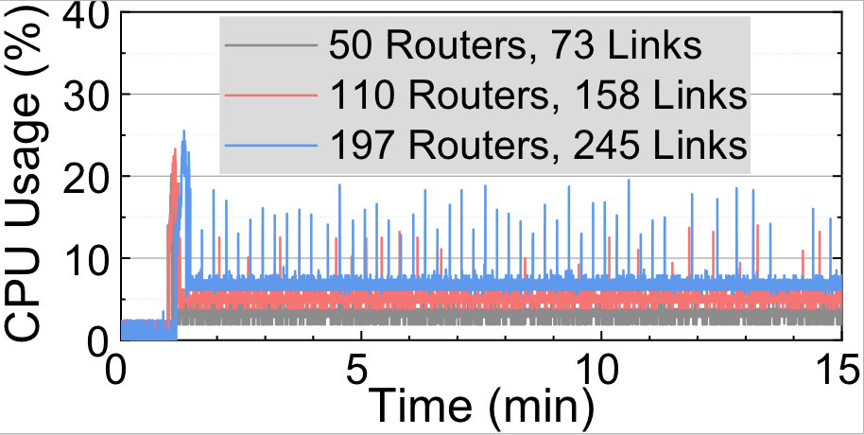
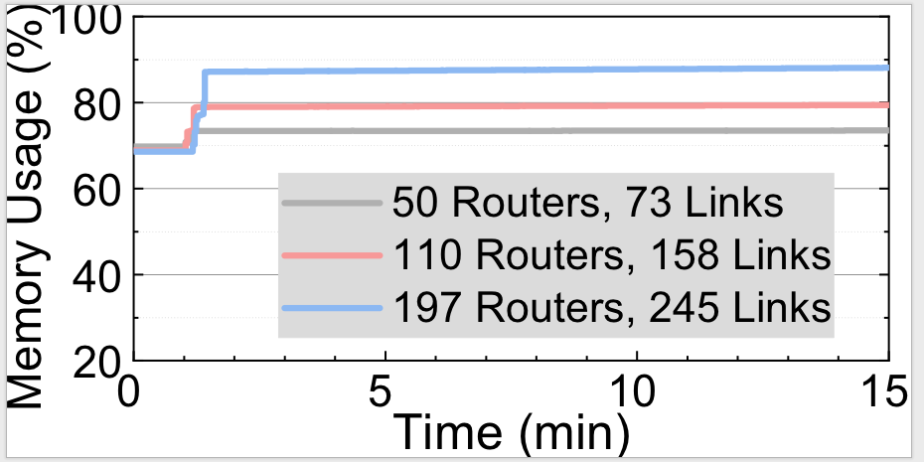
Control Plane Emulating Capability
Intel Pentium 4-core 1.60GHz CPU, 8GiB memory
All connected routers are BGP peers
CPU usage
Memory usage
TurboNet can easily support almost 200 BGP routing agents with 25% peak CPU usage.

Slide 47
Talk Outline
Motivation
1. TurboNet Overview
2. Data Plane Emulation
  Topology Emulation
  Metric Emulation: Background Traffic, Link Loss, Link Delay
3. Control Plane Emulation
4. Some Evaluation Results
5. Conclusion

Slide 48
Conclusion
TurboNet introduces a network experiment platform that leverages one programmable switch to faithfully mimic networks.
  Data plane
  Control plane
Future work
  More programmable switches
  Dynamically changing network emulation requirements

Slide 49

Thanks!

