Slide 1

CoNICE: Consensus in Intermittently-Connected Environments by Exploiting Naming
with Application to Emergency Response
Mohammad Jahanian and K. K. Ramakrishnan
(University of California, Riverside, USA)
IEEE ICNP 2020

Slide 2
Overview
In many scenarios, e.g., during disasters: information dissemination in intermittently-connected environments where infrastructure damaged
Many users, e.g., first responders, create updates to a shared dataset, e.g., map data
Consistency and order of applying update important, challenging, and complex

Slide 3




Overview
In many scenarios, e.g., during disasters: information dissemination in intermittently-connected environments where infrastructure damaged
Many users, e.g., first responders, create updates to a shared dataset, e.g., map data
Consistency and order of applying update important, challenging, and complex
CoNICE: a framework to ensure consistent dissemination of updates among users in intermittently-connected, infrastructure-less environments
R111
R111
R111

Slide 4
Overview
In many scenarios, e.g., during disasters: information dissemination in intermittently-connected environments where infrastructure damaged
Many users, e.g., first responders, create updates to a shared dataset, e.g., map data
Consistency and order of applying update important, challenging, and complex
CoNICE: a framework to ensure consistent dissemination of updates among users in intermittently-connected, infrastructure-less environments
  Multiple consistency levels, support both causal ordering and consensus
Consistency level 2: Consensus
Consistency level 1: Causality
Consistency level 0: Replication
R111
R111
R111

Slide 5
Overview
In many scenarios, e.g., during disasters: information dissemination in intermittently-connected environments where infrastructure damaged
Many users, e.g., first responders, create updates to a shared dataset, e.g., map data
Consistency and order of applying update important, challenging, and complex
CoNICE: a framework to ensure consistent dissemination of updates among users in intermittently-connected, infrastructure-less environments
  Multiple consistency levels, support both causal ordering and consensus
  Integration of consistent dissemination with naming of information for two purposes:
    Enhance relevancy of information dissemination (typical benefit in ICNs)
    Enhance the degree of information consistency among relevant users
  Application: Map Geo-tagging in Emergency Response
Consistency level 2: Consensus
Consistency level 1: Causality
Consistency level 0: Replication
R111
R1
R111
R111
Per-level subscription
R12
R11
R111
R112
R113
R121
R122
R123

Slide 6
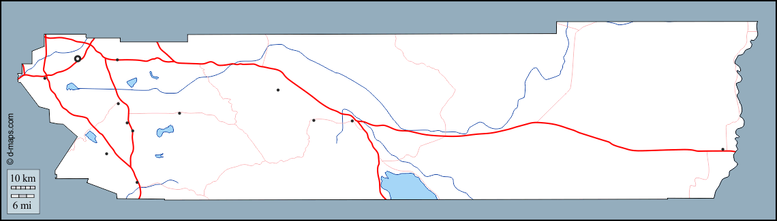
Map Regions and Namespace
Emergency response: map divided into regions with emergency response tasks
  Similar approach in online gaming, Augmented Reality, etc.
R111
R112
R113
R121
R122
R123
Map: base layer

Slide 7
Map Regions and Namespace
R1
Emergency response: map divided into regions with emergency response tasks
Hierarchical region-ing
  Multiple levels of geographical view; zoom in&out
R11
R12
R111
R112
R113
R121
R122
R123
Map: base layer

Slide 8
Map Regions and Namespace
R1
Emergency response: map divided into regions with emergency response tasks
Hierarchical region-ing
Namespace: hierarchical graph
  First responders indicate fine-grained interest (subscription)
    ‘R11’ includes ‘R111’, ‘R112’ and ‘R113’ too
    Subscription to ‘R11’ means implicit subscription to all its descendants too, i.e., ‘R111’, etc.
R11
R12
R111
R112
R113
R121
R122
R123
Map: base layer
R1
R11
R12
R111
R112
R113
R121
R122
R123
Namespace

Slide 9

Map Regions and Namespace
Emergency response: map divided into regions with emergency response tasks
Hierarchical region-ing
Namespace: hierarchical graph
Users create region-bound updates: Map geo-tagging
  Bootstrap: every first responder has the background map (base layer) and namespace (offline)
  Goal: updates (data layer) to be created and disseminated dynamically to relevant recipient, according to their namespace subscription (online)
  Can be an easy task in normal situation, but challenging in disaster situation: no central coordination, no network infrastructure, no time synchronization
Data: Pins (‘a’, ‘b’) and shapes (‘c’) with information associated with them; e.g.:
  This house marked as search & rescue completed.
  This building is 50% evacuated.
  This area needs a firefighting team.
R111
R112
b
R113
a
R121
R122
c
R123
Map: base layer + data layer
R1
R11
R12
R111
R112
R113
R121
R122
R123
Namespace

Slide 10
Intermittently-Connected Environment
Network is fragmented (not always a path); relies on users D2D and opportunistic exchanges
  Users A and B in one fragment; users C and D in another
  User A creates update about R111; how to reach C and D?
C
  Dealing with R111
A creates pin
on R111 at t1<t2
D
  Dealing with R11
R111
B
  Civilian
A
  Dealing with R111
R1
R11
R12
R111
R112
R113
R121
R122
R123
Namespace

Slide 11
Intermittently-Connected Environment
Network is fragmented (not always a path); relies on users D2D and opportunistic exchanges
  Users A and B in one fragment; users C and D in another
  User A creates update about R111; how to reach C and D?
Thanks to user B’s move (acting as a mule), message gets propagated
  Opportunistic or Delay-Tolerant Networking (DTN)
The use of namespace makes sure relevant, subscribed users are notified and participate
Many users create many updates without centralized coordination
D receives the pin at t3>t2
C receives the pin at t3>t2
R111
C
  Dealing with R111
R111
A creates pin
on R111 at t1<t2
D
B starts move at time t2
  Dealing with R11
R111
B
B
  Civilian
  Civilian
A
  Dealing with R111
R1
R11
R12
R111
R112
R113
R121
R122
R123
Namespace

Slide 12



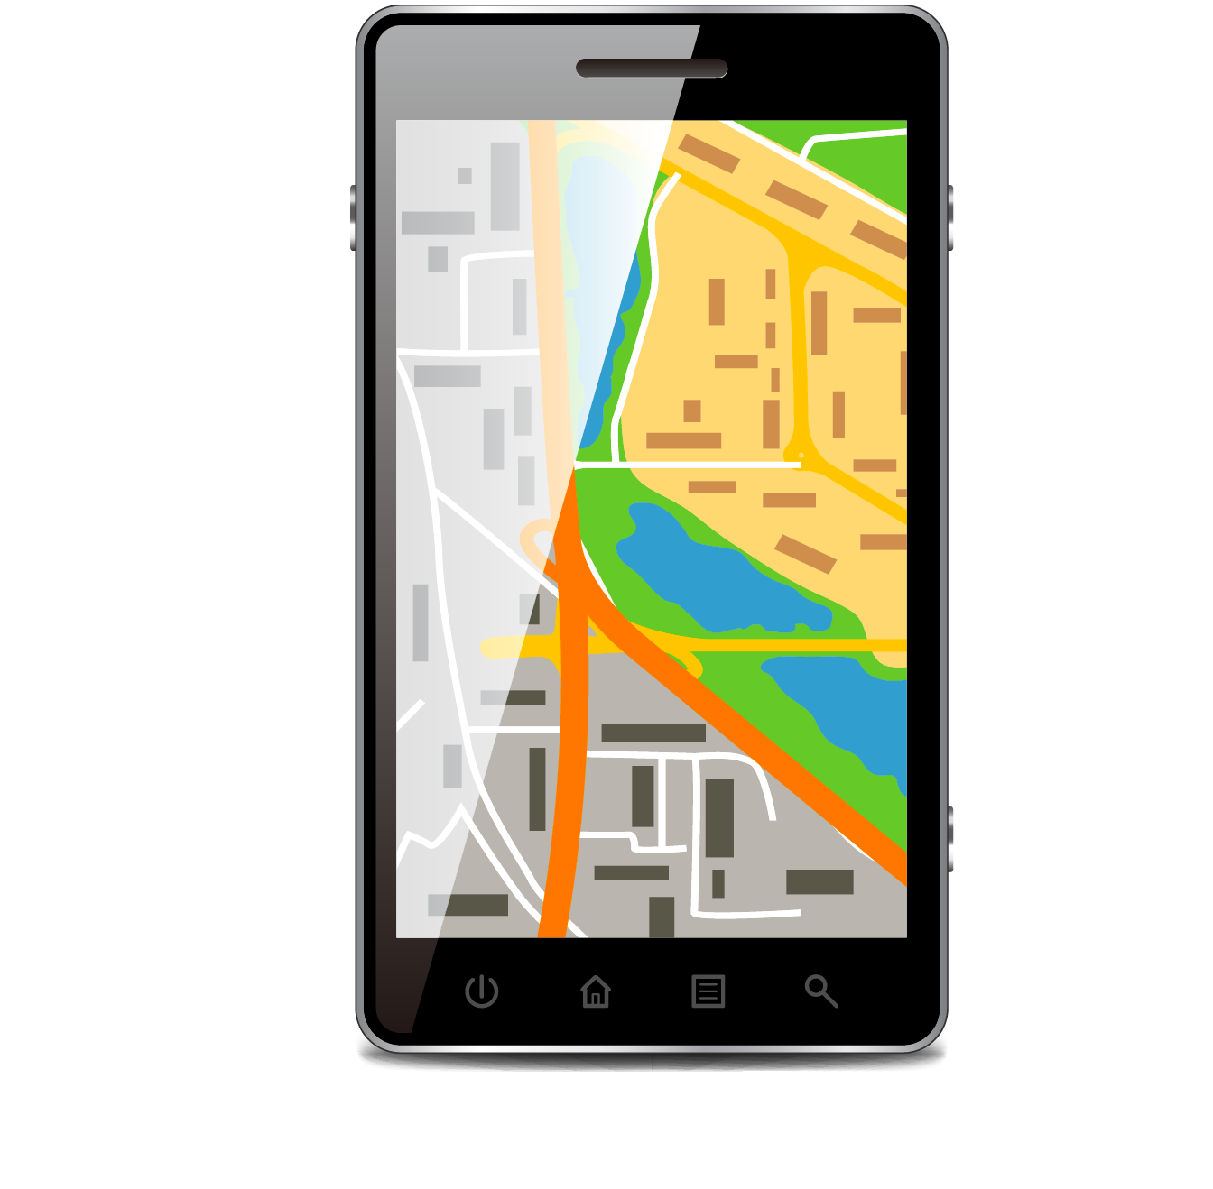


Consistent Dissemination
F1 @ t₁
F2 @ t₂
a
a
Updates on a single, shared dataset (map data layer)
Each update: add/remove/modify pins/shapes
  Order of applying matters in result (final map view on individual first responder device)
Consistency of updates is important and challenging
  Definitions later
add
remove
b
add
Initially
F3 @ t₃
F4 @ t₄
c
modify

Slide 13
Consistent Dissemination
F1 @ t₁
F2 @ t₂
a
a
Updates on a single, shared dataset (map data layer)
Each update: add/remove/modify pins/shapes
  Order of applying matters in result (final map view on individual first responder device)
Consistency of updates is important and challenging
  Definitions later
Goal: eventually, all relevant users have the same view of the map
  Strong consistency through consensus (agreement) on order of updates in each region
  Strong consistency requiring complex, time-consuming procedures → CoNICE provides flexibility of multiple consistency levels bound to named regions
add
remove
b
add
Initially
F3 @ t₃
F4 @ t₄
c
modify
F1 @ t_{n}
F2 @ t_{n}
c
c
After some time, at t_{n}
F3 @ t_{n}
F4 @ t_{n}
c
c

Slide 14
CoNICE Architecture
Consistency level 0: Replication – make sure users receive updates; Gossiping
Consistency level 1: Causality – make sure users get causally ordered view of updates (Moderate View); Causal Ordering
Consistency level 2: Agreement – make sure users get an agreed upon view of updates (Strong View); Consensus
Moderate View
Map Application
Strong View
Consistency
Levels
Consistency Level 2: Agreement
Consensus
Causal Ordering
Consistency Level 1: Causality
Consistency Level 0: Replication
Gossiping

Slide 15
CoNICE Architecture
Consistency level 0: Replication – make sure users receive updates; Gossiping
Consistency level 1: Causality – make sure users get causally ordered view of updates (Moderate View); Causal Ordering
Consistency level 2: Agreement – make sure users get an agreed upon view of updates (Strong View); Consensus
To achieve selectiveness: Name-based Interest Profiles (NBIPs) for each consistency level (NBIP0,1,2)
Each NBIP a name subscription, to limits a user’s participation according to relevant namespace subsets
Moderate View
Map Application
Strong View
Consistency
Levels
Name-based Interest Profiles
Namespace
Name Levels
Consistency Level 2: Agreement
NBIP2
Level 0 (root)
Consensus
Causal Ordering
Consistency Level 1: Causality
Level 1
NBIP1
.
.
.
.
.
.
Consistency Level 0: Replication
NBIP0
Gossiping
Subscriptions
Level n (leaves)

Slide 16
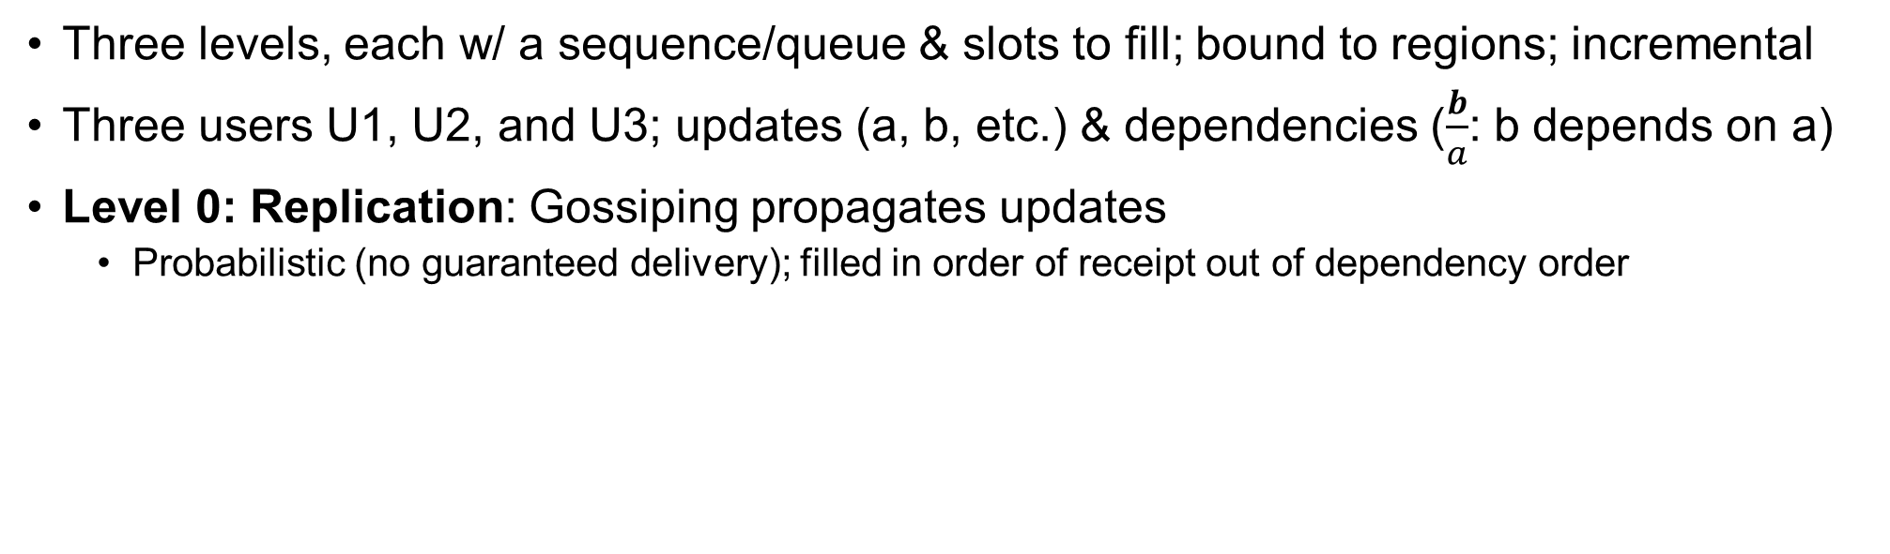

Consistency Levels
Three levels, each w/ a sequence/queue & slots to fill; bound to regions; incremental
Three users U1, U2, and U3; updates (a, b, etc.) & dependencies ($\frac{b}{a}$: b depends on a)
Level 0: Replication: Gossiping propagates updates
  Probabilistic (no guaranteed delivery); filled in order of receipt out of dependency order
@User
U1
@User
U2
@User
U3
0 1 2 3 4 5
0 1 2 3 4
0 1 2
Message buffer
b
─
a
a
c
g
─
c,f
d
─
a
e
─
c
a
g
─
c,f
d
─
a
e
─
c
c
b
─
a
a
f
─
b
$$Q_{0}^{}(R_{i})$$

Slide 17
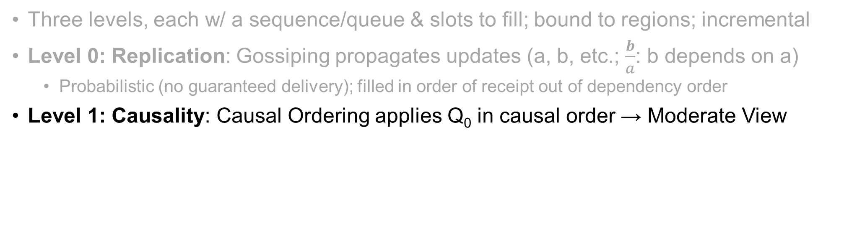

Consistency Levels
Three levels, each w/ a sequence/queue & slots to fill; bound to regions; incremental
Level 0: Replication: Gossiping propagates updates (a, b, etc.; $\frac{b}{a}$: b depends on a)
  Probabilistic (no guaranteed delivery); filled in order of receipt out of dependency order
Level 1: Causality: Causal Ordering applies Q₀ in causal order → Moderate View
@User
U1
@User
U2
@User
U3
0 1 2 3 4 5
0 1 2 3 4
0 1 2
Message buffer
b
─
a
a
c
g
─
c,f
d
─
a
e
─
c
a
g
─
c,f
d
─
a
e
─
c
c
b
─
a
a
f
─
b
$$Q_{0}^{}(R_{i})$$
0 1 2 3 4
0 1 2 3
0 1 2
Moderate view
$$Q_{1}^{}(R_{i})$$
a
b
─
a
c
d
─
a
e
─
c
a
d
─
a
c
e
─
c
a
b
─
a
f
─
b

Slide 18
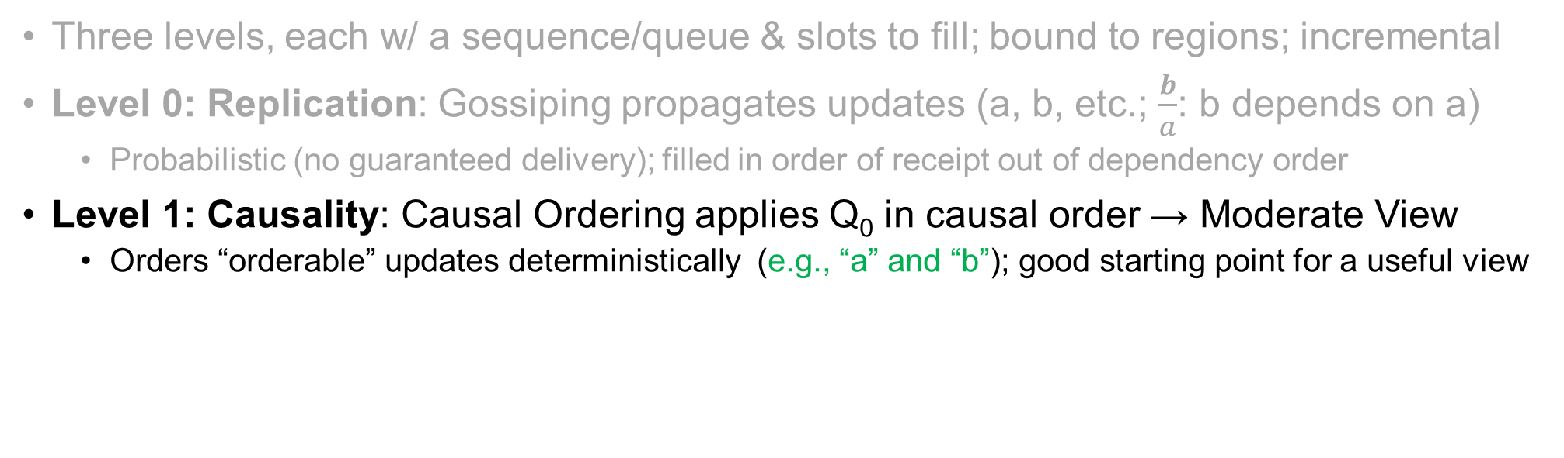
Consistency Levels
Three levels, each w/ a sequence/queue & slots to fill; bound to regions; incremental
Level 0: Replication: Gossiping propagates updates (a, b, etc.; $\frac{b}{a}$: b depends on a)
  Probabilistic (no guaranteed delivery); filled in order of receipt out of dependency order
Level 1: Causality: Causal Ordering applies Q₀ in causal order → Moderate View
  Orders “orderable” updates deterministically (e.g., “a” and “b”); good starting point for a useful view
@User
U1
@User
U2
@User
U3
0 1 2 3 4 5
0 1 2 3 4
0 1 2
Message buffer
b
─
a
a
c
g
─
c,f
d
─
a
e
─
c
a
g
─
c,f
d
─
a
e
─
c
c
b
─
a
a
f
─
b
$$Q_{0}^{}(R_{i})$$
0 1 2 3 4
0 1 2 3
0 1 2
Moderate view
$$Q_{1}^{}(R_{i})$$
a
b
─
a
c
d
─
a
e
─
c
a
d
─
a
c
e
─
c
a
b
─
a
f
─
b

Slide 19
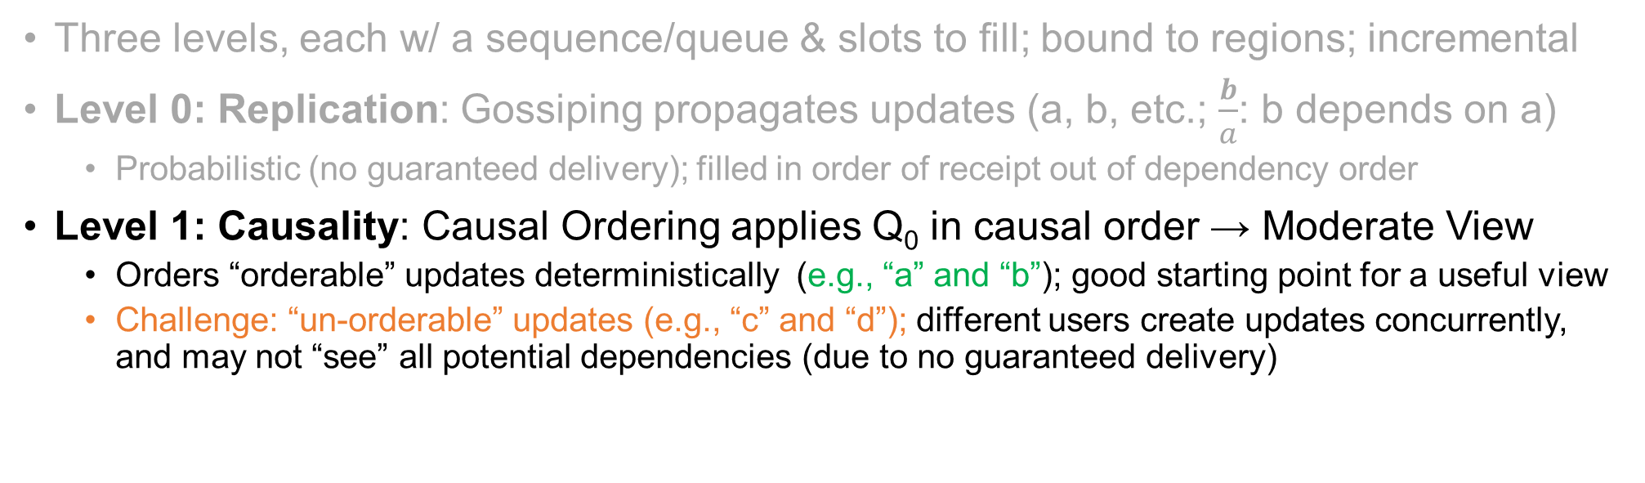
Consistency Levels
Three levels, each w/ a sequence/queue & slots to fill; bound to regions; incremental
Level 0: Replication: Gossiping propagates updates (a, b, etc.; $\frac{b}{a}$: b depends on a)
  Probabilistic (no guaranteed delivery); filled in order of receipt out of dependency order
Level 1: Causality: Causal Ordering applies Q₀ in causal order → Moderate View
  Orders “orderable” updates deterministically (e.g., “a” and “b”); good starting point for a useful view
  Challenge: “un-orderable” updates (e.g., “c” and “d”); different users create updates concurrently, and may not “see” all potential dependencies (due to no guaranteed delivery)
@User
U1
@User
U2
@User
U3
0 1 2 3 4 5
0 1 2 3 4
0 1 2
Message buffer
b
─
a
a
c
g
─
c,f
d
─
a
e
─
c
a
g
─
c,f
d
─
a
e
─
c
c
b
─
a
a
f
─
b
$$Q_{0}^{}(R_{i})$$
0 1 2 3 4
0 1 2 3
0 1 2
Moderate view
$$Q_{1}^{}(R_{i})$$
a
b
─
a
c
d
─
a
e
─
c
a
d
─
a
c
e
─
c
a
b
─
a
f
─
b

Slide 20
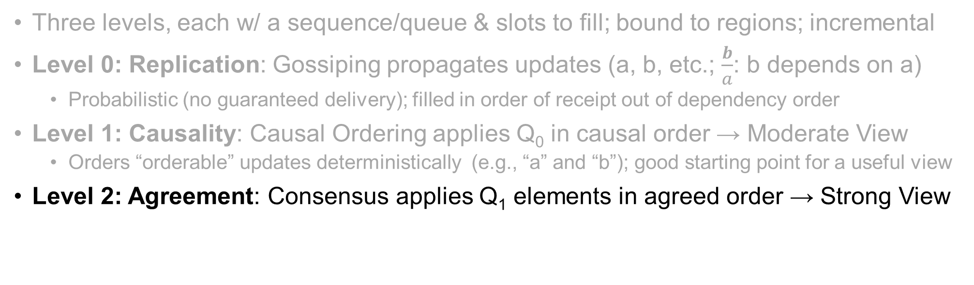

Consistency Levels
Three levels, each w/ a sequence/queue & slots to fill; bound to regions; incremental
Level 0: Replication: Gossiping propagates updates (a, b, etc.; $\frac{b}{a}$: b depends on a)
  Probabilistic (no guaranteed delivery); filled in order of receipt out of dependency order
Level 1: Causality: Causal Ordering applies Q₀ in causal order → Moderate View
  Orders “orderable” updates deterministically (e.g., “a” and “b”); good starting point for a useful view
Level 2: Agreement: Consensus applies Q₁ elements in agreed order → Strong View
@User
U1
@User
U2
@User
U3
0 1 2 3 4 5
0 1 2 3 4
0 1 2
Message buffer
b
─
a
a
c
g
─
c,f
d
─
a
e
─
c
a
g
─
c,f
d
─
a
e
─
c
c
b
─
a
a
f
─
b
$$Q_{0}^{}(R_{i})$$
0 1 2 3 4
0 1 2 3
0 1 2
Moderate view
$$Q_{1}^{}(R_{i})$$
a
b
─
a
c
d
─
a
e
─
c
a
d
─
a
c
e
─
c
a
b
─
a
f
─
b
0 1 2 3 4
0 1 2 3 4
0 1 2 3 4
Strong view
$$Q_{2}^{}(R_{i})$$
a
b
─
a
c
d
─
a
e
─
c
a
b
─
a
c
d
─
a
e
─
c
a
b
─
a
c
d
─
a
e
─
c

Slide 21
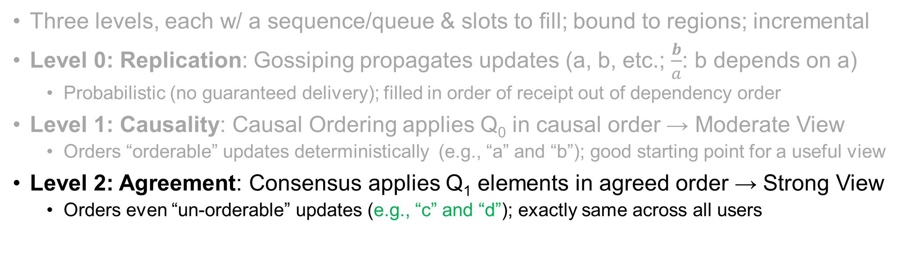
Consistency Levels
Three levels, each w/ a sequence/queue & slots to fill; bound to regions; incremental
Level 0: Replication: Gossiping propagates updates (a, b, etc.; $\frac{b}{a}$: b depends on a)
  Probabilistic (no guaranteed delivery); filled in order of receipt out of dependency order
Level 1: Causality: Causal Ordering applies Q₀ in causal order → Moderate View
  Orders “orderable” updates deterministically (e.g., “a” and “b”); good starting point for a useful view
Level 2: Agreement: Consensus applies Q₁ elements in agreed order → Strong View
  Orders even “un-orderable” updates (e.g., “c” and “d”); exactly same across all users
@User
U1
@User
U2
@User
U3
0 1 2 3 4 5
0 1 2 3 4
0 1 2
Message buffer
b
─
a
a
c
g
─
c,f
d
─
a
e
─
c
a
g
─
c,f
d
─
a
e
─
c
c
b
─
a
a
f
─
b
$$Q_{0}^{}(R_{i})$$
0 1 2 3 4
0 1 2 3
0 1 2
Moderate view
$$Q_{1}^{}(R_{i})$$
a
b
─
a
c
d
─
a
e
─
c
a
d
─
a
c
e
─
c
a
b
─
a
f
─
b
0 1 2 3 4
0 1 2 3 4
0 1 2 3 4
Strong view
$$Q_{2}^{}(R_{i})$$
a
b
─
a
c
d
─
a
e
─
c
a
b
─
a
c
d
─
a
e
─
c
a
b
─
a
c
d
─
a
e
─
c

Slide 22
Level 0: Replication – Gossiping
Design protocols for each level of consistency
Each update ‘belongs to’ exactly one, (smallest) region large enough to contain update on map
  ‘a’ belongs to R111, ‘b’ belongs to R12
Update identified as:
  update<userID, regionBelongTo, seqNum>
  Can have additional ‘regionsCovered’ field, to include ‘R122’ and ‘R123’ for ‘b’ too
R11
a
R111
R112
R113
R1
R12
R121
R122
R123
b
R1
R11
R12
R111
R112
R113
R121
R122
R123
Namespace

Slide 23
Level 0: Replication – Gossiping
Design protocols for each level of consistency
Each update ‘belongs to’ exactly one, (smallest) region large enough to contain update on map
  ‘a’ belongs to R111, ‘b’ belongs to R12
Update identified as:
  update<userID, regionBelongTo, seqNum>
DTN-based Epidemic Routing protocol (Vahdat & Becker '00) for gossiping
  Users exchange states from their buffers, & messages upon coming into contact
  Enhance with name-based relevance
  Use level 0 name-based interest profile (NBIP0)
Update collected by subscribers of its region-set and above them
  Subscribers of R1, R12 receive ‘b’
A
B
Buffered msg IDs
Request msg IDs of interest
Exchange requested msgs of interest
Mutual Replication of relevant updates
R11
a
R111
R112
R113
R1
R12
R121
R122
R123
b
R1
R11
R12
‘b’
R111
R112
R113
R121
R122
R123
Namespace

Slide 24
Level 1: Causality – Causal Ordering
Capture causal relations of updates → moderate consistency/view
Causality (Lamport ‘78): msg m1 “happened before” m2 (m1→m2) iff,
  Some user sends m1 and then sends m2 (FIFO order), or
  Some user receives m1 and then sends m2 (local order), or
  There exists some message m3 such that m1→m3 and m3→m2 (transitivity rule)
Logical clock, and its extension, Vector clock: carrying causal history of a message for causal ordering
Local VCs: VC(pi) initially all are 0’s
p1
[0,0,0]
[0,0,0]
p2
[0,0,0]
p3

Slide 25
Level 1: Causality – Causal Ordering
Capture causal relations of updates → moderate consistency/view
Causality (Lamport ‘78): msg m1 “happened before” m2 (m1→m2) iff,
  Some user sends m1 and then sends m2 (FIFO order), or
  Some user receives m1 and then sends m2 (local order), or
  There exists some message m3 such that m1→m3 and m3→m2 (transitivity rule)
Logical clock, and its extension, Vector clock: carrying causal history of a message for causal ordering
Local VCs: VC(pi) initially all are 0’s
p1
m1
[0,0,0]
m1
[1,0,0]
m1
[0,0,0]
p2
[1,0,0]
[0,0,0]
p3

Slide 26
Level 1: Causality – Causal Ordering
Capture causal relations of updates → moderate consistency/view
Causality (Lamport ‘78): msg m1 “happened before” m2 (m1→m2) iff,
  Some user sends m1 and then sends m2 (FIFO order), or
  Some user receives m1 and then sends m2 (local order), or
  There exists some message m3 such that m1→m3 and m3→m2 (transitivity rule)
Logical clock, and its extension, Vector clock: carrying causal history of a message for causal ordering
Local VCs: VC(pi) initially all are 0’s
p1
m1
m2
[0,0,0]
m1
[1,0,0]
m2
m1
[1,1,0]
m2
[0,0,0]
p2
Send m2 with incremented VC
m2
[1,1,0]
[0,0,0]
p3
Put m2 on hold since VC(m2) two steps ahead of VC(p3)

Slide 27
Level 1: Causality – Causal Ordering
Capture causal relations of updates → moderate consistency/view
Causality (Lamport ‘78): msg m1 “happened before” m2 (m1→m2) iff,
  Some user sends m1 and then sends m2 (FIFO order), or
  Some user receives m1 and then sends m2 (local order), or
  There exists some message m3 such that m1→m3 and m3→m2 (transitivity rule)
Logical clock, and its extension, Vector clock: carrying causal history of a message for causal ordering
Local VCs: VC(pi) initially all are 0’s
p1
m1
m2
[0,0,0]
m1
[1,0,0]
m2
m1
[1,1,0]
m2
[0,0,0]
p2
Send m2 with incremented VC
m1
m2
[1,0,0]
[1,1,0]
[0,0,0]
p3
m2
Put m2 on hold since VC(m2) two steps ahead of VC(p3)
m1

Slide 28

Level 1: Causality – Causal Ordering
We optimize the causality relation definition, and the causal history being carried
Causality (CoNICE): msg m1 “happened before in the same region” as m2 (m1→m2); additional condition: m1 and m2 have the same region ID
CoNICE causal ordering: carrying causal history; only include potentially dependent messages, rather than full vector (using namespace subscription)
  Users include same-region dependencies that they have seen
R11
R111
R112
R113
R1
R1
R12
R121
R122
R123
R11
R12
R111
R112
R113
R121
R122
R123
Namespace

Slide 29
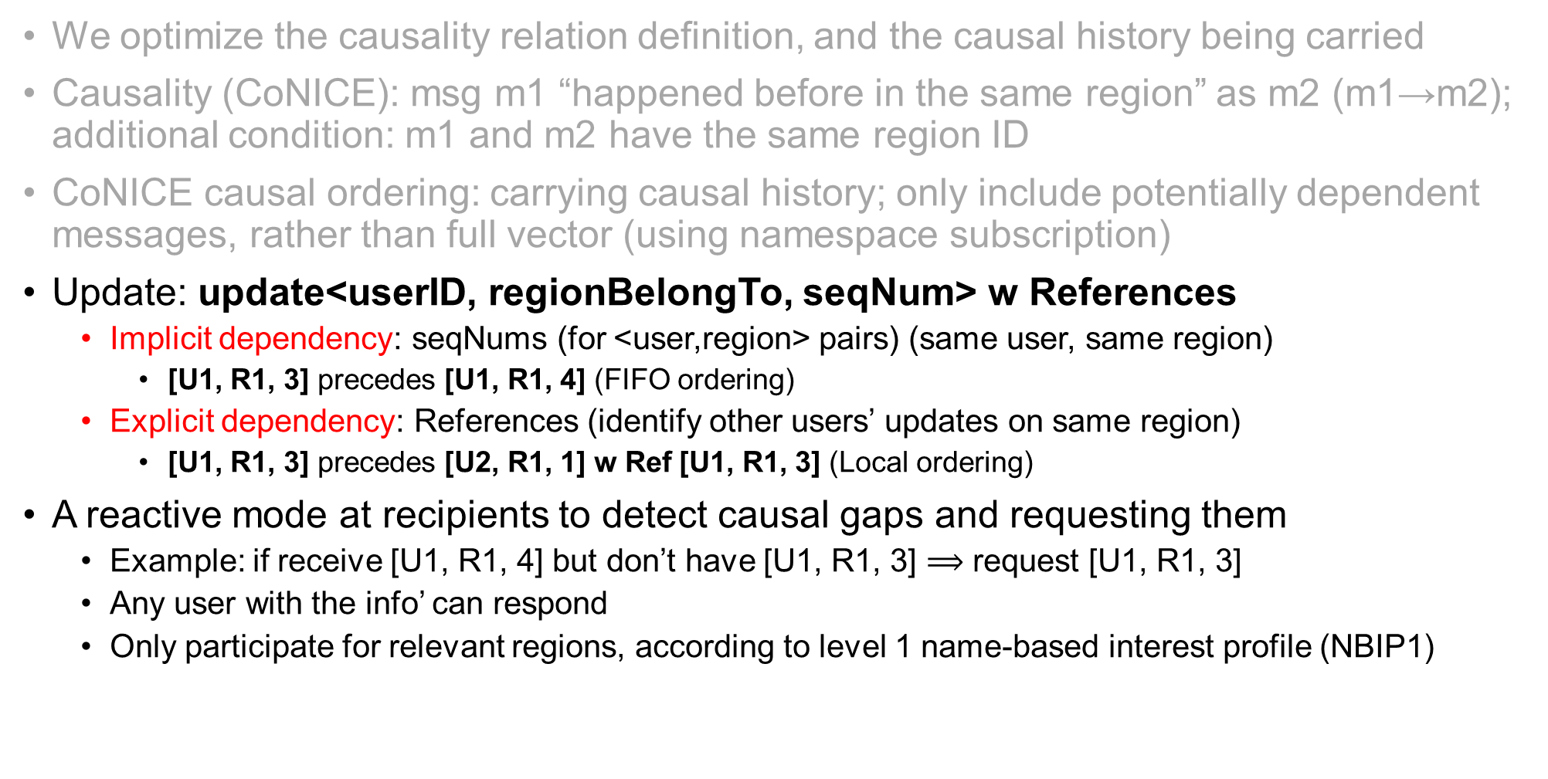
Level 1: Causality – Causal Ordering
We optimize the causality relation definition, and the causal history being carried
Causality (CoNICE): msg m1 “happened before in the same region” as m2 (m1→m2); additional condition: m1 and m2 have the same region ID
CoNICE causal ordering: carrying causal history; only include potentially dependent messages, rather than full vector (using namespace subscription)
Update: update<userID, regionBelongTo, seqNum> w References
  Implicit dependency: seqNums (for <user,region> pairs) (same user, same region)
    [U1, R1, 3] precedes [U1, R1, 4] (FIFO ordering)
  Explicit dependency: References (identify other users’ updates on same region)
    [U1, R1, 3] precedes [U2, R1, 1] w Ref [U1, R1, 3] (Local ordering)
A reactive mode at recipients to detect causal gaps and requesting them
  Example: if receive [U1, R1, 4] but don’t have [U1, R1, 3] $\text{⟹}$ request [U1, R1, 3]
  Any user with the info’ can respond
  Only participate for relevant regions, according to level 1 name-based interest profile (NBIP1)

Slide 30

Level 2: Agreement – Consensus
Consensus protocol to use in Total Ordering for Strong Consistency
  Goal of consensus: achieve agreement between a group of nodes on a value
  The value is the next update to apply for each <region, slot> (to order un-orderable updates)
Region
Slots
0 1 2 3 4
Strong view
$$Q_{2}^{}(R_{i})$$

Slide 31
Level 2: Agreement – Consensus
Consensus protocol to use in Total Ordering for Strong Consistency
  Achieve agreement between a group of nodes on a value
  The value is the next update to apply for each <region, slot> (to order un-orderable updates)
Classic consensus algorithms: Paxos [TOCS’98] (and Raft [ATC’14])
  Multiple rounds of leader election, voting, deciding, disseminating decision
  Common case is connected network with reliable links, and (eventually) synchronous environment
  Not suitable for highly transient networks
  Simply using it in intermittently-connected network results in many frequent re-attempts of sessions
Leader
Followers

Slide 32
Level 2: Agreement – Consensus
Consensus protocol to use in Total Ordering for Strong Consistency
  Achieve agreement between a group of nodes on a value
  The value is the next update to apply for each <region, slot> (to order un-orderable updates)
Classic consensus algorithms: Paxos [TOCS’98] (and Raft [ATC’14])
  Multiple rounds of leader election, voting, deciding, disseminating decision
  Common case is connected network with reliable links, and (eventually) synchronous environment
Consensus algorithms that tolerate loss and unreliable links
  Assume asynchronous environment but with “good periods”, where a message is eventually reachable to any node except for permanently-crashed ones
One-Third Rule (OTR) algorithm [ICDCN’15]
  Coordinator-less; nodes contribute (vote) and decide (two msg types)
  Decide on 2/3 majority rule needed (population need to be known by all)
  Allows 1/3 of nodes fail in one round
  Decision same across all users, i.e., agreement property
  Multiple rounds, but has the potential to finish in a single round
  May take a long time due to frequent disconnections
Contributors and Deciders

Slide 33
Level 2: Agreement – Consensus
CoNICE uses OTR and enhances it in a number of ways
Name-based selective consensus participation
  Rather than all users in the network, use level 2 name-based interest profile (NBIP2) at every user to determine participation
  Example: for slots of R11, only subscribers of R1 and R11
    Others can still help with relaying, if allowed by their NBIP0
R1
R11
R12
R111
R112
R113
R121
R122
R123
Namespace
Name-based Group

Slide 34
Level 2: Agreement – Consensus
CoNICE uses OTR and enhances it in a number of ways
Name-based selective consensus participation
Periodic reachability beaconing for population count estimation
  Rather than a priori known, fixed count of all users (to calculate majority constraints), periodically announce self, and NBIP2 subscription
  Each user estimates # of subscribers of each name-based group
Reachability Beacons

Slide 35
Level 2: Agreement – Consensus
CoNICE uses OTR and enhances it in a number of ways
Name-based selective consensus participation
Periodic reachability beaconing for population count estimation
Support decision invalidation in long-term fragmentation
  Isolated network fragments (e.g., shelters), connected after a very a long-time → different decisions for same <region, slot> pairs (violating agreement property)
  Rather than good period assumption in the whole network, support good period within fragments and decision invalidation
  To break tie, decision from the higher populated fragment wins, the other should be updated and follow
Fragment1
Fragment2
Fragments
New Path

Slide 36
Level 2: Agreement – Consensus
User X’s Contribution message for <R11, 0>, proposes ‘a’ to fill it; first round, for n participants:
  contribution<X, R11, slot=0, round=1, value=‘a’, population=‘n’>
  Disseminated for subscribers of R11 and above
  Users create contribution: via initiation or are triggered by receiving others’ contributions
  When entering new round, delete contributions of previous rounds from buffer (less storage)
R1
R11
R12
R111
R112
R113
R121
R122
R123
Namespace

Slide 37
Level 2: Agreement – Consensus
User X’s Contribution message for <R11, 0>, proposes ‘a’ to fill it; first round, for n participants:
  contribution<X, R11, slot=0, round=1, value=‘a’, population=‘n’>
  Disseminated for subscribers of R11 and above
  Users create contribution: via initiation or are triggered by receiving others’ contributions
  When entering new round, delete contributions of previous rounds from buffer (less storage)
Decision message:
  decision<X, R11, slot=0, value=‘a’, population=‘n’>
  Disseminated for subscribers of R11 and above
  Users decide and create decision message by reaching the 2/3 majority locally, or receiving decision from others
R1
R11
R12
R111
R112
R113
R121
R122
R123
Namespace

Slide 38
Level 2: Agreement – Consensus
User X’s Contribution message for <R11, 0>, proposes ‘a’ to fill it; first round, for n participants:
  contribution<X, R11, slot=0, round=1, value=‘a’, population=‘n’>
  Disseminated for subscribers of R11 and above
  Users create contribution: via initiation or are triggered by receiving others’ contributions
  When entering new round, delete contributions of previous rounds from buffer (less storage)
Decision message:
  decision<X, R11, slot=0, value=‘a’, population=‘n’>
  Disseminated for subscribers of R11 and above
  Users decide and create decision message by reaching the 2/3 majority locally, or receiving decision from others
Users build up their ‘snapshots’ based on region-slot decisions
This protocol ensures correct total ordering across relevant users eventually
  More details and proofs in the paper!
R1
R11
R12
R111
R112
R113
R121
R122
R123
Namespace

Slide 39
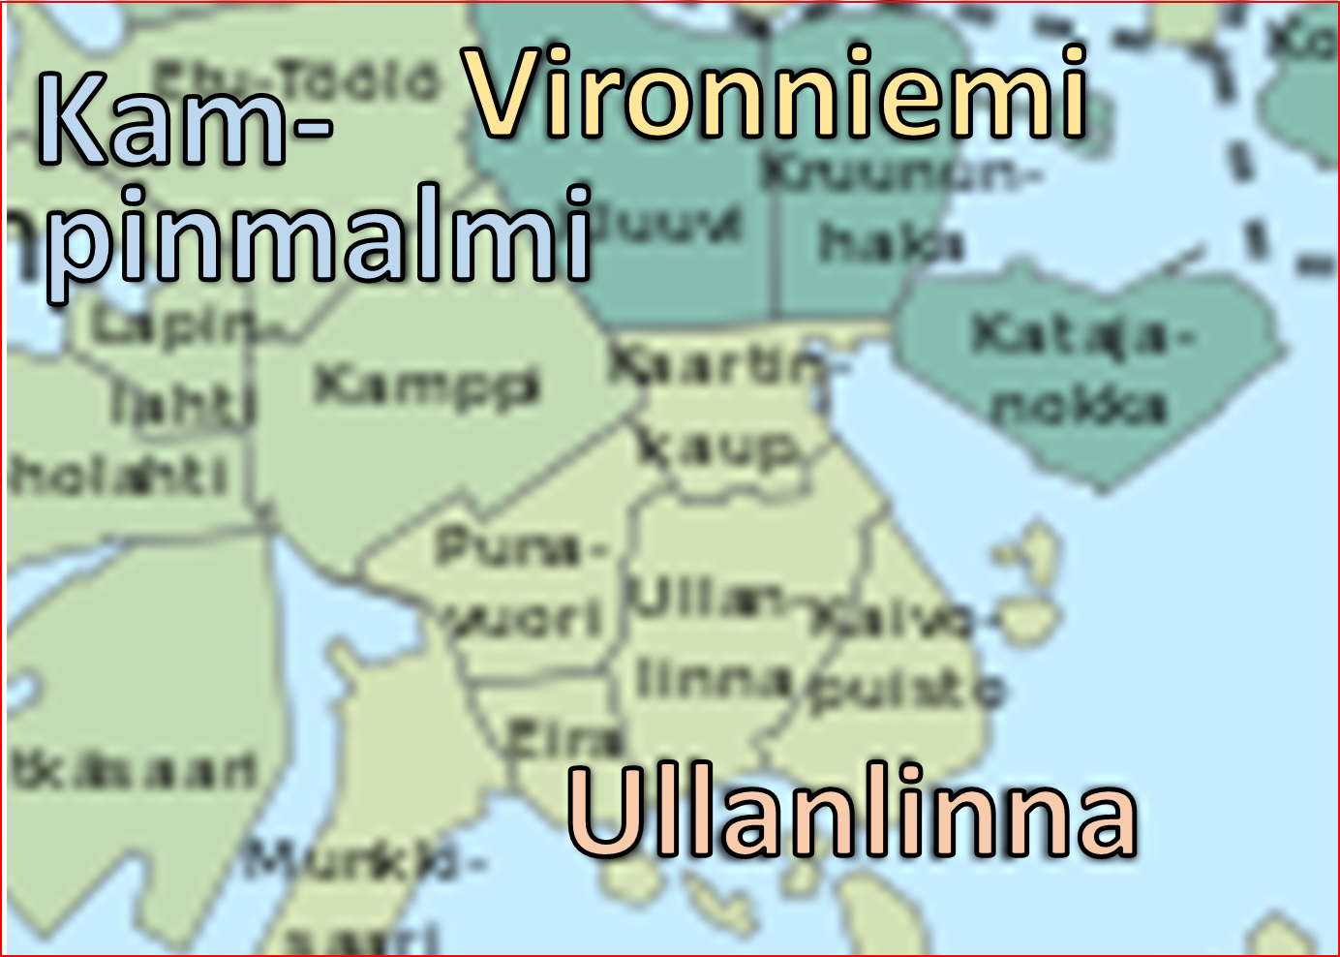
Experimentation
Subset of City of Helsinki; Namespace:
  city → major district → district → neighborhood
Subset (in southern major district): 3 districts; world size: 4500x3400 meters
30 mobile first responders; 10 responsible per district
Additional benevolent mules: 500 civilians and 50 vehicles for helping delivery (not participants of consensus sessions)
City
Helsinki
Each first responder creates 3 updates (1KB msgs)
Experiments: implemented in the ONE (Opportunistic Network Environment) simulator
Major Districts
Helsinki southern major district
Helsinki western major district
Helsinki central major district
…
Districts
Kampinmalmi
Ullanlinna
Vironniemi
Kampinmalmi
Taka-Töölö
Lauttasaari
…
Vironniemi
Neighbor-
hoods
Kluuvi
Etu-Töölö
…
Kruununhaka
Lapinlahti
Kaartinkaupunki
Kamppi
Jätkäsaari
Ruoholahti
Kaartinkaupunki
Punavuori
Ullanlinna
Kaivopuisto
Eira
Munkkisaari

Slide 40
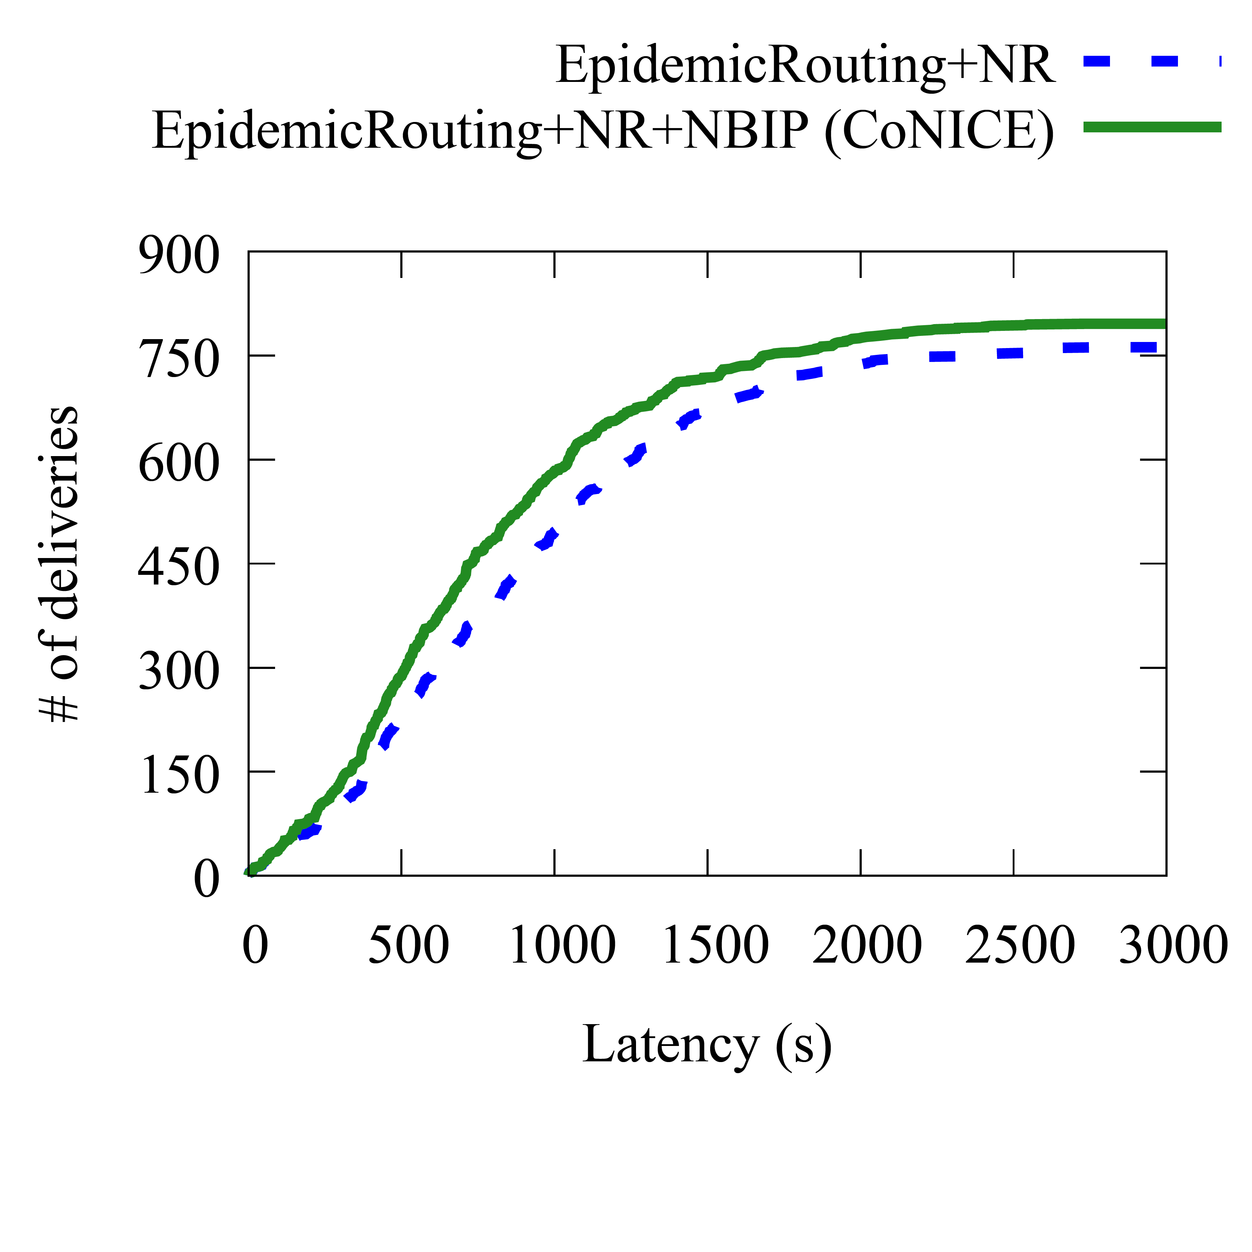
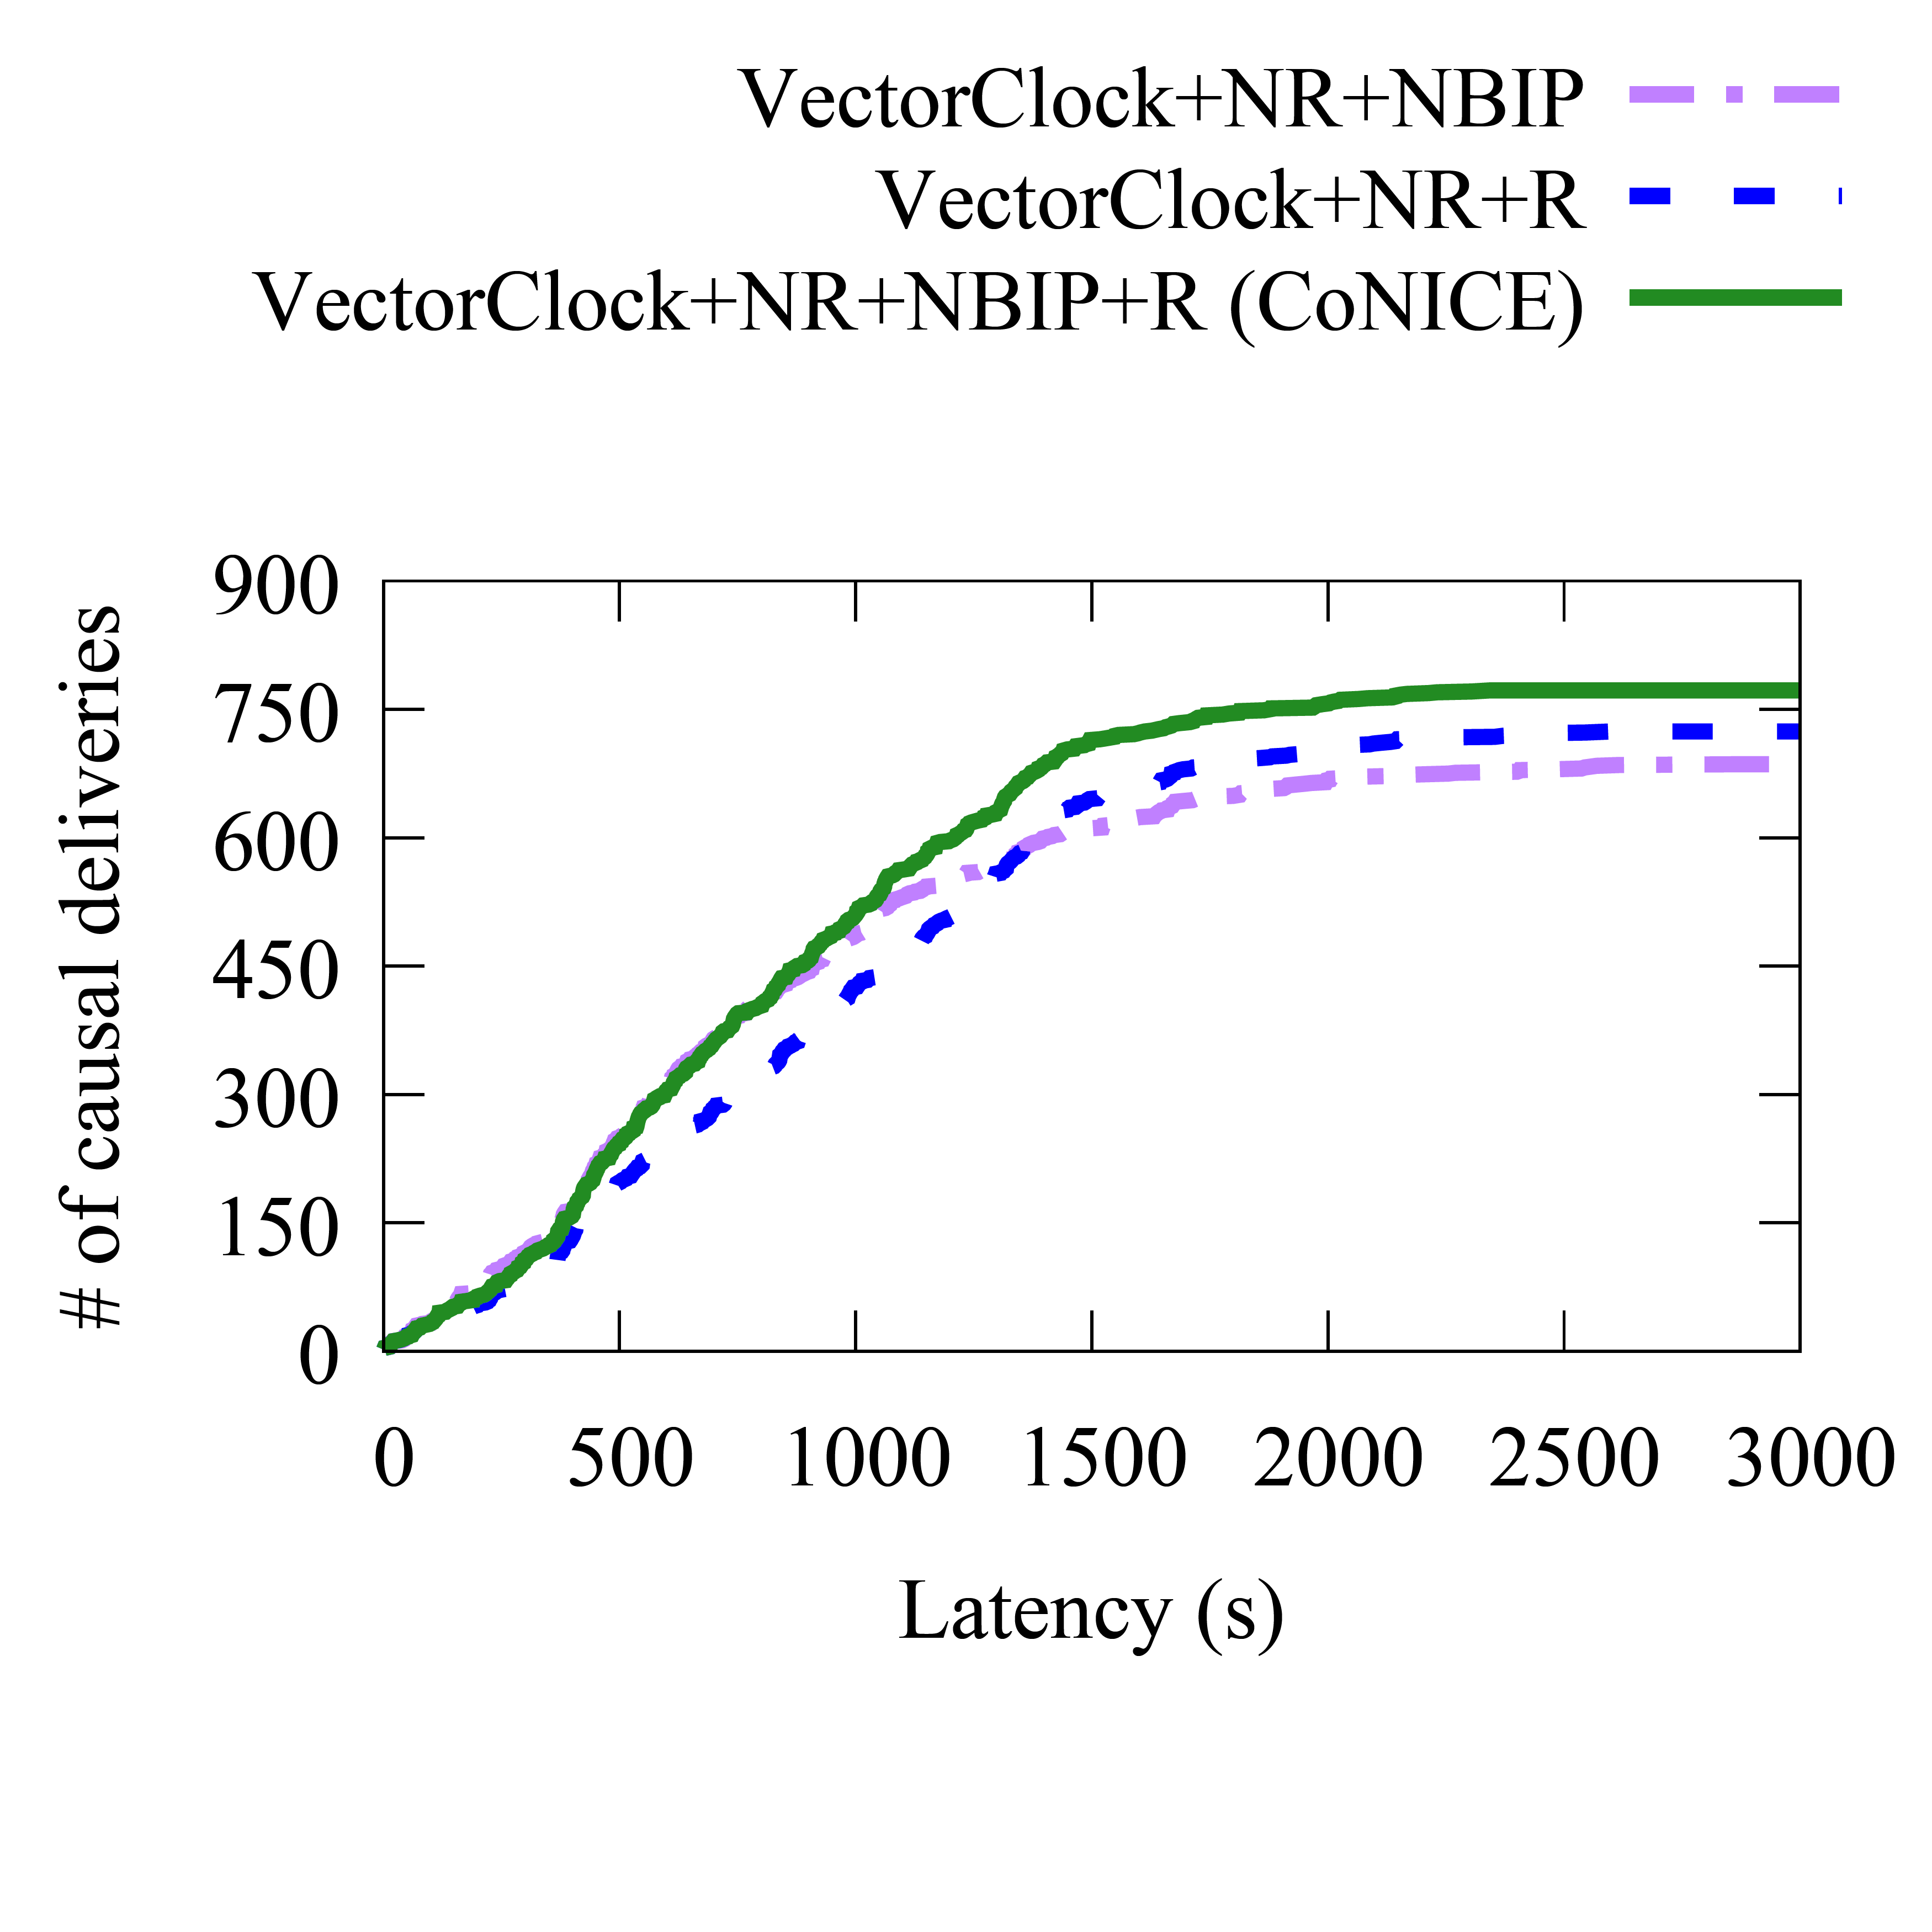
Simulation results: Gossiping & Causal Ordering
With use of naming (named region-ing (NR), name-based interest profiling (NBIP)), and reactive causal ordering (R), CoNICE
  Higher replication completeness (C) of relevant info (deliveries) and causal completeness at first responders (~5-10%)
  Achieves better average latencies in both
Avg C: 29.53
Avg C: 28.40
Avg C: 28.70
Avg C: 25.73
Avg C: 28.30
All diagrams are cumulative (CDF)

Slide 41
Simulation results: Gossiping & Causal Ordering
With use of naming (named region-ing (NR), name-based interest profiling (NBIP)), and reactive causal ordering (R), CoNICE
  Higher replication completeness (C) of relevant info (deliveries) and causal completeness at first responders (~5-10%)
  Achieves better average latencies in both
  Similar number of total relays, i.e., total network traffic
  CoNICE’s naming more efficient gossiping and causal ordering
Approach | Total Relays
EpidemicRouting | 49,612
EpidemicRouting+ NR | 50,123
EpidemicRouting+ NR+NBIP (CoNICE) | 48,612
Approach | Total Relays
VectorClock+NR+NBIP | 98,485
VectorClock+R | 108,289
VectorClock+NR+R | 88,134
VectorClock+NR+NBIP+R (CoNICE) | 89,792
All diagrams are cumulative (CDF)

Slide 42
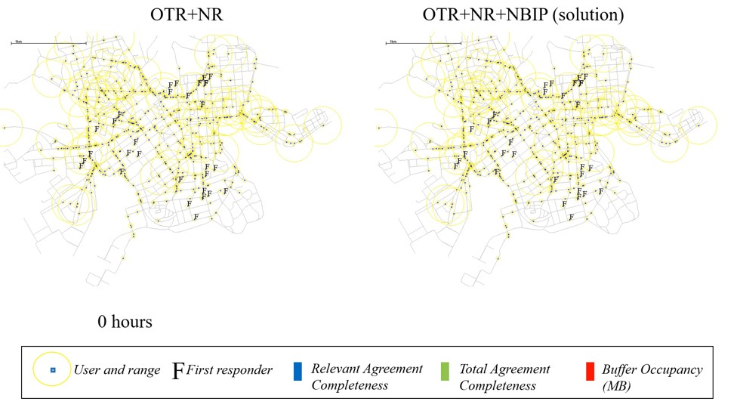
Simulation results on Consensus
OTR+NR OTR+NR+NBIP (CoNICE)
How many strong view slots filled for regions relevant for the first responder
How many strong view slots filled for regions at the first responder
How many MB of buffer occupied at first responder

Slide 43
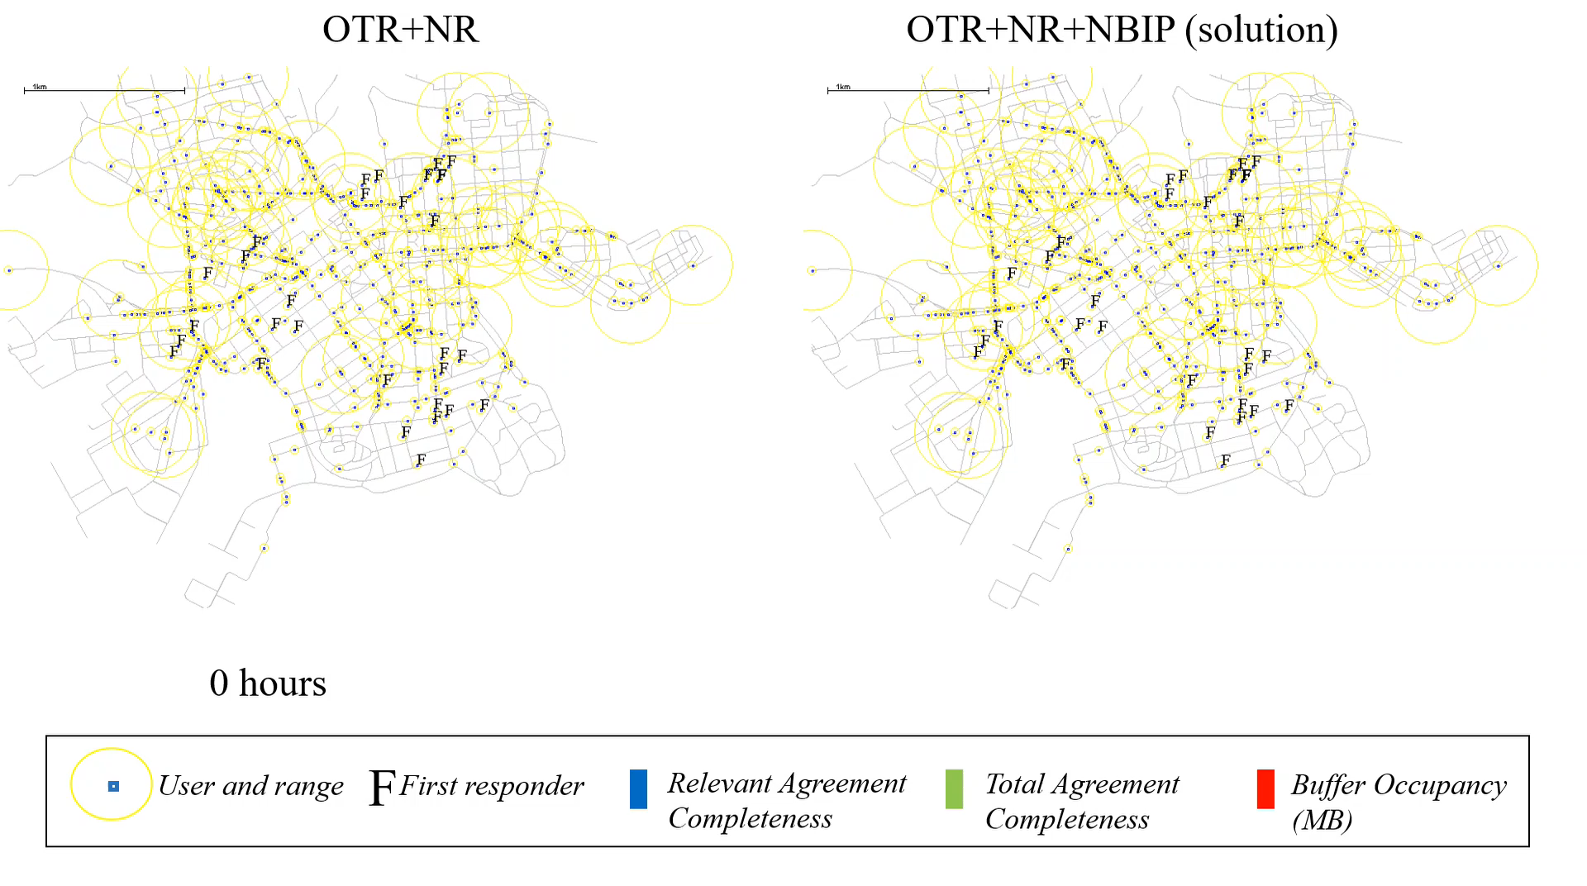
Simulation results on Consensus
OTR+NR OTR+NR+NBIP (CoNICE)
How many strong view slots filled for regions relevant for the first responder
How many strong view slots filled for regions at the first responder
How many MB of buffer occupied at first responder

Slide 44
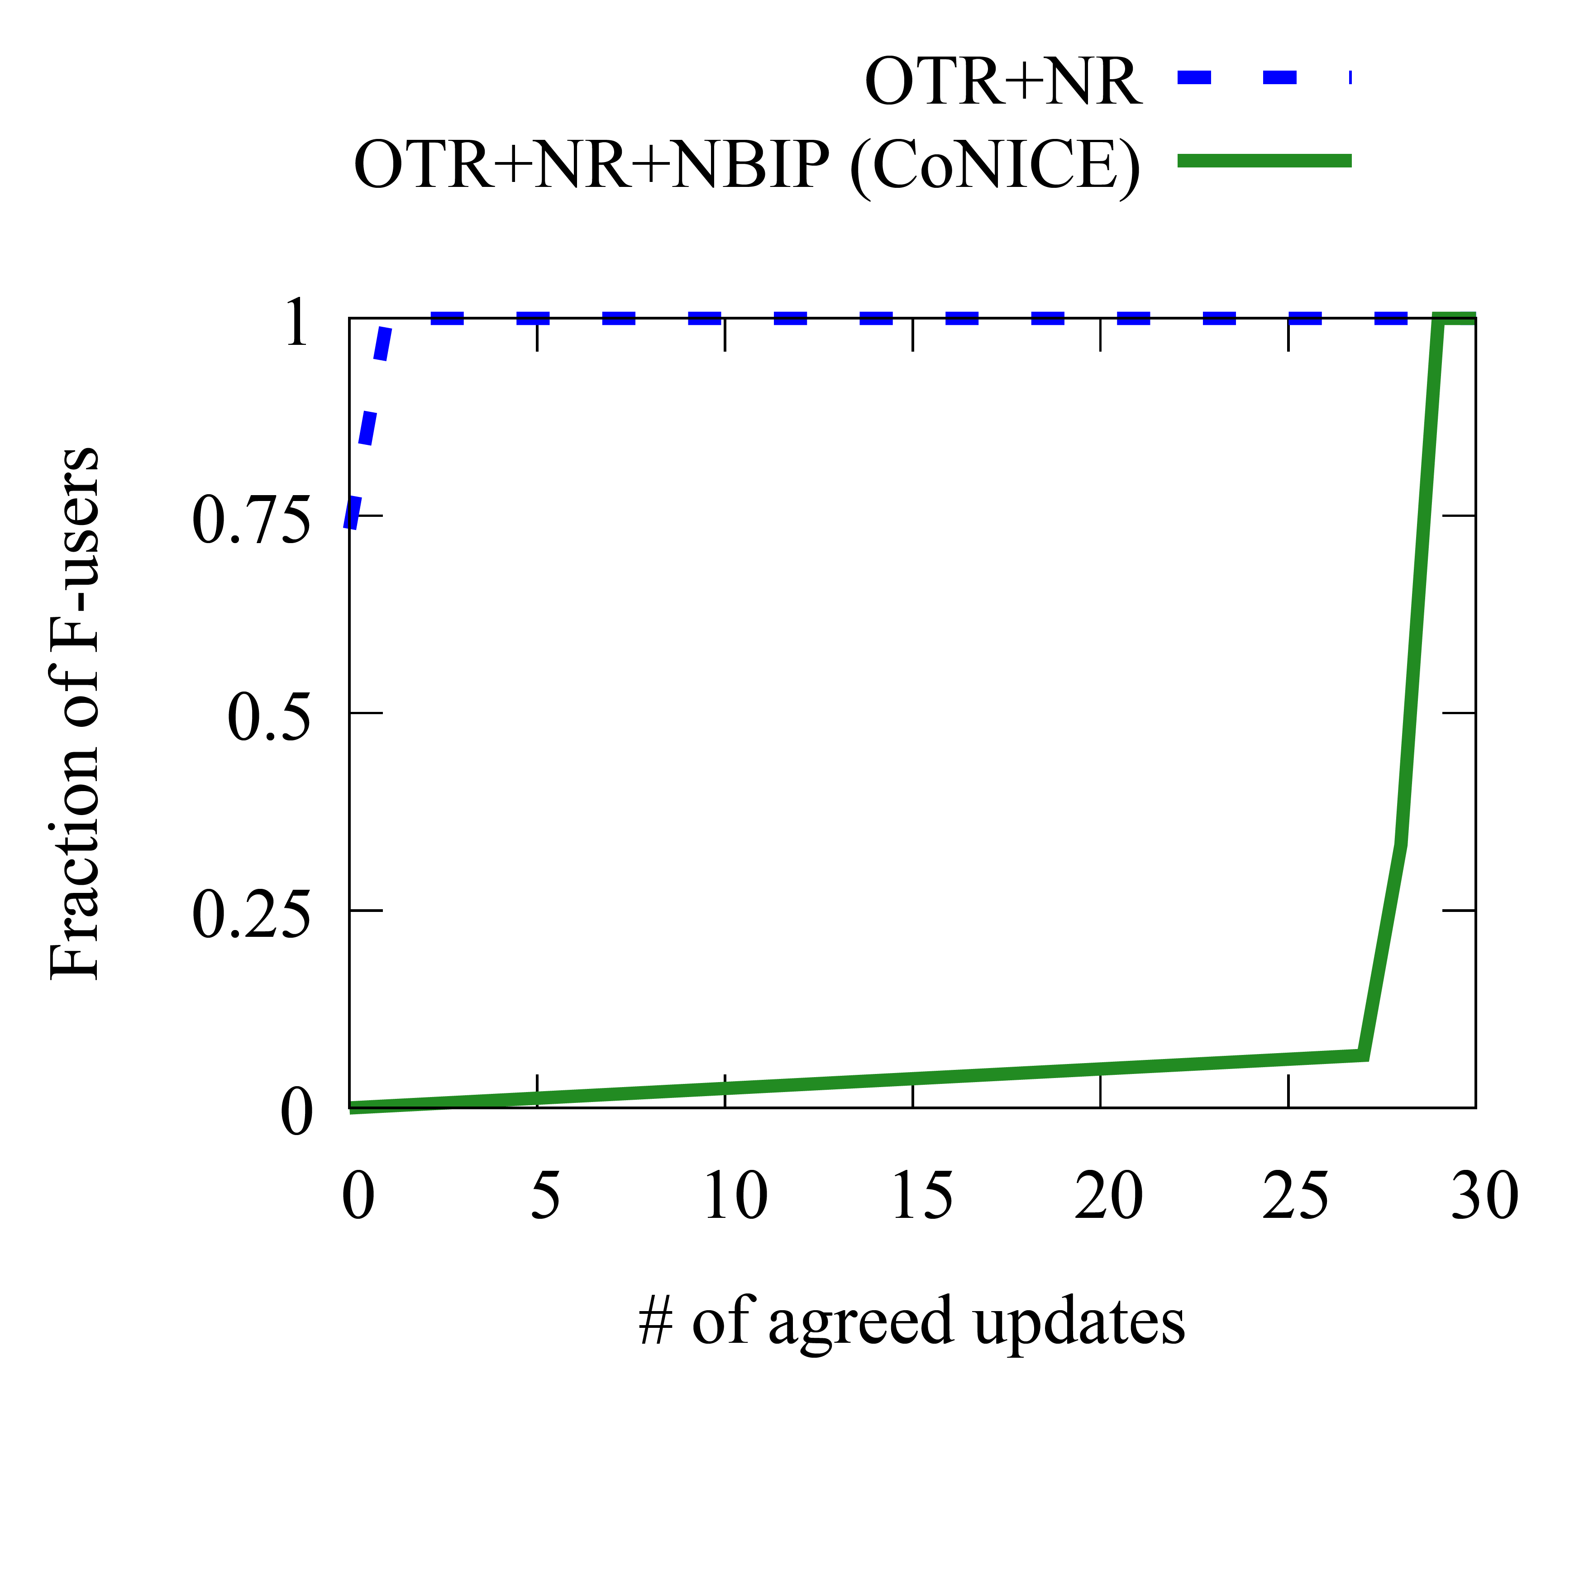
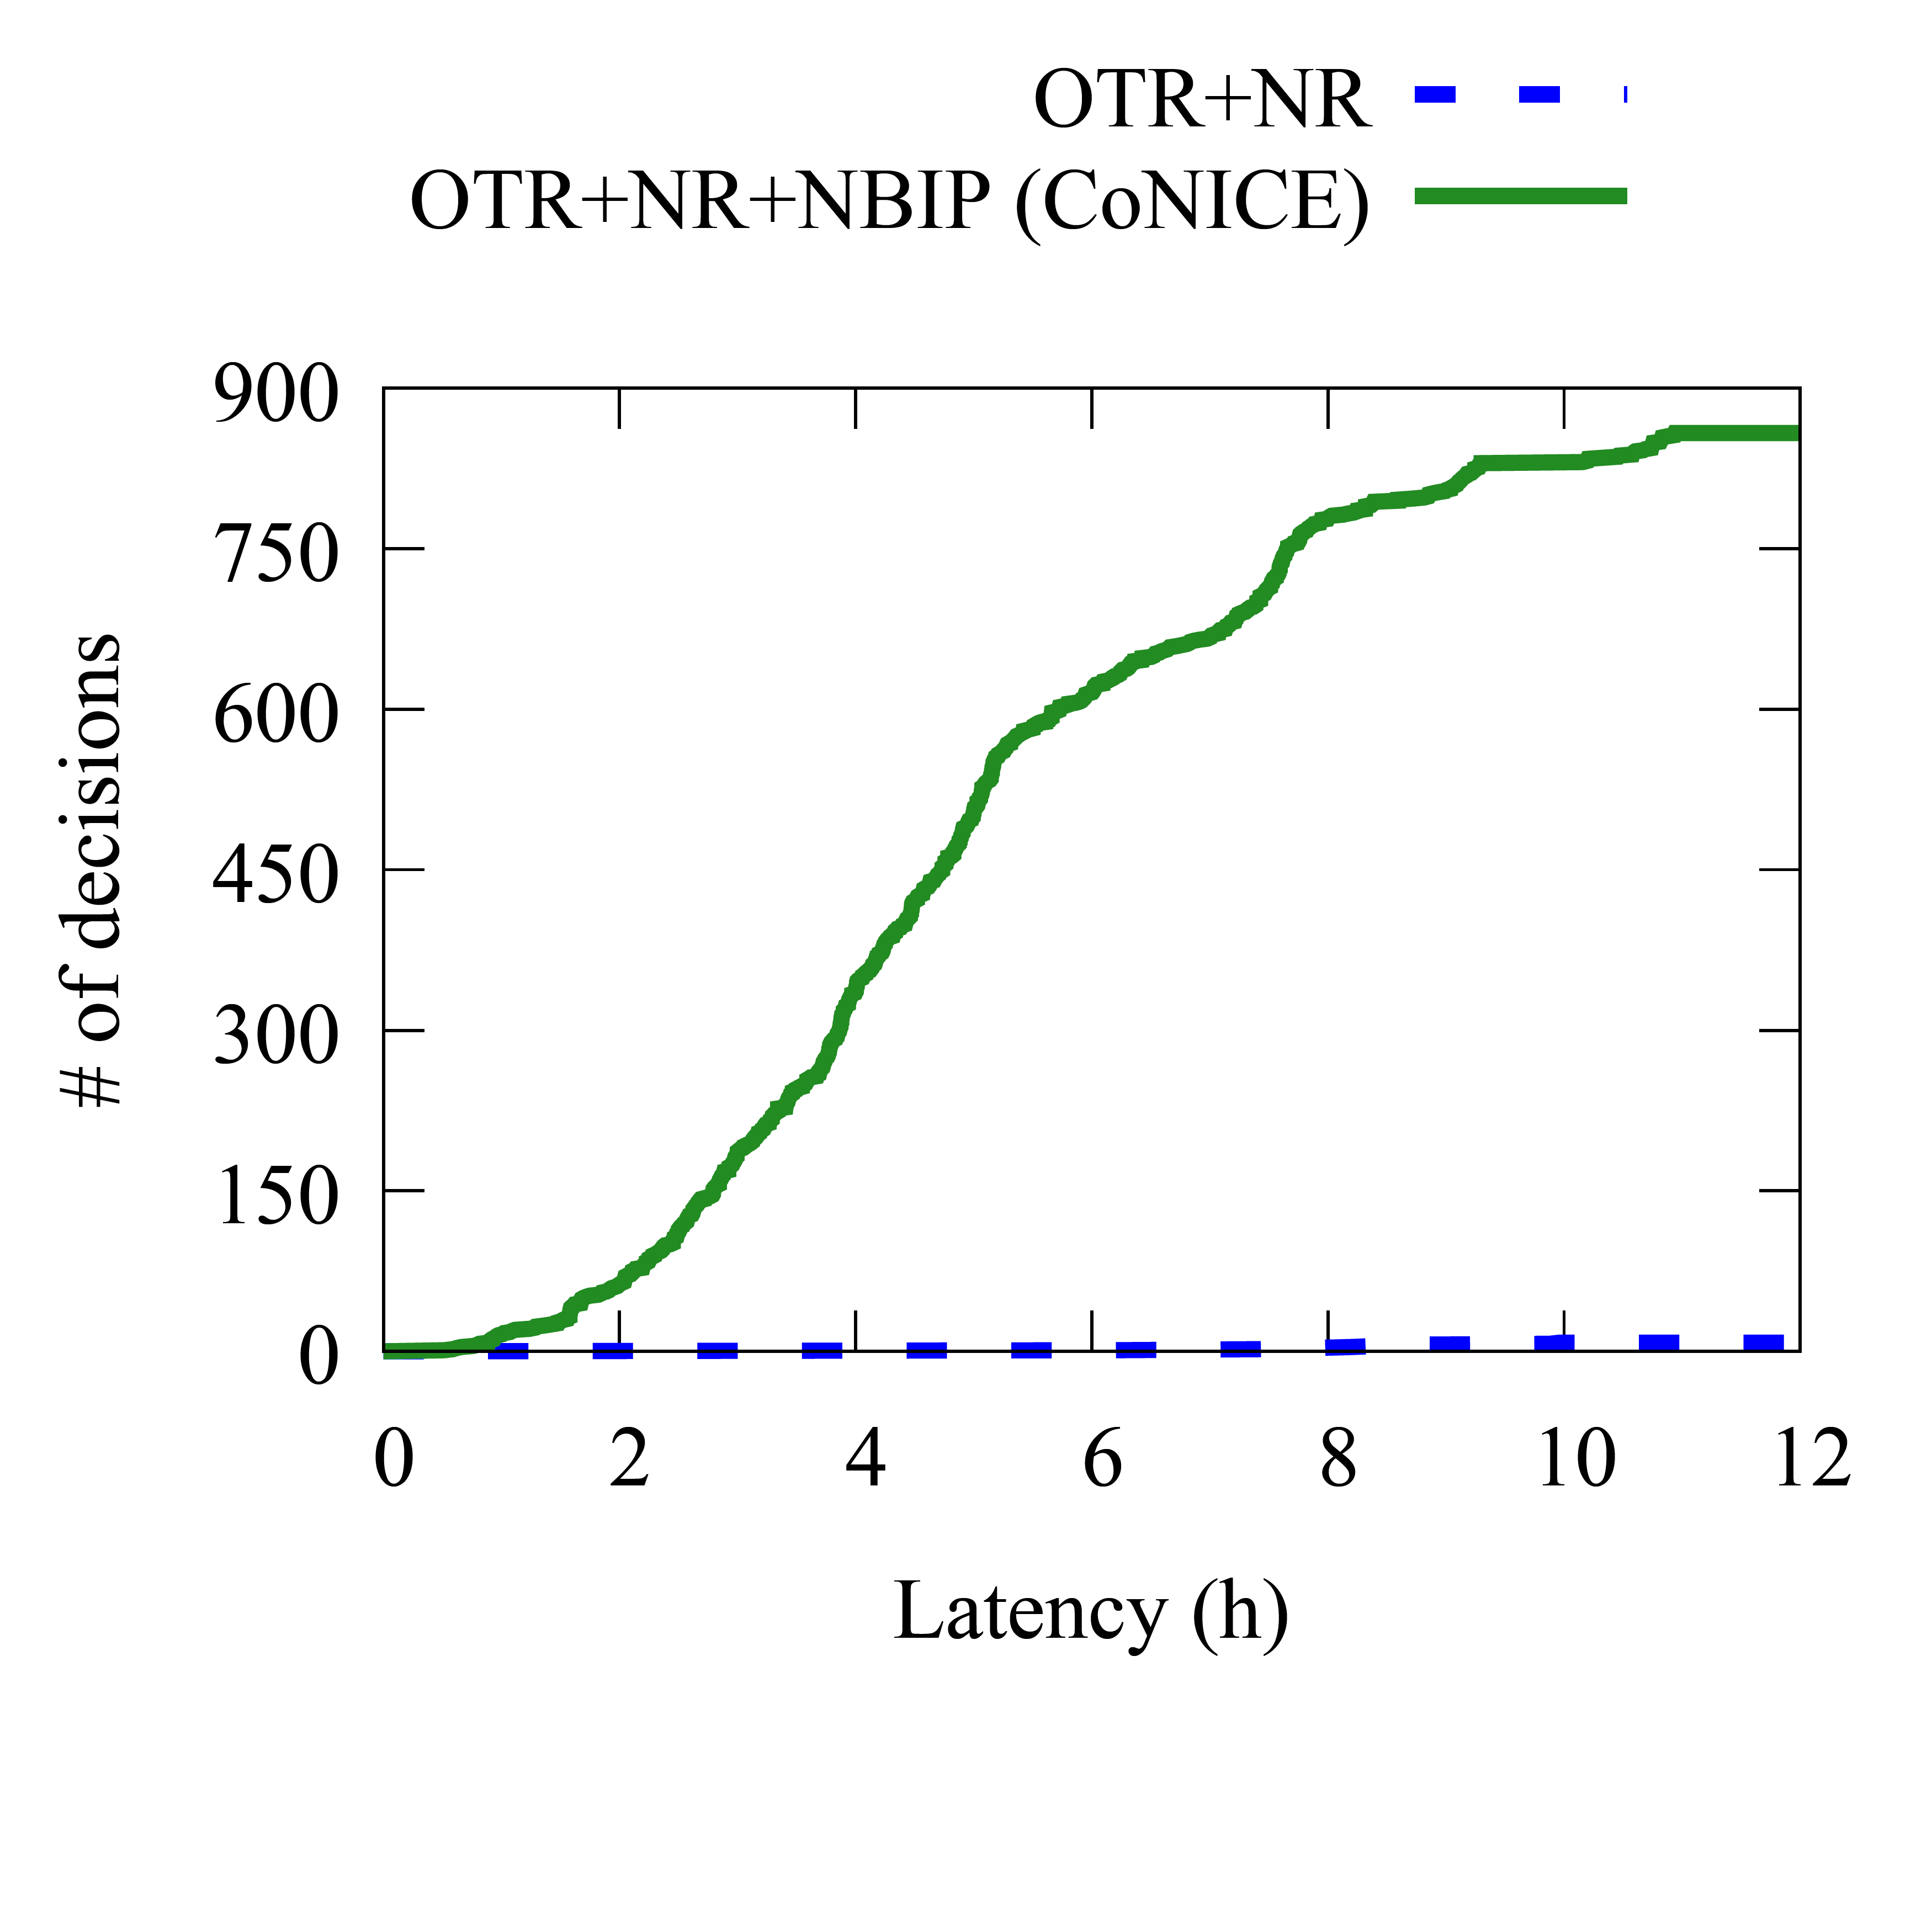
Simulation results on Consensus
With use of naming (named region-ing (NR), name-based interest profiling (NBIP)), our solution
  Achieves higher agreement completeness of relevant info at first responders (~100X using NBIP to identify groups)
  More relevant decisions deliveries, better latency at first responders (~2X using NBIP)
    High absolute values justify having a moderate view in the meantime
Avg: 0.26
Fraction of responders
Avg: 28.60
Avg: 4.91 h
Avg: 7.51 h
All diagrams are cumulative (CDF)

Slide 45
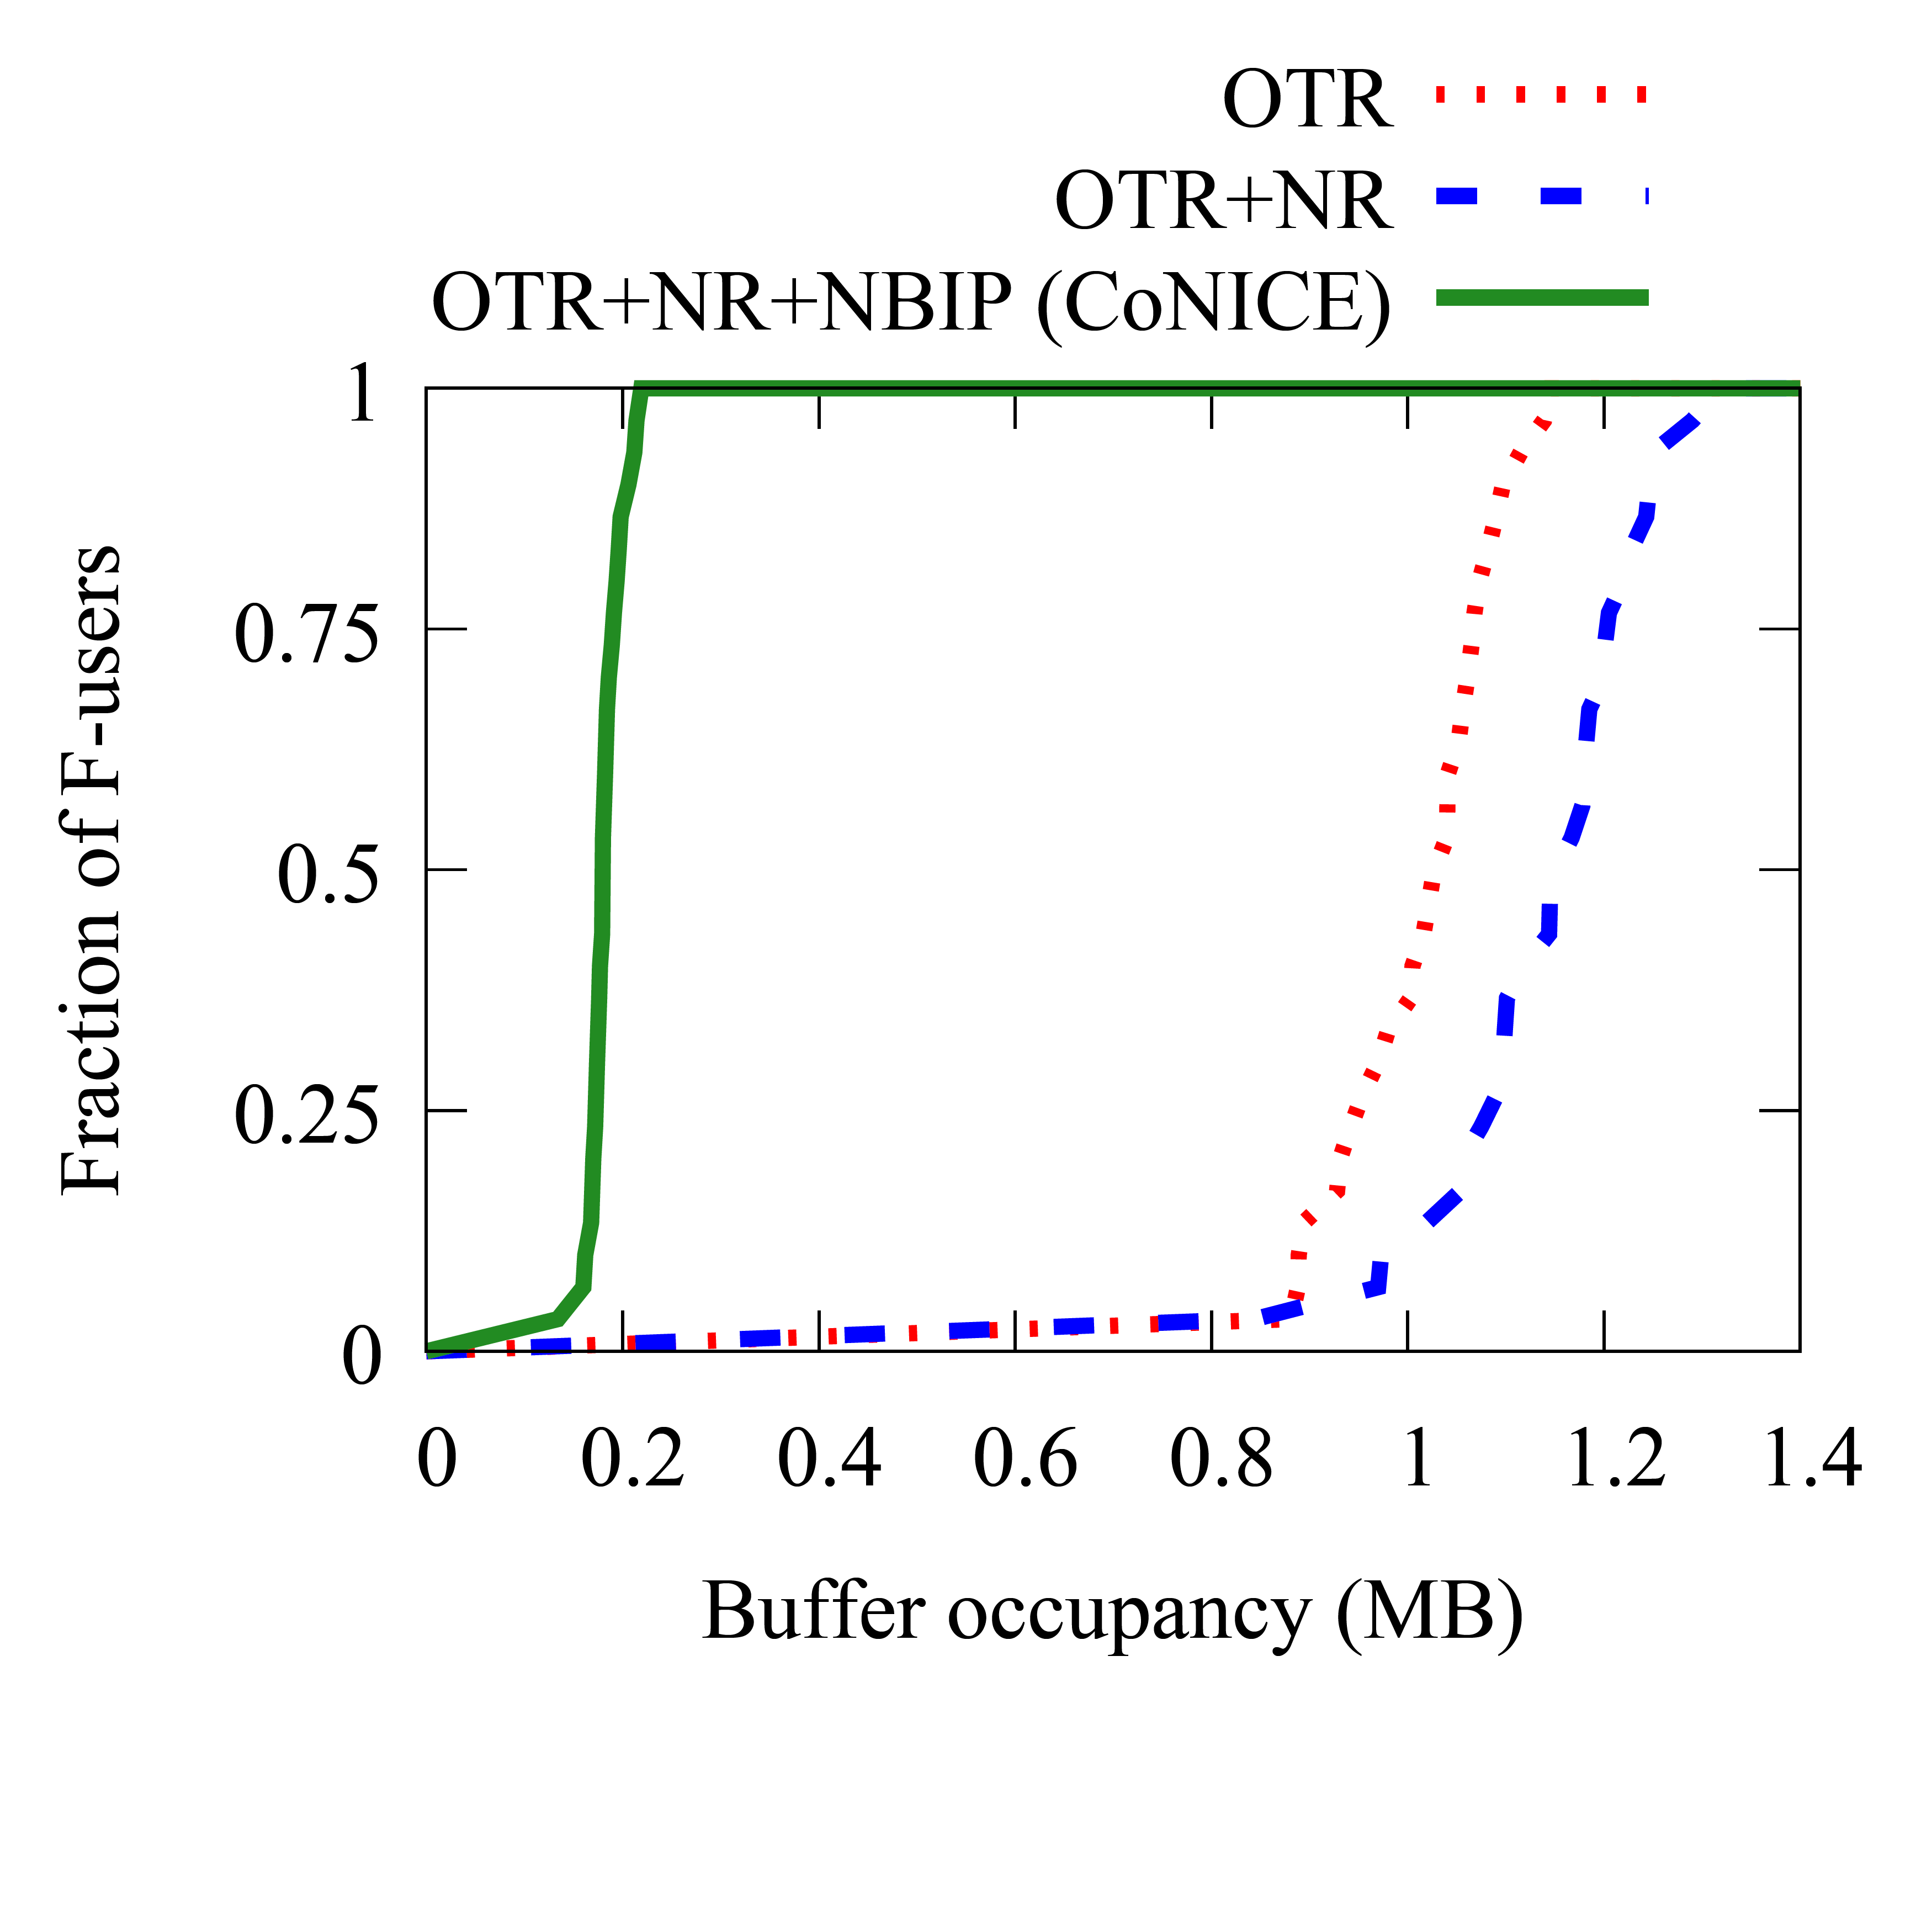
Simulation results on Consensus
With use of naming (named region-ing (NR), name-based interest profiling (NBIP)), our solution
  Achieves higher agreement completeness of relevant info at first responders (~100X using NBIP to identify groups)
  More relevant decisions deliveries, better latency at first responders (~2X using NBIP)
  Lowers buffer consumption at first responders (~5X with naming)
  Similar number of total relays in the network
  CoNICE’s name-based grouping achieve agreement in a more efficient and effective manner.
Fraction of responders
Approach | Total Relays
OTR | 3,489,035
OTR+NR | 3,512,598
OTR+NR+NBIP (CoNICE) | 3,504,557
Avg: 0.18 MB
Fraction of responders
Avg: 1.01 MB
All diagrams are cumulative (CDF)

Slide 46
Summary
CoNICE: a framework to ensure consistent dissemination of updates among users in intermittently-connected, infrastructure-less environments, e.g., emergency response
Multi-level consistency supporting causal ordering and consensus
  Flexible trade-off between completion time and degree of consistency during disasters
Multi-level naming schema for fine-grained subscription
  Reduces user storage usage for D2D buffering
  Achieves higher completeness of strong consistency and faster consensus convergence across relevant users
Moderate View
Map Application
Strong View
Consistency
Levels
Name-based Interest Profiles
Namespace
Name Levels
Consistency Level 2: Agreement
NBIP2
Level 0 (root)
Consensus
Causal Ordering
Consistency Level 1: Causality
Level 1
NBIP1
.
.
.
.
.
.
Consistency Level 0: Replication
NBIP0
Gossiping
Subscriptions
Level n (leaves)
Supported by US NIST (award 70NANB17H188) and US NSF (grant CNS-1818971)

