Slide 1
Oktopus: Service Chaining for Multicast Traffic
https://oktopus-project.org

Slide 2



Online Watching of Live Sessions
2.2M gamers share their live gameplay every month
Streaming millions of live sessions to millions of users
Streaming live VR content of sport games

Slide 3



Using Multicast
a
b
c
e
f
d
g
h
i
k
j

Slide 4






NFV Adoption
Network operators deploy network functions
Virtualized on general-purpose servers
  Referred to as services
Firewall
IDS
Monitoring
Video Encoder
Parental control
Network Functions
Virtualized on Servers

Slide 5
Multicast Service Chaining
Multicast traffic needs to traverse a specific order of services
  Before reaching all receivers
1
a
b
c
1
3
2
e
g
2
d
f
3
h
i
k
3
j

Slide 6
Multicast Service Chaining
Packets may traverse the same node or link multiple times
We refer to it as Multicast Distribution Graph
1
a
b
c
3
2
e
g
d
f
h
i
k
3
j

Slide 7
Problem Statement
Given:
  multicast sessions and their service requirements
Calculate:
  the Multicast Distribution Graphs
  that minimize the total routing cost
Such that:
  Link, processing and forwarding table capacities are not exceeded
Main Challenge
Large search space

Slide 8
Problem Hardness
We show that a special instance of the problem is NP-hard
Prior works showed that the problem:
  cannot be approximated within any ratio [1]
  is computationally intractable for unicast [2]
Practical and Important Problem
But very hard to solve
Our Approach: A principled heuristic to find solutions
[1] Huang et al., “Multicast traffic engineering for software-defined networks,” in Proc. of IEEE INFOCOM’16
[2] Amir et al., “Charting the algorithmic complexity of waypoint routing,” ACM SIGCOMM Comput. Commun. Rev., 2018

Slide 9
Proposed Solution: Oktopus
A new path-based approach to solve the Multicast Service Chaining problem
Design Principles:
  Reducing the search space
  Recursive composition of services
  Fine-grained control over paths

Slide 10
Overview of Oktopus
Phase 1: Generating Segments (Offline)
b
Segment Store
Generate Segments
a
b
c
a
c
Phase 2: Calculating Graphs (Online)
Weights
Sessions
Segment Store
Recursive Composition
Calculate Graphs
1
s
d
2
Update
3
d

Slide 11
Phase 1: Generating Segments
Pre-computes the segments to be used in Phase 2
Challenge: the number segments grows exponentially with the network size
Approach: employing TE observations and progressively adding new segments if needed

Slide 12
Phase 1: Generating Segments
For every node pair n and m:
  Traverse the network using breadth-first search
  Compute the first K loop-free segments
    Without exceeding a given path length
  Compute a set of edge-disjoint paths from n → m
    By using a maximum flow algorithm
→ These segments are stored in the Segment Store
Segment Store
a
b
c

Slide 13

Phase 2: Calculating a Distribution Graph
For every destination, Oktopus:
  calculates a path from an existing path to that destination
Session = < source=s, dsts = {a, b}, services = {1→2} >
Segment Store
Calculated Paths by Oktopus
1
2
s
i
j
a
s
i
j
a
Step 1: Searching from s→a
i
k
l
b
Picks min-cost path providing services {1→2}
s
m
n
c
s
a
i
k
l

Slide 14
Phase 2: Calculating a Distribution Graph
For every destination, Oktopus:
  calculates a path from an existing path to that destination
Session = < source=s, dsts = {a, b}, services = {1→2} >
Segment Store
Calculated Paths by Oktopus
1
2
Ensures no forwarding ambiguity
s
i
j
a
s
i
j
a
2
k
l
b
Step 2: Searching from
a→b (services = {})
j→b (services = {})
i→b (services = {2})
s→b (services = {1→2})
i
k
l
b
Partial services
s
m
n
c
s
a
i
k
l
Picks min-cost path

Slide 15
Phase 2: Calculating a Distribution Graph
Recursive Composition
When no segment can directly provide services without exceeding resources
Extending the search space beyond the Segment Store
1
2
3
1
Step 1: Pick a max-length path
s
i
d
Links do not exist in Segment Store
Step 2: Connect that path to a node supporting the next service
2
j
k
2
l
2
Step 3: Recursively search from the chosen node to destination using the Segment Store
3
m
n
d

Slide 16

Implementation
Network Application
Full implementation of:
  Optimization Engine
  APIs
Open source
  https://oktopus-project.org/
  Public data sets
  Reproducible environments
app = App(...)
s = Session(...)
s.traverse([ , ])
r = Routing()
r.addObjective('minRouting’)
app.solve()
Oktopus APIs
Oktopus Optimization Engine
Distribution Graphs
Network Data
Control Plane Framework
To Switches

Slide 17
Evaluation
Comparison versus OPT and the closest algorithm [3]
  Using five ISP topologies with different sizes
We run the three algorithms on a machine with 40 cores and 128 GB of memory
Performance Metrics:
  Percentage of allocated sessions
  Routing cost
  Graph size
  Running time
[3] Ren et al., “Optimal service function tree embedding for NFV enabled multicast,” in Proc. of IEEE ICDCS’18.

Slide 18
Comparison versus OPT
OPT fails to produce graphs for 50 concurrent sessions:
  Oktopus calculates the graphs in 1.2 minutes
For 10 concurrent sessions:
  Routing cost optimality gap is 5.3% on average
  For the largest topology:
    OPT running time is 1.4 hrs/session
    Oktopus running time is 6 sec/session
OPT is not practical for realistic scenarios
Oktopus is close to OPT

Slide 19
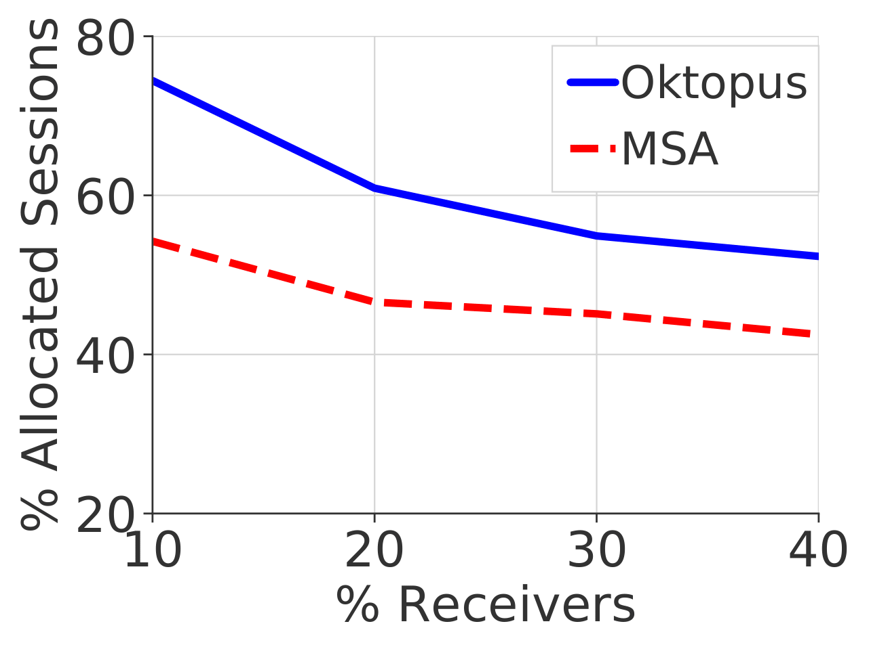
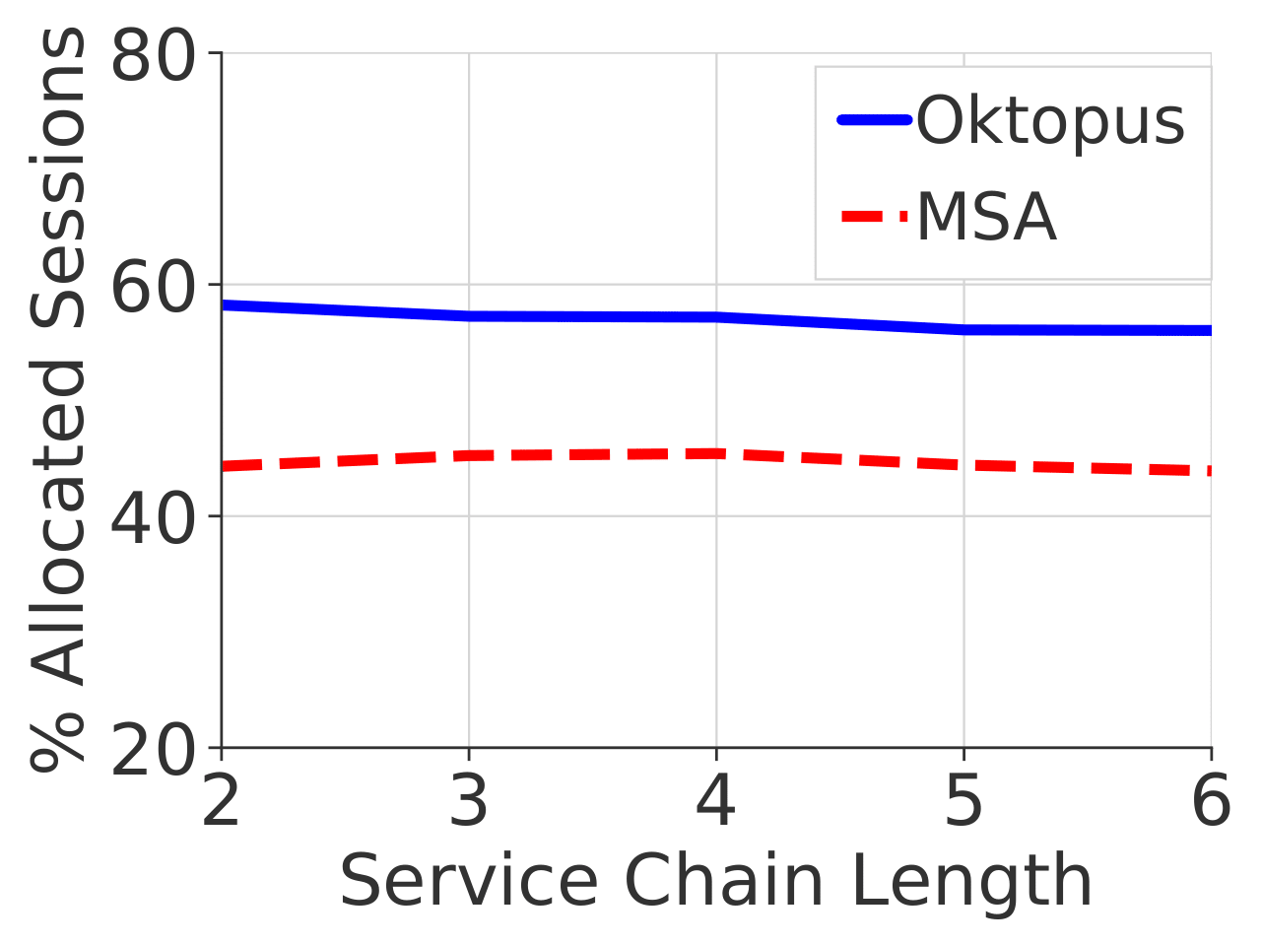
Comparison versus the Closest Algorithm
37%
30%
Oktopus outperforms MSA in all scenarios

Slide 20
Comparison versus the Closest Algorithm
Running time:
  Oktopus: 8.625 sec/session
  MSA: 8.5 sec/session
Routing cost:
  Oktopus and MSA are similar
Graph size:
  Oktopus’ graphs are larger by 2 links on average
  → Since it allocates more sessions than MSA
Oktopus is practical for realistic scenarios
Oktopus does not overload the network

Slide 21
Conclusions
Oktopus is:
  an algorithm solving the multicast service chaining problem
  a path-based approach that systemically reduces the search space
Compared to OPT, Oktopus is:
  close to OPT in terms of routing cost
  fast and efficient
Compared to the closest algorithm, Oktopus:
  allocates more sessions by up to 37%
  does not overload the network

