Slide 1

AdapLoRa: Resource Adaptation for Maximizing Network Lifetime
in LoRa networks
Weifeng Gao, Zhiwei Zhao, Geyong Min

Slide 2

Low-Power Wide-Area Networks (LPWANs)
Internet of Things (Smart city, etc.)
Low power, dense deployment
https://www.emerictimelapse.com/new-york/hd-empire-state-building-and-times-square-manhattan-new-york-city-at-night
1/

Slide 3



Low-Power Wide-Area Networks (LPWANs)

Slide 4
Low-Power Wide-Area Networks (LPWANs)
Open standard
Low complexity infrastructure deployment
Unlicensed ISM bands

Slide 5
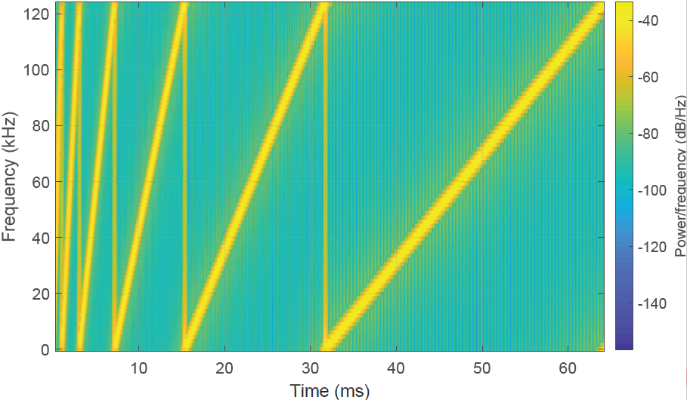

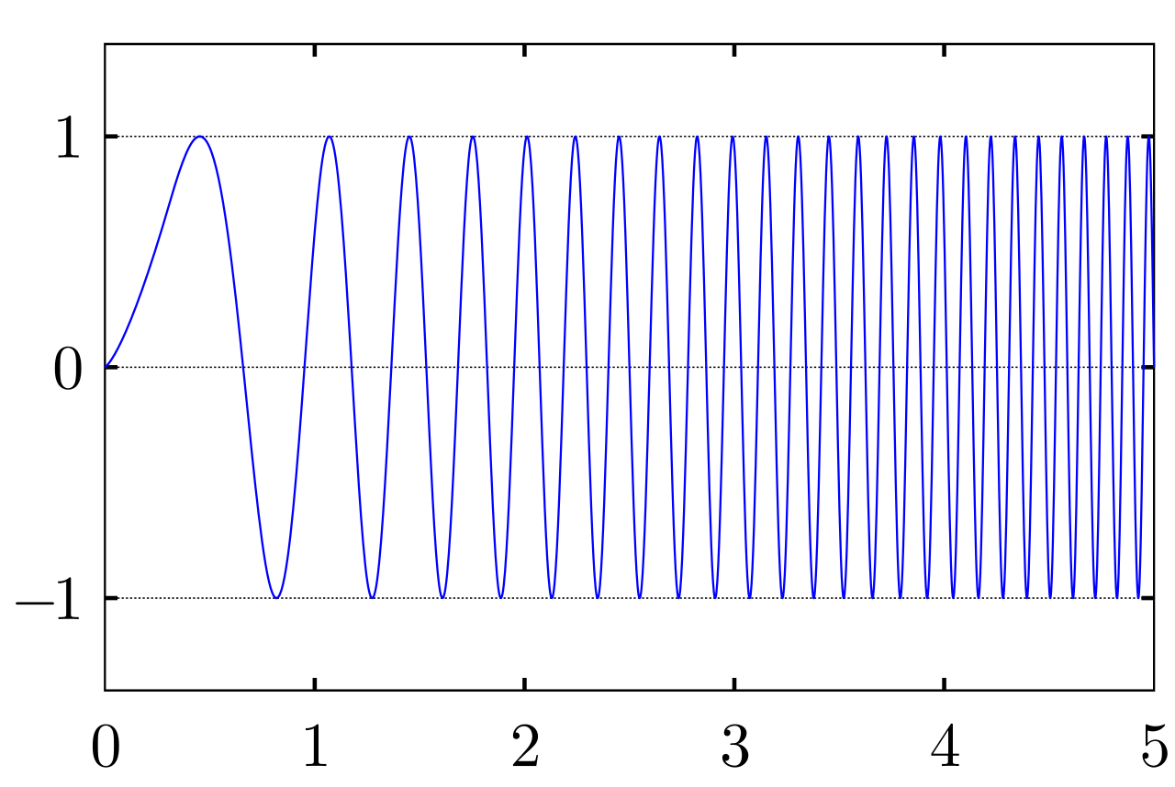
Low-Power Wide-Area Networks (LPWANs)
LoRa chirp with different spreading factors
chirp
Chirp signal
1760
bits/s
980
bits/s
440 bits/s
250 bits/s
https://en.wikipedia.org/wiki/Chirp

Slide 6
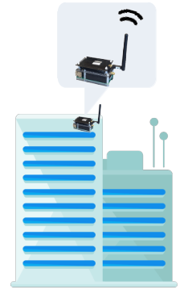


Energy unfairness in LoRa networks
Transmitting 10 bytes under 125kHz bandwidth: 14.6ms for SF7 and 320ms for SF12

Slide 7
Energy unfairness in LoRa networks
Transmitting 10 bytes under 125kHz bandwidth: 14.6ms for SF7 and 320ms for SF12
22x transmission time of SF12

Slide 8
Energy unfairness in LoRa networks
Transmitting 10 bytes under 125kHz bandwidth: 14.6ms for SF7 and 320ms for SF12
Energy unfairness
Run out of batteries much faster

Slide 9




Static resource allocation for fairness
Channel
Spreading factor
Transmission power
…
$$\min{max} p_{collision}(ch,sf,tp)$$
{ch₃,sf₃,tp₃}
$$\max{min} EE(ch,sf,tp)$$
{ch₄,sf₄,tp₄}
{ch₁,sf₁,tp₁}
{ch₂,sf₂,tp₂}

Slide 10
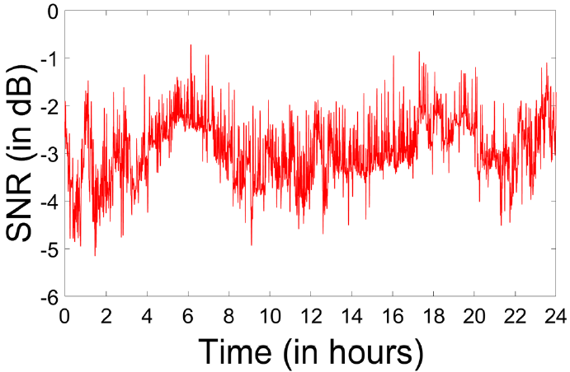

Wireless Links Dynamics
Static allocation is inefficient: Adaptive allocation
[1] Akshay Gadre, Revathy Narayanan, Anh Luong, Anthony Rowe, Bob Iannucci and Swarun Kumar. "Frequency Configuration for Low-PowerWide-Area Networks in a Heartbeat." in Proceedings of USENIX NSDI, 2020.

Slide 11
Inefficiency of static allocation
AdapLoRa: Adaptive allocation in LoRa networks

Slide 12
AdapLoRa
When to adapt?
How to adapt?
The unique feature: overhead of downlinks
…
Max-min optimization
Channel condition
Time

Slide 13
Challenge: overhead of downlinks
Transmission latency
Energy consumption

Slide 14




Challenge: overhead of downlinks
Transmission latency
Energy consumption
SF12, 14 bytes: 991ms
x1000 end devices
991.8s
LoRaWANs downlinks: Unicasting
Hundreds of end devices

Slide 15
Challenge: overhead of downlinks
Transmission latency
Energy consumption

Slide 16
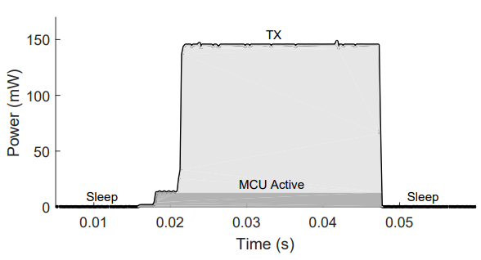
Challenge: overhead of downlinks
Transmission latency
Energy consumption
New allocation

Slide 17
Challenge: overhead of downlinks
Transmission latency
Energy consumption
New allocation
Energy consumption of receiving:
Almost half of that of transmission
Notes:
Generally，consume time to receive packets instead of keeping idle

Slide 18


Overview
Periodically evaluate network lifetime improvement
Allocation calculation

Slide 19
AdapLoRa
Collecting packets from the end devices:
  Obtaining bit error rate as the baseline of an allocation
Allocation calculation

Slide 20
AdapLoRa
Making decision:
  Modelling the network lifetime with different allocation
Allocation calculation

Slide 21
AdapLoRa
Decision dissemination
Allocation calculation

Slide 22
Decision making
Reducing downlinks latency
Allocation calculation

Slide 23

Decision making
Reducing downlinks latency
$$min \sum_{i=1}^{N}{latency ({sf}_{i})}$$
$${s.t. Lifetime}_{new}−{Lifetime}_{old}>δ$$

Slide 24
Decision making
Reducing downlinks latency
  Achieving network lifetime improvement with the shortest latency
SF9
SF12
SF7
SF11

Slide 25


Decision making
Evaluating different resource allocation
  Network lifetime:
  Symbol-level network model:
$$L_{i}=\frac{E_{i}}{(\frac{E_{t}^{i}}{1−r_{i}}+E_{r}^{i}+E_{s}^{i})}∙T_{g}$$
$${ser}_{i}=P\{\max_{n,n≠m}\left|N_{n}\right|+\left|I_{n}\right|>\left|E_{m}\right|+\left|N_{m}\right|\}$$
$$=P\{\left(\left(1+\sum_{\begin{aligned}j∈N, \\ {sf}_{i},{ch}_{i}\end{aligned}}{p_{j}∙a\left(d_{j}\right)}\right)∙φ_{n}\right)>(p_{i}∙a\left(d_{i}\right)+1)∙θ_{m}\}$$

Slide 26
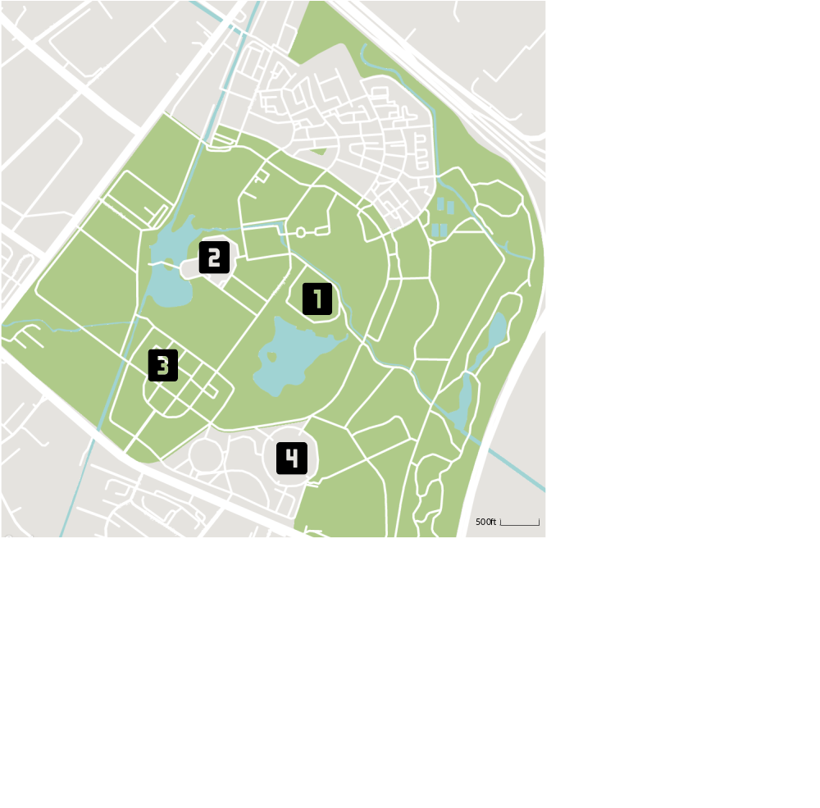
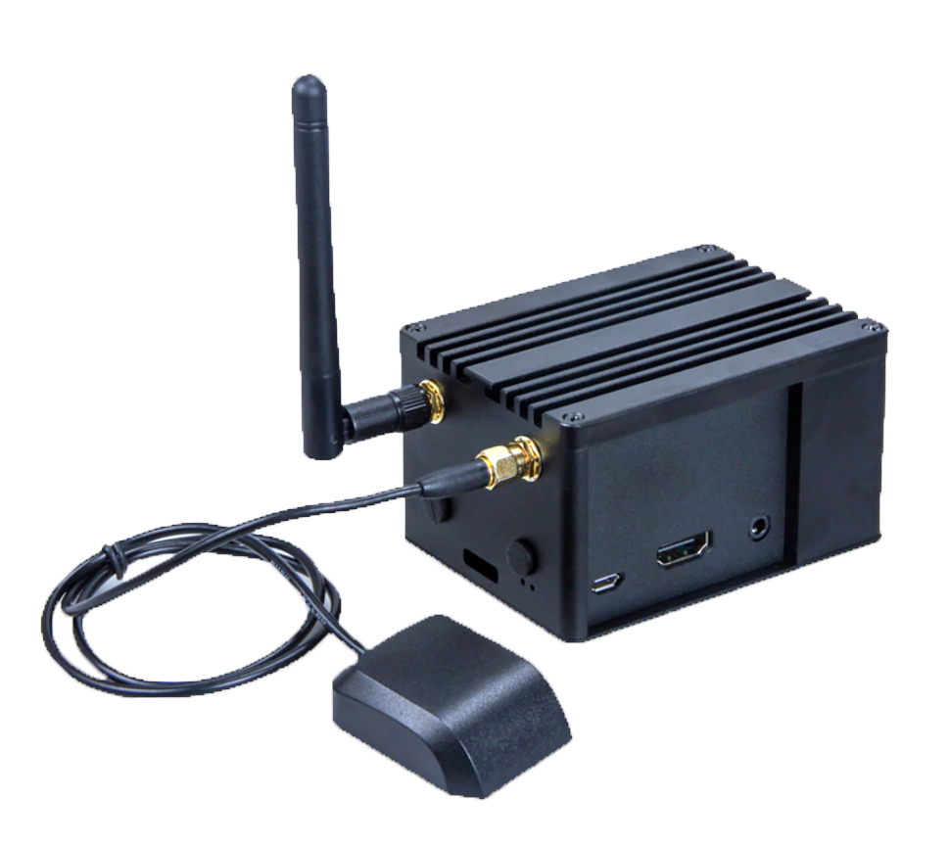
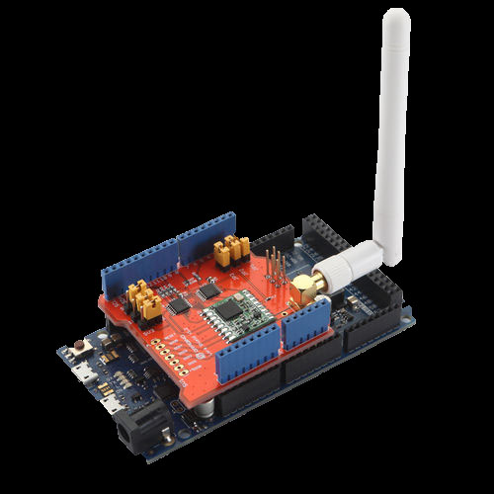
Evaluation
Testbed experiments
Benchmark
  EF-LoRa (static resource allocation with energy fairness)
Gateway
End device

Slide 27
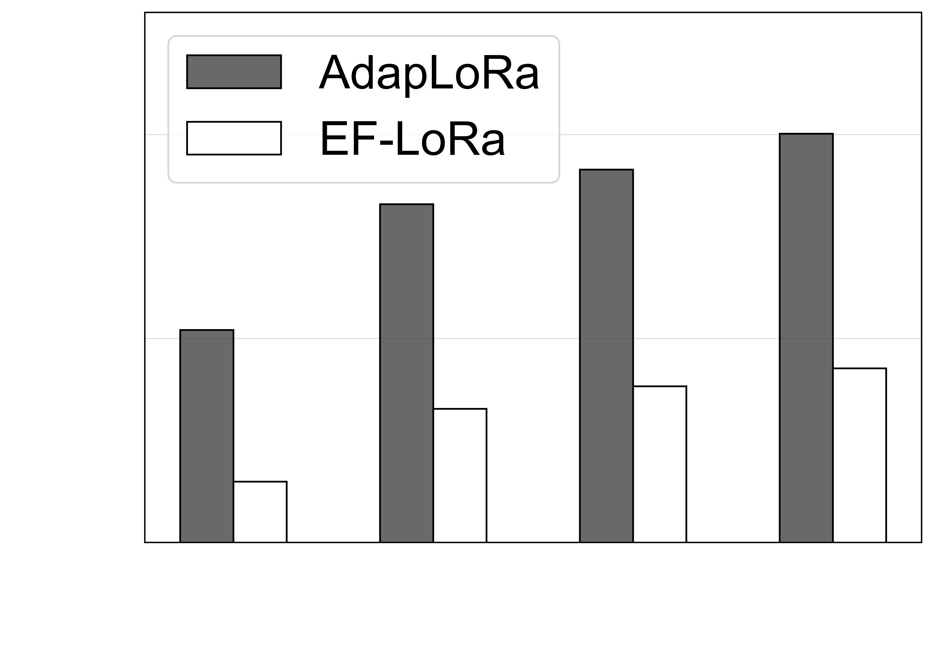
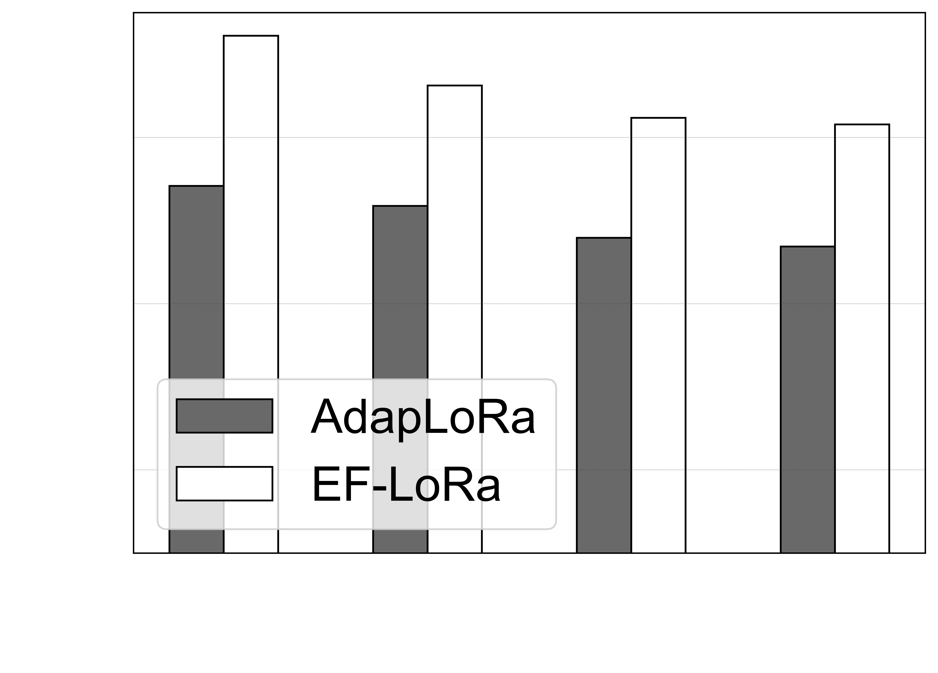
Testbed results
Network lifetime and energy fairness

Slide 28
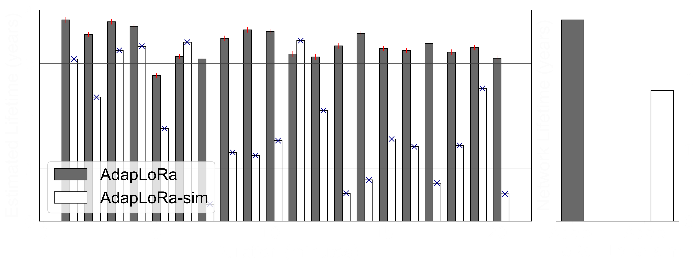
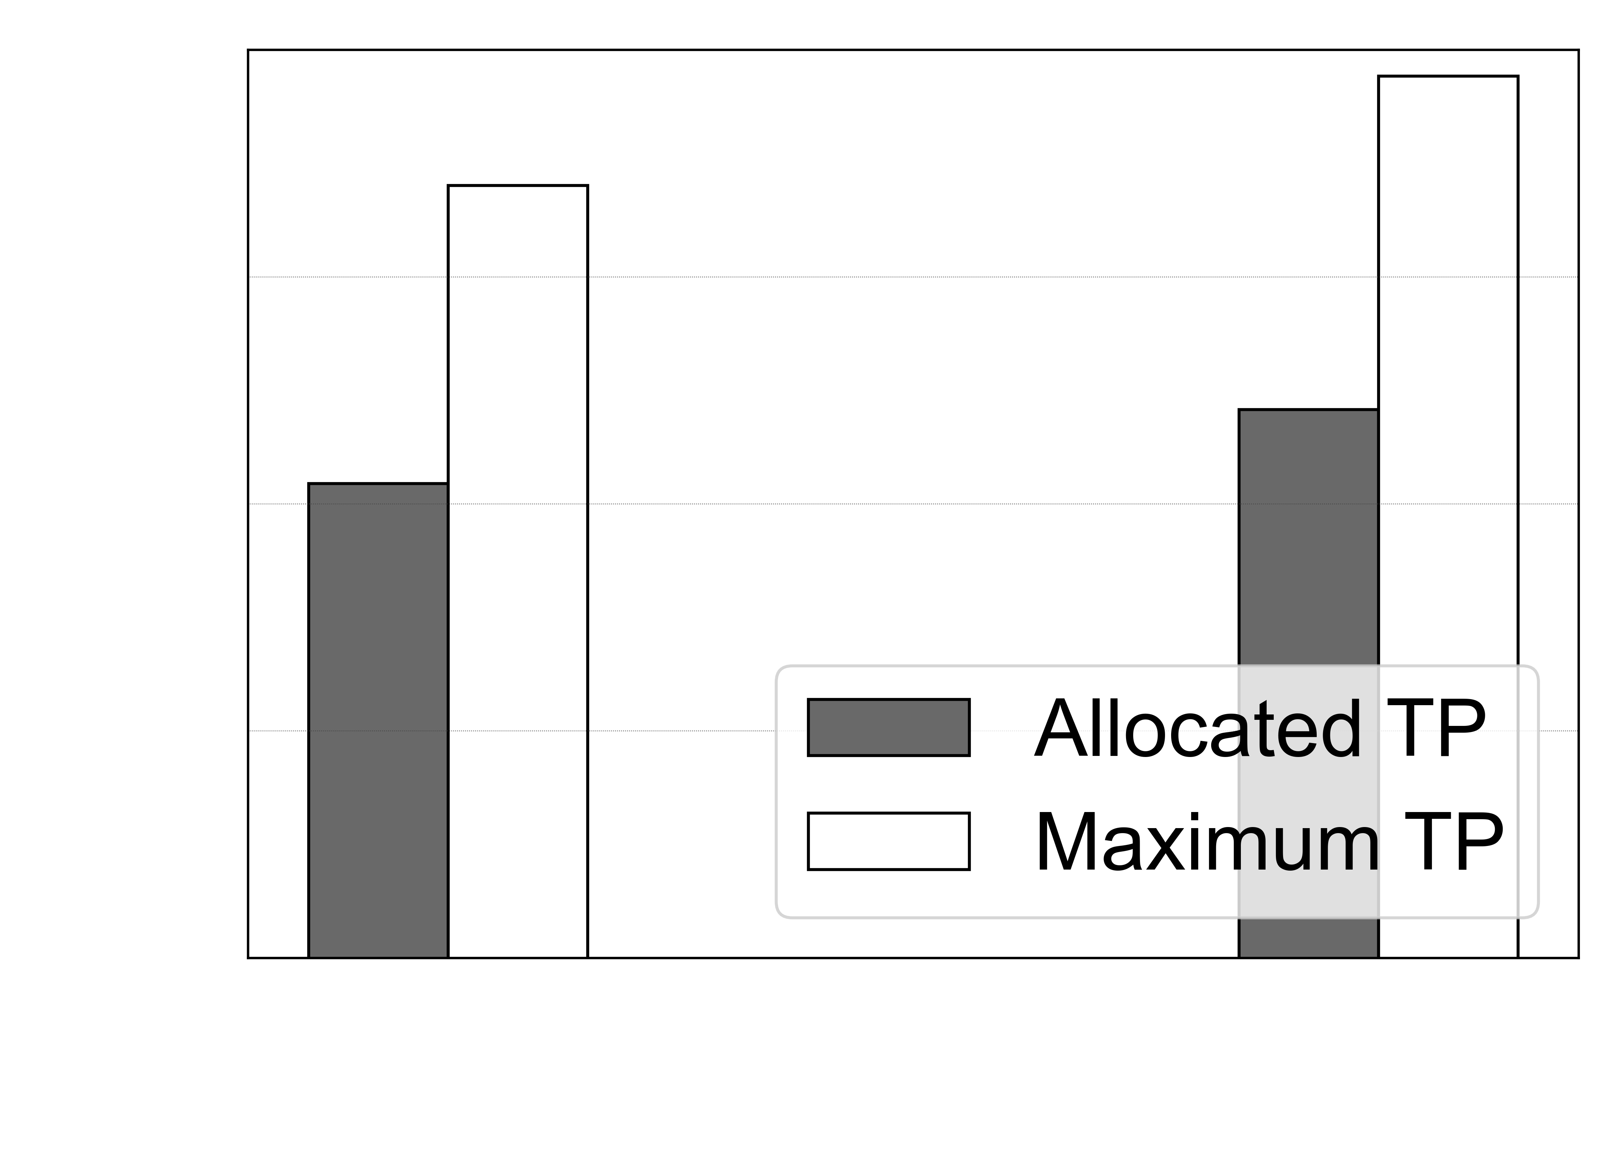
Performance decomposition
Consideration of downlinks overhead
Impact of transmission power

Slide 29
Conclusion
First to solve the resource adaptation problem considering downlinks overhead
Estimating the network lifetime with periodically updated network model
Fine-grained network model considering the impact of bit level error correction scheme

Slide 30
Thank you！
Q&A

