Slide 1

CloakLoRa:
A Covert Channel over LoRa PHY
Ningning HOU, Yuanqing Zheng
The Hong Kong Polytechnic University
ICNP 2020, Oct. 2020
Notes:
Hello, everyone. My name is HOU Ningning，I am a PhD student at The Hong Kong Polytechnic University. The paper I will present today is titled “CloakLoRa：A covert channel over LoRa PHY”. This is a joint work with my supervisor Dr. Zheng Yuanqing

Slide 2
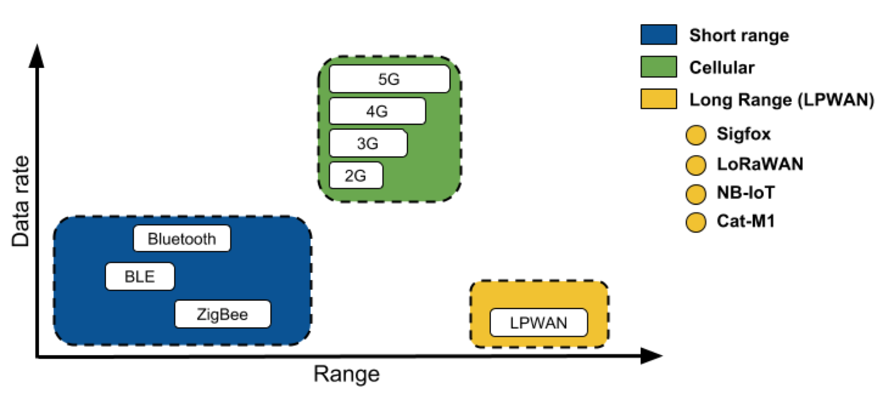



LoRa (Long Range) technology
Bandwidth
Range
Battery Life
125 KHz
1-10 kms
10 years on AA battery
Notes:
As we all know, long range technology, which simplified as LoRa, is one of the most promising LPWAN technologies. LoRa works with narrow bands and can transmit up to 10 km with a battery life of up to 10 years. Thus LoRa is very suitable for resource constrained, long range and low data rate applications.

Slide 3

LoRaWAN applications
Smart healthcare
Notes:
For example, to against Covid-19, one Italian company equipped Medical Gas Value Monitoring system with LoRaWAN for data transmission, which allows hospital staff to remotely monitor and control the amount of oxygen remaining in the cylinder.

Slide 4

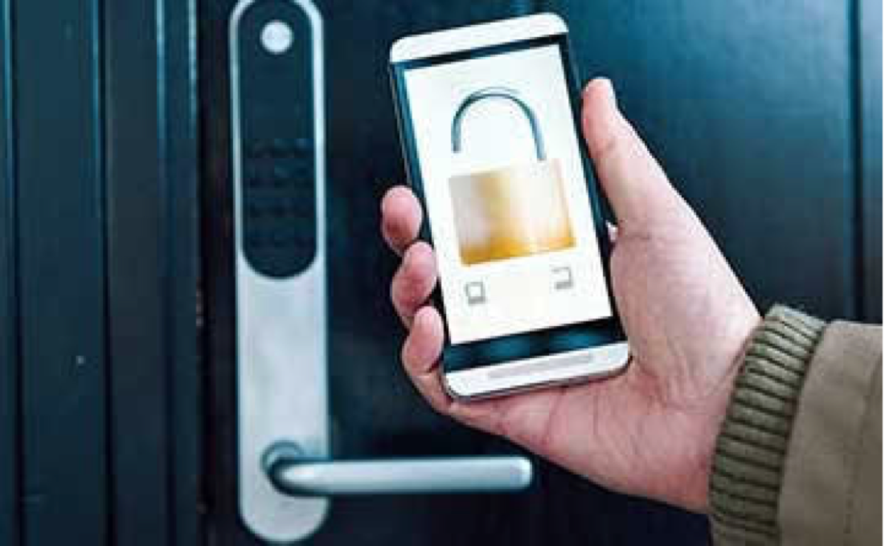

LoRaWAN applications
Smart healthcare
Smart city
Smart home
Smart supply chain
Notes:
Besides healthcare, LoRa has also been used in smart city, smart home, smart supply and so on.

Slide 5

Security issues of LoRaWAN
Smart healthcare
Smart city
Smart home
Smart supply chain
Notes:
However, the security issue of LoRaWAN is a big concern. For IoT applications, security is more important than ever. Then we ask a question: Is LoRaWAN secure?

Slide 6
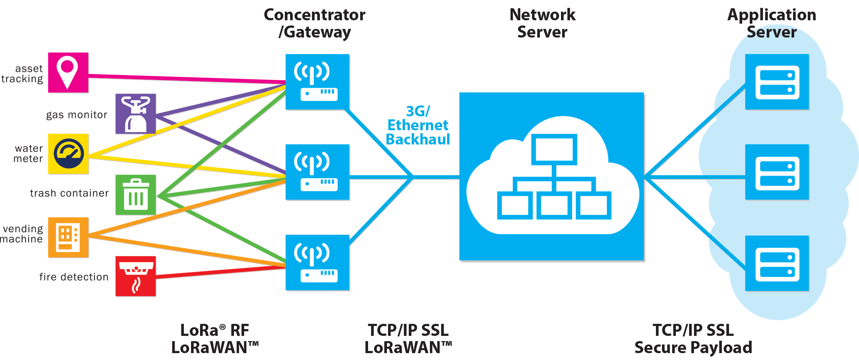
Is LoRaWAN secure? No!
PHY less protected
NwkSkey
AppSkey
Notes:
This figure shows the LoRaWAN topology. The sensor data will be encrypted at the network layer [ ] and application layer [ ]. These two layers use AES encryption to secure the end-to-end communication.
However, the above message encryptions only work at the upper layers, [ ] while the LoRa physical layer remains less protected, which leaves LoRa PHY vulnerable to attack.

Slide 7
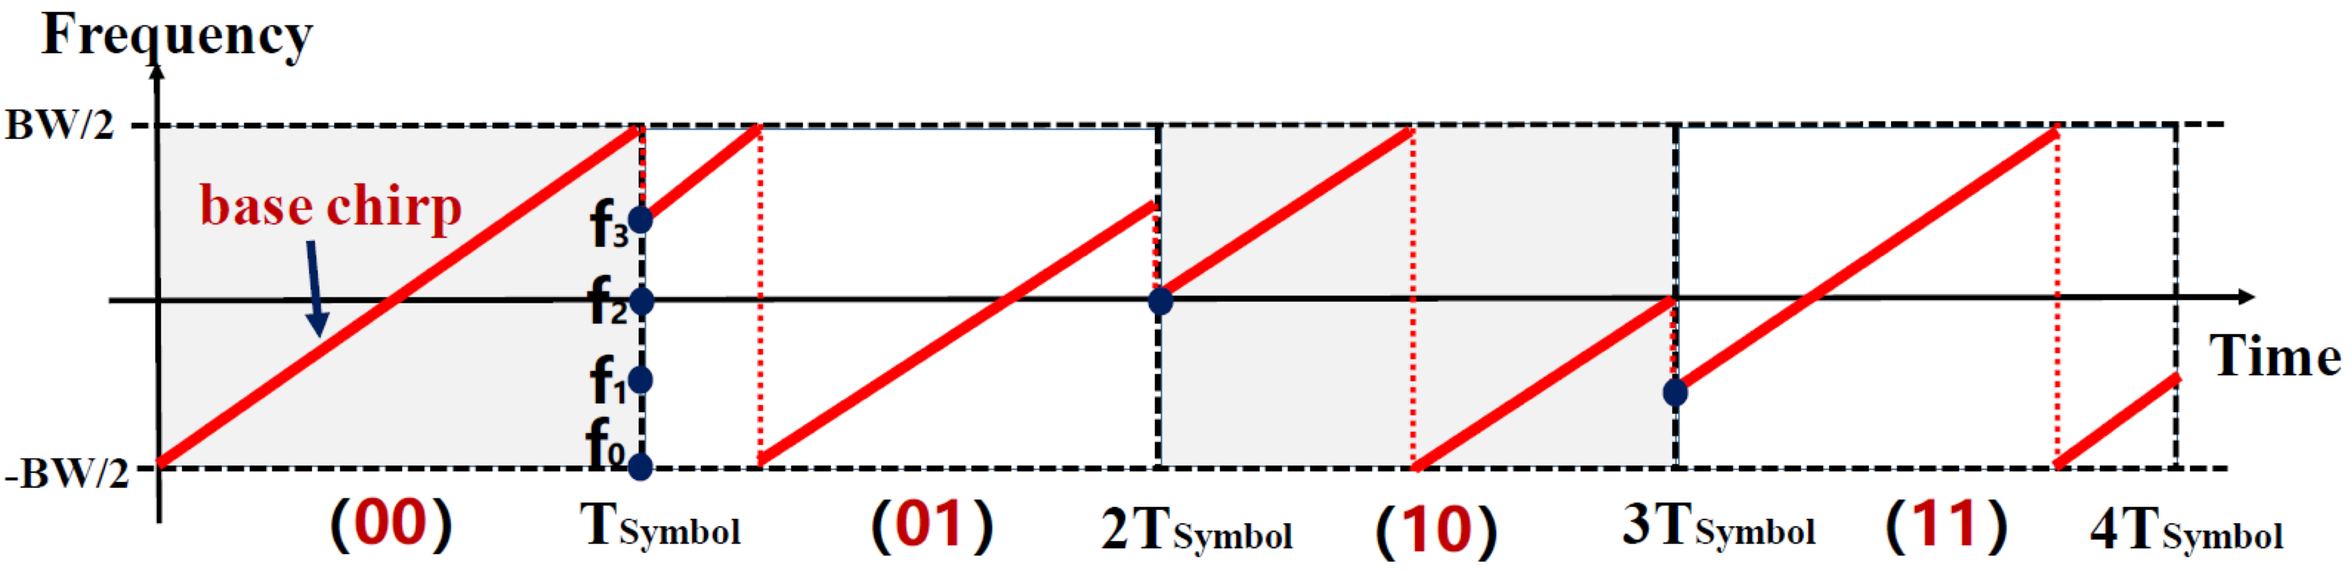

LoRa modulation
Chirp Spread Spectrum (CSS)
How to modulate 2 bits (00, 01, 10, 11)?
Use initial frequency of the chirp to indicate data.
00—>f0
01—>f3
10—>f2
11—>f1
Notes:
LoRa physical layer uses chirp spread spectrum to modulate data. How it works? It uses initial frequency of the chirp to indicate data. Assume we need to modulate 2 bits with each symbol, namely (“00”, “01”, “10”, “11”) . Then we need 4 different chirps with different initial frequencies. [ ] For example, 01 uses f3 as the initial frequency.

Slide 8
LoRa modulation
Chirp Spread Spectrum (CSS)
How to modulate 2 bits (00, 01, 10, 11)?
Use initial frequency of the chirp to indicate data.
00—>f0
01—>f3
10—>f2
11—>f1
Notes:
LoRa physical layer uses chirp spread spectrum to modulate data. How it works? It uses initial frequency of the chirp to indicate data. Assume we need to modulate 2 bits with each symbol, namely (“00”, “01”, “10”, “11”) . Then we need 4 different chirps with different initial frequencies. For example, 01 uses f3 as the initial frequency.

Slide 9
LoRa modulation
Chirp Spread Spectrum (CSS)
How to modulate 2 bits (00, 01, 10, 11)?
Use initial frequency of the chirp to indicate data.
00—>f0
01—>f3
10—>f2
11—>f1
Notes:
LoRa physical layer uses chirp spread spectrum to modulate data. How it works? It uses initial frequency of the chirp to indicate data. Assume we need to modulate 2 bits with each symbol, namely (“00”, “01”, “10”, “11”) . Then we need 4 different chirps with different initial frequencies. For example, 01 uses f3 as the initial frequency.

Slide 10
LoRa modulation
Chirp Spread Spectrum (CSS)
How to modulate 2 bits (00, 01, 10, 11)?
Use initial frequency of the chirp to indicate data.
00—>f0
01—>f3
10—>f2
11—>f1
Notes:
For example, 01 uses f3 as the initial frequency.

Slide 11
LoRa PHY Vulnerability
LoRa demodulation
Initial frequency
Other PHY parameters
Amplitude
Phase
Waveform
Goal: Build a covert channel over LoRa PHY to leak information out secretly
Notes:
For demodulation, LoRa also examines the initial frequency of chirps. However, [ ] there are other PHY layer parameters, for example, amplitude, phase, and waveform. These parameters are overlooked by the receiver, which leaves opportunities for attacker.
[ ] Our work aims to use amplitude to build a covert channel over LoRa PHY.

Slide 12
Design requirements
Be covert to regular LoRa transceiver
Be efficient to support more information leakage
Not substantially affect the communication performance of regular LoRa transceiver
Notes:
To achieve this goal, we first summarise the design requirements of covert channel.
First, the channel should be covert to regular LoRa transceiver. Covert means secrete. The legitimate LoRa transceiver should not be aware of the existence of covert communication.
Second, the channel should be efficient to support more information leakage.
And third, the covert channel should not substantially affect the regular LoRa communication.
//Current LoRa transmitter and receiver only examines the initial frequency of LoRa chirps to extract data but overlooks the amplitude. So Amplitude based covert channel is covert to regular LoRa transceiver and can bypass upper layer security mechanism.
Second, we aim to improve the efficiency of covert channel to support more information leakage.
And third, the covert channel should not substantially affect the regular LoRa communication performance.
//Now let’s focus on the second one.
//It turns out, however, this design requirement inherently conflicts with the second requirement. We need to strike a balance.

Slide 13
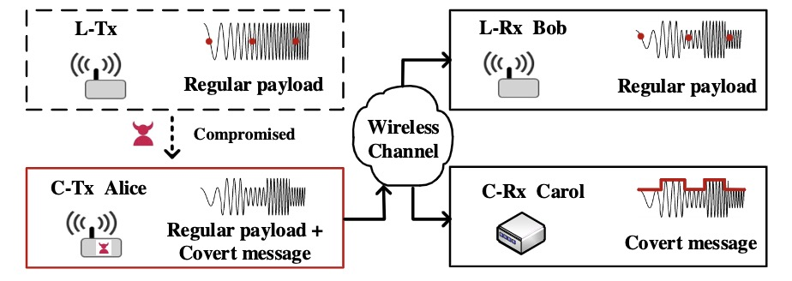
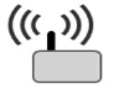
Attack model
Victim
LoRa node or gateway
Attacker
Software-based malware
Hardware-based spy chip
How to attack?
Modify the firmware of sensor node
Add micro hardware components in the PCB board
Notes:
Then I introduce the high level idea of our covert channel. In our scenario, Victim Alice [ ] is compromised to leak covert information. Alice can be a LoRa node or LoRa gateway.
[ ] As for attacker, an attacker can be an insider who aims to secretly send out sensitive information. An attacker can also be a LoRa node manufacturer who can modify the firmware of sensor node or add micro hardware components in the PCB board before delivering the bugged sensor to users.
Then the signal transmitted by Alice contains both original CSS information and AM covert information.

Slide 14
Attack model
Victim
LoRa node or gateway
Attacker
Software-based malware
Hardware-based spy chip
AM modulated LoRa chirps carry
original CSS information & AM covert information
Notes:
Then I introduce the high level idea of our covert channel. In our scenario, Victim Alice is compromised to leak covert information. Alice can be a LoRa node or LoRa gateway.
Attacks can be done by either software-based attack or hardware based attack. For example, an attacker can be an insider who aims to secretly send out sensitive information without being detected. An attacker can also be a LoRa node manufacturer who can modify the firmware of sensor node or add micro hardware components in the PCB board to enable covert communication before delivering the bugged sensor node to users.
In this way, the signal transmitted by Alice contains both original CSS information and AM covert information.

Slide 15
Attack model
Legitimate receiver Bob receives CSS modulated LoRa packet
Bob overlooks amplitude—>Not aware of covert channel
Notes:
The legitimate receiver Bob receives CSS LoRa packet. Since Bob only examines the initial frequency but overlooks amplitude, Bob cannot be aware of the existence of covert channel.

Slide 16
Attack model
Covert channel receiver Carol receives AM modulated covert info
Carol knows covert channel implementation detail
Carol does not need to decode regular LoRa packet
Notes:
While the covert receiver Carol receivers AM covert information. We assume that only Carol knows the implementation details of covert channel. Therefore, Carol can leverage the knowledge of the implementation to detect the existence of a covert channel and secretly receive the covert data. Carol only extracts the embedded covert information and doesn’t need to decode a regular LoRa packet.

Slide 17
Attack model
Covert channel
This AM-based channel is covert to regular LoRa transceiver
Notes:
Thus we can build an AM based covert channel over LoRa PHY. [ ] And this channel is covert to regular LoRa transceiver.

Slide 18
Design requirements
Be covert to regular LoRa transceiver
Be efficient to support more information leakage
Not substantially affect the communication performance of regular LoRa transceiver
Notes:
So our design can meet the first requirement. Now we move on to the second requirement: To improve the efficiency of covert channel.
//Current LoRa transmitter and receiver only examines the initial frequency of LoRa chirps to extract data but overlooks the amplitude. So Amplitude based covert channel is covert to regular LoRa transceiver and can bypass upper layer security mechanism.
Second, we aim to improve the efficiency of covert channel to support more information leakage.
And third, the covert channel should not substantially affect the regular LoRa communication performance.
//Now let’s focus on the second one.
//It turns out, however, this design requirement inherently conflicts with the second requirement. We need to strike a balance.

Slide 19
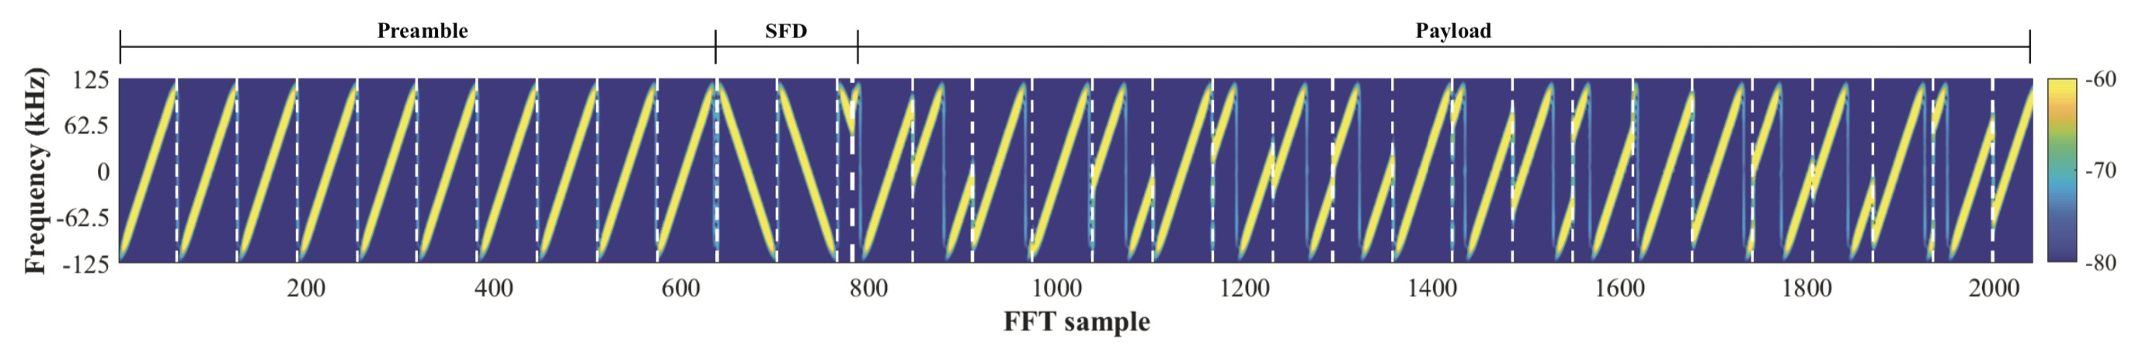
Straw-man approach
Configure the transmission power
COTS devices allow users to configure RF before sending a packet
Packet-level amplitude modulation
Inefficient: low duty cycle (1%) of LoRa
How to achieve higher data rate?
Notes:
To build a covert channel using amplitude modulation, a straw-man approach is to vary the transmission power of a LoRa node before every packet transmission.
Commodity LoRa devices allow users to configure the RF output before sending a packet. We can use lower power to indicate bit ‘0’ and high power to indicate bit ‘1’. A covert channel receiver may measure the RSSI to infer the covert information.
[ ] However, this packet-level amplitude modulation approach cannot [ ] provide sufficient data rate for practical covert channel applications. Because the duty cycle of LoRa is only 1%.
[ ]So how to achieve high data rate covert transmission under the constraint of low duty cycle?
Using power of one packet is low efficient, but what if using one chirp? [ ]
Each LoRa packet contains multiple chirps. Ideally, if we can vary the amplitude of chirps, we can transmit covert data at higher speed.

Slide 20
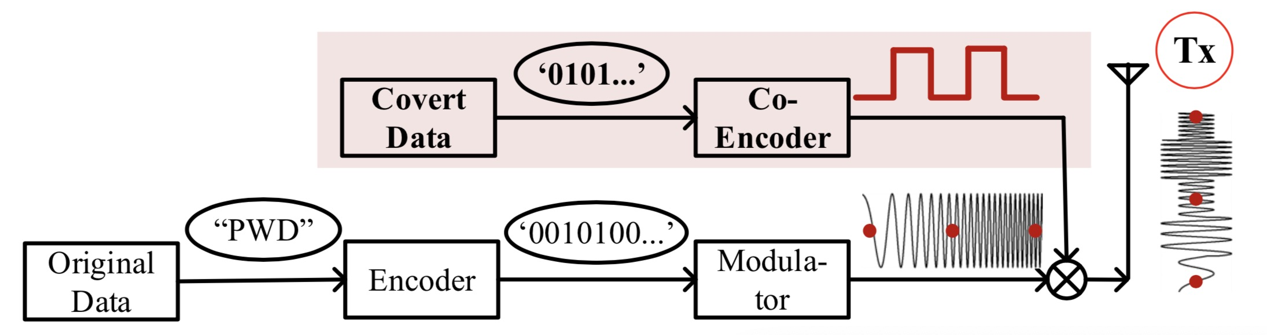
Advanced solution
Chirp-level amplitude modulation
Lower chain —> generate regular LoRa chirps
Upper chain —> generate AM signals
Notes:
So the advanced solution is to enable chirp level amplitude modulation. We propose to add an AM component to generate amplitude-modulated LoRa chirps.
The workflow of advanced covert transmitter contains two chains.
The lower chain is responsible for generating regular LoRa chirps while the upper chain generates AM signals. We multiply these two signals before transmission.
By configuring the duration of AM signals, we can modulate LoRa signals at chirp level.

Slide 21
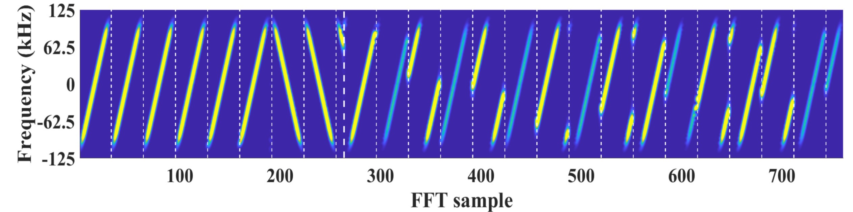
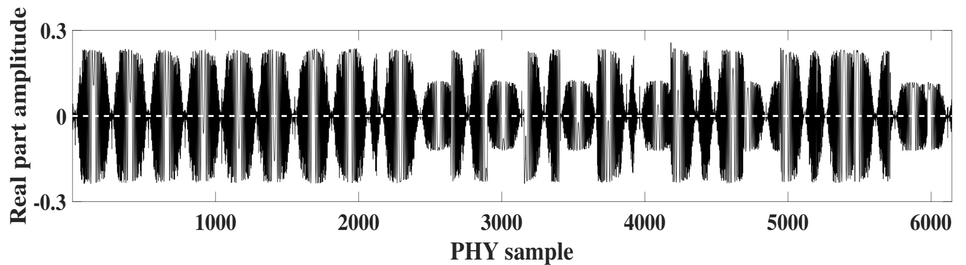
Advanced solution
Chirp-level amplitude modulation
Covert bits:
1 0 1 0 1 0 1 0 1 1 0 1 1 1 0…
Freq. domain
High
Low
Time domain
How to apply this to commodity LoRa node?
Notes:
We further test the feasibility of this idea by using software defined radios.
These two figures show results. The upper figure is a LoRa packet in frequency domain and lower one, in time domain. We control the amplitude of payload chirps to high and low states alternatively. The amplitude in frequency domain is color-coded.
[ ] Light color indicates high power, [ ] while dark color indicates low power. If Alice uses chirp with lower power to indicate bit ‘0’ and high power to indicate bit ‘1’, a series [ ] of covert bits can be embedded and Carol can use an envelope detector to decode the covert information.
[ ] Now the question is how to apply this to commodity LoRa nodes? Commodity LoRa devices don’t allow users to configure the power of chirps. Then how to change the amplitude of each chirp?

Slide 22
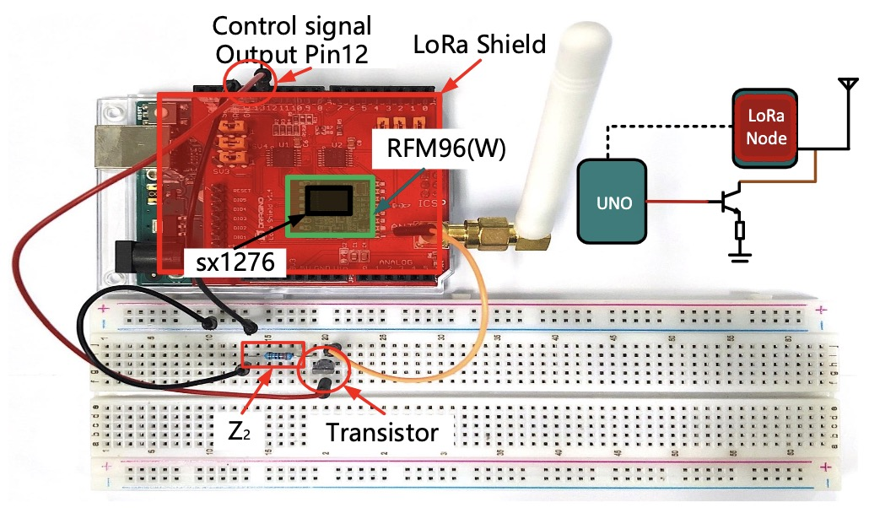

Covert Tx Prototype
Arduino Uno
Branch circuit
Component
Transistor
Resistor
Notes:
We use simple passive components to address this problem. This figure shows the our prototype with COTS LoRa.
[ ] The red one is loRa shield and the Green one is Arduino uno. The LoRa shield is sat on Arduino. We add a branch circuit [ ] to modulate LoRa signal at chirp level and this branch circuit only contains a transistor and a resistor.
So What’s the magic of these simple passive components?

Slide 23
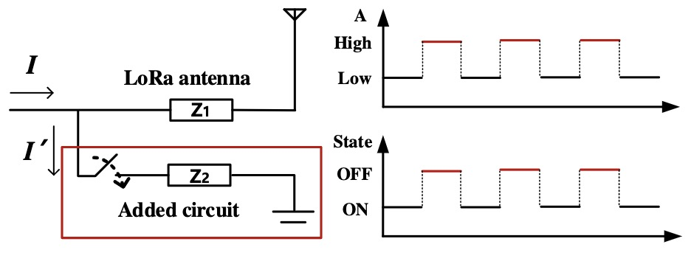
Branch circuit design
The switch controls the electric current through the antenna
Switch: OFF—> Branch circuit Open —> Current: I
Notes:
As shown in this figure, the switch in the new branch controls the electric current flows through the antenna load.
[ ] When the state of the switch is OFF, the current, denoted as I, flows through the antenna, as if there is no external circuit.

Slide 24
Branch circuit design
The switch controls the electric current through the antenna
Switch: OFF—> Branch circuit Open —> Current: I
Switch: ON —> Branch circuit Closed —> Current: I-I’
Adjust Z2 to vary I’
Notes:
When the state of the switch is ON, as a portion of current is leaked through the added circuit denoted as I ′ , the current flows through the antenna becomes I − I ′ . As such, the RF power of the outgoing signals becomes lower when the switch is ON, and becomes higher when the switch is OFF. As a result, by altering the state of the switch, we can generate changing amplitudes.
[ ] We can also control the lower amplitude value by adjusting Z2.

Slide 25
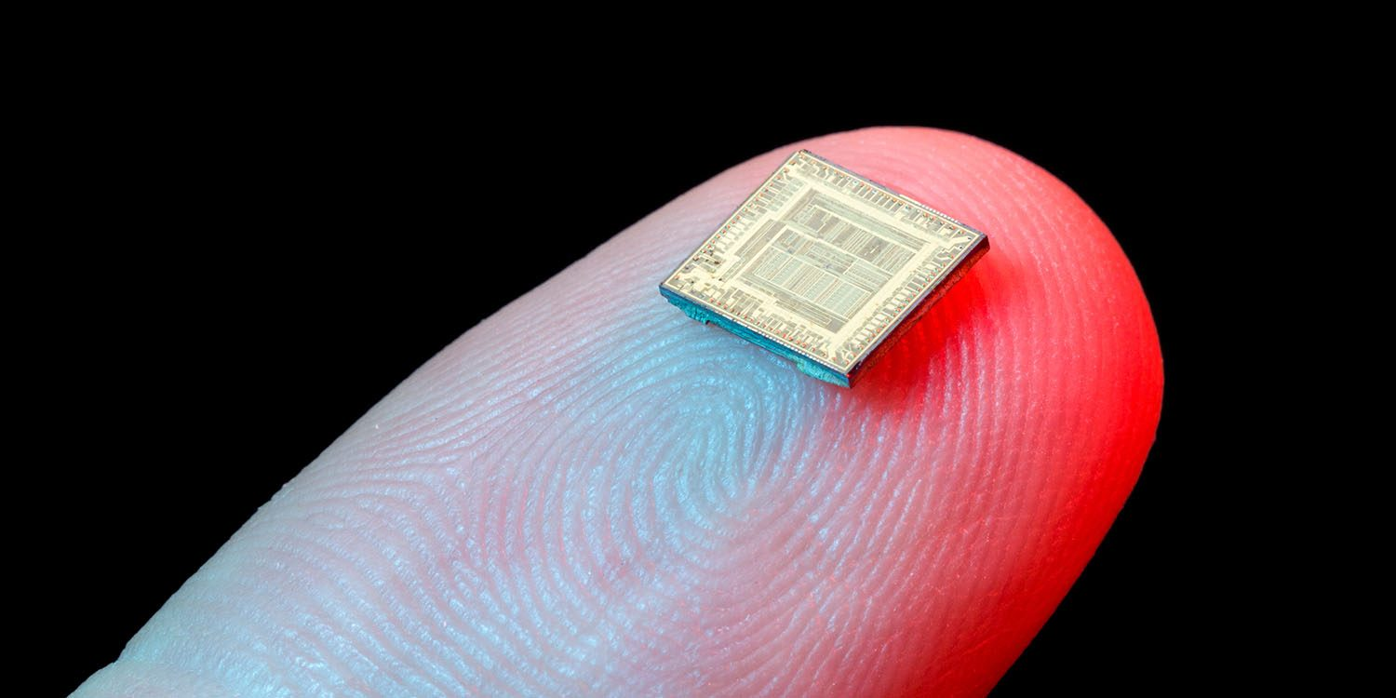
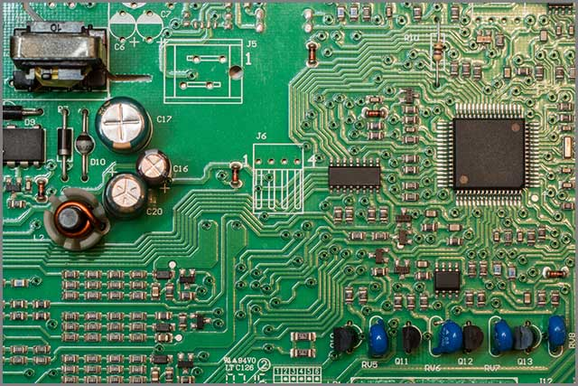
Covert Tx Prototype
Arduino Uno
Integrated
These passive components can be integrated in to tiny spy chips or PCB board of LoRa nodes.
Notes:
In practice, these passive components can be integrated in a tiny spy chip or PCB board of LoRa nodes before deliver them to the customer.

Slide 26

Covert Tx Prototype
LoRa PHY is vulnerable to attack!
Notes:
In practice, these passive components can be integrated in a tiny spy chip or PCB board of LoRa nodes before deliver them to the customer. This shows LoRa PHY is vulnerable to attack!

Slide 27
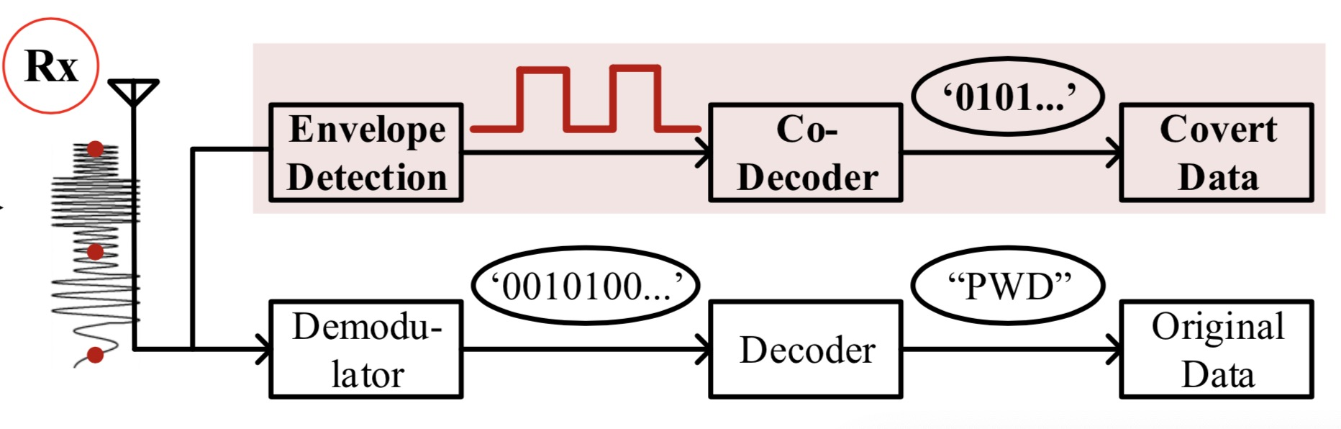
Covert Receiver
Covert receiver: Receive-only SDR dongle
Upper chain—> Covert receiver: Extract amplitude changes
Lower chain—> LoRa receiver: Extract initial frequency
Notes:
As for the covert receiver, we use receive-only SDR dongle. Because it only needs to extract amplitude changes.
[ ] The upper chain of this figure shows the workflow. Basically, we use envelope detection to extract the amplitude changes.

Slide 28
Design requirements
Be covert to regular LoRa transceiver
Be efficient to support more information leakage
Not substantially affect the communication performance of regular LoRa transceiver
Notes:
Till now, we have build AM based covert channel with high data rate.
Now we focus on the third requirement.
Since we vary the amplitude of LoRa signal, the regular LoRa communication may be impacted.

Slide 29
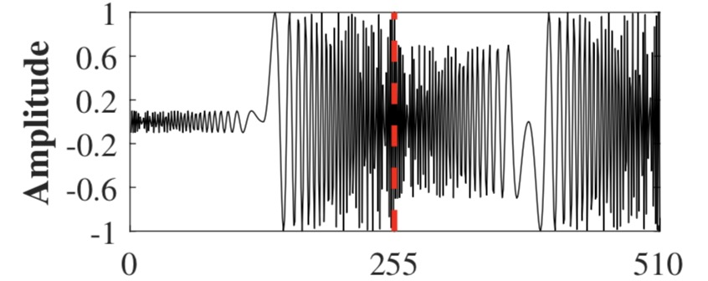


Impact on LoRa communication
Modulation Depth (D)
D=0.3
M
$$D=M/A$$
A
M: Peak-to-peak changes
D=0.9
A: Carrier amplitude
Covert receiver: larger D—> Higher SNR
Regular LoRa receiver: larger D—> Lower SNR of partial chirps
$$Conflict!$$
Adjust D—>Covert Rx can receive covert info correctly
&LoRa Rx can receive LoRa info correctly
Notes:
In our work, we use modulation depth (D) to represent signal variations of carrier waves. We define D = M/A, where M is the peak-to-peak changes and A is the original carrier amplitude.
[ ] For LoRa covert channel, a larger D is preferred as it indicates a higher SNR at covert channel receiver. However, for Bob, the legitimate LoRa receiver, a larger D means weaker signal strength of part of the regular LoRa chirps.
[ ] These two are conflict.
[ ] So in practice, Alice can actively adjust D and transmission power to make sure the covert information can be received by Carol while regular LoRa packets can be correctly decoded by Bob. In our prototype, we use a fixed D for proof-of-concept.
// attackers can adjust D by modifying the value of resistor Z2 in branch circuit.
//D indicates the degree of amplitude change.

Slide 30
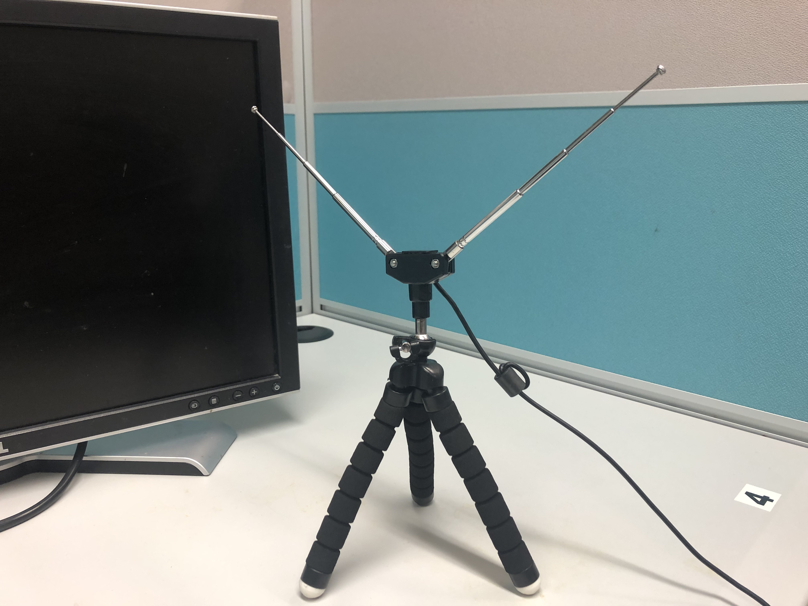
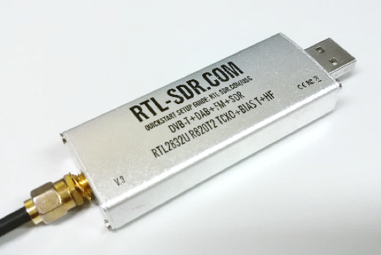
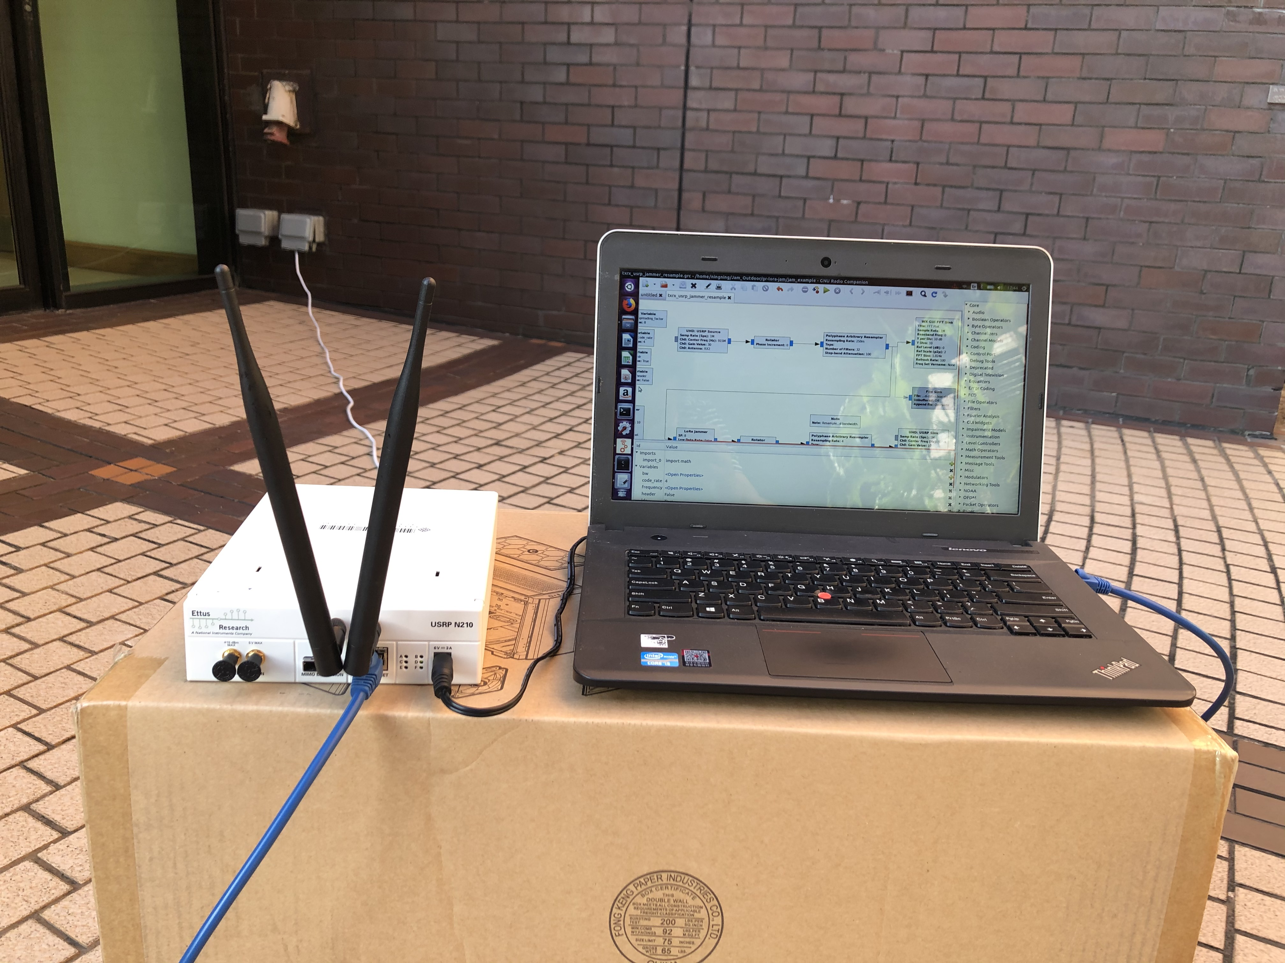
Evaluation
Covert Tx
Covert Rx
COTS LoRa node
LoRa shield
SX 1276
SDRs
USRP N210
Low cost receive-only SDR
RTL-SDR dongle
Notes:
For evaluation, we use both COTS LoRa node and software defined radios as covert transmitter. And we use low cost receive only SDR dongle as covert receiver.

Slide 31
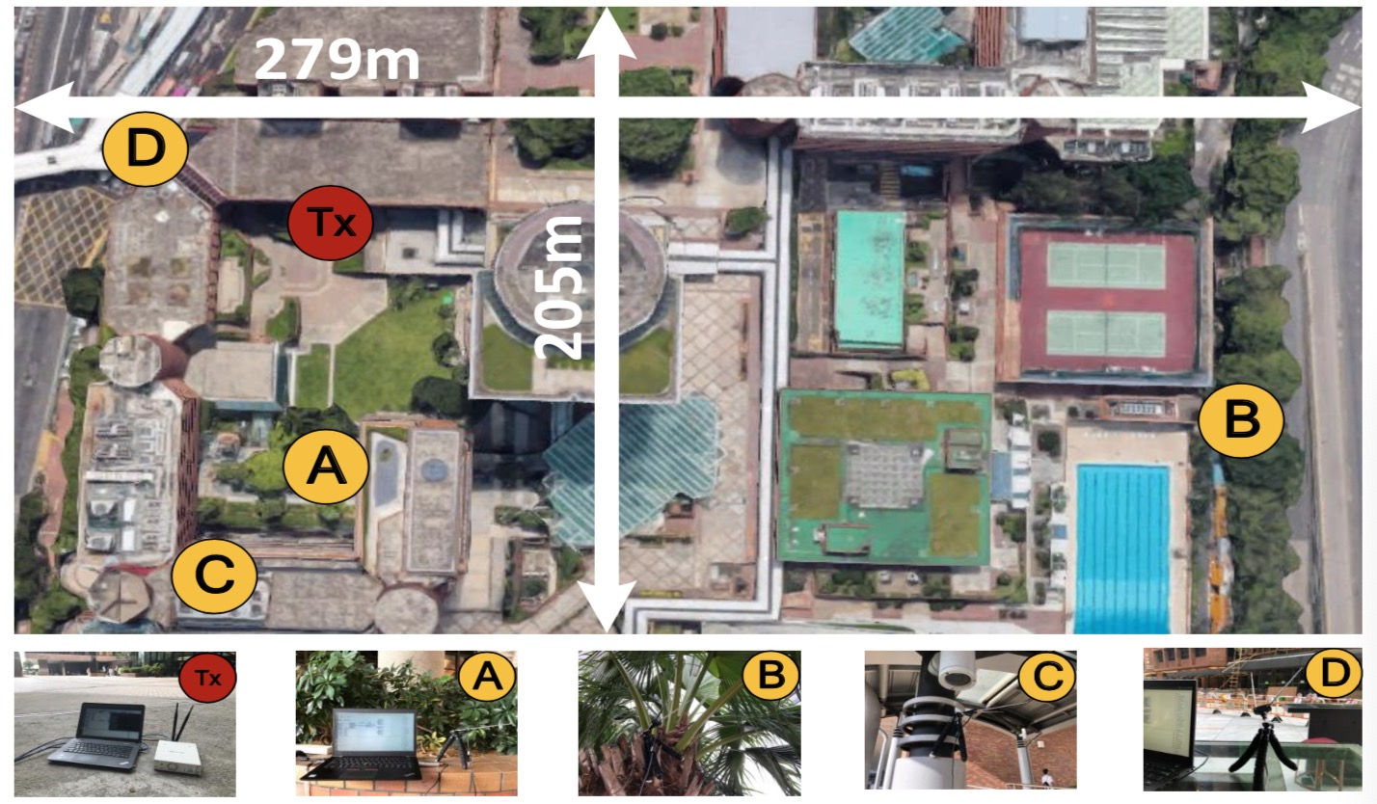
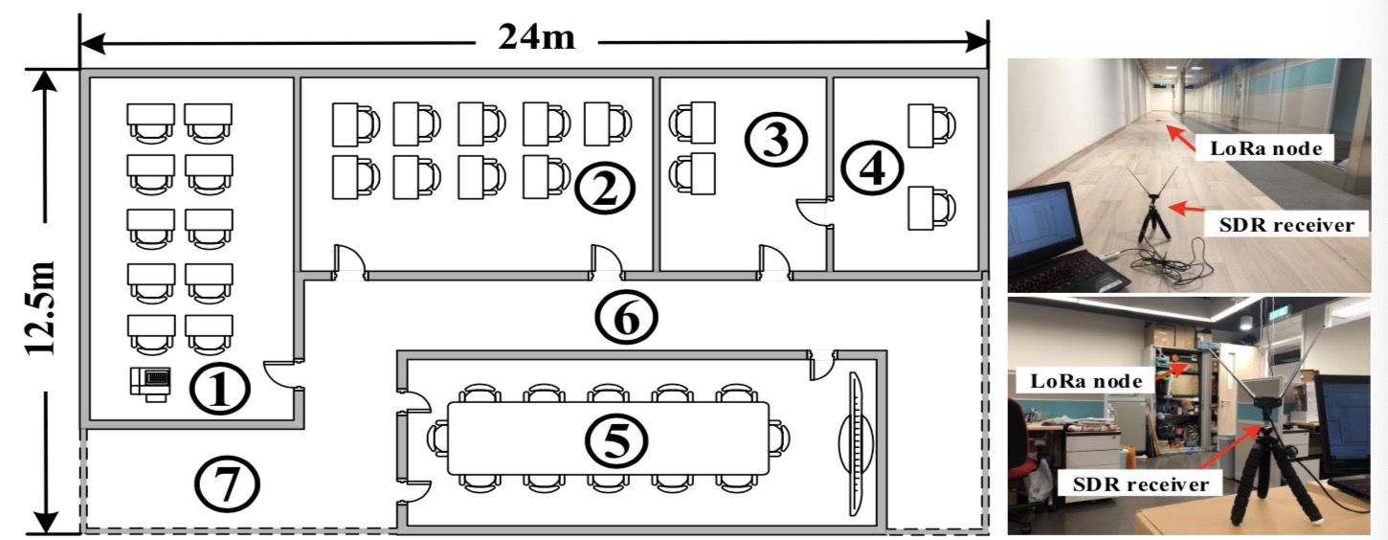
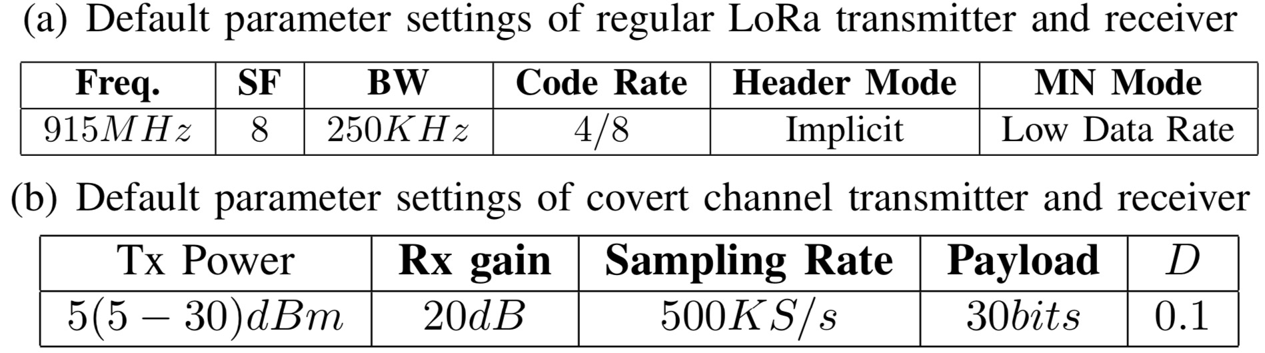
Evaluation
Evaluation metrics
Bit Error Rate (BER)
Throughput
Symbol Error Rate (SER)
Notes:
We conduct experiment with these devices in our campus in both outdoor and indoor environment.
And we use Bit error rate, throughput, and symbol error rate as evaluation metrics.
The tables show the default parameter settings of covert channel as well as regular LoRa communication.
We configure the regular LoRa works at 915 MHz ISM band and set bandwidth to 250 KHz.
For the covert message, we set payload length to 30 bits and default modulation depth to 0.1.

Slide 32
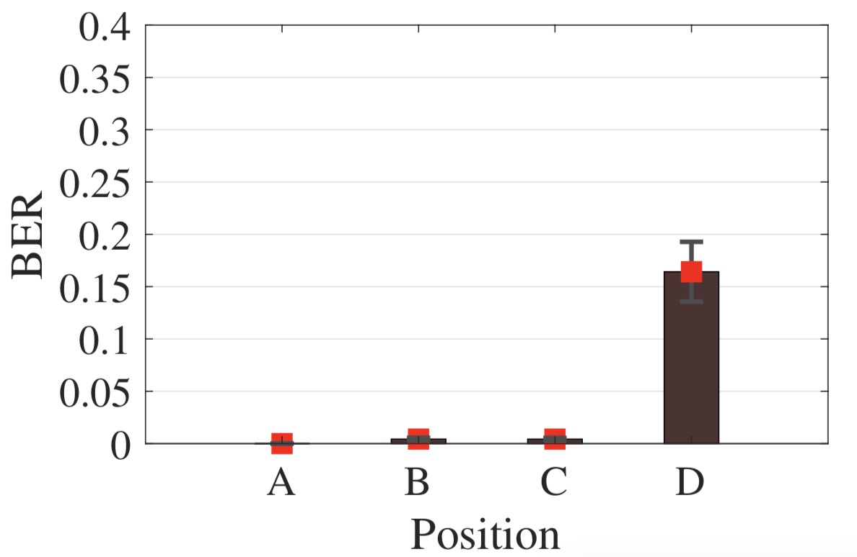
Covert communication range
Tx: USRP, Power: 30 dBm, D=0.3, Metrics: Bit Error Rate (BER)
NLOS
BER < 2%
Line-Of-Sight
250 m X 279 m = 69,750 m2
Effective range of covert channel can be influenced by communication distance & channel quality
Notes:
We first explore the effective communication range. We use USRP as Covert transmitter (red dot) and keep it stationary. We place the SDR dongle at four different positions in our campus. As the yellow dots show. The whole testbed spans about 70,000 meters square.
Results show that receivers at ABC with line-of-sight path to transmitter can achieve less than 2% bit error rate. While receiver at D, though closest to Tx, without line-of-sight path, gets much larger BER. Actually, there are multiple concrete walls and scaffold between them, making covert signal too weak to be decoded correctly by the SDR dongle.

Slide 33
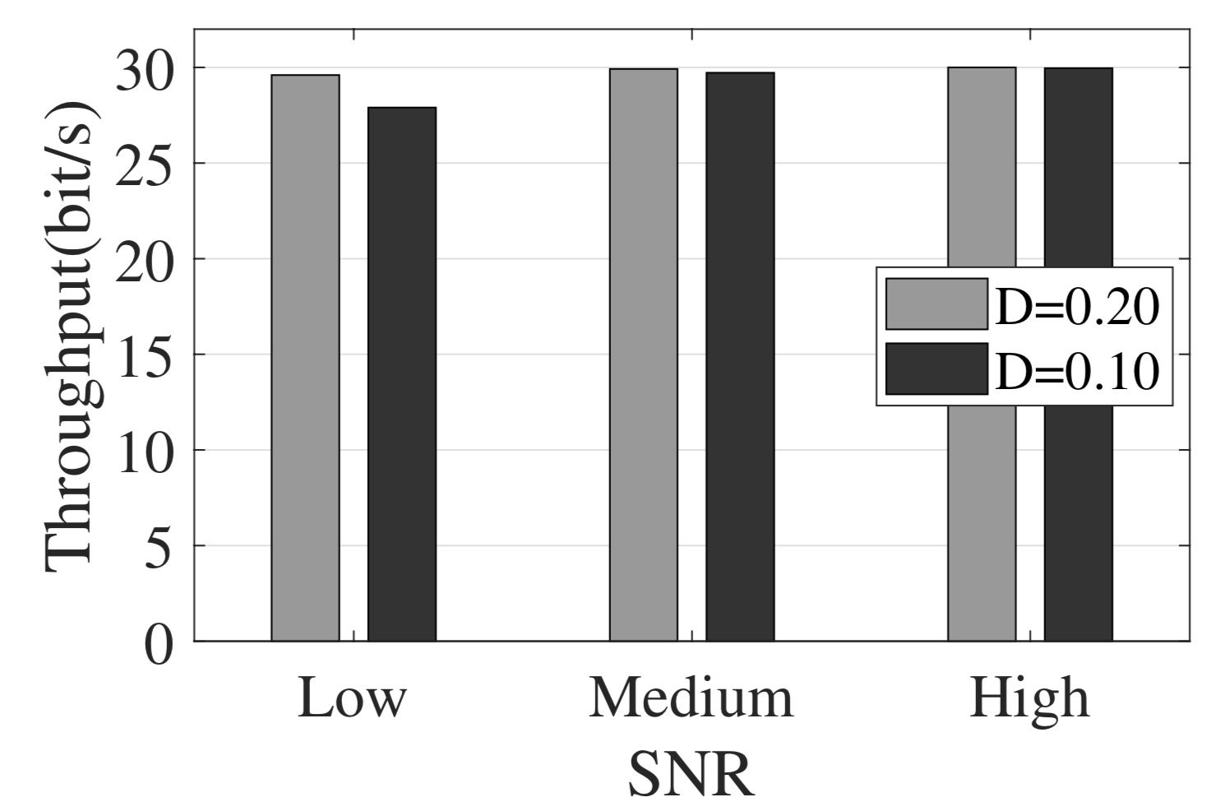
Throughput
Message sending: 1 pkt/s, payload length: 30
Packet-level: 1 bit/s
Chirp level: 30 bit/s
Improvement: 30 X
Improve throughput by extending payload length
Notes:
Next, we evaluate the throughput of covert channel. We configure the transmitter to transmit LoRa packet once per second and the payload length of covert message is 30 bits. This figure shows the throughput of covert channel in different SNR scenarios. If we use power of the whole LoRa packet as covert information, we can only transmit 1 bit per second. But if we use chirp level amplitude to encode covert information, we can transmit 30 bits per second. We can further improve covert channel throughput by extending payload length of covert packet.

Slide 34
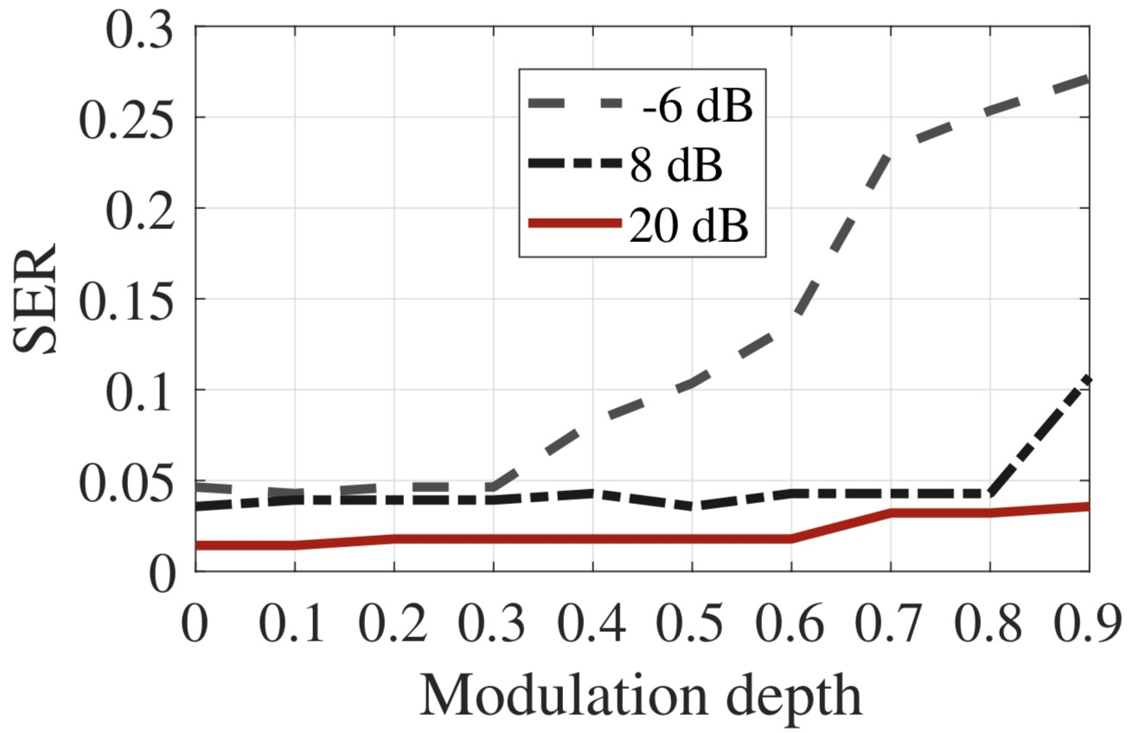
Impact on LoRa communication
Symbol Error Rate vs. D under different SNRs
Larger D —> higher SER
D has bigger influence on SER when SNR is low
Notes:
We then investigate the impact of covert channel on regular LoRa communication. This figure shows symbol error rate of regular packet versus D under different SNR scenarios.
We can observe that for regular LoRa packet, a larger D leads to higher symbol error rate.
But in high SNR scenarios, even when D is 0.9, LoRa receiver can still decode LoRa packets with SER less than 4%. D has bigger influence on LoRa communication when the SNR is low while it slightly influences regular LoRa communication when the SNR is high.
//But when D is smaller than 0.3, the symbol error rate of regular packet is smaller than 5%.
//This is because when D becomes larger, chirps with low amplitude will become weaker, which make it hard for regular LoRa receiver to demodulate them correctly.

Slide 35
Conclusion
We investigate the vulnerability of current LoRaWAN physical layer where the legacy end-to-end security mechanisms fail to protect
We implement a hardware prototype of covert channel with commodity LoRa node
We conduct comprehensive experiments with COTS LoRa node and software defined radios
Notes:
To conclude, we…
A covert channel is actually a double-edged sword. It can be used by attackers as well as defenders.In the future, we plan to use covert channel to do something good. For example, we can use covert channel to transmit coordinate information or even enhance LoRaWAN security.

Slide 36
Thank you!
(Q&A)
Notes:
Thank you for your listening and I welcome questions.
******************************************************************************
1. Crucial information may be accessed through leaked data from software, hardware(specific registers) or protocol layers.
2. The rising edge of AM signal does not necessarily to be synchronised with chirp edge. Because covert receiver only need to extract the profile of AM signal, it does not need to decode LoRa signal. So it doesn’t matter whether these two edge synchronised or not.
3. Other information embedding approaches: decimal part of initial frequency, initial phase or phase shifts. However, we note that the implementation of phase based covert information can be more challenging especially with passive components. In the future, we plan to explore other ways of building covert channels.
4. Prior knowledge of covert channel?
If LoRaWAN has the prior knowledge of our covert channel design, specifically, AM-based covert channel, one may design and implement a countermeasure to detect such a covert channel. However, current LoRaWAN does not detect the existence of such a covert channel and is totally oblivious of such an AM-based embedding method. So the key contribution of our work is that cloaklora reveals the vulnerability of current LoRa PHY.
5. The ethical aspects of this work are definitely very important.
We hope our work can reveal the potential risk so that LoRa PHY can be better protected from being abused to leak sensitive information by malicious users. As researchers in the field, we think it is our duty to report such a vulnerability that may cause security issues before the wider adoption and deployment of LoRaWAN in practice. To detect and defend against AM-based covert channels, LoRa nodes can be enhanced to examine amplitude changes in the CSS demodulation process. In practice, LoRa gateways could collaborate in covert channel detection.
6. Covert Receiver feedback? 1) the covert Tx does not need explicit feedback from the LoRa Rx and does not need to know LoRa Rx’s experience; 2) Power adaption is automatically done by regular LoRa Rx and regular LoRa Tx.
7. One may add a separate transmitter to send information. Compared with this method, our approach only needs to add a few passive components and the communication channel is covert. Deploying additional sensors can help collect sensor data but the sensors can be noticed. If an upper layer encryption key is leaked to an attacker, the attacker can decrypt all messages at upper layer.

Slide 37
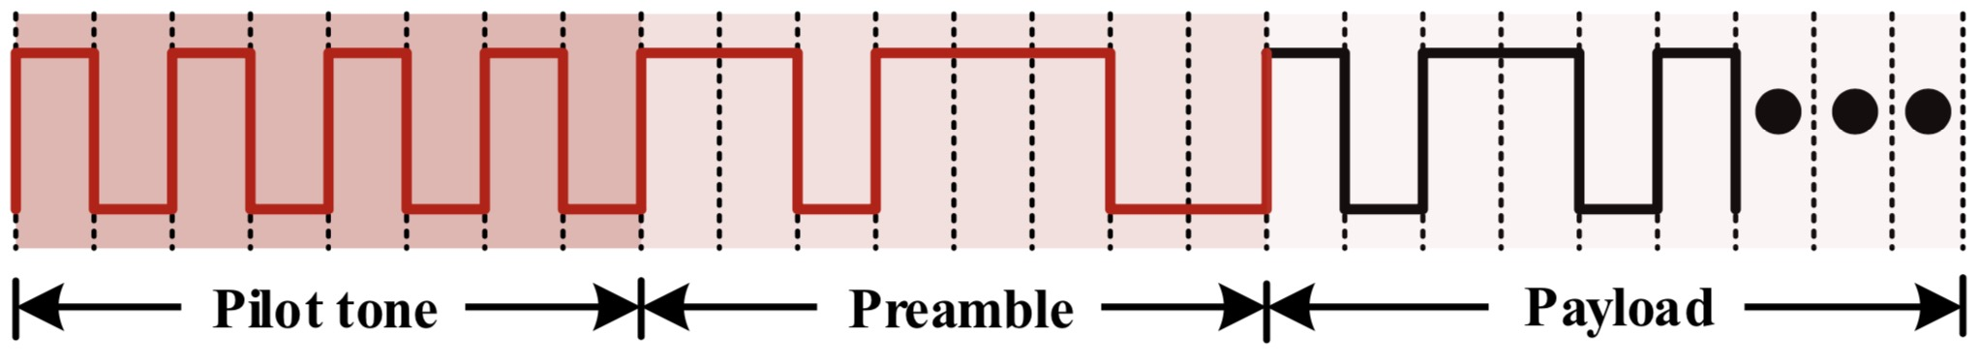
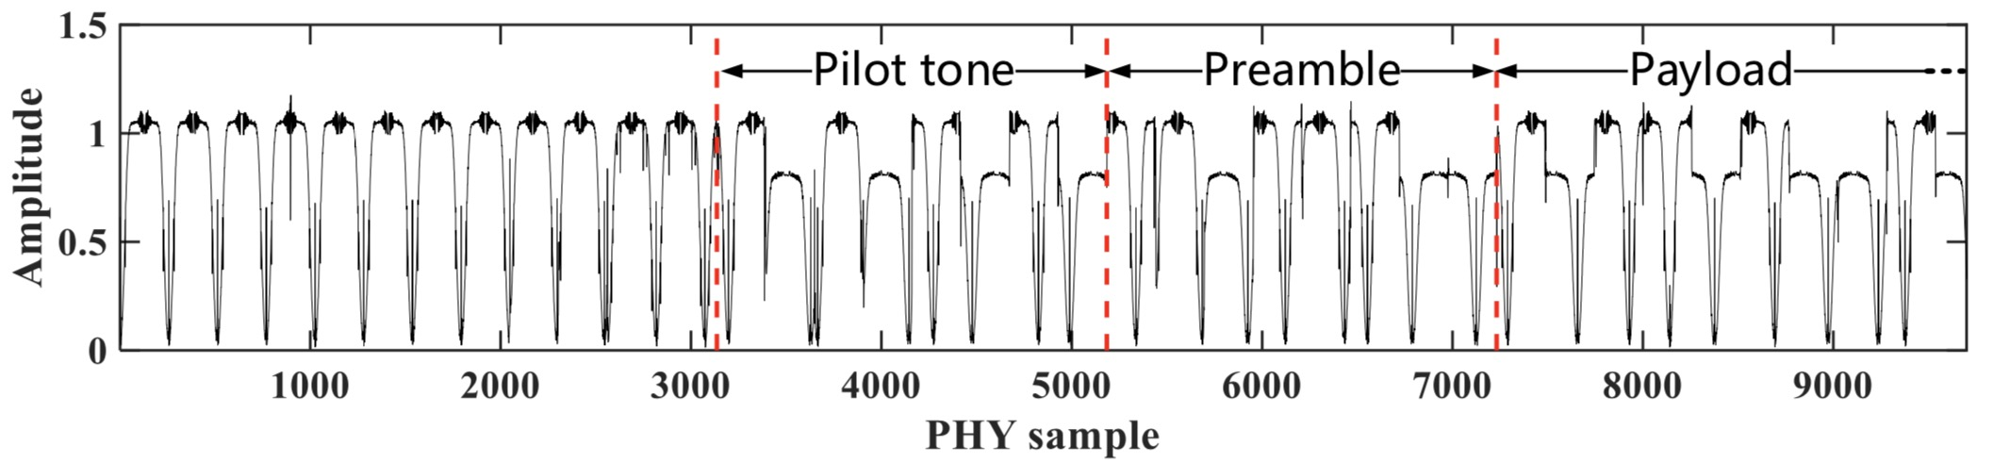
Covert packet structure
Notes:
To facilitate covert packet reception and covert data decoding, we use FM0 as an example to encode covert data. We also design covert packet structure for our system. In particular, we use 8 alternating chips as the leading pilot tone, which is followed by the preamble. The encoding method and length of payload can be adjusted according to different design requirements.

Slide 38
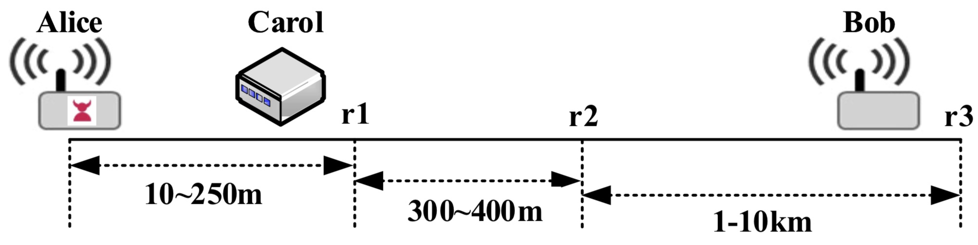
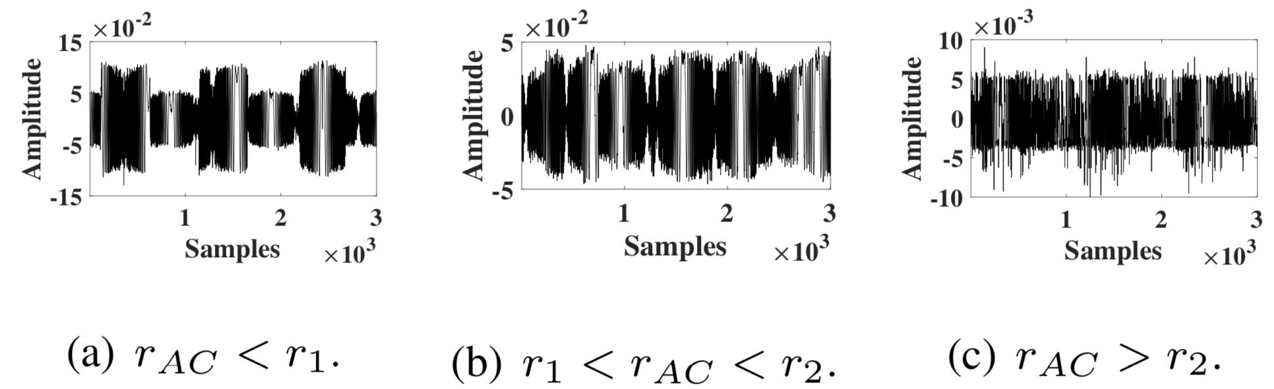
Efficiency vs. Distance
Notes:
This figure shows the amplitude of signal recorded by carol at different distances. R1 is the largest distance for Carol to correctly decode the covert data from Alice. If Carol is placed further, it can only receive a portion of covert information. If Carol moves further away from Alice, it cannot reliably receive even 1-bit information.

