Slide 1



A Multi-agent Reinforcement Learning Perspective on Distributed Traffic Engineering
Nan Geng (THU), Tian Lan (GWU), Vaneet Aggarwal (Purdue), Yuan Yang (THU), Mingwei Xu (THU)
October 2020, ICNP

Slide 2
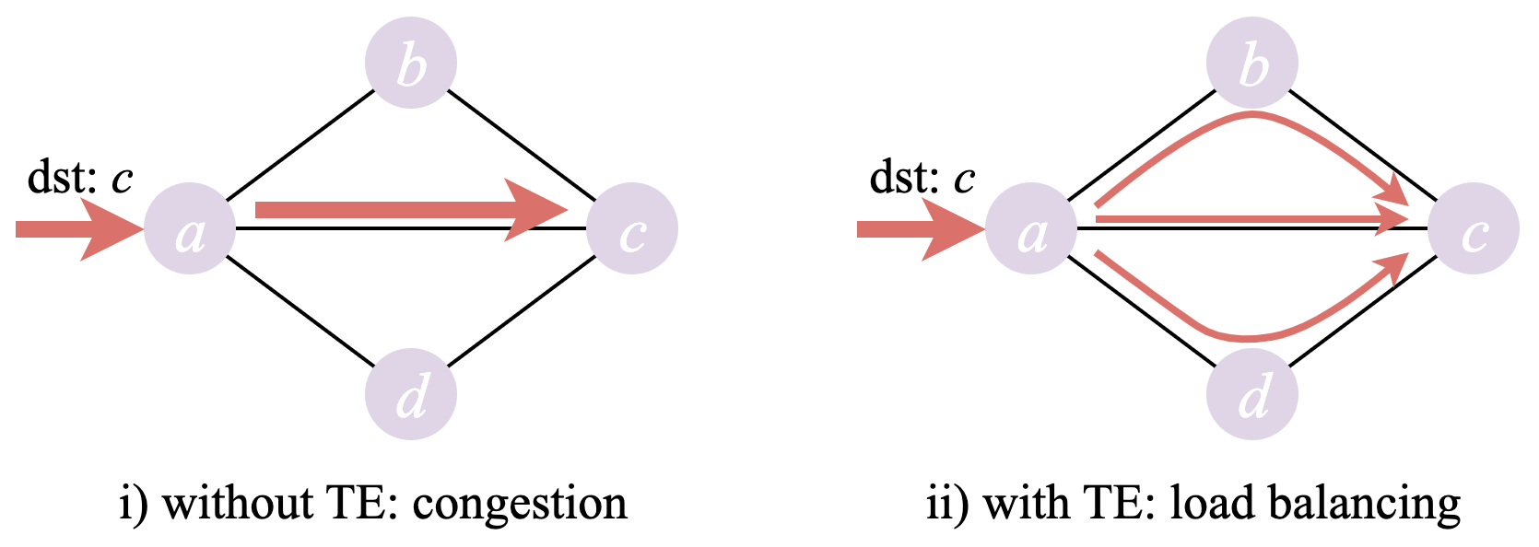
Traffic Engineering (TE)
Optimize routings based on observed network status for improving network performance or resource utilization

Slide 3
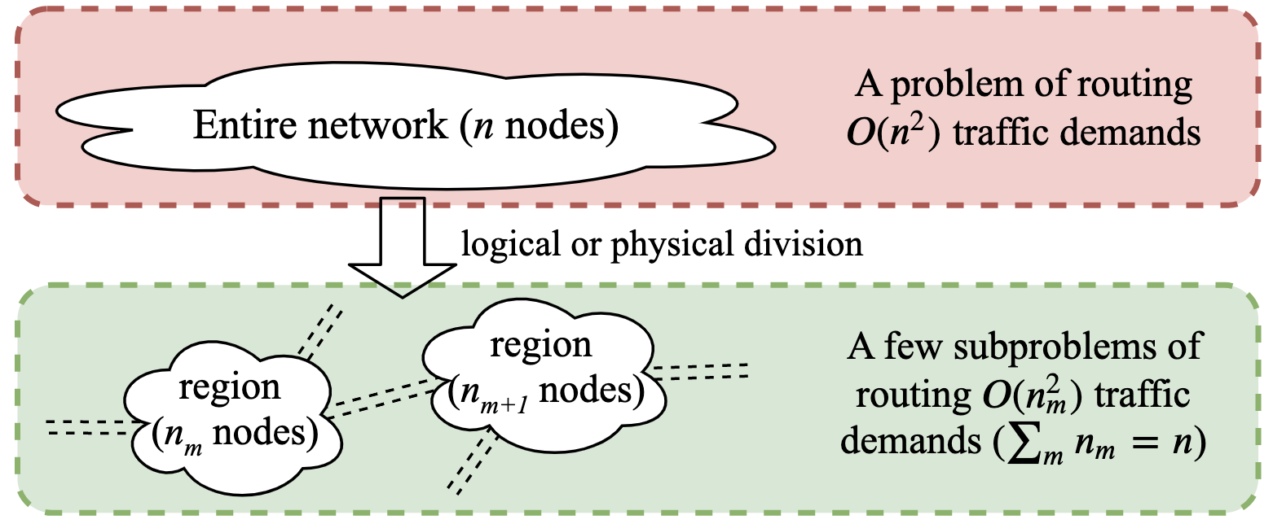
Multi-region Networks
facilitate decentralized scalable management
The network may be divided to satisfy domain/enterprise requirements, or in accordance with geographical locations and heterogeneous routing technologies.

Slide 4
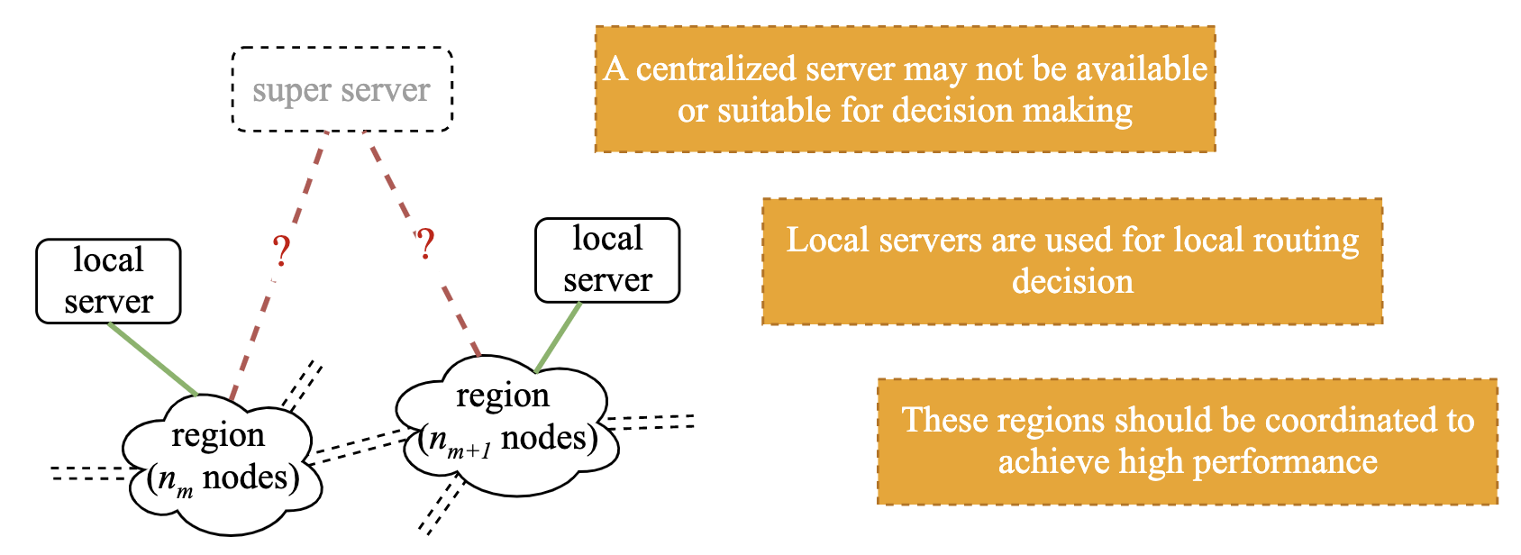
TE in Multi-region Networks

Slide 5
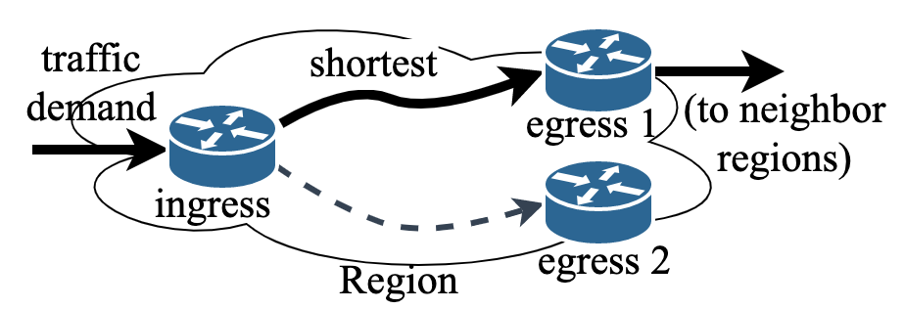
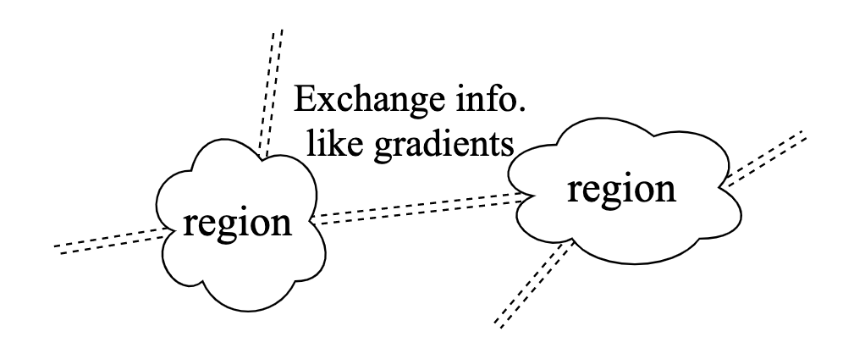
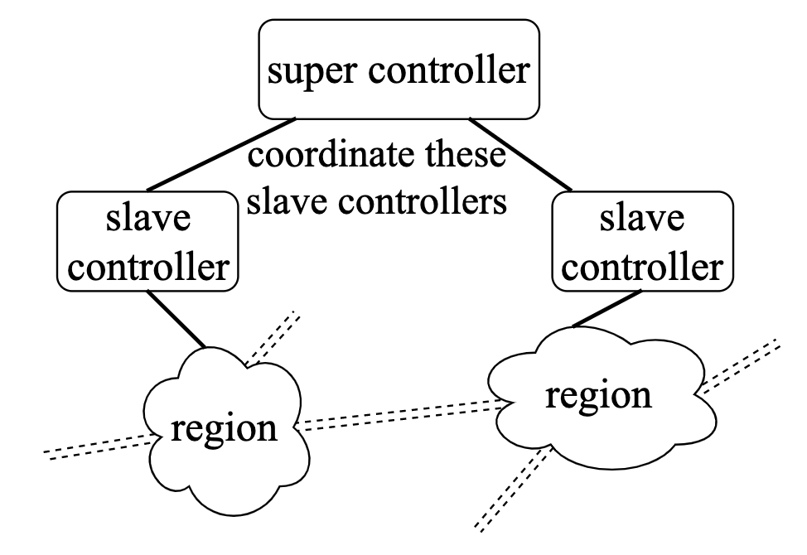
Related Work
Hot potato routing: choose the closest egress node; but over-use bottleneck links
Hierarchical SDN-based TE (HotSDN’12): require global control; communication overhead
Decoupling the problem for distributed optimization (TON’09): adjacent regions share info.; but communication overhead and slow convergence

Slide 6
Opportunity of Deep Reinforcement Learning
Exploit hidden patterns in training data automatically and continue improving TE strategy over time.
Well-trained Deep RL agents (also models) can do inference efficiently even for the inputs that never appeared before.
Deep RL agents can be trained by interacting with the network environment without requiring labeled data.
However, most of the existing RL-based approaches are for intra-region TE, i.e., single-agent designs.

Slide 7
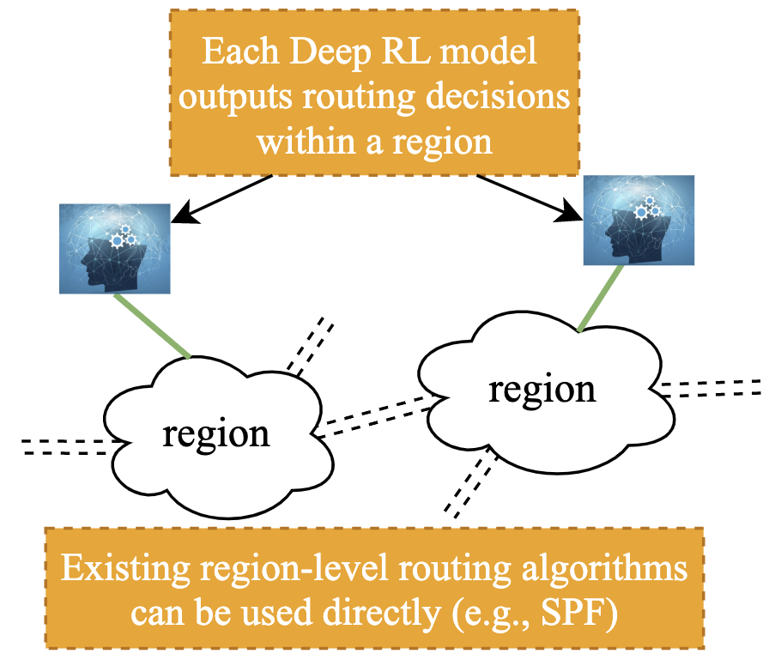
Distributed Multi-agent Deep RL for TE
Modeling network regions as individual agents that seek to jointly optimize global TE objectives naturally captures the interplay between them
Routing task: deliver traffic demands from the ingress nodes to the proper egress nodes within each region
Global objective: min max link cost (NSDI’18, TON’17), e.g., min max link utilization

Slide 8
Distributed Multi-agent Deep RL for TE
Modeling network regions as individual agents that seek to jointly optimize global TE objectives naturally captures the interplay between them
Main challenges:
good cooperative TE performance under traffic dynamics
adaptiveness to link failures
quick convergence
low decision overhead

Slide 9
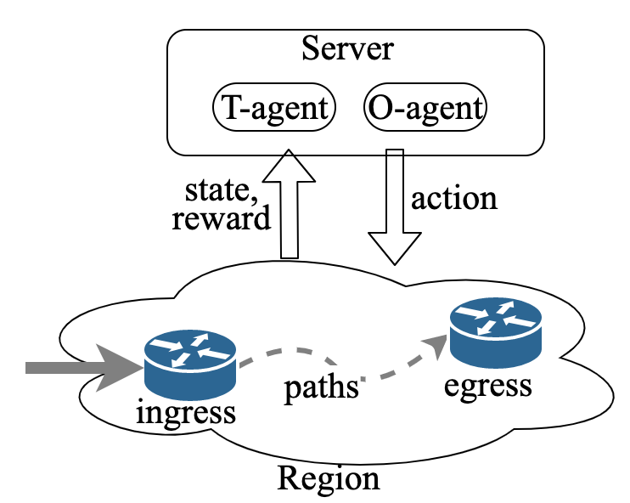
Framework
Two deep RL agents for each region instead of one

Slide 10
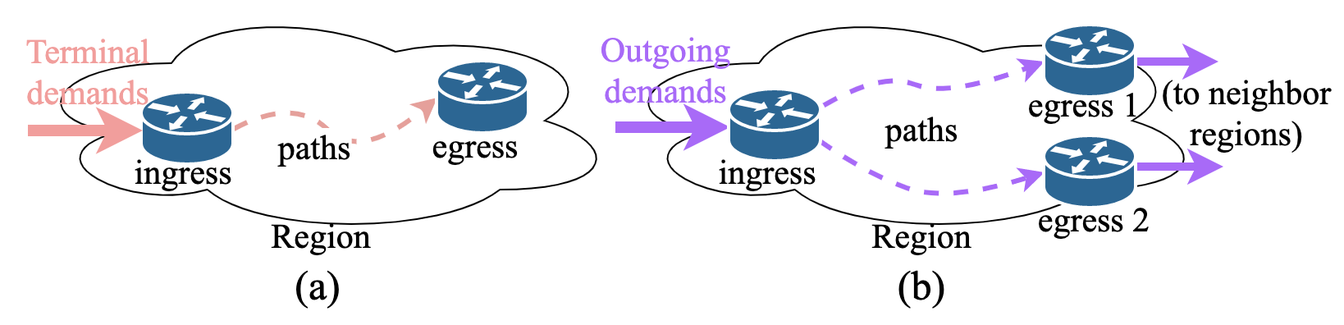
Framework
Observation: The routings of different kinds of traffic have different impacts
To evaluate the quality of routings accurately for TE policy improvement, we deal with the two kinds of traffic separately

Slide 11
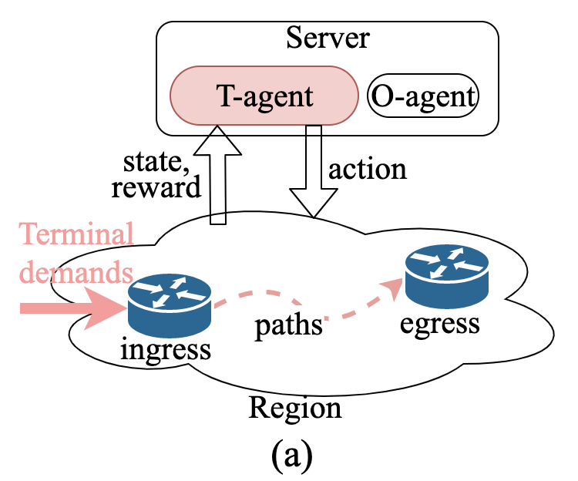
Framework
T-agents with some reward structure for terminal traffic

Slide 12
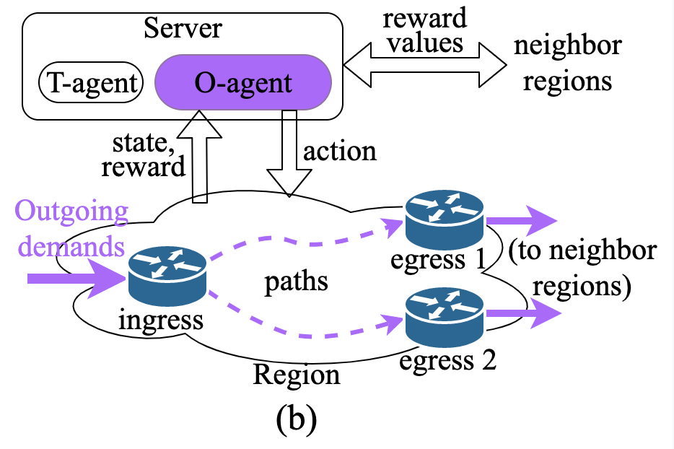
Framework
T-agents with some reward structure for terminal traffic
O-agents with a different reward structure for outgoing traffic

Slide 13
Next
T-agent Development
O-agent Development
Offline training
Evaluation results

Slide 14
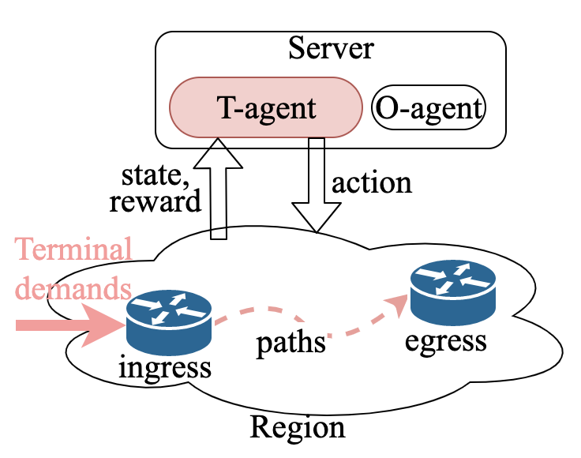
T-agent Development
State input: local link utilizations
implicitly reflect traffic demand changes
indicate congested links and broken links
can be measured easily
How to deal with link failure?
manually set the utilization of broken links to a relatively large value.

Slide 15
T-agent Development
Action output: splitting ratios over pre-computed forwarding paths
simplify action space
avoid the overhead of dynamic path construction
How to reduce action space?
adaptive routing for elephant flow and static routing for mice flow.

Slide 16
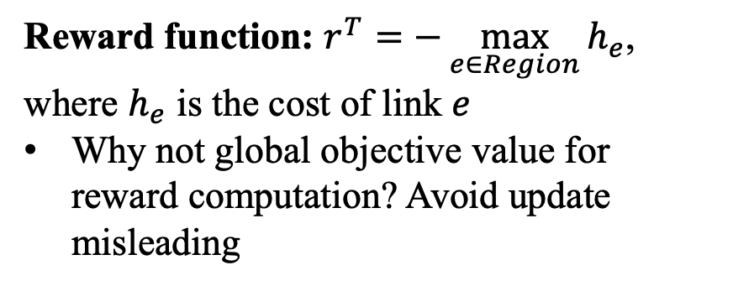
T-agent Development
Reward function: $r^{T}=−\max_{e∈Region}{h_{e}}$, where $h_{e}$ is the cost of link $e$
Why not global objective value for reward computation? Avoid update misleading
A T-agent causing extremely link congestion will result in a small reward value for other well behaved T-agents.

Slide 17
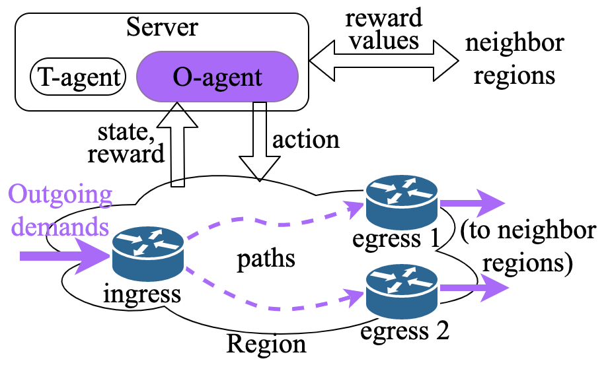
O-agent Development
State input: local link utilizations
Action output: splitting ratios over pre-computed forwarding paths; but not distinguish elephant and mice flows
Correctly routing a “long path” mice flow may even be more crucial than routing a “short path” elephant flow.

Slide 18
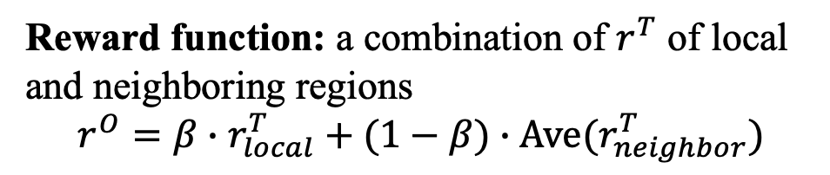
O-agent Development
Reward function: a combination of $r^{T}$ of local and neighboring regions
$$r^{O}=β∙r_{local}^{T}+(1−β)∙Ave(r_{neighbor}^{T})$$
Reward exchanging is needed only for training.

Slide 19
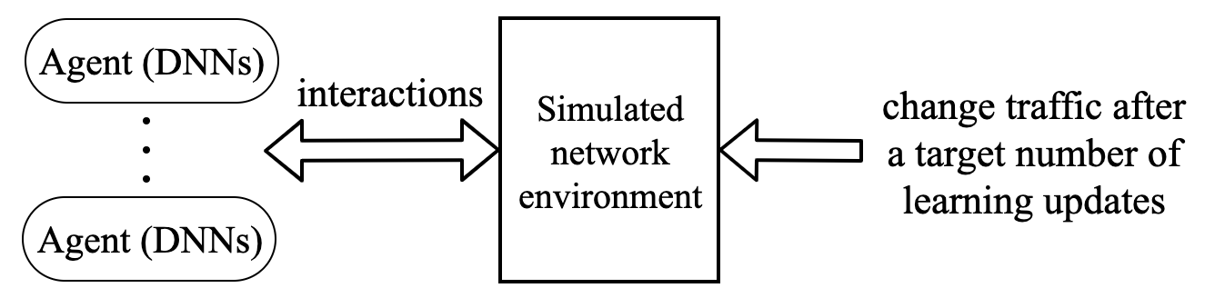
Offline Training
Train agents incrementally in simulated network environment
  DDPG algorithm for constructing each agent
Training manner
  Centralized training for fast learning
  Decentralized training for sensitive internal information (e.g., region’s topology) protection

Slide 20
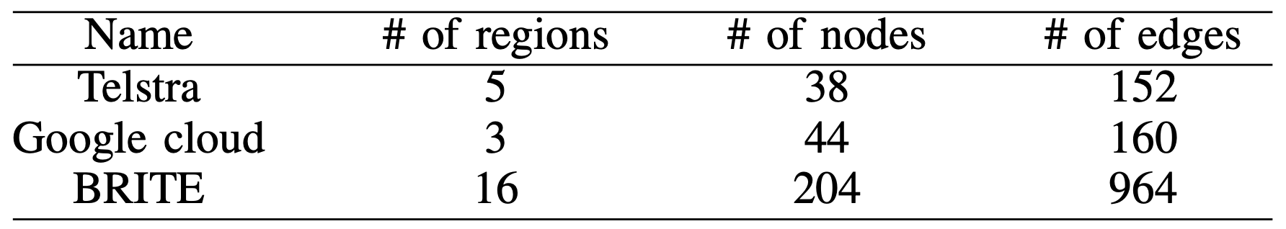
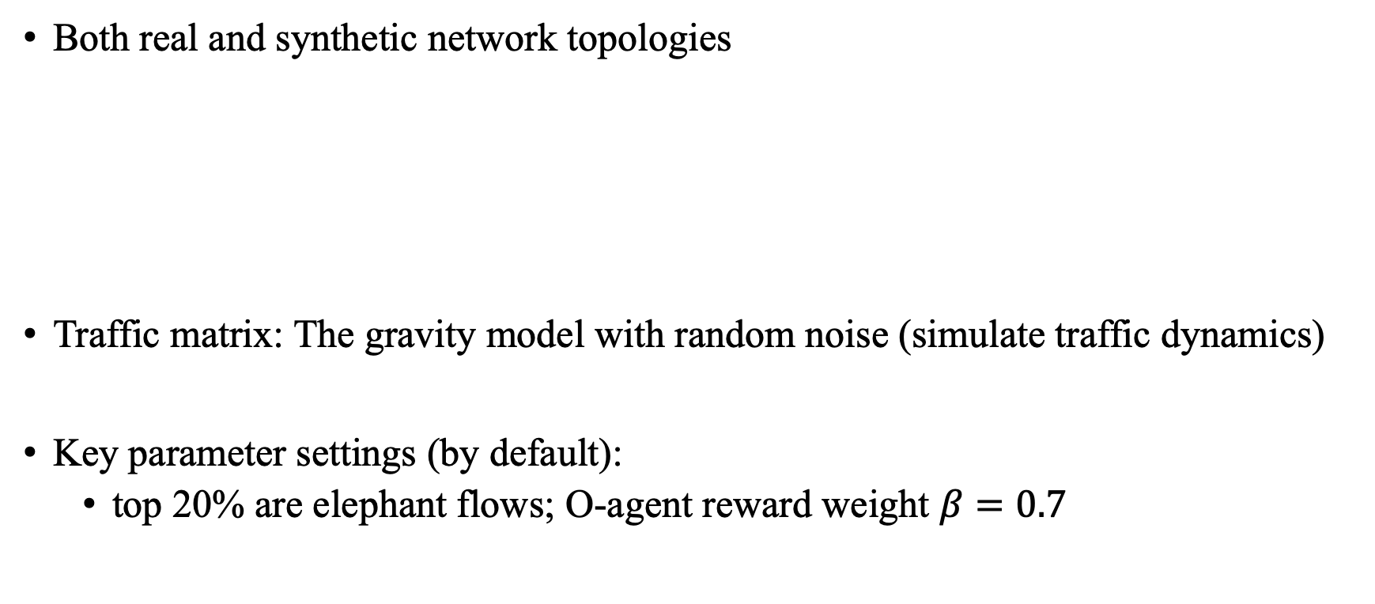
Simulation Setup
Both real and synthetic network topologies
Traffic matrix: The gravity model with random noise (simulate traffic dynamics)
Key parameter settings (by default):
  top 20% are elephant flows; O-agent reward weight $β=0.7$
*BRITE: http://www.cs.bu.edu/brite/

Slide 21
Compared Approaches and Metrics
Compared approaches
Metrics
  Normalized congestion: actual objective value/optimal objective value
  ... ...
Approach | Description
MRTE | Multi-Region Traffic Engineering, our proposed approach
TRPO | Single-agent Deep RL-based routing (NIPS’17)
HPR | Hot potato routing + intra-region routing optimization
ECMP | Equal-cost multi-path

Slide 22
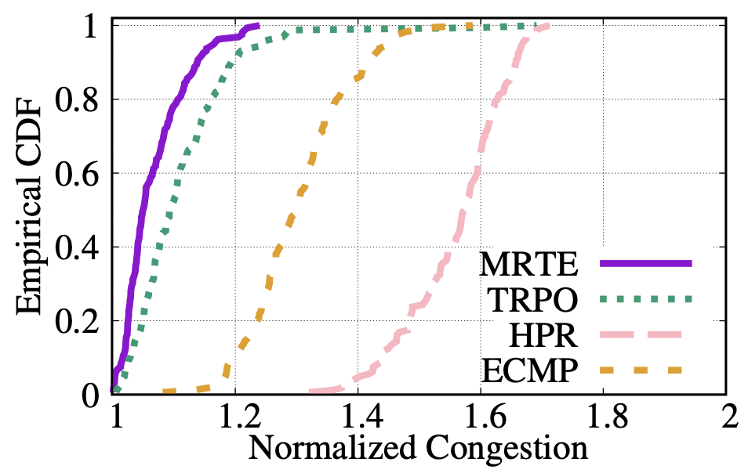
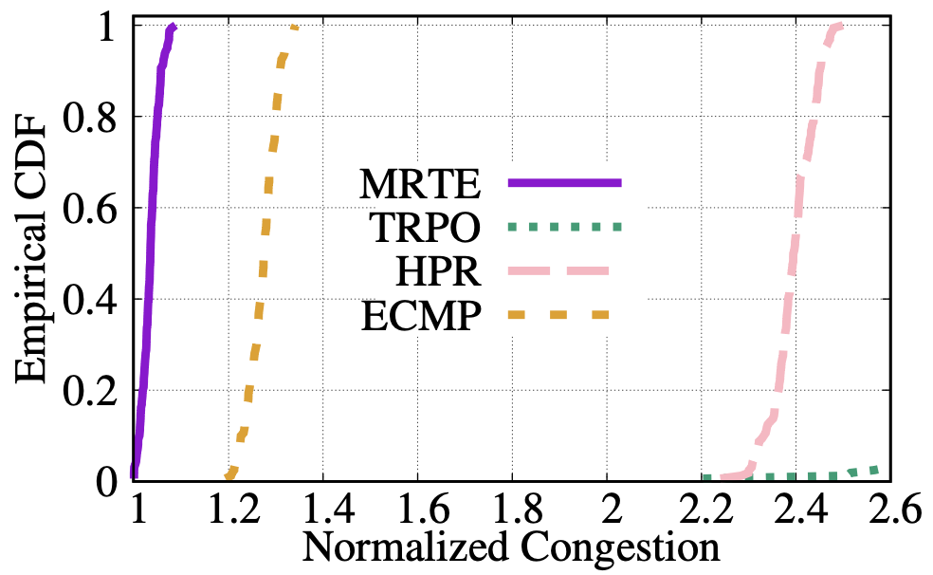
Effectiveness
MRTE results in congestion within 1.2 for over 90% tests
TRPO (single-agent) can hardly converge well for the large topology
bad convergence
Results of a small topology: Telstra
Results of a large topology: BRITE

Slide 23
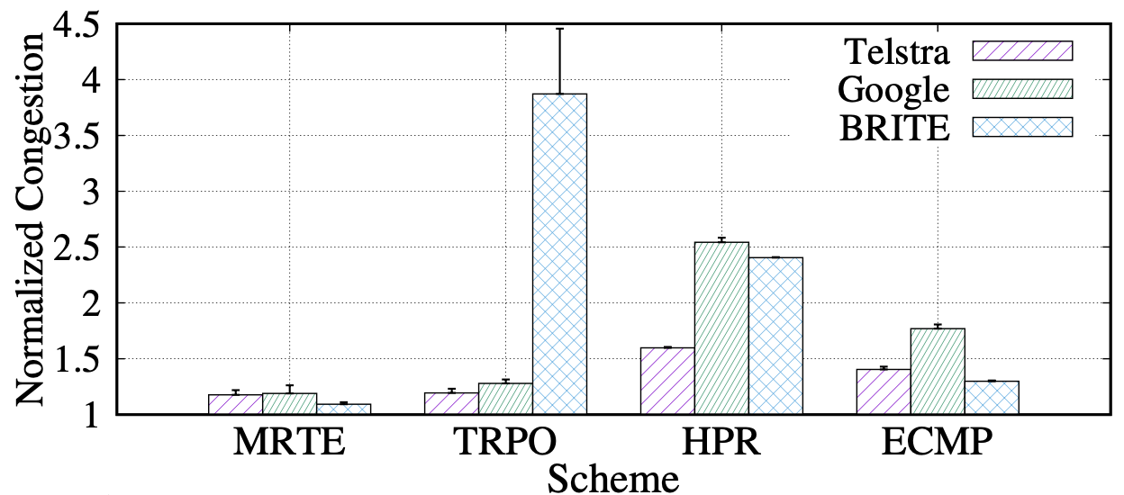
Adaptiveness to Single Link Failure
Two steps for adapting to link failure
  Set a large utilization value for the broken link when doing inference
  Reroute traffic on the broken path to the other paths
best adaptiveness

Slide 24
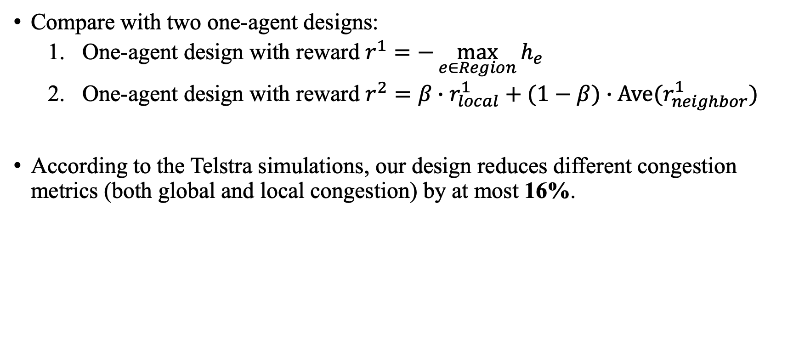
Effectiveness of the Two-agent Design
Compare with two one-agent designs:
  One-agent design with reward $r^{1}=−\max_{e∈Region}{h_{e}}$
  One-agent design with reward $r^{2}=β∙r_{local}^{1}+(1−β)∙Ave(r_{neighbor}^{1})$
According to the Telstra simulations, our design reduces different congestion metrics (both global and local congestion) by at most 16%.

Slide 25
Conclusion
A deep RL-based framework for scalable and adaptive TE in multi-region networks.
  T-agent for managing terminal traffic
  O-agent for managing outgoing traffic
Future work:
  Investigation of robust algorithms that can cope with topology changes
  Designs for some other TE objectives (e.g., end-to-end QoE metrics)

Slide 26
Thank you! Q&A?

