Slide 1





Perishable Data in Smart Communities
Glenn.Ricart@us-ignite.org
13 October 2020
HDR-Nets at ICNP 2020

Slide 2

is a nonprofit
accelerating the smart city movement
and creating value for an entire ecosystem
by guiding communities into the connected future,
creating a path for private sector growth,
and advancing technology research
that’s at the heart of smart city development.

Slide 3
Intelligent Infrastructure is the
Foundation for a Smart Community
Because it conveys perishable data

Slide 4
Perishable Data from smart community sensors or to actuators
Value in immediately actionable decision-making decreases over time
Value of data in
Decision-making
(e.g., in
cyber-physical system loops)
Actionable, e.g.,
ML Recognition
Cyberphysical systems
ML training
Historic
μs ms s m h d
Time (delay in data delivery)

Slide 5
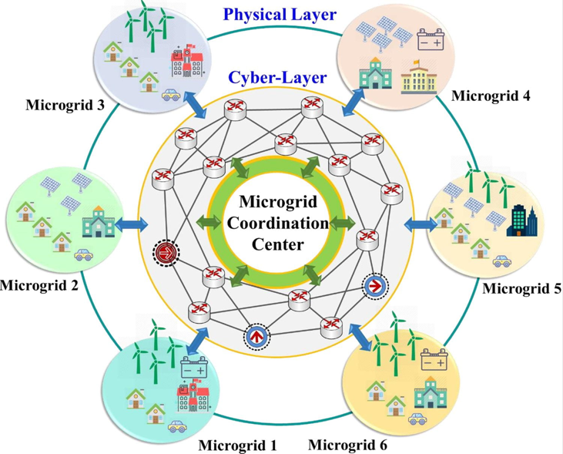
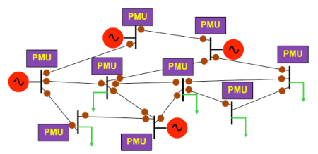
Power Microgrid Coordination
Milliseconds count
Image: Husham I. Hussein
Time accuracy: 32 μs
React in < 10 ms
Image: Penn State EMPower Research Group

Slide 6

Connected Vehicle Management
Milliseconds count
Platooning Vehicles
Time accuracy: 1 ms
React in < 10 ms

Slide 7
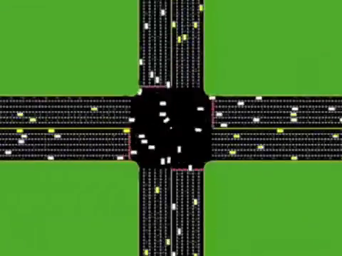
Connected Vehicle Management
Milliseconds count
Intersection sharing
Time accuracy: 1 ms
React in < 10 ms
Dresner, Kurt, and Peter Stone. "A multiagent approach to autonomous intersection management." Journal of artificial intelligence research 31 (2008): 591-656.

Slide 8


Managing Ischemic Stroke
Seconds count
Every second, the patient loses:
32K neurons
230M synapses
200 meters axonal fibers
Administering tPA can cure or kill
Image sent about 100 MB
Brain continues deteriorating;
CT Image validity is perishable
Time accuracy: 1 s
React ASAP (seconds)

Slide 9
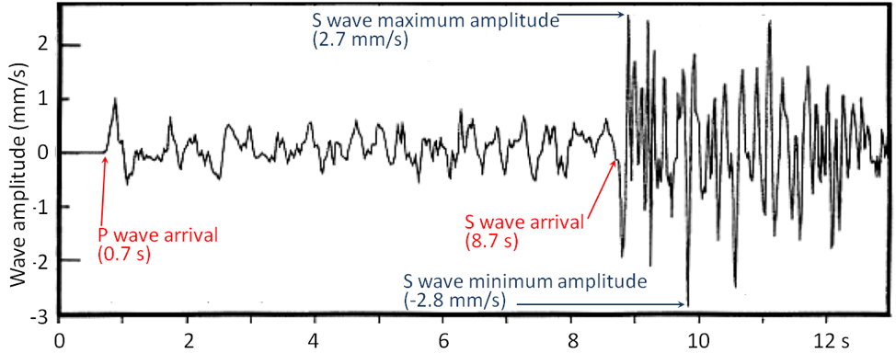

Earthquake Prediction / Notification
Seconds count
P-wave precedes damaging S-wave
Time accuracy: 0.5 s
React in < 0.5 s

Slide 10

Simultaneous Music Performance in a COVID-19 Era
10’s of milliseconds count
JackTrip software
Short packets
Sent frequently
Hardwired networks
Audio only
Headroom advantage
Time accuracy: 5 ms
Communicate in < 10 ms

Slide 11
Known Approaches for Handling Perishable Data
All buffering is harmful Sample just before you send
Pre-allocate time slots
(resource reservation)
Minimize media serialization time Keep packets short
Compress if time favorable
Maximize media data rate
Minimize packet headers/preambles/etc.
Prioritize Move to head of queues
Preempt
Don’t retransmit on error Forward error correction if time favorable
Manage missing data
Don’t move the data Edge Computing

Slide 12
Standards for Deterministic Networking
2019 IETF RFCs 8557 (problem),
8578 (use cases), 8655 (architecture)
Time synchronization to 1 μs
Resource reservation
Extraordinarily low packet loss
Guaranteed end-to-end latency

Slide 13
Standards for Time-Sensitive Networking
2017-2020 IEEE
New standards:
Timing and Synchronization for time-sensitive applications
Frame replication and elimination for reliability
Amendments to other standards such as network bridging
Active continuing agenda in cyber-physical systems loops

Slide 14
Perishable Data from smart community sensors or to actuators
Value in immediately actionable decision-making decreases over time
Value of data in
Decision-making
(e.g., in
cyber-physical system loops)
Actionable, e.g.,
ML Recognition
Cyberphysical systems
ML training
Historic
μs ms s m h d
Time (delay in data delivery)

Slide 15
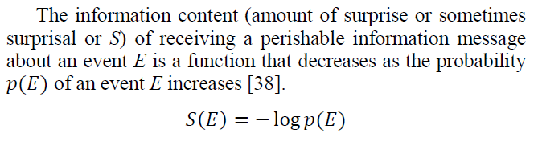
Perishability and Information Theory
Do all messages have the same information value?
- Microgrid demand is steady
- Microgrid demand has dropped 50%

Slide 16
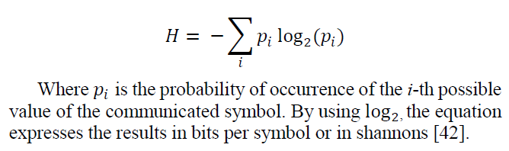

Perishability and Information Theory
Shannon entropy Η of an information source is defined as

Slide 17
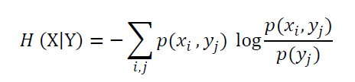
Perishability and Information Theory
The time-delayed value of information (which creates
uncertainty as to the current information) can be computed
as the conditional entropy of
X – random variable representing the current state
Y – random variable representing the state reported some time ago

Slide 18
New Approaches for Handling Perishable Data
Cross-layer communication between network and content
Keep packets short Send differential information
Send differential information from
last key frame
Use “Bad News Travels Fast” approach
- Prioritize based on information value (“surprisal”) and application criticality
- Ensure delivery: replicate frames, forward-error correction, make it a key frame
Send over multiple paths simultaneously
- Include predictive information if available
- If sufficiently critical, request acknowledgment and keep sending until then
- Increase sampling interval (if situation still changing)
- Always send most recent data (not just copies of the original)
- Overtake older messages with newer ones combining differential information

Slide 19

Checklist of Tools
Don’t use TCP
Build in critical damping if the response will alter
a closed-loop dynamic system
Time-stamp perishable data; makes it easier to discard
Leverage mutually-known information (e.g., the expected
change in a sensor reading)
Cross-layer communication between network and content
Luke: Use the Edge (for both data exchange and processing)
Controller to smart object collaboration (e.g., frequency of reporting)
Discard the least valuable messages instead of buffering
Least value = least surprisal + high accumulated or anticipated delay)
Big picture before details
Try new ideas on FABRIC

Slide 20

Upcoming Events
October 27-29, 2020
Virtual

