Slide 1
Machine Learning for Distributed Dynamic Resource Allocation in 5G networks
Sayandev Mukherjee & Bernardo Huberman
s.mukherjee@cablelabs.com, b.huberman@cablelabs.com

Slide 2
Outline
Resource allocation problems in 5G networks
New set of constraints:
  Size of the problem larger
  Time deadlines tighter
The traditional centralized problem formulations do not scale
Automation of resource allocation at scale:
  AI/ML models
  Market-based resource allocation
Example (work in progress):
  Resource allocation to UEs served by a CoMP cluster

Slide 3
Network Automation is a must for 5G
Need to enhance network intelligence to gain cost efficiencies? Looking to reduce customer service time? Want to use data analytics to craft the services that customers imagine in a 5G/IoT world? Then you need network automation. [Ericsson]
Network automation = automatic configuration, provisioning, assurance and orchestration of network services
Resource allocation is part of the provisioning
  Needs to be dynamic and scalable to high loads, large numbers of cells and UEs, and low-latency in order to support new 5G services
  Centralized allocation algorithms on a CU are unlikely to scale

Slide 4
Intelligent Distributed Resource Allocation
We propose resource allocation schemes that are
  Intelligent – this permits allocations that are:
    Personalized to the user’s behavior
    Localized to the demand in the coverage area of a single cell or CoMP cluster
    Resilient to abrupt changes in operating environments
  Distributed – this allows allocation algorithms that:
    Scale to large numbers of cells and users
    Support heterogeneous services and devices with very different needs and capabilities
    Operate with low latency
    Are dynamic – able to react to changing scenarios quickly
AI/ML
Market-based methods

Slide 5
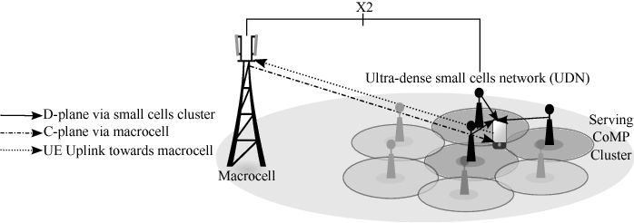
Example: CoMP cluster to UE
S. Mukherjee, B.A. Huberman, “Market-based Short-Term Allocations in Small Cell Wireless Networks,” https://arxiv.org/abs/2005.04326
M. Joud et al., “User specific cell clustering to improve mobility robustness in 5G ultra-dense cellular networks,” Wireless On-demand Network Systems and Services (WONS) 2018
Fast, temporary resource assignment by a CoMP cluster to a UE in order to handle an abrupt change in:
  Environment – e.g. UE suddenly turns a corner in a dense urban area
  Demand – e.g. UE in congested cell has a sudden spike in resource needs for an application

Slide 6
Market-based CoMP resource allocation
Assume Coordinated Beamforming (CB) form of CoMP instead of the more overhead-heavy Joint Transmission (JT)
Each UE gets a certain budget to purchase resources
The BSs in a given CoMP cluster are sellers of resources, the UEs served by the CoMP cluster are buyers
A UE can buy resources from a BS for a limited time
UEs are strategic actors: actions of one buyer influence other buyers and affect the price charged by the sellers
Buyers (UEs) and sellers (the BSs in a given CoMP cluster) try to maximize distinct utility functions

Slide 7
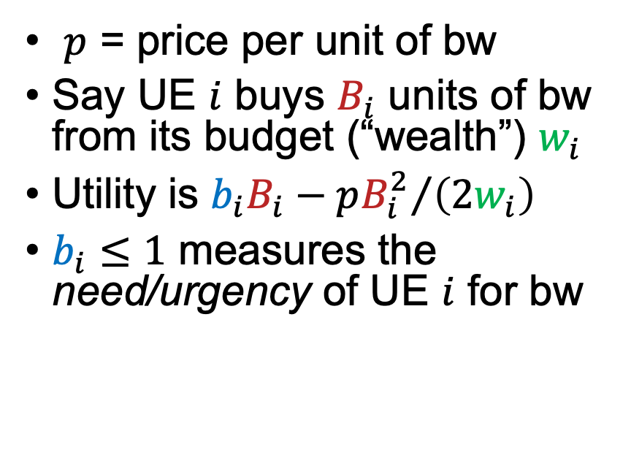
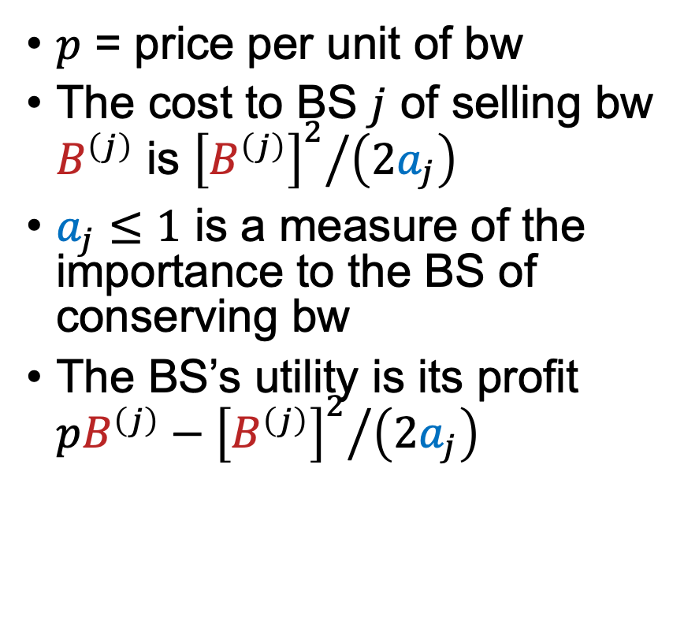

BidPacket utilities for bw allocation
B.A. Huberman, S. Asur, “BidPacket: Trading bandwidth in public spaces,” Netnomics 17:223-232, 2016
UE (buyer) utility function
BS (seller) utility function

Slide 8
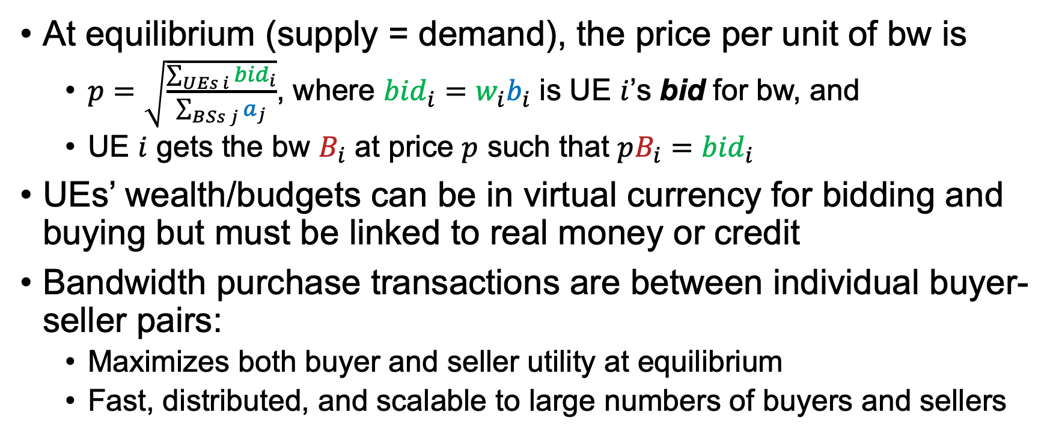
Equilibrium pricing and demand

Slide 9
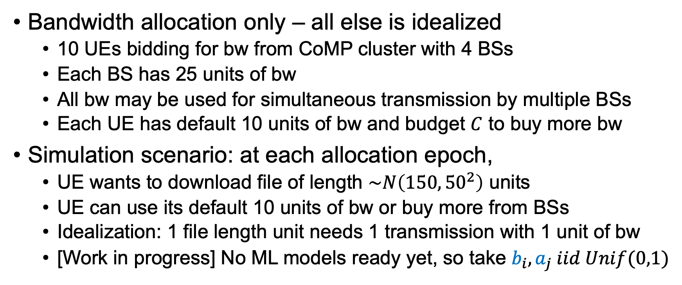
Numerical example

Slide 10
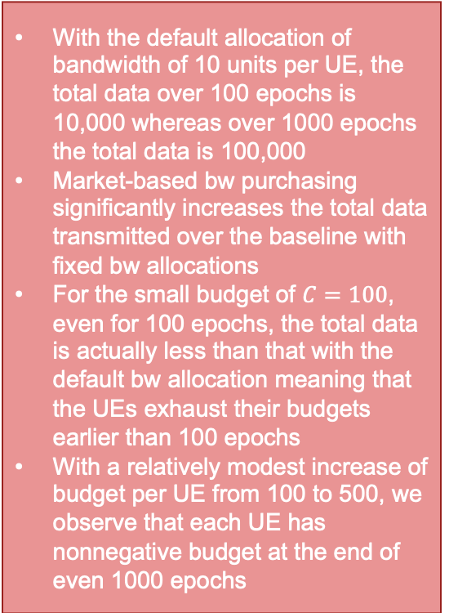
Numerical results and discussion
Vertical axis:
"1" : UE budget = 500
"2": UE budget = 1000
"3": UE budget = 5000
Total data transmitted versus total overall bandwidth, for the BidPacket bandwidth purchase strategy and the baseline with fixed allocation of bandwidth to each UE

Slide 11

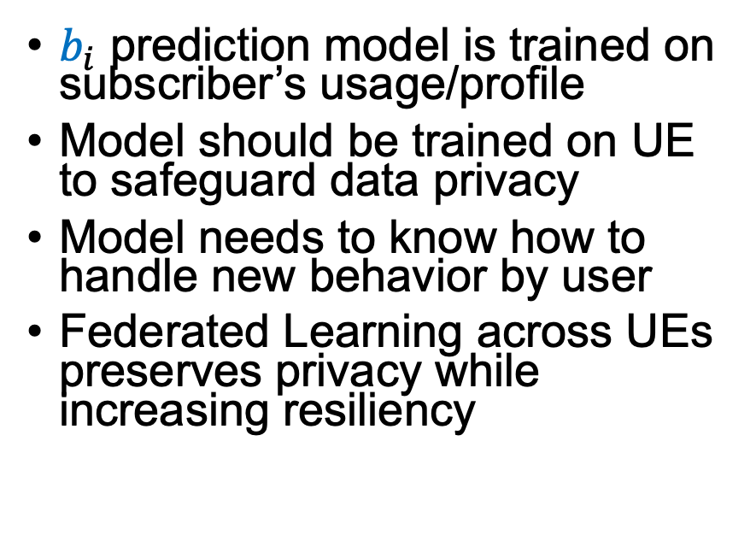
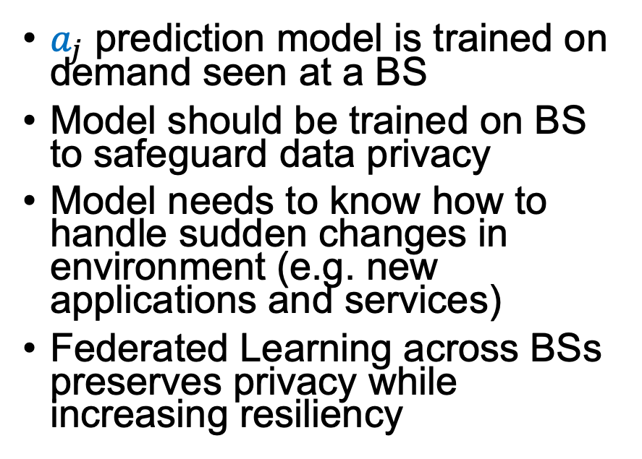
AI/ML and future directions
AI/ML at the UE
AI/ML at the BS

Slide 12
Federated Learning
In each round of training:
Each local learner trains a local version of the ML model on its local data
Only the local model parameter updates are sent up to the controller (this reduces the load on the links to the controller)
The controller performs a weighted average of the parameter updates to get the new set of parameters for the global model
The controller sends the new global model back down to each local learner as its initialized local model for the next round of training
FL controller
3
Parameter update to local model
2
4
1
Local model trained on local data
Local model trained on local data
Local model trained on local data
Local model trained on local data
Source: https://miro.medium.com/max/1400/1*HaH611vAy2eB1e42vz3X4g.png

Slide 13
Summary
5G network deployments at scale will need automation at various stages
Automation in resource allocation can be done by a combination of market-based allocation schemes with ML-based prediction models for demand prediction
The benefits of this approach include personalization/localization and resiliency in addition to scalability
Privacy considerations can be accommodated via Federated Learning

