Slide 1
Automated Saturation Mitigation Controlled by Deep Reinforcement Learning
Elkin Aguas^{1,2}, Anthony Lambert¹, Grégory Blanc², Hervé Debar²
¹ Orange Labs, Châtillon, France
² Télécom SudParis, Institut Polytechnique de Paris,
Evry-Courcouronnes, France
HDR-Nets Workshop
The 28th IEEE International Conference on Network Protocols (ICNP 2020)
October 13-16, 2020
1

Slide 2
Content
Introduction
Problematic
Proposed solution
Experiment and results
Conclusion
2

Slide 3
Introduction
Automation and Machine Learning can optimize security, management, and performance of network infrastructures.
Allow a transition from error-prone and time-consuming manual manipulations to faster and more refined automated actions.
This could help Internet Service Providers (ISP) with the challenges they face in massive content delivery scenarios.
Content Delivery Networks (CDN) have control on how content is delivered by their geographically distributed cache servers.
3

Slide 4
Problematic
CDNs’ complex and
dynamic delivery strategies
4

Slide 5
Problematic
CDNs’ complex and
dynamic delivery strategies
ISPs → “dumb pipes”
4

Slide 6
Problematic
CDNs’ complex and
dynamic delivery strategies
ISPs → “dumb pipes”
This can cause link saturation that lead to different problems
4

Slide 7
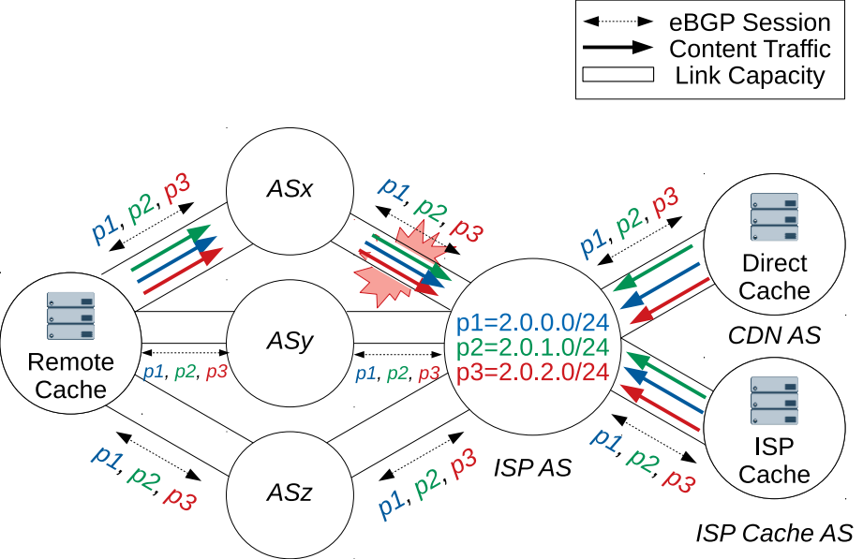
Problematic
Delivery and Saturation with Prefix Load Balancing
5

Slide 8
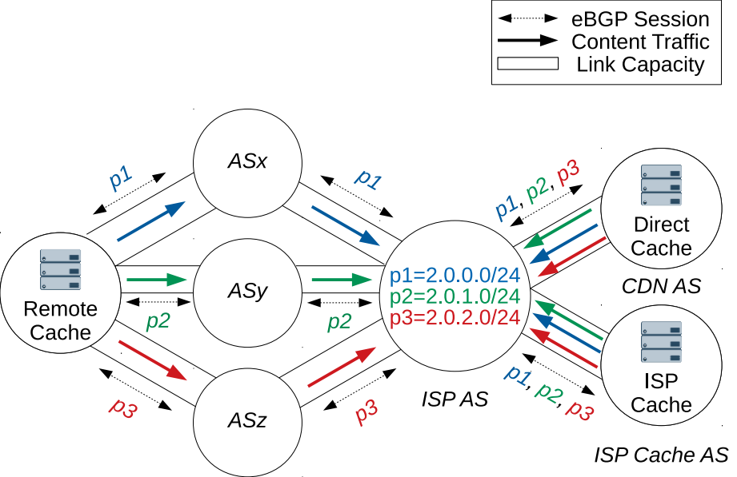
Problematic
Delivery and Saturation with Prefix Load Balancing
Saturation avoidance through Prefix Load Sharing
6

Slide 9
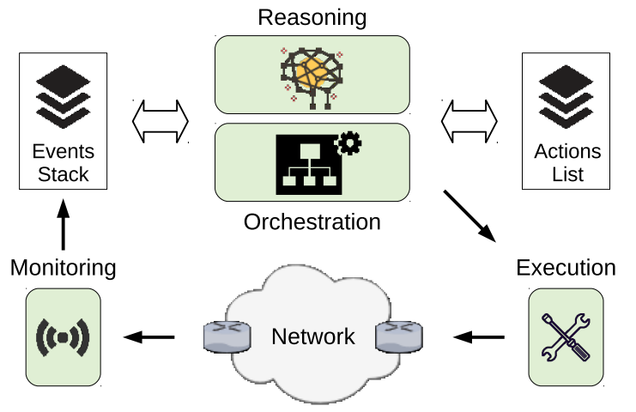
Proposed solution
7

Slide 10
Proposed solution
Reasoning block
The reasoning block uses Deep Reinforcement Learning (DRL).
More specifically Deep Q-Learning (DQL).
8

Slide 11
Proposed solution
Reasoning block
State
Link’s maximum capacity: c_{ASx,t}, c_{ASy,t}, c_{ASz,t}
Link’s number of prefixes: p_{ASx,t} , p_{ASy,t} , p_{ASz,t}
Link’s volume of traffic: tr_{ASx,t} , tr_{ASy,t} , tr_{ASz,t}
Actions
Move prefixes from one AS to(→) another AS:
m_{ASx→ASy} , m_{ASx→ASz}
m_{ASy→ASx} , m_{ASy→ASz}
m_{ASz→ASx} , m_{ASz→ASy}
9

Slide 12
Proposed solution
Reasoning block
Balanced reward function:
r_{t} = −|c_{ASz,t} − tr_{ASz,t} |
−|c_{ASy,t} − tr_{ASy,t} | − |c_{ASx,t} − tr_{ASx,t} |
Priority aware reward function:
r_{t} = −w₀ |tr_{ASz,t} − min(tr_{t}, c_{ASz,t} )|
−w₁ |tr_{ASy,t} − min(|tr_{ASz,t} − tr_{t}|, c_{ASy,t} )|
−w₂ |tr_{ASx,t} − min(|tr_{ASz,t} + tr_{ASy,t} − tr_{t} |, c_{ASx,t} )|
Where w₀, w₁ and w₂ are the weights used to enforce priority.
10

Slide 13
Experiment and results
100 prefixes and each prefix is responsible for 1/100 of the total traffic delivered.
One prefix is only announced over
one link at a time (prefix load sharing).
The initial percentage of prefixes per link is set randomly, but making sure saturation on exactly one link arises.
c_{ASx,t} , c_{ASy,t} , c_{ASz,t} set to 20%, 30%, 50% of the maximum generated daily traffic volume.
Traffic is measured every 5 minutes, resulting in 288 discrete time steps per day.
11

Slide 14
Experiment and results
Algorithms
No-function (NOF): it represents today’s situation when saturation arises.
Naive function (NAIF): it is a basic straightforward automation of today’s manual prefix load sharing.
Balanced DRL (BDRL): it considers every link equally to redistribute prefixes.
Priority Aware DRL (PADRL): it prioritizes some links over others.
12

Slide 15
Experiment and results
Algorithms
No-function (NOF): it represents today’s situation when saturation arises.
Naive function (NAIF): it is a basic straightforward automation of today’s manual prefix load sharing.
Balanced DRL (BDRL): it considers every link equally to redistribute prefixes.
Priority Aware DRL (PADRL): it prioritizes some links over others.
Performance
Traffic loss: cumulative traffic loss due to saturation.
Number of actions: cumulative number of actions taken.
13

Slide 16
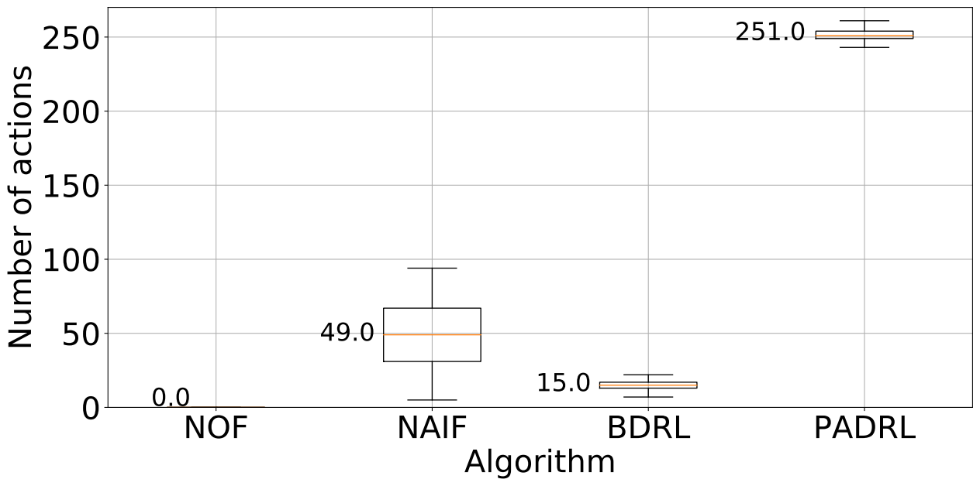
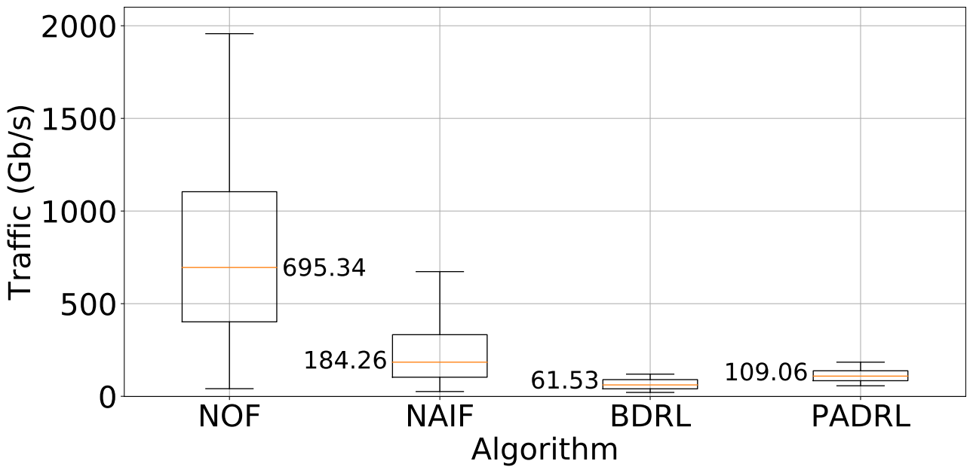
Experiment and results
Number of actions per algorithm
Traffic loss per algorithm
14

Slide 17
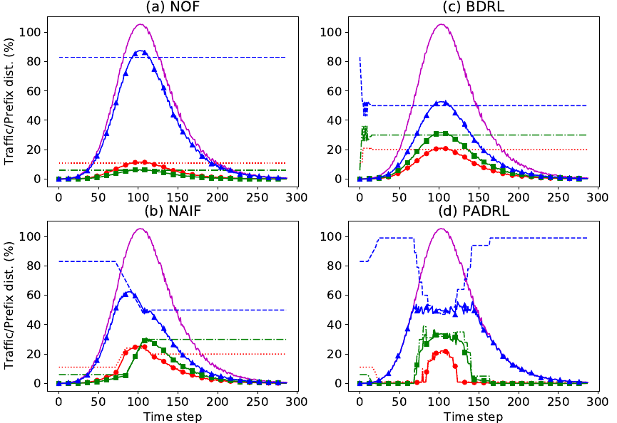
Experiment and results
15

Slide 18
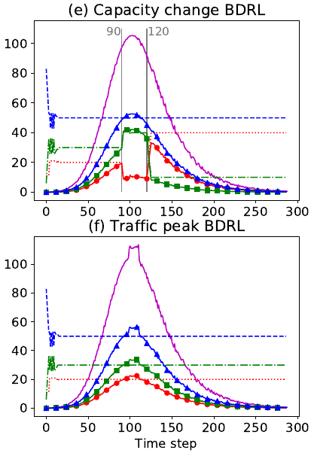
Experiment and results
16

Slide 19
Conclusion
Automating actions to mitigate critical events such as saturation therefore appears feasible and benefit from Machine Learning to optimize its control.
It is feasible to build a deep reinforcement learning (DRL) agent that controls the choice of actions to be executed in case of saturation.
This DRL agent can minimize traffic loss as well as the number of actions to be performed by the automation process.
Future work needs to focus on stabilizing the prefix distribution process and the ability of the agent to adapt to network real time changes.
17

Slide 20
Thank You!

