Slide 1





A Constrained Reinforcement Learning Based Approach
for Network Slicing
Yongshuai Liu (UC DAVIS), Jiaxin Ding (SJTU), Xin Liu (UC DAVIS)
HDR-Nets 2020
October 13, 2020
Notes:
hello everyone, I’m yongshuai liu, from UC DAVIS.
today I‘m going to talk about our recent work on 5G network slicing and how we handle it with constraint reinforcement learning.
This is a co-authored work with Professor Ding and Professor Liu.

Slide 2
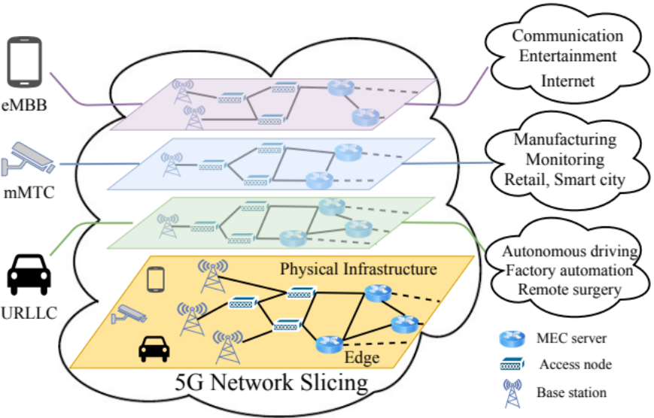
CRL Based Network Slicing
Problem Statement
5G network slicing enables the multiplexing of logical networks on the same physical network infrastructure.
The network slicing is essentially a resource allocation problem.
Notes:
With the increase of mobile networks, we face strong diversification of services, for example we have autonomous driving, industry 4.0, virtual and augmented reality, Internet of Things (IoT), etc [ˌet ˈsetərə; ˌɪt ˈsetərə].
These services are characterized by different performance, functional, and operational requirements. Therefore, they demand the network to be more flexibility. Because of the lack of flexibility in existing networks, independent initiatives of dedicated infrastructure solutions are deployed: for example, 3GPP has developed an IoT specific MAC that can co-exist with general purpose MAC [1]; the industry has deployed specific architectures for extreme reliability [2]. Such solutions are clearly highly expensive and inefficient.
To address this issue, in 5G and future networks, network slicing, enabled by network function virtualization (NFV) and software defined networking (SDN), is considered as a promising solution for flexible resource allocation – Basically, it creates multiple virtual network instances, named network slices, with service isolation and guarantees on top of a common physical infrastructure.
The resource allocation problem in network slicing is to provide the required service isolation and guarantees.
In our work, we handle the network slicing problem with reinforcement learning.
With the increase of mobile networks, we face strong diversification of services, for example we have autonomous driving, industry 4.0, virtual and augmented reality, Internet of Things (IoT), etc [ˌet ˈsetərə; ˌɪt ˈsetərə].
These services are characterized by heterogeneous [ˌhetərəˈdʒiːniəs] performance, functional, and operational requirements. Therefore, they demand the network to be more flexibility. Because of the lack of flexibility in existing networks, independent initiatives of dedicated infrastructure solutions are deployed: for example, 3GPP has developed an IoT specific MAC that can co-exist with general purpose MAC [1]; the industry has deployed specific architectures for extreme reliability [2]. Such monolithic vertical developments are clearly highly expensive and inefficient.
To address this issue, in 5G and future networks, network slicing, enabled by network function virtualization (NFV) and software defined networking (SDN), is considered as a promising solution for flexible resource allocation – Basically, it creates multiple virtual network instances, named network slices, with service isolation and guarantees on top of a common physical infrastructure.
The resource allocation problem in network slicing is to provide the required service isolation and guarantees.
In our work, we handle the network slicing problem with reinforcement learning.

Slide 3
CRL Based Network Slicing
Why Learning-based Approach
Traditional optimization approaches require accurate mathematical models with parameters known.
Traditional methods do not adapt to epistemic uncertainty.
Notes:
So the number one question we ask is why a learning-based approach instead of the traditional optimization approach .
First, traditional optimization approaches require accurate mathematical models with parameters known, This is often difficult to achieve in practice, especially with the increasing complexity, scale and service diversity of the 5G and future networks. Furthermore, Constraints from the physical systems and service demands are prevalent and complex, such as latency requirement and service level agreement, which further increases the difficulty in modeling . Additionally, the network environment is affected by the location, geographical properties, mobility, etc., all difficult to measure and model. Because of these reasons, it is very difficult to obtain accurate model parameters in real networks, on which traditional optimization approaches rely.
Second, traditional methods do not adapt to hidden structures in networks, due to a lack of knowledge and subsequent ability to explore and learn from the system. For example, a user, experiences poor quality of service, may decide not to use the service again or at a reduced frequency. Such hidden structures can significantly affect user experience and network performance but are usually not directly observed or modeled.
Because of these reasons, we explore a learning-based approach in this work.

Slide 4
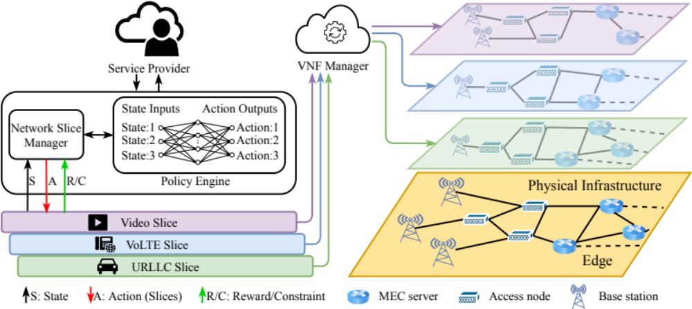
CRL Based Network Slicing
Notes:
this is a framework of our method.
so basically, we have a physical infrastructure on top of it .
we have network slices and, in this case, we consider three different network slices.
we have a network slice manager which makes decisions on its resource allocation. it takes input from the policy engine and this policy engine is basically what the reinforcement learning algorithm can provide.
this framework can be applied to general network slicing problems, including radio access, edge, cloud and core networks.
To bring RL, especially DRL, into the network slicing, there are many challenges. In our work, we will focus on one, namely constraints.
We may know in many existing RL problems, the goal is to maximize the reward. However, Network slicing problems, in addition to maximizing the reward, need to satisfy certain constraints as well.
To satisfy these constraints, we formulate the network slicing problems as constrained Markov decision process.

Slide 5


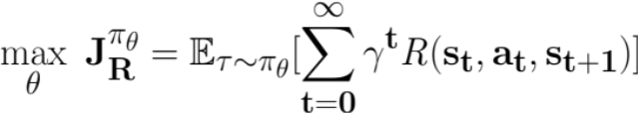
Problem Formulation
Markov Decision Process (MDP)
Agent
States S: {s₁, s₂ … s_{n}}
Actions A: {a₁, a₂ … a_{n}}
Reward R: S×A×S -> ℝ
Transition Probability: P(s_{t+1}|s_{t}, a_{t})
Discount Factor: 𝛾
Policy 𝜋_{𝜃}: S -> A
State
s_{t}
Reward
R_{t}
Action
a_{t}
R_{t+1}
s_{t+1}
Environment
Notes:
let’s first look at the MDP framework.
Most people are probably familiar with the framework of MDP.
we have a state s and and given this state we take action a.
we receive a reward r and we transit to the next state.
here we have a discount factor gamma
and our goal is to find the policy pi theta so that it decides the action a given state s
and they want to maximize the overall cumulative reward defined here

Slide 6
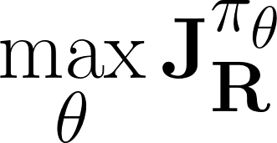

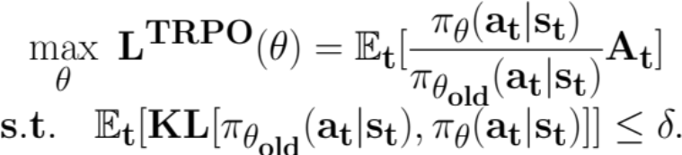
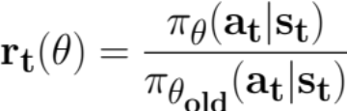
Solutions
Objective:
REINFORCE:
TRPO:
PPO:
    where
Sutton, Richard S., et al. "Policy gradient methods for reinforcement learning with function approximation." , 2000.
Schulman, John, et al. "Trust region policy optimization." , 2015.
Schulman, John, et al. "Proximal policy optimization algorithms.”, 2017.
Notes:
In typical RL, we face an MDP without a known system models, in other words, we do not know the transition matrix and rewards.
In DRL, a few popular algorithms are developed to solve such an MDP problem. Such as, reinforce trpo and ppo.
%These algorithms target reward maximization.
%A is the advantage function

Slide 7
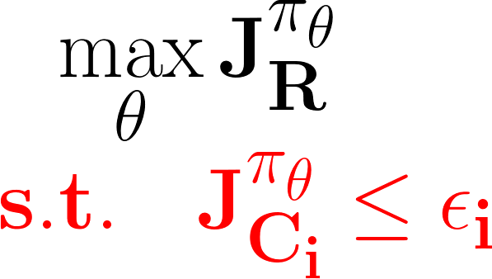
Problem Formulation
Constrained Markov Decision Process (CMDP)
Agent
States S: {s₁, s₂ … s_{n}}
Actions A: {a₁, a₂ … a_{n}}
Reward R: S×A×S -> ℝ
Cost C: S×A×S -> ℂ
Transition Probability: P(s_{t+1}|s_{t}, a_{t})
Discount Factor: 𝛾
Policy 𝜋_{𝜃}: S -> A
State
s_{t}
Cost
C_{t}
Reward
R_{t}
Action
a_{t}
R_{t+1}
C_{t+1}
s_{t+1}
Environment
Each a is feasible
Notes:
Now, let’s look at how to formulate the constraints. Given a state action pair, the agent also receives a cost c.
so in addition to maximizing the reward defined here, the policy also need to satisfy some predefined constraints.
%the constraint is that the cost is bounded by a predefined parameter

Slide 8
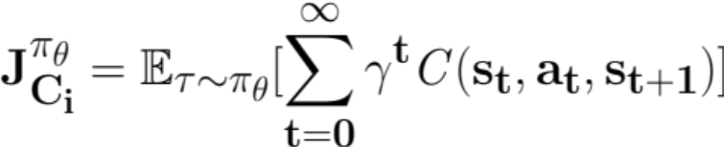
Problem Formulation
Constraints
Discounted cumulative constraints
Instantaneous constraints
          Each action a is feasible
Notes:
often, we consider two types of constraints.
the first one is cumulative constraint it is a sum of a constrained variable from the beginning to the time being accumulated.
for example in networks we may want to maximize the overall throughput, we may also have constraints on user experience over time.
we also have another type of constraints namely instantaneous constraints. It means each action needs to satisfy in each step.
for example in networks we may want to maximize video quality for users. at the same time an instantaneous constraint is a bandwidth allocated to all users cannot be higher than the overall bandwidth resource we have.
To illustrate our method, we consider a case study next.

Slide 9
Case Study
Three types of users [1] (three network slices):
  Video, VoLTE, URLLC
Time slotted system (1 second)
State: the number of active users in each network slice
Action: bandwidth allocation to each network slice
Reward: overall throughput
[1] . Li, Z. Zhao, Q. Sun, I. Chih-Lin, C. Yang, X. Chen, M. Zhao, andH. Zhang, “Deep reinforcement learning for resource management in network slicing,”IEEE Access, vol. 6, pp. 74 429–74 441, 2018.
Notes:
To help us understand.
Here, we consider a radio resource slicing scenario based on a previous work as a case study and it can be extended to more generally cases easily.
we consider three types of users, basically three network slices.
one is video, another is volte, and the third one is urllc.
we consider a time slotting system in the simulation. each time slot is one second
at the beginning of the time slot, we assume we can observe the state which is a number of active users in each network slice and we can take an action.
it's basically the bandwidth allocation to each network slice.
the overall reward we consider in this case is the overall throughput of all slices

Slide 10
Case Study
Cumulative constraint: user satisfaction over time
  User satisfaction: min (bandwidth allocated/bandwidth required, 1)
Explicit instantaneous constraint: available bandwidth
Implicit instantaneous constraint: latency (FIFO queue)
Dynamic hidden structure:
  Users (of each slice) arrive and depart following an unknown Poisson Process
  Arrival/departure rate depends on the user satisfaction
  Key reason why a learning-based approach can outperform
Notes:
we consider different constraints
first is cumulative constraint. it is user satisfaction over time.
we define user satisfaction at each time slot as follows
it is a basically a bandwidth allocated to this user divided by the bandwidth it requires and of course it cannot be larger than one
we also consider an explicit instantaneous constraint. basically the bandwidth allocated to all network slices cannot be more than what we have
the third one is an implicit instantaneous constraint which is a latency requirement of users and we obtain this by simulation using a FIFO queue
it worth mentioning in this work we consider a dynamic hidden structure.
Users of each network slides arrive and depart following an unknown Poisson process, furthermore the arrival and departure rate depends on user satisfaction.
this part is probably the key reason why a learning-based approach can potentially outperform a traditional optimization-based approach

Slide 11
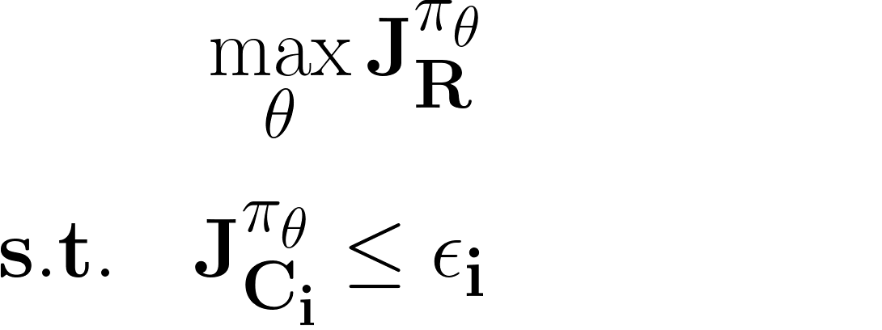
Case study
Problem Formulation
Cumulative constraints: IPO
bw allocation feasible Explicit Instantaneous constraint: safe layer
latency requirement Implicit Instantaneous constraint: safe layer
Notes:
here's a problem formulation
we want to maximize the overall reward which is the throughput of all network slices over time
and we try to find the policy to achieve it with constraints
cumulative constraint is the satisfaction ratio of users over time
and the values allocation has to be feasible subject to the bandwidth constraint
and we have a latency requirement for users
To handle the cumulative constraint, we propose a method called Interior-point policy optimization (IPO).
For the instantaneous constraints, we handle them with safe layer method.
Next, I will introduce these methods.

Slide 12
IPO: Interior-point policy optimization
Cumulative constraints
Notes:
IPO is a method we proposed to handle cumulative constraints.

Slide 13
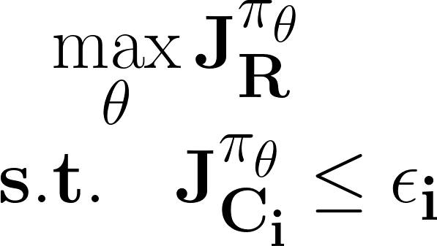
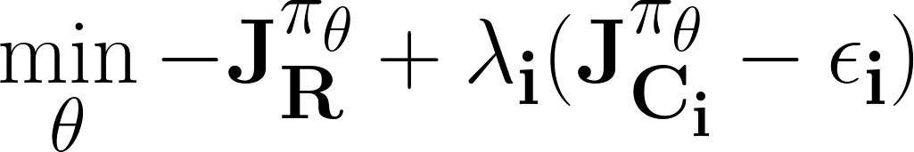
Solutions & Limitations to CMDP
Objective:
Lagrangian Relaxation Method:
  Sensitive to initialization of hyperparameters
  Large reward and constraint variation during training.
Constrained Policy Optimization (CPO): Quadratic approximation
  Complicated computation and implementation
  Difficult to handle to mean-value constraints and multiple constraints.
Chow, Yinlam, et al. “Risk-constrained reinforcement learning with percentile risk criteria.”, 2017.
Achiam, Joshua, et al. “Constrained policy optimization.” , 2017.
Notes:
so in the literature there are two types of algorithms that solves cumulative constraints
one is called lagrangian relaxation method, where we want to maximize the reward or minimize minus of the reward
and at the same time lambda is a lagrangian multiplier and we put a constraint into the optimization framework then we can optimize this as an unconstrained optimization
we'll adjust to find the appropriate lagrangian multiplier
the problem is this approach is typically very sensitive to the initialization of the hyperparameter. specifically this lagrangian multiplier
and also, we often see large reward and constrained variations during training .
another algorithm is so-called constraint policy optimization it is a trust region method for constrained RL which approximately enforces the constraints in every policy update.
It uses approximations of the constraints to predict how much the constraint costs might change after any given update, and then chooses the update that will most improve performance while keeping the constraint costs below their limits.
the limitation of this approach is complicated to compute and implement

Slide 14
IPO: Interior-point Policy Optimization
Intuition
Add constraints as penalty to the objective function
if a constraint is satisfied, the penalty added to the reward function is zero.
if the constraint is violated, the penalty goes to negative infinity.
Notes:
so let me introduce a basic idea of ipo.
just as its name suggests. the intuition is we want to add constraints as a penalty to the objective function
if a constraint is satisfied the penalty added to the reward function is zero and if the constraint is violated then the penalty goes to negative infinity

Slide 15



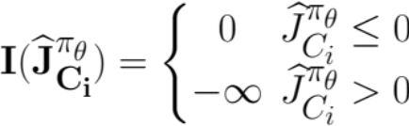
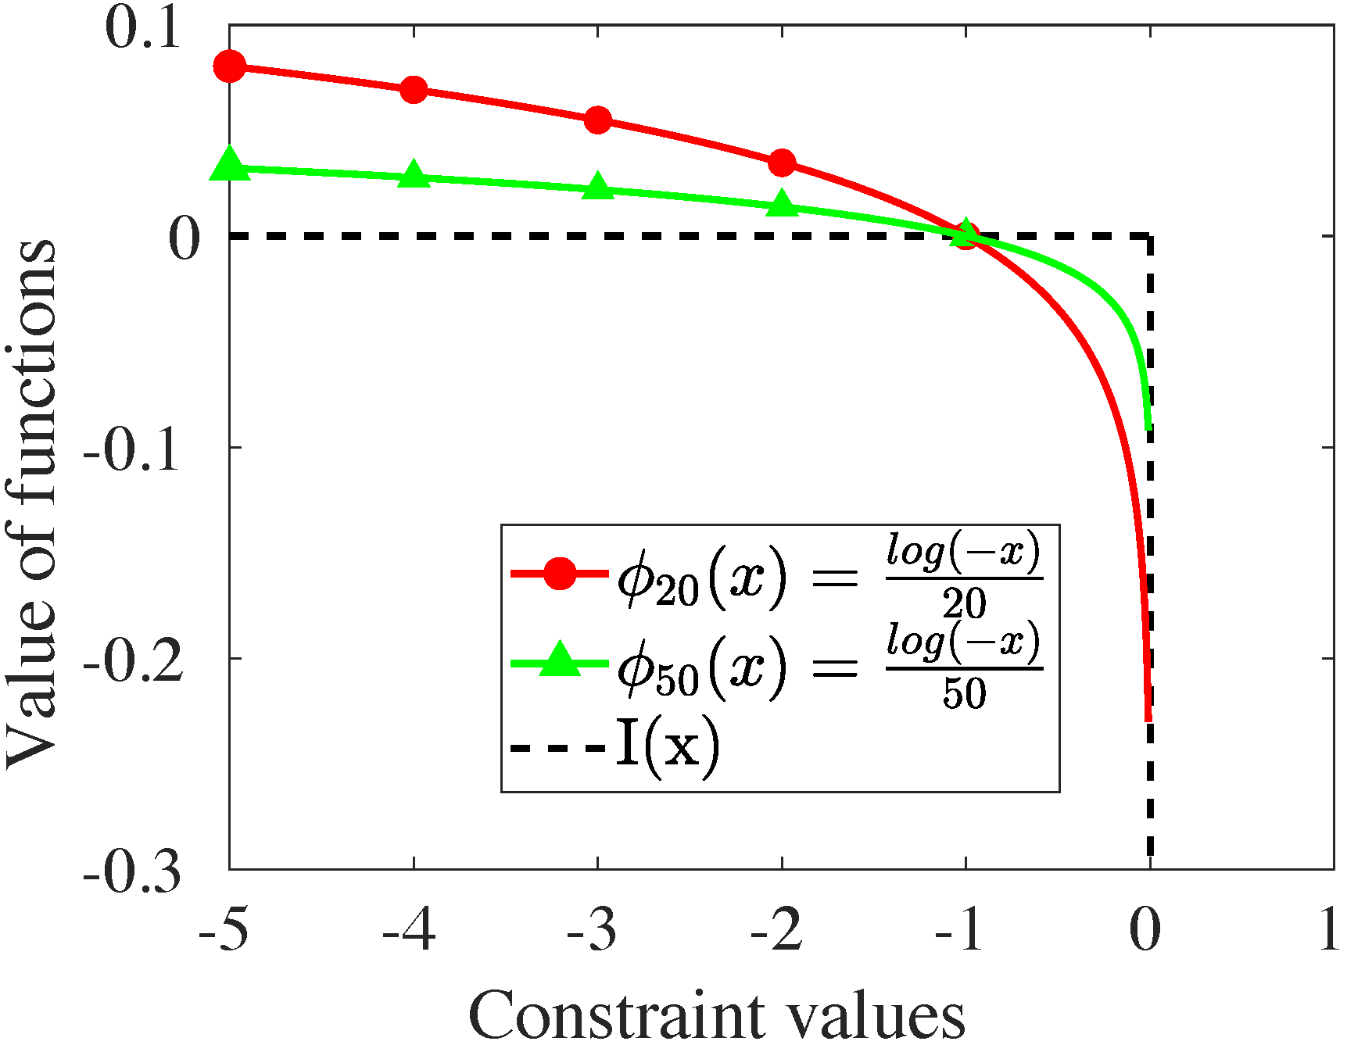
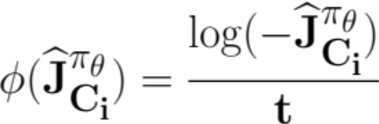
IPO: Interior-point Policy Optimization
Penalty function
Denote
Ideal penalty function
Logarithmic barrier function:
A differentiable approximation
Notes:
in other words, this is the ideal penalty function we want
if the constraint is satisfied the penalty is zero otherwise it's minus infinity
of course this is hard to compute in practice
so we introduce a logarithmic barrier function which is a differentiable approximation of this ideal penalty function
and here we illustrate the idea . the dotted line is kind of our ideal function
the green line and red line are two approximations of logarithmic barrier function with different parameters which is this value t
one use 20 and another one use 50

Slide 16
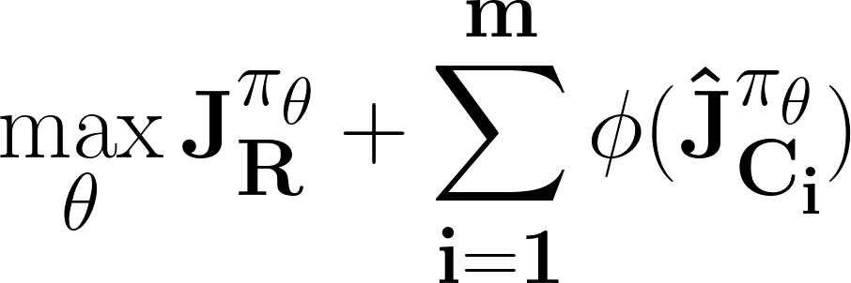
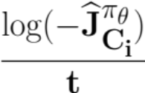
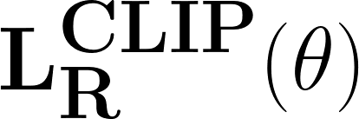
IPO: Interior-point Policy Optimization
Objective function
Notes:
here using this penalty function, we convert the constraint optimization into an unconstrained optimization problem
the first part is objective function
the second part is a penalty and then we use a standard ppo to solve this problem where ppo does a clip
so that the policy doesn't change too much also it guarantees each time improves the policy.
compared with lagrangian relaxation, we know the cause of this t can be a fixed hyper parameter
and we don't have to change it over time
although in practice we also developed an adaptive one that t can change over time
so that it is much less sensitive to the hyperparameter

Slide 17
IPO: Interior-point Policy Optimization
Performance Bound
Theorem: The maximum gap between the optimal value of the constrained optimization problem and IPO is bounded by m/t.
  m is the number of constraints
  t is the hyperparameter of logarithmic barrier function
Notes:
we can show that the maximum gap between the optimal value of the constraint optimization problem and ipo is bounded by this m over t
where m is a number of constraints and t is a hyperparameter of the logarithmic carrier function as we showed earlier

Slide 18
IPO Summary
IPO outperforms the state-of-art methods.
Achieves monotonic improvement on the policy.
Can handle multiple constraints.
Easy to compute and implement
Easy-to-tune hyperparameters.
Can easily incorporate with instantaneous constraints.
Notes:
so in summary of IPO, we propose ipo to handle the cumulative consttaints and ipo performs a state-of-the-art method
it achieves a monotonic improvement on the policy which is a property inherited from ppo
it can handle multiple constraints
it's easy to compute and implement
and this hyperparameter is easy to tune
it can also incorporate with instantaneous constraints. that we'll see next

Slide 19
Safe layer
Instantaneous constraints
Notes:
the idea of solving instantaneous constraint is introducing an additional safe layer to the policy network
this is an idea borrowed from the literature

Slide 20
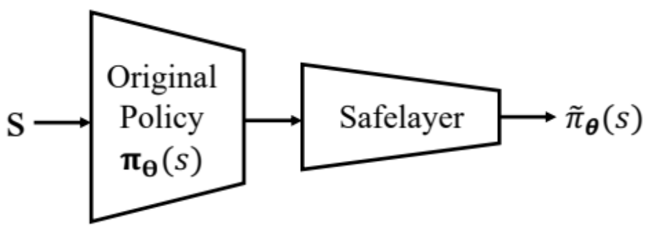
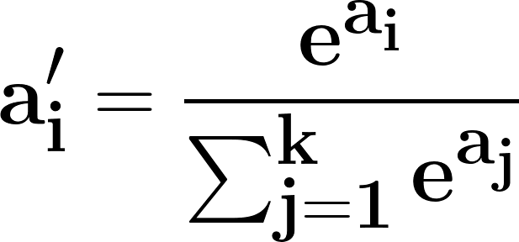
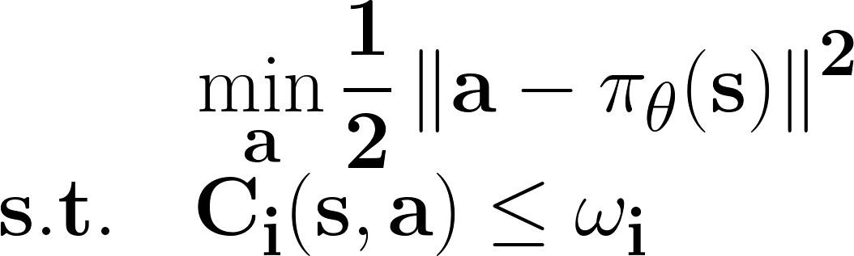
Safe layer
Instantaneous constraints
Explicit instantaneous constraints (bandwidth)
Implicit instantaneous constraints (latency)
Notes:
so basically at a given state, the original policy will give us a set of action. The action maybe infeasible.
we put this action into the safe layer and the safe layer will generate a policy so that the constraint can be satisfied
so for the explicit constraint, basically the bandwidth constraint. we do it in a simple way .
we proportionally scale down the bandwidth required if it‘s more than the total that we have. so this is easily done
for the latency requirement which is implicit we use the projection here and the idea is also simple
we have this learn function of the latency and we want it to below a given threshold
and we find the action a that is as close to the original policy as possible but satisfying this constraint so
this is where the safe layer is working

Slide 21
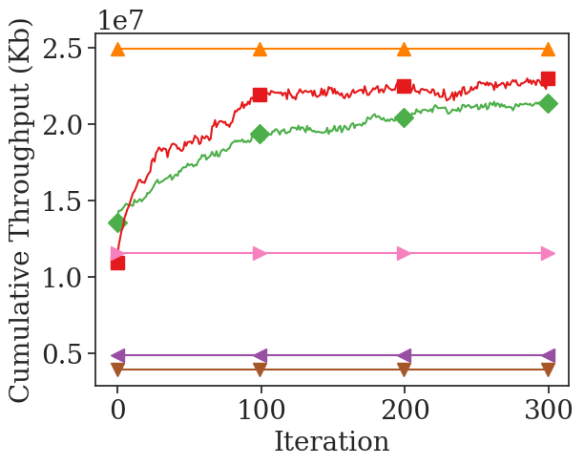
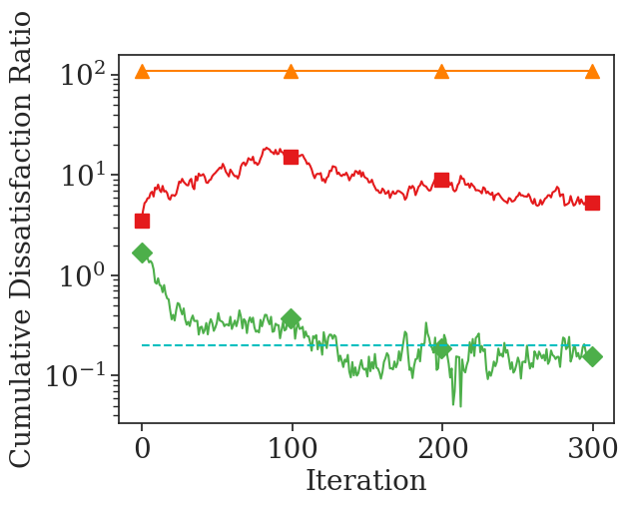
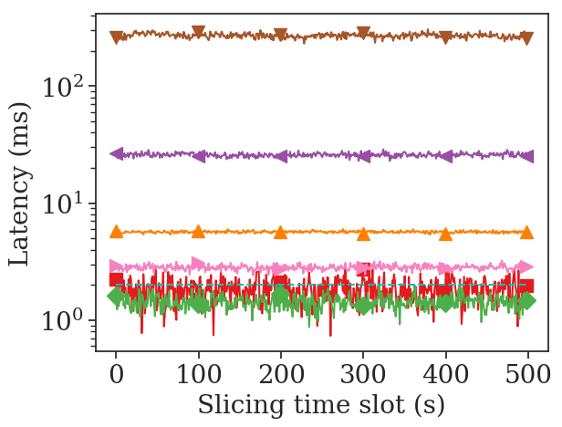
CRL Based Network Slicing
Evaluation
Traditional baselines:
User number
Packet number
Traffic demand
RL algorithms:
PPO
Notes:
so next we present the evaluation of our method
we consider traditional baselines where we evenly allocate resource based on user number or packet number or traffic demand
because we don’t know the hidden structure. this is really what traditional optimization framework will give us
we also consider ppo which is a typical RL methods without considering constraints.
so in this figure the x axis is time. how long we have been simulating and the y-axis is accumulated throughput
in the first figure the higher the better of course
the second figure is cumulative discounted ratio. the lower the better this is the threshold where we have.
and the third one is latency. the implicit instantaneous constraint.
the constraint is here, it's hard to see hidden between them.
Overall, we can see our proposed algorithm the green curve can achieve pretty good overall performance and it satisfied the constraint after certain iterations
and also it satisfies the instantaneous constraint

Slide 22
Conclusion
Network slicing -> CMDP
IPO: cumulative constraints
Safe layer: instantaneous constraints
Other challenges
  Sample efficiency
  Trustiness
Notes:
so in summary in this work, we talk about why we should use such learning-based approaches in network slicing resource allocation.
we formulate the network slicing problem as a constrained MDP.
we proposed ipo which is to handle cumulative constraints.
We also introduce safe layer for instantaneous constraints.
there are a lot of other challenges that we have to address if we want to apply RL in real
the first challenge is sample efficiency we all know training a deep reinforcement learning algorithm is expensive.
it often requires millions of samples to train a good policy
in network how do we get such data especially suitable data to train such a policy is a challenging issue.
so we have to improve the sample efficiency.
%there are a number of ways that the research literature is going in this direction.
%one is to find better exploration techniques, the other is to use simulation and then adapt the simulation-based approach to a real scenario
%the third is consider model-based approach. each of them there are related challenges especially how do we adapt quickly from simulation-based approach to real approach
%or how do we count the imperfectness in the model-based approach because error could accumulate
another important issue is trustness of the policy, so a network operator is unlikely to adapt a black box policy without knowing what's going on
% the probably justifiable concern is okay it may improve performance by 10 percent in some cases but what if it generates very undesirable results
so clearly that's a very valid question
there are two key components in this part
one is interpretability .can we explain a policy to an operator and let operator understand why it's working
a related part is safety how do we know this policy is not going to generate undesirable results or reach danger states these are related questions
there are many other challenges, but these are two of the key issues especially for network

Slide 23
Q&A
Notes:
Ok. Thanks for your attention. Next let’s go to the Q&A session.

