Slide 1
HDR-Nets’20
Panel Discussion:
The Future of Data, Machine Learning, and Networks
Challenges and Opportunities
5:30 - 6:50pm (CEST)
Moderators
  Harshit Chitalia (Juniper Networks, USA)
  Zhi-Li Zhang (Minnesota University, USA),
Panelists
  Nirmit Desai (IBM Research, USA)
  Sumi Helal (Lancaster University, UK),
  Xin Liu (University of California – Davis, USA)
  Sayandev Mukherjee (CableLabs, USA),

Slide 2
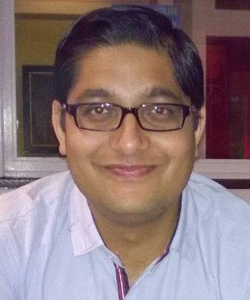





Nirmit Desai
Principal Research Scientist and Manager, IBM Research
Mission: Develop practical solutions to hard problems and test them in the real-world
CS PhD, NCSU 2007
Interaction-oriented design of complex software
Representing and reasoning about socio-technical abstractons
Edge AI: Enabling data and AI applications across distributed nodes
Federated learning, edge model mgmt, edge data mgmt
E.g. Watson flu-risk predictions
Edge infrastructure: large-scale DTN over mobile platforms
E.g., “Mesh Network Alerts” for offline messaging reaching millions of users via Weather Channel apps
E.g., “Watson Works” contact tracing with accurate proximity estimation via ultrasound
1

Slide 3
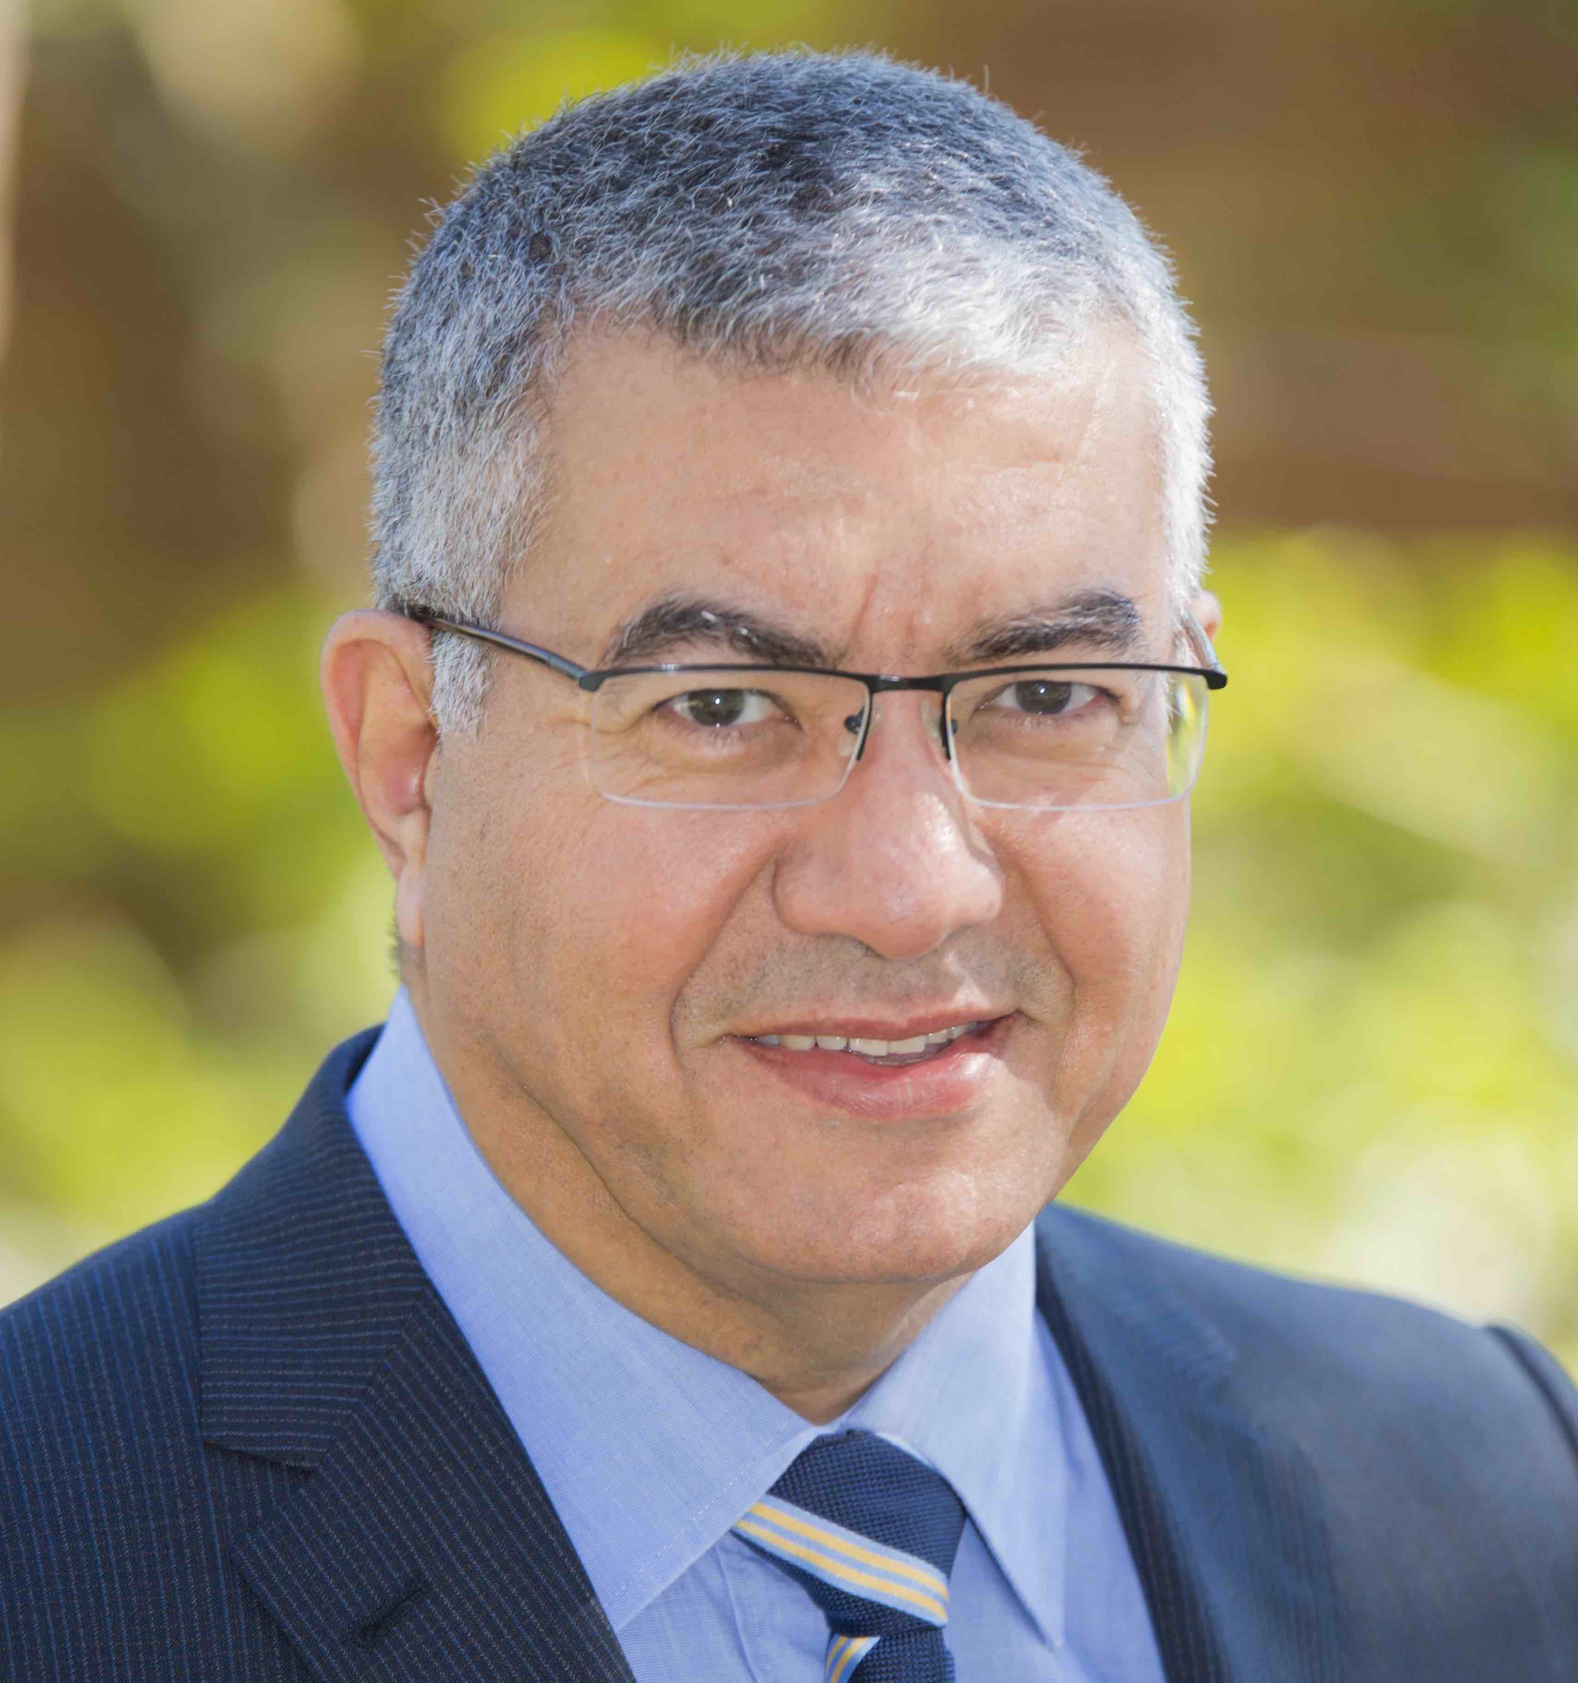
Sumi Helal www.sumihelal.com
Professor, CISE, University of Florida & Chair in Digital Health, Lancaster University
Fundamentals: IoT, Smart Spaces, Mobile Computing
Applied: Digital Health, Aging, Disabilities
Data-driven approaches:
  Predictability
  Real-time, distributed optimization of data-driven systems
sumi.helal@gmail.com

Slide 4

Xin Liu, CS, UC Davis
Ph.D., ECE, Purdue University
Professor, CS, UC Davis
MSRA, 2012- 2014
Wireless and cellular networks
  Opportunistic scheduling
  Cognitive radio
Data-driven approach in networking
  Cellular network resource management, network configuration,
  Mobile system personalization
  Encrypted traffic classification
Machine learning algorithm development
  Opportunistic learning
  RL sample efficiency & interpretability
ML applications in human and animal health
  UCD AI center for Security, Privacy, and Inclusion
  NSF/USDA AI Institute for Next Gen Food Systems
  NSF AI Convergence Accelerator
  Research scientists and postdoc positions
Notes:
Cognitive disease identification throughEEG-signal word repetition experiment (John Olichney)
Neuron-muscular disease mobility patten identification (Erik Henrickson)
ICU patient movement identification (With Sarina Fazio from Jason Adams group)
I-CARE for healthy aging (Sarah Farias & Alyssa Weakley)
Lifestyle intervention for Alzhermer’s disease
Heart disease readmission prediction with Kathy Kim

Slide 5
Sayandev Mukherjee
Principal Architect, CableLabs
Ph.D, Cornell, 1997
  Ph.D Dissertation, “Neural Network Training Algorithms based on Quadratic Error Surface Models”
  M.S. Thesis, “Asymptotics of Gradient-Based Neural Network Training Algorithms”
Many years of research experiences, including nearly 10 years at Bell Labs as Member of Technical Staff
More than 20 patents, etc.
Machine and Deep Learning applied to wireless networks -- MLaaS platform for a wireless network:
s.mukherjee@cablelabs.com

