Slide 1
Panel Discussion: The Future of Data, ML, Smart Networks, and Applications
Sayandev Mukherjee | Principal Architect
s.mukherjee@cablelabs.com

Slide 2
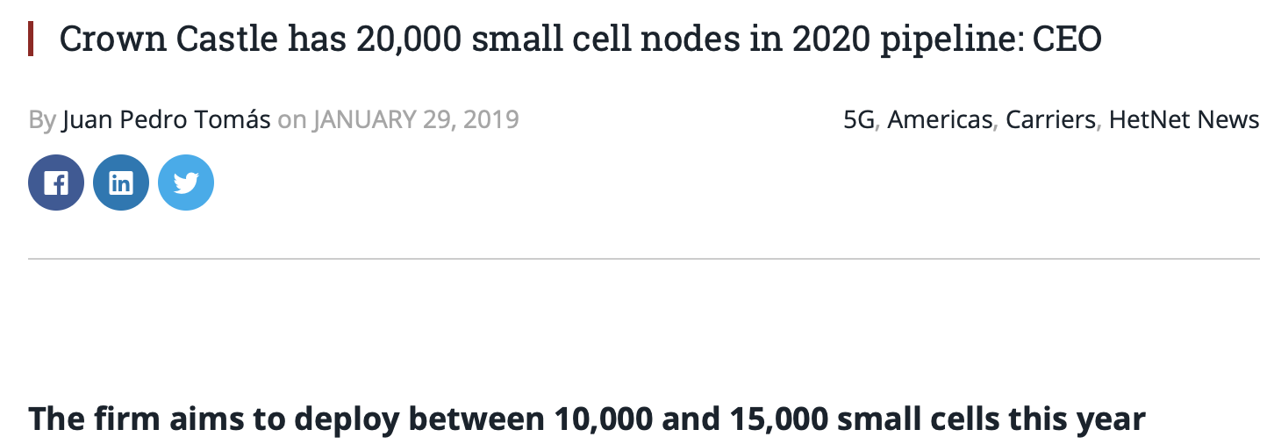
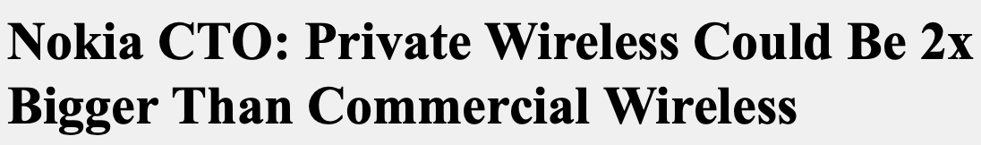
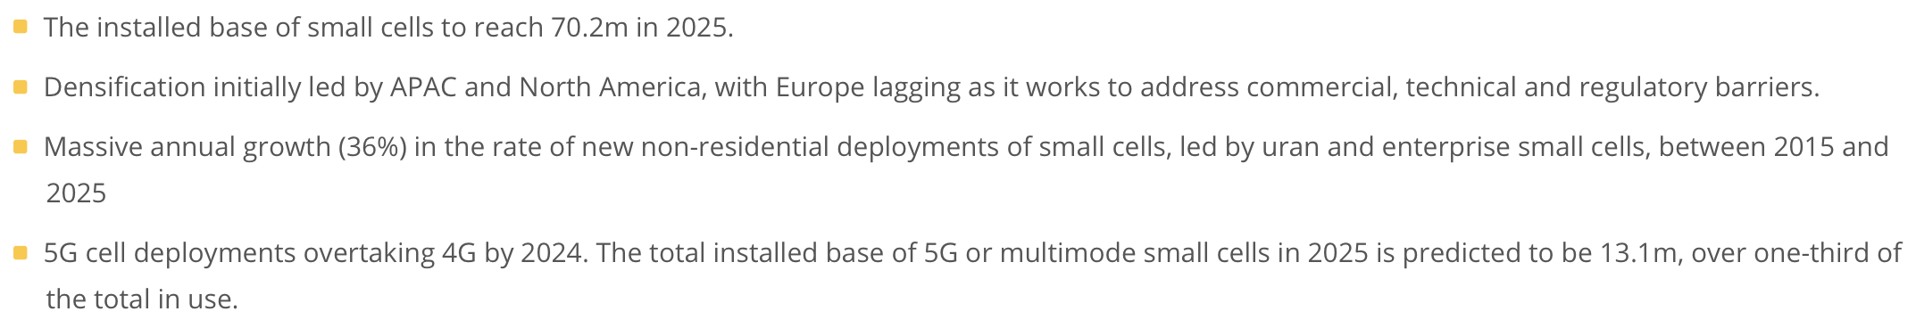
With 5G and Private Networks comes an explosion in the number of cells

Slide 3
Deployment and operation at this scale requires automation
The existing pool of human experts is not big enough, and will not grow fast enough, to tackle the challenges of (just to name a few):
  Network planning
  Fault prediction
  Coexistence with previous generations of networks
  At scale, and over many more spectrum bands than ever before
Automation is therefore essential for successful and economical deployment and operation of these future networks
  The ultimate goal is to move toward full automation, with fully-autonomous networks that configure, optimize, run and heal themselves with no human intervention
  This level of automation requires ML!
Forecast levels of network automation by MNOs worldwide 2018-2025 (Based on a survey of 76 Tier 1 and 2 MNOs worldwide, Q32018) (source: Analysis Mason)
3

Slide 4
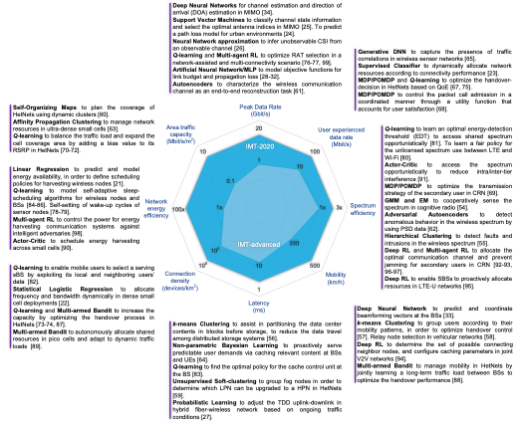
AI/ML for IMT-2020 goals
M.E. Morocho-Cayamcela et al., “Machine Learning for 5G/B5G Mobile and Wireless Communications: Potential, Limitations, and Future Directions,” IEEE Access 7, 137184 – 137206, Sep. 2019

Slide 5
Federated Learning
In each round of training:
Each local learner trains a local version of the ML model on its local data
Only the local model parameter updates are sent up to the controller (this reduces the load on the links to the controller)
The controller performs a weighted average of the parameter updates to get the new set of parameters for the global model
The controller sends the new global model back down to each local learner as its initialized local model for the next round of training
Source: https://miro.medium.com/max/1400/1*HaH611vAy2eB1e42vz3X4g.png
FL controller
3
Parameter update to local model
2
4
1
Local model trained on local data
Local model trained on local data
Local model trained on local data
Local model trained on local data
The backhaul on a wireless network is very congested: we don’t want to move data over it
Federated Learning allows for collaborative training of a single global model by multiple local learners without exchanging or transporting data anywhere!
The localized (local data trained model) vs. global model tradeoff is an open research problem

Slide 6
Hierarchical Federated Learning
Base stations (or DUs, to be precise) in a cellular network are typically provisioned such that they have little or no additional computational or storage capacity
  In other words, they are not capable of training even modestly-sized models on local data
On the other hand, CUs may have access to cloud-based computing and storage resources, but the DU-to-CU backhaul is very congested
Proposed solution: Hierarchical Federated Learning with Split Learning
  The (computation graph for the) model to be trained by a DU on local data is split between the DU and collectors at the local (rack) level and central office level, and maybe even other edge computing resources – Stadia servers perhaps?

Slide 7




Example: Hierarchical FL with Split Learning
Federated Learning
Collector, central office level
Split Learning
$$M_{higher}^{(DU1+DU2)}$$
Local collector,
rack level
$$M_{lower}^{(DU2)}$$
$$M^{(DU3)}$$
$$M_{lower}^{(DU1)}$$
DU 1
DU 2
DU 3
Local data
Local data
Local data

Slide 8
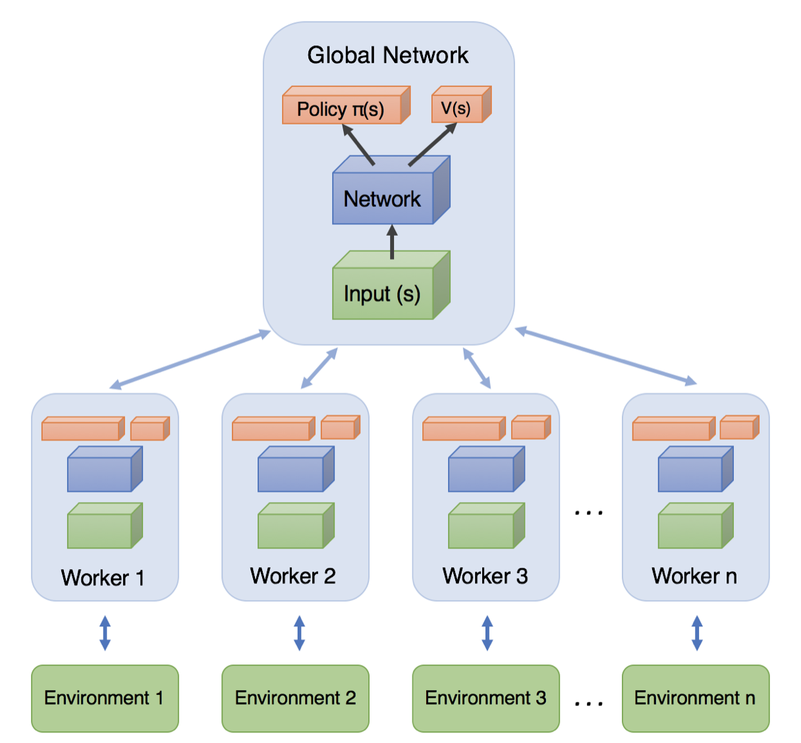
Reinforcement Learning
For RSRP prediction, the “labeled” output for supervised learning can be obtained by just waiting for the next measurement
However, there are other applications like base station configuration where obtaining such labeled outputs may require human curation
  This is expensive, time-consuming, and cannot scale
Reinforcement Learning offers the possibility to train models on incoming unlabeled data
  The actions to be taken by the system (say in configuration, or congestion avoidance) are learnt from future rewards (which may be defined as functions of the key performance indicators or KPIs that are routinely measured at the base stations)
  A popular RL algorithm named A3C can even be run in federated fashion (including hierarchically, with split learning)
A3C architecture
Source: https://miro.medium.com/max/1400/1*YtnGhtSAMnnHSL8PvS7t_w.png

Slide 9
Enabling it all with an MLaaS platform
We require a machine learning as a service (MLaaS) platform to:
  Enable any developer (with or without expertise in data science, deep learning, etc.) to train and deploy deep learning-based applications on the network
  This is different from the familiar cloud-based approach because the data is collected at the edges of the network and it is expensive to transport it to the cloud
  Provide end-to-end tools and support for the complete lifecycle of model training and deployment, starting with data ingestion, feature extraction (if necessary), model training, zero-touch deployment on a variety of targeted platforms, and model performance monitoring after deployment
  Orchestrate the split and hierarchical model training across multiple computing and storage resources, accounting for latencies and bandwidths in the links between these resources
    The natural way to optimize this resource allocation for distributed training is to specify an economic model and optimize a utility function

Slide 10
Summary
Wireless networks come with a unique set of challenges:
  Communications constraints
  Computing and storage constraints
The usual “IT-centric” (i.e., cloud-hosted, cloud-trained model) approach to AI/ML model development, training, and deployment is not directly applicable to a wireless network
Successful integration of AI/ML into network operations will involve:
  MLaaS platforms with enhanced capabilities
  Utility-based assignment of computation/storage jobs to different network, computing, and storage elements in the different phases of model training, deployment, and monitoring
The lessons learned here will also apply to next-gen cable networks

