Slide 1

Xin Liu, CS, UC Davis
Ph.D., ECE, Purdue University
Professor, CS, UC Davis
MSRA, 2012- 2014
Wireless and cellular networks
  Opportunistic scheduling
  Cognitive radio
Data-driven approach in networking
  Cellular network resource management, network configuration,
  Mobile system personalization
  Encrypted traffic classification
Machine learning algorithm development
  Opportunistic learning
  RL sample efficiency & interpretability
ML applications in human and animal health
  UCD AI center for Security, Privacy, and Inclusion
  NSF/USDA AI Institute for Next Gen Food Systems
  NSF AI Convergence Accelerator
  Research scientists and postdoc positions
Notes:
Cognitive disease identification throughEEG-signal word repetition experiment (John Olichney)
Neuron-muscular disease mobility patten identification (Erik Henrickson)
ICU patient movement identification (With Sarina Fazio from Jason Adams group)
I-CARE for healthy aging (Sarah Farias & Alyssa Weakley)
Lifestyle intervention for Alzhermer’s disease
Heart disease readmission prediction with Kathy Kim

Slide 2
Networks Meets Machine Learning
ML is not a cure-all.
Networks are large engineered complex systems – beyond white-box modeling
Environment: highly dynamic and partially observable
All layers
  Ex: AMC, MAC, routing, TCP, video bit rate control
All players
  Ex: network operators, CDN operators, content providers, application software
All objectives:
  Networked users (churn, fraud, etc.)
  Network services (video, etc.)
  Networks – both existing (e.g., TCP) and new architecture

Slide 3
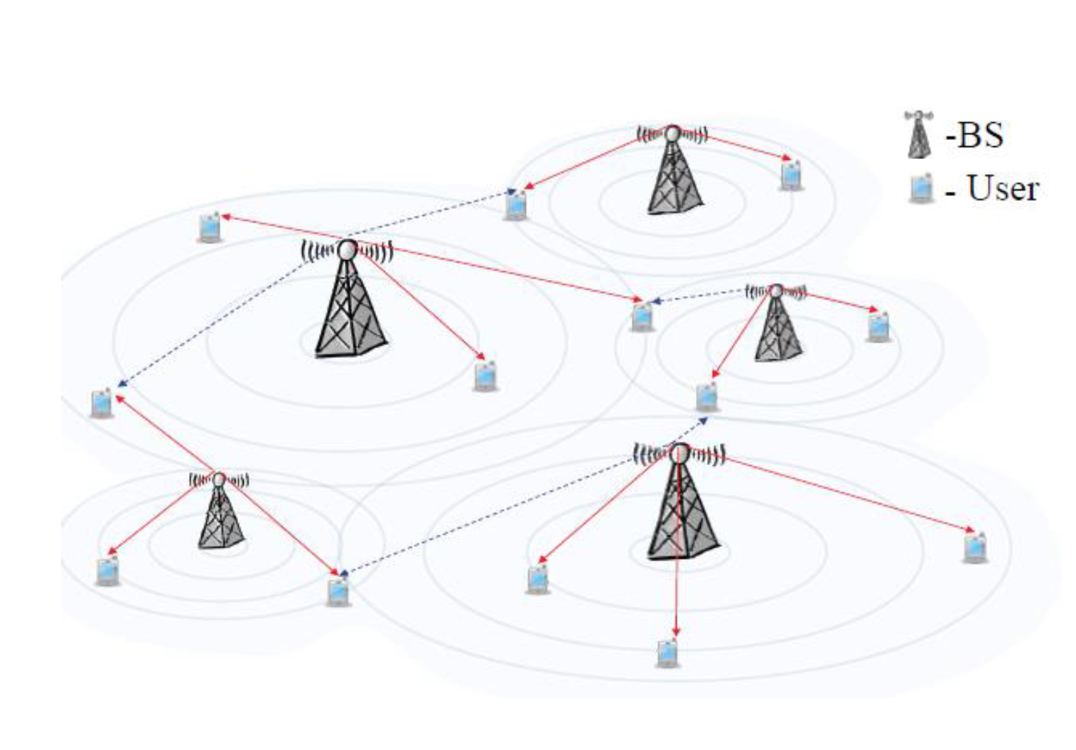
Case Study: Cellular Network Configuration
A large number of parameters to configure

Slide 4
Cellular Network Configuration
A large # of parameters
  BS transmission power
  Thresholds for handover
  Max. # of users
  Antenna direction
  Etc.
Performance metrics
  Total throughput
  Average data rate
  Edge user performance
  Resource utilization rate
  Etc.

Slide 5
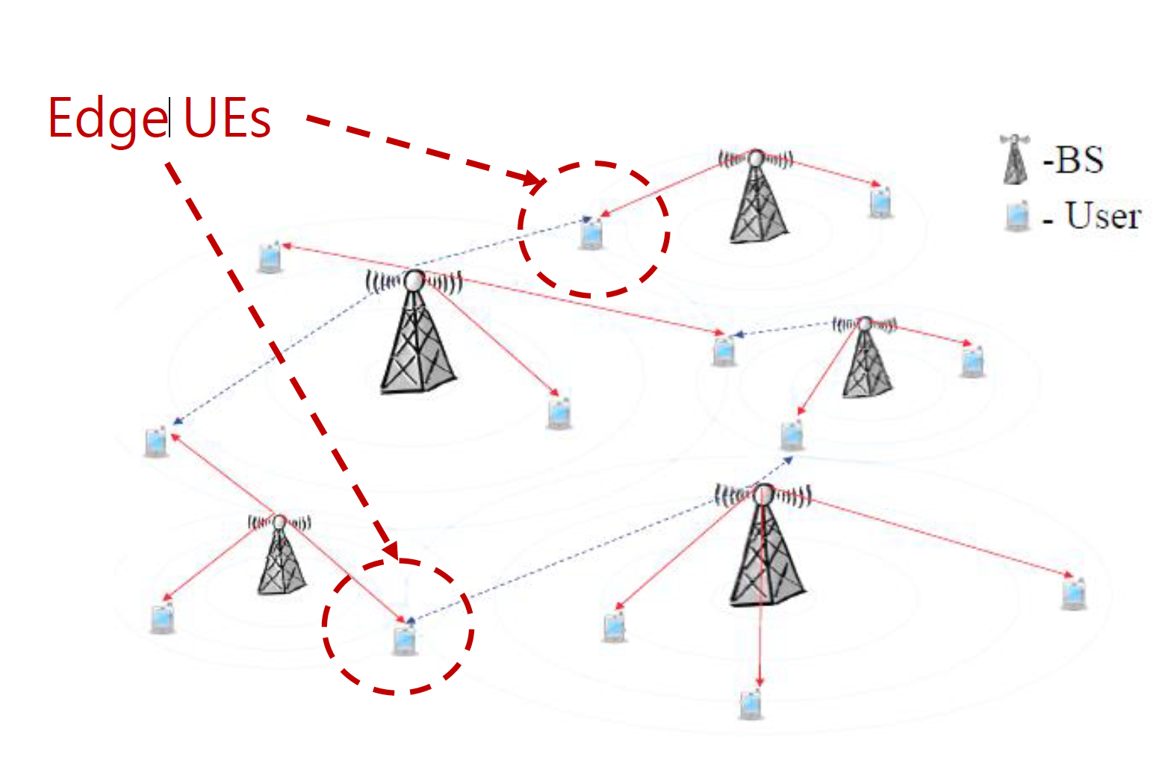
Example: Handover
Performance metric
  Edge UE throughput
Parameter conf.
  A2-threshold-RSRP
  Defined in LTE
Impact on performance
  Too small
  Too large
Notes:
A2-threshold-RSRP is a parameter used during LTE handover process. When camping
on a cell, a User Equipment (UE) keeps monitoring the signal quality (the Reference Signal Received Power, or RSRP value) of the serving cell. Once the RSRP value of the serving
cell is worse than the A2-threshold-RSRP, UE starts to send measurement reports such that the serving cell can identify a target cell and prepare for handover.
Too small: handover is hard to be triggered -bad signal or call drop
•Too large: much bandwidth occupied by handover control signaling
Setting A2-threshold-RSRP to the best value requires taking into consideration of many factors including the traffic load of a cell, the number of (active) users, channel quality,
etc., and thus is not easy.

Slide 6
Traditional Approach
Traditional approach
  By human expert
  Labor intensive and suboptimal
    Hours/days to tune on configuration based on experience
    Tune one or two parameters each time
    Hundreds of parameters
As a result, most cells set the configurations to default values
  Lots of data, still a cold start
Notes:
Complex relationship between conf. and perf. And network state, no white box modeling. Highly noisy observations

Slide 7
Our Study
Machine-learning-based approaches to automate this process
Challenges:
  Lots of data and still a cold start
  Network performance is a highly complex (and noisy) function of configurations and cell states
  Limited amount of exploration
    Network operators are risk-averse
    Limited configuration adjustment frequency (e.g., one adjustment a day)
    Limited duration for adjustment (e.g., two weeks)

Slide 8
Our Approaches
Approach 1: Prediction-model-based optimization
Approach 2: Kernel-based contextual bandits
Approach 3: Collaborative-learning-based approach
20% improvement in KPI in real operational networks with 1700+ cells!
Theoretical inspiration
  Opportunistic learning: exploration cost depends on the context (ICML, IJCAI)

Slide 9
Typical Steps
Why learning is a suitable approach
  Do not use ML for the purpose of using ML
  Evaluate existing approaches and room for improvement
Problem abstraction and formulation
  Model complexity, data availability, evaluation
  Domain knowledge critical
Data collection and data cleaning
  What, where, and how
ML algorithms
  This is sometimes the “easy” part
  Iterate with data collection and evaluation
Evaluation
Notes:
Problem abstraction and formulation can be important. In networks, the number of states can be extremely large is not carefully managed. This is a place where domain knowledge can be important. What are the important features, what are independent, what is the time granularity?
Consider the cellular QoE example (call complain). There are many different ways we could potentially formulate the problem: prediction-model + optimization, bandit algorithms, RL, deep RL. Data availability is a key factor. Learning complexity is another.

Slide 10
Technical Gaps and Challenges
Sample efficiency & evaluation
Interpretability, safety, security, privacy
Apply, twist, or develop machine learning algorithms
Does not always outperform existing algorithms

