Slide 1
The 2nd IEEE International Workshop on
Harnessing the Data Revolution in Networking
HDR-Nets 2020
ICNP 2020
Madrid, Spain
Oct. 13, 2020

Slide 2
HDR-Nets Organizers
  Steering Co-Chairs
    Zhi-Li Zhang
    (University of Minnesota, USA)
  General Co-Chairs
    Dan Pei
    (Tsinghua University, China)
    Anwar Walid
    (Nokia Bell Labs, USA)

Slide 3
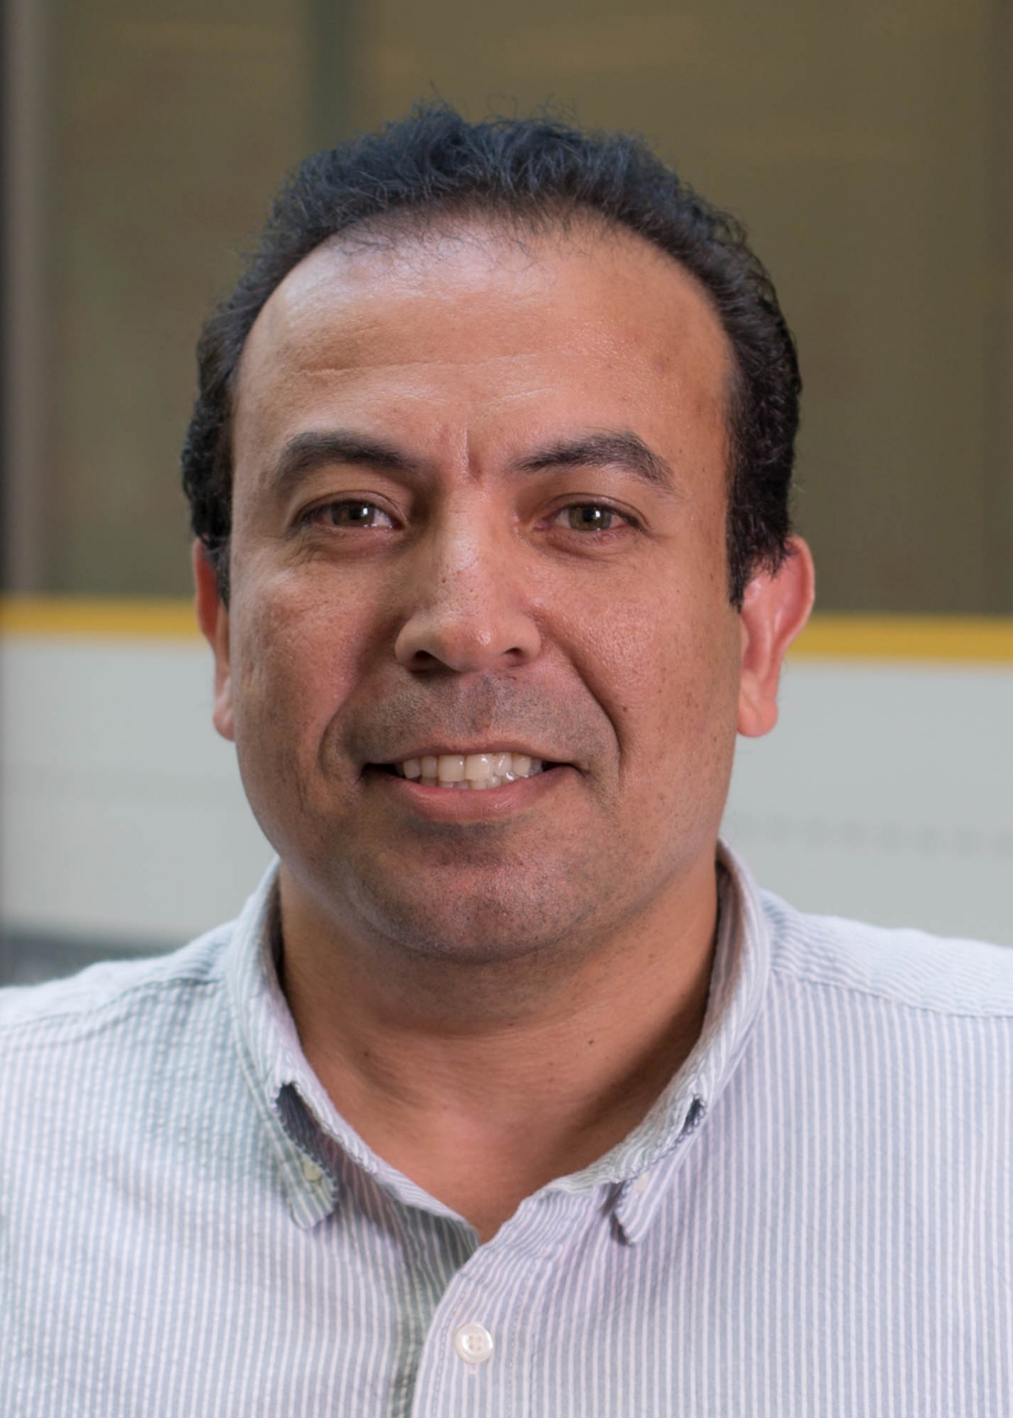
HDR-Nets Organizers
  TPC Co-Chairs
    Harshit Chitalia (Juniper Networks, USA)
    Bartosz Krawczyk (Virginia Commonwealth University, USA)
    Tamer Nadeem (Virginia Commonwealth University, USA)

Slide 4

Technical Program Committee
Abhimanyu Gosain, Northeastern University
Ajay Mahimkar, AT&T Labs - Research
Carlee Joe-Wong, CMU
Chuanxiong Guo, Bytedance
Gurkan Solmaz, NEC Laboratories - Europe
Isaac Triguero, Nottingham University
Jun (Jim) Xu , Georgia Institute of Technology
Kuai Xu, Arizona State University
Maria Gorlatova, Duke University
Mostafa Uddin, Perspecta Labs
Shenglin Zhang, Nankai University
Xin Liu, UC Davis
Yongqian Sun, Nankai University
Zihui Ge, AT&T Labs - Research

Slide 5
HDR-Nets ’20
Statistics
10 Full Paper Submissions
3-4 Reviewers for each paper
5 Accepted Papers
2 Invited Papers

Slide 6
HDR-Nets ‘20 Full Day Program
10:40 – 11:40am: Keynote Talk #1
11:40 – 12:00pm: Technical Session #1: In the Beginning
12:00 – 12:30pm: Coffee Break
12:30 – 2:00pm: Technical Session #2: Machine Learning for Networks
2:00 – 3:30pm: Lunch Break
3:30 – 4:20pm: Keynote Talk #2
4:20 – 5:00pm: Technical Session #3: The Power of Data
5:00 – 5:30pm: Coffee Break
5:30 – 6:50pm: Panel Discussion
6:50 – 7:00pm: Closing Remarks

Slide 7
HDR-Nets ‘20 Full Day Program
10:40 – 11:40am: Keynote Talk #1
11:40 – 12:00pm: Technical Session #1: In the Beginning
12:00 – 12:30pm: Coffee Break
12:30 – 2:00pm: Technical Session #2: Machine Learning
for Networks
2:00 – 3:30pm: Lunch
3:30 – 4:20pm: Keynote Talk #2
4:20 – 5:00pm: Technical Session #3: The Power of Data
5:00 – 5:30pm: Coffee Break
5:30 – 6:50pm: Panel Discussion
6:50 – 7:00pm: Closing Remarks

Slide 8

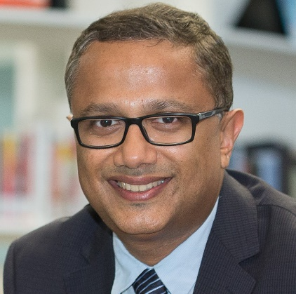
Hdr-Nets’20
Keynote Talk #1
10:40 - 11:40pm (CEST)
Collaborative Edge-based Machine Intelligence:
Promise and Challenges
Vice Provost (Research)
Professor of Information Systems
Director, Centre for Applied Smart-Nation Analytics
School of Information
Singapore Management University
Singapore
Archan Misra

Slide 9

HDR-Nets’20
Technical Session #1: In the Beginning
11:40-12:00pm (CEST)
A Semi-supervised Stacked Autoencoder Approach for Network Traffic Classification
  Ons Aouedi and Kandaraj Piamrat (University of Nantes); Dhruvjyoti Bagadthey (IIT Madras)

Slide 10
HDR-Nets’20
Technical Session #2: Machine Learning for Networks
12:30 - 2:00pm (CEST)
A Constrained Reinforcement Learning Based Approach for Network Slicing
  Yongshuai Liu (University of California, Davis); Jiaxin Ding (Shanghai Jiao Tong University); Xin Liu (University of California, Davis)
Automated Saturation Mitigation Controlled by Deep Reinforcement Learning
  Elkin Aguas and Anthony Lambert (Orange Labs); Gregory Blanc and Herve Debar (Télécom SudParis (SAMOVAR), Institut Polytechnique de Paris)
MoGAN: GAN based Next PoA Selection for Proactive Mobility Management
  Boyun Jang and Syed Muhammad Raza (Sungkyunkwan University); Moonseong Kim (Seoul Theological University); Hyunseung Choo (Sungkyunkwan University)
Invited Talk: Machine Learning for distributed dynamic resource allocation in 5G networks
  Sayandev Mukherjee and Bernardo. Huberman (CableLabs)

Slide 11
Hdr-Nets’20
Keynote Talk #2
3:30 - 4:20pm (CEST)
Data-driven Modeling and Design of Networked Mobile Services
Playing with Matches, Flutes and Cellos!
Ahmed Helmy
Professor & Graduate Director
Computer & Information Science & Engineering (CISE) Department
Founder and Director: Mobile Networking Laboratory (NOMADS group)
University of Florida, USA

Slide 12
HDR-Nets’20
Technical Session #3: The Power of Data
4:20 - 5:00pm (CEST)
Invited Paper: Perishable Data in Smart Communities
  Glenn Ricart (US Ignite and U. Utah)
Anomalous Model-Driven-Telemetry Network-Stream BGP Detection
  Rostand A. K. Fezeu and Zhi-Li Zhang (University of Minnesota - Twin Cities)

Slide 13
HDR-Nets’20
Panel Discussion:
The Future of Data, Machine Learning, and Networks
Challenges and Opportunities
5:30 - 6:50pm (CEST)
Moderators
  Zhi-Li Zhang (Minnesota University, USA), Harshit Chitalia (Juniper Networks, USA)
Panelists
  Nirmit Desai (IBM Research, USA)
  Sumi Helal (Lancaster University, UK),
  Xin Liu (University of California – Davis, USA)
  Sayandev Mukherjee (CableLabs, USA),

