Slide 1












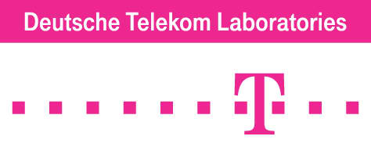



Data-driven Modeling & Design of Networked Mobile Services: Playing with Matches, Flutes and Cellos!
Ahmed Helmy
Professor, Graduate Director, Steering Committee Chair
Founder / Director: Mobile Networking Lab
Dept. of Computer & Information Science & Engineering (CISE)
University of Florida

Slide 2
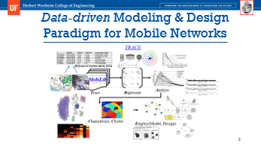
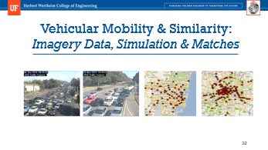
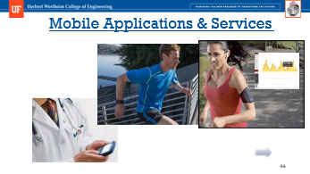
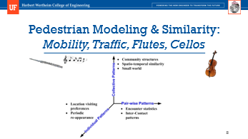

Slide 3
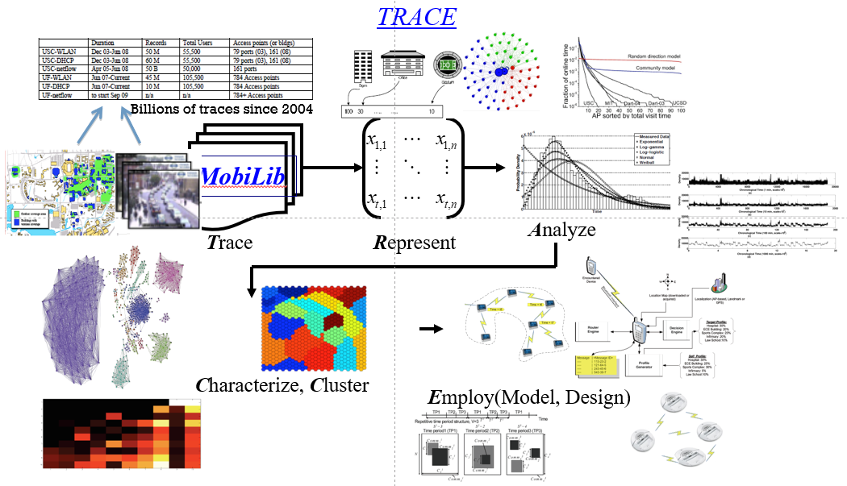
Data-driven Modeling & Design Paradigm for Mobile Networks

Slide 4
Protocol Design & Architecture
Methodology & Tools
Design – Specification Implementation (pimd) – Testing
Network Simulation (NS-2)
IP Multicast (PIM-SM)
Early
Evaluation
Test
Generation
Representative
Scenarios
STRESS
Modeling
Noise & Loss Dynamics
Geo Hash Tables (R2D2)
Realism
Robustness
Location-based Services
Synthetic Framework (IMPORTANT)
Trace-based Models (TVC, COBRA)
Vehicular Mobility (En-route)
Data-driven
Mobility Modeling
Adhoc Routing, Discovery (CARD)
Sensor Queries (AQUIRE)
Mobility Assisted Networks (MAID)
IoT (iHospital)
Mobile Health
Wireless Mobile Networks
- F. Bai, N. Sadagopan, A. Helmy, “IMPORTANT: A framework to systematically analyze the Impact of Mobility on Performance of RouTing protocols for Adhoc NeTworks”, IEEE INFOCOM, April 2003.
- W. Hsu, T. Spyropoulos, K. Psounis, A. Helmy, TVC: “Modeling Time-variant User Mobility in Wireless Mobile Networks”, IEEE INFOCOM, May 2007.
- G. Thakur, A. Helmy, “COBRA: A Framework for the Analysis of Realistic Mobility Models”, In proceedings of IEEE INFOCOM - Global Internet (GI) Symposium, April 2013. [Best Paper Award of the Internet Technical Committee (ITC)]
- R. Ketabi, B. Alipour, A. Helmy, “En Route: Towards Vehicular Mobility Scenario Generation at Scale”, In proceedings of the IEEE INFOCOM – SmartCity, May 2017. [Also, Best Poster Award of INFOCOM ‘17]
Increase Dimensionality
Utilize Insights
- D. Estrin, D. Farinacci, A. Helmy, D. Thaler, S. Deering, V. Jacobson, M. Handley, C. Liu, P. Sharma, L. Wei, “Protocol Independent Multicast - Sparse Mode (PIM-SM): Protocol Specification” IETF RFC 2362, June 1998.
- L. Breslau, D. Estrin, K. Fall, S. Floyd, J. Heidemann, A. Helmy, P. Huang, S. McCanne, K. Varadhan, Y. Xu, H. Yu, "Advances in Network Simulation", IEEE Computer, May 2000.
Similarity Routing (Profile-cast)
Mobility-traffic modeling (Flutes vs Cellos)
Shared Transportation (Matches) & Forecast (Eyes)
Data-driven Design & Evaluation

Slide 5
Paradigm Shift in Protocol Design
Used to:
1- Design general purpose protocols
2- Evaluate using generic models (random mobility, exp. traffic, …)
3- Deployment context: Modify to improve performance and failures for specific context
  Problem: Use of unrealistic models results in suboptimal performance or failures due to lack of context in the design phase. We need a data-driven approach instead!
Propose to:
1- Trace, analyze deployment context
2- Drive design of ‘application class’-specific parameterized protocols
3- Utilize insights from context analysis to fine-tune protocol parameters

Slide 6
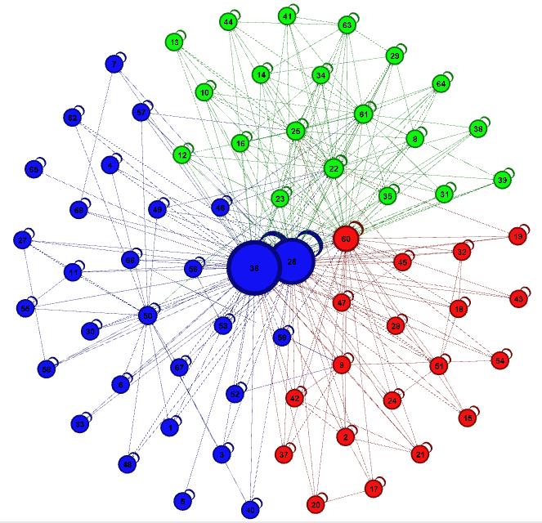
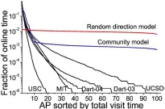

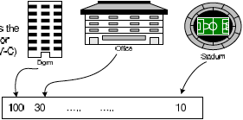
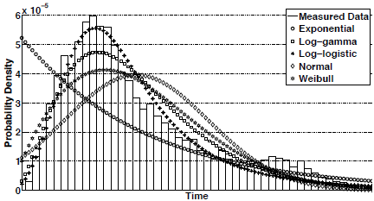
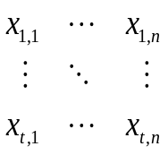
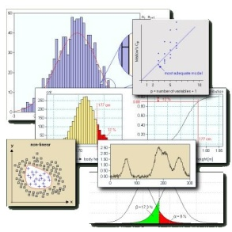
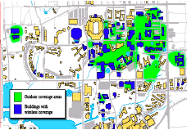
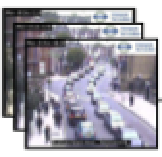
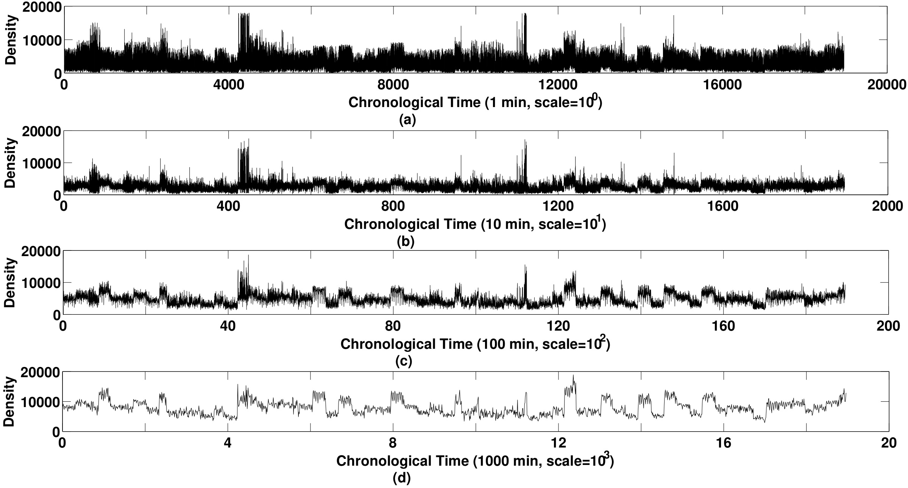
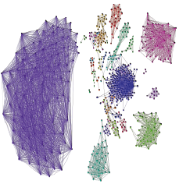
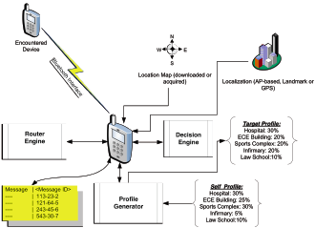
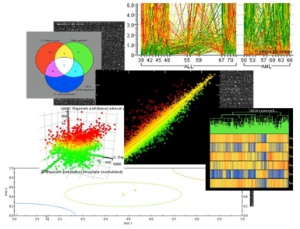
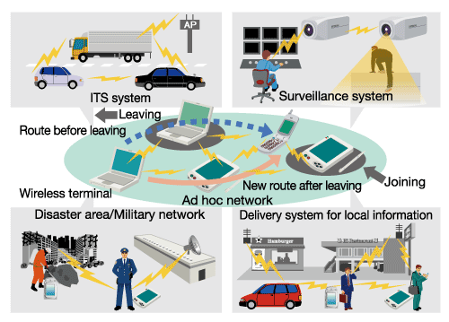
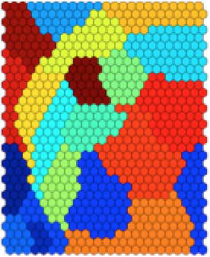
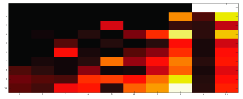
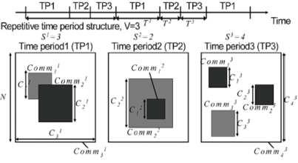

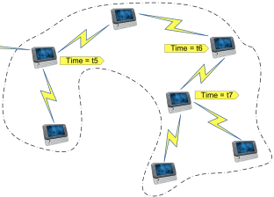



Systematic TRACE framework
W. Hsu, D. Dutta, A. Helmy, TRACE: "Structural Analysis of User Association Patterns…", IEEE TMC ‘12, IEEE WinMee ‘06, IEEE TMC ’10
Data-driven Mobile Network Mining, Modeling and Design
Billions of traces since 2004
MobiLib
Analyze
Trace
Represent
Characterize, Cluster
Employ(Model, Design)
- Mobility Modeling
- Adhoc & Sensor Network Design

Slide 7
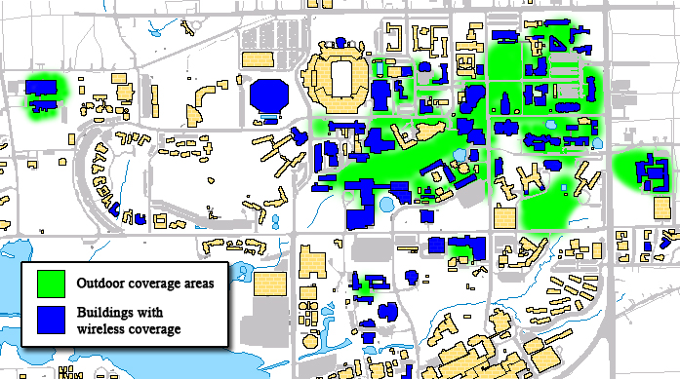
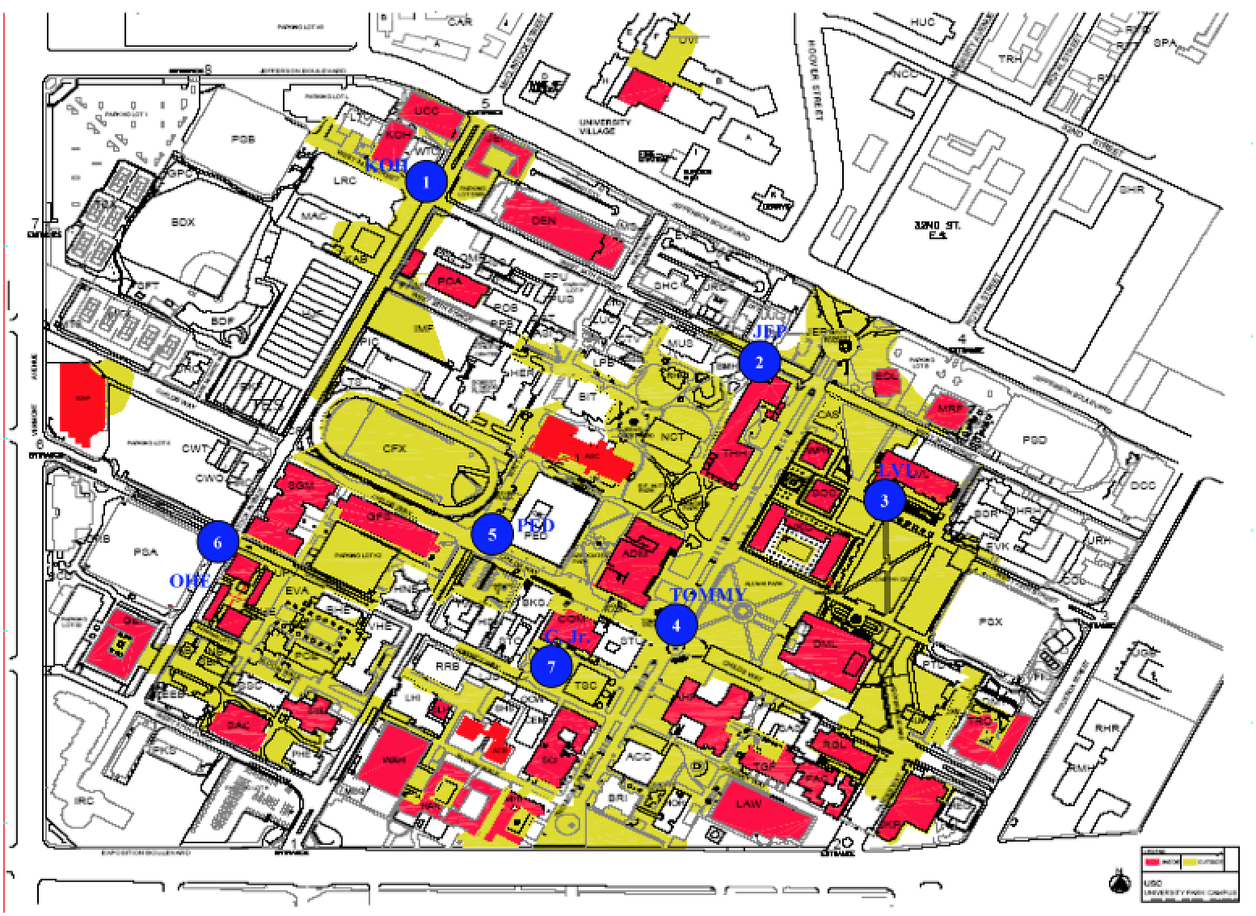
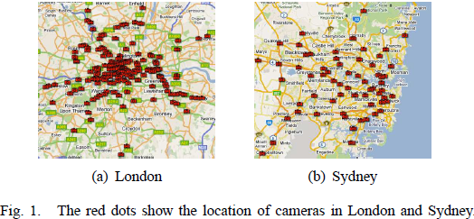
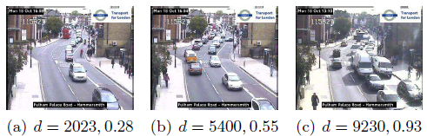
Community-wide Mobile Library
Vision: Library of
  Measurements: campuses, streets
  Realistic models: behavior, traffic
  Benchmarks & Net analytics tools
Available libraries:
  CRAWDAD (Dartmouth, ‘05-)
  MobiLib (USC & UFL, ’04-)
    cise.ufl.edu/~helmy/MobiLib (40+TB)
    Tools for mobility modeling (IMPORTANT, TVC, COBRA)
  65+ Traces from: UFL, USC, Dartmouth, MIT, UCSD, UCSB, UNC,
    UMass, GATech, Cambridge, …
Types of traces:
  Campuses (WLANs), Conference AP and encounter traces
  Municipal wireless APs
  Taxi cabs, bus & vehicular traces
  Vehicular imagery data (planet scale)
Trace
U. Florida
USC

Slide 8


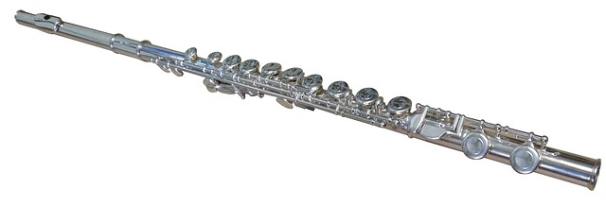
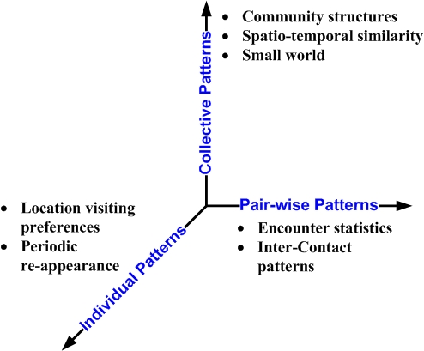
Pedestrian Modeling & Similarity: Mobility, Traffic, Flutes, Cellos

Slide 10
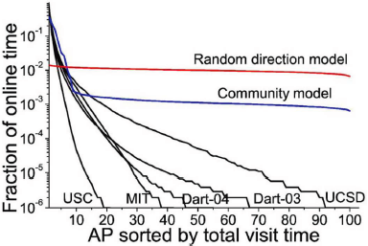
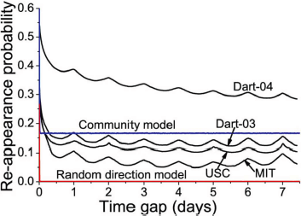
Spatio-temporal Mobility in WLANs
Two main mobility features analyzed:
  user location preference
  periodic re-appearance at previous location
Five month-long WLAN/DHCP traces analyzed
Skewed location preference
Bldg
Flr
Rm
95% on-line time at 5 most visited APs
Periodic repetition peaks daily/weekly

Slide 11
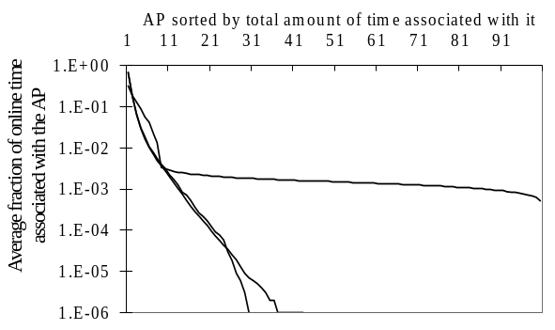
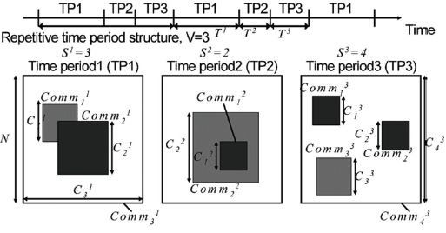
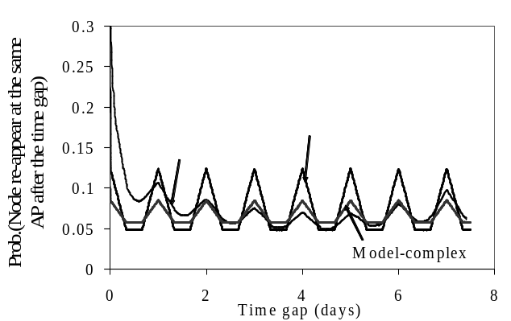
Individual Mobility Model: The TVC Model
Time-Variant Community (TVC) Model:
1- Assigns communities (locations) to users
to re-produce location visiting preference
2- Varies temporal assignment of communities for periodic re-appearance
CCDF
Skewed location visiting preference
Periodic re-appearance
Hsu, Spyropoulos, Psounis, Helmy, IEEE INFOCOM 2007
IEEE/ACM Trans. on Networking 2009
* Model-simplified: single community per node. Model-complex: multiple communities
** Similar matches achieved for USC and Dartmouth traces

Slide 13
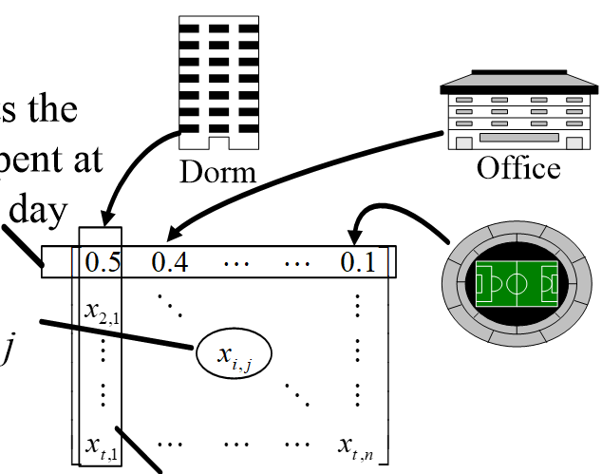

Behavior-based Community Analysis
Identify groups of users with similar behavior/interest
Summarize user associations by a vector per day
  a = {a_{j} : time user i spends at AP_{j} on day d} e.g. [ofc, class,lab]=[0.2, 0.4, 0.4]
Sum long-run mobility in “association matrix”
Multi-dimensional
Behavioral
Space
rows are days
(time window)
Sim(U,V)
V
% time spent
on day i @loc j
U
columns are locations (spaces)
Assoc. matrix describes user’s location preference
Eigen-behavior distance captures user similarity
Behavior similarity clusters
* W. Hsu, D. Dutta, A. Helmy, “Mining Behavioral Groups in WLANs”, ACM MobiCom 2007, IEEE TMC 2012.
Represent

Slide 14
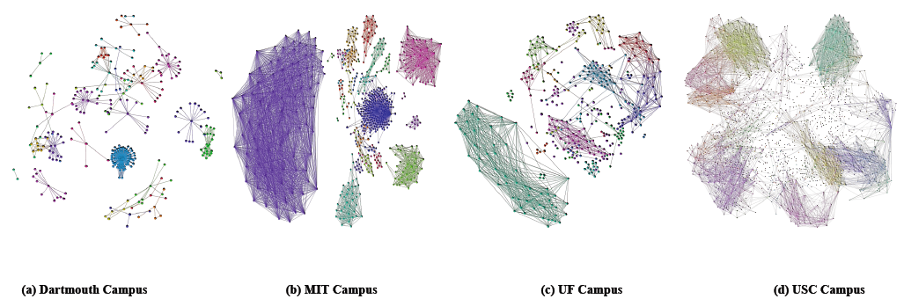
Behavioral Similarity Graphs
(a) Dartmouth Campus (b) MIT Campus (c) UF Campus (d) USC Campus
* G. Thakur, A. Helmy, W. Hsu, “Similarity analysis and modeling of similarity in mobile societies: The missing link”, ACM MobiCom CHANTS 2010

Slide 15
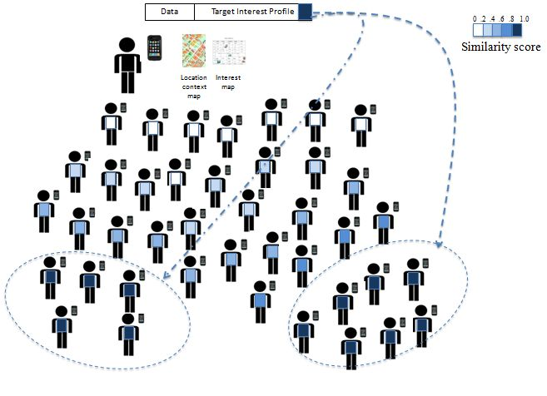
Behavioral Similarity Graphs & Profile-cast Comm Paradigm
(a) Dartmouth Campus (b) MIT Campus (c) UF Campus (d) USC Campus
Destination is defined by the target interest profiles. Destination(s) match based on inferred behavioral similarity, instead of machine (IP) address.
* G. Thakur, A. Helmy, W. Hsu, “Similarity analysis and modeling of similarity in mobile societies: The missing link”, ACM MobiCom CHANTS 2010
Extend profile dimensions with: - load (traffic) - device types, - encounters - friendship, etc.
Potential for forming support groups for health and education
* Profile-cast/CSI, IEEE Trans. Mobile Computing ‘12, *CoBRA, IEEE GI-Infocom ‘13 [ITC Best Paper ‘15]

Slide 16
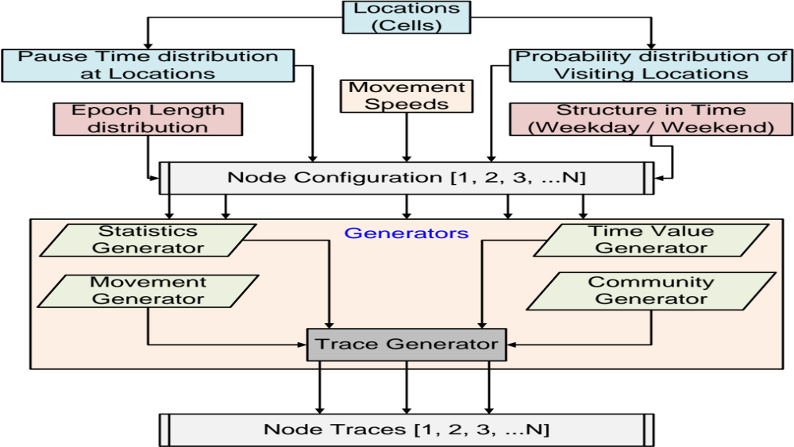
COBRA: COllective Behavior based on
Realistic Aspects of human mobility
G. Thakur, A. Helmy, “COBRA: A Framework for the Analysis of Realistic Mobility Models”,
IEEE INFOCOM – Global Internet, April 2013. (Best Paper Award – Internet Tech. Comm., IEEE ComSoc – 2015)

Slide 17
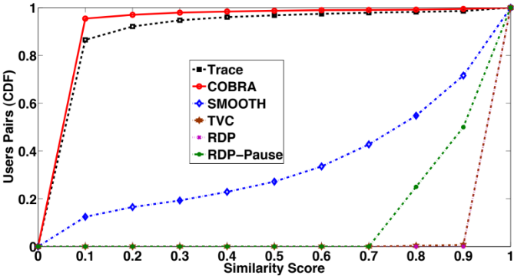
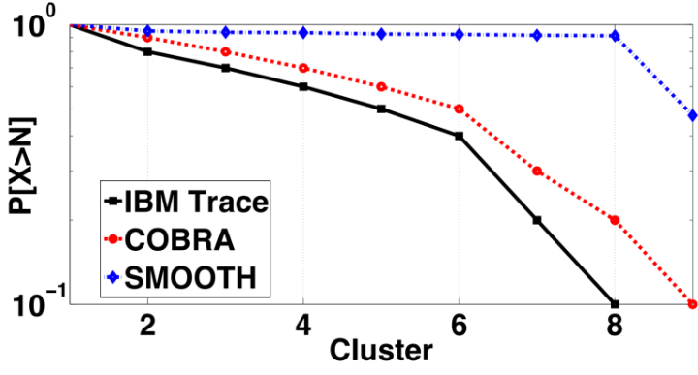
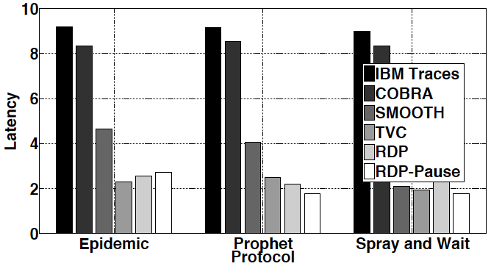
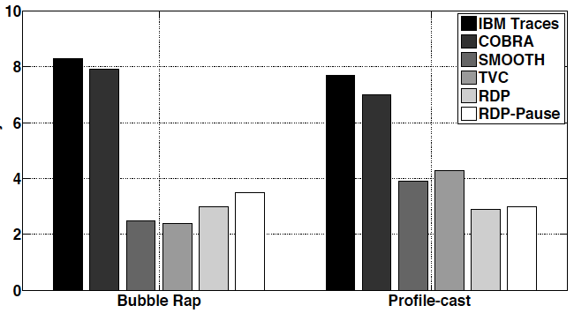
COBRA Model Analysis
Trace
Models
COBRA
COBRA
(Models) TVC, RD
SMOOTH, RD-P
Similarity gap
Clustering matches
Trace
COBRA captures > 95% of similar user pairs, other models deviate significantly

Slide 19
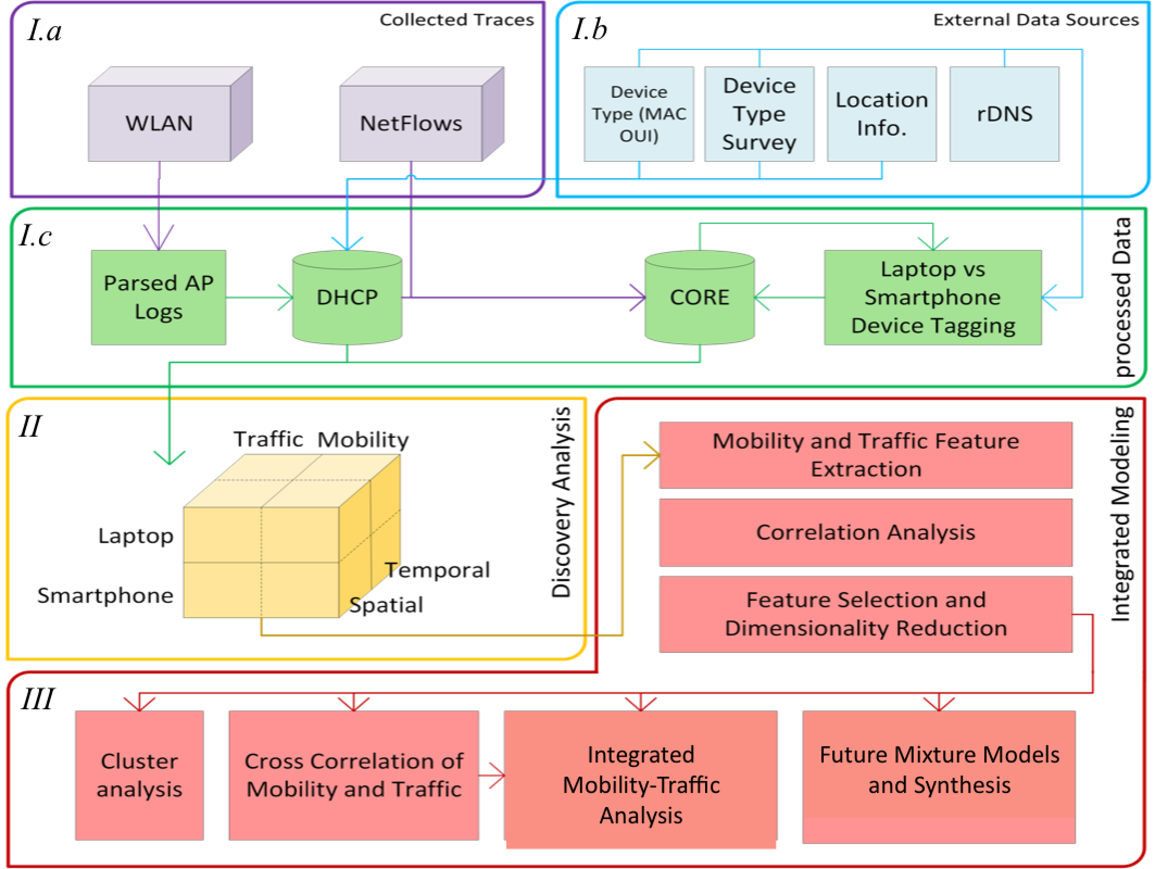
FLAMeS (Framework for Large-scale Analysis of the Mobile Society)
Framework
Multi-sourced data, Modular design, to address our goals of:
Goal I) Get device type, time and space features
Goal II) Analyze relationships
Goal III) Quantify the value of integrated model
(Generative Models)
Notes:
To enable this multi-dim net analytics problem , we use the Flames framework, that performs multi-tiered potation ….

Slide 20
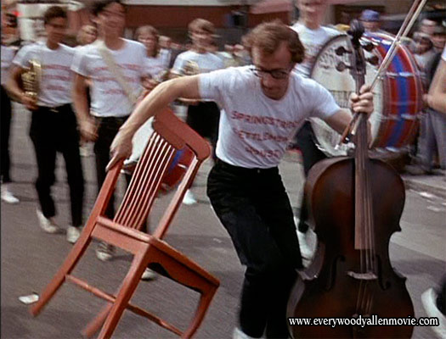
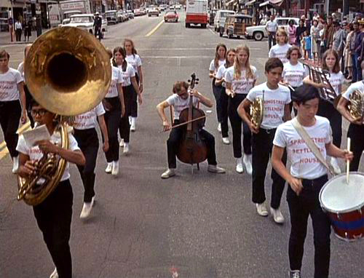
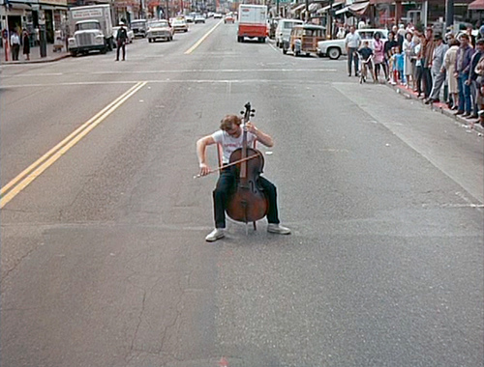
Flutes vs Cellos: Analyzing Mobility –Traffic Correlations in Large WLAN Traces
Cello ‘Mobility’!!
* Prof. M. Ammar (GATech) suggested the term ’Cello Mobility’
* B. Alipour, L. Tonneto, R. Ketabi, A. Ding, J. Ott, A. Helmy, IEEE INFOCOM 2018 (Best Presentation in-session)

Slide 21
FLAMeS System Overview
Datasets
Goal I) Get device type, time and space features
Notes:
Let’s talk about the datasets, because they are used throughout multiple studies. Datasets were presented before, so here is a quick recap.

Slide 22
Multi-source Mobility Usage Datasets
I. Wireless/WiFi (WLAN)
  Association/auth. events:
    555 M records
  Spatio-temporal scale:
    1760 access points (APs)
    138 buildings, 2,000 acres
    479 days in ‘11-’12
    316k devices
  Main entries:
    user MAC & IP address
    AP Name & assoc. times
  Location information:
    APName embeds building, floor and room numbers
    Google Maps API used to fetch latitude/longitude
II. Network Flows (NetFlow)
  Packet Header Records
    76 Billion records
    30 TB in size
  Spatio-temporal scale:
    Same WLAN area coverage
    25 days in April ‘12
    80k devices
  Main entries:
    source/destination IP address & port numbers
    packet/byte count, times, protocol, flow duration.
    Location information:
      joined with WLAN trace
III. Auxiliary Sources
  Location & Context
    University buildings listing
    Class schedules
    Google Maps API
    Crowd-sourced wigle.net data
  Device-type classification
    Reverse DNS, website resolution
    MAC OEM prefix list
    Device type survey
    97% of devices in NetFlow labeled as ‘Flute’ or ‘Cello’!
MAC | IP | AP | Start | End
Src IP/port | Dst IP/port | Pkts | Start | End

Slide 23
FLAMeS System Overview
Goal II) Analyze relationships/correlations of this data cube
Data cube, traffic/mobility analyzed temporally, spatially, and per device type
Notes:
We’re done with preprocessing and sanitation of datasets, let’s move on to analysis of this data cube.

Slide 24
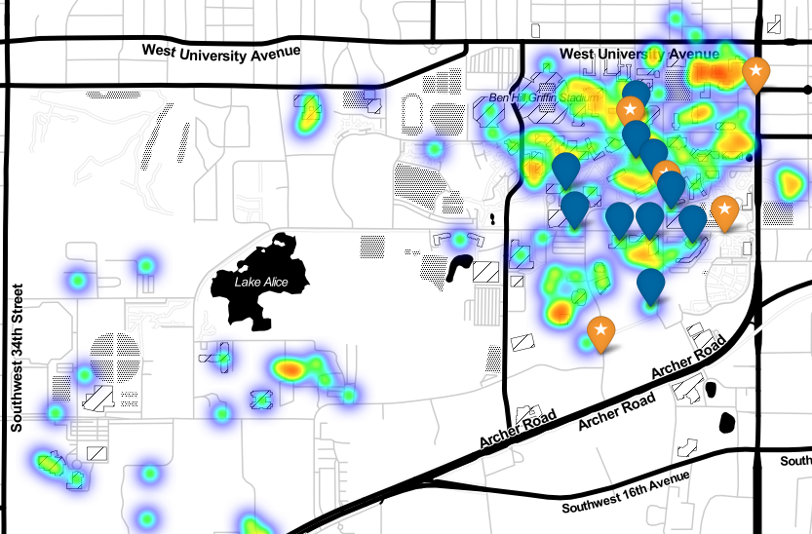
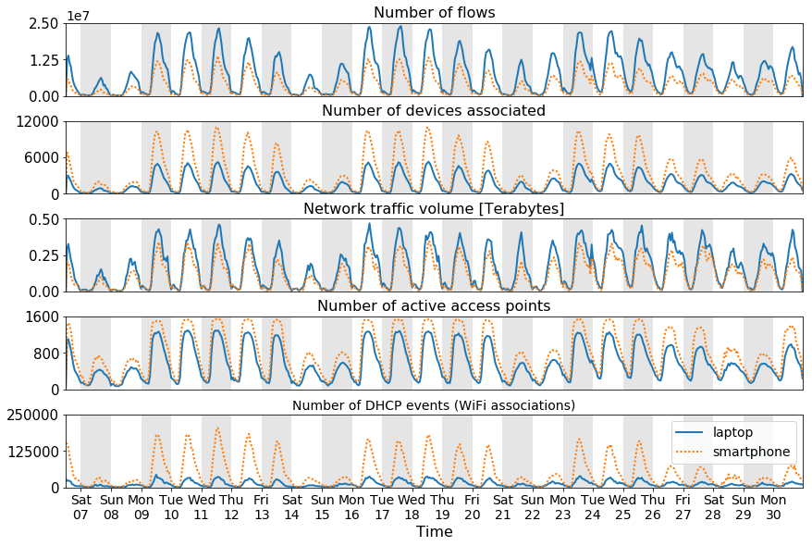
Time series for 25 days of combined WLAN-NetFlow traces after preprocessing and sanitation of datasets

Slide 25
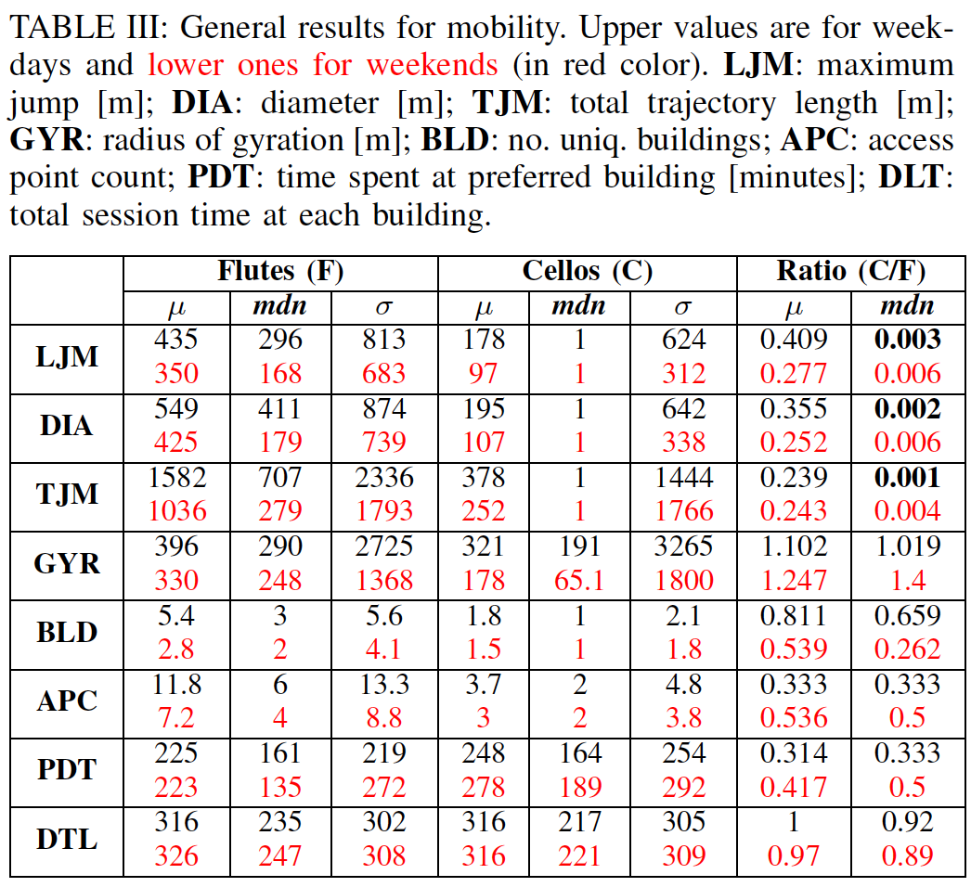
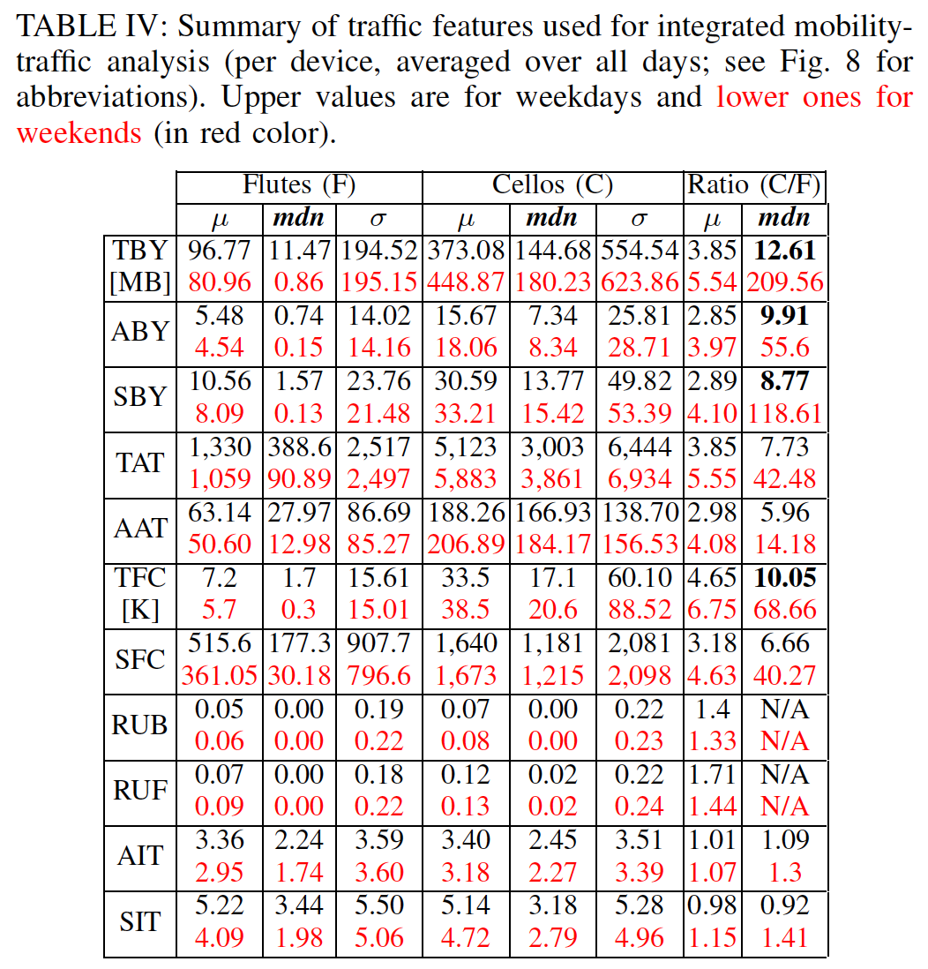
Mobility Features
Traffic Features
(C/F=Cellos/Flutes)
Week
day
Weekday
Total flow bytes
Week
end
maximum jump [m]
Weekend
Avg. flow bytes
diameter [m]
Std. flow bytes
total trajectory length [m]
Total active time
radius of gyration [m]
Avg. active time
Total flow count
no. uniq. buildings
Std. flow counts
no. uniq. APs
UDP bytes / total bytes
UDP flows / total flows
time spent at preferred bldg [min]
Avg. IAT
total session time at each bldg [s]
Std. IAT
Most studies use pre-smartphone datasets, this motivates re-visiting many of the papers in this field!
Up to 3 orders of magnitude difference between Cellos and Flutes
Up to 2 orders of magnitude difference between Cellos and Flutes

Slide 26

Feature engineering : Mobility-Traffic Cross-dimension
Flute - Weekday
Cello - Weekday
Mobility
Traffic
Flute - Weekend
Cello - Weekend
No existing model captures these correlations!
Notes:
Mobility vs Traffic features for (Flutes/Cellos, Weekday/Weekend)
There are currently no existing models that capture these correlations, that can be crucial in many applications including prediction, caching, resource allocation, among others. They are modeled independently, but correlations matter, and they help in modeling.
​

Slide 27
Modeling Insights: Accuracy Improvement
Q. What is the utility of an integrated model?
Can we classify devices using their mobility and/or traffic features?
Generative Modeling Benefits Significantly from combined features
  Gaussian Mixture Model (GMM): 84% , Variational Auto Encoder (VAE): 92% (accuracy)
91
Significant boost in accuracy! (despite increase in dimensionality)
Mobility
Traffic
Combined
Combined (weekday/weekend)
+ Predictability
Classification Features
Notes:
SVM classifier. 5-fold Cross-Validation. Using default parameters.

Slide 28
Notes:
The first set of case studies targets pedestrian mobility modeling, and user similarity, with multi-dimensional analysis of flutes & cellos

Slide 29
Mobility Encounters
Encounter definition:
  Two user devices, at the same AP (location proximity), with overlapping periods of time
3 types of encounters, based on device types:
  Flute-Flute (FF)
  Cello-Cello (CC)
  Flute-Cello (FC)
AP
Encounter
Notes:
The encounter type categories use the same device type classification developed for Flutes vs Cellos study.

Slide 30

Pairwise Encounter-Traffic Results
Are physical encounters correlated with similarity of traffic profiles?
  $≈93\%$ of the time, in all buildings, average similarity of encountered pairs $>$ non-encountered pairs
  Mann–Whitney U test, $p<0.05$ for 86% of cases
  Exceptions:
    Buildings close to bus stop hubs, high pass-by rate
    Most encounters in these places are short ($≤38 s$)
B. Alipour, M. Al-Qathrady, A. Helmy, “Learning the Relation Between Mobile Encounters and Web Traffic Patterns: A Data-driven Study”, ACM MSWiM October 2018
Notes:
Mann–Whitney U test (used with two independent sets) does not require the assumption of normal distributions.

Slide 31

Learning Encounters:
Can we learn to predict an encounter given two traffic profiles?
Unexpectedly has potential use for contact tracing!
SDAE (Stacked Denoising Auto-Encoder)
The autoencoder does a great job of capturing high-dimensional, sparse input!
Notes:
In the deep model, comparing device type categories of encounters, we find cello-cello encounters to be the most distinguishable, followed by flute-cello and flute-flute. However, the difference between accuracies for different device type categories is <5% in most locations and dates, a testimony to the robustness of the model.
Stratified K-fold cross validation.

Slide 32

Vehicular Mobility & Similarity: Imagery Data, Simulation & Matches

Slide 33



Vehicular Mobility Sensing at Planet Scale
* G. Thakur, P. Hui, A. Helmy
Vehicular Tracing System
Traffic density estimates
- Imagery data from webcams
- Estimate traffic density
- Spatio-temporal analysis, modeling
* IEEE INFOCOM NetSciCom 2012, GI 2013.
* ACM MobiSys HotPlanet 2012, * ACM SIGSPATIAL IWCTS 2013 (Best Paper Award)

Slide 34

Vehicular Traffic Modeling: self-similarity
Heavy-tailed distributions better at modeling empirical values of traffic densities.
They model more than 85% of all 700+ locations.
- Memory-less
- Heavy-tailed
Notes:
The table shows the 1st, 2nd and 3rd best fits and last two columns shows the models at 3 and 5% deviation.
We find that memory less models failed to capture the statistical properties of empirical distribution and heavy tailed distributions like Weibull are better at modeling the densities.
Btw, many current studies assume exponential or Poisson process.

Slide 35



Spatio-temporal exploration
Layout of cameras on the scaled
lat-lon map of London

Slide 36



Spatio-Temporal Causality & Traffic Forecast
Sydney 67
camera locations
Causality (Granger) Network can predict traffic intensity 30mins ahead with 3-9% error
* ACM SIGSPATIAL - IWCTS 2013 (Best Paper Award)

Slide 37
Similarity and Matching
Comparing trips demands and trajectories
Clustering trips based on pairwise similarity
Matching trips for applications in shared transportation

Slide 38


Trip Similarity
Trip similarity is essential for transportation
Trip P1 more similar to P2 than P3 spatially
What if P1 and P2 occur in different times?
P3
P2
Heatmap of trip density in the city
P1
We compare against Euclidean based similarity on 6-tuple of o/d space and time.

Slide 39



Similarity score using weighted geometric mean (WGM)
Distance similarity:
Time similarity:
Weighted Geometric Mean (WGM) similarity:
Dataset
City of Köln, Germany [4,5]
Realistic Simulation Generated Traces
location, time and speed of vehicles on a trip
700K trips, 350M records in a 400 km2 area
Focus on 6-10am (approx. 175k trips)

Slide 40



Visualizing Spectral Clustering
GM (Geometric mean)
EUCL (Euclidean)
Green and Red clusters are overlapping in space but separate in time.
Blue and Purple clusters are overlapping in time but separable in space.
- Temporal distribution of the clusters. GM (left) finds clusters that are very overlapping in time but separable in space, or vice versa.
- Spectral clustering is applied on an affinity matrix with the GM similarity score

Slide 41







Demonstration of shared transportation scenarios
CarPooling (and its dual catch-a-ride):
Car Sharing (free float car sharing or fleet
of autonomous/taxi systems)
CarPool (CP):
T2
T1
Catch-a-Ride (CaR):
T3
T1
T2
T1
T2

Slide 42
Main Findings for Playing with Matches
Spatio-temporal similarity of trips can be used to efficiently match users (riders and rides) in shared transportation
Using the weighted geometric mean (WGM) the clustered matches are clearly separable in time or in space
Saving of 25% for CarPooling and 40% for Catch-a-Ride achieved in total traveled distance, with added ~0.4mi on average to pick-up/drop-off.
Car sharing:
  each chain of trips serviced by one vehicle on average consists of ≈ 4.07 pick-ups
  calculated through a polynomial time algorithm, instead of NP-Hard problem formulation, by adding sequencing constraints
For 50 waypoints matches, WGM was able to find shortest matches as desired. It has flexibility knobs for time and distance weights.
For waypoint matching, WGM computation is linear in time ☺

Slide 43






Recently Collected Traffic Cam. Images
YOLOv3 deep net for car counting, density
Challenges still exist
☺

Slide 44




Mobile Applications & Services

Slide 45

Application: Mobile Health Care
Long term, continuous, multi-modal behavioral sensing
Differential behavioral longitudinal analysis
Promise:
  Early detection of risks, behavioral disorders
Targets:
  Obesity, mobility, frailty
  Directly related: encounter-
  based infection trace-back (i-Hospital)

Slide 46

Application: Mobile Health Care
Similarity-based “support group” formation, emergency detection, support notification
Promise:
  Disease self-management, self-efficacy
Targets:
  Diabetes, depression, social isolation, elderly care, Alzheimer’s care, autism, dementia, epilepsy, fall-risk

Slide 47


Putting it Together: Transportation, Health, Emergency Mgmt
Interdisciplinary Framework for Mobile Social Sensing, Computing and Networking

Slide 48

Putting it Together: Transportation, Health, Emergency Mgmt
Interdisciplinary Framework for Mobile Social Sensing, Computing and Networking

Slide 49

Putting it Together: Transportation, Health, Emergency Mgmt
Interdisciplinary Framework for Mobile Social Sensing, Computing and Networking

Slide 50




Thank you!
Ahmed Helmy
URL: cise.ufl.edu/~helmy
NOMADS, MobiLib: http://cise.ufl.edu/~helmy/MobiLib
IEEE INFOCOM, Orlando ‘12
IEEE INFOCOM, Atlanta ‘17
ACM MobiCom , Chicago‘10
* Thanks to my students and collaborators!

Slide 51





NOMADS, MobiLib: http://cise.ufl.edu/~helmy/MobiLib
ACM MobiCom , Chicago‘10
ACM MobiCom , Miami‘13

