Slide 1

Welcome to IEEE ICNP 2020 AIMCOM² workshop

Slide 2
AIMCOM²
Riding with AI towards Mission-Critical Communications and Computing at the Edge
Motivation & Scope
The ever-growing mission-critical services, like the Internet of vehicles, AR/VR and haptic communications, have sprung recently and required the communications and computing framework to be more reliable, efficient and secure.
However, it raises severe challenges due to the spatial and/or temporal diversity of the entities possibly involved in communications and computing.
The artificial intelligence (AI) for mission-critical communications and computing is expected to fundamentally address these increasing challenges.
IEEE ICNP 2020

Slide 3
AIMCOM²
Riding with AI towards Mission-Critical Communications and Computing at the Edge
Organizing Committee
Workshop Chairs
  Jon Crowcroft (Cambridge University, UK)
  Shuguang Cui (The Chinese University of Hong Kong (Shenzhen), China)
  Hulya Seferoglu (University of Illinois at Chicago, USA)
Workshop Technical Program Committee Chairs
  Rongpeng Li (Zhejiang University, China)
  Salim El Rouayheb (Rutgers University, USA)
  Venkat Dasari (CCDC Army Research Laboratory, USA)
  Meddhi Bennis (University of Oulu, Finland)
  Macro Di Renzo (CentraleSupelec, France)
Workshop Publicity Chairs
  Xianfu Chen (VTT, Finland)
  Guoru Ding (Army Engineering University, China)
Program Committee
Balajee Vamanan (University of Illinois at Chicago, USA)
Yasaman Keshtkarjahromi (Seagate, USA)
An Liu (Zhejiang University, China)
Qingjiang Shi (Tongji University, China)
Guanding Yu (Zhejiang University, China)
Shunqing Zhang (Shanghai University, China)
Chungang Yang (Xidian University, China)
Tao Chen (VTT Technical Research Centre, Finland)
Kyunghan Lee (Seoul National University, Korea)
Sheng Zhou (Tsinghua University, China)
Celimuge Wu (The University of Electro-Communications, Japan)
Boya Di (Imperial College London, UK)
Omer Sella (Cambridge University, UK)
IEEE ICNP 2020

Slide 4


AIMCOM²
Riding with AI towards Mission-Critical Communications and Computing at the Edge
Program (4 Sessions)
2 Keynotes
4 Papers from Open Call
  Two from China, one from Japan, and one from USA
4 Invited Talks
  Three from Academia and one from industry
Prof. Junshan Zhang
(Arizona State University, USA)
Dr. Ananthram Swami
(ARL, USA)
IEEE ICNP 2020

Slide 5
AIMCOM²
Riding with AI towards Mission-Critical Communications and Computing at the Edge
Session A
A Blind CSI Prediction Method Based on Deep Learning for V2I Millimeter-Wave Channel
  Jingxiang Yang, Liyan Li, and Min-Jian Zhao (Zhejiang University, China)
Context-Aware Clustering for SDN Enabled Network
  Ran Duo, Celimuge Wu, Yoshinaga Tsutomu (University of Electro-Communications, Japan), and Yusheng Ji (National Institute of Informatics, Japan)
Real-World ADS-B signal recognition based on Radio Frequency Fingerprinting
  Haoran Zha, Qiao Tian, and Yun Lin (Harbin Engineering University, China)
IEEE ICNP 2020

Slide 6
AIMCOM²
Riding with AI towards Mission-Critical Communications and Computing at the Edge
Session B
Towards Smart and Reconfigurable Environment: Intelligent Reflecting Surface Enabled 6G Wireless Networks
  Qingqing Wu (University of Macau, China)
Bring AI into 5G Radio Access Network
  Qi Sun (China Mobile)
AI-based phsyical layer and protocol design towards beyond 5G/6G radio access networks
  Maziar Nekovee (University of Sussex, UK)
IEEE ICNP 2020

Slide 7
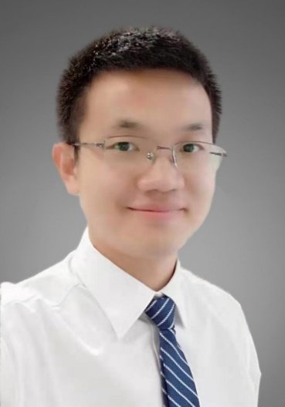
AIMCOM²
Riding with AI towards Mission-Critical Communications and Computing at the Edge
[Inivted] Towards Smart and Reconfigurable Environment: Intelligent Reflecting Surface Enabled 6G Wireless Networks by Prof. Qingqing Wu
Abstract: In this talk, we introduce a new wireless research paradigm by employing a massive number of low-cost passive reflecting elements with controllable phase, named intelligent reflecting surface (IRS), which is able to smartly change the wireless signal propagation to enable various functions such as beamforming and interference nulling/cancelation. We illustrate the main applications of IRS in achieving spectrum and energy efficient as well as secure and sustainable wireless networks in the future, and its advantages as compared to existing technologies such as massive MIMO and active relaying. We then present the signal and channel model of IRS by taking into account its hardware limitation in practice. Next, we focus on discussing the main design challenges in IRS-aided wireless networks, including joint active and passive beamforming optimization, channel estimation, etc., and highlight important directions for future work.
IEEE ICNP 2020

Slide 8

AIMCOM²
Riding with AI towards Mission-Critical Communications and Computing at the Edge
[Inivted] Bring AI into 5G Radio Access Network by Dr. Qi Sun
Abstract: With the global deployment and commercialization of the 5G network, Wireless big data and ML/AI are widely recognized as the essential element to drive 5G network intelligence evolution in order to deliver the necessary efficiency, flexibility, and cost effectiveness. Significant progress and validation on the network operation and maintenance using ML/AI technologies have been made in 4G/5G networks. Various study on the network intelligence standardization from management to control planes, including use cases and requirements, AI functional framework, procedures and architecture have been actively explored. This talk will explore the journey of pursuing native RAN intelligence, from theory to preliminary practice validation. The AI/ML use cases in 5G network and some validations results will be shared followed by the standardization progress. Further, the challenges and gaps are shared based on the lessons learned from the practice so far.
IEEE ICNP 2020

Slide 9
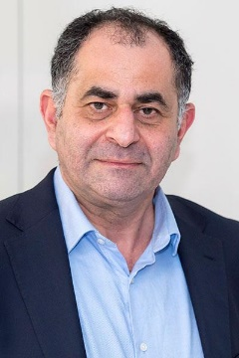
AIMCOM²
Riding with AI towards Mission-Critical Communications and Computing at the Edge
[Inivted] AI-based phsyical layer and protocol design towards beyond 5G/6G radio access networks by Prof. Maziar Nekovee
Abstract: 5G technologies are expected to enable new verticals, services, and business models. Recently, the use of artificial intelligence (AI) and data analytics is shown to provide massive advantages in terms of reducing network complexity and enhancing
its performance. In this talk , I provide an overview of the recent studies on AI-assisted solutions in 5G and beyond-5G wireless networks, followed by three case studies of our recent research, including a Q-learning-assisted cell selection mechanism, an AI engine that enables intelligent 5G fronthaul slicing, multiple radio access technology (RAT) spectrum sharing in millimetre-wave bands via reinforcement learning-based beam management and the application of deep neural network auto-encoders for beyond-5G physical layer design. The recent industry and standardization activities of using AI in 5G networks are summarized.
IEEE ICNP 2020

Slide 10
AIMCOM²
Riding with AI towards Mission-Critical Communications and Computing at the Edge
Session C
Machine Learning at the Edge: Efficient Utilization of Limited CPU/GPU Resources by Multiplexing
  Aditya Dhakal (University of California, Riverside, USA), Sameer G Kulkarni (Indian Institute of Technology, Gandhinagar, India), and K. K. Ramakrishnan (University of California, Riverside, USA)
[Keynote] Edge Intelligence in IoT Ecosystems: A Continual Edge Learning Approach
  Junshan Zhang (Arizona State University, USA)
IEEE ICNP 2020

Slide 11

AIMCOM²
Riding with AI towards Mission-Critical Communications and Computing at the Edge
[Keynote] Edge Intelligence in IoT Ecosystems: A Continual Edge Learning Approach by Prof. Junshan Zhang
Abstract: Many IoT applications demand intelligent decisions in a real-time manner. The necessity of real-time edge intelligence dictates that decision making takes place right here right now at the network edge. Since an edge node often has a limited amount of data and is constrained with computational resources, we advocate continual edge learning to achieve edge intelligence. To this end, we develop an edge learning framework where the edge node learns its model based on local data in real-time, while leveraging the cloud knowledge transfer or learning from peer edge nodes.
IEEE ICNP 2020

