Slide 1



Machine Learning at the Edge: Efficient Utilization of Limited CPU/GPU Resources by Multiplexing
Aditya Dhakal¹, Sameer G Kulkarni² and K. K. Ramakrishnan¹
¹University of California, Riverside
²Indian Institute of Technology, Gandhinagar
Notes:
Good Afternoon, today I am going to present our paper, Machine Learning at the Edge: Efficient Utilization of Limited CPU/GPU Resources by Multiplexing. This work is done by me, Aditya Dhakal, my colleague Sameer Kulkarni and my advisor Prof. K. K. Ramakrishnan in University of California, Riverside.

Slide 2




Edge Computing for Machine Learning Applications
Higher Latency
Lower Latency
Edge Cloud
Cloud Server
2
Notes:
Use of applications such as Augmented Reality and Virtual Reality, speech translation, image recognition, autonomous driving etc. are rising. These applications often are compute heavy and also require low latency. The user devices are usually incapable of providing enough compute. However, offloading computation to a distant cloud can have high network latency, and can therefore be unsuitable. Edge clouds can offer these applications the required compute resource and provide lower latency by being located closer.

Slide 3
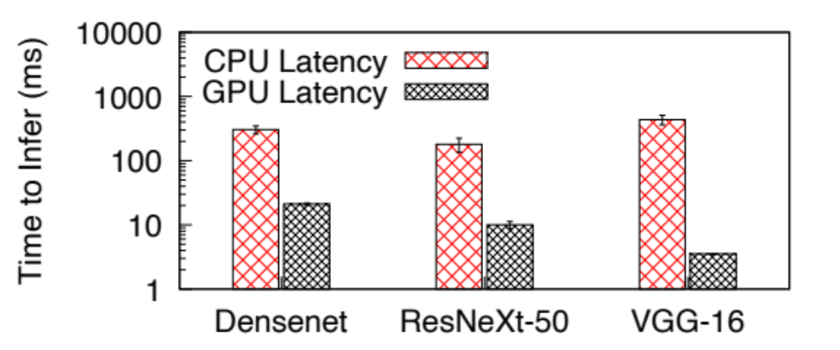
User application requirements
User application often use compute intensive Deep Neural Network (DNNs)
Specialized hardware (eg. GPU) is necessary for the low latency inference and learning of DNN
Fig: Time taken to infer one image using CPU and GPU
Notes:
These applications often use compute intensive Deep Neural network (DNN) models for inference of user data. DNNs are compute heavy and require specialized accelerators such as a GPU for low latency inference. DNNs are a good application for GPU as the parallelism offered by GPU is suitable for accelerating matrix convolution operations in the DNN. To see the benefits of using a GPU, we conducted an experiment with 3 different DNN models, Densenet, ResNext-50 and VGG-16 using GPU and CPU. We have presented the result in the plot. Please see that y-axis, which shows the latency of inference is in log scale. We can see the latency of inference using GPU is much lower than using CPU.

Slide 4
User application requirements
User application often use compute intensive Deep Neural Network (DNNs)
Specialized hardware (eg. GPU) is necessary for the low latency inference and learning of DNN
GPU can lower the latency of inference by orders of magnitude
Fig: Time taken to infer one image using CPU and GPU
Notes:
We can see that, use of GPU can lower the latency by orders of magnitude. Therefore, it is necessary to have GPUs in the edge cloud for running these DNN based applications.

Slide 5
ML Inference Framework in the Edge Server
Unlike cloud environment with ‘almost infinite scalability’ of resource, edge clouds have relatively scarce resource
Edge based ML framework needs to multiplex the system resources (CPU, GPU, memory, storage, network bandwidth etc.) to be able to serve request for multiple applications
Notes:
Unlike cloud environment with hugely scalable hardware resources, edge clouds have relatively modest resources. Edge based ML frameworks needs to multiplex the system resources (such as CPU, GPU, memory etc) to be able to serve requests for multiple applications.

Slide 6
Requirements for an Edge ML framework
Judicious sharing of GPU
  Naïve GPU multiplexing shares GPU temporally, thus, lowering GPU utilization
  Spatial sharing of GPU among multiple application increases utilization
Low latency transfer of streaming user data to GPU
  Edge server will host many application, incoming high-volume streaming data has to be moved to GPU with less time penalty
Ability to run models trained in different ML platforms (eg. PyTorch, Tensorflow)
  Most ML framework run model trained for that specific application. Edge ML framework needs to support ML framework diversity
Judicious use of CPU and other system resources
Notes:
There are few requirements for an Edge ML framework. We require judicious sharing of the GPU. Naïve GPU multiplexing time-shares the GPU resource among applications, therefore, have lower GPU utilization. Spatial sharing of GPU would allow multiple application to run concurrently therefore utilizes the GPU better.
Running multiple applications in edge means receiving streaming data for multiple applications. This high volume of data has to be streamed to the GPU with as little additional latency as possible.
DNN models are often designed and trained using ML platforms such as PyTorch and TensorFlow. For the best outcome, they are often inferred using the same platform they are trained in. So, Edge ML framework needs to be able to run DNNs deployed in diverse ML frameworks.
Beyond the GPU, the edge ML framework also needs to have judicious use of CPU and other system resources.

Slide 7
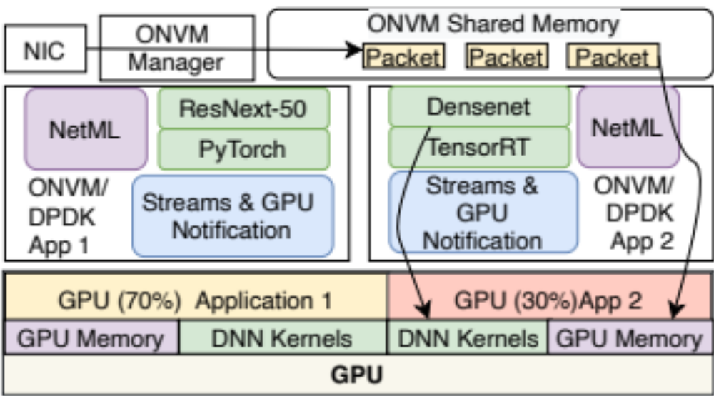
Edge Inference & Learning Framework Architecture
OpenNetVM/DPDK Based streaming data handling
We present the architecture of edge ML framework
We use OpenNetVM (ONVM), a DPDK based network function virtualization platform to receive application data used for ML processing
Notes:
We designed a ML Inference and Learning Framework with multiplexing of the GPU in mind. We present the architecture of edge ML framework in the figure. Our framework is based on OpenNetVM, a DPDK based network function virtualization platform. Here, as seen in the red rectangle the streaming application data is processed by OpenNetVM platform and buffered in the shared memory.

Slide 8
Inference & Learning Framework Architecture
We run different ML models as network function applications in ONVM.
Notes:
We have modified the OpenNetVM platform to run ML models similar to a network function application. The ML models come up as a DPDK application and have access to the streaming data packets in the shared memory as well as GPU.

Slide 9
Inference & Learning Framework Architecture
GPU is virtualized with help of CUDA Multi-process service
Multiple ML applications can run concurrently by spatially sharing GPU resources
We set limits on GPU resources for each application to provide performance isolation for each ML application
Notes:
In our framework, GPU is virtualized with help of CUDA Multi-process service or (MPS). Multiple ML applications can run concurrently by spatially sharing the GPU resource. We set limits on GPU resources for each application to provide performance isolation for each ML application. As you can see in the figure, 70% of GPU compute resources are dedicated to Application 1 while 30% is given to application 2. I will explain the technique for spatial sharing of GPU in later slides.

Slide 10
Inference & Learning Framework DNN Inference application
Network Component (ONVM/DPDK)
ONVM
Manager
ONVM Shared Memory
NIC
Packet
Packet
Packet
NetML module for low latency data transfer to GPU
DNN platform for loading desired ML/DNN model in GPU
Streams and GPU module for running DNN model in GPU/spatially sharing GPU
Notes:
Our edge ML framework application is divided into 3 different modules. NetML for low latency data transfer to GPU, the ML platform code for loading the DNN model into the GPU and a Streams & GPU notification module for spatial sharing of GPU.

Slide 11
Experimental Testbed
Dell PowerEdge R740XD with Intel® Xeon® Gold 6148 CPU (20 cores)
256 GB system memory
NVIDIA V100 GPU (16 GB GPU memory, 80 streaming multiprocessors)
Image recognition tasks: Color image of 224x224 resolution.
Image size: 588 kilobytes
4x10 GbE (40 GbE total) connection between traffic generator and receiving server
Image transferred over UDP packets. Our experiments ignored the network-related latency contributed by network protocol
Notes:
For image recognition tasks: We use color images of 224x224 resolution. We choose this resolution as it has been the resolution of choice by many researchers for training image recognition models.

Slide 12
Streams & GPU notification module
Streams and GPU module for running DNN model in GPU/spatially sharing GPU
Notes:
We will now discuss about Streams & GPU notification module.

Slide 13
Improving GPU utilization: Sharing of GPU
By default, GPU runtime environment (CUDA, OpenCL etc.) time-share the GPU among different processes multiplexing GPU
Temporal sharing of GPU interleaves the GPU kernels of concurrently running applications by providing equal time quantum to each running application.
All streaming Multiprocessors (SMs) will be used by 1 process only
ML application with lower compute requirement also get same time slice as application with higher compute requirement
Notes:
By default, GPU runtime environment (CUDA, OpenCL etc.) time-share the GPU among different processes multiplexing GPU. Temporal sharing of GPU interleaves the GPU kernels of concurrently running applications by providing equal time quantum to each running application. Temporal sharing of the GPU can lead to underutilization of GPU. ML application with lower compute requirement also get the same time slice as an application with higher compute requirement.

Slide 14
Spatial Sharing of the GPU
CUDA Multi-process system (MPS) provides concurrent multiplexing of DNN models. (spatial sharing of GPU)
  Kernels from different applications can run concurrently
  Streaming multiprocessors (SMs) are divided across different applications
CUDA MPS has two modes for spatial sharing of GPU.
  Default (uncontrolled) Mode: GPU subsystem determines how concurrent applications share resources.
  Controlled Mode: Users set desired maximum GPU resource for each application. By specifying integer GPU % during the launch of application
Notes:
On the other hand, the CUDA Multi-process system (MPS) provides concurrent multiplexing of DNN models. This is Spatial sharing of GPU. The spatial sharing allows kernels, (which are program functions that run in GPU) from different applications to run concurrently. While running concurrently, Spatial sharing would allow for an application to use the GPU resources that are unused by other applications, therefore increasing the GPU utilization.
CUDA MPS has two modes for spatial sharing of the GPU.
Default Mode: Here multiple applications run concurrently and share the GPU, however, the GPU subsystem determines the amount of resources provided to each application. Users have no ability to influence the amount of compute resource each application can get.
Controlled mode: Users can set the desired maximum GPU resource for each application. They can specify an integer GPU % during the launch of the application.

Slide 15
Controlled Spatial Sharing of the GPU
User can provide GPU% by setting GPU% in an environment variable before the application starts
e.g. 50% GPU corresponds to half of all SMs, i.e. 40 SMs in V100 GPU
Some DNN applications have a limit on how many SMs they can effectively use. i.e. they show diminishing return in the latency beyond certain GPU resources
GPU% where these DNN show diminishing return varies based on batch size and DNN models
Division of SM in V100 GPU
Densenet (15% GPU)
ResNeXt-50 (35% GPU)
VGG-16 (50% GPU)
Notes:
User can provide a GPU% by setting that GPU% in an environment variable before the application starts. As we can see in the figure, if application 1 is limited to 15% GPU, it will only use 12 out of 80 SMs. Some DNN applications have a limit on how many SMs they can effectively use. i.e., they show a diminishing return in the latency beyond a certain GPU%. This GPU% where these DNN show a diminishing return varies based on the batch size and the DNN model

Slide 16
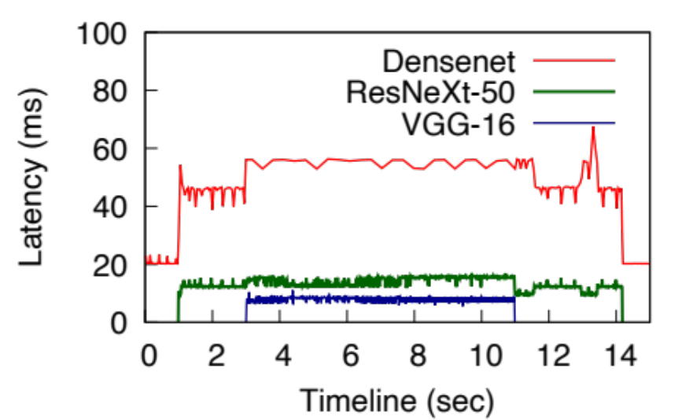
Different ways to share a GPU
Temporal Sharing
Temporal sharing: Latency increases with addition of DNN
Notes:
We now show the result of sharing the GPU temporally, with default MPS, and with controlled spatial sharing. In the first figure we can see the latency as 3 DNNs share the same GPU temporally. Here, Densenet DNN comes up at first and has 20 ms latency for inferring 1 image. ResNext-50 comes up next at 1 second mark. We can notice that DenseNet’s latency increases to 40 ms per inference. Adding another DNN, VGG-16 at 3 second further increase the latency of Densenet as well as of ResNext-50.

Slide 17
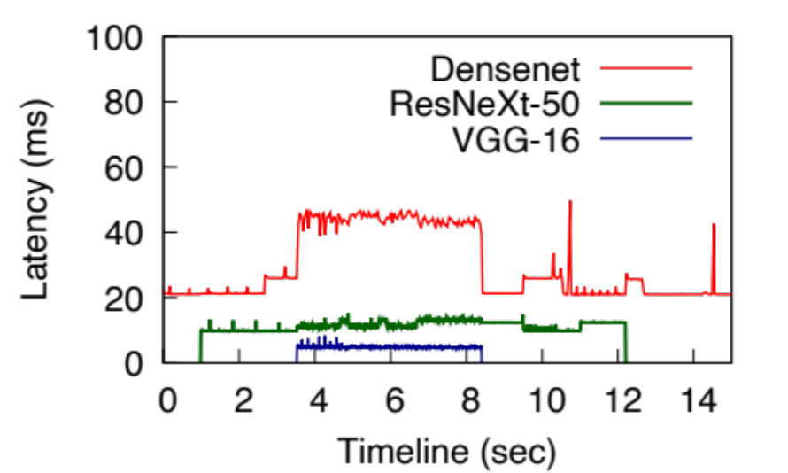
Different ways to share a GPU
Temporal Sharing
Default MPS Spatial Sharing
Temporal sharing: Latency increases with addition of DNN
Default MPS: Better inference latency than temporal. But, some DNN’s latency affected worse than other while sharing GPU.
Notes:
In case of Default MPS, we can see that Densenet’s latency does not change when ResNext-50 comes up at 1 second. This is due to spatial sharing of GPU allowing both the models to use GPU without affecting each other. However, when the 3rd model start at 3 second mark, the latency for Densenet increases to more than 40 ms per image and stays at that level till vgg-16 DNN finishes. While, default MPS can provide spatial sharing when the number of DNN concurrently running is small and the compute load is relatively light, when the compute load increases, we can see the increase in latency for some of the models. We have observed that there is no way of knowing which model will be affected by multiplexing more DNNs in the GPU and also we do not know how much increase in latency a given model will suffer.

Slide 18
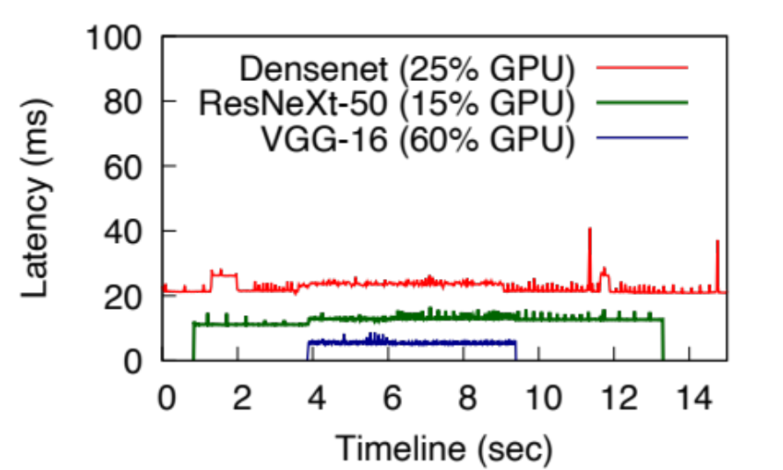
Different ways to share a GPU
Temporal Sharing
Default MPS Spatial Sharing
Controlled MPS Spatial Sharing
Temporal sharing: Latency increases with addition of DNN
Default MPS: Better inference latency than temporal. But, some DNN’s latency affected worse than other while sharing GPU.
Controlled MPS: Addition/Removal of other concurrent application do not affect inference latency.
Notes:
Finally, when we use controlled MPS spatial sharing by providing 25% of GPU to Densenet, 15% to ResNext-50 and 60% to VGG-19, we can see that latency does not vary while multiplexing more DNN. Also, we can see that with just 25% of GPU densenet has about same latency as when it has 100% GPU. Therefore, with careful selection of GPU% for each application, we can get good latency, therefore good overall throughput for the system compared to temporal sharing or default MPS sharing.

Slide 19
Different ways to share a GPU
Temporal Sharing
Default MPS Spatial Sharing
Controlled MPS Spatial Sharing
Temporal sharing: Latency increases with addition of DNN
Proper choice of GPU% can achieve good latency for all DNNs
Default MPS: Better inference latency than temporal. But, some DNN’s latency affected worse than other while sharing GPU.
Controlled MPS: Addition/Removal of other concurrent application do not affect inference latency.
Notes:
Finally, when we use controlled MPS spatial sharing by providing 25% of GPU to Densenet, 15% to ResNext-50 and 60% to VGG-19, we can see that latency does not vary while multiplexing more DNN. Also, we can see that with just 25% of GPU densenet has about same latency as when it has 100% GPU. Therefore, with careful selection of GPU% for each application, we can get good latency, therefore good overall throughput for the system compared to temporal sharing or default MPS sharing.
We can also see that proper choice of GPU%. In case of Densenet 25% of GPU can achieve good latency for all DNNs.

Slide 20
Different ways to share a GPU
65% lower latency for Densenet compared to temporal sharing
Temporal Sharing
Default MPS Spatial Sharing
Controlled MPS Spatial Sharing
Temporal sharing: Latency increases with addition of DNN
Proper choice of GPU% can achieve good latency for all DNNs
Default MPS: Better inference latency than temporal. But, some DNN’s latency affected worse than other while sharing GPU.
Controlled MPS: Addition/Removal of other concurrent application do not affect inference latency.
Notes:
Finally, when we use controlled MPS spatial sharing by providing 25% of GPU to Densenet, 15% to ResNext-50 and 60% to VGG-19, we can see that latency does not vary while multiplexing more DNN. Also, we can see that with just 25% of GPU densenet has about same latency as when it has 100% GPU. Therefore, with careful selection of GPU% for each application, we can get good latency, therefore good overall throughput for the system compared to temporal sharing or default MPS sharing.
We can also see that proper choice of GPU%. In case of Densenet 25% of GPU can achieve good latency for all DNNs.
We can see with controlled spatial sharing the latency of slowest running model, Densenet is lowered by 65% compared to temporal sharing.

Slide 21
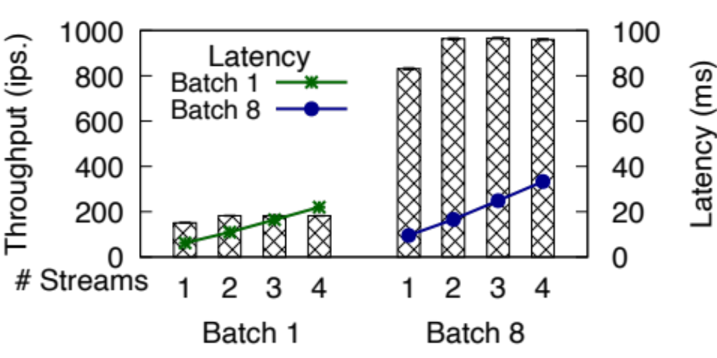
Spatial Sharing: Limitation of Streams
CUDA streams also provide spatial sharing, like Default MPS.
CUDA streams increase the throughput while going from 1 stream to 2 but have diminishing return on the latency.
Spatially sharing GPU
with controlled MPS spatial
sharing provides better
latency for inference
ResNet-50 with different number of streams
Notes:
There is another way of spatial sharing of GPU. It is by using CUDA Streams. CUDA streams share the GPU like Default MPS case. Here also the user cannot determine how much resource could be given to one DNN in stream.
We can see in the figure that increasing the number of streams from 1 to 2 increases the throughput of the ResNet-50 model. However, increasing the number of streams beyond that only increases the latency. We can see a similar effect while increasing the batch size of inference to 8. Batch size of 8 means 8 images are inferred at once.
As controlled MPS spatial sharing provides a way to allocate the resources to each application, we prefer to use MPS with controlled sharing over CUDA streams for the ML framework.

Slide 22
Notification from GPU
GPU execution are asynchronous with respect to CPU.
CUDA API offers ‘callback’ function to notify end of GPU processing by running a callback function on CPU.
Callback function stops the execution in GPU until callback is processed
Callback function cannot launch any CUDA API functions
CPU (Host system)
ML application/Other CPU tasks
Callback execution
ML
application
GPU Subsystem
ML application kernels
Call
back
ML app. kernels
Gap due to callback
Notes:
Another function of the ML framework is to facilitate low latency notification from GPU. GPU execution is asynchronous with respect to CPU. The CUDA API offers ‘callback’ function to notify the end of GPU processing by running a callback function on the CPU. We can see in the figure, once the CPU launches the ML application kernels in GPU, there is a callback mechanism in place. Once the ML application kernel finishes processing, the callback is activated, which will launch a callback function in the CPU. While a callback can notify the CPU of completion of the task in GPU, it has limitations. First, the callback function blocks any further execution in the GPU until the callback is processed. Second the callback function cannot launch any CUDA API functions, therefore it cannot launch any other ML application kernels in GPU. These limitations can create a gap where the GPU is idle.

Slide 23
Notification from GPU
CPU (Host system)
CPU can query GPU every 1 milliseconds to check if event added to end of ML application kernels is processed.
cudaEventQuery is lightweight API call that takes only 5 microseconds to resolve.
CPU thread never goes out of context and can launch another ML application kernel immediately
ML application/ Other CPU tasks
ML application kernels
Event
ML application kernels
GPU Subsystem
No gap
Notes:
In our framework, we use a method where CPU can query GPU periodically – say once every millisecond to check if an event added to the end of the ML application kernel is processed or not. cudaEventQuery is a fairly lightweight API call that takes only five microseconds to resolve. One advantage over the callback method is that the CPU thread is not preempted, as it is by the callback, and can launch GPU kernels immediately after knowing the previous kernels have finished the execution. This helps reduce the GPU idle time, therefore, increasing utilization.

Slide 24
Data transfer to GPU
NetML module for low latency data transfer to GPU

Slide 25
Streaming Data transfer to GPU: CPU Copying & NetML
CPU-Copy: Incoming data from packet payload is copied into a CPU side contiguous buffer before transferring into the GPU for ML processing.
We use NetML [1] to cut the extra copy by utilizing GPU’s DMA engine to perform scatter-gather of data from host CPU memory.
We extended the original NetML to be able to create batches of application data (eg. Image) in GPU.
We added a lightweight checking to verify if data for a whole application unit (eg. Image) is ready before initiating the transfer.
Batch is formed in contiguous GPU buffer by transferring images using GPU DMA
[1] A. Dhakal and K. K. Ramakrishnan, “Netml: An nfv platform with efficient support for machine learning applications,” in 2019 IEEE Conference on Network Softwarization (NetSoft). IEEE, 2019, pp. 396–404.
Notes:
We now discuss different methods of transferring data from the packets to GPU.
Usually the incoming data from packet payload is copied into CPU side contiguous buffer before transferring it into GPU for ML process.
This incurs an extra copy of the data from packets to CPU side buffer.
We use NetML [1] to cut the extra copy by utilizing GPU’s DMA engine to perform scatter-gather of data from host CPU memory.
We extended the original NetML to be able to create batches of application data (eg. Image) in GPU.
We added a lightweight checking to verify if data for a whole application unit (eg. Image) is ready before initiating the transfer.

Slide 26
Data transfer Impact: CPU Load
We measured the impact of data transfer for both NetML and CPU-copy in terms of CPU load while transferring data
We present the relative CPU cycles for transferring image data from packets with two alternatives and inferring the image with Alexnet image recognition DNN
We defined relative CPU Cycles as:
(CPU Cycles for transferring data to GPU)/ (Total CPU cycles for performing inference)
Batch Size | Data Size (MB) | CPU-Copy Cycles (%) | NetML Cycles (%)
1 | 0.57 | 10.6 | 0.12
4 | 2.29 | 29.2 | 0.15
8 | 4.59 | 35.99 | 0.16
16 | 9.19 | 43.8 | 0.20
32 | 18.37 | 45.73 | 0.21

Slide 27
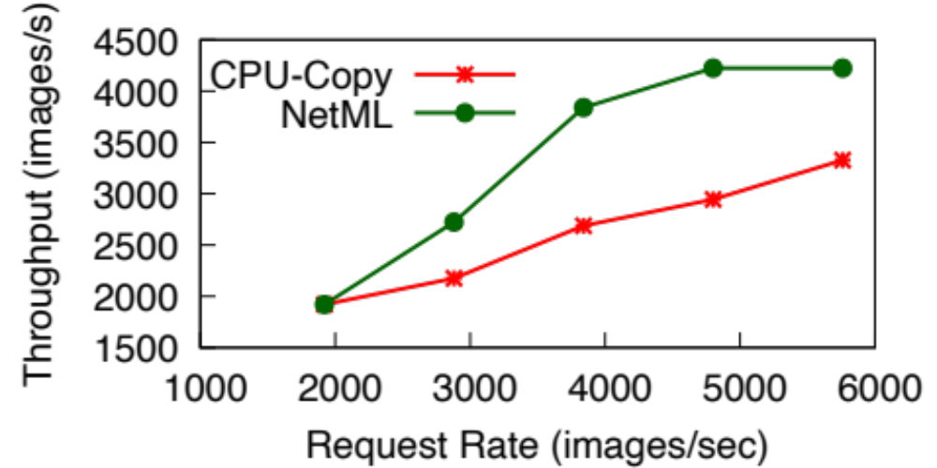
Data Transfer Impact: Throughput
We then used Alexnet model for inference and used fixed batch size of 8 for measuring inference throughput
We delivered multiple images with network and were able to generate upto 6000 inference request per second.
NetML performs better beyond request rate of 2000 images/sec due to lower CPU load while transferring images
NetML’s throughput flattens at about 4000 images/sec due to limits on GPU compute

Slide 28

Integration of various ML platforms
DNN platform for loading desired ML/DNN model in GPU

Slide 29
ML platforms and their characteristics
ML Platform | Programming Model | CUDA Streams | Batching | Startup Time (sec) ResNet-50
CNTK | CUDA | No | yes | 2.2
Darknet | CUDA | No | No | 5.7
MxNet | CUDA/OpenCL | Yes | Yes | 5.53
PyTorch | CUDA/ROCm | Yes | Yes | 5.03
TensorFlow | CUDA/OpenCL | Yes | Yes | 9.2
TensorRT | CUDA | Yes | Yes | 3.2
Notes:
We can see that there are variation in features of ML platforms. Some ML Platforms are only available in CUDA while other also support OpenCL or ROCm. Some ML platforms support cuda streams natively, while some do not. There is variation in support of batching as well.
Similarly, the internal working of ML platforms are also different. Some ML platforms take over all available GPU while other dynamically allocate GPU memory when necessary. We can see the variation in the startup time of ResNet-50 model. Load time for ResNet-50 model takes 2.2 seconds to more than 9 seconds. This is due to platform like tensorflow taking much more time on setup of the model than other ML patforms.

Slide 30
Accommodating ML platform variability
Characteristics of ML platforms might be varied, but the functionality required for ML inference operation are similar and can be summarized as:
  Initialization
  Loading DNN model
  Transferring data to GPU for inference
  Inference of the data
  Obtaining the result
Our ML framework uses a callback API to link with ML platforms so that it can run above mentioned operations

Slide 31
Conclusion
With the relatively limited amount of computational capacity, there is a need to better utilize CPU and GPU resources at the edge cloud.
We propose an ML framework for edge clouds that
  adds controlled spatial sharing in Edge cloud ML framework for lower, predictable inference latency and higher inference throughput.
  Provides timely notification from GPU to improve latency and GPU utilization
  Uses a small GPU kernel can help fully utilize GPU-resident DMA and can substantially relieve CPU load and improve inference throughput
With our contribution we can see upto 65% reduction in latency of DNN model while multiplexing GPU. And 1.6 times throughput improvement by using GPU-resident DMA.

Slide 32
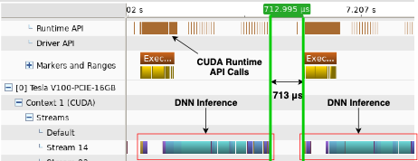
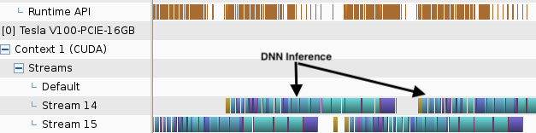

Spatial Sharing: CUDA Streams
CUDA streams is another mechanism to share GPU spatially.
Stream acts as a queue where kernels running in GPU can be enqueued.
Two independent streams can spatially share a GPU in an uncontrolled manner.
Single CUDA stream
Two CUDA streams

Slide 33
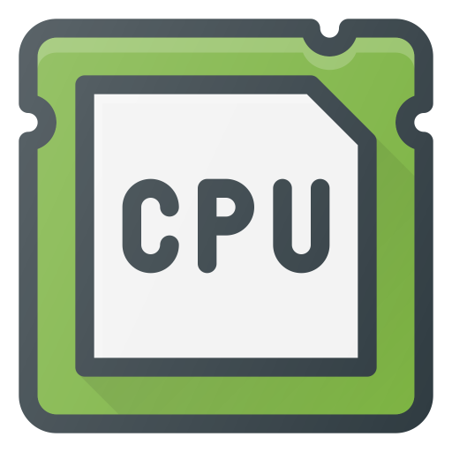
Streaming Data transfer to GPU: CPU Copying & NetML
CPU-Copy: Incoming data from packet payload is copied into a CPU side contiguous buffer before transferring into the GPU for ML processing.
We use NetML [1] to cut the extra copy by utilizing GPU’s DMA engine to perform scatter-gather of data from host CPU memory.
packets
packets
Copy
from
Packet Payload
to buffer
CPU calls
cudaMemcpy
Address of packet payload
*
*
*
*
*
GPU Subsystem
Data transfer
kernel
GPU DMA engine
GPU Buffer
GPU Buffer
ML application kernels
ML application kernels
CPU-Copy
NetML
[1] A. Dhakal and K. K. Ramakrishnan, “Netml: An nfv platform with efficient support for machine learning applications,” in 2019 IEEE Conference on Network Softwarization (NetSoft). IEEE, 2019, pp. 396–404.

