Slide 1


哈尔滨工程大学
Harbin Engineering University
AIMCOM2 Program
Real-World ADS-B signal recognition based on Radio Frequency Fingerprinting
Author : Haoran Zha, Qiao Tian, Yun Lin
email : zhahaoran@hrbeu.edu.cn
Speaker : Haoran Zha
1
Notes:
Ladies and gentlemen, I’m hornored and proud to have the opportunity to speak at this meeting.Today I would like to present my paper” Real-World ADSB signal recognition based on Radio Frequency Fingerprinting”,First of all, I would like to introduce my school harbin engineering university.

Slide 2





Harbin Engineering University, Harbin, China
哈尔滨工程大学
Harbin Engineering University
Harbin Engineering University (HEU) was established in 1953, which was defined as a national key institute.
In 1996, HEU was listed as one of the key universities being enhanced by the first batch of the '211 Project’.
Now, HEU is a highly developing research university and has severall world-class academic disciplines, such as shipping industry and ocean exploration.
Spring-- Apricot Blossom
Summer– Lake Hiking
Autumn-- Maple Leaf
Winter-- Snow Carrier
2
Notes:
As a national 3A level scenic area, the HEU campus has picturesque landscape in four seasons, such as Spring apricot blossom, Summer lake hiking, Autumn maple leaf and winter snow carrier. It is a very comfort to learn and live in HEU.

Slide 3
哈尔滨工程大学
Harbin Engineering University
1
Introduction
2
Signal Preprocessing
CONTENTS
3
Experiment
4
Conclusion
3
Notes:
I will do this report for this four part, First is the introduction of Real-World ADS-B signal recognition based on Radio Frequency Fingerprinting

Slide 4
哈尔滨工程大学
Harbin Engineering University
PPT模板下载：www.1ppt.com/moban/ 行业PPT模板：www.1ppt.com/hangye/
节日PPT模板：www.1ppt.com/jieri/ PPT素材下载：www.1ppt.com/sucai/
PPT背景图片：www.1ppt.com/beijing/ PPT图表下载：www.1ppt.com/tubiao/
优秀PPT下载：www.1ppt.com/xiazai/ PPT教程： www.1ppt.com/powerpoint/
Word教程： www.1ppt.com/word/ Excel教程：www.1ppt.com/excel/
资料下载：www.1ppt.com/ziliao/ PPT课件下载：www.1ppt.com/kejian/
范文下载：www.1ppt.com/fanwen/ 试卷下载：www.1ppt.com/shiti/
教案下载：www.1ppt.com/jiaoan/ PPT论坛：www.1ppt.cn
1
Introduction
4

Slide 5
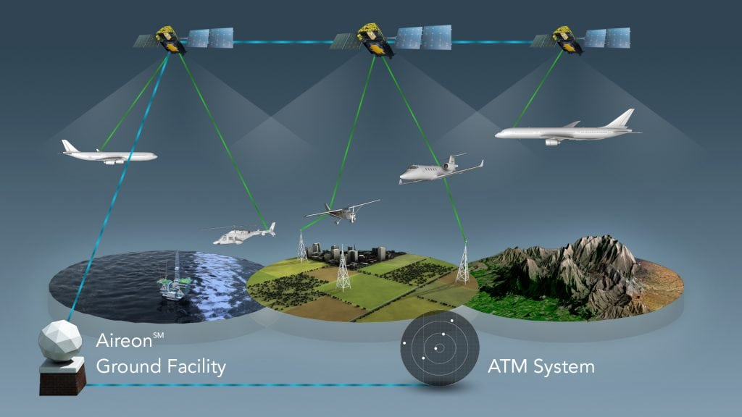
哈尔滨工程大学
Harbin Engineering University
Background
ADS-B System
5
Notes:
In the future ,(ATC) technology currently in use will quickly reach its capacity limit. To replace traditional primary and secondary surveillance radar methods, the International Civil Aviation Organization has adopted a new protocol standard called Automatic Dependent Surveillance-Broadcast (ADSB} ADSB is to collect navigation information by the airborne information processing unit, and then broadcast it through the airborne communication equipment. For the aircraft equipped with ADSB receiver, combining all the broadcast information and the received monitoring information with its location information, it can form a more intuitive and three-dimensional surrounding traffic information for the pilot. Any aircraft equipped with ADS-B system broadcasts the location information through the public communication channel, Nevertheless, the ADS-B protocol does not provide any encryption and authentication methods. Due to the advent of cheap and accessible software-defined radios, today, anonymous devices can be attacked using widely available SDRs .

Slide 6
哈尔滨工程大学
Harbin Engineering University
Main Contributions
The main contributions of this article are as follows:
1. We propose and design a novel RFF recognition scheme based on the Contour Stellar Images and CNN.
2. We proposed an ADS-B original signal detection acquisition and real-time labeling method and verified this method by using a 1090MHz baseband signal collected by RTL-SDR.
3. We compared the performance of Contour Stellar images and Constellation Diagram under the Alexnet network and different signal-to-noise ratio（SNR）.
6
Notes:
first. We propose and design a novel RFF recognition scheme based on the Contour Stellar Images and CNN. The generated equipotential planet map is similar to the "fingerprint" graphic, so it can be identified using image recognition CNN.
second. We proposed an ADS-B original signal detection acquisition and real-time labeling method and verified this method by using a One thousand and ninety MHz baseband signal collected by RTL-SDR, collecting signals from a total of 5 aircraft, 500 signals were selected uniformly for each aircraft.
third. We compared the performance of Contour Stellar images and Constellation Diagram under the Alexnet network and different signal-to-noise ratio（SNR）. Besides, we also compared the performance of Contour Stellar images on Alexnet and GoogleNet.

Slide 7
哈尔滨工程大学
Harbin Engineering University
PPT模板下载：www.1ppt.com/moban/ 行业PPT模板：www.1ppt.com/hangye/
节日PPT模板：www.1ppt.com/jieri/ PPT素材下载：www.1ppt.com/sucai/
PPT背景图片：www.1ppt.com/beijing/ PPT图表下载：www.1ppt.com/tubiao/
优秀PPT下载：www.1ppt.com/xiazai/ PPT教程： www.1ppt.com/powerpoint/
Word教程： www.1ppt.com/word/ Excel教程：www.1ppt.com/excel/
资料下载：www.1ppt.com/ziliao/ PPT课件下载：www.1ppt.com/kejian/
范文下载：www.1ppt.com/fanwen/ 试卷下载：www.1ppt.com/shiti/
教案下载：www.1ppt.com/jiaoan/ PPT论坛：www.1ppt.cn
2
Signal Preprocessing
7
Notes:
Then is the Signal Preprocessing

Slide 8
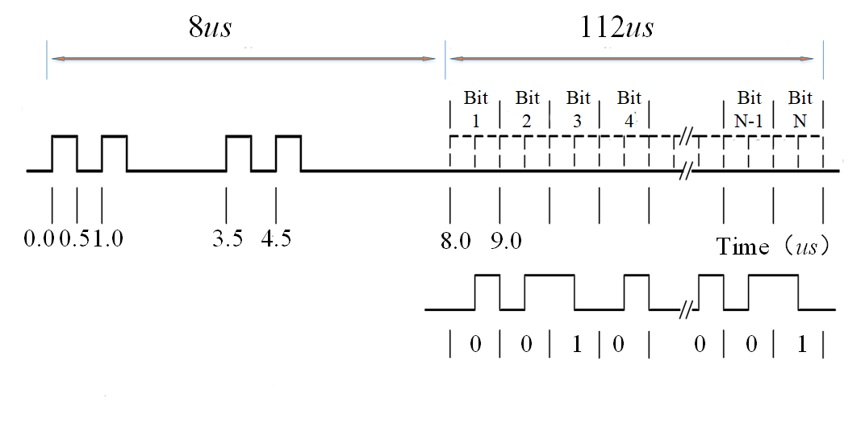
ADS-B signals
哈尔滨工程大学
Harbin Engineering University
1090 MHz Extended Squitter(1090ES)
8
Notes:
Next, An aircraft reclaims its position and velocity using an onboard spy-in-the-sky receiver. This information is sent twice per second by the transmitting subsystem ADS-B Out. They are sustained by ground stations and by nearby aircraft if equipped with ADS-B In, where they are concocted further (e.g., by collision avoidance systems such as TCAS). ADS-B offers many further fields such as ID, intent, urgency code, and navigation accuracy. Two ADS-B data link standards are currently in use, Universal Access Transceiver(UAT) and One thousand and ninety MHz Extended Squitter.
1090 MHz Extended Squitter(1090ES) is a technology-based on S-mode transponder, with a frequency of 1090MHz. The format of the ADS-B message data block utilizes Pulse Position Modulation (PPM) coding. The first half of each transmitted pulse is 1, and the second half is 0. A complete ADS-B signal is composed of 8us preamble pulse and 112us data information bit pulse . as shown in Fig. 2.

Slide 9
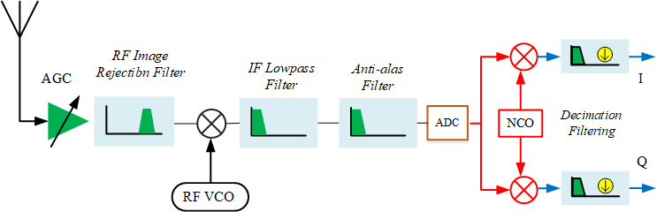

ADS-B signal receiver
哈尔滨工程大学
Harbin Engineering University
8
Notes:
After receiving the RF signal containing ADS-B signal from the antenna, the received signal shall first be amplified by automatic gain control (AGC), and then throughRF Image Rejection Filter Image Rejectibn Filter is a band-pass filter, which filters out unnecessary image signal, and then mixes it.
and the IQ signal is decoded by using the relevant decoding algorithm , the total data collection and labeling process is shown in Fig.

Slide 10
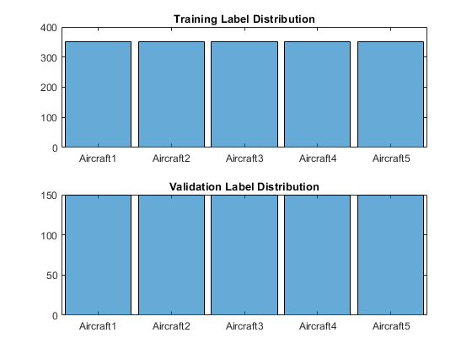
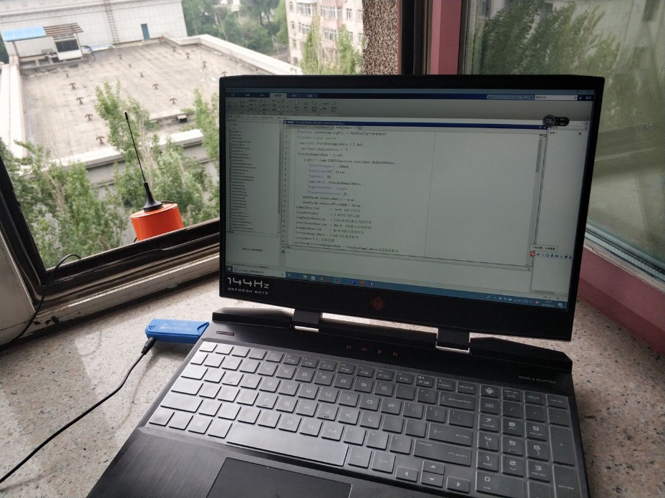

Datasets
哈尔滨工程大学
Harbin Engineering University
8
Notes:
the total data collection and labeling process is shown in the slide ,we collected data from a total of 5 aircraft at fixed locations. Each aircraft randomly selected 500 original baseband IQ signals, and each signal was annotated with an ICAO code. And then, we divided the data into training and validation data sets. We use 70\% of the signal for training and 30\% for validation. Avoid class imbalance in ADS-B data by ensuring a uniform distribution of labels (Aircraft types). Fig in the right show the label distributions to check if the generated labels are uniformly distributed.

Slide 11

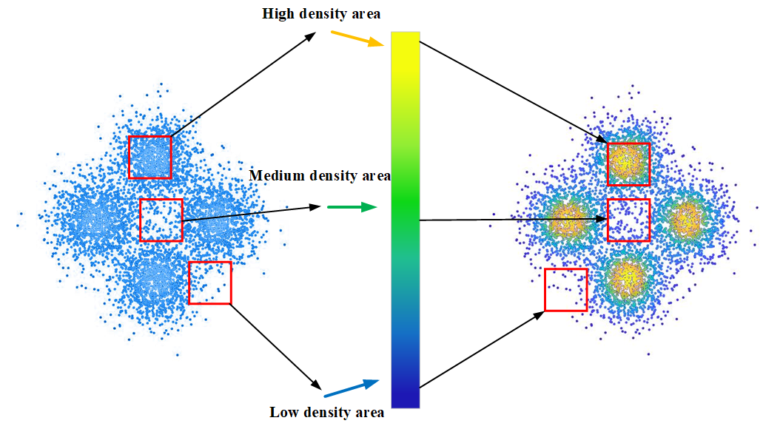



Contour stellar images
哈尔滨工程大学
Harbin Engineering University
(1)
(2)
(3)
8
Notes:
In RFF classification, the data to be concocted is not an image，What we get is complex IQ data. To manipulate the existing DL models, we transform complex data samples into the Contour Stellar images for DL. The first step in data processing is to plot the signal into the form of a Constellation diagram. And then, we color the Constellation diagram according to the normalized dot density of each point in the Constellation picture. Furthermore, the normalized point density of the p symbol in each sample, calculated as Formula 1 in the slide shows;
Where h(p) function and v(p) function obtain the horizontal axis and the vertical axis value of the p- symbol, N is the number of the symbols of this sample, ris half the length of the selected rectangular region when determining the normalized point density.
Then, every point in the Constellation diagram will be colored according to the color bar. and its normalized point density. The overall calculation formula of the contour stellar images is (3):
Where W_{0}$, H_{0}$ are the upper left corner coordinates of the contour stellar images, $W_{1}$ , $H_{1}$ are lower right corner coordinates the contour stellar images, $x_{0}$ , $y_{0}$ are the upper left coordinate of the density window function, $x_{1}$ , $y_{1}$ are the lower right corner of the density window function. Fig of botton of the slide shows the contour stellar images of the 5 aircraft ADS-B signals we captured;

Slide 12
哈尔滨工程大学
Harbin Engineering University
PPT模板下载：www.1ppt.com/moban/ 行业PPT模板：www.1ppt.com/hangye/
节日PPT模板：www.1ppt.com/jieri/ PPT素材下载：www.1ppt.com/sucai/
PPT背景图片：www.1ppt.com/beijing/ PPT图表下载：www.1ppt.com/tubiao/
优秀PPT下载：www.1ppt.com/xiazai/ PPT教程： www.1ppt.com/powerpoint/
Word教程： www.1ppt.com/word/ Excel教程：www.1ppt.com/excel/
资料下载：www.1ppt.com/ziliao/ PPT课件下载：www.1ppt.com/kejian/
范文下载：www.1ppt.com/fanwen/ 试卷下载：www.1ppt.com/shiti/
教案下载：www.1ppt.com/jiaoan/ PPT论坛：www.1ppt.cn
3
Experiment
11
Notes:
next.,we talk about the experiment

Slide 13
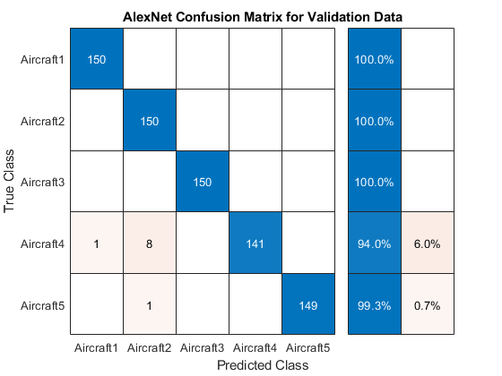
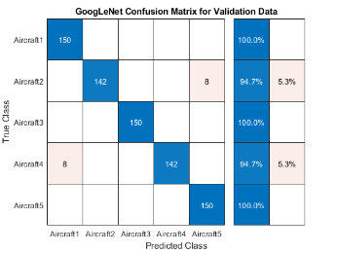
哈尔滨工程大学
Harbin Engineering University
Simulation Results and Analysis
13
Notes:
In AlexNet and GoogLeNet networks, the last layer with learnable weights is fully connected. Replace this fully connected layer with a new fully-connected layer with the number of outputs equal to the number of classes in the ADS-B dataset. We classify the validation images using the fine-tuned network and calculate the classification precision.
The test precision of ADS-B data in AlexNet and GoogLeNet networks is 98.66% and 97.87%, Fig. 9 and Fig. 10 show the networks' Confusion Matrix.

Slide 14
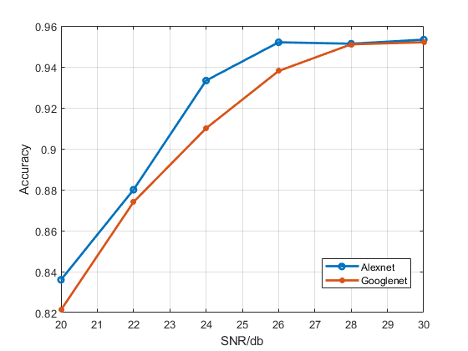
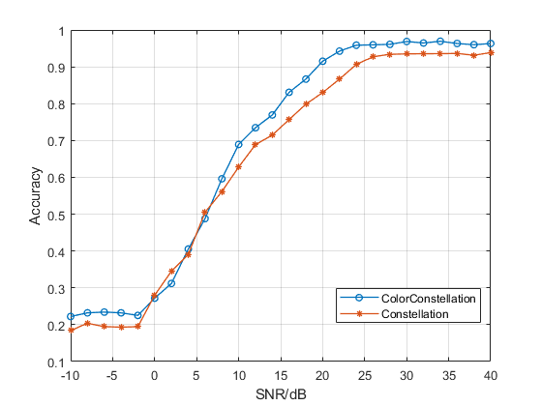
哈尔滨工程大学
Harbin Engineering University
Simulation Results and Analysis
12
Notes:
To cover the classification performance at different noise levels, we added additive white Gaussian noise to the test data for experiments. Fig. 10.show the classification performance of Contour Stellar Images at different noise levels. It should be noted that the signal-to-noise ratio(SNR) here refers to the SNR after noise is enumerated when we regard the original signal as a pure signal without noise(in fact, the original signal itself also contains noise). Therefore, the actual SNRs are more diminutive than those shown in the figures. It can be seen that although these noisy samples have not been trained, the Contour Stellar Images have the excellent performance to classify these noisy samples. When the SNR is greater than 28 dB, the classification accuracy under both datasets is higher than 95\%. Also, comparing the classification accuracy of Alexnet and GoogLenet at different SNRs, the Alexnet classification is more robust to noise.

Slide 15
哈尔滨工程大学
Harbin Engineering University
PPT模板下载：www.1ppt.com/moban/ 行业PPT模板：www.1ppt.com/hangye/
节日PPT模板：www.1ppt.com/jieri/ PPT素材下载：www.1ppt.com/sucai/
PPT背景图片：www.1ppt.com/beijing/ PPT图表下载：www.1ppt.com/tubiao/
优秀PPT下载：www.1ppt.com/xiazai/ PPT教程： www.1ppt.com/powerpoint/
Word教程： www.1ppt.com/word/ Excel教程：www.1ppt.com/excel/
资料下载：www.1ppt.com/ziliao/ PPT课件下载：www.1ppt.com/kejian/
范文下载：www.1ppt.com/fanwen/ 试卷下载：www.1ppt.com/shiti/
教案下载：www.1ppt.com/jiaoan/ PPT论坛：www.1ppt.cn
4
Conclusion
15

Slide 16
哈尔滨工程大学
Harbin Engineering University
Conclusion and Future work
Conclusion
We propose and design a novel RFF recognition scheme based on Contour Stellar Images and deep learning.
We designed an ADS-B original signal capture and labeling method and verified this method by using a 1090MHz baseband signal collected by RTL-SDR,
the experimental conclusions under different signal-to-noise ratios and different networks show the effectiveness of the Contour Stellar Images, and it shows that the excellent identification performance of the RF fingerprint can lay a foundation for the physical layer security of aircraft.
Future work
1.Use better equipment to collect more adsb signals to study RF fingerprints
2.Adjust Contour Stellar Images to adapt to different channel requirements
16
Notes:
We propose and design a novel RFF recognition scheme based on Contour Stellar Images and deep learning.
We designed an ADS-B original signal capture and labeling method and verified this method by using a 1090MHz baseband signal collected by RTL-SDR,
the experimental conclusions under different signal-to-noise ratios and different networks show the effectiveness of the Contour Stellar Images, and it shows that the excellent identification performance of the RF fingerprint can lay a foundation for the physical layer security of aircraft.
1.Use better equipment to collect more adsb signals to study RF fingerprints
2.Adjust the planet map to adapt to different channel requirements

Slide 17
哈尔滨工程大学
Harbin Engineering University
THANK YOU
17
Notes:
That’s all for my talk, Thank you for your listening.

