Slide 1
A Blind CSI Prediction Method Based on Deep Learning for V2I Millimeter-Wave Channel
Jingxiang Yang
Zhejiang University

Slide 2
Contents
01
05
Introduction
Conclusion
02
04
System model
03
Simulation results
Channel prediction model

Slide 3
Research Background
Present works
Introduction
Our works

Slide 4
Research Background
The application of 5G in vehicular communication scenarios.
The high sensitivity of mm-wave wireless system to channel quality and environmental conditions.
The application of MEC and ACM technology.

Slide 5
Present works
Channel estimator:
  Date-aided: maximum-likelihood (ML) estimator
  squared signal-to-noise variance (SNV) estimator
  Blind: second- and fourth-order moments (M2M4) estimator
Channel prediction:
  Yadan Zheng proposed a modified ARIMA model for channel quality indication (CQI) prediction to solve the long delay problem in satellite environment.
  G. Liu used long short-term memory (LSTM) network to predict SNR.
  C. Luo proposed an OCEAN model to predict CSI in 5G wireless communication system.

Slide 6
Our works
Blind channel information prediction model based on deep neural network(BCPMN):
  Fast-varying channel model
  No pilot required
  CNN and LSTM used
  Future CSI prediction

Slide 7
System model

Slide 8
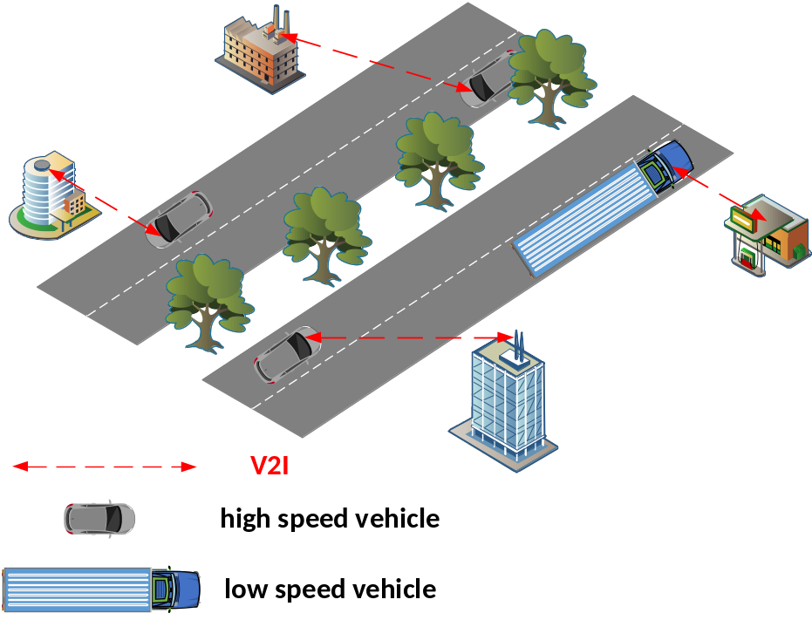
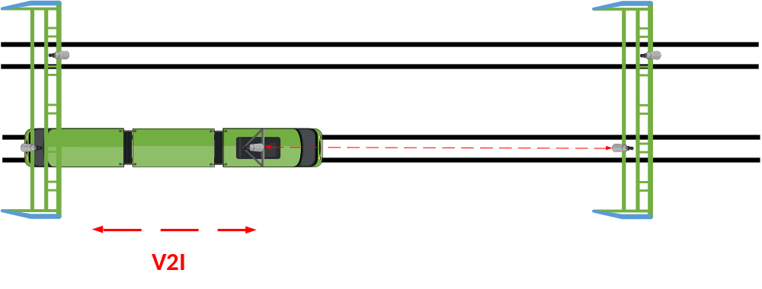
System model
Fig. 1. Typical V2I communication scenarios of high speed train environment and highway environment.

Slide 9
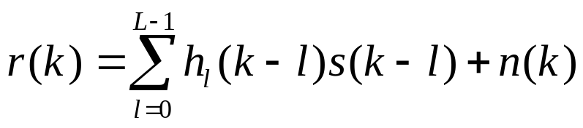
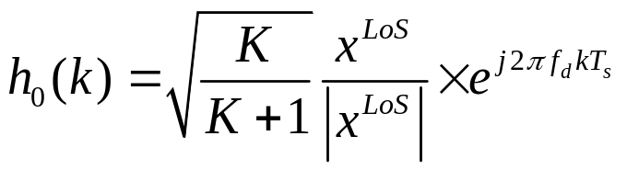
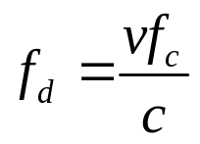
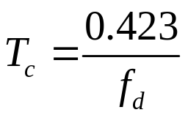
System model
The received signal model:
where k represents the index of sample in time domain. s(k) is the transmitted signal and n(k) is the Gaussian noise. L is the number of multipath, and hl(k) is the lth multipath channel model. When l = 0, h0(k) is the LoS path as below

Slide 10
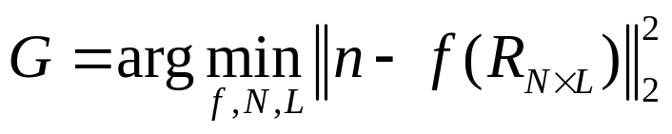


System model
The objective function:
where n is the true SNR value, f represents the function that the neural network needs to fit, R is the received data matrix and is the matrix dimension. is the matrix obtained from the received signal sequence after data preprocessing.

Slide 11
Data Preprocessing
Channel prediction model
The BCPMN

Slide 12
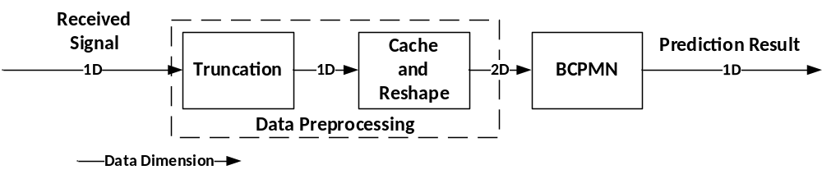
Channel prediction model
The flow chart:
The model includes a data preprocessing module and a deep neural network prediction module
Fig. 2. The flow chart of the model.

Slide 13
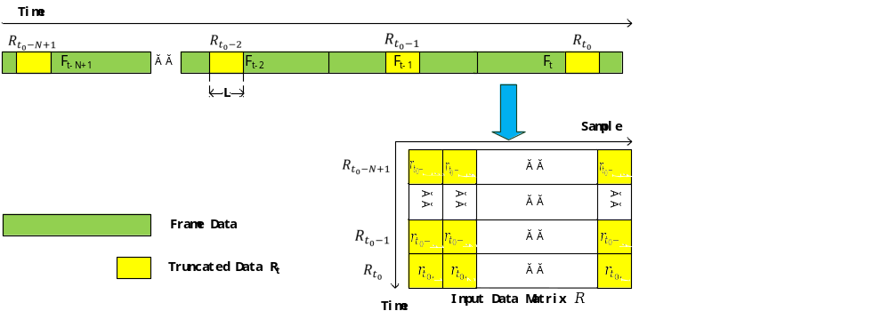
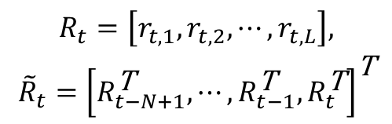
Data Preprocessing
The 1-dimensional data of t0-th frame is converted into a 2-dimensional matrix in the data preprocessing scheme:
$$\begin{matrix}R_{t}=\left[r_{t,1},r_{t,2},⋯,r_{t,L}\right], \\ {\tilde{R}}_{t}={\left[R_{t−N+1}^{\text{T}},⋯,R_{t−1}^{\text{T}},R_{t}^{\text{T}}\right]}^{\text{T}}\end{matrix}$$
Fig. 3. The data preprocessing scheme.

Slide 14
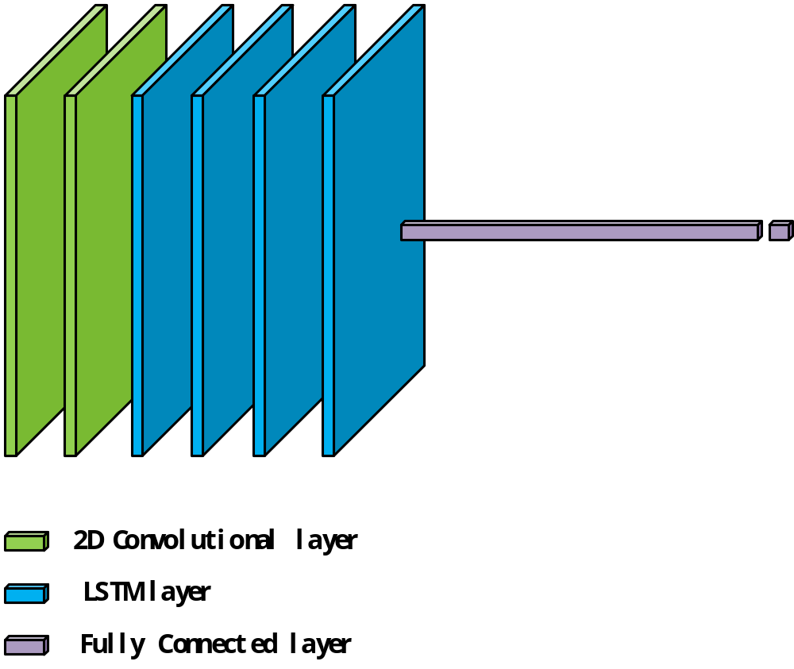
The BCPMN
The BCPMN model contains of 2 convolutional layers, 4 LSTM layers and 2 fully connected layers：
Fig. 4. The structure of the BCPMN.

Slide 15
Simulation results

Slide 16
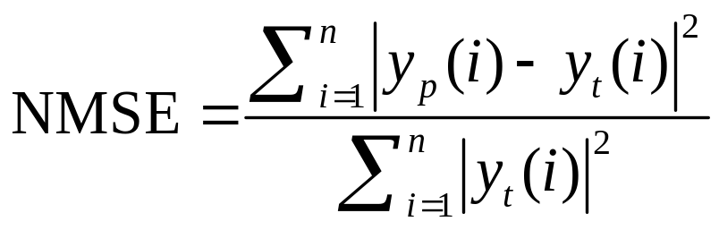


Simulation results
We use the normalized mean square error(NMSE) to calculate the error between the predicted value and the true value. The definition of NMSE is as follows：
where is the predicted value and is the true value. The dataset size is 20000 frames and the ratio of training set, verification set and test set is 0.8, 0.1, 0.1 respectively.

Slide 17
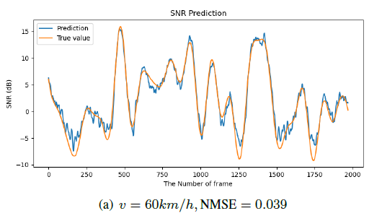
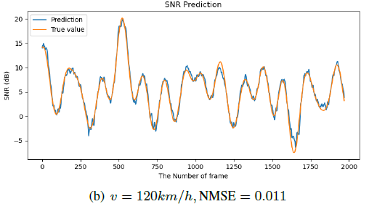
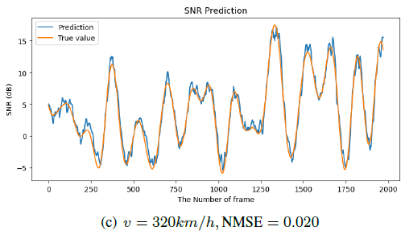
Simulation results
Fig. 5. SNR prediction results and NMSE at different vehicle speeds.

Slide 18
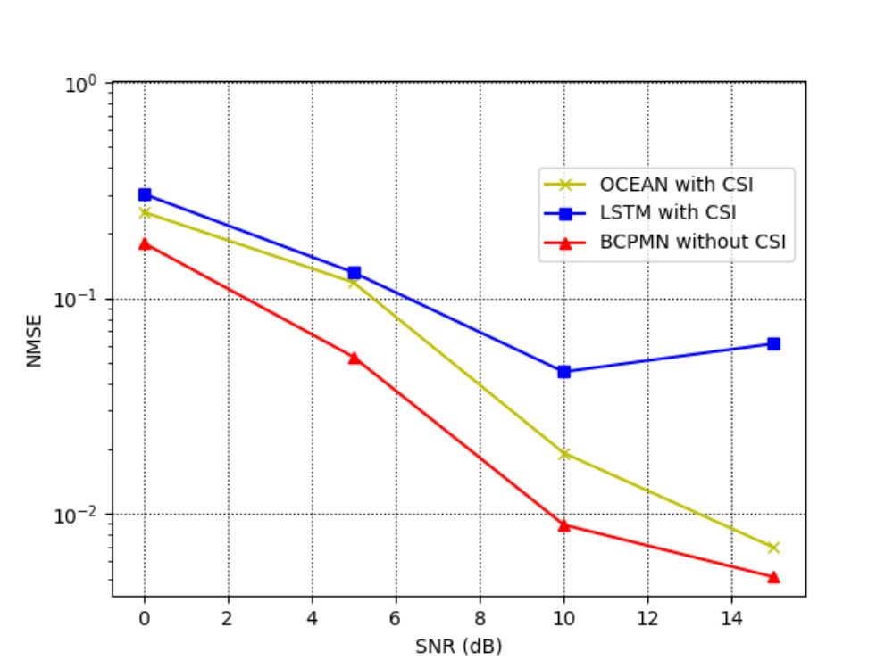
Simulation results
Fig. 6. The comparison of prediction performance between LSTM, OCEAN and BCPMN under different SNR

Slide 19
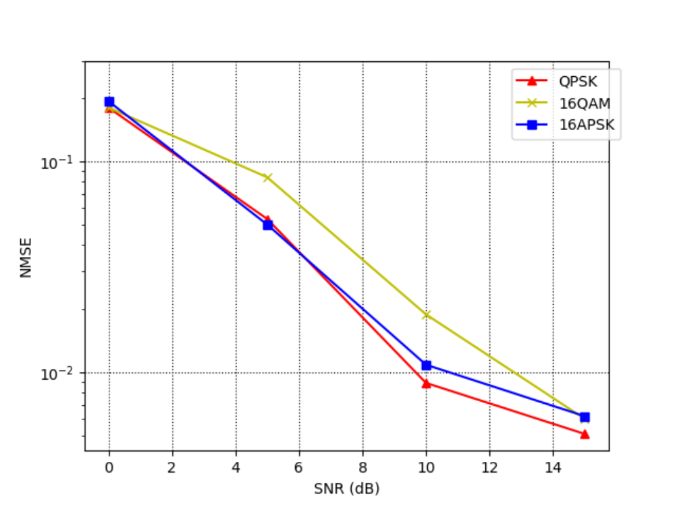
Simulation results
Fig. 7. Adaptability experiment of BCPMN model to QPSK, 16QAM and 16APSK modulation modes

Slide 20
Conclusion

Slide 21
Conclusion
A blind channel information prediction model based on deep neural network(BCPMN) in mm-wave wireless communication system.
Fast-varying channel
Data preprocessing method
Compared with LSTM and OCEAN

Slide 22
THANK YOU

