Slide 1

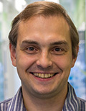
Welcome
from the
General
Chair!
Sergey Gorinsky
IMDEA Networks Institute
Spain

Slide 2
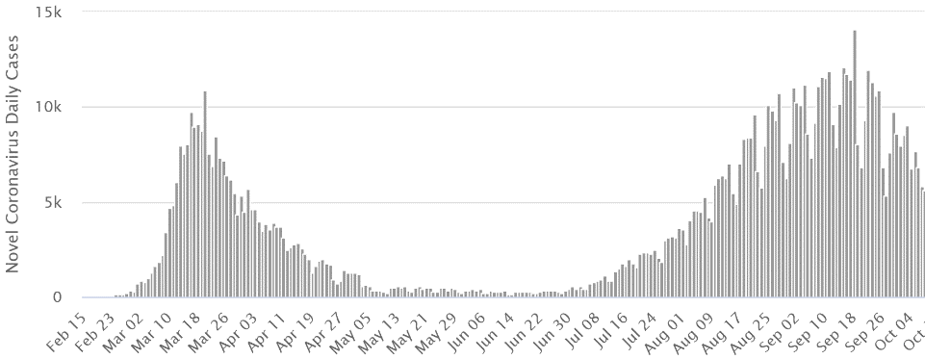
Coronavirus in Spain
Lockdown imposed
Vacations end
Lockdown eased
Vacations start
New normality
Source: https://www.worldometers.info/coronavirus/country/spain/

Slide 3
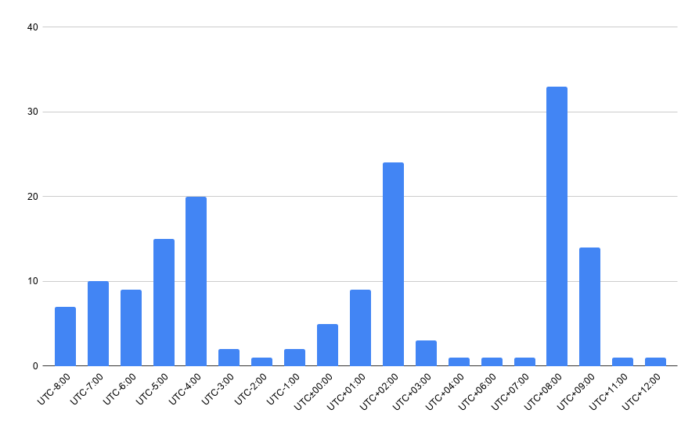
Attendees around the World
160 registrants altogether
AIMCOM2, HDR-Nets, NIPAA workshops: 78
Main conference: 129
Beijing
Madrid
New York

Slide 4

Yes, We are Hybrid: Greetings from the Reception

Slide 5

Supporters

Slide 6
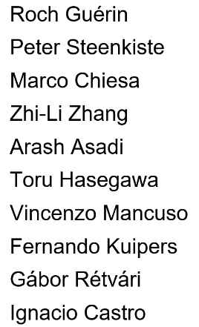
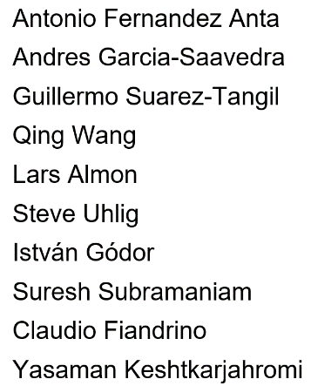
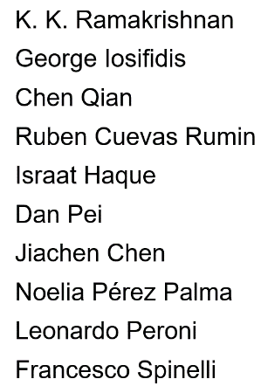
Organizers

