Slide 1

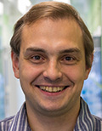
Closing Session
Sergey Gorinsky
IMDEA Networks Institute
Spain

Slide 2
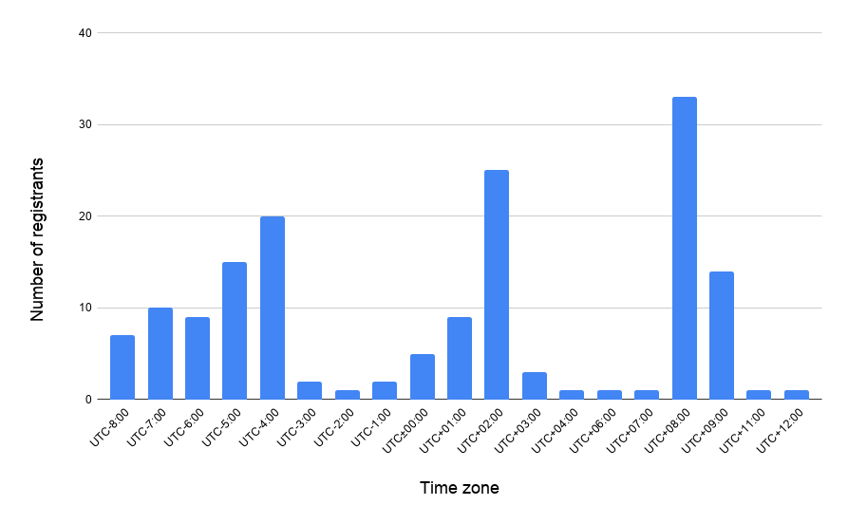
Attendees around the World
160 registrants altogether
AIMCOM2, HDR-Nets, NIPAA workshops: 78
Main conference: 129
Asia
Europe
Americas

Slide 3
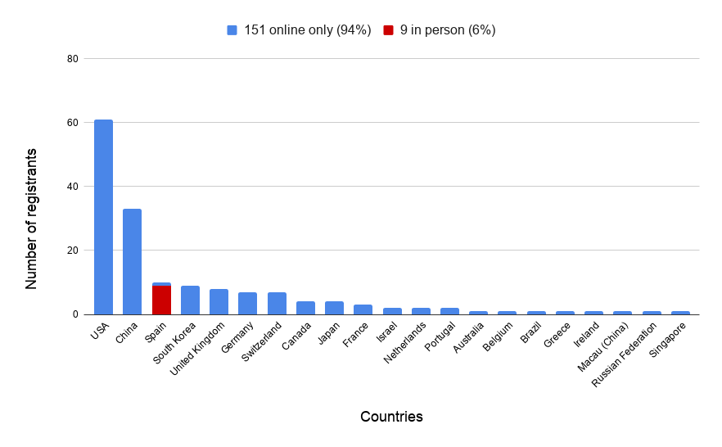
Countries of the Attendees

Slide 4

Yes, We were Hybrid: The Welcome Reception

Slide 5
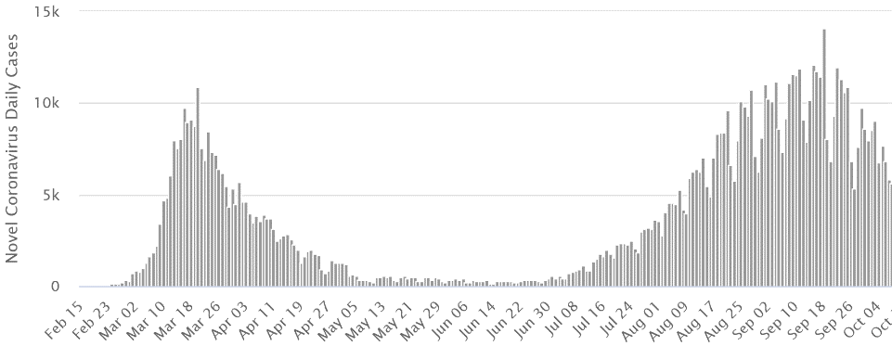
Coronavirus in Spain (one week ago)
Lockdown imposed
Vacations end
Lockdown eased
Vacations start
New normality
Source: https://www.worldometers.info/coronavirus/country/spain/

Slide 6
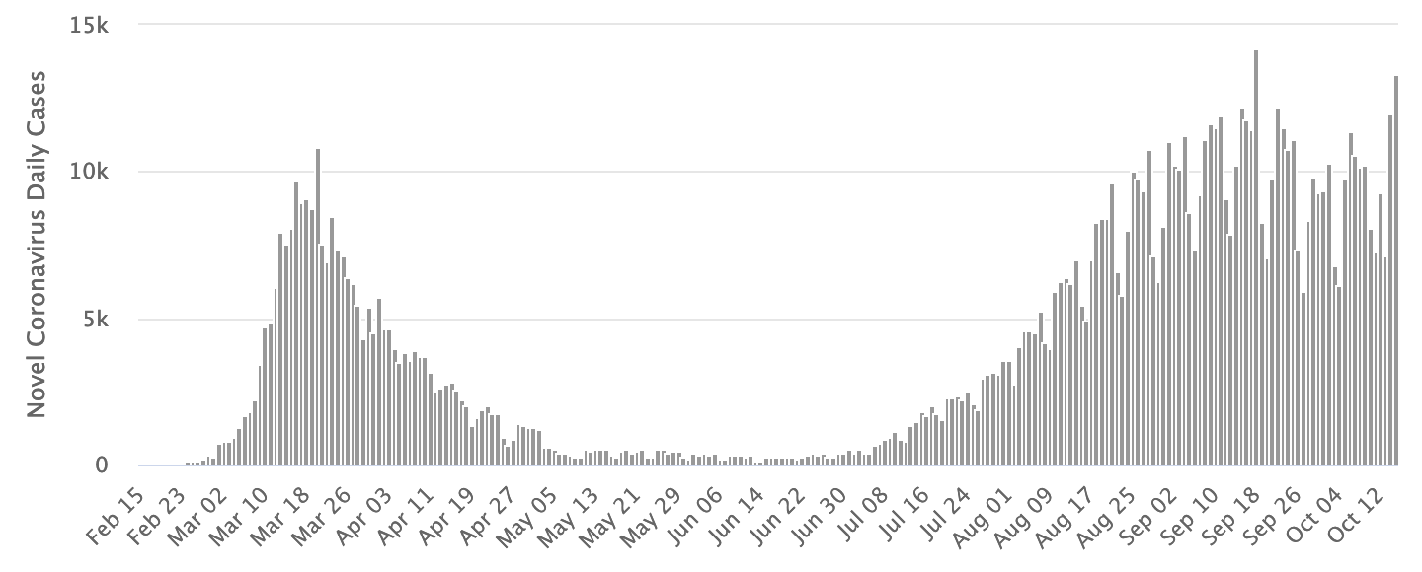
Coronavirus in Spain (today)
Lockdown imposed
The second wave is not over?
Vacations end
Lockdown eased
Vacations start
New normality
Source: https://www.worldometers.info/coronavirus/country/spain/

Slide 7
Coming Up …
Souvenirs for everyone
  by mail
Recorded videos of the live presentations and Q&As
  linked to the conference website from the YouTube channel

