Slide 1
Imperfect Competition in the
Labour Market
Alan Manning

Slide 2
Apologies
Strange Talk
  No paper
  Overview of an area
  Idiosyncratic Overview at that
Based on Handbook of Labor Economics Chapter
Not description of canonical models – more emphasis on general principles

Slide 3
Outline
Imperfect competition as rents
Sources of rents
Size of rents
Splitting of rents
So what?

Slide 4
Defining Imperfect Competition
Rents to employment relationship between worker and firm
i.e. one or both would be strictly worse off if forcibly separated
Contrast with perfect competition
  Worker can immediately get another identical job
  Employer can immediately replace worker with clone

Slide 5
Sources of Rents
Frictions (imperfect information)
Idiosyncracies – lots of ways in which jobs differ from each other
Specific human capital
All have feature that can’t find perfect substitute for current job
Institutions (collusion)
  Unions
  Employers

Slide 6
The size of rents
Need to know if rents are a big deal
Review some different ways of trying to get at this:
  Employer and worker side
Complications
  Lots of heterogeneity for sure – all agree rents for senior workers but for new hires more controversy.
  Do I care if a newly hired worker does not turn up the first day?
  Rag-bag of estimates
  Think of as ballpark estimates

Slide 7
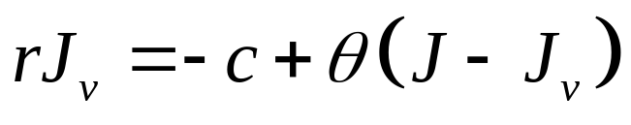
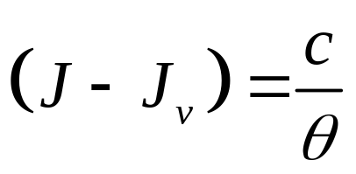
Employer Rents
Basic idea is that we get some idea of size of rents from how much employers seem prepared to spend to get those rents
An example: value of vacant job in Pissarides model
So that when J_{v}=0 (free entry)

Slide 8
General Principle
Marginal rents equal marginal hiring costs
We have some estimates of hiring costs
Need to normalize by wage and expected job duration
Oi estimates about 5% - seem to stand up quite well
But not sure if these are average or marginal

Slide 9
A Great New Paper
Adam Isen (Wharton) uses matched employer-employee data to look at impact of sudden death of a work on firm revenues and labour costs
Finds a large gap between marginal product and the wage

Slide 10
Increasing or Constant Marginal
Hiring Costs
Important question is whether marginal hiring costs are rising or not
  Models with constant marginal costs will be quasi-competitive as employer will face perfectly elastic supply of labour
What evidence we have suggests rising marginal costs – though not huge

Slide 11
Estimating Worker Rents
Again use idea of expenditure on rent-seeking to get idea of size of rents
Here it is time/money spent by unemployed on getting a job
E.g. in simple search model would expect unemployed to invest more time in job search the greater are the rents from having a job

Slide 12
estimates
Lots of variation but perhaps surprisingly small amount of time – Krueger and Mueller
Does this chime with other evidence on well-being of unemployed?
Why might be misleading:
  Job search unpleasant
  Marginal return to extra job search low
  Time/money complementary and unemployed short of cash
  Unemployed those for whom rents are lowest

Slide 13
Costs of job loss
Literature on costs of job loss can be thought of as estimates of worker rents if separation random
These are large and long-lasting – von Wachter 15-20%
Got job, lost job, got promoted are major life events

Slide 14
Splitting the rents: theory
2 main theories:
  Ex post wage bargaining (macro labour literature)
  Ex ante wage posting
Some discussion of what is ‘right’ model
  Perhaps not very helpful – a false dichotomy
How do they differ
  Wage bargaining extracts all ex post surplus (but not necessarily ex ante efficiency)
  Wage-posting: not all surplus extracted
Relates to classic debates about ‘wage rigidity’

Slide 15
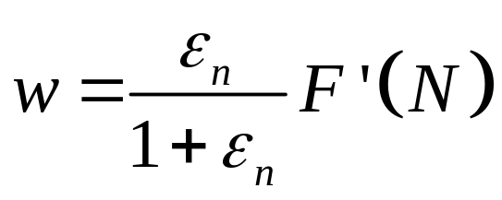
Splitting the rents: theory
In ex post wage bargaining, bargaining power exogenous
With wage-posting ‘bargaining power’ is elasticity of labour supply curve to employer – best thought of as monopsony

Slide 16
Splitting the rents: experimental evidence
Want random rise in wage at single firm and watch what happens to employment
Some studies like this – all suggest very low elasticities
The ‘too much monopsony’ problem
May be biases:
  Short-run response
  Temporary wage rise
  May not be on supply curve
But perhaps estimates are right but interpretation is wrong

Slide 17
Mandated Employment Rises
Matsudaira (ReStat forthcoming) looks at mandated increase in employment in long-term care homes and looks at wage response
In simple monopsony model should get inverse of estimates for mandated wage rise

Slide 18
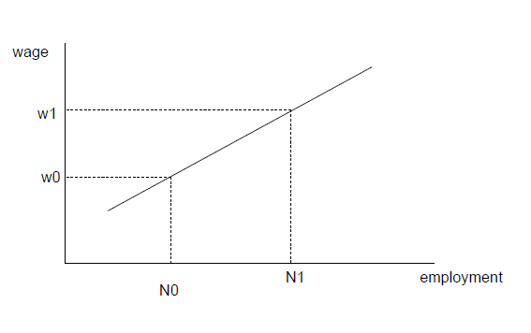

Slide 19
The ‘No Monopsony At All’ Problem
Matsudaira finds no wage response
Suggests no monpsony power
Could this be difference in market considered
  I suspect this is not the case
Suggests problem is simple monopsony model – can only raise employment by raising the wage

Slide 20
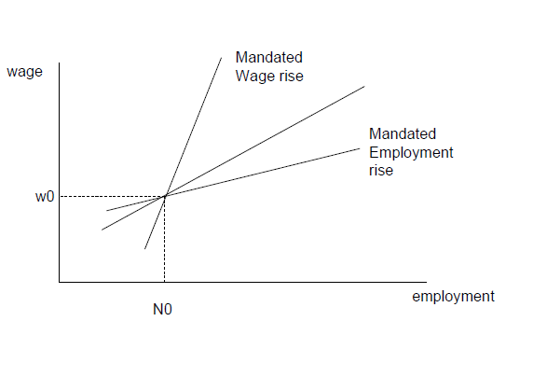

Slide 21
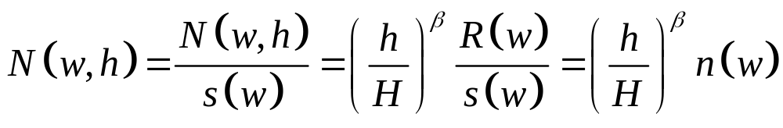
A Reconciliation
Suggest better model is one in which supply of labour to firm influenced by:
  Wage
  Recruitment expenditure
  Quality thresholds
Shows this can reconcile ‘too much’ and ‘no monopsony’ problems – can also use quality models
These studies do not estimate what we think they do

Slide 22
Splitting the rents: non-experimental evidence
Most studies estimating sensitivity of quits to the wage
Then using result to equate recruitment and quit elasticities
There is a long tradition (back to 1940s) of finding these elasticities are low

Slide 23
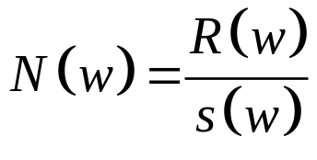
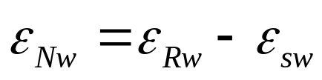
Quit and Recruitment Elasticities
In steady-state
So that:
Long tradition of estimating separation elasticities
But recruitment elasticities more difficult though some studies now arriving:
  Dal Bo, Finan and Rossi

Slide 24
Quit elasticity = recruitment elasticity
Some seem to think of as smoke and mirrors
But assumption for it not so implausible – worker mobility depends on relative wage
If a worker quits one firm because relative wages are low, that is a recruit for another firm because its relative wages are high

Slide 25
Estimates of quit elasticities
Always find negative relationship between quits and wages
Elasticities not that high
Are some issues about biases
  Transitory vs. permanent wage shocks
  Other controls
  Measurement error

Slide 26
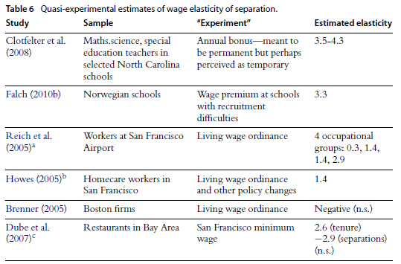

Slide 27
So What?
Why is Imperfect Competition not everywhere in labour?
Little value-added to perfect competition
  Perfect competition a reasonable approximation
  Comparative statics often the same
Don’t need theory, just good experiments
  Ask what happened, not why

Slide 28
Some areas where it makes a difference?
Labour market regulation
  E.g. minimum wage
Law of one wage
Gender pay gap
Economic geography
Education/training
macro

Slide 29
Labour Market Regulation
Minimum wage might raise employment but might not
  Not just wage elasticity that is important
  Constant/increasing marginal hiring costs very important
Can also apply to other regulations e.g.:
  Hours restrictions
  Mandated benefits

Slide 30
Law of One Wage
Explains why we see wage dispersion in tightly-defined labour markets
Caused by combination of imperfect competition and employer heterogeneity

Slide 31
Gender Pay Gap
Original Joan Robinson application of monopsony
Number of papers seeing whether female quits less elastic than male
Even if not, career interruptions+ wage dispersion leads to wage penalties not justified by productivity effect

Slide 32
Economic geography
Potential explanation of agglomeration
Labour markets in agglomerations more competitive – leads more productive firms to locate there
Manning, Journal of Economic Geography 2010

Slide 33
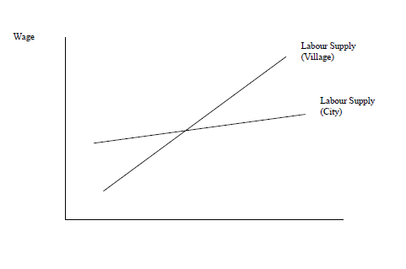

Slide 34
Education and training
Not all returns to human capital investment internalized
Firms can get some return from general training

Slide 35
Macro
Perhaps can help to explain lack of cyclicality in wages
This is a current project of mine

Slide 36
Conclusion
I will be happy if:
  Have convinced you this might be the right way to think about labour markets
  Made you think it might make a difference
  Can help to answer interesting in important questions – model should always be the means not the ends.

